Slide 1
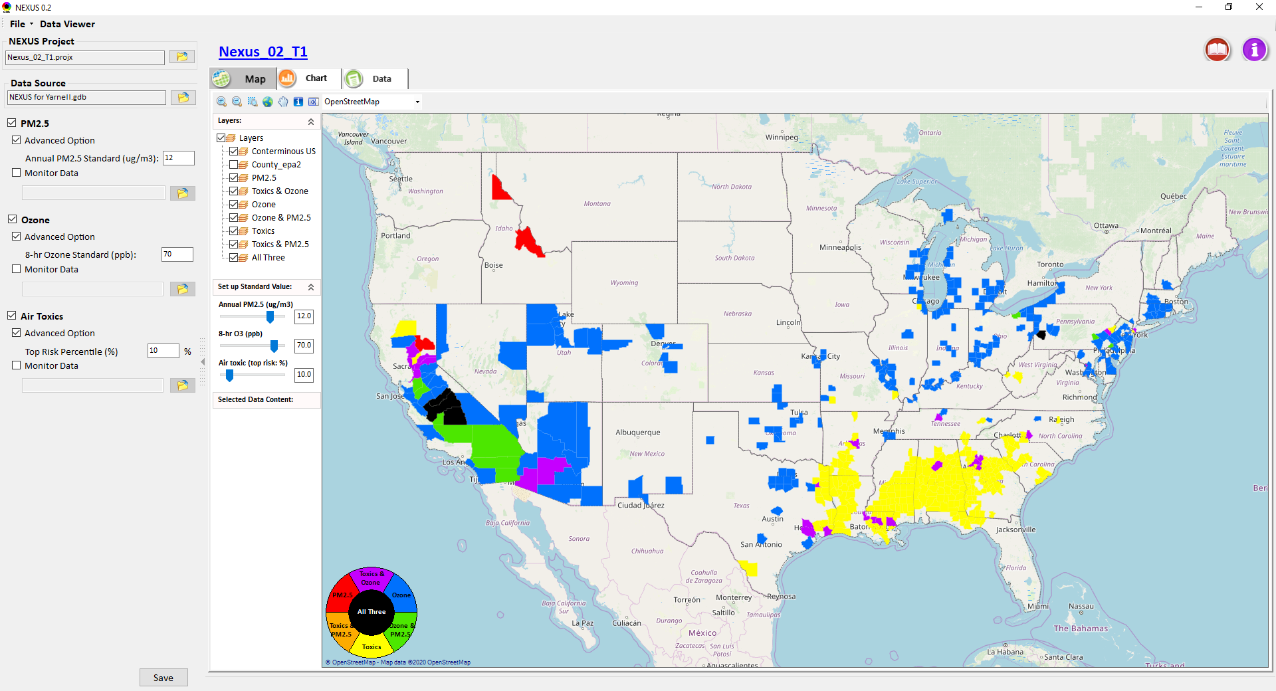
NEXUS Multi-Pollutant Analysis Tool Development: Status Update & Work Plan
Carey Jang, Sharon Phillips, James Thurman and Tyler Fox
AQAD/Air Quality Modeling Group, March 24, 2020
1

Slide 2
NEXUS Tool Development
Motivation: Develop a multi-pollutant risk-based analysis tool to identify and evaluate overlapping areas of high health risks associated with PM2.5, O3, and air toxics
Phase-1: Develop a GIS-based tool prototype with a user-friendly GUI to provide analysis and visualization functions of potential multi-pollutant AQ issues for PM2.5, O3, and air toxics across the nation.
Phase-2: Expand NEXUS to allow users to select a region or metropolitan area and provide data query and visualization functions of air quality and emissions information over the selected (or combined) region or metropolitan area of interest
NEXUS Prototype download: I:\SHARE\NEXUS_Tool\NEXUS 0.2\*
2

Slide 3
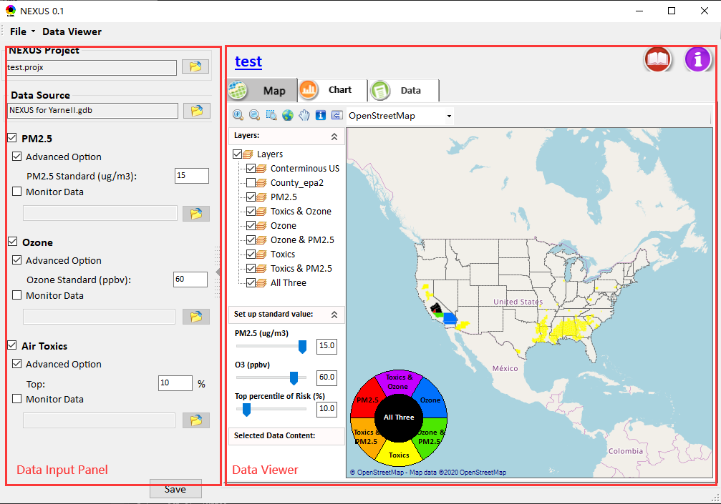
NEXUS prototype: Phase-1
Develop a NEXUS multi-pollutant analysis tool prototype with user-friendly GUI to provide visualization and query functions of potential multi-pollutant air quality issues for PM_{2.5}, O₃, and air toxics over a national level (based on 2014 Geodatabase “NEXUS for Yanell.gdb”)
Under Data input panel:
  Allow users to input the data source in geodatabase format (*.gdb), and then check interested pollutant (e.g., PM_{2.5}, Ozone and Air toxics) and set the concentration and/or risk levels for evaluation.
Under Data viewer panel:
  Provides GIS map, graphics and data tables that access an area’s data to highlight air quality pollutant concentrations and risk profiles.
3

Slide 4
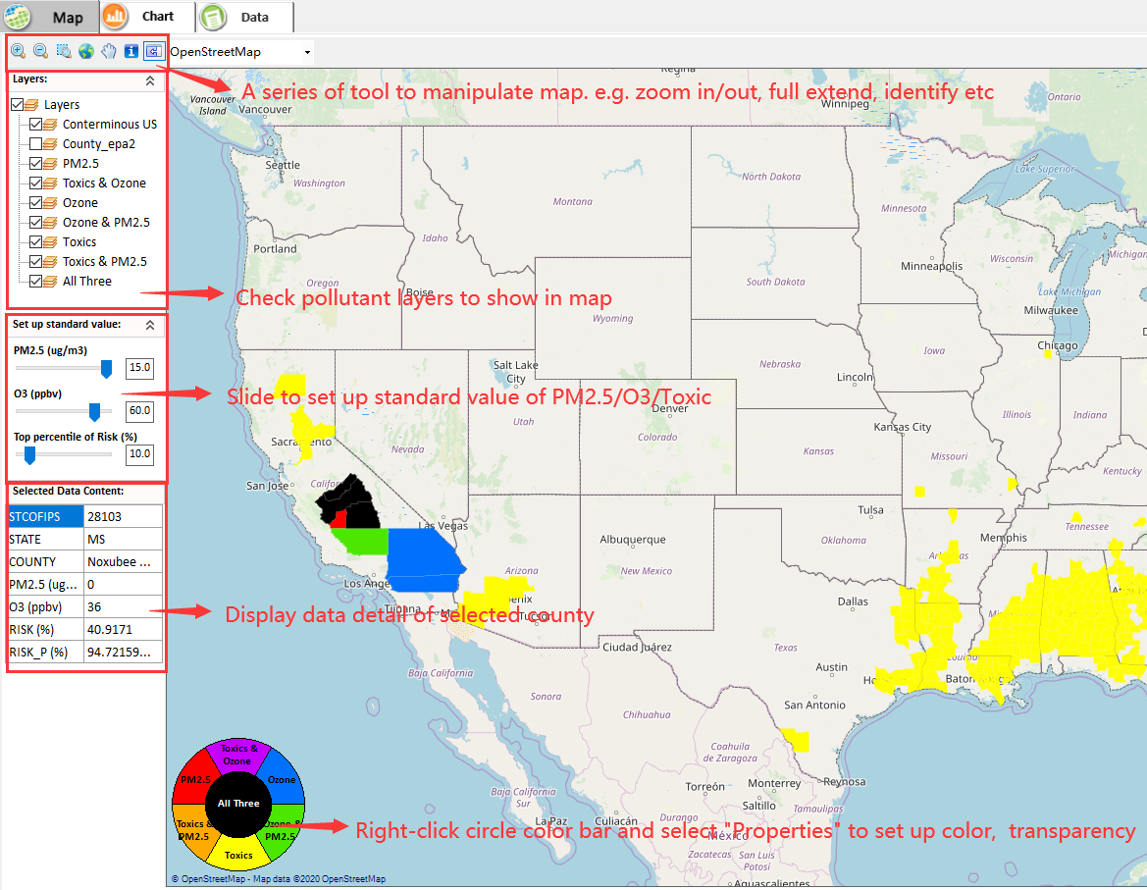
NEXUS prototype: Phase-1
Under GIS map:
Provide a series of functions to support map operations, e.g., Zoom in/out or Zoom to full extent and identify the detailed information for selected region, and multiple online base maps for users (e.g., open street map, google map and Bing Map, etc.)
Allow to check different pollutant layers and show those areas with O₃ and/or PM_{2.5} concentrations above specified levels in GIS map;
Support to set the layer transparency/color.
Support to set up standard value flexibly.
Support to display data details of selected county.
4

Slide 5
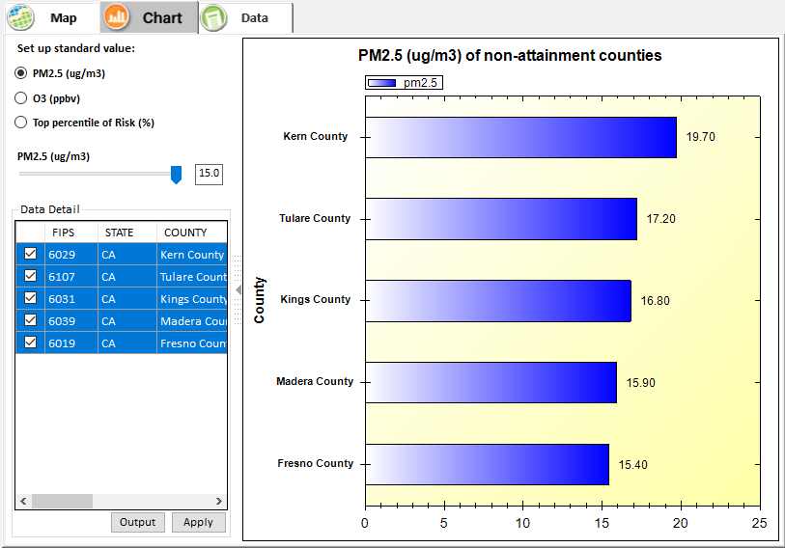
NEXUS prototype: Phase-1
Under Chart page:
Show those areas with O₃ or PM_{2.5} concentrations above user-defined air quality levels or modeled county-level cancer risk estimated from NATA in user-defined top percent in descending order
5

Slide 6
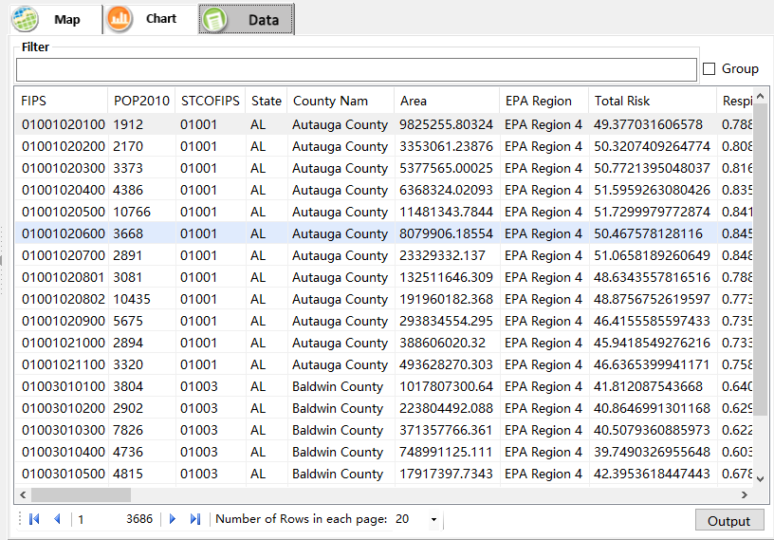
NEXUS prototype: Phase-1
Under Data tab page:
List those data elements used for ranking areas from input geodatabase (based on 2014 Geodatabase “NEXUS for Yanell.gdb”)
Support to sort, group and output these data for further study
6

Slide 7
List of Tasks under Development
Enhance/Improve “Data” module:
  Add “Advanced Filter” to customize the expression to filter data；
  Show “Statistics” for selected item；
Include ambient/emission and other dataset & display in GIS
  Design values (current and past trends)
  Emissions NEI – county level by sector/source category
  Emissions NEI – individual source
  Regulatory/policy relevant geographic boundaries
    O3 and PM2.5 nonattainment areas (designated)
    Ozone and PM advance areas
Phase 2：Expand NEXUS tool
  Allow to select pollutants of interest and then show the corresponding sorting results of pollutant sources (e.g., Top 10 pollutant sources)
Develop draft on-line User’s Manual and Quick Start Guide for the NEXUS tool
7

Slide 8
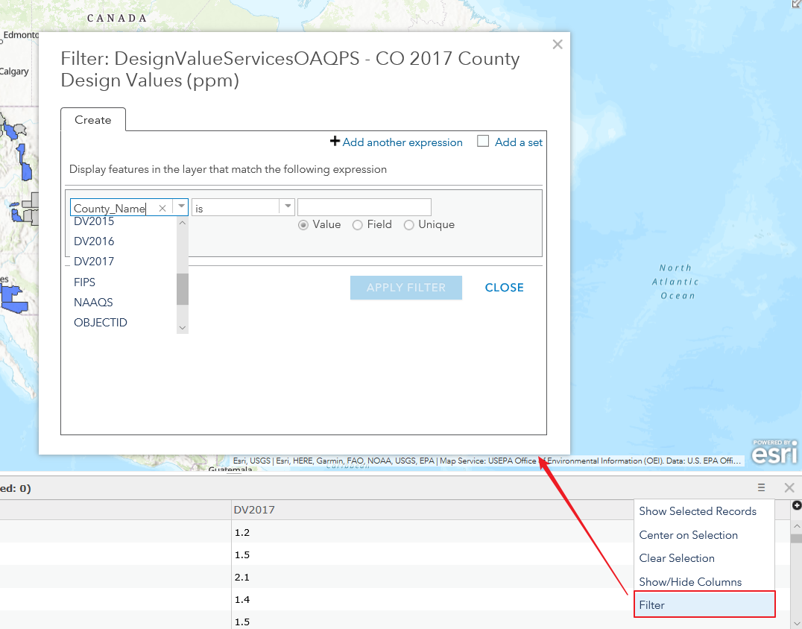
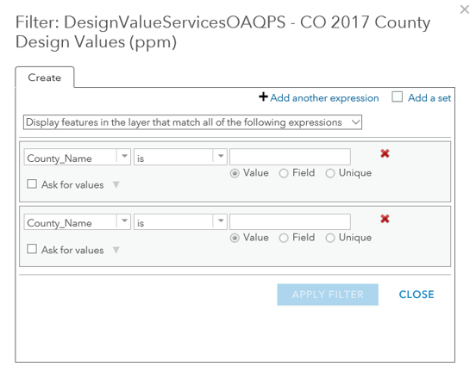
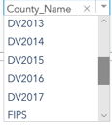

List of Tasks under Development
Enhance/Improve “Data” module:
Add “Advanced Filter”to custom the expression to filter data
8

Slide 9
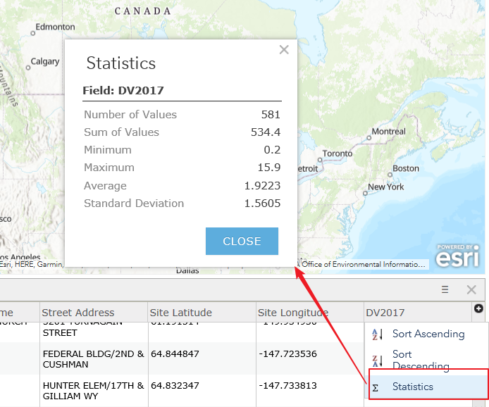
List of Tasks under Development
Enhance/Improve “Data” module:
Show “Statistics” for selected item
9

Slide 10
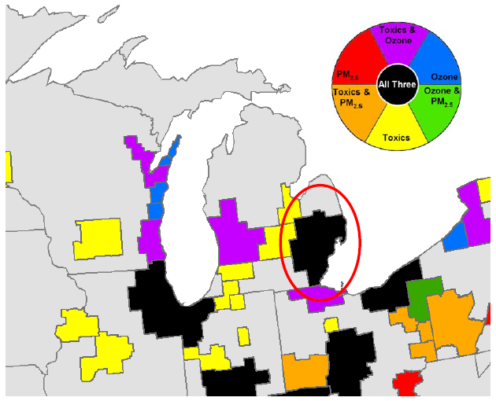
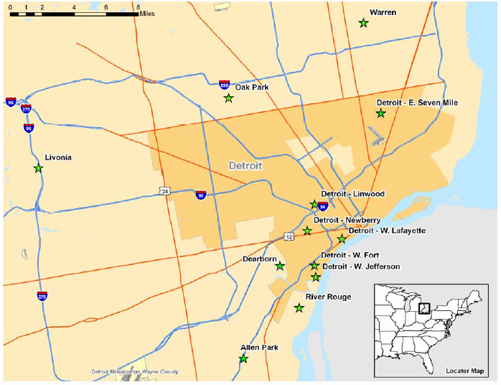
Phase-2 Extended NEXUS tool
Future Tasks: Phase 2
Expand the NEXUS tool functions to allow user to select a region or metropolitan area and provide analysis and visualization functions of air quality and emissions information over the selected (or combined) region or metropolitan area of interest
Multi-pollutant nexus of air quality issues for selected regions/areas
Air sampling network and traffic volumes network for selected regions/areas
10

Slide 11
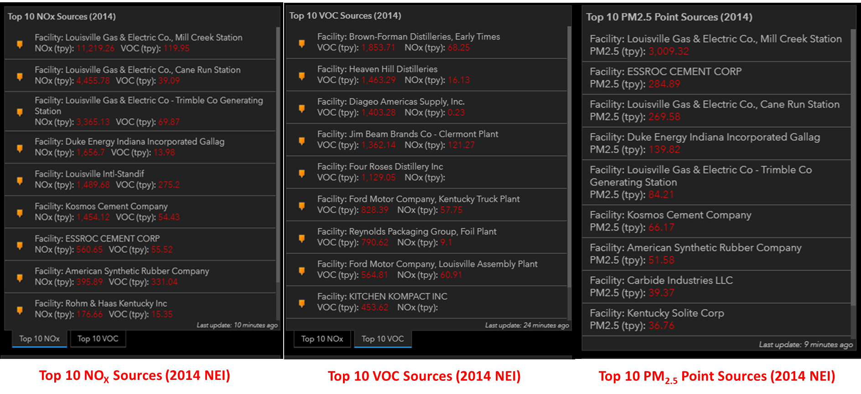
Phase-2 NEXUS tool: Extended functions
Future Tasks: Phase 2
Expand NEXUS funcitons to select pollutants of interest and then show the corresponding sorting results of pollutant sources (e.g., Top 10 pollutant sources)
Example sorting results of pollutant sources
11

Slide 12
NEXUS Tool Development: Schedule
Work Plan | Date
Develop Phase-1 NEXUS tool prototype and functions | Dec. 2019 ~ March 2020
Expand Phase-2 NEXUS tool and functions | June 2020
Deliver a fully functional NEXUS tool and draft on-line User’s Manual | July 2020
NEXUS Prototype download: I:\SHARE\NEXUS_Tool\NEXUS 0.2\*
12

Slide 13
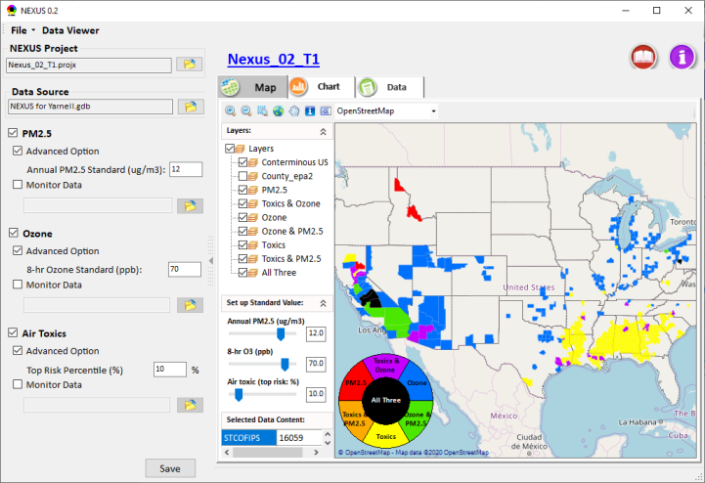
NEXUS Enhancements & Expanded Functions
Add O3 and PM2.5 Risk option:
  Risk (top risk percentile% & mortality/per million)
  Ambient
    Fused/Modeled conc. & Monitoring data
Air Toxics:
  i. Add Ambient option:
    Risk (top risk percentile% & mortality/per million)
    Ambient
      Hybrid modeled conc. & Monitoring data
  ii. Add “Air Toxic” species:
  Air toxic - VOCs
  Air toxic - Heavy metal PM2.5
  iii. Add “Air Toxic” risks:
  Cancer risk (mortality)
  Non-Cancer risk (mortality)
Add emission inventory & major sources (Phase 2 for Regions):
  O3, PM2.5 and Air toxic emission inventory (CBSA/county–based)
  Major emission sources (CBSA/county–based)
13

Slide 14
NATA Data Needs
Current NEXUS tool prototype is based on 2014 CBSA & County-based Geodataset from HEID
    What years of NATA data available?
  Temporal and spatial resolution?
NATA dataset availability (based on NATA team discussion)
    Ambient:
      Fused/modeled conc.? Hybrid data (AERMOD+CMAQ) available
      Monitoring data? Limited, check later
    Species:
      Toxic VOCs? Available from Hybrid modeled data
      Heavy metal PM? Same
    Risk: (both percentile & mortalities/million)
      Cancer risk (mortality)? Geodatabase (Mark Morris or Doug Solomon?)
      Non-cancer risk (mortality)? Same
    Emissions (CBSA/county-based):
      Major point/area emission sources? Check w/ Madeleine in Phase 2
      Air toxics emission inventory (tonnage)? Same
14

Slide 15
Potential O3 and PM2.5 Data for NEXUS
List of potential datasets to be added to new NEXUS tool for O3 and PM2.5 (if data not already included):
Design values (Current and past trends)
Emissions NEI – county level by data category
Emissions NEI – individual sources
O3 and PM2.5 nonattainment area boundaries
Ozone and PM advance area boundaries
Air Quality Projections (TBD)
15

Slide 16
Potential New Datasets for NEXUS
MAP services for NEXUS Tool: (Note: Ambient dataset can be retrieved from these websites)
1. Design Values (Includes last 10 years of data for trends)
https://epa.maps.arcgis.com/home/item.html?id=30debe97c9c448fcb04baa035b50ea85
2. NEI Point Sources
https://epa.maps.arcgis.com/home/item.html?id=f494c815624143919a3055ec9cfc60b7
3. NEI County Summary
https://epa.maps.arcgis.com/home/item.html?id=845becfb9fe04349add261f7c3e80e56
4. NAAQS Dashboards app: (Doug Solomon)
https://arcg.is/1jf5nL
5. The NATA map app is here: https://gispub.epa.gov/NATA/
GIS dataset: https://gispub.epa.gov/arcgis/rest/services/OAR_OAQPS :
  The rest services for the links: https://services.arcgis.com/cJ9YHowT8TU7DUyn/arcgis/rest/services/
specific NATA datasets:
OAR_OAQPS/2014_NATA_Emissions (MapServer)
OAR_OAQPS/2014_NATA_Monitor_Data (MapServer)
OAR_OAQPS/2014_NATA_Risks (MapServer)
16

Slide 17
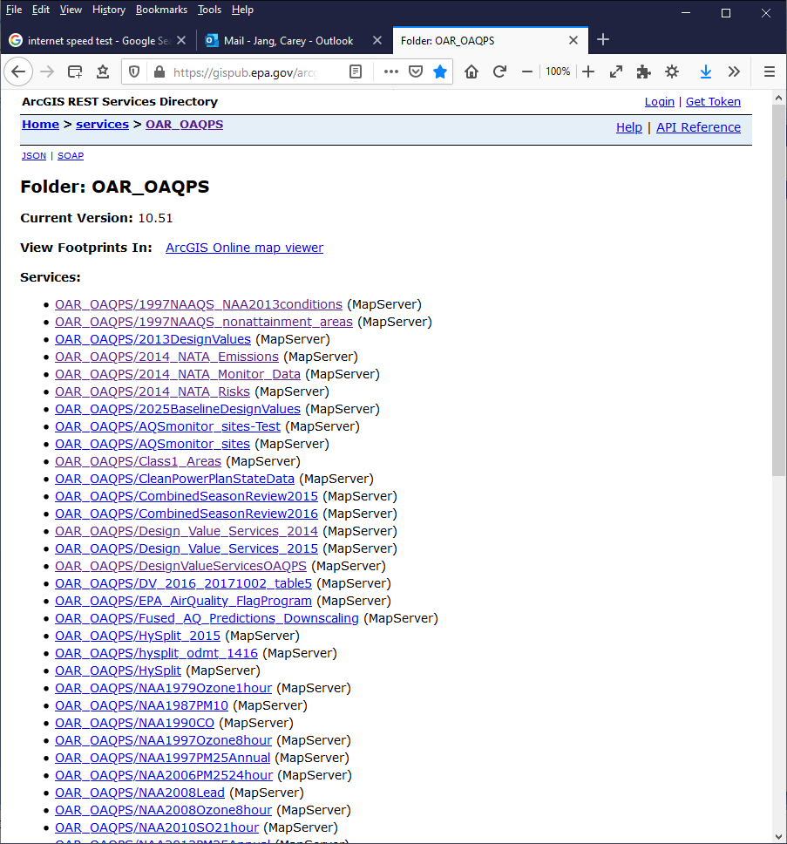
OAQPS Datasets for NEXUS
Raw data
Available?
In what format?
17

Slide 18
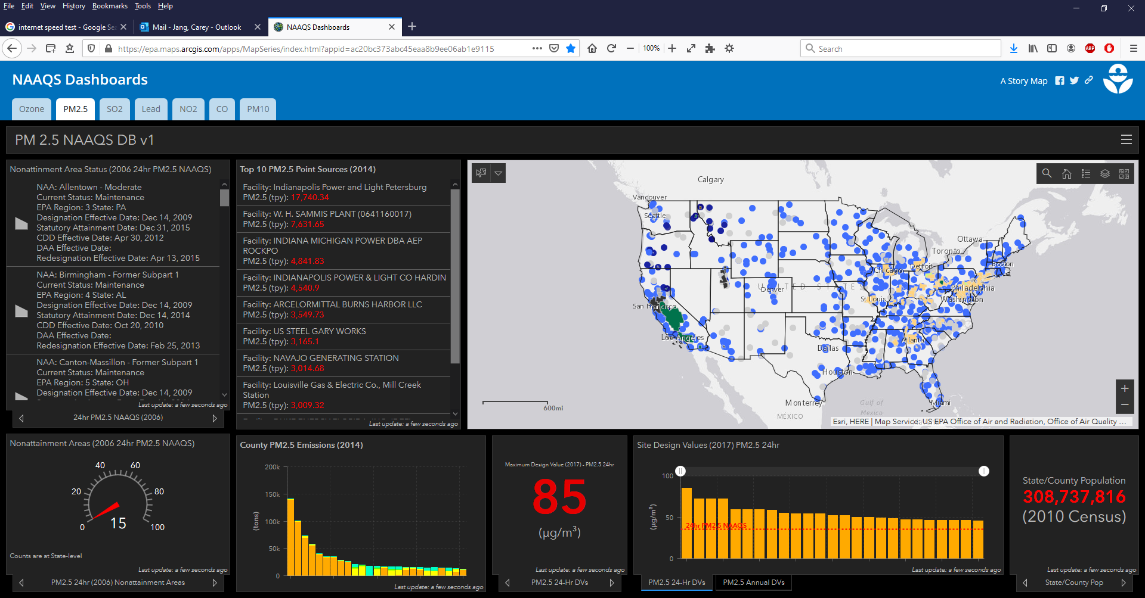
OAQPS Datasets for NEXUS
1. Raw data Available? 2. Access outside of EPA?
18

Slide 19
End

