Slide 1
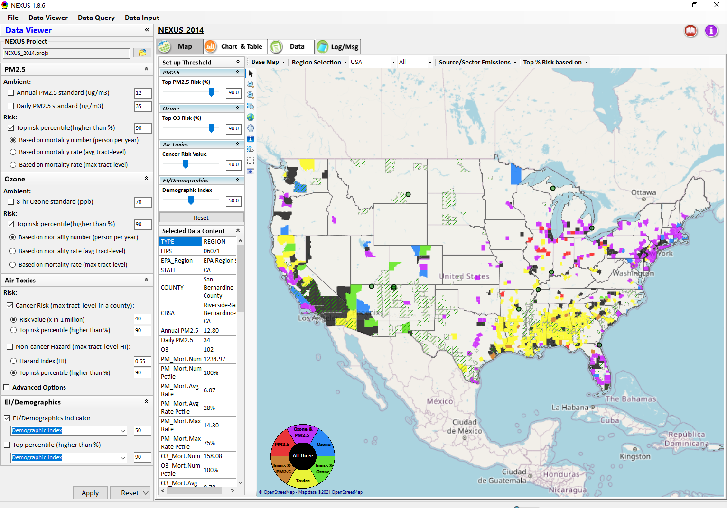
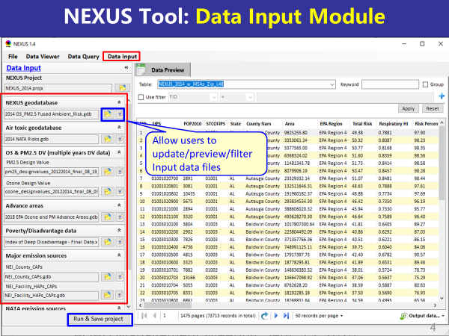
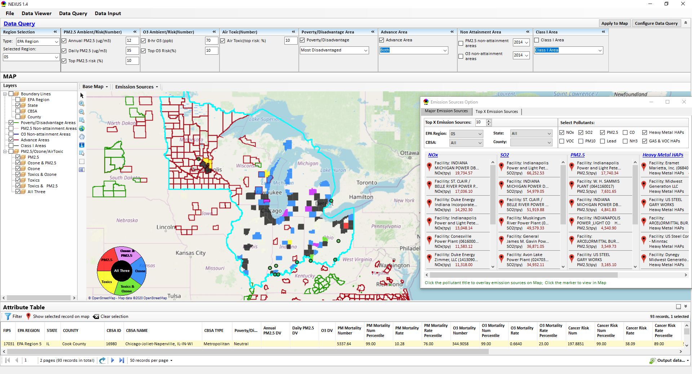
“NEXUS” Multi-Pollutant Analysis Tool: Development Status and Progress
Data Viewer Module
Data Input Module
Data Query Module
“NEXUS 1.8.6” available at:
https://gaftp.epa.gov/Air/aqmg/cjang/NEXUS/
ORD Briefing
June 29, 2021
OAQPS’s Multi-Pollutant Team: Beth Landis, Carey Jang, etc.
1

Slide 2
Overview
Multi-Pollutant Background
NEXUS Tool Development
Expected Use
Key Modules
Questions NEXUS Can Answer & Examples
Recent Updates & Next Steps
NEXUS Tool (v. 1.8.6) Demo
2

Slide 3
Multi-Pollutant (MP) Background
Support a comprehensive, MP treatment of air quality problems to effectively improve air quality and make the most efficient use of available resources
Primary Goal - identify & evaluate local control strategies targeting emissions of O₃ & PM_{2.5} and their precursors while at the same time reducing Air Toxics of concern for communities to maximize both health benefits and air quality improvements
MP planning has the potential to reduce the costs and increase benefits associated with air quality management (AQM)
Supports S/L/T air agencies in developing MP, risk-based AQM plans and implementing strategies that reduce air pollution emissions & improve public health
Success has been demonstrated in Detroit and SC; another project is currently underway in Louisville, KY
Tools needed to analyze MP data are either available currently or being developed in OAQPS (e.g., NEXUS)
3

Slide 4
NEXUS Tool Development
Motivation: Develop a new multi-pollutant analysis tool to identify and assess areas with high ambient levels and/or health risks associated with PM_{2.5}, O₃ and Air Toxics
Phase-1: Develop a GIS-based NEXUS prototype with a user-friendly graphical interface to provide analysis and visualization functions of potential multi-pollutant AQ issues at national level (continental US)
Phase-2: Expand the NEXUS tool to allow users to dial into an EPA region, State, or metropolitan area and provide data query and visualization functions for “emissions and air quality” information over the selected region of interest
4

Slide 5
Expected Use of NEXUS Tool
The NEXUS tool will allow users to do the following:
National screening for areas with MP issues: Phase 1 development provides ability to quickly screen areas across nation that have combination of high air quality and/or risk levels for O₃, PM_{2.5} and Air Toxics.
Area screening to understand nature of MP problem: Phase 2 development provides ability to ‘dial-into’ specific areas to determine extent to which common emissions sources are causing the MP issues.
We expect to use this tool to engage with Regions and identify areas that would potentially benefit most from MP approaches to reduce emissions (including current NA areas).
The NEXUS tool will essentially provide a ‘conceptual model’ of MP issues to facilitate engagement with state/local/tribal agencies and community stakeholder groups.
We also expect that it can have additional uses across the Office for Air Toxics, Environmental Justice and other programs.
5

Slide 6
Planned Use of NEXUS: Multi-Pollutant Assessment
Assemble technical information for accessibility and transparency to facilitate understanding of multi-pollutant air quality issues across the U.S.
Provide information on O₃, PM_{2.5}, and Air Toxics (and GHGs in future) to inform and connect our program efforts
Multi-pollutant Assessment
Identify highest risk areas across O₃, PM_{2.5}, and Air Toxics to promote MP considerations across the office
Engage with EPA Regions in these areas to consider MP control strategies and outreach purposes
Identify the nature of multi-pollutant risks across EJ communities to identify sources/sectors/areas of focus for our programs
6

Slide 7
Potential Use of NEXUS: Policy, Planning & Outreach
Non-attainment areas/Advance program
Understand multi-pollutant risks to consider more effective multi-pollutant control strategies
Overlay high MP risk areas with NAAs and Advance areas:
What are the top emissions sources by pollutant?
What specific sources are common across pollutants that may indicate co-control potential?
Engage with EPA regions, S/L/T air agencies, & community stakeholders to consider MP control strategies as part of SIP or voluntary programs and address other pollutant concerns such as within EJ communities
EJ Strategy and Outreach
Assist in understanding the nature of multi-pollutant risks for EJ communities as part of upcoming OAQPS EJ Strategy including identifying sources/sectors/areas of focus
Use formally as a screening tool under OAQPS EJ strategy (in complimentary manner w/ EJSCREEN)
Tribal Programs: Identify high risk areas for O₃, PM_{2.5}, & Air Toxics; Engage with EPA regions and tribal air agencies to consider MP control strategies as part of TIPs or voluntary programs
7

Slide 8
Potential Use of NEXUS: Source/Sector Prioritization
Inform prioritization of sources/sectors that significantly contribute to highest nationwide risk across O₃, PM_{2.5}, and Air Toxics
Identify facilities and/or sectors with potential co-benefits of control in areas with highest multi-pollutant risks
For example, help GHG rules/policies focus on sectors that have highest local air quality health benefits
Identify sources/sectors that significantly contribute to toxics and criteria pollutant risks within EJ communities
8

Slide 9
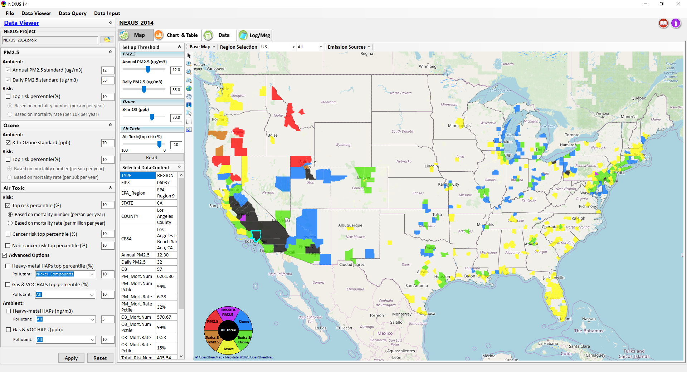
NEXUS Tool: Three Key Modules
Data Viewer module
Data Input module
Data Query module
View and create interactive Map/Data/Chart/Table
Provide flexible selections & mapping of “Ambient” and/or “Risk” levels of PM_{2.5}, O₃ and Air Toxics
Provide regional analysis for “EPA region”, “States”, “CBSA”, and “County”
Link and display major emission sources locations & emitted pollutants info.
Allow to update & change input data files
Provide data preview and filter functions
Currently uses 10 publicly available input data files (~4GB)
Quick turnaround to run & save to a new “project” using new input data files
Expand data field selections and flexibility for exploratory/advanced users
Provide overlaying map and summary table for data query results
Current data query based on selected data fields: “Ambient/Risk, Advance area, Socio-demographic (EJ) area, NA Area, Class I area”
9

Slide 10
NEXUS Tool: Examples
How can NEXUS be used to identify highest risk areas across O₃, PM_{2.5}, and Air Toxics, the sector(s) contributing and EJ communities impacted?
Example 1 → Region 5 → Detroit
How can NEXUS be used to identify how best to address multi-pollutant risks in nonattainment areas?
Example 2 → Region 4 → Atlanta
How can NEXUS be used to review industrial sources and potential impacts on EJ communities?
Example 3 → Region 4 → Birmingham
10

Slide 11
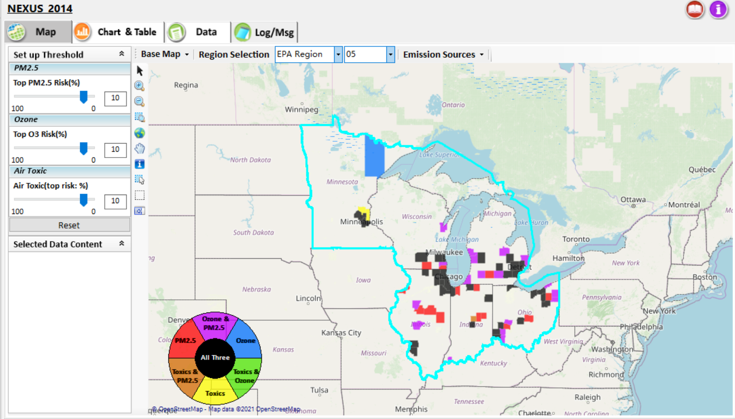
NEXUS Tool: Example 1 - ID High MP Risk Areas, Contributing Sector(s) & EJ Areas
NEXUS can be used to identify highest risk areas across O₃, PM_{2.5}, and Air Toxics.
Example map above is for Region 5
11

Slide 12
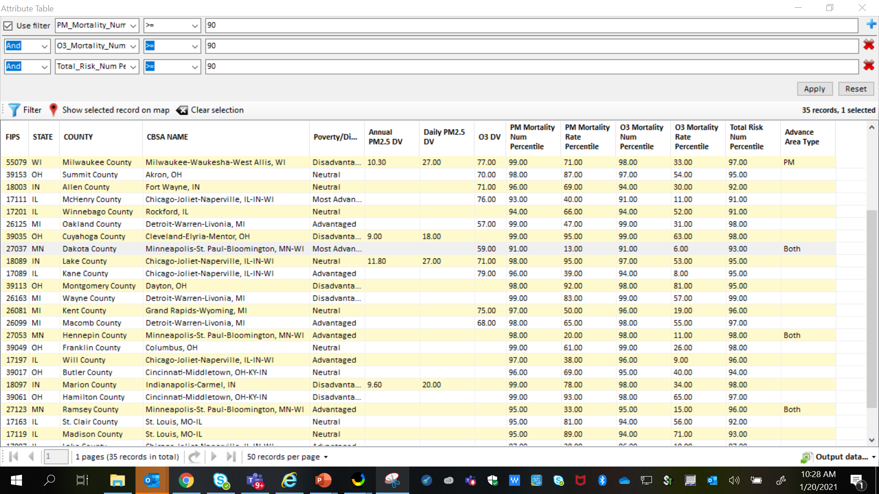
NEXUS Tool: Highest MP Risk Areas in R5
NEXUS can be used to identify highest risk areas across O₃, PM_{2.5}, and Air Toxics. Example table above was generated in Data Query for Region 5. Table Generator Module is planned for future development. Currently, data can be exported to Excel.
12

Slide 13
NEXUS Tool: R5 Rankings from Data Query Module
STATE | COUNTY | CBSA NAME | PM Mortality Num % | O3 Mortality Num % | Total Risk Num % | Overall Rank | Poverty / Disadvantage | Advance Area Type
IL | Cook County | Chicago-Joliet-Naperville, IL-IN-WI | 99 | 99 | 99 | 1 | Neutral
MI | Wayne County | Detroit-Warren-Livonia, MI | 99 | 99 | 99 | 1 | Disadvantaged
MI | Oakland County | Detroit-Warren-Livonia, MI | 99 | 99 | 98 | 2 | Advantaged
OH | Cuyahoga County | Cleveland-Elyria-Mentor, OH | 99 | 99 | 98 | 2 | Disadvantaged
OH | Franklin County | Columbus, OH | 99 | 99 | 98 | 2 | Neutral
IN | Marion County | Indianapolis-Carmel, IN | 99 | 98 | 98 | 3 | Disadvantaged
OH | Hamilton County | Cincinnati-Middletown, OH-KY-IN | 99 | 98 | 97 | 4 | Disadvantaged
WI | Milwaukee County | Milwaukee-Waukesha-West Allis, WI | 99 | 98 | 97 | 4 | Disadvantaged | PM
MN | Hennepin County | Minneapolis-St. Paul-Bloomington, MN-WI | 98 | 98 | 98 | 4 | Advantaged | Both
IL | DuPage County | Chicago-Joliet-Naperville, IL-IN-WI | 98 | 97 | 98 | 5 | Most Advantaged
MI | Macomb County | Detroit-Warren-Livonia, MI | 98 | 98 | 97 | 5 | Advantaged
OH | Montgomery County | Dayton, OH | 98 | 98 | 95 | 6 | Disadvantaged
IN | Lake County | Chicago-Joliet-Naperville, IL-IN-WI | 98 | 97 | 95 | 7 | Neutral
OH | Summit County | Akron, OH | 98 | 97 | 95 | 7 | Neutral
IL | Lake County | Chicago-Joliet-Naperville, IL-IN-WI | 97 | 96 | 97 | 7 | Advantaged
NEXUS can be used to identify highest risk areas across O₃, PM_{2.5}, and Air Toxics. Information above was generated in Data Query for Region 5 and exported into excel where rankings were applied.
Top CBSAs (using this approach) – Chicago, Detroit, Cleveland, Columbus, Indianapolis, Cincinnati, Milwaukee, Minneapolis, Dayton & Akron
13

Slide 14
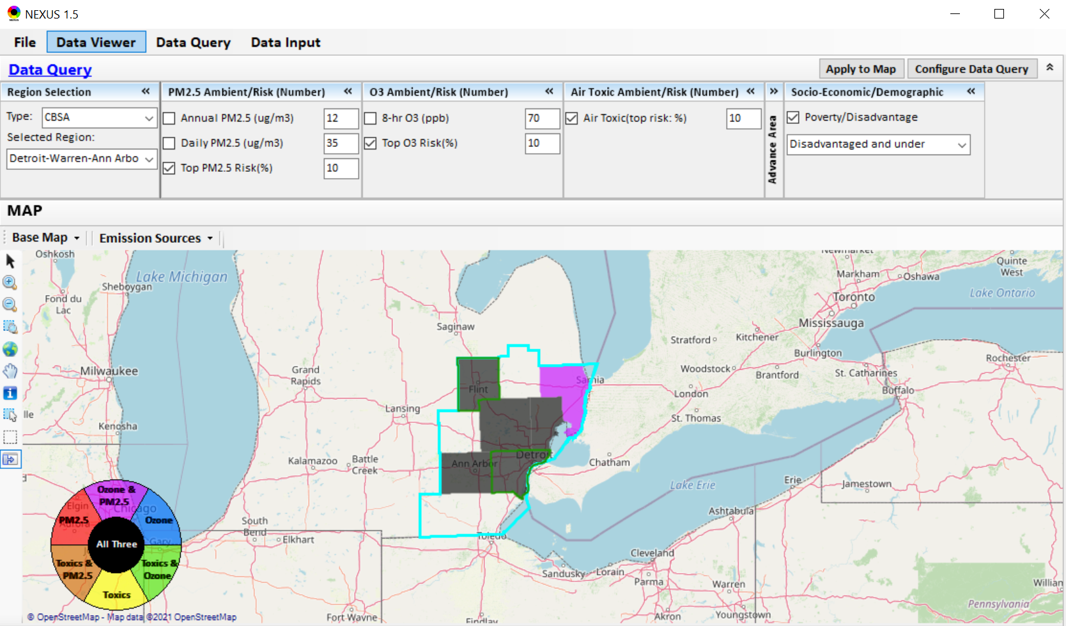
NEXUS Tool: Detroit CBSA
NEXUS can be used to explore CBSAs with multi-pollutant concerns. This information was generated in Data Viewer for the Detroit CBSA. Two counties (Wayne & Genessee) are outlined in green, showing that they are “disadvantaged or under”. Let’s explore where the major sources are located in the CBSA…
14

Slide 15
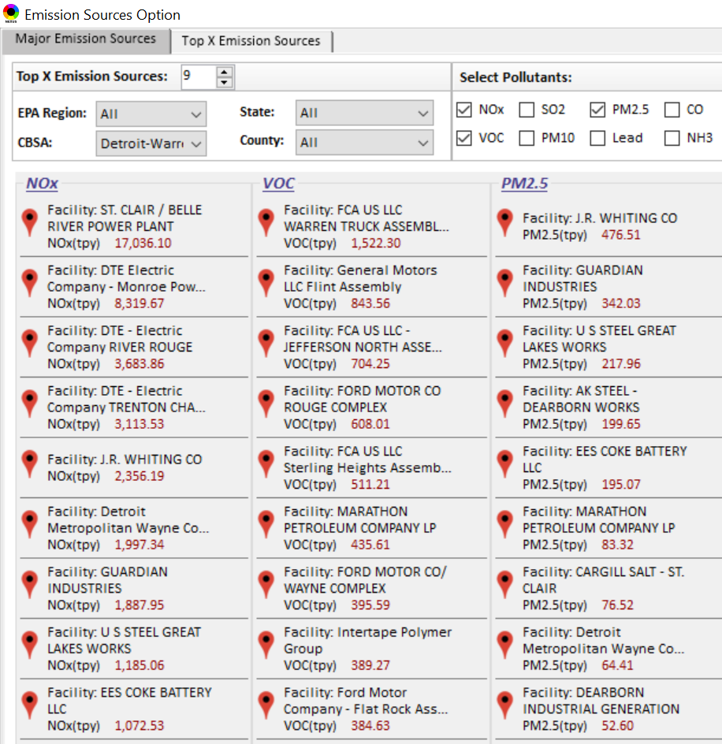
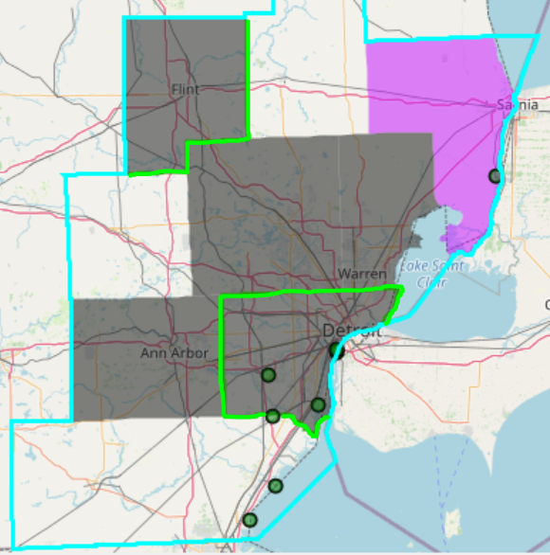

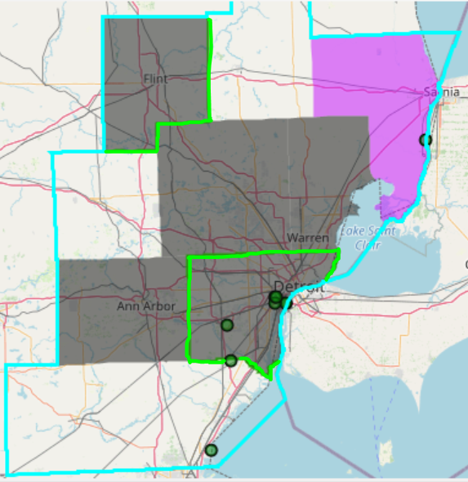
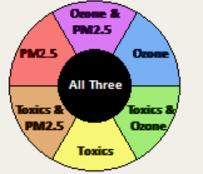
NEXUS Tool: Emissions Sources in Detroit CBSA
G
S
G
S
Ma
Ma
S
Ma
M
W
W
M
G
M
M
M
W
W
W
Top NOx Emission Sources
Top VOC Emission Sources
W
W
W
M
Ma
W
G
S
W
W
W
Ma
M
W
S
W
W
S
W
W
W
W
M
G = Genessee Co., Ma= Macomb Co., M= Monroe Co., S = St. Clair Co., W = Wayne Co.
Top PM_{2.5} Emission Sources
NEXUS can be used to identify top emission sources. The information above was generated in Data Query for the Detroit CBSA . We can quickly see that the majority of the NOx, VOC & PM_{2.5} emission sources are located in Wayne County. Let’s explore the Wayne County sources further…
15

Slide 16
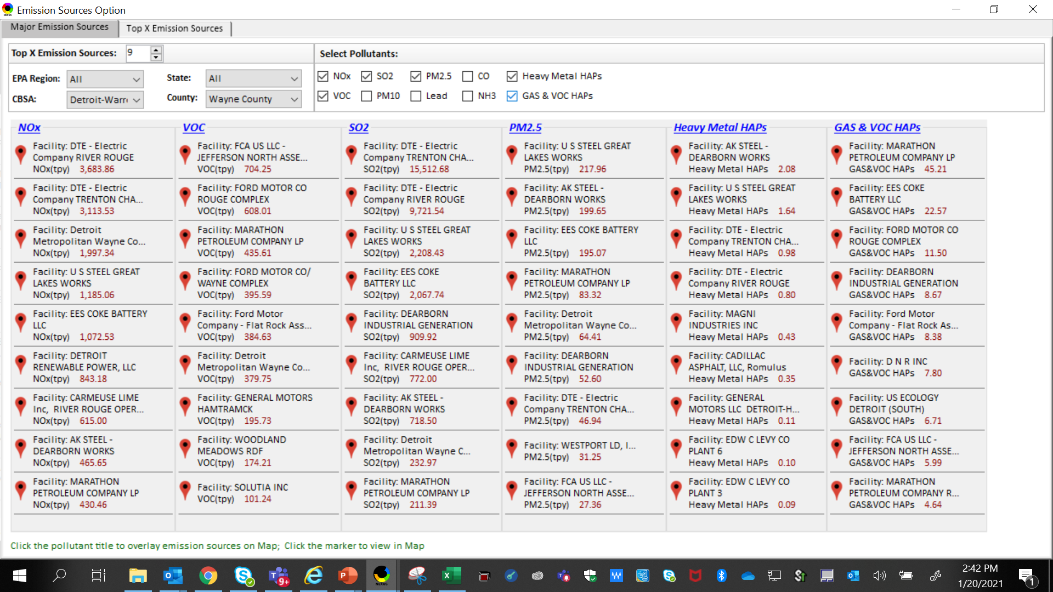
NEXUS Tool: Emissions Sources in Wayne County
NEXUS can be used to identify top emission sources. The information above was generated in Data Query for Wayne County, MI. This can help identify the potential co-benefits of controls. Let’s explore AK Steel and US Steel further...
16

Slide 17
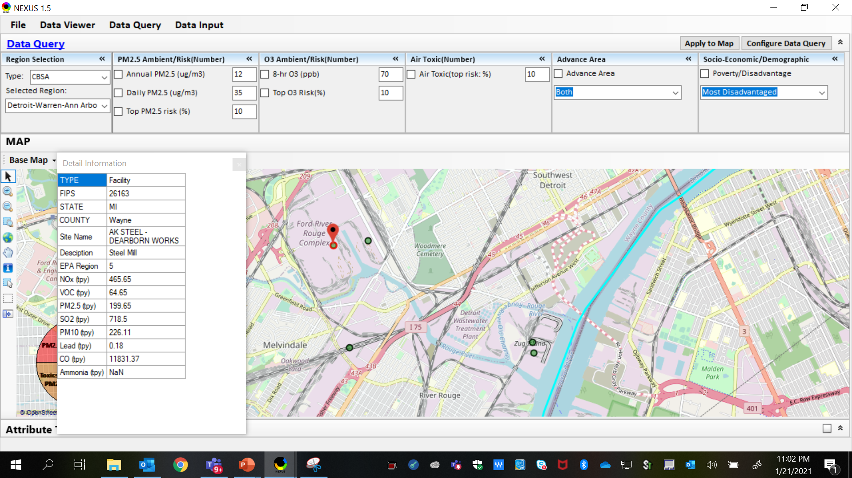
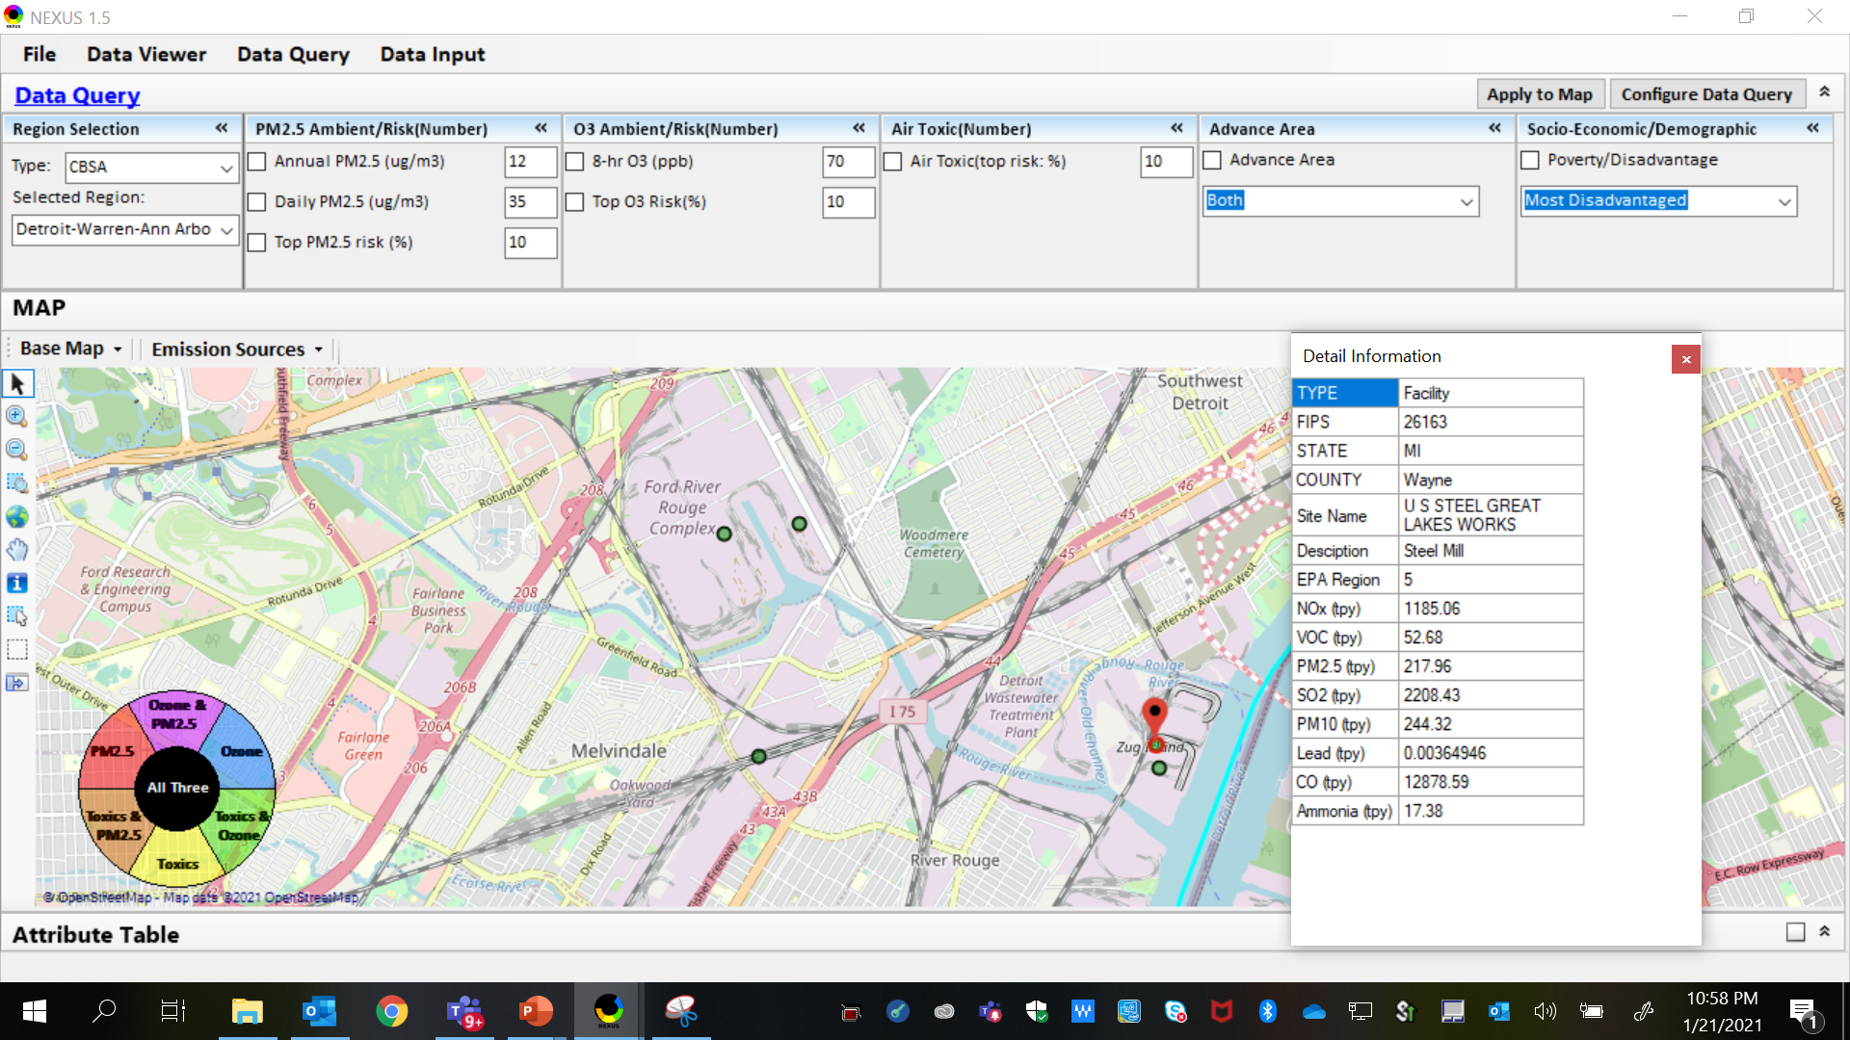
NEXUS Tool: Steel Mills in Wayne County
AK Steel
US Steel
AK Steel & US Steel were both identified as top emitters for NOx, SO₂, PM_{2.5} and Heavy Metal HAPs, highlighting the potential co-benefits of controls in these steel mills. The above map was generated in NEXUS Data Query. Let’s see the proximity of these steel mills to EJ communities…
17

Slide 18
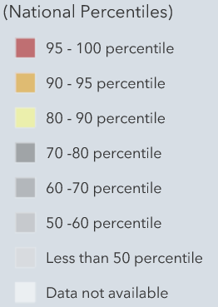
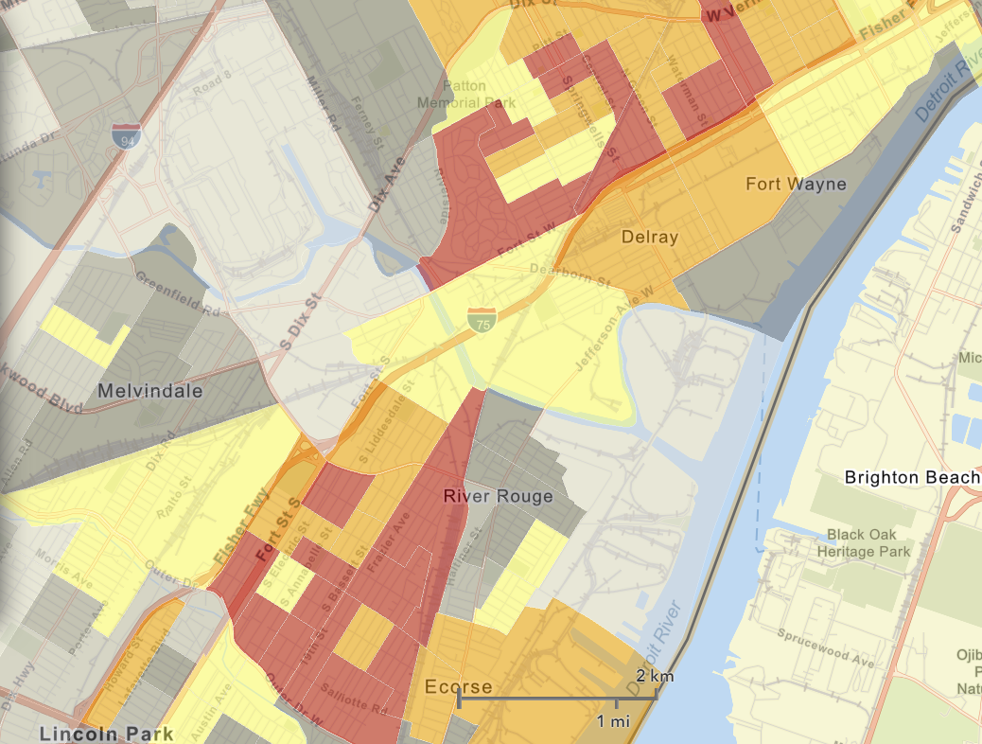
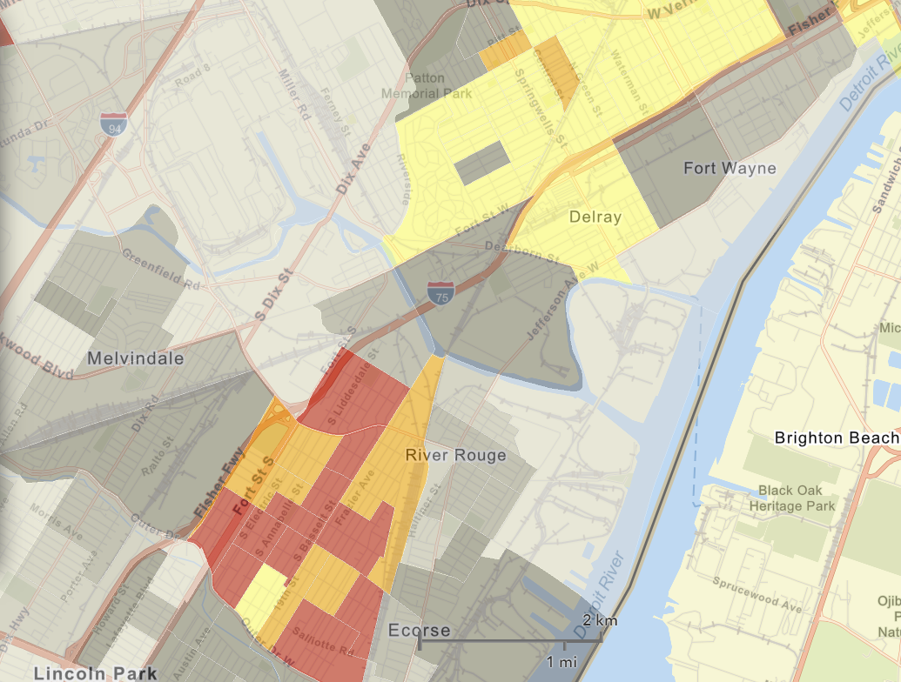
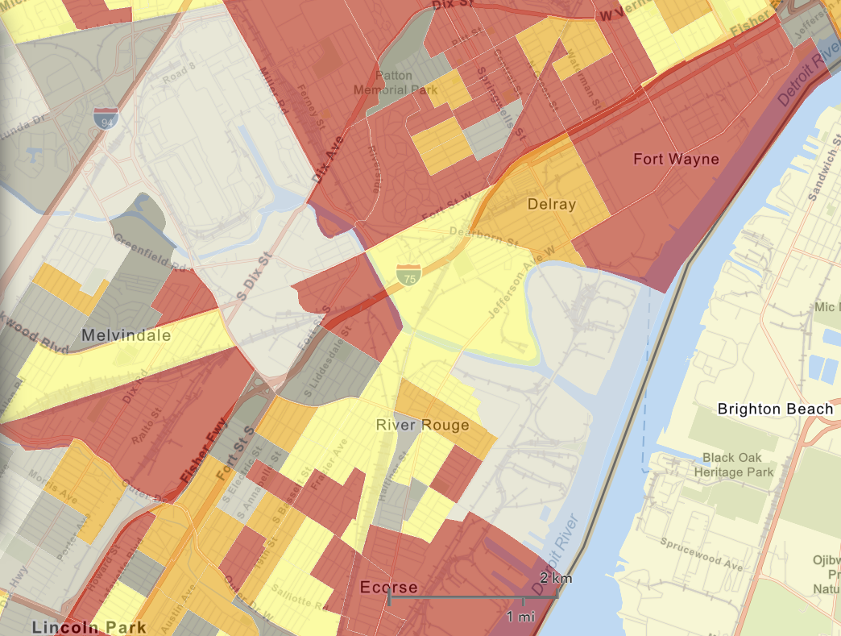

NEXUS Tool: EJ Indices in Wayne County
NEXUS Map
NEXUS can be used to determine EJ communities in areas with MP concerns. NEXUS currently includes a poverty/disadvantage index, and we plan to incorporate additional EJ metrics such as the data inputs below from EJSCREEN. These indices show the close proximity of AK Steel & US Steel to EJ communities.
AK Steel
US Steel
EJSCREEN Demographic Index
EJSCREEN Minority Population
EJSCREEN Low Income Population
18

Slide 19
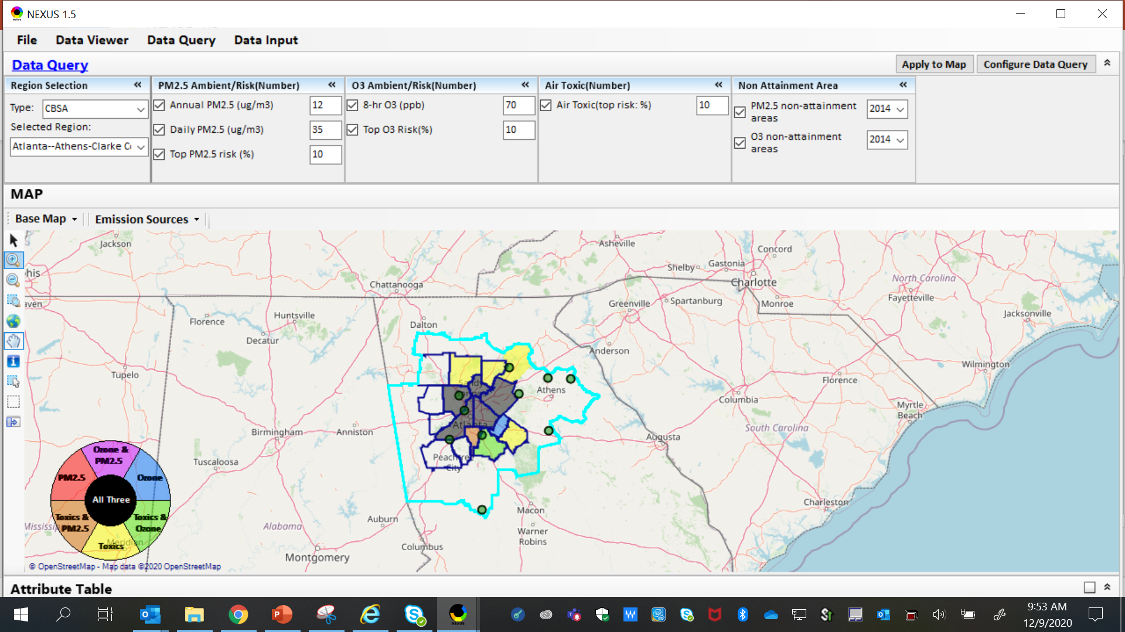
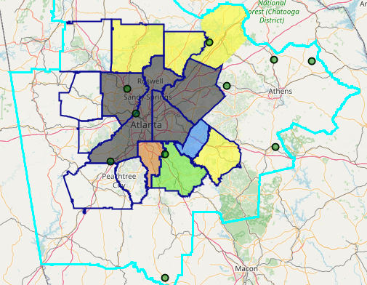
NEXUS Tool: Example 2 – MP Risk in NAAs
The maps above were generated for the Atlanta CBSA (2015 O₃ NAA), using the data query module. The top 10 Gas & VOC HAPS emission sources are plotted.
19

Slide 20
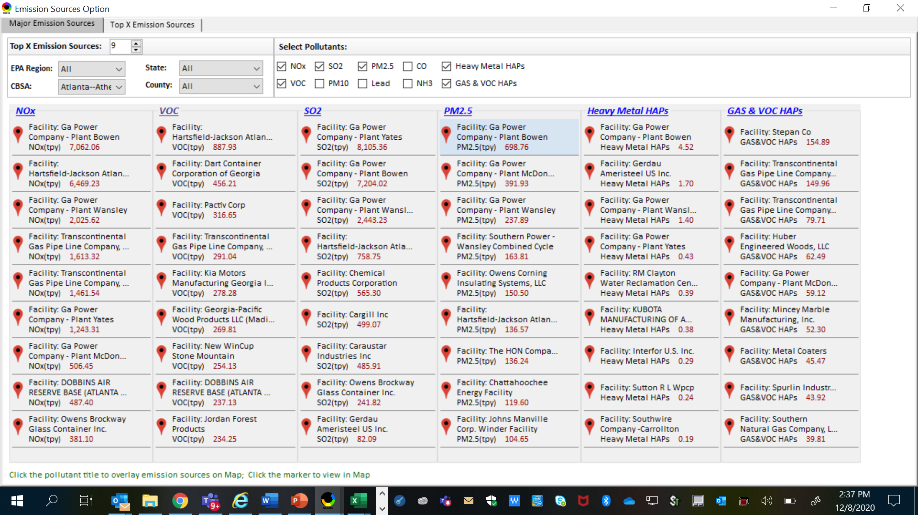
NEXUS Tool: Identifying MP Co-Controls
NEXUS can be used to identify top emission sources. Information above was generated in Data Query for the Atlanta CBSA. This can help identify the potential co-benefits of controls, e.g., Transcontinental Gas Pipeline Co.
20

Slide 21
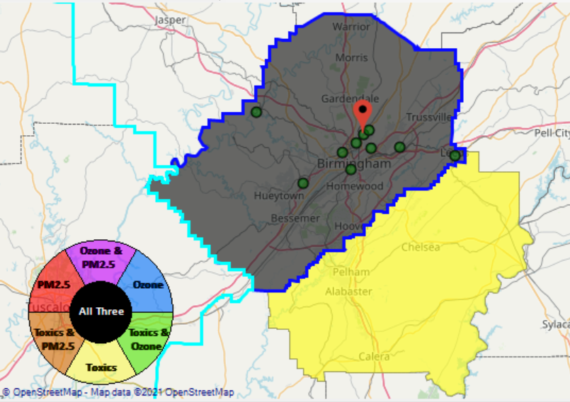
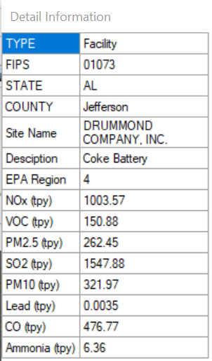
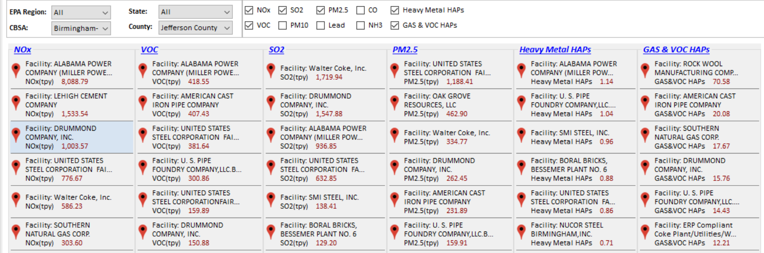
NEXUS Tool: Example 3 – Reviewing an Industrial Source
Drummond’s ABC Coke facility in Tarrant, AL, just outside the Birmingham city limits in Jefferson County, recently paid fines under settlement agreement for emitting 10x more benzene than reporting, along with other violations. We can use NEXUS to take a look at the facility.
21

Slide 22
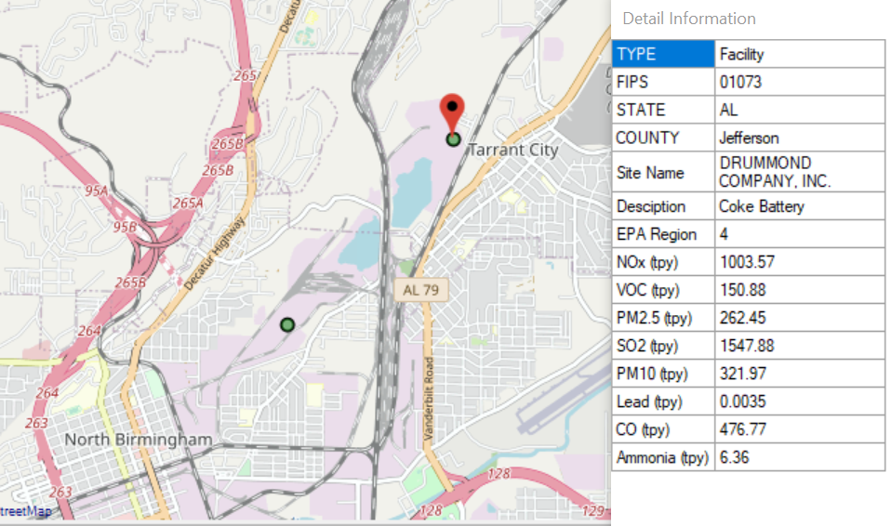
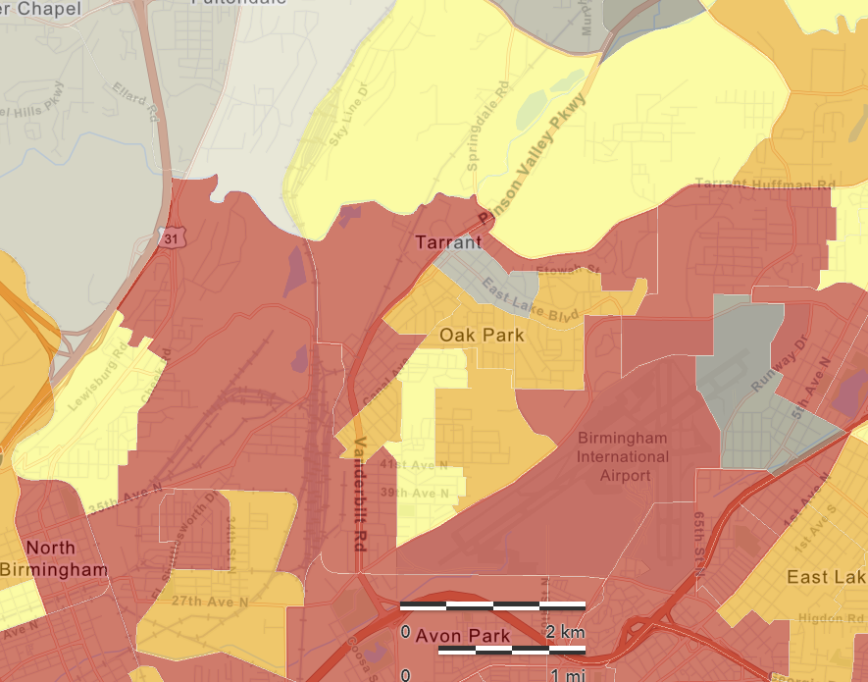
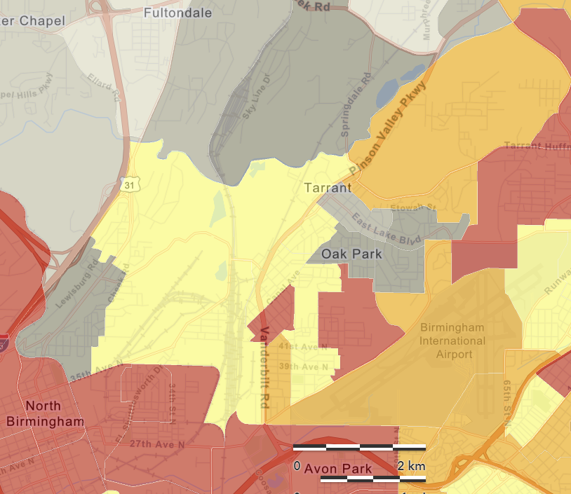
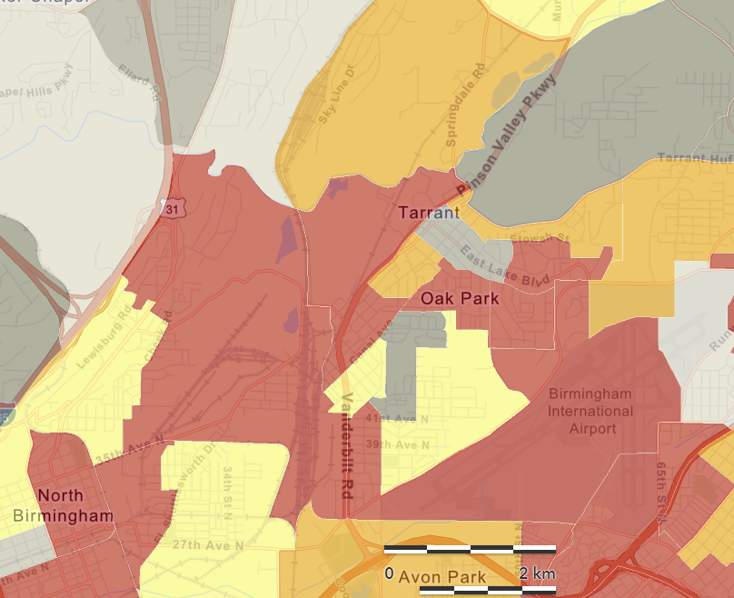
NEXUS Tool: Reviewing an Industrial Source near EJ Areas
NEXUS Map
Adding EJ metrics, such as those shown below in EJSCREEN, can be used in NEXUS to determine the proximity of industrial sources to EJ communities in areas with MP concerns.
EJSCREEN Demographic Index
EJSCREEN Minority Population
EJSCREEN Low Income Population
22

Slide 23
NEXUS: Recent Upgrades & Improvements
Recent Upgrades & Improvements (NEXUS “1.5” → “1.8.6”)
New/revised Metrics (Air Toxics, PM2.5, O3 & EJ)
New/updated data inputs and functions:
EJ/Demographic data (from EJSCREEN)
Tribal areas & Advance areas
2017 emissions data (including GHG & sector mapping) (updated from 2014)
“Source & Sector” emissions summary to support “Sector prioritization” effort
“Source Category” emissions analysis (point, non-point, road, non-road, event)
Complete EPA region “Table Generator”
Upgrade “Data Query” module & “Data Input” module
Next Steps and Work Plan
2017 fused PM2.5 & O3 and risk data (Aug.) and 2017 fused air toxic and risk data (Oct.)
Include Monitoring sites/data (PM2.5 & O3 first, then AT) (Aug.)
Developing screening capabilities for “Proximity analysis of MP risks and EJ” (TBD)
23

Slide 24
Need for Proximity Screening for Air Quality Planning
Proximity Screening Analysis helps answer…
What are the risks in close proximity to my monitor and/or community of interest?
What source(s) are in close proximity to my monitor and/or community of interest?
What are the demographics of communities in close proximity to monitor(s) and/or source(s) of interest?
How do the demographics of communities near my monitor/source compare to area/state/national averages?
How do the risks within communities near my monitor/source compare to area/state/national averages?
24

Slide 25
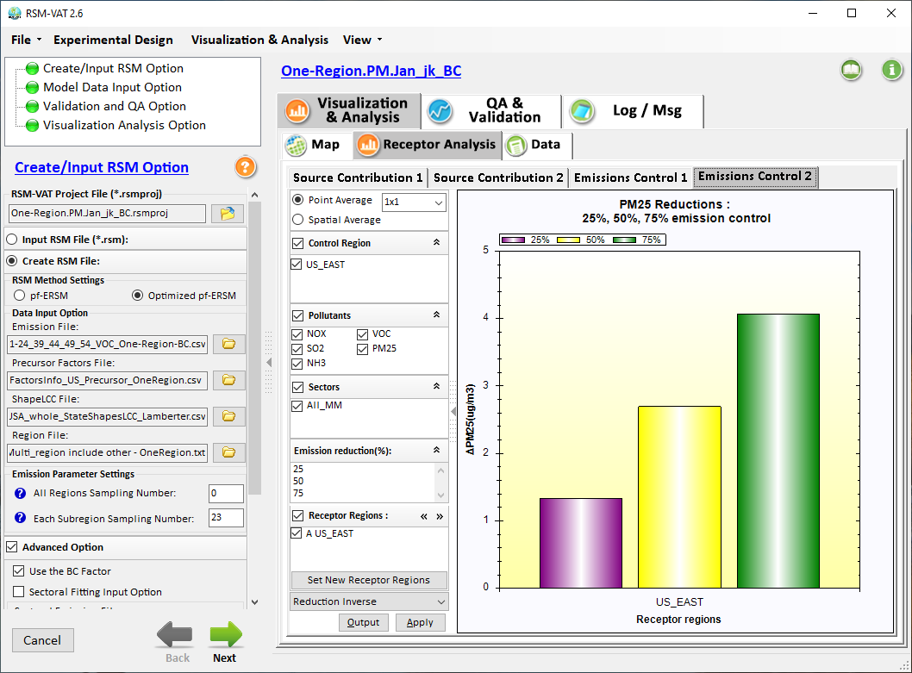

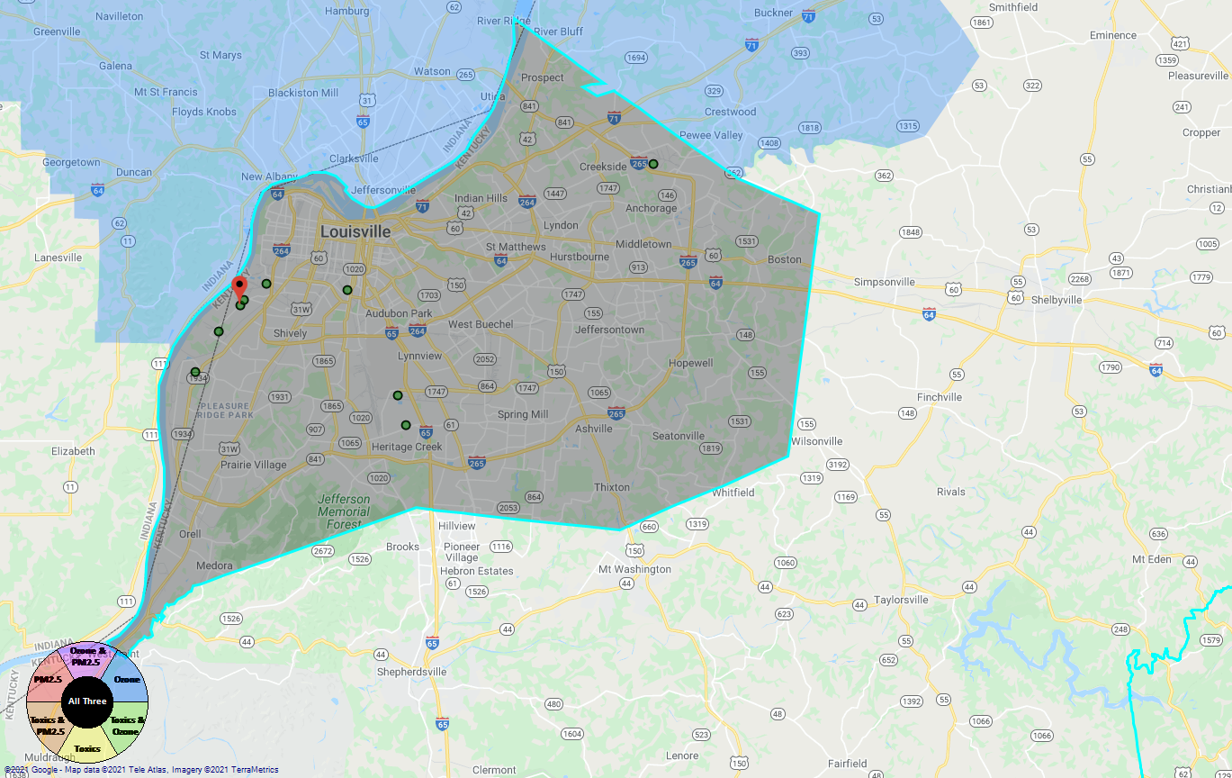
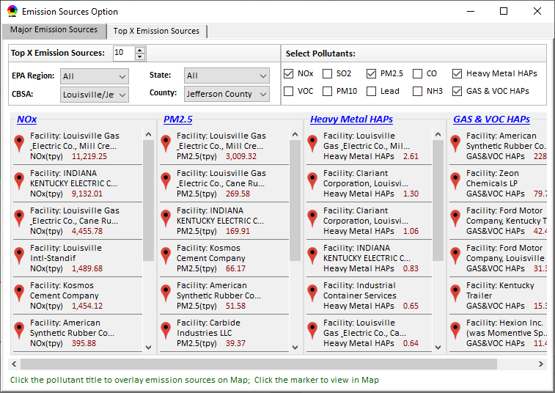
Developing Screening Capabilities for “Proximity Analysis of MP Risks & EJ”
NEXUS now can be used to quickly identify top emitters of NOx, SO₂, PM_{2.5}, and heavy-metal & VOCs HAPs near EJ areas of concern; plan to develop proximity & spatial analysis capabilities
Spatial
Analysis
Air Quality
PM2.5 risk
O3 risk
Air Toxics risk
Cancer risk
Non-Cancer risk
EJ Indicators
Proximity Analysis
(Selected Facility or Monitoring Site)
Climate Risks
Population
Minority
Income
Education
Language
Flood
Fire
Sea Level Rise
Heat
Disease
Climate Risks
Flood
Fire
Sea Level Rise
Heat
Disease
Proximity and Spatial Analysis for MP Risk and EJ
Proximity Analysis
Spatial Analysis
MP Risk
Air Toxics
EJ Indicator
Minority
Facility: American Synthesis Rubber Co., Louisville, KY Sector Group: Polymers and Resins Production Top Risk Drivers: ETO, Formaldehyde (examples) |  |  |  |  | Selected Options: Radius of Impact: 10km Number of CBSAs: 25 (top MP risk ranking) Air Toxics Risk threshold: 10 (“x”-in-a million)
 | Within Radius of Facility | County Avg. | State Avg. | EPA Region Avg. |  | Nation Avg. | Sector Group (within radius) National avg. | Sector Group (within radius) Top 25 CBSAs
Population total | x,xxx | xx,xxx | xxx,xxx | xxx,xxx |  | 317,xxx,xxx | xxx,xxx | xxx,xxx
PM2.5 risk (%tile) | x% | x% | x% | x% |  | x% | x% | x%
Ozone risk (%tile) | x% | x% | x% | x% |  | x% | x% | x%
Air Toxics risk: Cancer risk (%tile) | x% | x% | x% | x% |  | x% | x% | x%
Cancer risk value (“x”-in-a million)) | x.x | x.x | x.x | x.x |  | x.x | x.x | x.x
Cancer risk value above selected threshold (population %tile) | x% | x% | x% | x% |  | x% | x% | x%
Non-cancer risk (%tile) | x% | x% | x% | x% |  | x% | x% | x%
Non-cancer risk (Hazard Index) | x.x | x.x | x.x | x.x |  | x.x | x.x | x.x
Climate risks: Flood (%tile) | x% | x% | x% | x% |  | x% | x% | x%
Sea level rise (%tile) | x% | x% | x% | x% |  | x% | x% | x%
Fire (%tile) | x% | x% | x% | x% |  | x% | x% | x%
Disease (%tile) | x% | x% | x% | x% |  | x% | x% | x%
EJ/Demographics: Minority group (%tile) | x% | x% | x% | x% |  | x% | x% | x%
Low-income group (%tile) | x% | x% | x% | x% |  | x% | x% | x%
Demographic Index (%tile) | x% | x% | x% | x% |  | x% | x% | x%
Linguistic Isolation (%tile) | x% | x% | x% | x% |  | x% |  | x%
Proximity and Spatial Analysis for MP Risks and EJ
Proximity Analysis
Spatial Analysis
Graphical
& Tabular
Analysis
Facility: American Synthesis Rubber Co., KY Sector group: Polymers and Resins Production
[ x Display national map for Sector group
Radius of Influence
5
50km
Create Table
Create Plot
25

Slide 26
Appendix A
Developing Screening Capabilities for “Proximity Analysis of MP Risks & EJ”
26

Slide 27
Developing Capabilities for Proximity and Spatial Analysis
Proximity analysis will allow to set a flexible “Radius of Influence” for a selected facility or monitoring site (based on census tract- and/or block group-level)
NEXUS now can quickly identify top emitters of CAPs & HAPs; Plan to develop proximity screening capabilities to include EJ/demographic indicators
Proximity and Spatial Analysis for MP Risks and EJ
Proximity Analysis
Spatial Analysis
Facility: American Synthesis Rubber Co., KY Sector group: Polymers and Resins Production
[ x Display national map for Sector group
Radius of Influence
5
50km
Create Table
Create Plot
27

Slide 28
Developing Capabilities for Proximity and Spatial Analysis
Air Quality
PM2.5 risk
O3 risk
Air Toxics risk
Cancer risk
Non-Cancer risk
EJ Indicators
Climate Risks
Population
Minority
Income
Education
Language
Flood
Fire
Sea Level Rise
Heat
Disease
Climate Risks
Flood
Fire
Sea Level Rise
Heat
Disease
Proximity and Spatial Analysis for MP Risk and EJ
Proximity Analysis
Spatial Analysis
MP Risk
Air Toxics
EJ Indicator
Minority
28

Slide 29
Screening Proximity Analysis in NEXUS: Example Tabular Data Summary
Facility: American Synthesis Rubber Co., Louisville, KY Sector Group: Polymers and Resins Production Top Risk Drivers: ETO, Formaldehyde (examples) |  |  |  |  | Selected Options: Radius of Impact: 10km Number of CBSAs: 25 (top MP risk ranking) Air Toxics Risk threshold: 10 (“x”-in-a million)
 | Within Radius of Facility | County Avg. | State Avg. | EPA Region Avg. |  | Nation Avg. | Sector Group (within radius) National avg. | Sector Group (within radius) Top 25 CBSAs
Population total | x,xxx | xx,xxx | xxx,xxx | xxx,xxx |  | 317,xxx,xxx | xxx,xxx | xxx,xxx
PM2.5 risk (%tile) | x% | x% | x% | x% |  | x% | x% | x%
Ozone risk (%tile) | x% | x% | x% | x% |  | x% | x% | x%
Air Toxics risk: Cancer risk (%tile) | x% | x% | x% | x% |  | x% | x% | x%
Cancer risk value (“x”-in-a million)) | x.x | x.x | x.x | x.x |  | x.x | x.x | x.x
Cancer risk value above selected threshold (population %tile) | x% | x% | x% | x% |  | x% | x% | x%
Non-cancer risk (%tile) | x% | x% | x% | x% |  | x% | x% | x%
Non-cancer risk (Hazard Index) | x.x | x.x | x.x | x.x |  | x.x | x.x | x.x
Climate risks: Flood (%tile) | x% | x% | x% | x% |  | x% | x% | x%
Sea level rise (%tile) | x% | x% | x% | x% |  | x% | x% | x%
Fire (%tile) | x% | x% | x% | x% |  | x% | x% | x%
Disease (%tile) | x% | x% | x% | x% |  | x% | x% | x%
EJ/Demographics: Minority group (%tile) | x% | x% | x% | x% |  | x% | x% | x%
Low-income group (%tile) | x% | x% | x% | x% |  | x% | x% | x%
Demographic Index (%tile) | x% | x% | x% | x% |  | x% | x% | x%
Linguistic Isolation (%tile) | x% | x% | x% | x% |  | x% |  | x%
29

Slide 30
Proximity Analysis for Selected Facility/Sector or Monitoring Site: Example Chart
Air Quality
PM2.5 risk
O3 risk
Air Toxics risk
Cancer risk
Non-Cancer risk
(%tile)
EJ Indicators
Climate Risks
Population
Minority
Income
Education
Language
Flood
Fire
Sea Level Rise
Heat
Disease
Climate Risks
Flood
Fire
Sea Level Rise
Heat
Disease

Slide 31
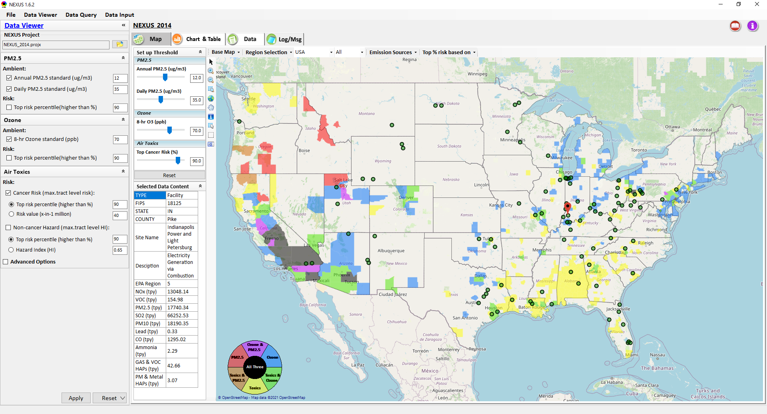
Proximity & Spatial Analysis: Allow to “Zoom-out” & “Zoom-in” Nationally for all Facilities under same “Sector Group”
Display all facilities within same “Sector group”
Allow to “zoom out” nationally and “zoom-in” back to facility level
Provide color scale for selected MP risk value (e.g., red w/ high MP risk)
Proximity Analysis for Source/Sector
Zoom-out
Proximity and Spatial Analysis for MP Risks and EJ
Proximity Analysis
Spatial Analysis
Zoom-in
Facility: American Synthesis Rubber Co., KY Sector group: Polymers and Resins Production
[ x Display national map for Sector group
Radius of Influence
5
50km
Create Table
Create Plot
31

Slide 32
“NEXUS 1.8.6”Demo
NEXUS 1.8.6 “Quick Tutorial” slides attached
Carey Jang
32

Slide 33
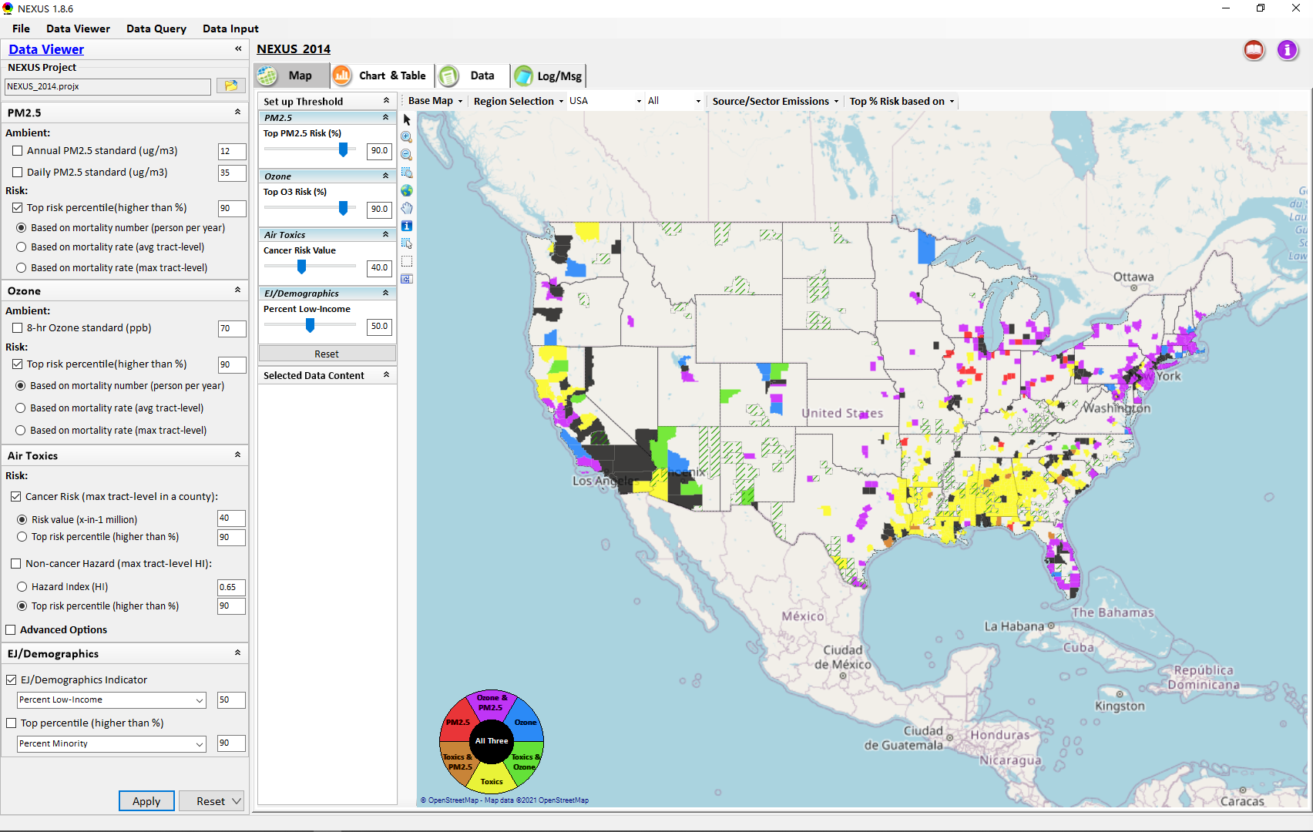
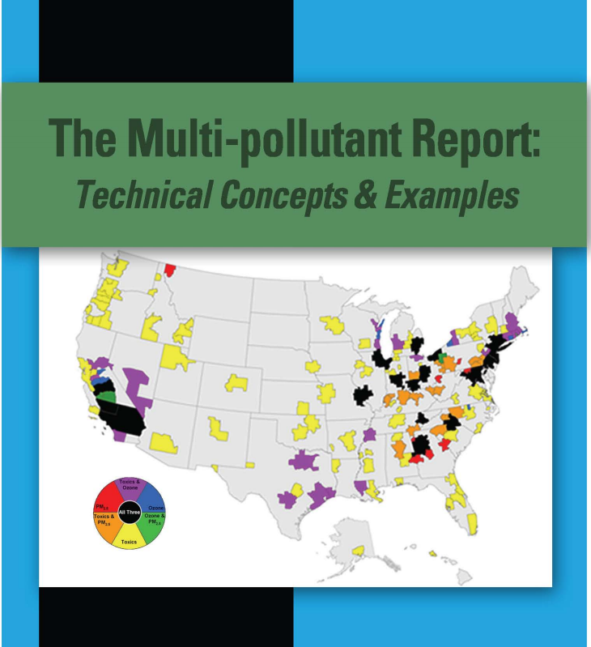
“NEXUS 1.8.6” Demo: 2014 NEXUS Case
Launching Page
2008
Roadmap for Demo:
(Use example cases)
National View: Use “NEXUS” across pollutants to provide an initial “SCREEN” at the national level by providing an indicator where there may be a common set of sources contributing to Multi-pollutant issues.
Regional View: Dial into a region or area of interest to understand the pollutant/source connections, and potential for more effective and efficient multi-pollutant solution.
33

Slide 34
“NEXUS 1.8.6”: Quick Tutorial
Download “NEXUS” tool: The “NEXUS 1.8.6” package (“NEXUS 1.8.6 Setup.exe” & “NEXUS 1.8.6 Data.exe”: run both “*.exe” files to install) can be downloaded at EPA’s new FTP site:
https://gaftp.epa.gov/aqmg/cjang/NEXUS/NEXUS 1.8.6/*
or ftp://newftp.epa.gov/aqmg/cjang/NEXUS/NEXUS 1.8.6/*
Note: Require software installation privilege or “Power Broker” (limited elevated privilege) to install “NEXUS tool” at EPA’s PC;
Check “This PC\Documents\My NEXUS files\data\* (\tool\*, \result\*)” to see if NEXUS program & input dataset are installed successfully
Carey Jang
34

Slide 35
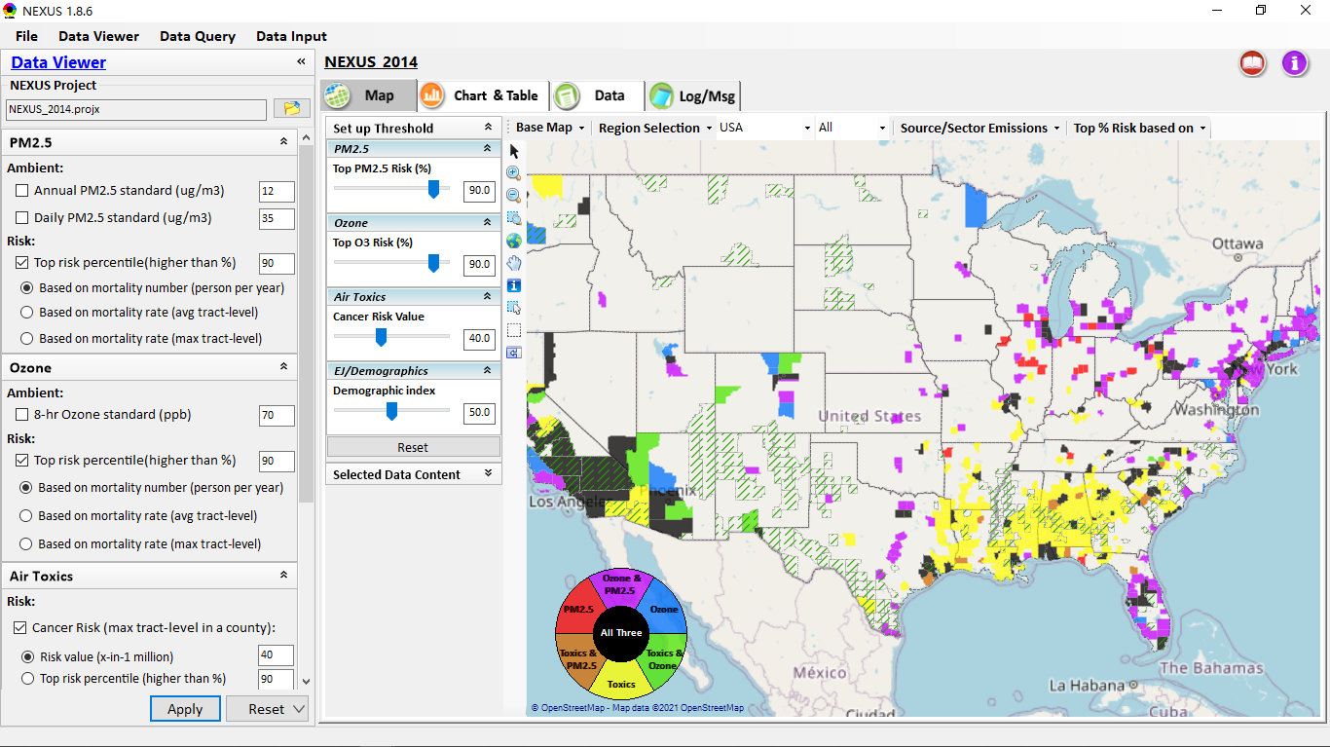
NEXUS Tool: On-line User’s Manual
Click “book” icon to launch “User’s manual”
Hot link to User’s manual’s “Data Viewer” chapter (same for “Data Input” module & “Data Query” model)
35

Slide 36
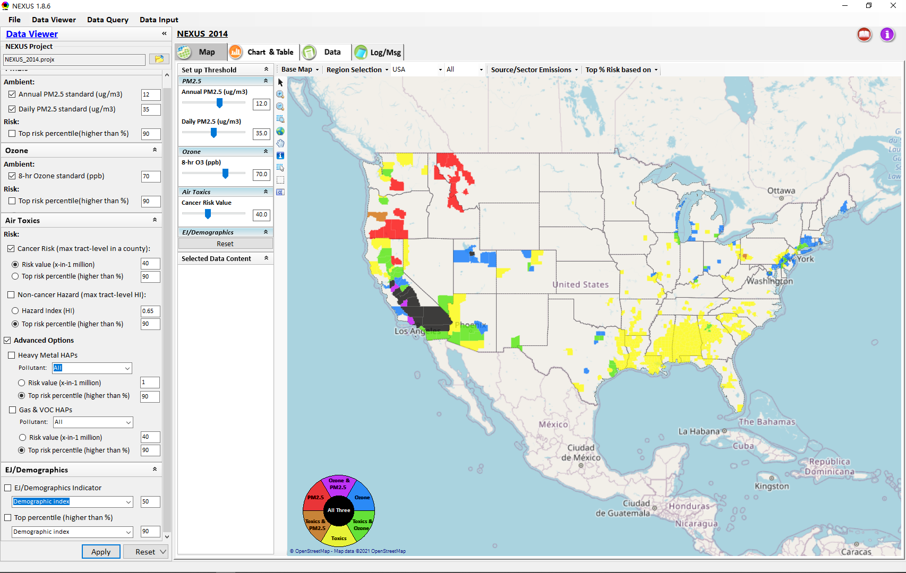

NEXUS Tool: Data Viewer Module
Click “File” to open or save a project
Switch between 3 key modules
NEXUS project file name
Select & adjust “Ambient” or “Risk” levels
“Advanced Option”: provide HAPs & species selections
36

Slide 37
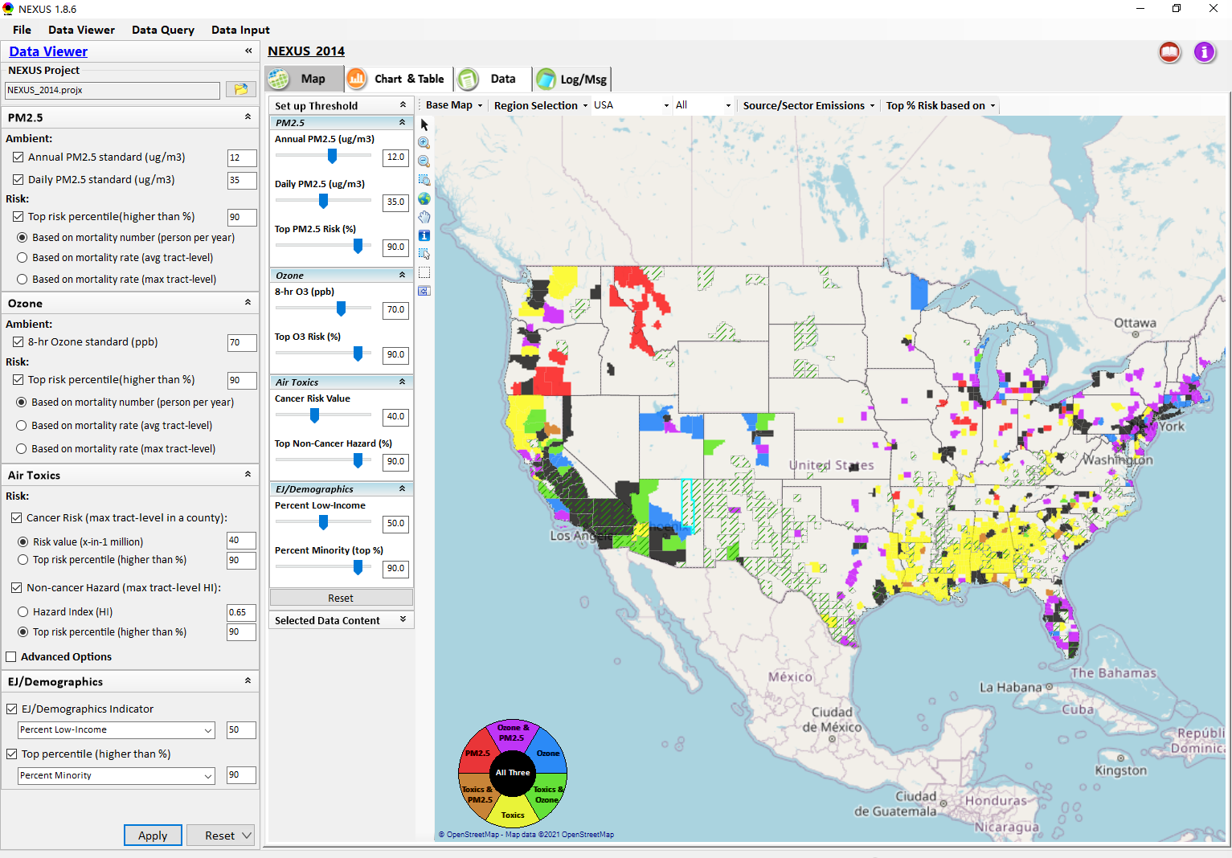
Data Viewer: “Apply” New Selections
“Check” boxes to change/add selections
New selections will appear in “Slider bars” panel and map display
“Slider bars” allow to select & adjust “Ambient” and/or “Risk” threshold levels and displaying color map
“Apply” new selections
37

Slide 38
NEXUS Update: New EJ Metric and Data

Slide 39
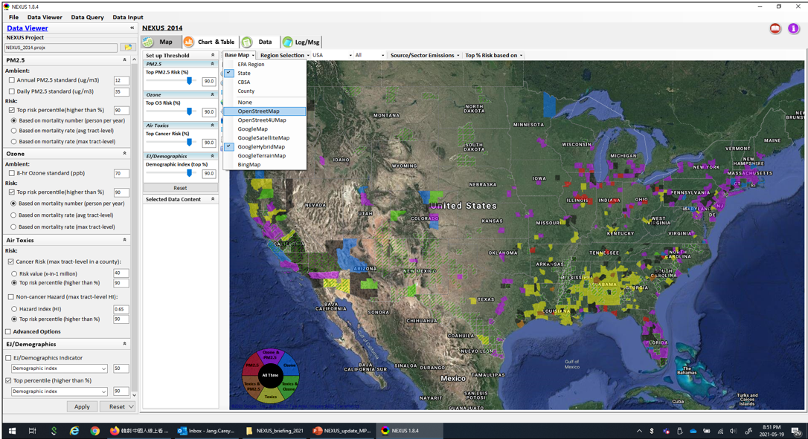
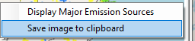
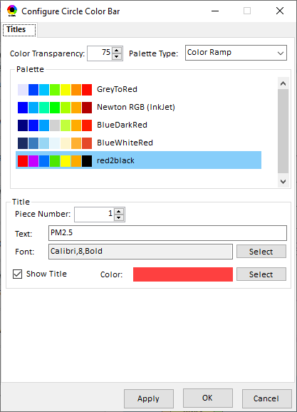
Data Viewer Module: Base Map & Color
“Base Map”: Change boundary lines and background map
“Right-click” map to save image
Click to change color & transparency
39

Slide 40
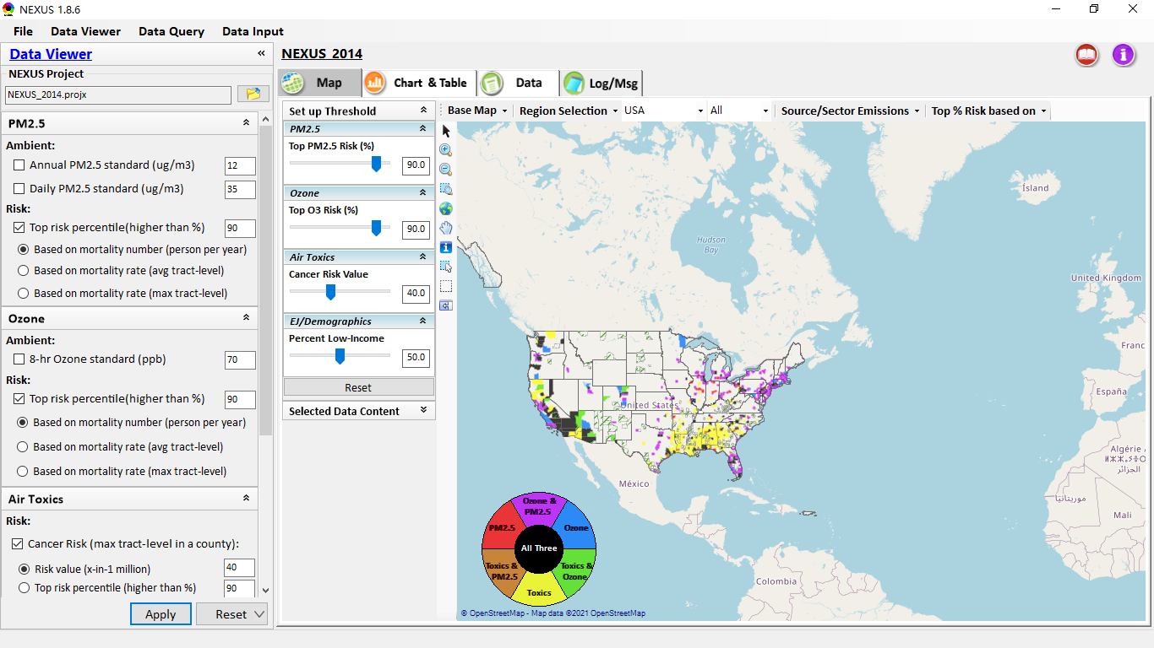
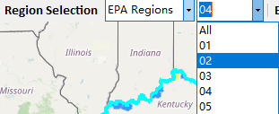
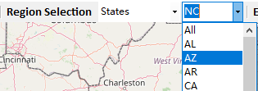
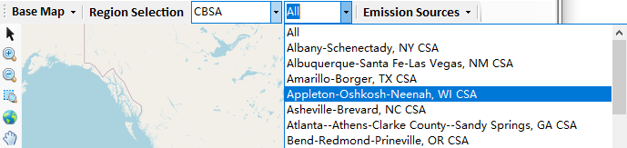
Data Viewer: “Region Selection”
Allow to select “EPA regions”, “States”, or “CBSA”
40

Slide 41
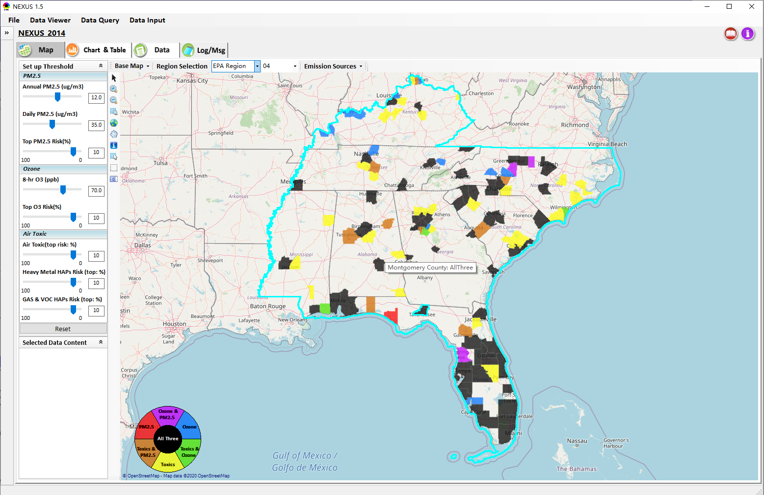
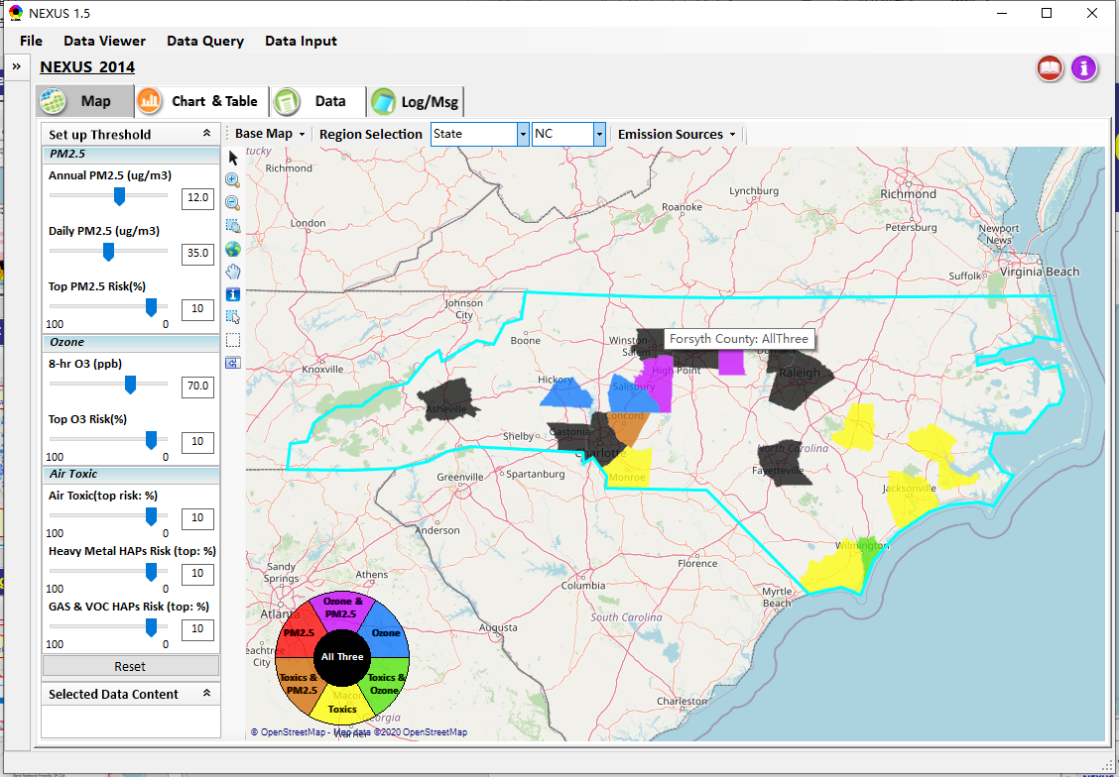
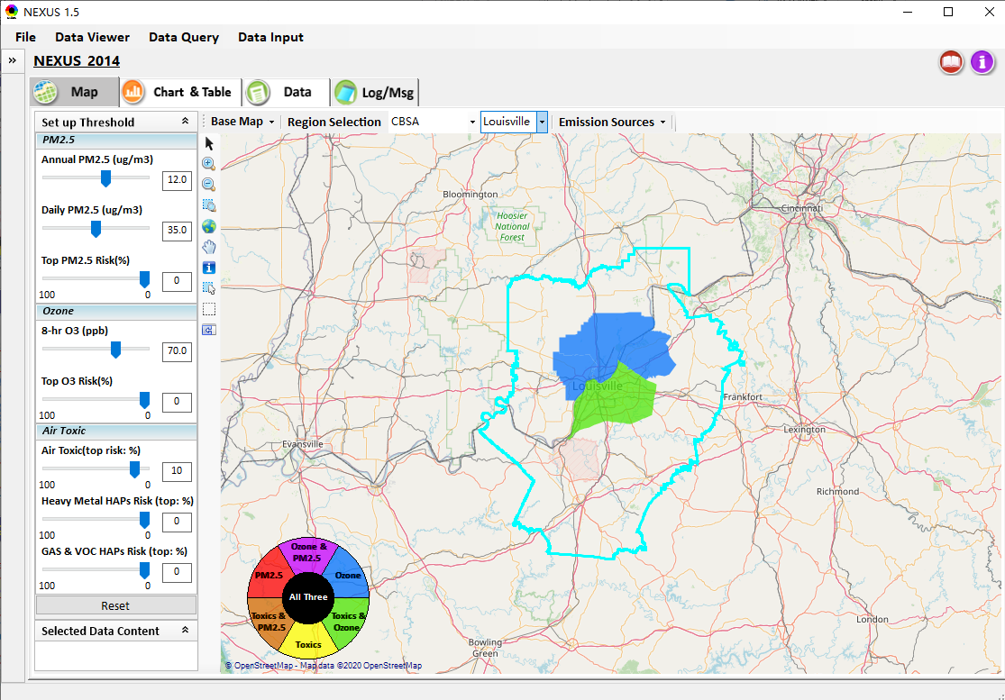
Data Viewer: Select EPA Region/State/CBSA
Examples:
EPA Region 4
NC State
Louisville CBSA
41

Slide 42
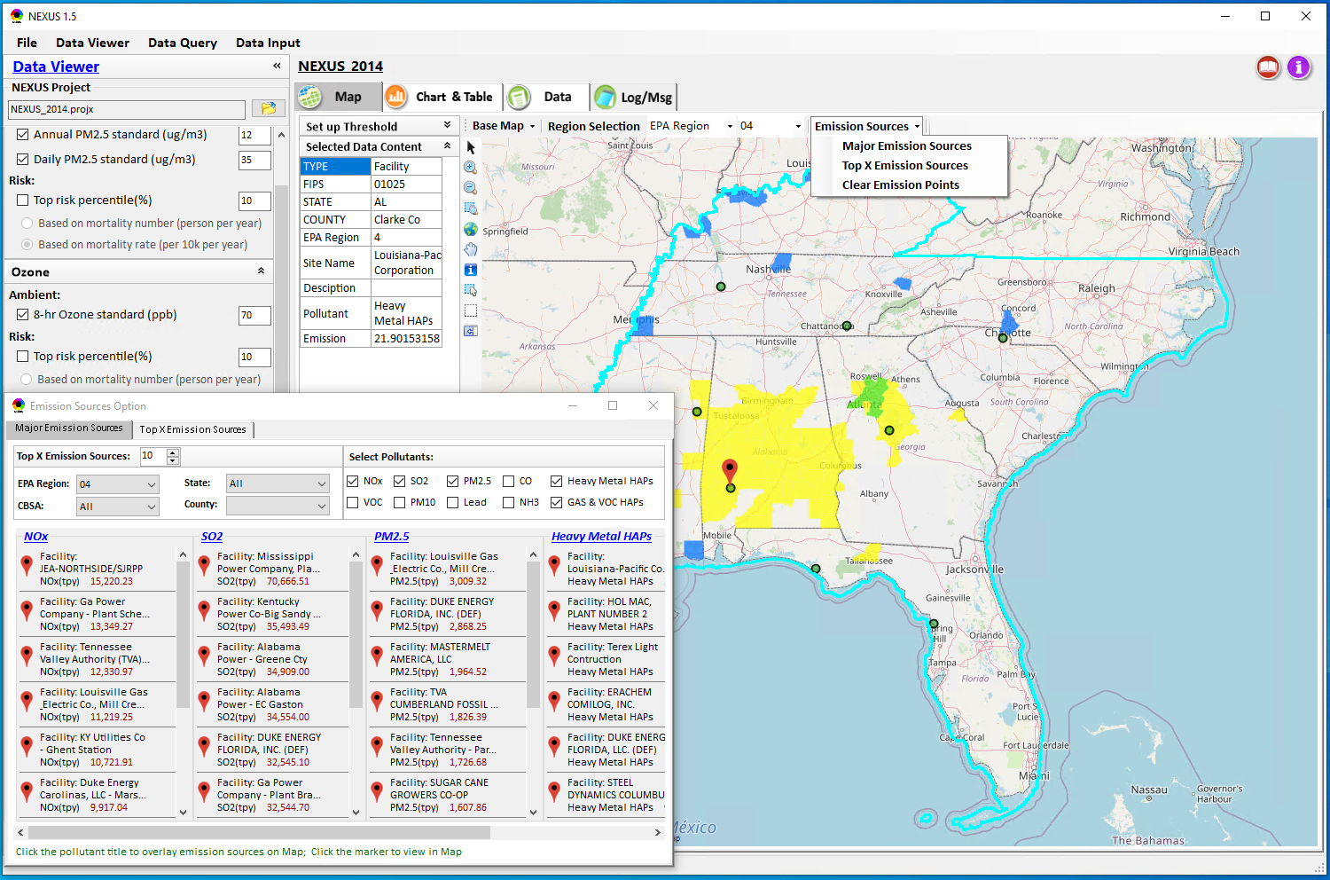
Data Viewer: Major Emission Sources
Click “Emission Sources” tab to display emission sources (green dots) and launch new window
Click any “facility” to link & display source location and emission information
42

Slide 43
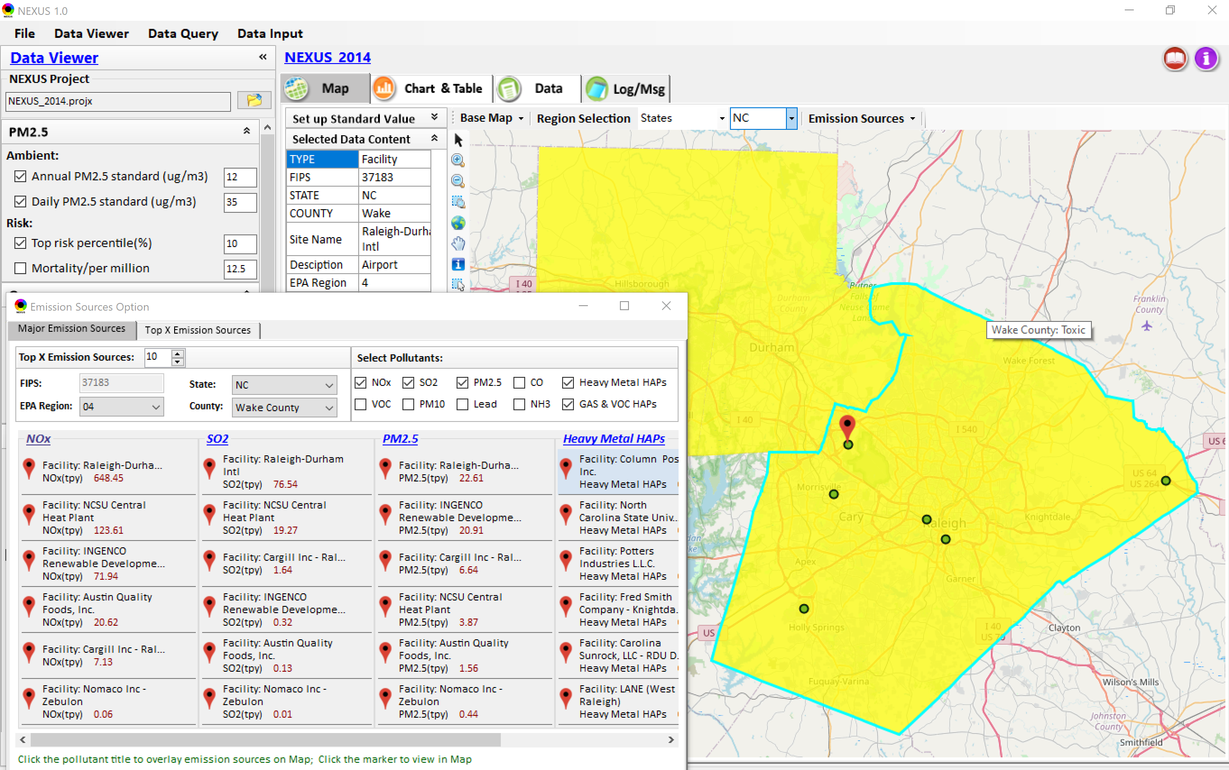
Data Viewer: Major Emission Sources
Allow to scroll down to county-level (e.g., Wake County, NC)
Wake county, NC
43

Slide 44
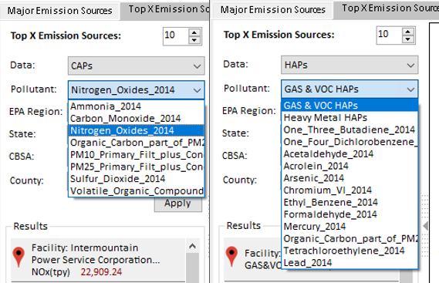


Data Viewer: Top “x” Emission Sources
Provide selection of CAPs precursors & HAPs species
Durham county, NC
44

Slide 45

NEXUS Update: “Source/Sector” Emissions Summary
“Source/Sector Emission Summary” function allow to select major CBSAs and provides source and sector emissions summary to support OAQPS’s “Sector Prioritization” project effort
45

Slide 46

Data Viewer: EPA Region Table Generator
“EPA Region Table Generator” provides attainment status of O3 and PM2.5 and their DVs; also allows to select any EPA region based on data updated to 2018.
46

Slide 47

Data Viewer: Data Search & Filter
Click “+” to add filters; Click “x” to remove current filter;
Show specified records per page.
Click “Output data…” to output current page records or all records

Slide 48

Data Query Module: Overlaying Map
Region Selection
Data Query Configuration
Data Query qualifier selection
Overlaying Map selection
48

Slide 49

Data Query Module: Configure Data Query
“Data Query Filter” allows to select “qualifiers” for query
“Data Query Preview” displays the selected “qualifiers” at the same time
49

Slide 50


Data Query Module: Attribute Table
Filter/search/export functions
Detachable “Attribute Table”
50

Slide 51



Data Query Module: Attribute Table
Click a “record” to link and display its location & info.
51

Slide 52

Data Input Module: Data Preview
“Transparency” & “Open-Source”:
All NEXUS input/output data files are available under:
“This PC\Documents\My NEXUS files\Data (\Result)”
Check to use filter to query data
Select a table to view if there are multiple tables in the selected data source file
Click to change input data file
Click to view data
Click to run & save project

Slide 53
End
53

