Slide 1
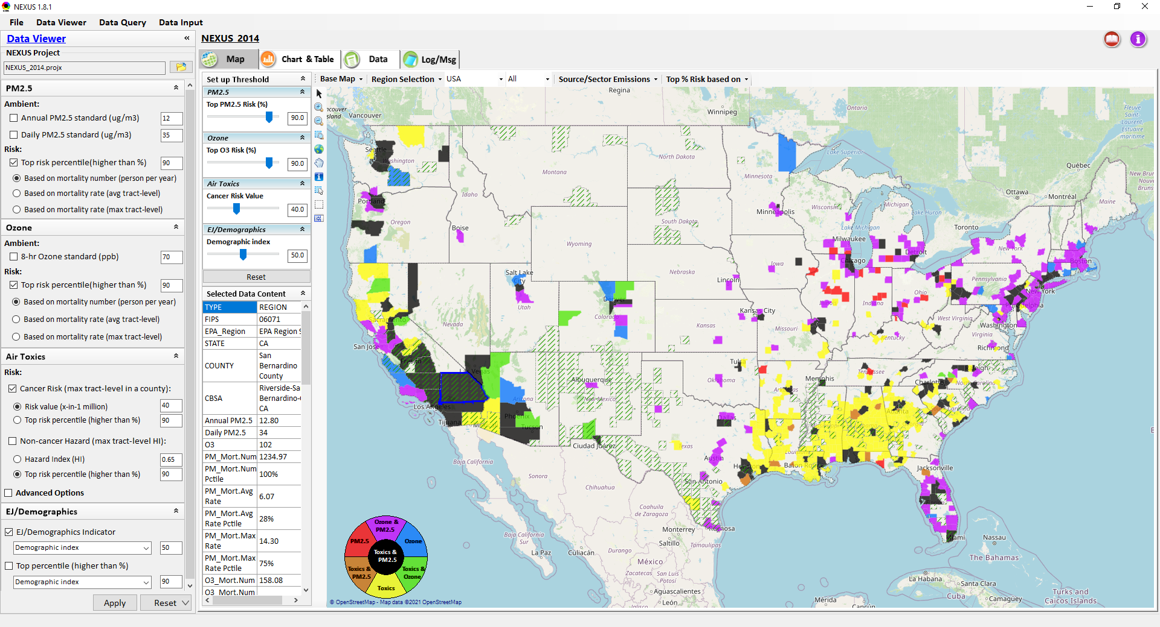
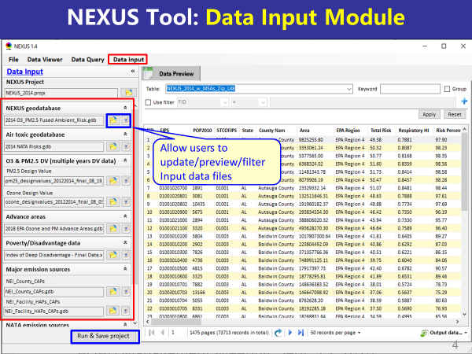
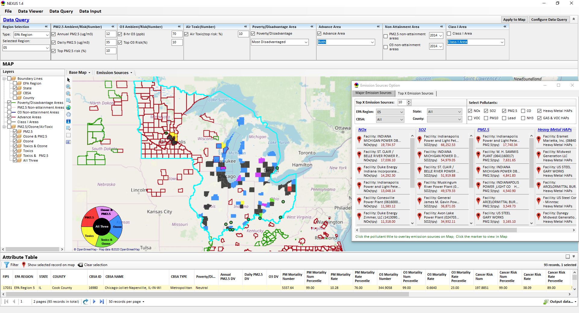
“NEXUS” Multi-Pollutant Analysis Tool: Recent Upgrades and Improvements
Data Viewer Module
Data Input Module
Data Query Module
“NEXUS 1.8.5” available on OAQPS’s Shared Drive at: “G:\SHARE\NEXUS\NEXUS 1.8.5\”
or EPA’s new FTP site: ftp://newftp.epa.gov/aqmg/cjang/NEXUS/NEXUS 1.8.5/
MP Team Briefing
May 24, 2021
Carey Jang, Beth Landis and Matt Woody

Slide 2
Outline
Feedback from OAQPS/SMT Briefings and MP Team
NEXUS Upgrades & Improvements (NEXUS “1.5” → “1.8.5”)
New/revised Metrics (Air Toxics, PM2.5, O3 & EJ)
New/updated data inputs and functions:
EJ/Demographic data (from EJSCREEN)
Tribal areas & Advance areas
2017 emissions data (including GHG & sector mapping) (updated from 2014)
“Source & Sector” emissions summary to support “Sector prioritization” effort (Appendix B)
“Source Category” emissions analysis (point, non-point, road, non-road, event)
Complete EPA region “Table Generator”
Upgrade “Data Query” module & “Data Input” module
Demo of NEXUS Updates (v.1.8.5) (w/ “Quick tutorial” attached)
Next Steps and Work Plan
2017 fused PM2.5 & O3 and risk data (July) and 2017 fused air toxic and risk data (TBD)
Include & display Monitoring sites/data (PM2.5 & O3 first, then AT) (August)
Developing screening capabilities for “Proximity analysis of MP risks and EJ” (TBD) (Appendix A)
2

Slide 3
Main Feedback from OAQPS/SMT and MP Team
Improve the national screening metrics for air toxics to reduce possible “false-negatives”
Update to recent emissions, AQ and health risk data and include EJ/demographic indicators, tribal areas, and monitoring data
Enhance current “region” focus of tool to provide “national” (zoom-out) and “area-specific” (zoom-in) screening capabilities for “sources/sector groups” in multi-pollutant context
Within high-risk areas, provide proximity screening capabilities for selected source, monitoring site, or community of interest to conduct analyses for both MP and EJ issues of concern
3

Slide 4
NEXUS: 2021 Development Plan
Near-term Priorities for 2021 NEXUS development:
Upgrade NEXUS (metrics/EJ indicators) for EPA beta testing
Revising national air toxic (AT) metrics based on AT team’s suggestions
Include EJ/demographic index from EJSCREEN and Tribal areas
Update to 2017 emissions data and develop “source/sector emissions summary” and “source category emissions” function
Update to 2017 AQ fused data (PM_{2.5}, O₃, AT) and health risk data (Note: need approval from SMT on updating AT risk work)
Include & display AQ monitoring sites/data (PM_{2.5}, O₃, AT)
Develop screening capabilities for “Proximity analysis for MP risk and EJ” at census tract-level and/or block group-level
Ongoing
Planned
4

Slide 5
NEXUS Updates: New Metrics and EJ Data

Slide 6
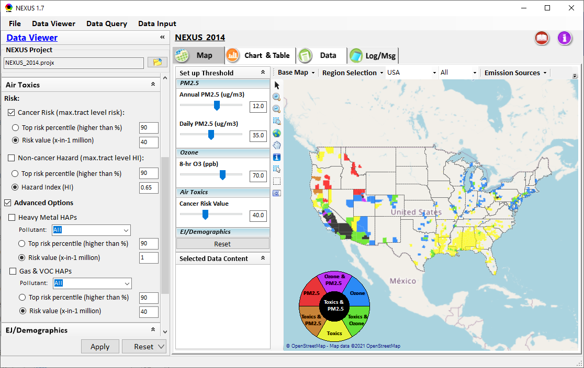
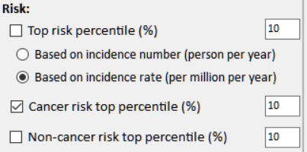
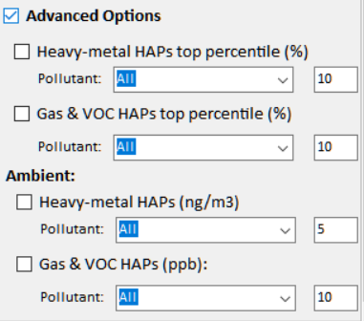
NEXUS Updates: New Air Toxics Metrics
Previous
Updated
6

Slide 7
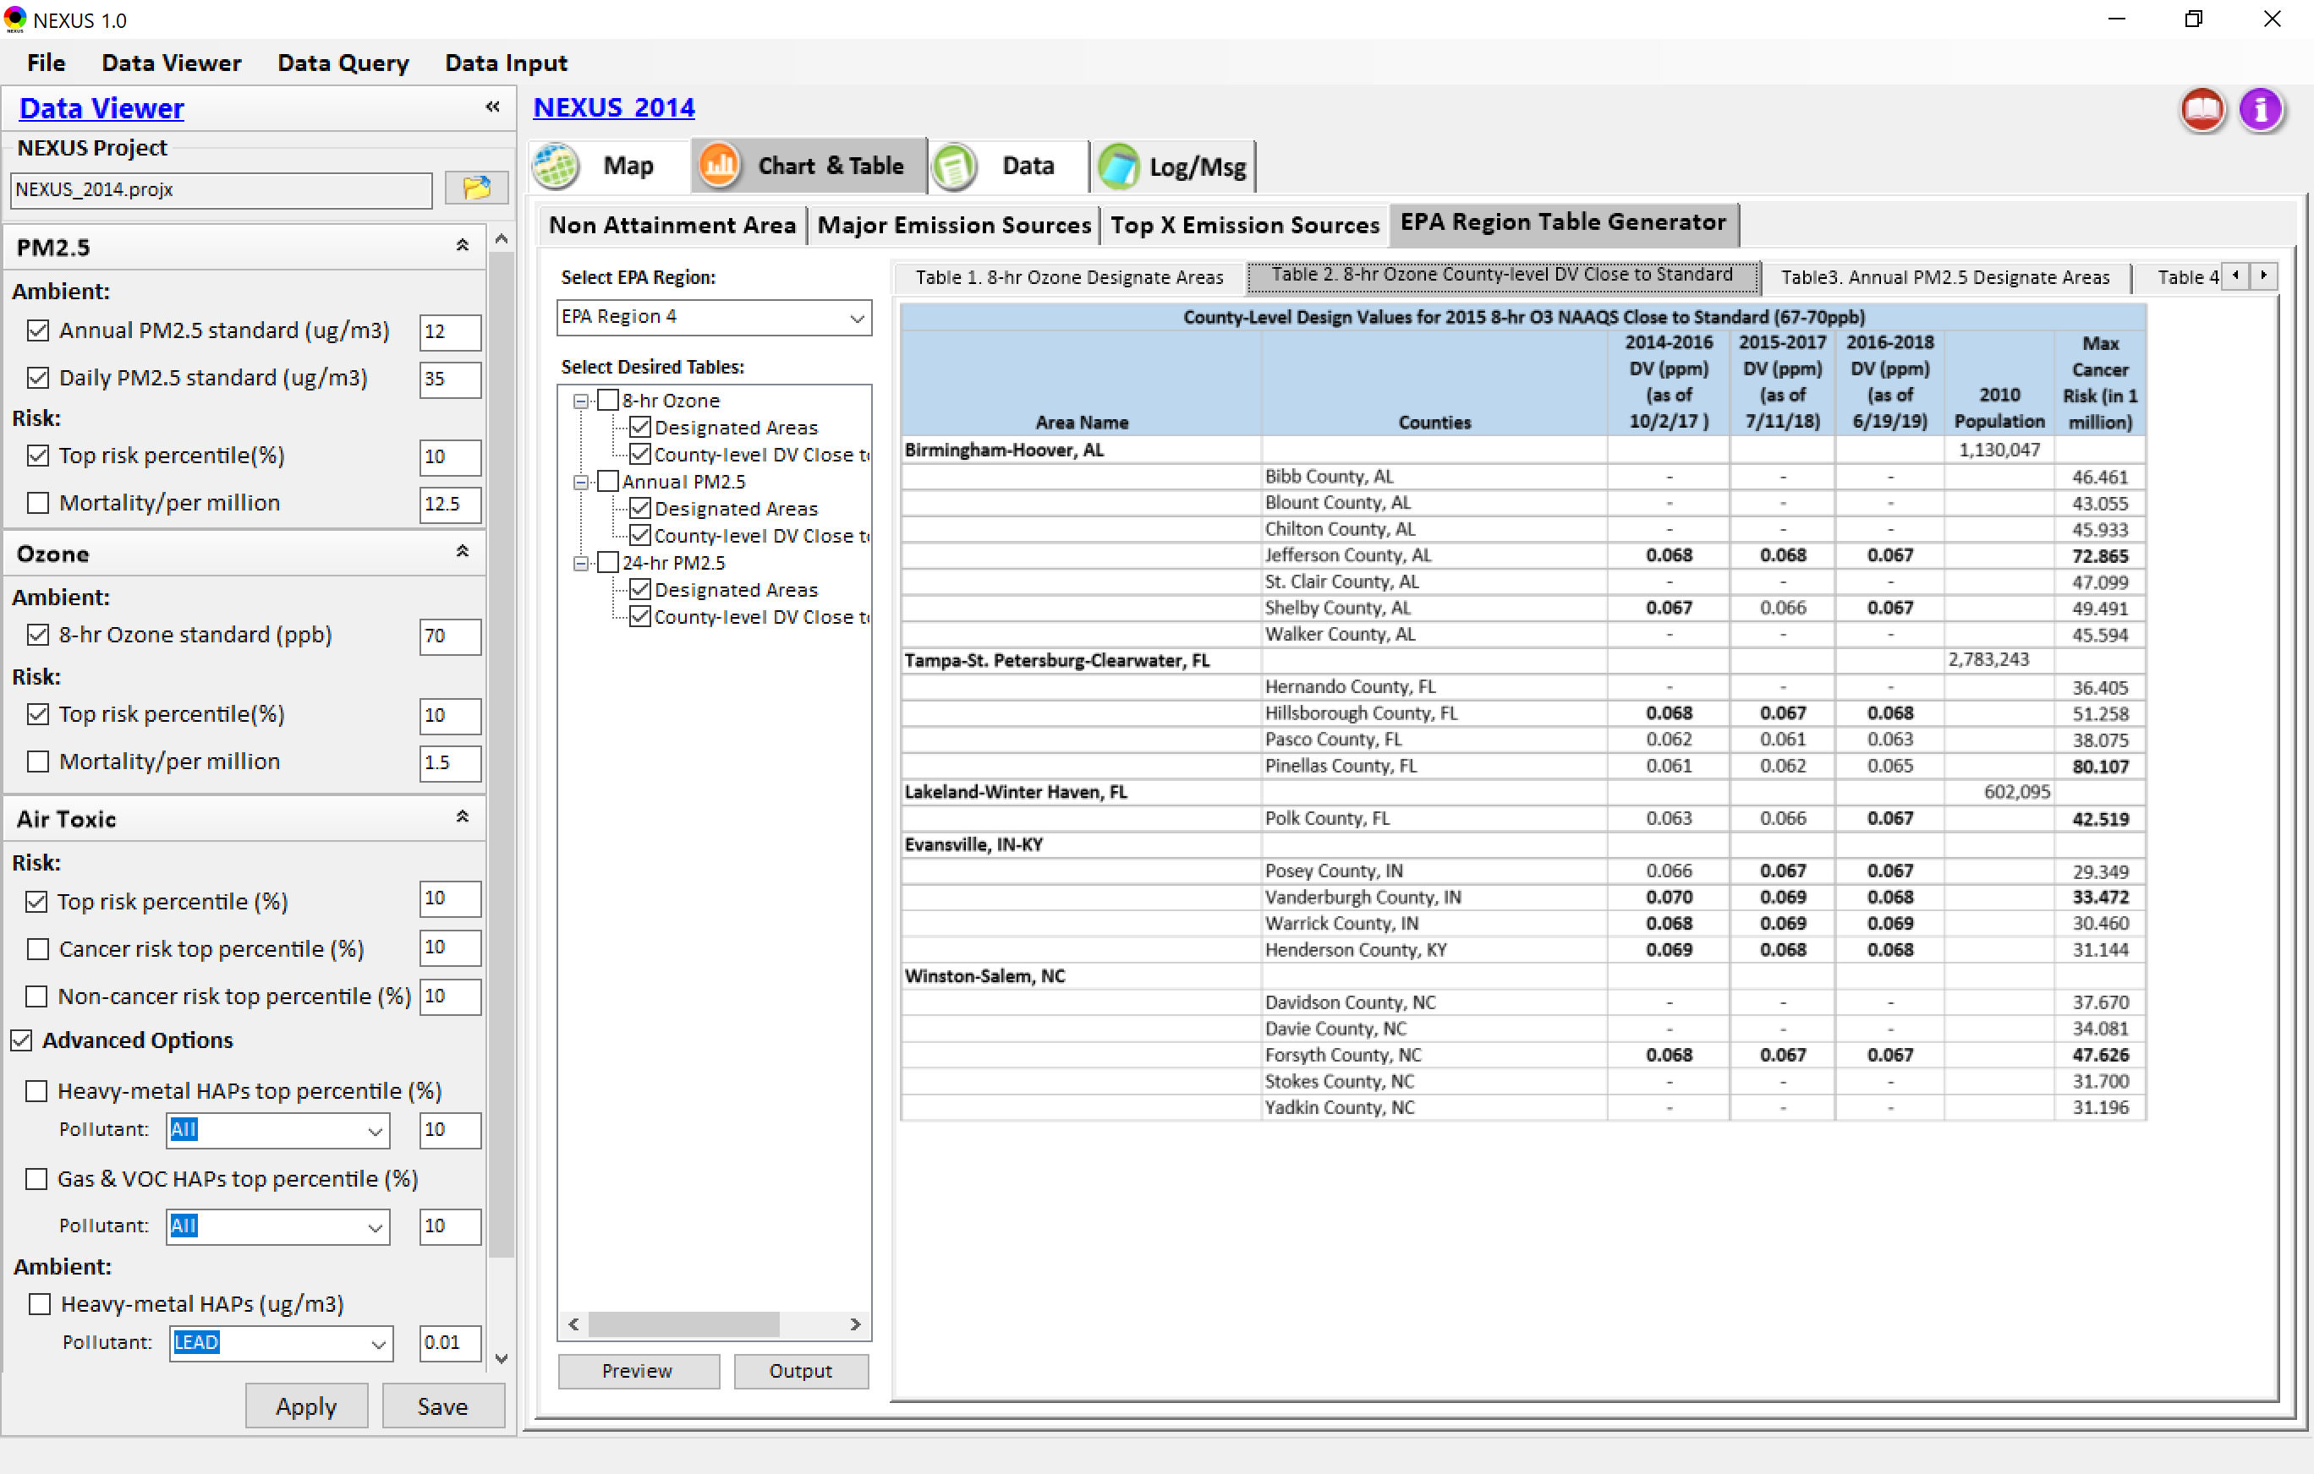
NEXUS Updates: EPA Region “Table Generator”
“EPA Region Table Generator” provides attainment status of O3 and PM2.5 and their DVs; also allows to select any EPA region based on data updated to 2018
7

Slide 8
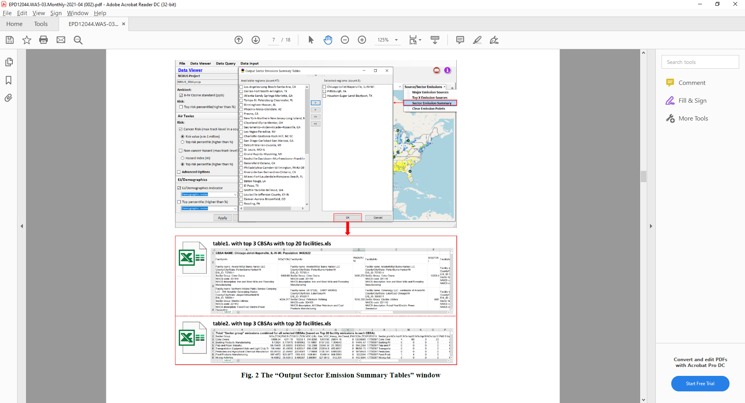
NEXUS Update: “Source/Sector” Emissions Summary
“Source/Sector Emissions Summary” function allows to select major CBSAs and provides source and sector emissions summary to support OAQPS’s “Sector Prioritization” project effort
8

Slide 9
Sectors Most Prevalent in Highest Risk Areas
Method: Highest emitting sectors within top ranked 50 CBSAs (Note: Facilities are grouped based on “Sector definition” spreadsheet created by Marc H. & SPPD)*
“Sector group” emissions combined for all 50 Highest Risk Ranked CBSAs Total Population: 134,940,816
Sector Group | SO2 (TON) | NOx (TON) | PM2.5 (TON) | Gas_VOC_HAPs (LB) | Heavy_Metal_HAPs (LB) | CO2e (TON) | SO2 Score (freq. & rank)
Electric Utilities | 276526 | 195865 | 25828 | 6432707 | 127030 | 485754073 | 2014
Petroleum Refining | 52943 | 40169 | 12438 | 10295621 | 99736 | 95097998 | 574
Coke Ovens | 22405 | 15473 | 5158 | 1787622 | 29716 | 14570119 | 132
Pesticides and Agricultural Chemical Manufacturing | 17644 | 5861 | 1292 | 1627958 | 1788 | 18233480 | 153
Inorganic Chemical Manufacturing | 14522 | 7273 | 1405 | 1073205 | 48966 | 5231826 | 190
Mineral Processing | 13714 | 12628 | 1659 | 886251 | 33740 | 8364046 | 256
Iron and Steel Production | 10679 | 13345 | 5691 | 858984 | 110757 | 33030868 | 375
Cement Manufacturing | 10566 | 44083 | 5007 | 1472498 | 25010 | 27859268 | 444
Air Transportation | 8127 | 63035 | 2685 | 10417526 | 122777 | 18485627 | 1380
Pulp and Paper Industry | 7413 | 9791 | 2779 | 7227413 | 23704 | 10517197 | 251
Organic Chemical Manufacturing | 6240 | 38070 | 6254 | 10280694 | 20059 | 82521408 | 299
Landfills | 2952 | 9872 | 2356 | 2799470 | 1880 | 28651639 | 563
Consumer Products (Cleaning, Photographic, etc.) | 2815 | 1980 | 486 | 1363144 | 1724 | 1389978 | 66
Oil and Gas Production and Distribution | 2717 | 28271 | 2259 | 4467061 | 1804 | 12342771 | 466
Food Products Manufacturing | 2705 | 6197 | 3085 | 4110212 | 2496 | 3408089 | 327
Non-Ferrous Metals Production | 2694 | 3511 | 1695 | 3663067 | 91643 | 2165692 | 212
Glass Manufacturing | 2355 | 5832 | 953 | 92289 | 9990 | 1174855 | 210
Clay Products Manufacturing | 1349 | 685 | 602 | 650323 | 1631 | 200293 | 311
Waste Incineration | 1024 | 11872 | 483 | 679918 | 1801 | 9825913 | 189
*Appendix B contains example graphic with sector ranking by pollutants
9

Slide 10
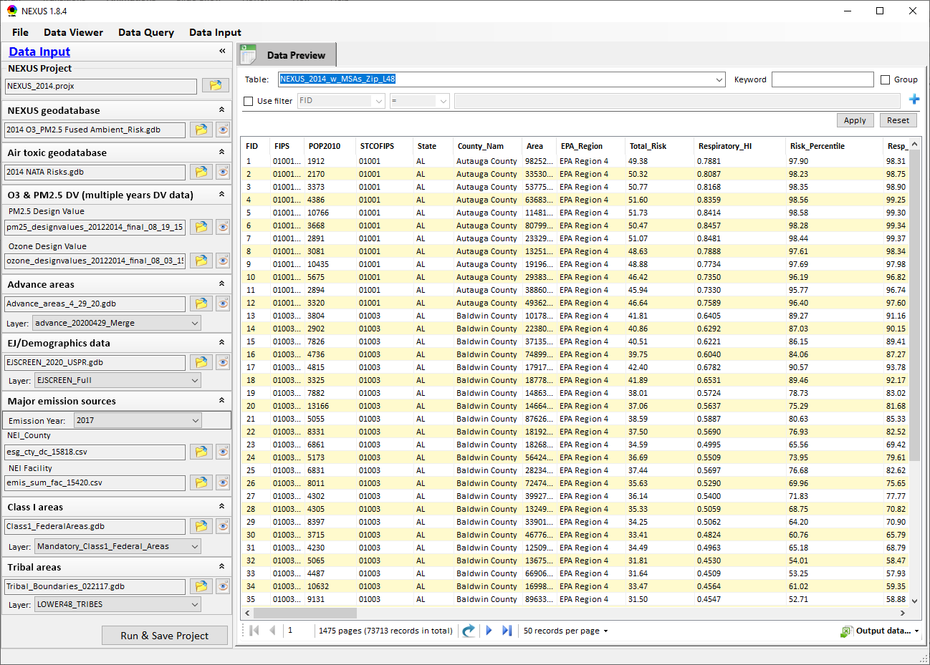
NEXUS Updates: Data Input Module
“Transparency” & “Open-Source”:
All NEXUS input/output data files are available under:
“This PC\Documents\My NEXUS files\Data (\Result)”
O3 & PM2.5 DVs data updated to 2018 (to 2020 as planned in June)
Advance areas updated to 2020 (to 2021 in June)
EJSCREEN data (updated to 2020) are used for EJ/Demographic data
Emissions data (county & facility) are updated to 2017 from 2014
Tribal boundaries & areas data are inlcuded
10

Slide 11
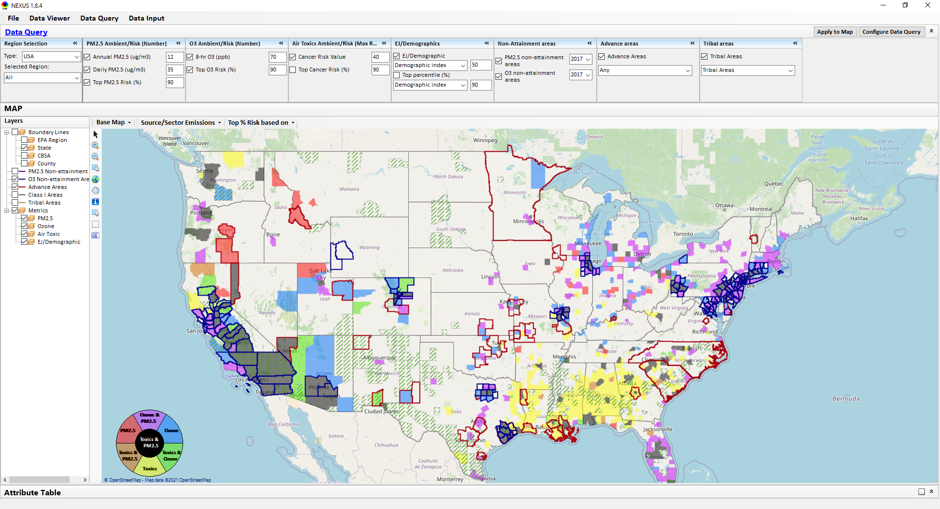
NEXUS Upgrades: Data Query Module
Data Query Configuration
Data Query qualifier selection
Overlaying Map selection
11

Slide 12
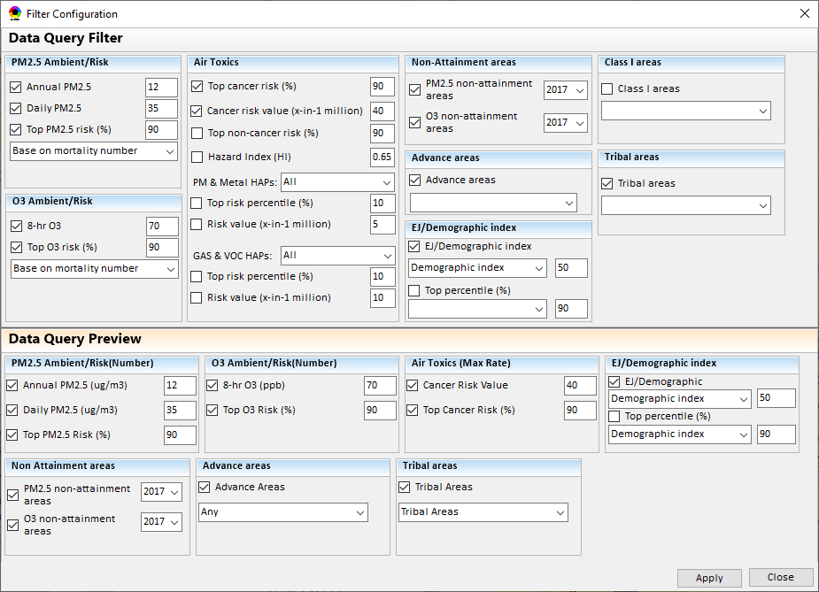
Data Query Module Upgrades: Configure Data Query
“Data Query Filter” allows to select “qualifiers” for query
“Data Query Preview” displays the selected “qualifiers” at the same time
12

Slide 13
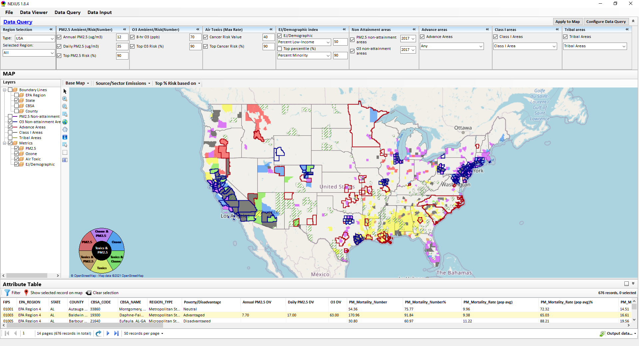
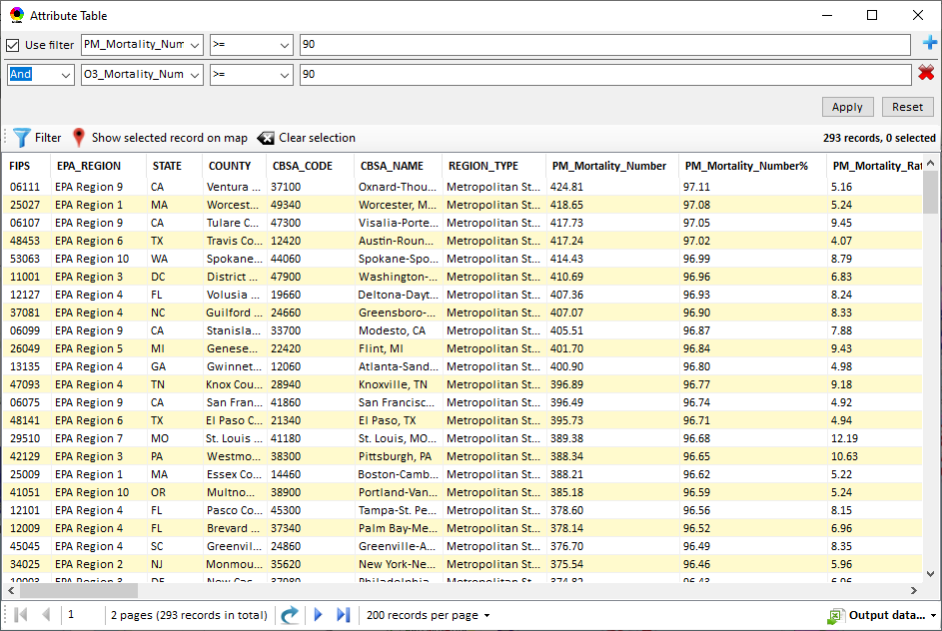
Data Query Module Upgrades: Attribute Table
Click “+” to add filters; Click “x” to remove current filter;
“Data Filter” functions to search/sort/export data of interest
Detachable “Attribute Table”
Click “Output data…” to output current page records or all records
13

Slide 14
“NEXUS 1.8.5”Demo
NEXUS 1.8.5 “Quick Tutorial” slides attached
14

Slide 15
“NEXUS 1.8.5”: Quick Tutorial
Download “NEXUS” tool: The “NEXUS 1.8.5” package (“NEXUS 1.8.5 Setup.exe” & “NEXUS 1.8.5 Data.exe”: run both “*.exe” files to install) can be downloaded at OAQPS’s Shared Drive: G:\SHARE\NEXUS\NEXUS 1.8.5\*
or at EPA’s new FTP site:
ftp://newftp.epa.gov/aqmg/cjang/NEXUS/NEXUS 1.8.5/*
Note: Require software installation privilege or “Power Broker” (limited elevated privilege) to install “NEXUS tool” at EPA’s PC;
Check “This PC\Documents\My NEXUS files\data\* (\tool\*, \result\*)” to see if NEXUS program & input dataset installations are successful
Carey Jang
15

Slide 16
NEXUS 1.8.5 Demo: Upgrades/Improvements
Data Viewer:
Air Toxics: new Metric (max tract-level risk value)
AT: species (updated list of H.M. & G.V.)
PM2.5 & O3: new Risk Metric (max/avg/#)
Slider bars: >90 %tile (from top 10%tile) w/ EJSCREEN
New EJ metrics
Chart & Table :
EPA Region “Table Generator” (Region 4 & 9)
EPA Region/State/CBSA View:
“Zoom-in” for regional (all risk: 10%)
EPA Regions -> CBSA: Louisville
“right-click” -> Major Emis. Sources
Change color transparency/Google Map
Major Emission Sources:
CBSA: Louisville -> Jefferson Co. -> Facility (Louisville G&E)
CO2e & Diesel PM
Source/Sector Emissions Summary
Source Category Emissions
Data Input module:
Data transparency: My Nexus files location
PM & O3 DVs (update to 2020 in June)
Advanced area (will update to 2021)
EJSCREEN data
2017 Emissions
Tribal areas
Data Query Module:
Add new fields/flexibility: Exploratory users
Configure DQ” window: Select EJ, Tribal areas, 2017 NA & DVs => Apply map
Overlaying Map
Detachable table to allow data filter/search/sort/export
CBSA: Houston -> Harris Co. (EJ off)
16
Notes:
1. Thank Cen/Gao/Luo/Chen; 2. HZ more visits; 3. AP on HZ

Slide 17
Next Steps and Development Plan
Main Feedback from OAQPS/SMT Briefings and MP Team
NEXUS Upgrades & Improvements
Metrics (Air Toxics, PM2.5, O3 & EJ)
New/updated data inputs:
2017 emissions data (source/sector & GHG)
EJ data (from EJSCREEN),
Tribal areas & Advance areas
EPA region “Table Generator”
“Source & Sector” emissions summary
“Source category” emissions (point, non-point, road, non-road, event)
NEXUS (v.1.8.5) Demo
Next Steps and Work Plan
2017 fused PM2.5 & O3 data and health risk data (July)
2017 fused air toxic data and health risk data (TBD)
Include & display monitoring sites/data (PM2.5 & O3 first, then AT) (August)
Developing screening capabilities for “Proximity analysis of MP risks and EJ” (TBD)
Close proximity analysis of MP risks & EJ/demographics to community of concern or monitoring site
Select a source/facility or site within a flexible “Radius of influence” (e.g., 5 km)
High spatial resolution: Census tract-level and/or block group-level
Compare MP risks & EJ/demographics of interested community to CBSA/State/Nation
17

Slide 18
Appendix A
Developing Screening Capabilities for “Proximity Analysis of MP Risks & EJ”
18

Slide 19
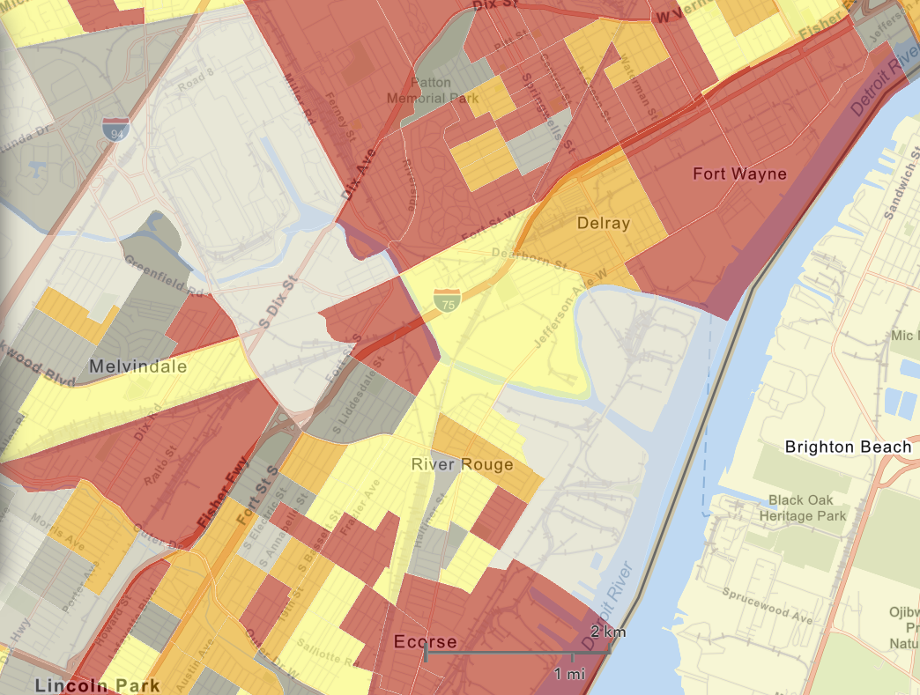
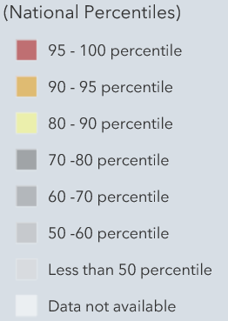
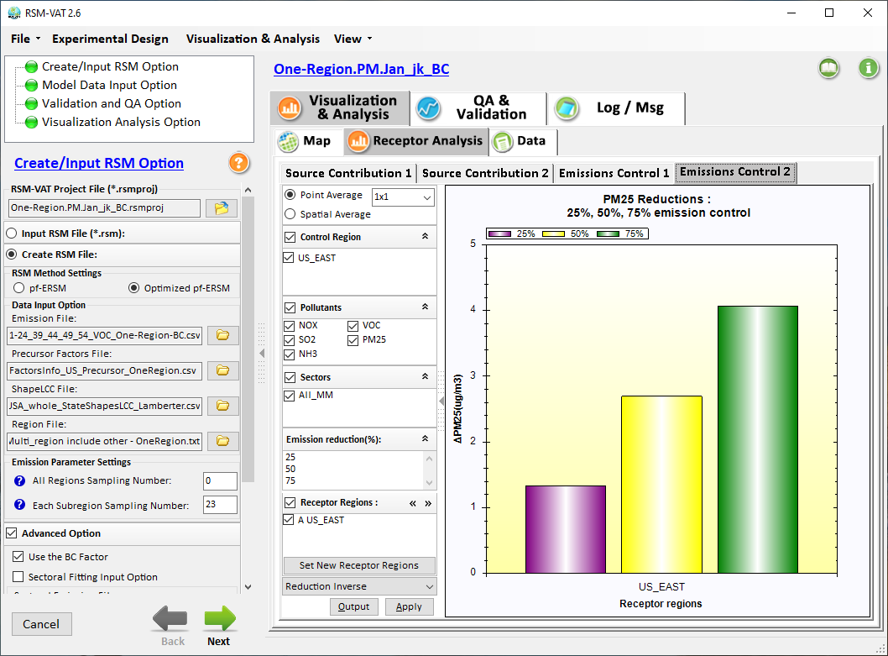

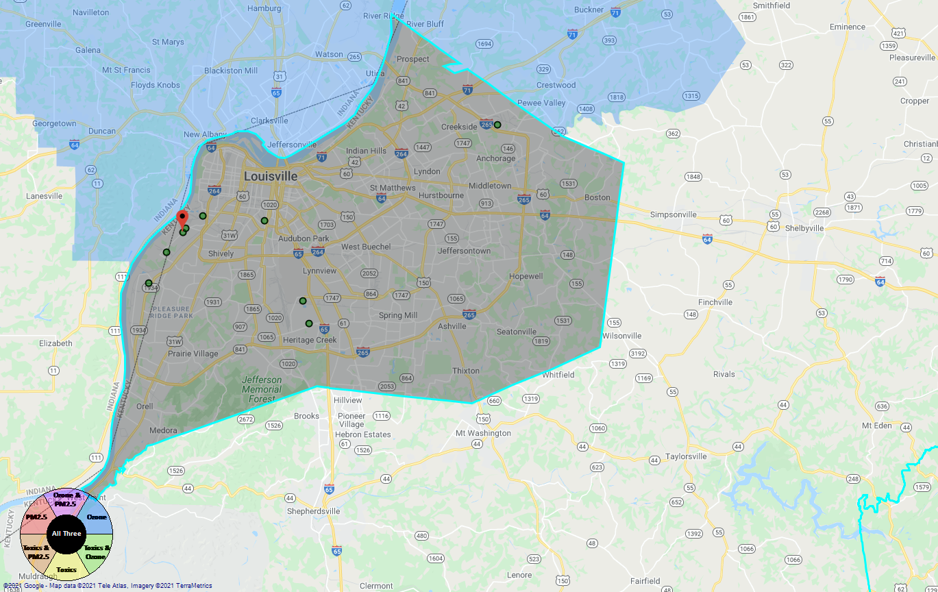
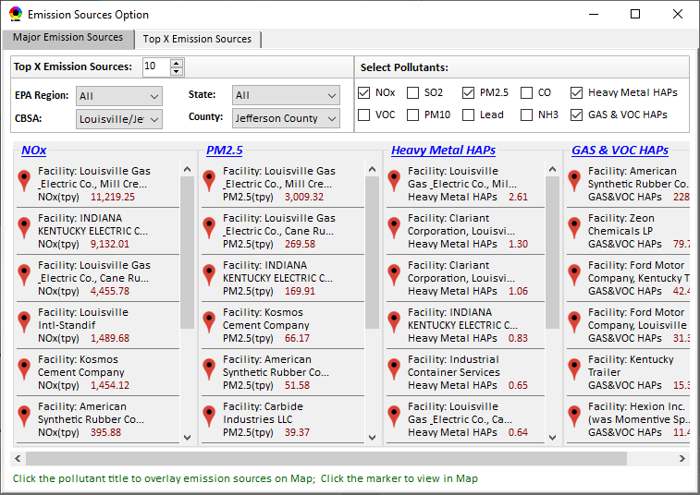
Developing Screening Capabilities for “Proximity Analysis of MP Risks & EJ”
NEXUS now can be used to quickly identify top emitters of NOx, SO₂, PM_{2.5}, and heavy-metal & VOCs HAPs near EJ areas of concern; plan to develop proximity & spatial analysis capabilities
Spatial
Analysis
Air Quality
PM2.5 risk
O3 risk
Air Toxics risk
Cancer risk
Non-Cancer risk
EJ Indicators
Proximity Analysis
(Selected Facility or Monitoring Site)
Climate Risks
Population
Minority
Income
Education
Language
Flood
Fire
Sea Level Rise
Heat
Disease
Climate Risks
Flood
Fire
Sea Level Rise
Heat
Disease
Proximity and Spatial Analysis for MP Risk and EJ
Proximity Analysis
Spatial Analysis
MP Risk
Air Toxics
EJ Indicator
Minority
Facility: American Synthesis Rubber Co., Louisville, KY Sector Group: Polymers and Resins Production Top Risk Drivers: ETO, Formaldehyde (examples) |  |  |  |  | Selected Options: Radius of Impact: 10km Number of CBSAs: 25 (top MP risk ranking) Air Toxics Risk threshold: 10 (“x”-in-a million)
 | Within Radius of Facility | County Avg. | State Avg. | EPA Region Avg. |  | Nation Avg. | Sector Group (within radius) National avg. | Sector Group (within radius) Top 25 CBSAs
Population total | x,xxx | xx,xxx | xxx,xxx | xxx,xxx |  | 317,xxx,xxx | xxx,xxx | xxx,xxx
PM2.5 risk (%tile) | x% | x% | x% | x% |  | x% | x% | x%
Ozone risk (%tile) | x% | x% | x% | x% |  | x% | x% | x%
Air Toxics risk: Cancer risk (%tile) | x% | x% | x% | x% |  | x% | x% | x%
Cancer risk value (“x”-in-a million)) | x.x | x.x | x.x | x.x |  | x.x | x.x | x.x
Cancer risk value above selected threshold (population %tile) | x% | x% | x% | x% |  | x% | x% | x%
Non-cancer risk (%tile) | x% | x% | x% | x% |  | x% | x% | x%
Non-cancer risk (Hazard Index) | x.x | x.x | x.x | x.x |  | x.x | x.x | x.x
Climate risks: Flood (%tile) | x% | x% | x% | x% |  | x% | x% | x%
Sea level rise (%tile) | x% | x% | x% | x% |  | x% | x% | x%
Fire (%tile) | x% | x% | x% | x% |  | x% | x% | x%
Disease (%tile) | x% | x% | x% | x% |  | x% | x% | x%
EJ/Demographics: Minority group (%tile) | x% | x% | x% | x% |  | x% | x% | x%
Low-income group (%tile) | x% | x% | x% | x% |  | x% | x% | x%
Demographic Index (%tile) | x% | x% | x% | x% |  | x% | x% | x%
Linguistic Isolation (%tile) | x% | x% | x% | x% |  | x% |  | x%
Proximity and Spatial Analysis for MP Risks and EJ
Proximity Analysis
Spatial Analysis
Graphical
& Tabular
Analysis
Facility: American Synthesis Rubber Co., KY Sector group: Polymers and Resins Production
[ x Display national map for Sector group
Radius of Influence
5
50km
Create Table
Create Plot
19

Slide 20
Developing Capabilities for Proximity and Spatial Analysis
Proximity analysis will allow to set a flexible “Radius of Influence” for a selected facility or monitoring site (based on census tract- and/or block group-level)
NEXUS now can quickly identify top emitters of CAPs & HAPs; Plan to develop proximity screening capabilities to include EJ/demographic indicators
Proximity and Spatial Analysis for MP Risks and EJ
Proximity Analysis
Spatial Analysis
Facility: American Synthesis Rubber Co., KY Sector group: Polymers and Resins Production
[ x Display national map for Sector group
Radius of Influence
5
50km
Create Table
Create Plot
20

Slide 21

Developing Capabilities for Proximity and Spatial Analysis
Air Quality
PM2.5 risk
O3 risk
Air Toxics risk
Cancer risk
Non-Cancer risk
EJ Indicators
Climate Risks
Population
Minority
Income
Education
Language
Flood
Fire
Sea Level Rise
Heat
Disease
Climate Risks
Flood
Fire
Sea Level Rise
Heat
Disease
Proximity and Spatial Analysis for MP Risk and EJ
Proximity Analysis
Spatial Analysis
MP Risk
Air Toxics
EJ Indicator
Minority
21

Slide 22
Screening Proximity Analysis in NEXUS: Example Tabular Data Summary
Facility: American Synthesis Rubber Co., Louisville, KY Sector Group: Polymers and Resins Production Top Risk Drivers: ETO, Formaldehyde (examples) |  |  |  |  | Selected Options: Radius of Impact: 10km Number of CBSAs: 25 (top MP risk ranking) Air Toxics Risk threshold: 10 (“x”-in-a million)
 | Within Radius of Facility | County Avg. | State Avg. | EPA Region Avg. |  | Nation Avg. | Sector Group (within radius) National avg. | Sector Group (within radius) Top 25 CBSAs
Population total | x,xxx | xx,xxx | xxx,xxx | xxx,xxx |  | 317,xxx,xxx | xxx,xxx | xxx,xxx
PM2.5 risk (%tile) | x% | x% | x% | x% |  | x% | x% | x%
Ozone risk (%tile) | x% | x% | x% | x% |  | x% | x% | x%
Air Toxics risk: Cancer risk (%tile) | x% | x% | x% | x% |  | x% | x% | x%
Cancer risk value (“x”-in-a million)) | x.x | x.x | x.x | x.x |  | x.x | x.x | x.x
Cancer risk value above selected threshold (population %tile) | x% | x% | x% | x% |  | x% | x% | x%
Non-cancer risk (%tile) | x% | x% | x% | x% |  | x% | x% | x%
Non-cancer risk (Hazard Index) | x.x | x.x | x.x | x.x |  | x.x | x.x | x.x
Climate risks: Flood (%tile) | x% | x% | x% | x% |  | x% | x% | x%
Sea level rise (%tile) | x% | x% | x% | x% |  | x% | x% | x%
Fire (%tile) | x% | x% | x% | x% |  | x% | x% | x%
Disease (%tile) | x% | x% | x% | x% |  | x% | x% | x%
EJ/Demographics: Minority group (%tile) | x% | x% | x% | x% |  | x% | x% | x%
Low-income group (%tile) | x% | x% | x% | x% |  | x% | x% | x%
Demographic Index (%tile) | x% | x% | x% | x% |  | x% | x% | x%
Linguistic Isolation (%tile) | x% | x% | x% | x% |  | x% |  | x%
22

Slide 23
Proximity Analysis for Selected Facility/Sector or Monitoring Site: Example Chart
Air Quality
PM2.5 risk
O3 risk
Air Toxics risk
Cancer risk
Non-Cancer risk
(%tile)
EJ Indicators
Climate Risks
Population
Minority
Income
Education
Language
Flood
Fire
Sea Level Rise
Heat
Disease
Climate Risks
Flood
Fire
Sea Level Rise
Heat
Disease

Slide 24
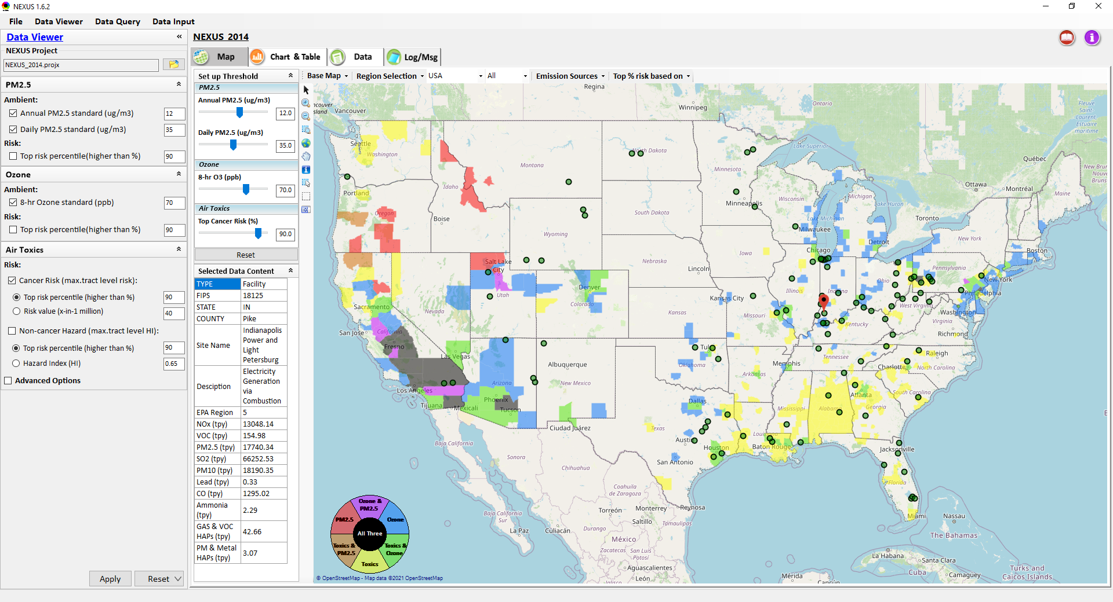
Proximity & Spatial Analysis: Allow to “Zoom-out” & “Zoom-in” Nationally for all Facilities under same “Sector Group”
Display all facilities within same “Sector group”
Allow to “zoom out” nationally and “zoom-in” back to facility level
Provide color scale for selected MP risk value (e.g., red w/ high MP risk)
Proximity Analysis for Source/Sector
Zoom-out
Proximity and Spatial Analysis for MP Risks and EJ
Proximity Analysis
Spatial Analysis
Zoom-in
Facility: American Synthesis Rubber Co., KY Sector group: Polymers and Resins Production
[ x Display national map for Sector group
Radius of Influence
5
50km
Create Table
Create Plot
24

Slide 25
Appendix B
Source & Sector Emissions Summary for High MP Risk Ranking CBSAs
(Support “Sector Prioritization” Effort)
25

Slide 26
MP Ranking: CBSAs w/ Top-Ranked MP Risks
Method: Identify CBSAs with top MP risk ranking: Major CBSAs are selected.
 | EPA_REGION | STATE | CBSA_NAME | Overall Rank
1 | EPA Region 5 | IL-IN-WI | Chicago-Joliet-Naperville, IL-IN-WI | 1
2 | EPA Region 3 | PA | Pittsburgh, PA | 1
3 | EPA Region 6 | TX | Houston-Sugar Land-Baytown, TX | 1
4 | EPA Region 9 | CA | Los Angeles-Long Beach-Santa Ana, CA | 2
5 | EPA Region 6 | TX | Dallas-Fort Worth-Arlington, TX | 2
6 | EPA Region 4 | GA | Atlanta-Sandy Springs-Marietta, GA | 3
7 | EPA Region 4 | FL | Tampa-St. Petersburg-Clearwater, FL | 3
8 | EPA Region 4 | AL | Birmingham-Hoover, AL | 3
9 | EPA Region 9 | AZ | Phoenix-Mesa-Glendale, AZ | 3
10 | EPA Region 9 | CA | Fresno, CA | 3
11 | EPA Region 2 | NY-NJ-PA | New York-Northern New Jersey-Long Island, NY-NJ-PA | 3
12 | EPA Region 5 | OH | Cleveland-Elyria-Mentor, OH | 3
13 | EPA Region 9 | CA | Sacramento--Arden-Arcade--Roseville, CA | 4
14 | EPA Region 9 | NV | Las Vegas-Paradise, NV | 4
15 | EPA Region 4 | NC-SC | Charlotte-Gastonia-Rock Hill, NC-SC | 5
16 | EPA Region 9 | CA | San Diego-Carlsbad-San Marcos, CA | 5
17 | EPA Region 5 | MI | Detroit-Warren-Livonia, MI | 5
18 | EPA Regions 5 & 7 | MO-IL | St. Louis, MO-IL | 5
19 | EPA Region 5 | MI | Grand Rapids-Wyoming, MI | 6
20 | EPA Region 4 | TN | Nashville-Davidson--Murfreesboro--Franklin, TN | 6
21 | EPA Region 9 | CA | Bakersfield-Delano, CA | 6
22 | EPA Regions 2 & 3 | PA-NJ-DE-MD | Philadelphia-Camden-Wilmington, PA-NJ-DE-MD | 6
23 | EPA Region 9 | CA | Riverside-San Bernardino-Ontario, CA | 6
24 | EPA Region 4 | FL | Miami-Fort Lauderdale-Pompano Beach, FL | 6
25 | EPA Region 6 | LA | Baton Rouge, LA | 7
26 | EPA Region 6 | TX | El Paso, TX | 7
27 | EPA Region 10 | WA | Seattle-Tacoma-Bellevue, WA | 7
28 | EPA Region 4 & 5 | KY-IN | Louisville-Jefferson County, KY-IN | 7
 | EPA_REGION | STATE | CBSA_NAME | Overall Rank
29 | EPA Region 8 | CO | Denver-Aurora-Broomfield, CO | 8
30 | EPA Region 3 | PA | Reading, PA | 8
31 | EPA Region 9 | CA | Visalia-Porterville, CA | 8
32 | EPA Region 1 | CT | Bridgeport-Stamford-Norwalk, CT | 8
33 | EPA Region 4 & 6 | TN-MS-AR | Memphis, TN-MS-AR | 8
34 | EPA Regions 2 & 3 | PA-NJ | Allentown-Bethlehem-Easton, PA-NJ | 9
35 | EPA Region 6 | LA | New Orleans-Metairie-Kenner, LA | 9
36 | EPA Region 4 | NC | Greensboro-High Point, NC | 10
37 | EPA Region 4 | AL | Mobile, AL | 10
38 | EPA Region 4 | TN-GA | Chattanooga, TN-GA | 11
39 | EPA Region 4 | TN | Knoxville, TN | 11
40 | EPA Region 3 | DC-VA-MD-WV | Washington-Arlington-Alexandria, DC-VA-MD-WV | 11
41 | EPA Region 6 | OK | Tulsa, OK | 11
42 | EPA Region 9 | AZ | Tucson, AZ | 11
43 | EPA Region 4 | SC | Charleston-North Charleston-Summerville, SC | 12
44 | EPA Region 4 | SC | Greenville-Mauldin-Easley, SC | 12
45 | EPA Region 3 | WV | Charleston, WV | 13
46 | EPA Region 4 | SC | Spartanburg, SC | 13
47 | EPA Region 4 | NC | Winston-Salem, NC | 13
48 | EPA Region 4 | FL | Lakeland-Winter Haven, FL | 13
49 | EPA Region 5 | OH | Akron, OH | 13
50 | EPA Region 6 | TX | Beaumont-Port Arthur, TX | 14
51 | EPA Region 5 | MI | Lansing-East Lansing, MI | 14
52 | EPA Region 4 | FL | Orlando-Kissimmee-Sanford, FL | 14
53 | EPA Region 10 | OR | Eugene-Springfield, OR | 14
54 | EPA Region 9 | NV | Reno-Sparks, NV | 14
55 | EPA Regions 4 & 5 | OH-KY-IN | Cincinnati-Middletown, OH-KY-IN | 14
56 | EPA Region 3 | PA | Lancaster, PA | 14
26

Slide 27
NEXUS Update: “Source/Sector” Emissions Summary
“Source/Sector Emission Summary” function allow to select major CBSAs and provides source and sector emissions summary to support OAQPS’s “Sector Prioritization” project effort
27

Slide 28
Sectors Most Prevalent in Highest Risk Areas
Method: Highest emitting sectors within top ranked 50 CBSAs (Note: Facilities are grouped based on “Sector definition” spreadsheet created by Marc H. & SPPD)*
“Sector group” emissions combined for all 50 Highest Risk Ranked CBSAs Total Population: 134,940,816
Sector Group | SO2 (TON) | NOx (TON) | PM2.5 (TON) | Gas_VOC_HAPs (LB) | Heavy_Metal_HAPs (LB) | CO2e (TON) | SO2 Score (freq. & rank)
Electric Utilities | 276526 | 195865 | 25828 | 6432707 | 127030 | 485754073 | 2014
Petroleum Refining | 52943 | 40169 | 12438 | 10295621 | 99736 | 95097998 | 574
Coke Ovens | 22405 | 15473 | 5158 | 1787622 | 29716 | 14570119 | 132
Pesticides and Agricultural Chemical Manufacturing | 17644 | 5861 | 1292 | 1627958 | 1788 | 18233480 | 153
Inorganic Chemical Manufacturing | 14522 | 7273 | 1405 | 1073205 | 48966 | 5231826 | 190
Mineral Processing | 13714 | 12628 | 1659 | 886251 | 33740 | 8364046 | 256
Iron and Steel Production | 10679 | 13345 | 5691 | 858984 | 110757 | 33030868 | 375
Cement Manufacturing | 10566 | 44083 | 5007 | 1472498 | 25010 | 27859268 | 444
Air Transportation | 8127 | 63035 | 2685 | 10417526 | 122777 | 18485627 | 1380
Pulp and Paper Industry | 7413 | 9791 | 2779 | 7227413 | 23704 | 10517197 | 251
Organic Chemical Manufacturing | 6240 | 38070 | 6254 | 10280694 | 20059 | 82521408 | 299
Landfills | 2952 | 9872 | 2356 | 2799470 | 1880 | 28651639 | 563
Consumer Products (Cleaning, Photographic, etc.) | 2815 | 1980 | 486 | 1363144 | 1724 | 1389978 | 66
Oil and Gas Production and Distribution | 2717 | 28271 | 2259 | 4467061 | 1804 | 12342771 | 466
Food Products Manufacturing | 2705 | 6197 | 3085 | 4110212 | 2496 | 3408089 | 327
Non-Ferrous Metals Production | 2694 | 3511 | 1695 | 3663067 | 91643 | 2165692 | 212
Glass Manufacturing | 2355 | 5832 | 953 | 92289 | 9990 | 1174855 | 210
Clay Products Manufacturing | 1349 | 685 | 602 | 650323 | 1631 | 200293 | 311
Waste Incineration | 1024 | 11872 | 483 | 679918 | 1801 | 9825913 | 189
*Appendix contains graphics with sector ranking by pollutants
28

Slide 29
SO₂ & NOx: Sector Group emissions Summed up top 20 facility emissions over 50 major CBSAs
over
29

Slide 30
Questions?
30

Slide 31
“NEXUS 1.8.5”: Quick Tutorial
Download “NEXUS” tool: The “NEXUS 1.8.5” package (“NEXUS 1.8.5 Setup.exe” & “NEXUS 1.8.5 Data.exe”: run both “*.exe” files to install) can be downloaded at OAQPS’s Shared Drive: G:\SHARE\NEXUS\NEXUS 1.8.5\*
or at EPA’s new FTP site:
ftp://newftp.epa.gov/aqmg/cjang/NEXUS/NEXUS 1.8.5/*
Note: Require software installation privilege or Power Broker (limited elevated privilege) to install “NEXUS tool” at EPA’s PC;
Check “This PC\Documents\My NEXUS files\data\* (\tool\*, \result\*)” to see if NEXUS program & input dataset installations are successful
Carey Jang
31

Slide 32
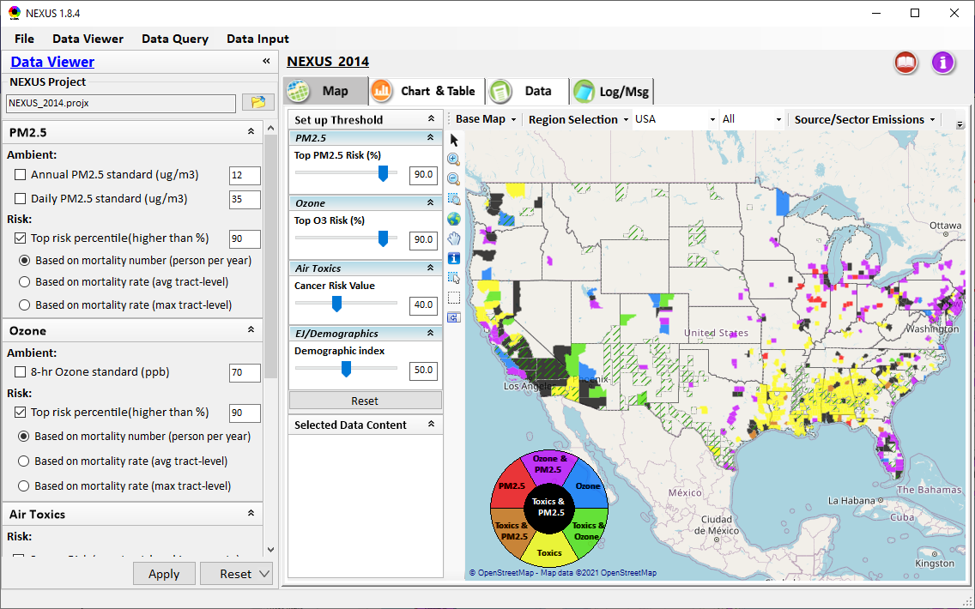
NEXUS Tool: On-line User’s Manual
Click “book” icon to launch “User’s manual”
Hot link to User’s manual’s “Data Viewer” chapter (same for “Data Input” module & “Data Query” model)
32

Slide 33
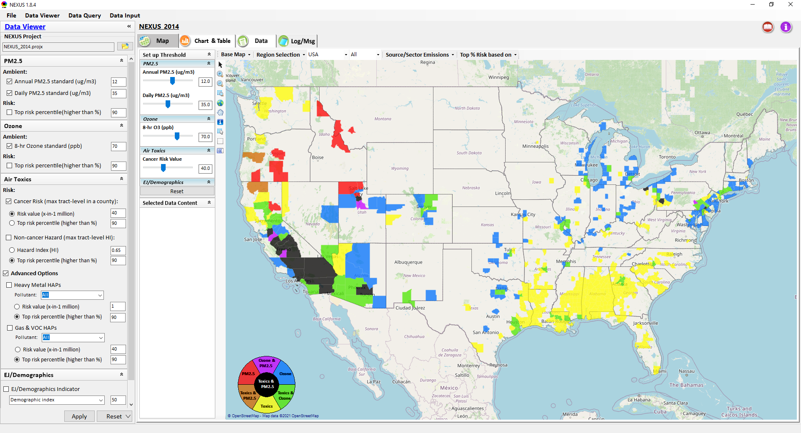

NEXUS Tool: Data Viewer Module
Click “File” to open or save a project
Switch between 3 key modules
NEXUS project file name
Select & adjust “Ambient” or “Risk” levels
“Advanced Option”: provide HAPs & species selections
33

Slide 34
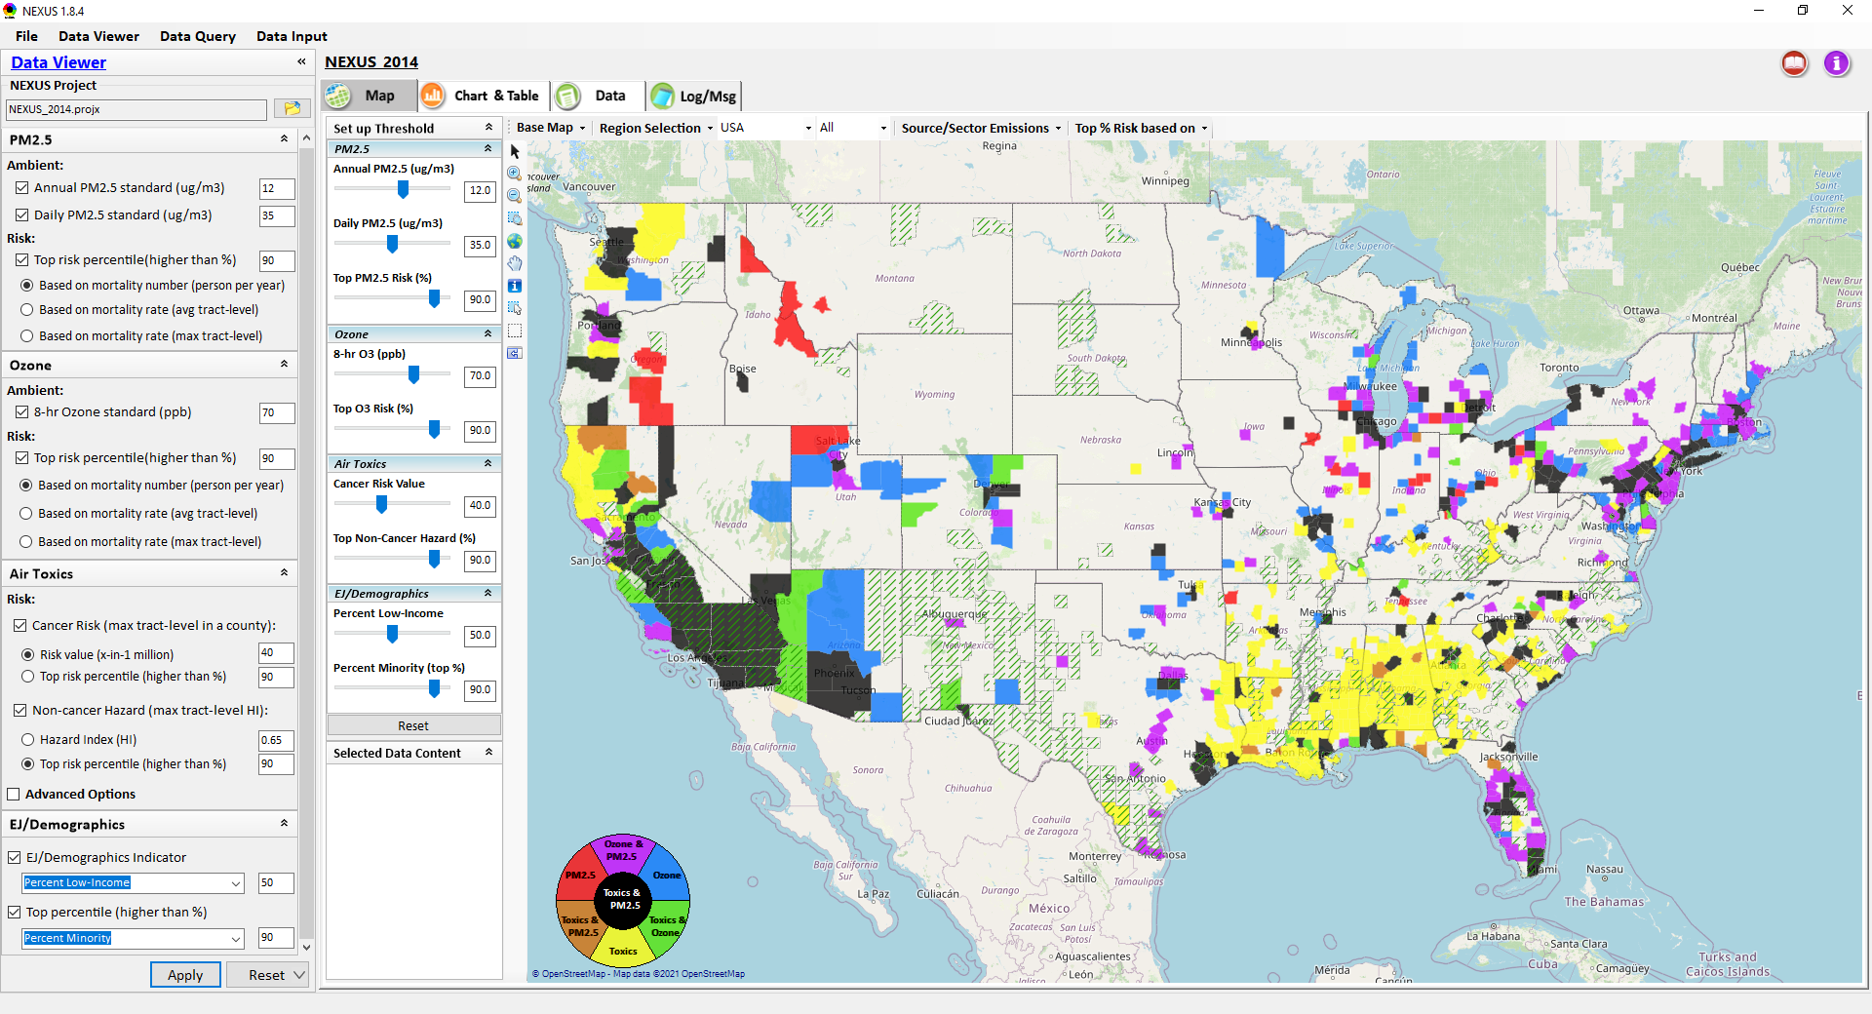
Data Viewer: “Apply” New Selections
“Check” boxes to change/add selections
New selections will appear in “Slider bars” panel and map display
“Slider bars” allow to select & adjust “Ambient” and/or “Risk” threshold levels and displaying color map
“Apply” new selections
34

Slide 35
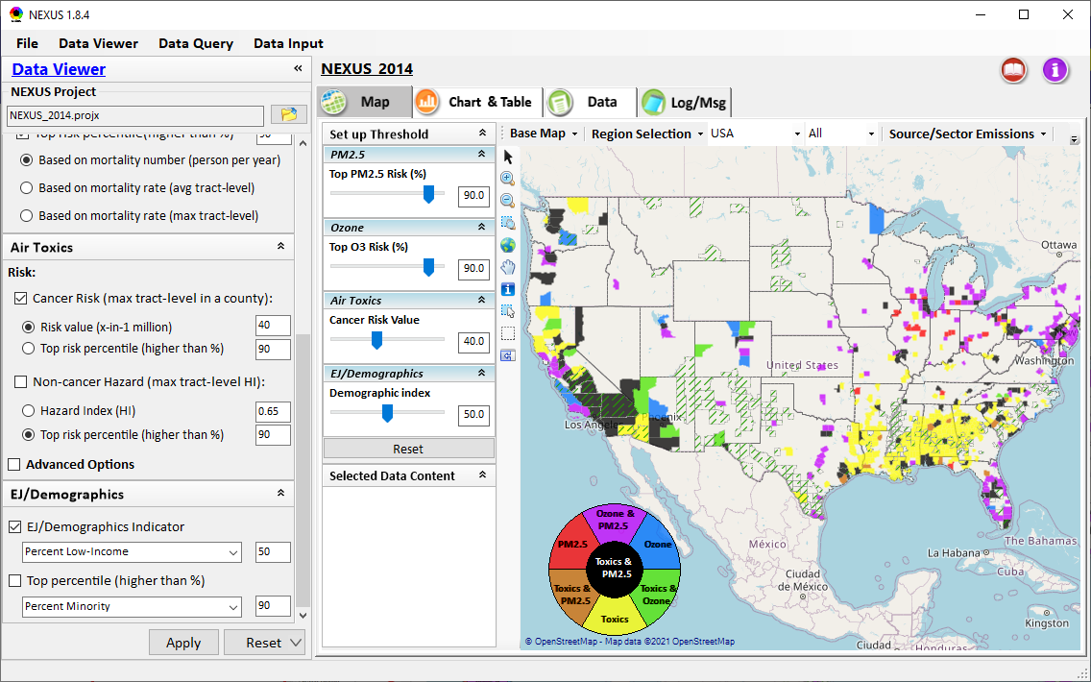
NEXUS Update: New EJ Metric and Data

Slide 36
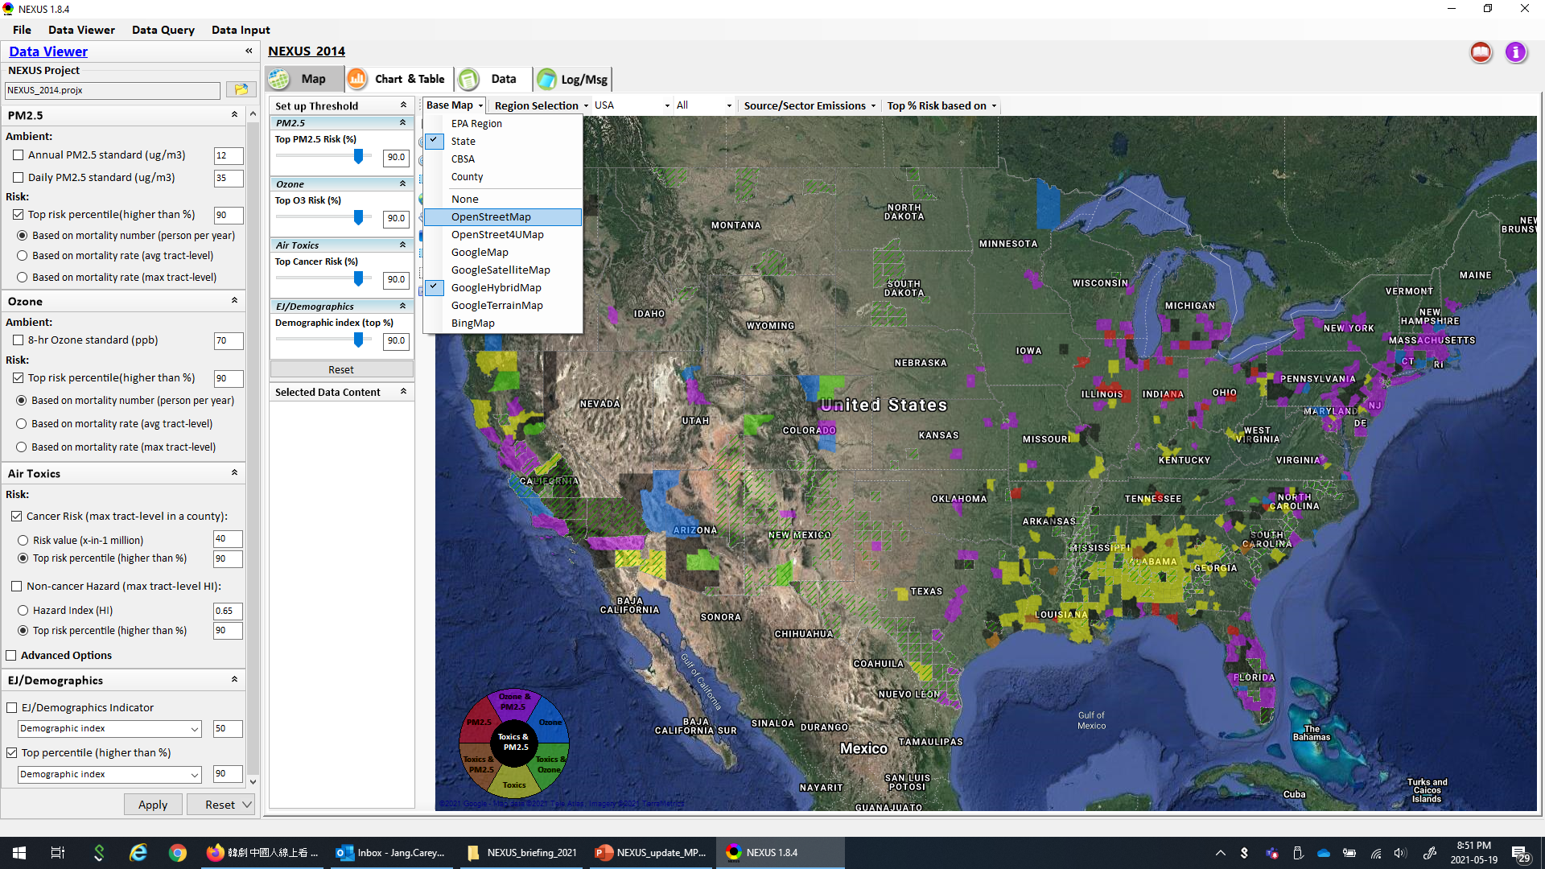
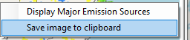
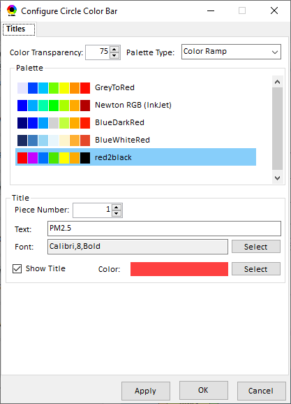
Data Viewer Module: Base Map & Color
“Base Map”: Change boundary lines and background map
“Right-click” map to save image
Click to change color & transparency
36

Slide 37
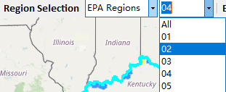
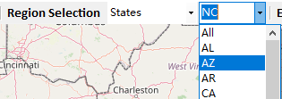
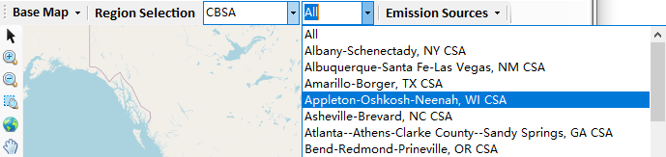
Data Viewer: “Region Selection”
Allow to select “EPA regions”, “States”, or “CBSA”
37

Slide 38
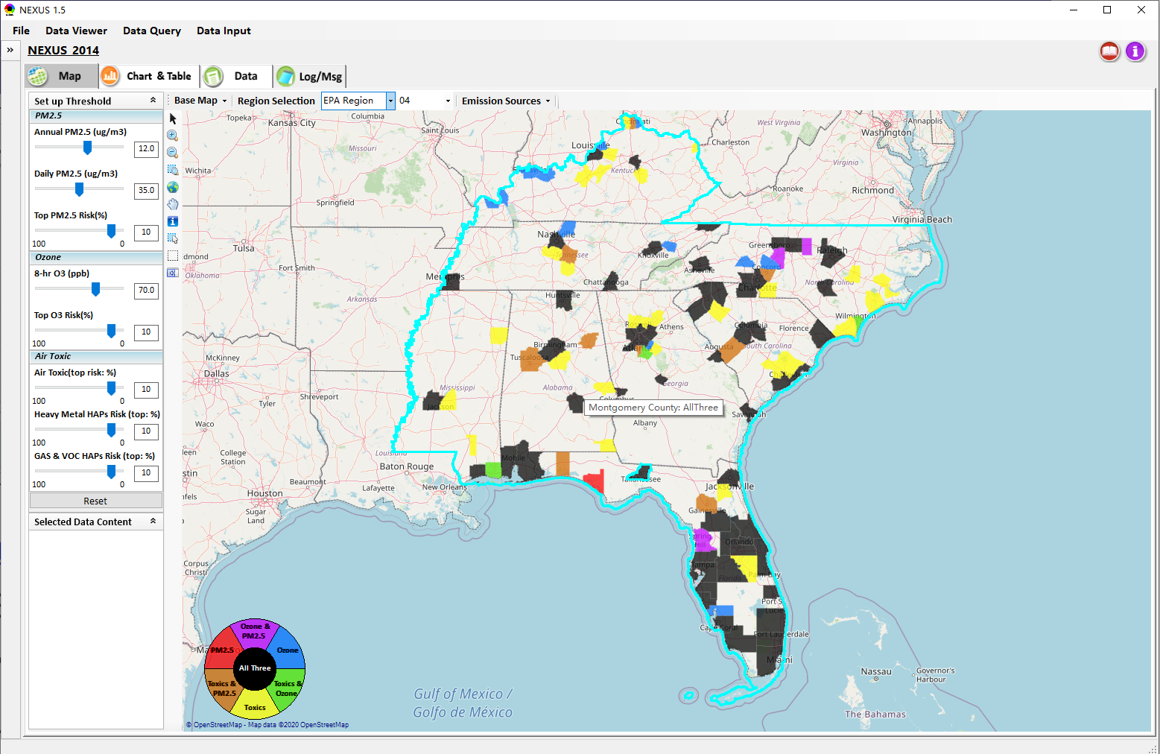
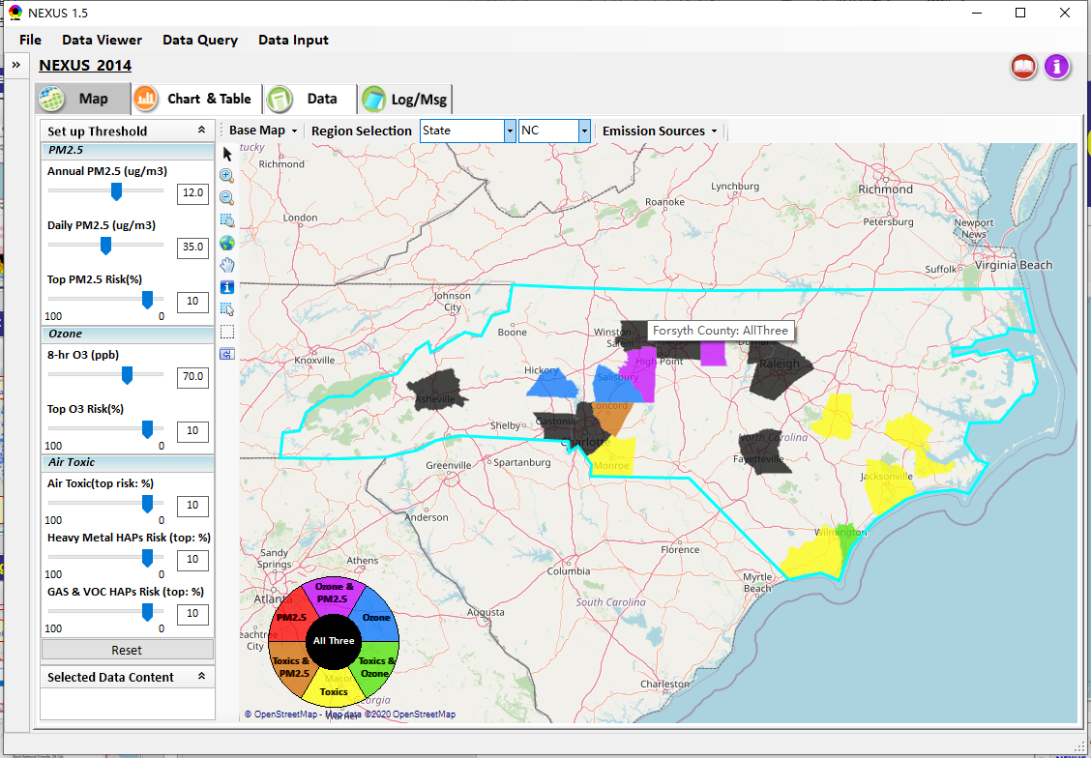
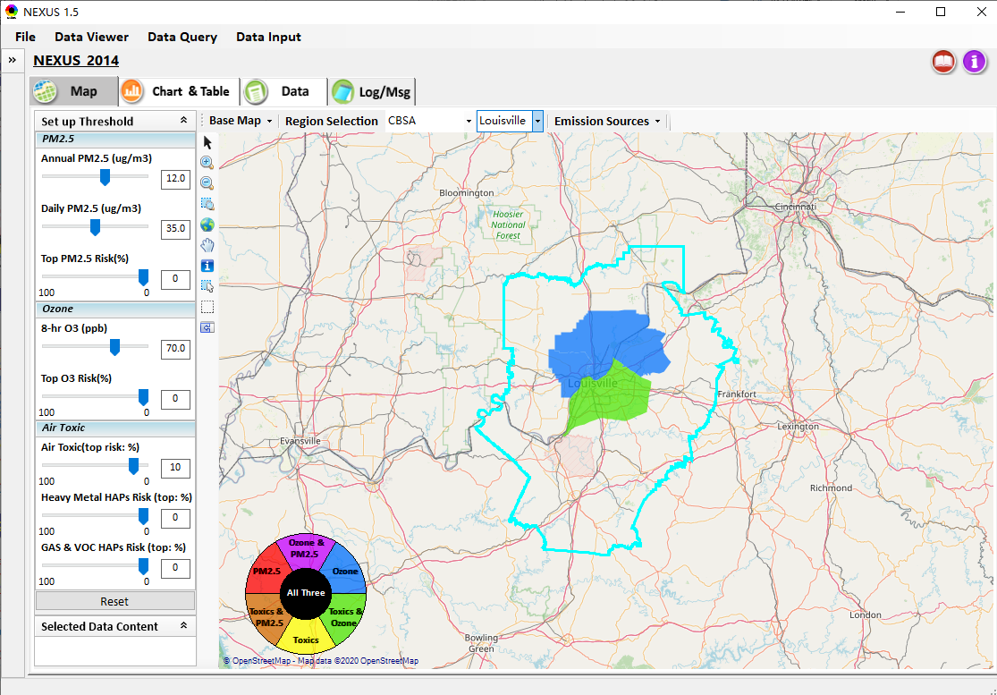
Data Viewer: Select EPA Region/State/CBSA
Examples:
EPA Region 4
NC State
Louisville CBSA
38

Slide 39
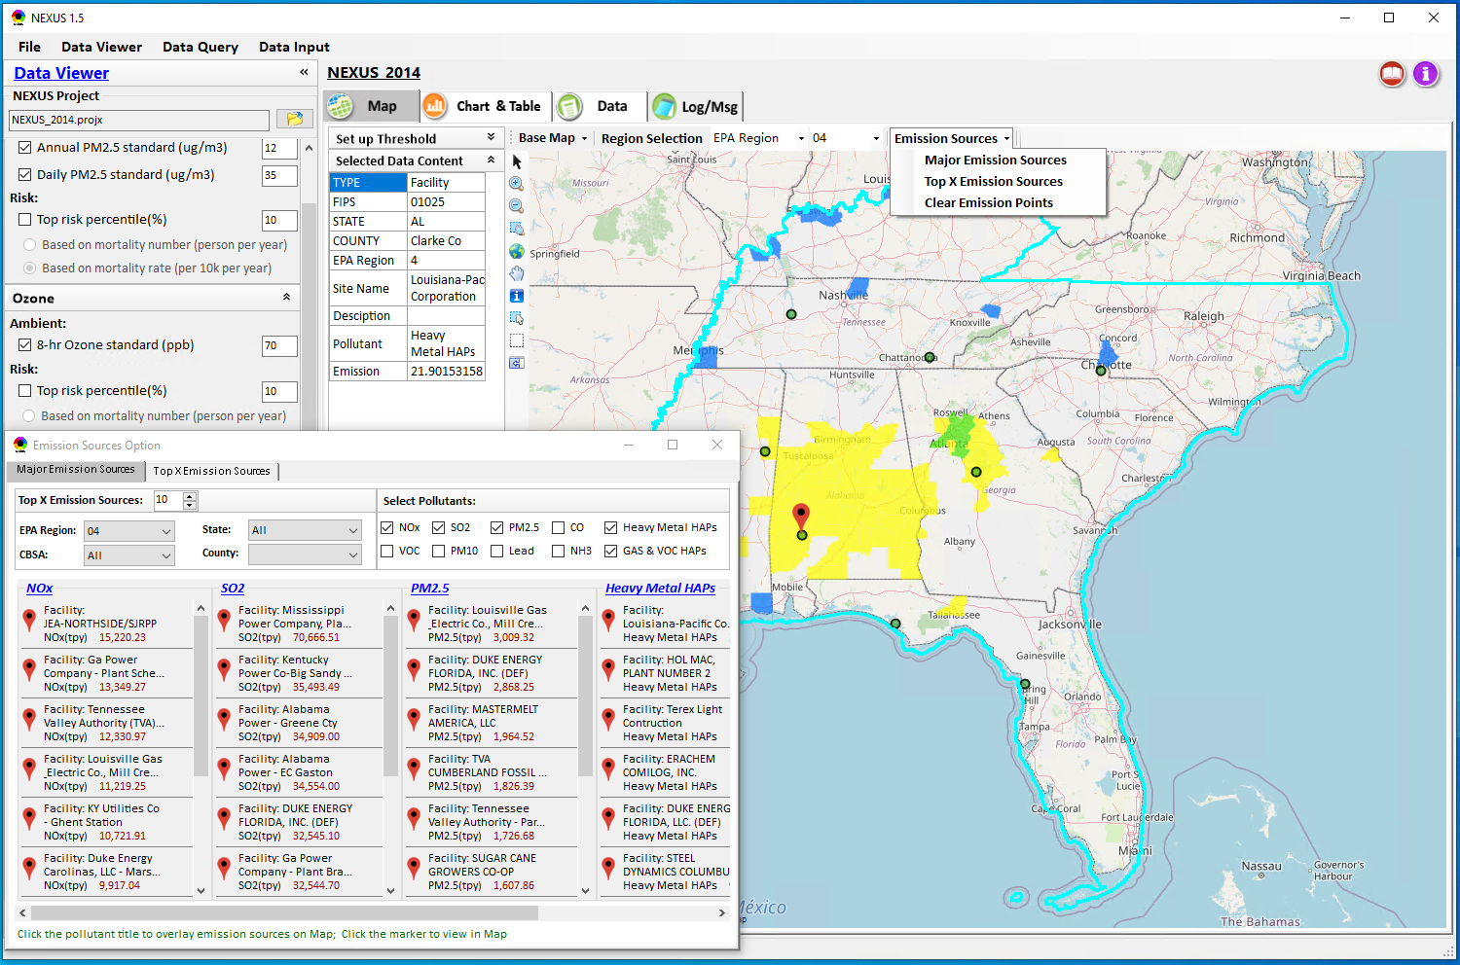
Data Viewer: Major Emission Sources
Click “Emission Sources” tab to display emission sources (green dots) and launch new window
Click any “facility” to link & display source location and emission information
39

Slide 40
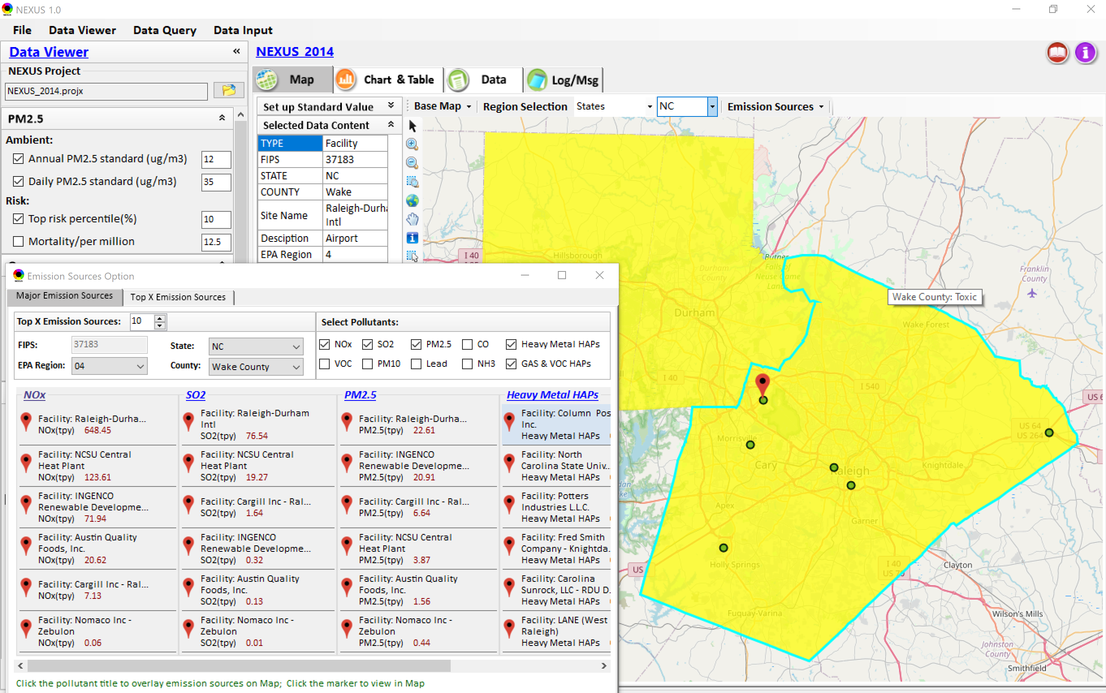
Data Viewer: Major Emission Sources
Allow to scroll down to county-level (e.g., Wake County, NC)
Wake county, NC
40

Slide 41
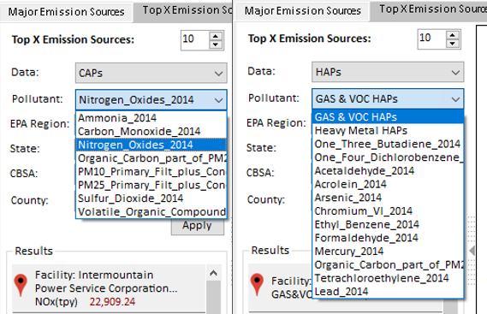
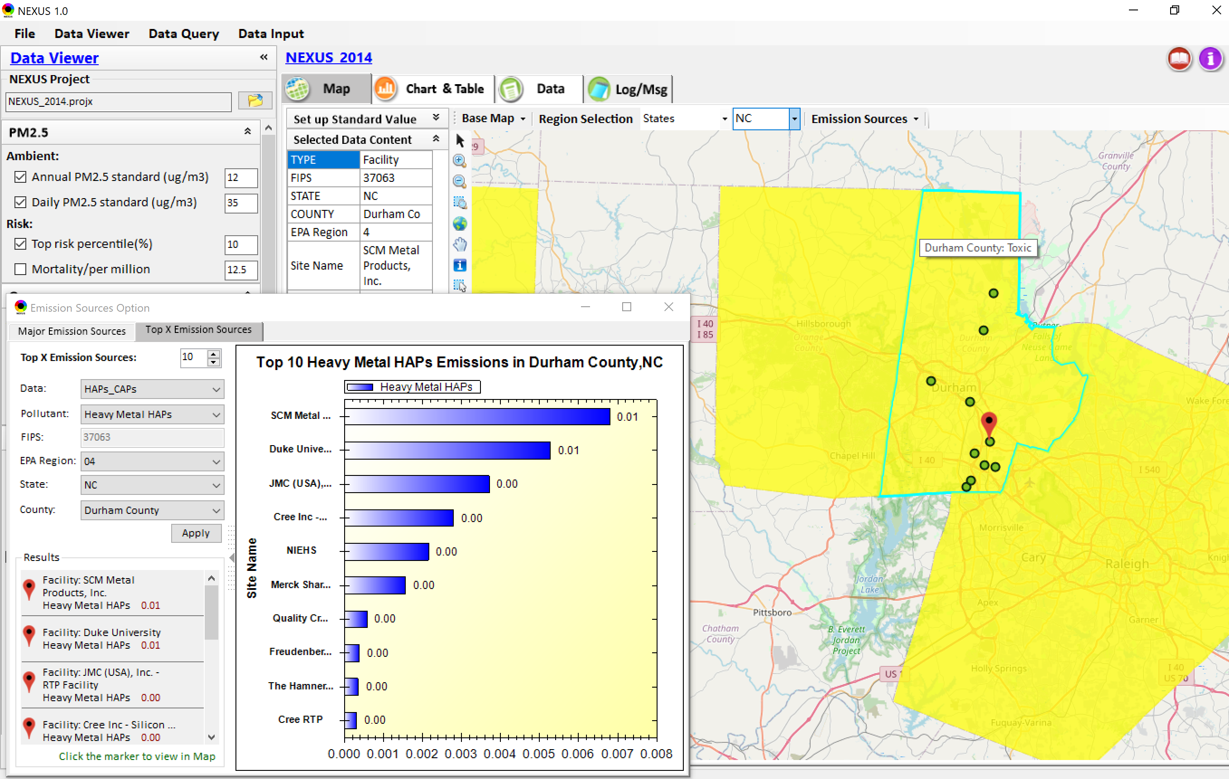
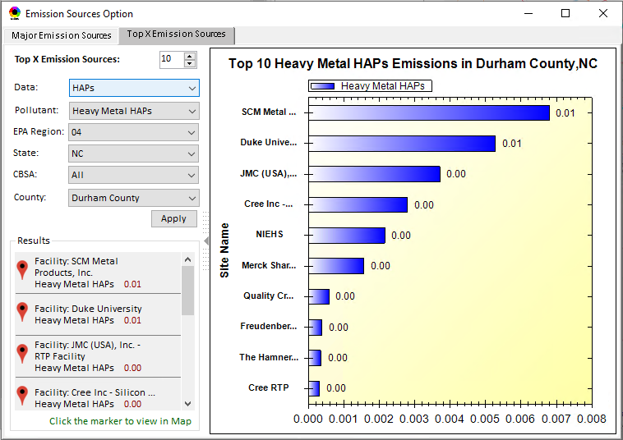
Data Viewer: Top “x” Emission Sources
Provide selection of CAPs precursors & HAPs species
Durham county, NC
41

Slide 42
NEXUS Update: “Source/Sector” Emissions Summary
“Source/Sector Emission Summary” function allow to select major CBSAs and provides source and sector emissions summary to support OAQPS’s “Sector Prioritization” project effort
42

Slide 43
Data Viewer: EPA Region Table Generator
“EPA Region Table Generator” provides attainment status of O3 and PM2.5 and their DVs; also allows to select any EPA region based on data updated to 2018.
43

Slide 44
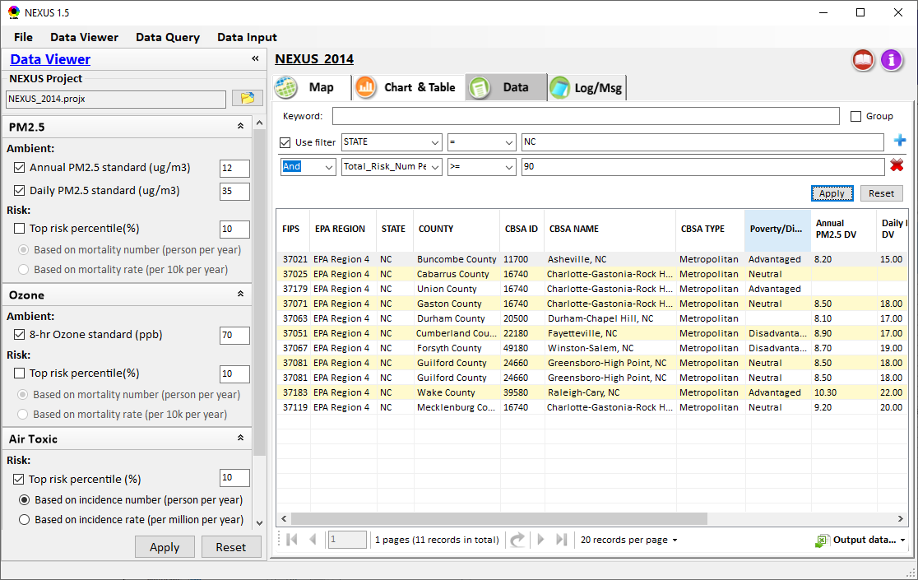
Data Viewer: Data Search & Filter
Click “+” to add filters; Click “x” to remove current filter;
Show specified records per page.
Click “Output data…” to output current page records or all records

Slide 45
Data Query Module: Overlaying Map
Region Selection
Data Query Configuration
Data Query qualifier selection
Overlaying Map selection
45

Slide 46
Data Query Module: Configure Data Query
“Data Query Filter” allows to select “qualifiers” for query
“Data Query Preview” displays the selected “qualifiers” at the same time
46

Slide 47
Data Query Module: Attribute Table
Filter/search/export functions
Detachable “Attribute Table”
47

Slide 48
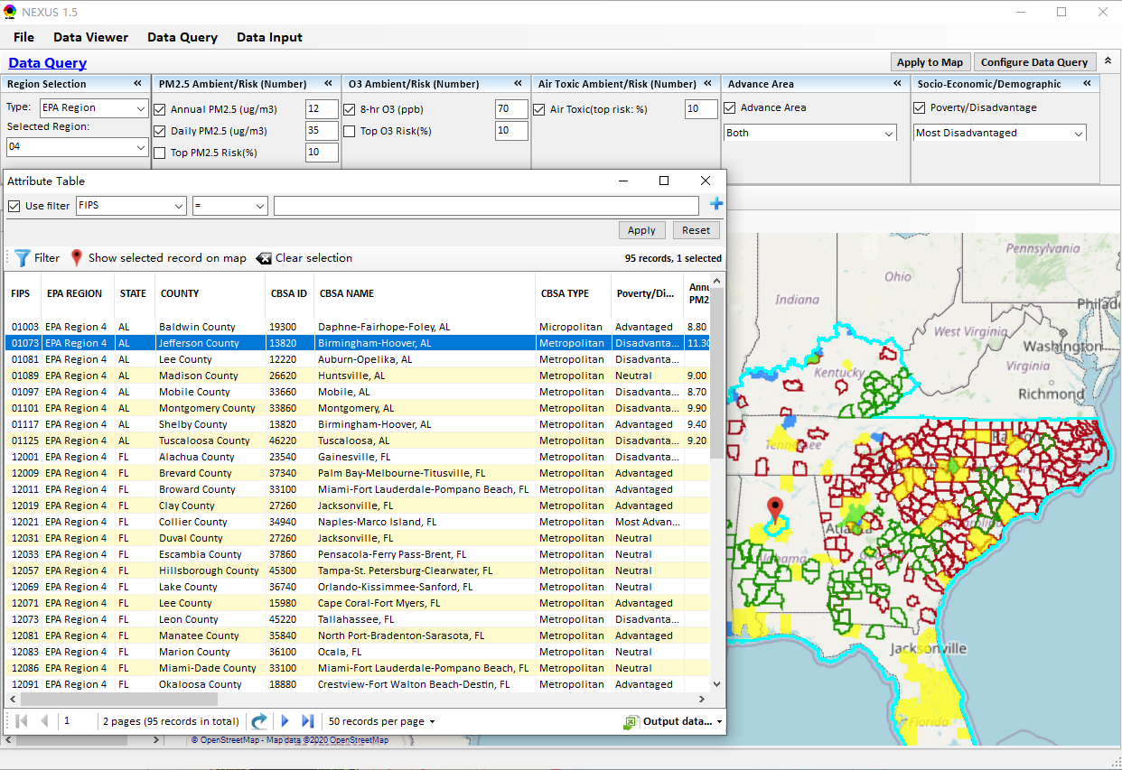
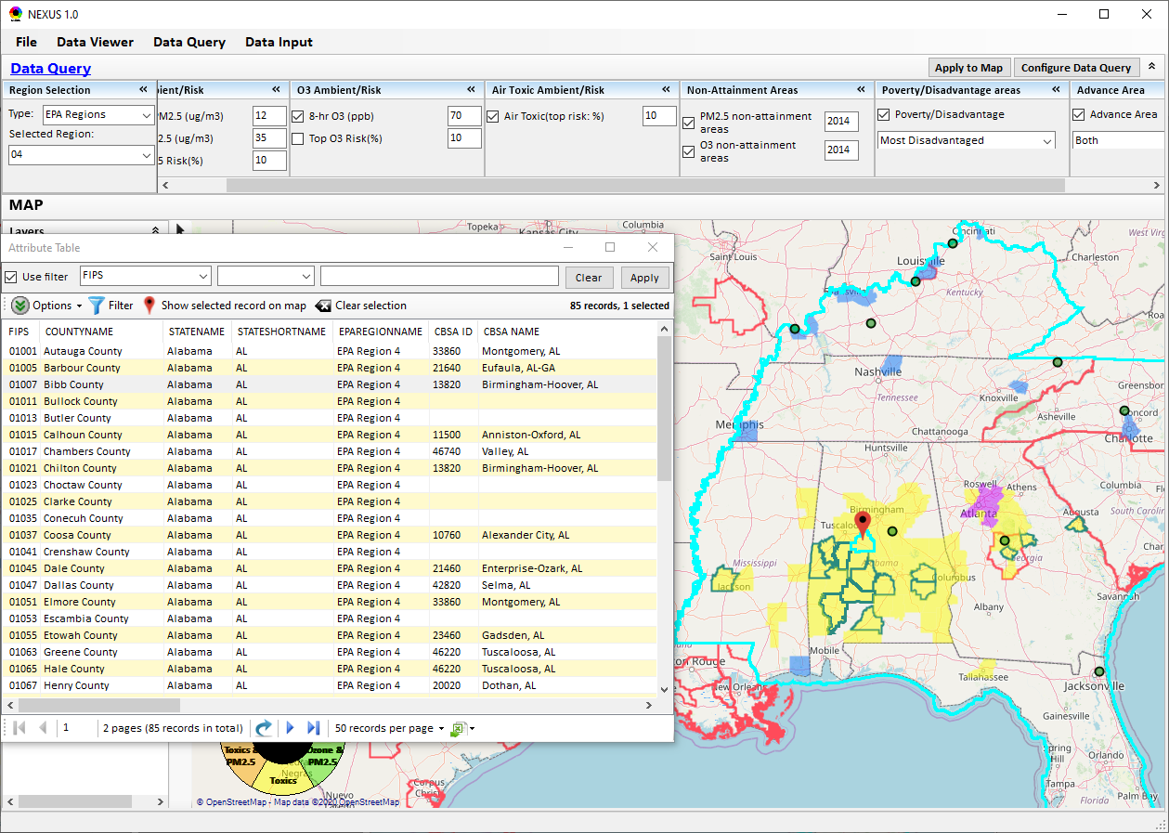
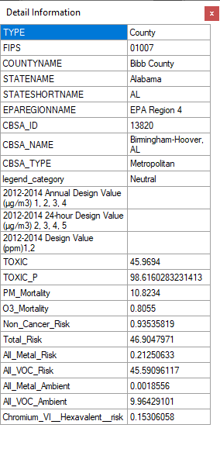
Data Query Module: Attribute Table
Click a “record” to link and display its location & info.
48

Slide 49
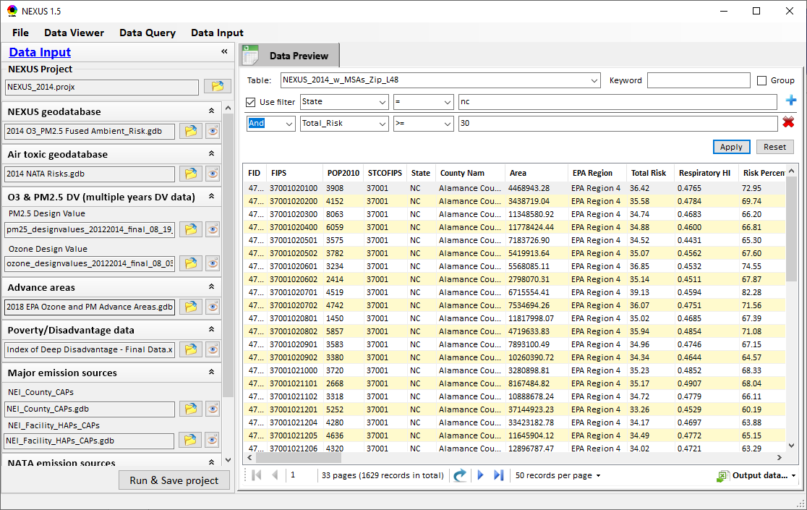
Data Input Module: Data Preview
Click to view data
“Transparency” & “Open-Source”:
All NEXUS input/output data files are available under:
“This PC\Documents\My NEXUS files\Data (\Result)”
Check to use filter to query data
Select a table to view if there are multiple tables in the selected data source file
Click to change input data file
Click to view data
Click to run & save project

Slide 50
End
50

