Slide 1
Overview of EJ Relevant Activities

Slide 2
AQMG Involved in a Number of EJ Relevant Activities
NEXUS Tool Development*
  National and area specific advanced screening capabilities: proximity analysis
“Area of Influence” for Proximity Screening Analysis*
  OID/CTPG question about appropriate distance for such screening
  OAP’s Power Plants and Neighboring Communities tool
Regulatory Impact Analysis (RIAs)
  Full form modeling allows for AQ exposure and impact estimates for EJ assessments
  Reduced form approaches vary in capabilities here:
    BPTs do not allow for estimation of necessary distributional impacts
    FAST can provide such impact estimates based on spatially resolved emissions changes
* Topic to be covered here

Slide 3
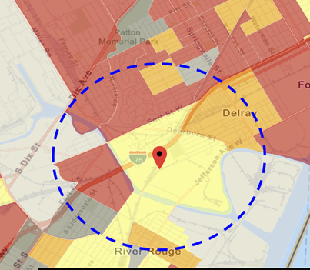
Current Practice for Proximity Screening: EJ Example
“Proximity analysis” is the primary EJ screening approach because close proximity to air pollutant sources, such as industrial plants and major highways, is correlated with exposure and adverse health risks.
  Involves comparison of demographic distributions near source(s) (e.g., within 5, 10, 50 km) to those for the state, region, and nation
Types of Proximity Analysis
  Demographic analysis
  Risk-based demographic analysis
  Can consider other factors for use (next slide)
Current Tools Used
  EJSCREEN by OID for initial screening and rules (with added GIS scripting)
  Project specific efforts for criteria and toxic rules (in-house or contractor)

Slide 4
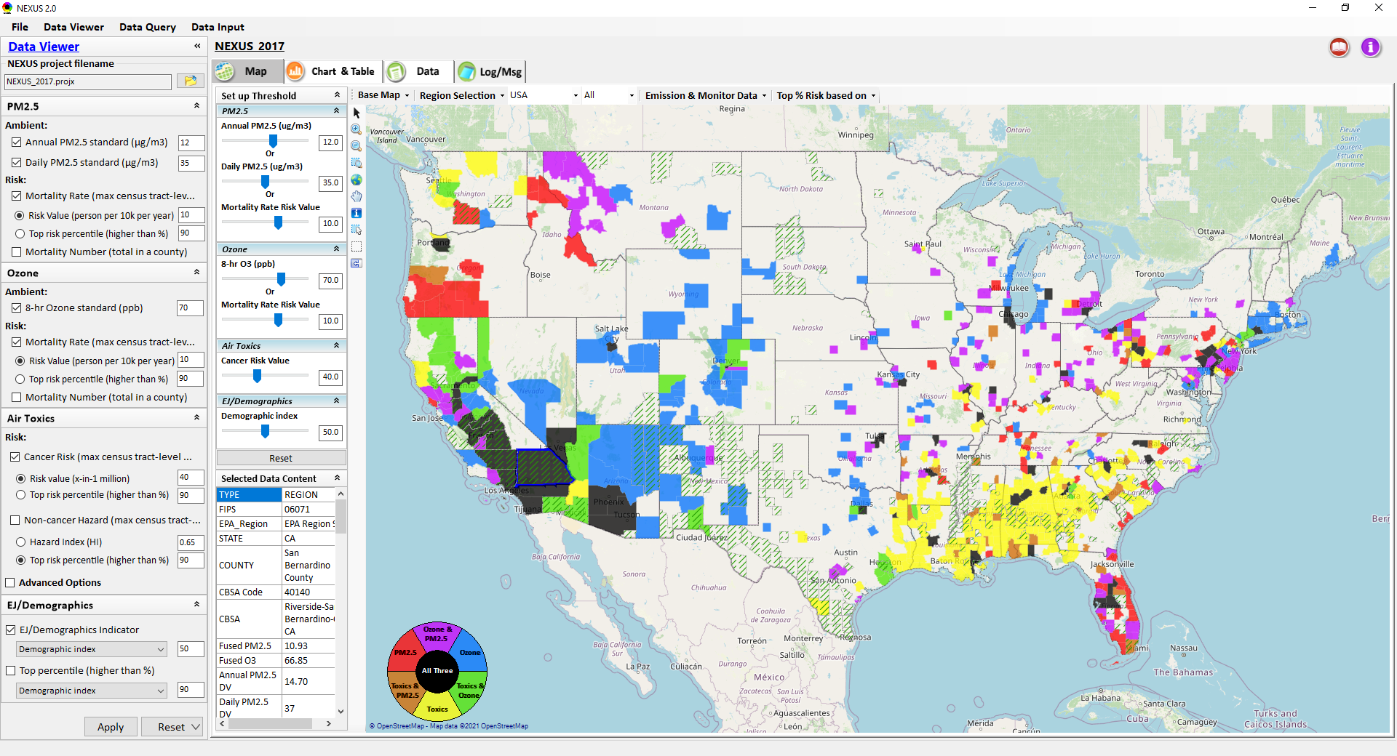
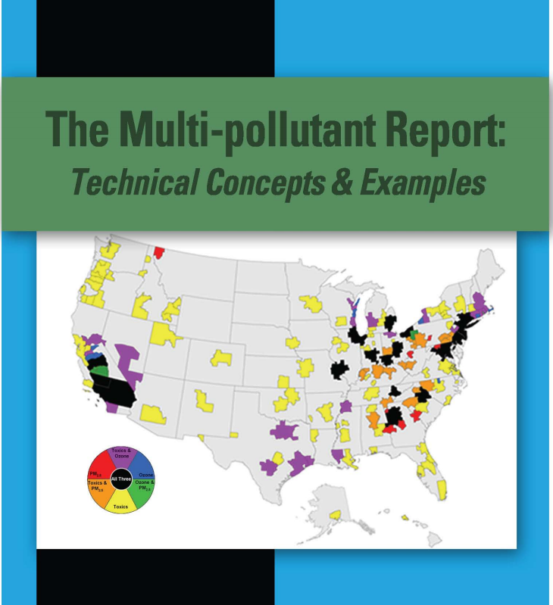
NEXUS Multi-pollutant AQ Planning Tool
Launching Page
2008
Roadmap for Demo:
(Use example cases)
National View: Use “NEXUS” across pollutants to provide an initial “SCREEN” at the national level by providing an indicator where there may be a common set of sources contributing to multi-pollutant issues.
Regional View: Dial into a region or area of interest to understand the pollutant/source connections, and potential for more effective and efficient multi-pollutant solution.
4

Slide 5
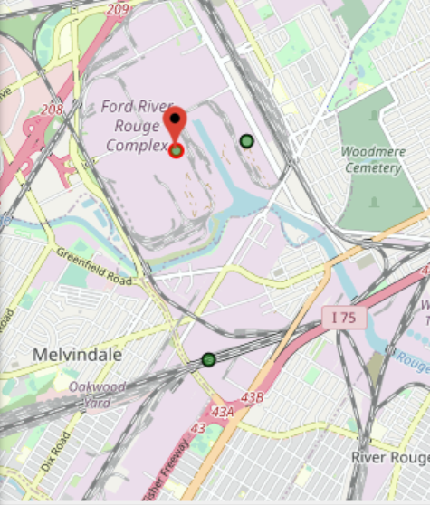
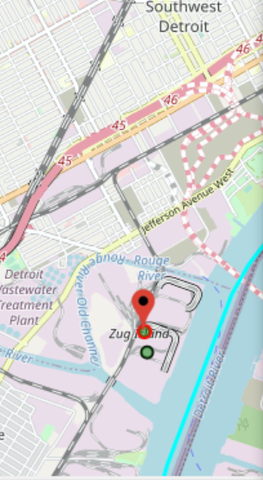
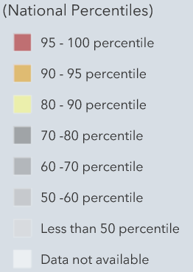
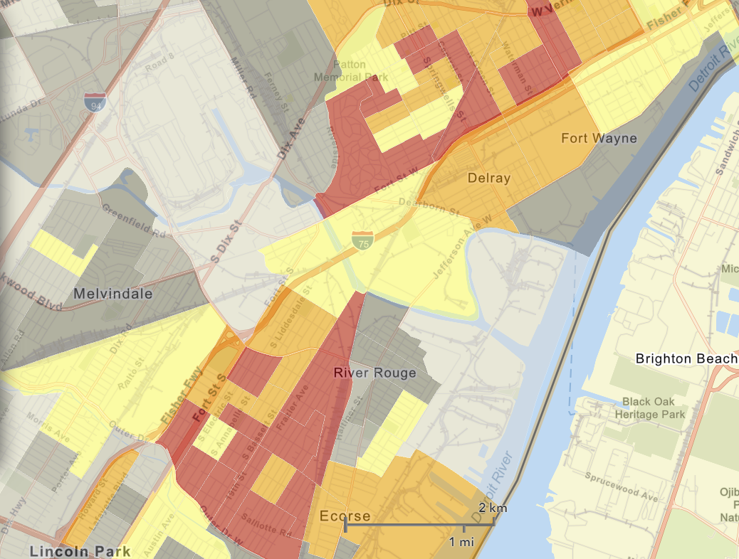
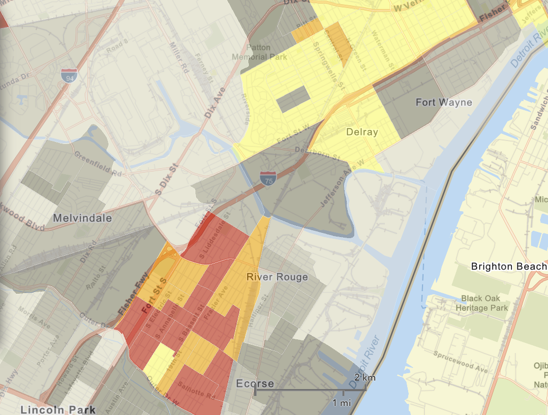
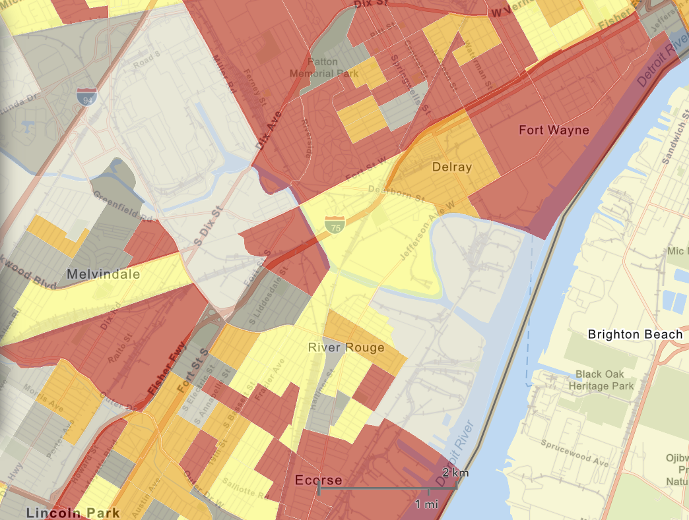

NEXUS Tool - EJ Indices in Wayne County
NEXUS Map
AK Steel
NEXUS can determine the presence or absence of environmental justice concerns in communities in areas with MP concerns. We are incorporating the EJ metrics from EJSCREEN. These indices show the close proximity of AK Steel & US Steel to EJ communities.
US Steel
EJSCREEN Demographic Index
EJSCREEN People of Color Population
EJSCREEN Low Income Population
5

Slide 6
NEXUS & EJSCREEN
  EJ Layers
    Hazardous waste
    EJ Grants
    Water features
    Places
    Schools & Parks
    Transportation
    Boundaries
    Prisons
    Public Housing
    Subsidized Housing
    Climate
    Sites reporting to the EPA
    Superfund (NPL)
    RSEI
  Environmental Indicators
    Wastewater Discharge Indicator
    Hazardous Waste Proximity
    Superfund Proximity
    Lead Paint Indicator
    Traffic Proximity
    RMP Proximity
EJ Layers
Tribal Areas
Nonattainment Areas
  Environmental Indicators*
    NATA Respiratory HI
    NATA Cancer Risk
    NATA Diesel PM
    Ozone Model Concentrations
    PM_{2.5} Model Concentrations
Demographic Indicators
    People of Color Population
    Less Than HS Educated
    Low Income Population
    Linguistically Isolated
    Demographic Index
    Under Age 5
    Over Age 64
Ozone and PM_{2.5}
Emissions and source data
Mortality Risk data
Monitoring data
Air Toxics
Emissions and source data
Modeled concentration data
Risk data
Monitoring data
GHG emissions
*Provided to OEJ by OAQPS (AQAD & HEID)
6

Slide 7
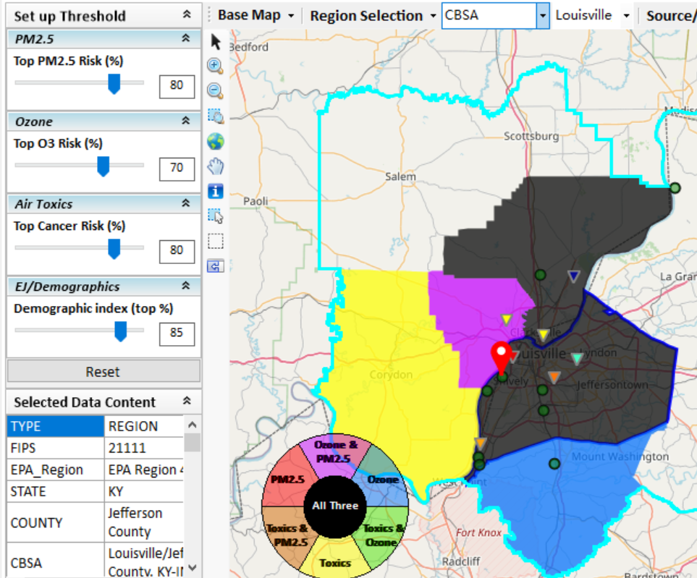
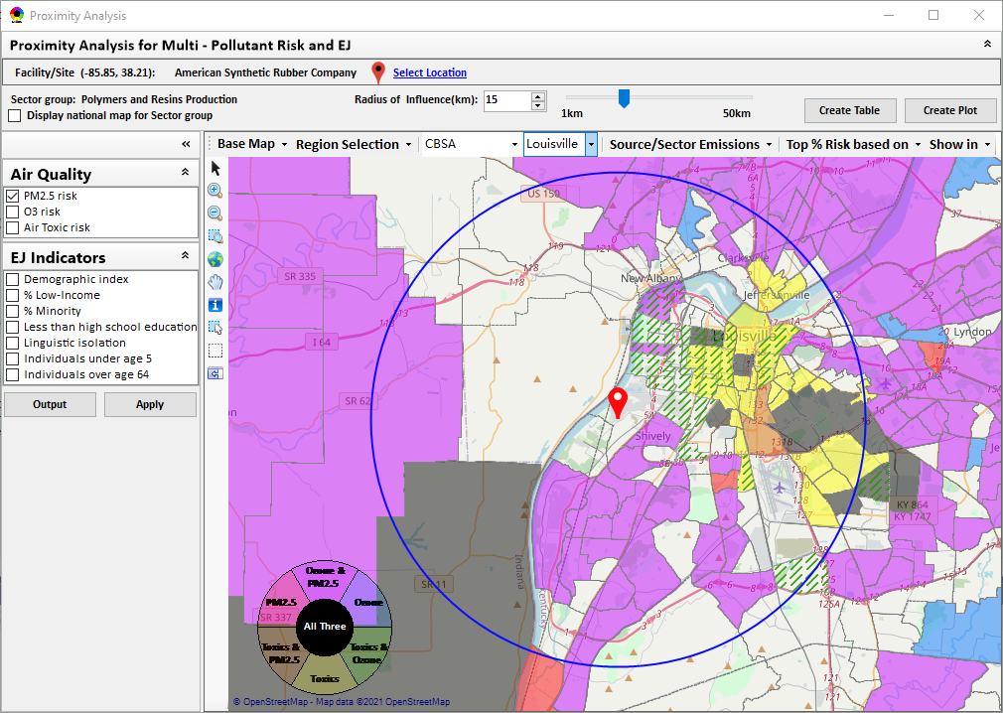
New “Proximity Analysis” Module (under development)
Currently in NEXUS
Proximity Analysis for MP Risks and EJ
County – level (current)
Community (Census Tract) - level
7

Slide 8
“Area of Influence” for Proximity Screening Analysis
OID/CTPG inquired with AQMG on what is the appropriate distance for use in proximity screening analysis
OAP has inquired about the appropriate “area of influence” for EGUs generally and with respect to their Power Plants and Neighboring Communities tool
AQMG has started efforts to engage and address this question by sector and pollutant, i.e.,
  Dispersion modeling for air toxics & direct PM2.5 (Alyssa Zimmerman)
  Photochemical modeling for O3 and secondary PM2.5 (Kirk Baker)
Expecting a peer-review publication that provides better basis for defining appropriate distance(s) for proximity screening analyses and EPA recommendations that can be incorporated into EPA tools as defaults (e.g., EJSCREEN, OAP EJ tool, NEXUS, etc).

