Slide 1
FAST-CE
CAMD Cases: “75L” & “CES8”
QA & Comparisons:
Baseline (2023): O3-MDA8, O3-MDA1 & PM2.5
Control: 2035, 2040, 2045, and 2050
(Note: 2030 provided by Heather, used for QA here)
Cases: “75L” and “CES8”

Slide 2
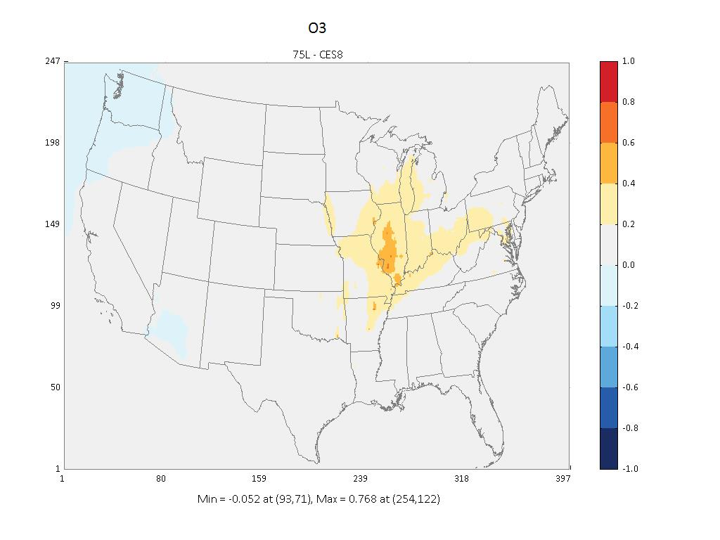

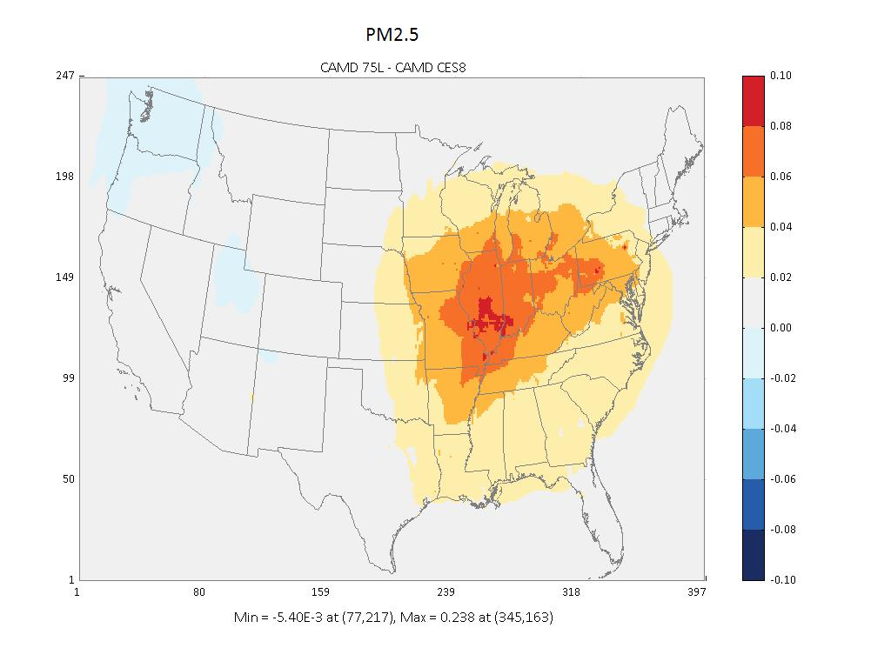
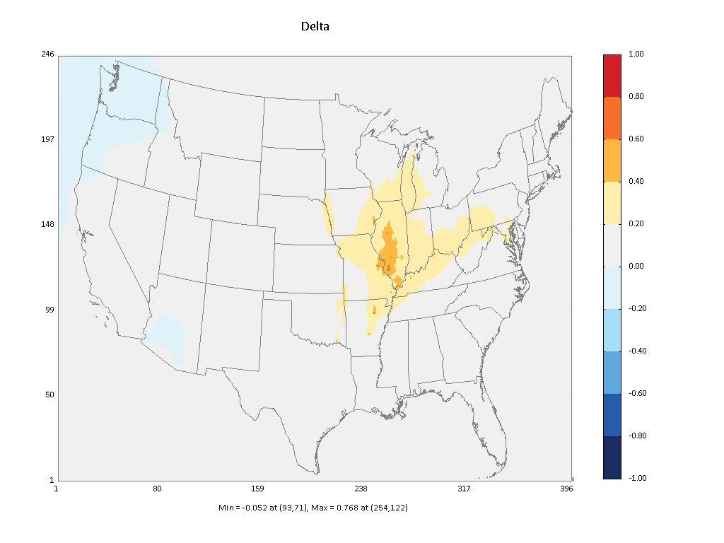


QA of “2030” Results from Heather (top) vs. Carey (bottom)
O3_MDA8 (75L – CES8)
O3_MDA1 (75L – CES8)
PM2.5 Annual (75L – CES8)
1
1
0.10
-1
-1
-0.10
1
1
0.10
-1
-1
-0.10

Slide 3
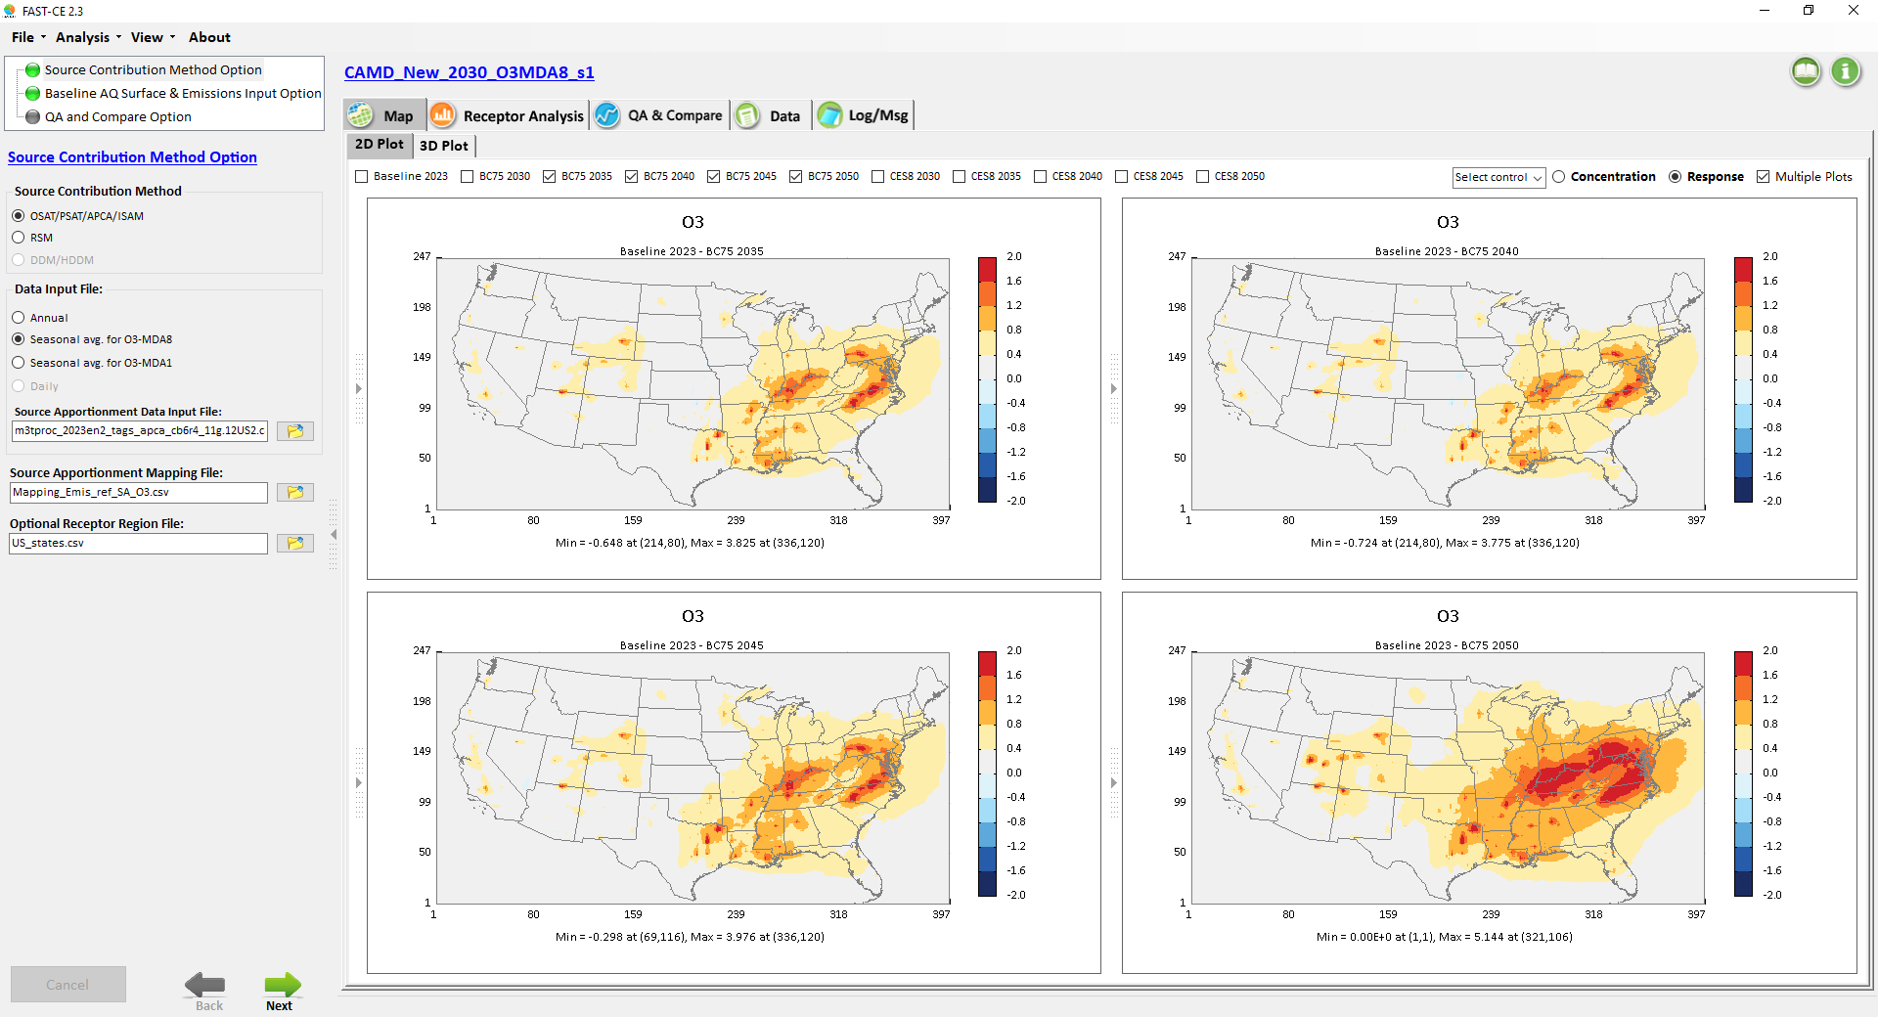
CAMD_O3_MDA8: Control Responses of “BC75” (2035, 2040, 2045, 2050)
2
2
-2
-2
2
2
-2
-2

Slide 4
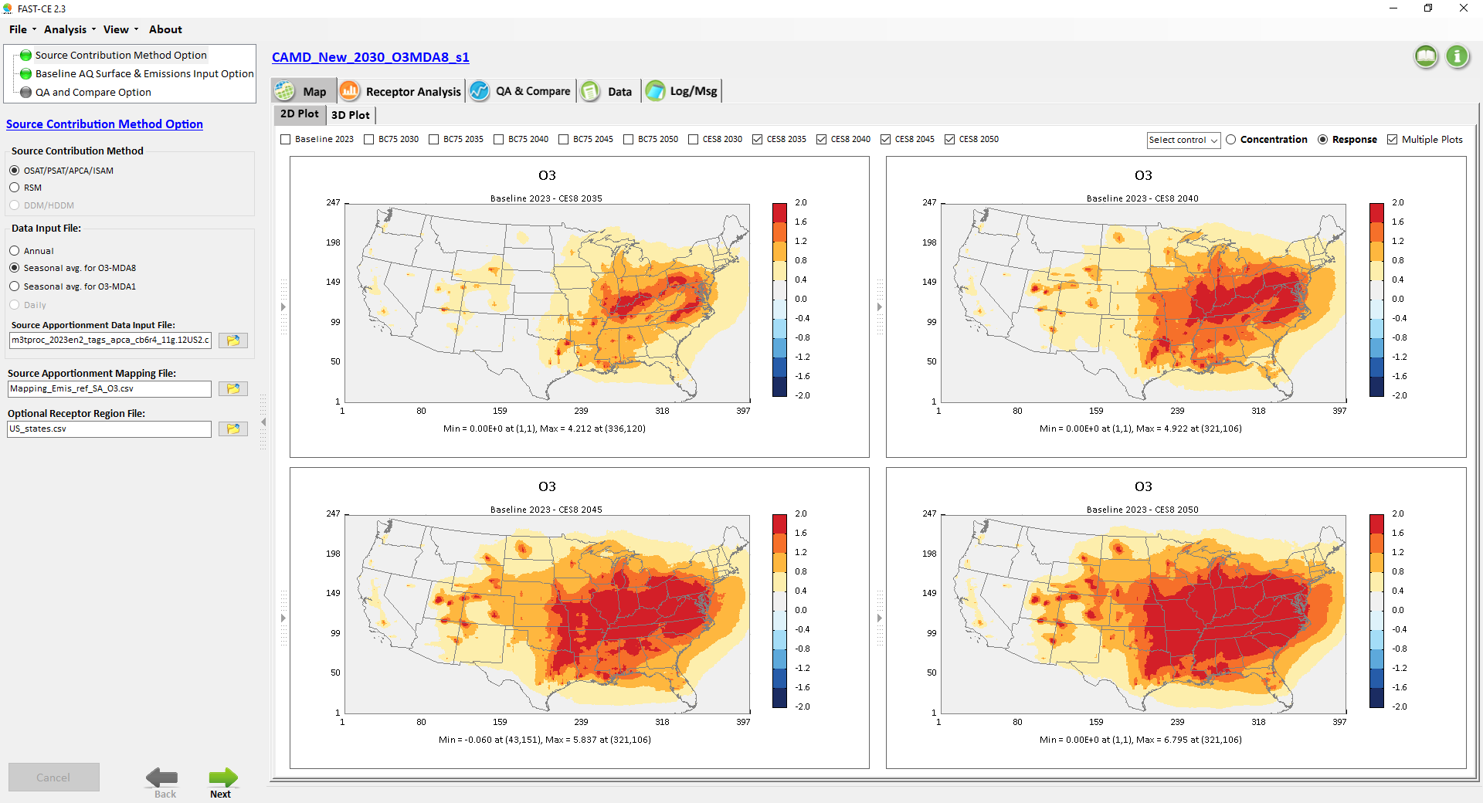
CAMD_O3_MDA8: Control Responses of “CES8” (2035, 2040, 2045, 2050)
2
2
-2
-2
2
2
-2
-2

Slide 5
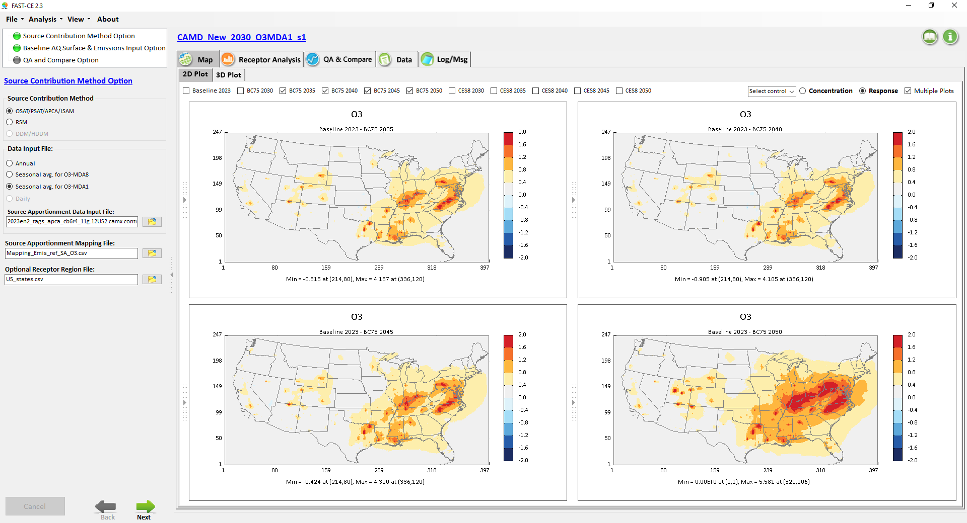
CAMD_O3_MDA1: Control Responses of “BC75” (2035, 2040, 2045, 2050)
2
2
-2
-2
2
2
-2
-2

Slide 6
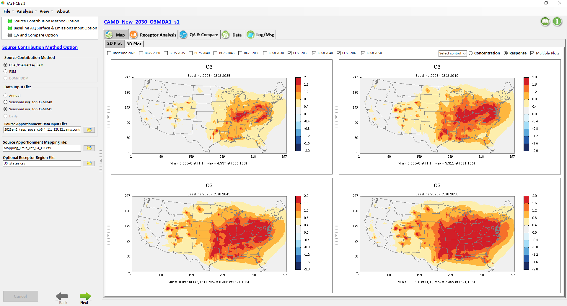
CAMD_O3_MDA1: Control Responses of “CES8” (2035, 2040, 2045, 2050)
2
2
-2
-2
2
2
-2
-2

Slide 7
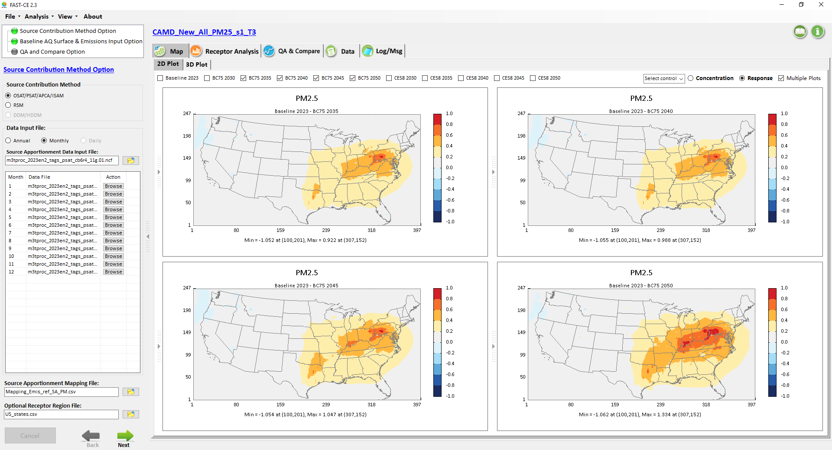
CAMD_PM2.5: Control Responses of “BC75” (2035, 2040, 2045, 2050)
1
1
-1
-1
1
1
-1
-1

Slide 8
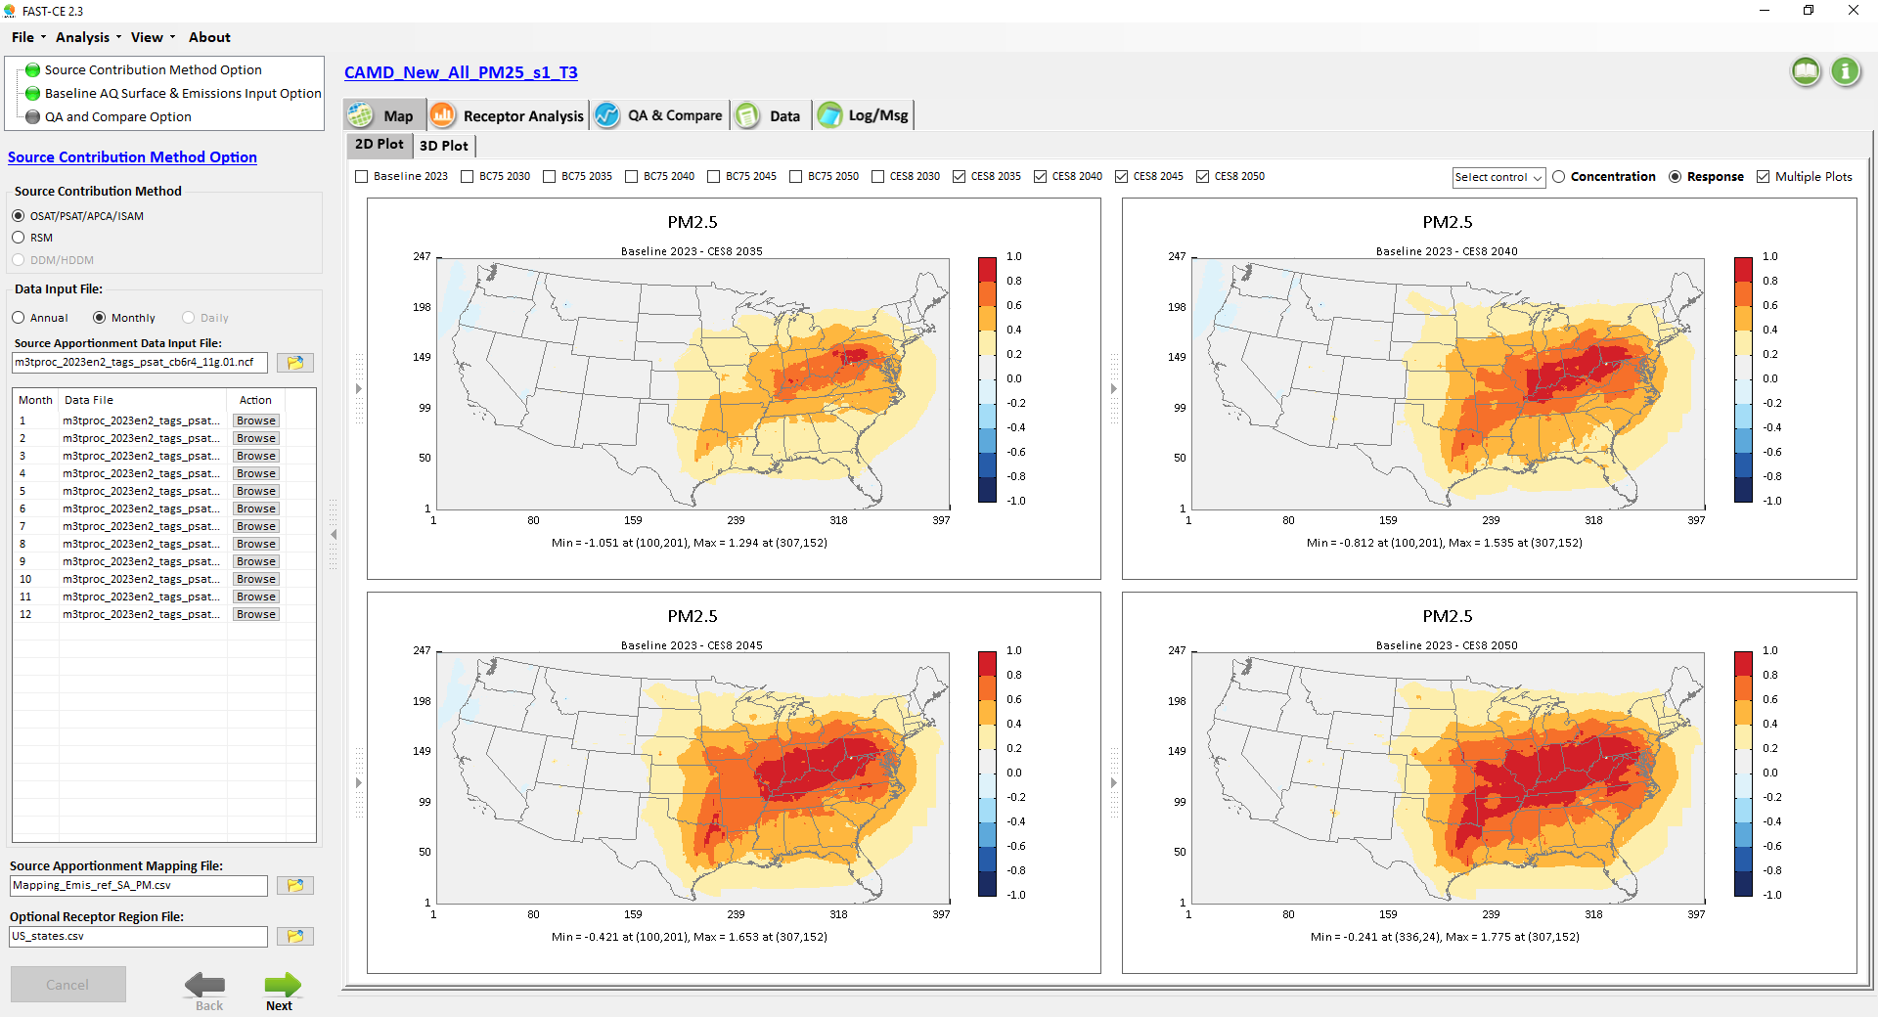
CAMD_PM2.5: Control Responses of “CES8” (2035, 2040, 2045, 2050)
1
1
-1
-1
1
1
-1
-1

Slide 9
End

