Slide 1
Thoughts on Air Quality and Climate
S. Koplitz, J. Kelly, K. Baker, B. Henderson, H. Simon, C. Jang, S. Phillips, C. Misenis, N. Possiel, T. Fox

Slide 2
Overview
Update on 5th National Climate Assessment and Other Climate Efforts
Overview of Air Quality-Climate Relevance for OAQPS Programs/Activities
Presentation and Discussion of Potential Screening Tools
Leveraging AQAD Capabilities for Air Quality-Climate Applications

Slide 3
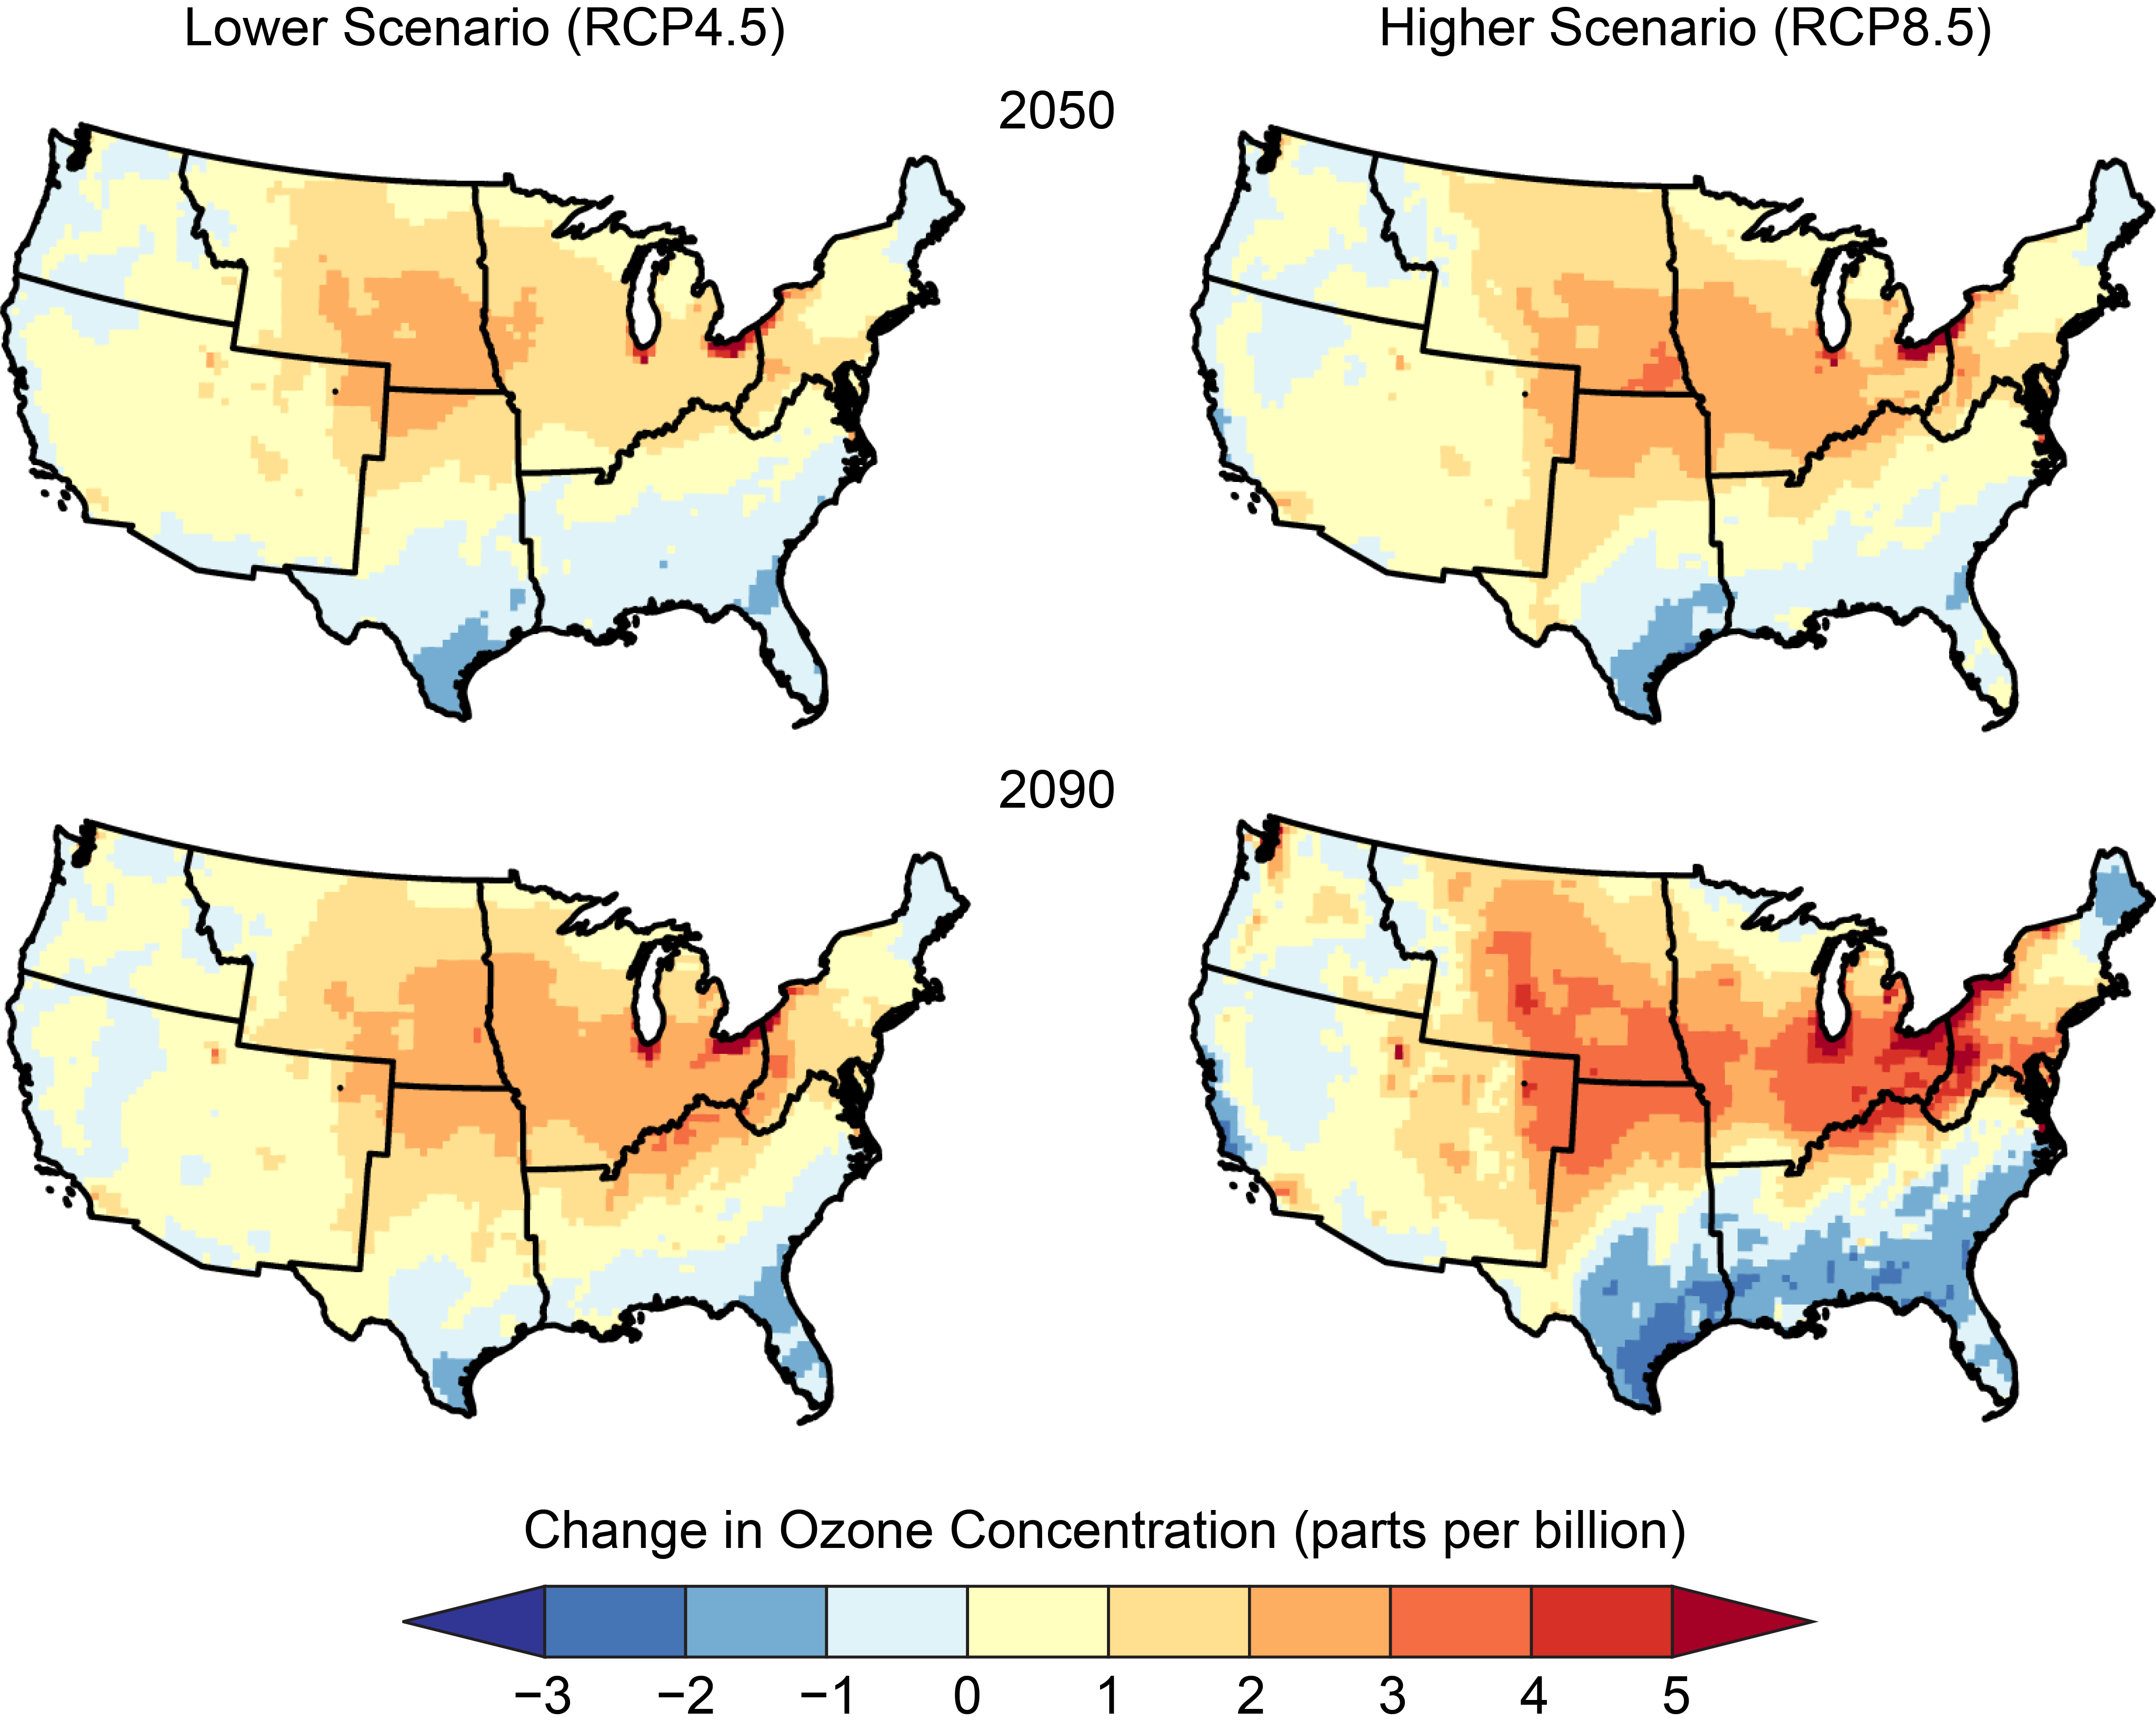
National Climate Assessment
The Global Change Research Act of 1990 mandates that U.S. Global Change Research Program (USGCRP) produces a report for Congress and the President at least every four years that:
“…analyzes the effects of global change on the natural environment, agriculture, energy production and use, land and water resources, transportation, human health and welfare, human social systems, and biological diversity; and…analyzes current trends in global change, both human-induced and natural, and projects major trends for the subsequent 25 to 100 years.”
4th National Climate Assessment (NCA4) published in 2018
Projected Changes in Summer Season Ozone
Chris Nolte (ORD) was coordinating lead author for the Air Quality Chapter, which included sections on:
Air Pollution
Wildfires
Airborne Allergens
Co-benefits of Mitigation
Chapter Authors from EPA:
Pat Dolwick (AQAD at the time), Neal Fann (HEID), Rob Pinder (HEID), Tanya Spero (ORD), Darrell Winner (ORD)
NCA4, Air Quality Chapter

Slide 4
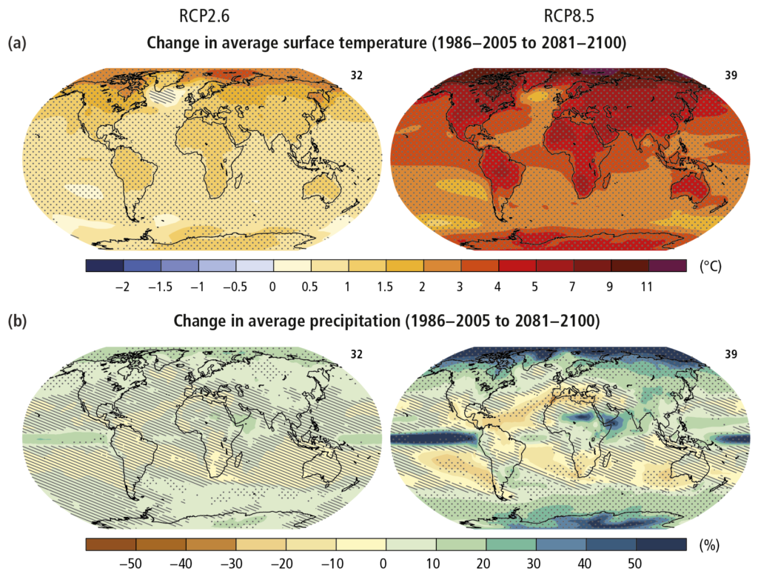
Intergovernmental Panel on Climate Change (IPCC)
Intergovernmental body jointly established by the World Meteorological Organization and the United Nations for assessing the state of climate change science
Identifies areas of consensus in the scientific community related to:
Physical science basis
Impacts, adaptation and vulnerability
Mitigation
Fifth Assessment Report (AR5) finalized in 2014
IPCC AR5

Slide 5
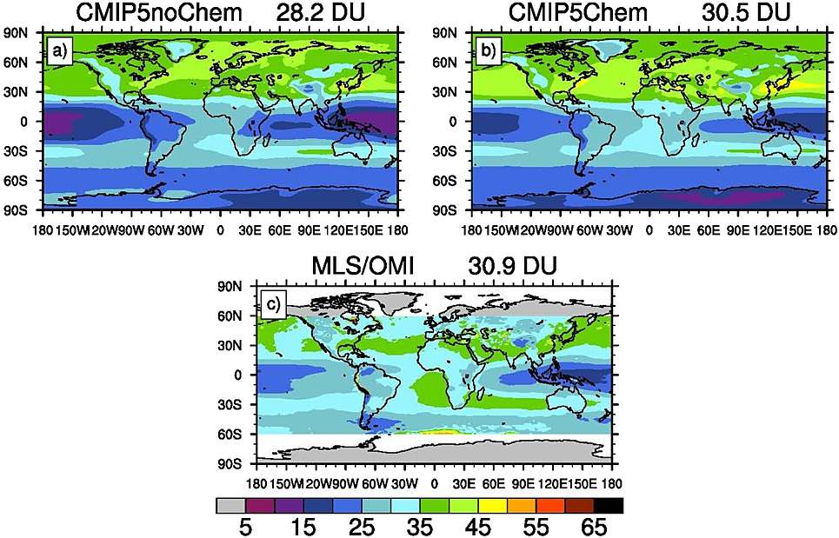
Coupled Model Intercomparison Project (CMIP)
Suite of modeling experiments with standardized inputs designed to evaluate and compare across an ensemble of over 20 different global climate models from around the world, including groups at NASA and NCAR
CMIP5 simulations completed in 2013 for use in the IPCC AR5
Datasets are available publicly for download
2000-2005 Mean Tropospheric Column O₃
Eyring et al., 2013

Slide 6
Updates to National/Global Climate Efforts
5th National Climate Assessment
Currently undergoing chapter lead author selection for the 5th National Climate Assessment (selections expected by ~March 2021)
OAQPS representatives: Shannon Koplitz (AQAD)*, Neal Fann (HEID), Rob Pinder (HEID)
* role previously held by Pat Dolwick
IPCC AR6
Working Group reports expected to be released throughout 2021: WG1 (Physical Science Basis) in April 2021; WG2 (Impacts, Adaptation and Vulnerability) in October 2021; WG3 (Mitigation of Climate Change) in September 2021
Synthesis Report expected in early 2022
CMIP6
Ongoing, in support of IPCC AR6
Model simulation output being released to the public as available

Slide 7
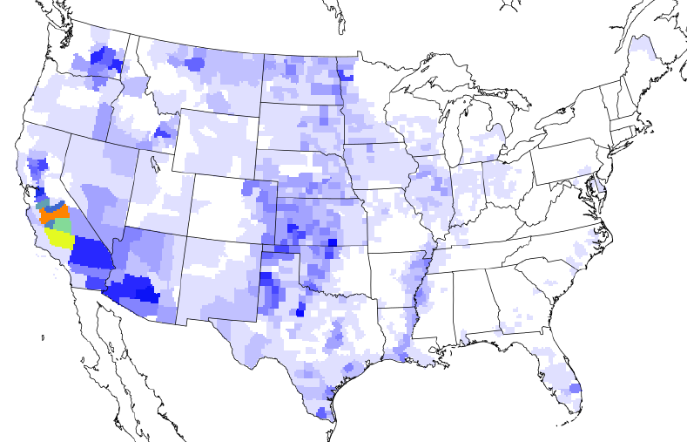
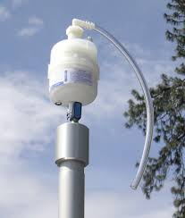
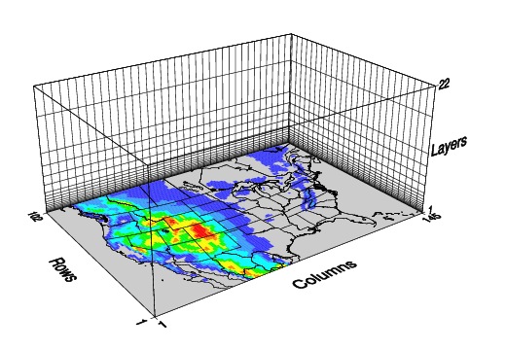
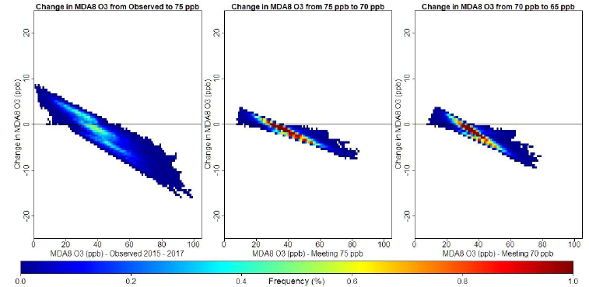
Climate in OAQPS/AQAD Activities
Within OAQPS, AQAD provides foundational technical expertise through emissions development, air quality modeling, monitoring, and data analysis to inform assessments of how pollutant distributions respond to and interact with changes in greenhouse gases and associated changes in climate
AQAD’s depth and range of technical expertise also provides opportunities to identify intersections between climate and other EPA priority action areas, e.g. Environmental Justice
Emissions
Measurements and Monitoring
Air Quality Modeling
Data Analysis
“Projecting future climate and air quality impacts from changing emissions requires models, but their credibility is rooted in the ability to diagnose, interpret, and evaluate properly their process-level representation with high-quality measurements.” -Fiore et al., 2015

Slide 8
Climate in OAQPS/AQAD Activities: Examples
Regulatory Impact Analyses (RIAs)
AQAD has extensive experience developing technical analyses for RIAs as part of rulemakings with direct climate relevance in reducing GHGs including:
Clean Power Plan (CPP) (H. Simon, AQMG Lead)
OTAQ GHG rules such as Light and Heavy-Duty Vehicles (S. Phillips, AQMG lead)
How do considerations of climate impacts and vulnerabilities affect cost-benefit estimates? Are there hidden co-/dis-benefits associated with specific rules or policies that emerge when considering AQ-Climate interactions, or more broadly AQ-Climate-EJ?
NAAQS Reviews & Implementation
AQAD routinely combines air quality modeling with available monitoring data to develop future air quality projections (J. Kelly, AQMG lead for PM2.5; H. Simon, AQMG lead for Ozone)
How can we account for climate when projecting future air quality? How well characterized are DV predictions by EPA and others when projected with a single meteorological year? How are contributions from natural and international sources expected to change in a future climate?
Exceptional Events/179b Demonstrations
AQAD provides technical guidance and also conducts air quality modeling assessments of wildfire smoke (K. Baker, AQMG lead) and global pollutant transport (B. Henderson, AQMG lead)
How will wildfire smoke and international pollutant transport vary under future climate? How will the frequency of extreme events change?

Slide 9
Climate in OAQPS/AQAD Activities: Examples (cont.)
Regional Haze Program
AQAD (EIAG/AQMG) performed extensive air quality modeling and data analysis to assess progress on Regional Haze at individual Class I areas and assist state in their SIP efforts.
Reductions to achieve program goals have focused mainly on aerosol species with large optical influence (e.g., sulfate), how have these changes impacted national/regional/local energy budgets?
State Implementation Plans (SIPs)
AQAD actively engages with Regions and State/local/tribal air agencies to provide updated technical guidance and offer technical expertise on SIPs and attainment demonstrations
What is EPA guidance for inclusion of future climate change effects in SIPs? What is the relative influence of climate change vs. year-to-year variability in meteorology?
Met Adjusted Ozone Trends
AQAD (B. Wells AQAG lead) leads work to statistically characterize the major meteorological drivers of ozone variability by region and use this information to produce a historical dataset of met-adjusted trends in seasonal mean and peak ozone concentrations
How will these relationships between meteorology and ozone change under future climate change?

Slide 10
Climate in OAQPS/AQAD Activities: Examples (cont.)
Emission Inventories
AQAD/EIAG leads the development and publication of the National Emission Inventory, which includes accounting of point source GHGs and well as short-lived pollutants (i.e. relatively short atmospheric lifetimes compared to CO₂) with climate forcing potential: e.g. black carbon, other aerosol precursors, ozone precursors
How can the characterization of black carbon and other PM_{2.5} components be improved? How will spatial patterns of short-term climate forcers change in response to national energy system/climate policies and how will that impact air quality? How will these changes impact regional climate?
Trends Reports
AQAD/AQAG leads the development and publication of the annual Trends Report, demonstrating the progress achieved through national air quality policy and regulation relative to the historical baseline
How have long-term changes in air pollution levels affected local/regional/national energy balances? e.g., are long-term reductions in U.S. NO_{x} warming or cooling for the global atmosphere?

Slide 11
Climate Vulnerability
“Vulnerability is the susceptibility to the adverse effects of climate change, including both climate variability and extremes. Vulnerability measures the intersection of exposure, sensitivity to harm, and capacity to adapt to change. “ - NRDC Report; Turner et al 2003
1. What populations are particularly vulnerable to the projected effects of climate change?
2. Where is climate change vulnerability likely to increase baseline susceptibility to air pollution?
3. How might these vulnerabilities intersect with vulnerabilities relevant for EJ issues?
How can we identify/consider compounding vulnerabilities in communities likely to simultaneously experience air pollution, Environmental Justice, and climate issues?

Slide 12
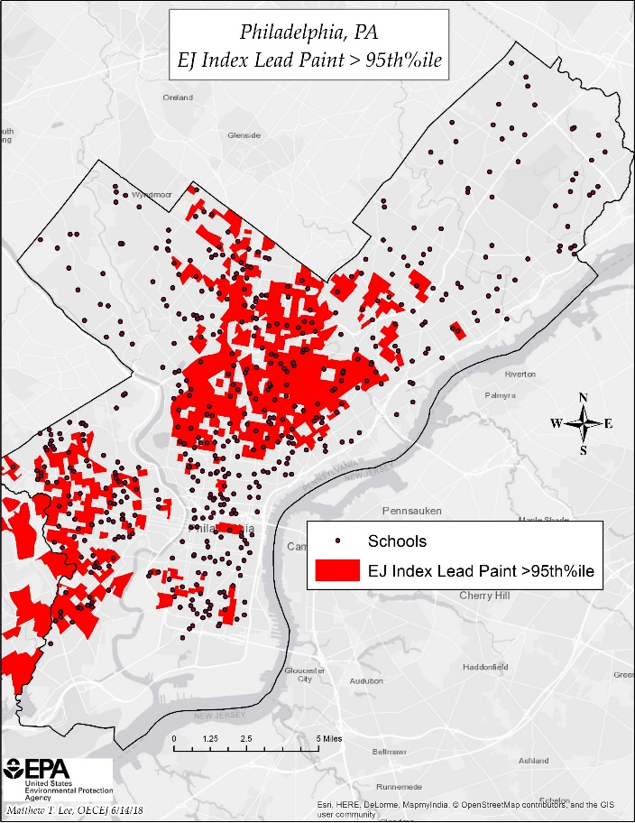
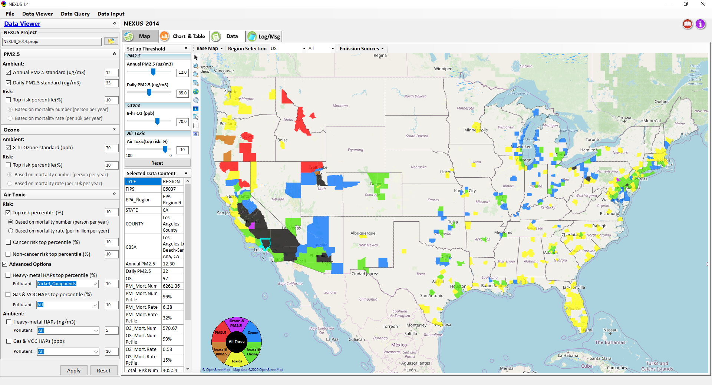
Data Driven Screening Tools
Data driven EJ screening tools either exist (i.e., EJ Screen/OEJ) or are in development (i.e., NEXUS, C. Jang/AQMG)
Biden EO specifies “the development of a Climate and Environmental Justice Screening Tool, building off EPA’s EJSCREEN, to identify disadvantaged communities, support the Justice40 Initiative, and inform equitable decision making across the federal government”
AQAD can assist in the effort to enhance these tools to reflect climate vulnerability thereby allowing for development of strategies and programs seeking to protect public and environmental health in areas with elevated risk for climate change impacts by identifying compounding vulnerabilities across the Climate-EJ space
Addition of policy-relevant data layers / new indices
Enhanced proximity analysis capabilities
Geographically explicit screening tools also help connect across scales, e.g., characterizing impacts of national climate strategies at the local/community level
EJ Screen (OEJ)
NEXUS Tool
(slide from C. Jang)

Slide 13
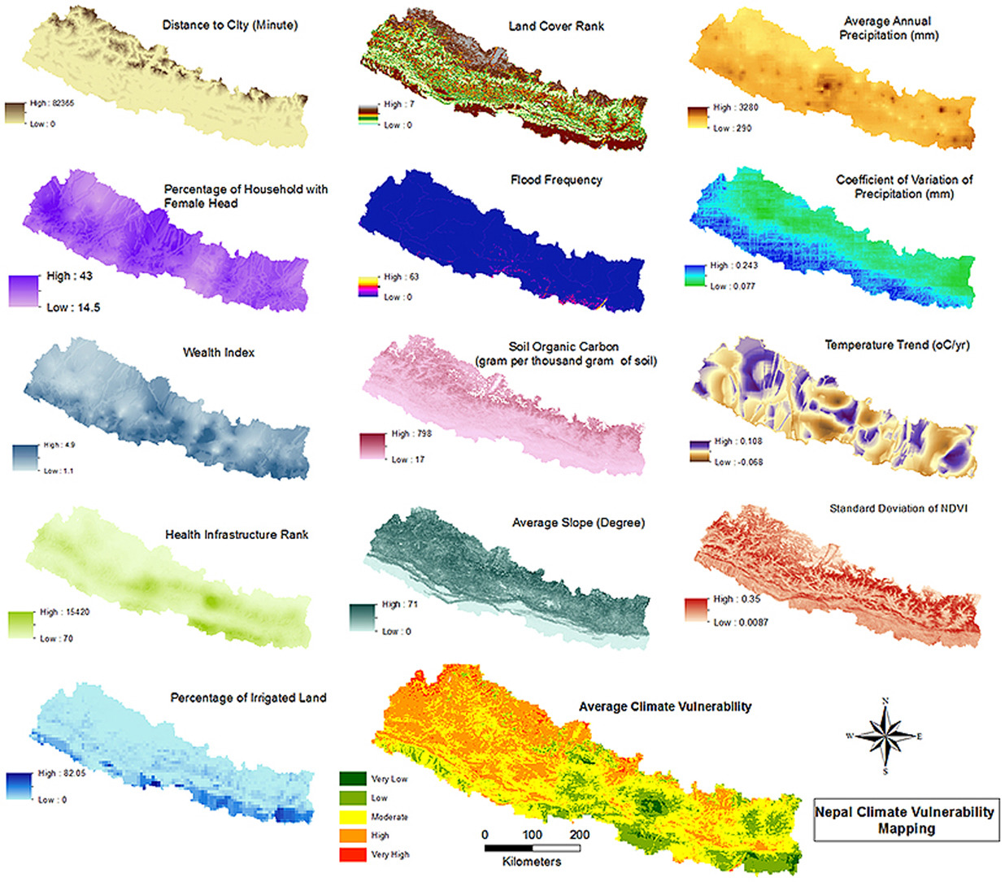
Elements of Climate Vulnerability
Components of climate vulnerability include environmental, physical, social, and economic factors (United Nations 2004 Report)
We can begin to characterize environmental and physical vulnerability with existing data sets and modeling tools
Many components contributing to underlying vulnerability are not explicitly tied to specific areas or environmental factors, but rather are intrinsic to broader socio-economic systems (e.g. food security, income and education, etc)
Opportunities for collaboration with HEID, ORD, OAP, and other partners with expertise in identifying and incorporating these elements of climate vulnerability
Potential overlap with EJ vulnerabilities
Mainali and Pricope 2017

Slide 14
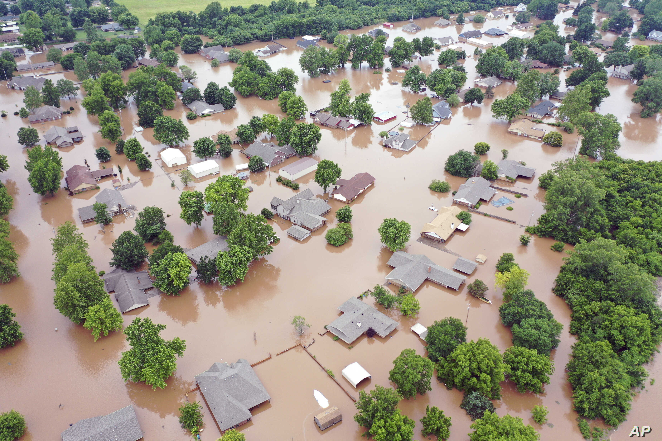
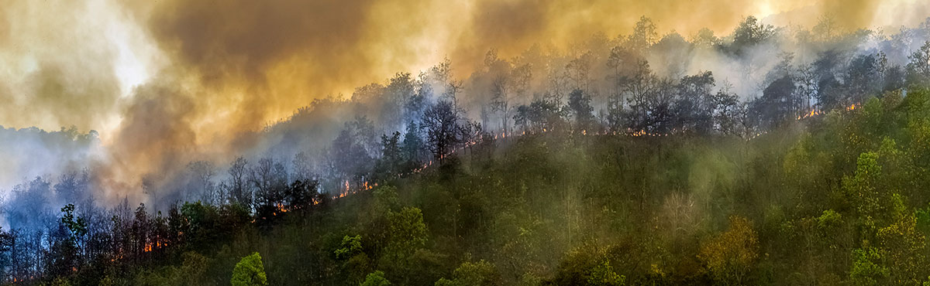
Geospatial Components of Climate Vulnerability
Geographic/Demographic Indicators
Low-lying/coastal
High elevation
Dense Urban
Extremely rural
Environmental Indicators*
Wildfire smoke prevalence
Precipitation (high and low)
Temperature stress (hot and cold)
Changes in meteorology (T, Precip, etc)
* These types of layers can be difficult to quantify directly without additional tools, e.g. meteorological or air quality models
Image credit: Associated Press
Image credit: cdc.gov
References: IPCC, NCA4

Slide 15
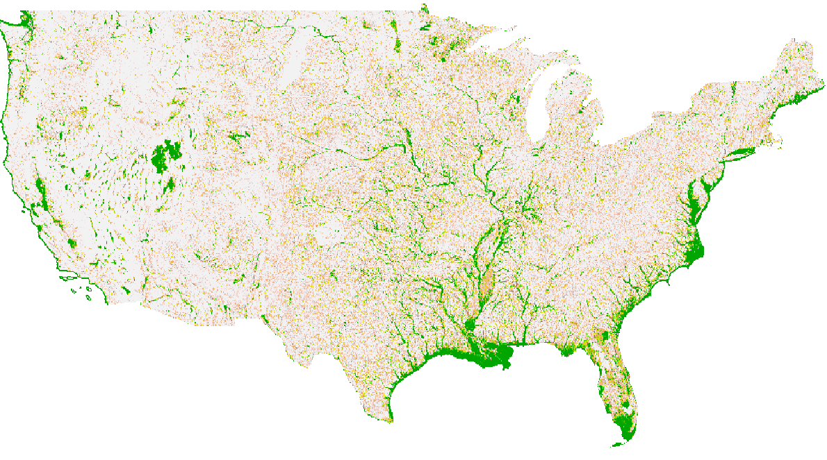
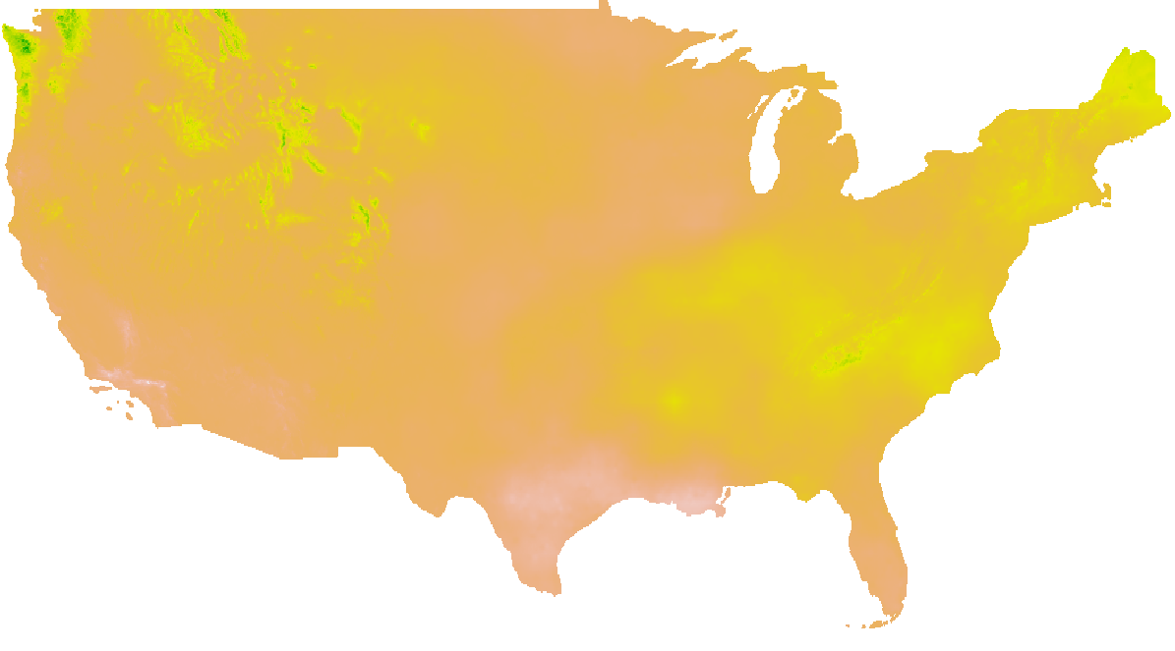
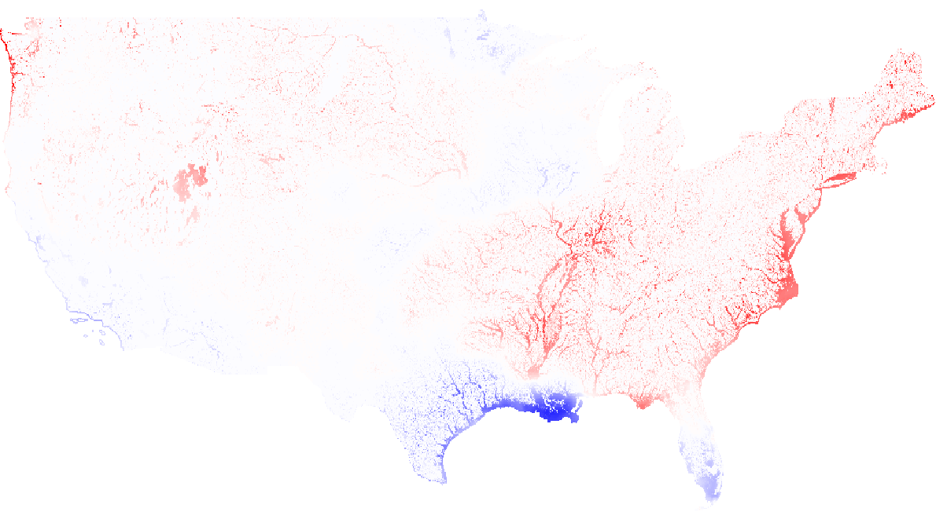
Addition of Policy-Relevant Data Layers / Indices
Floodplain
Projected Change in Precipitation by 2050
EnviroAtlas
NASA/NEX project
Combined Climate Indicators

Slide 16
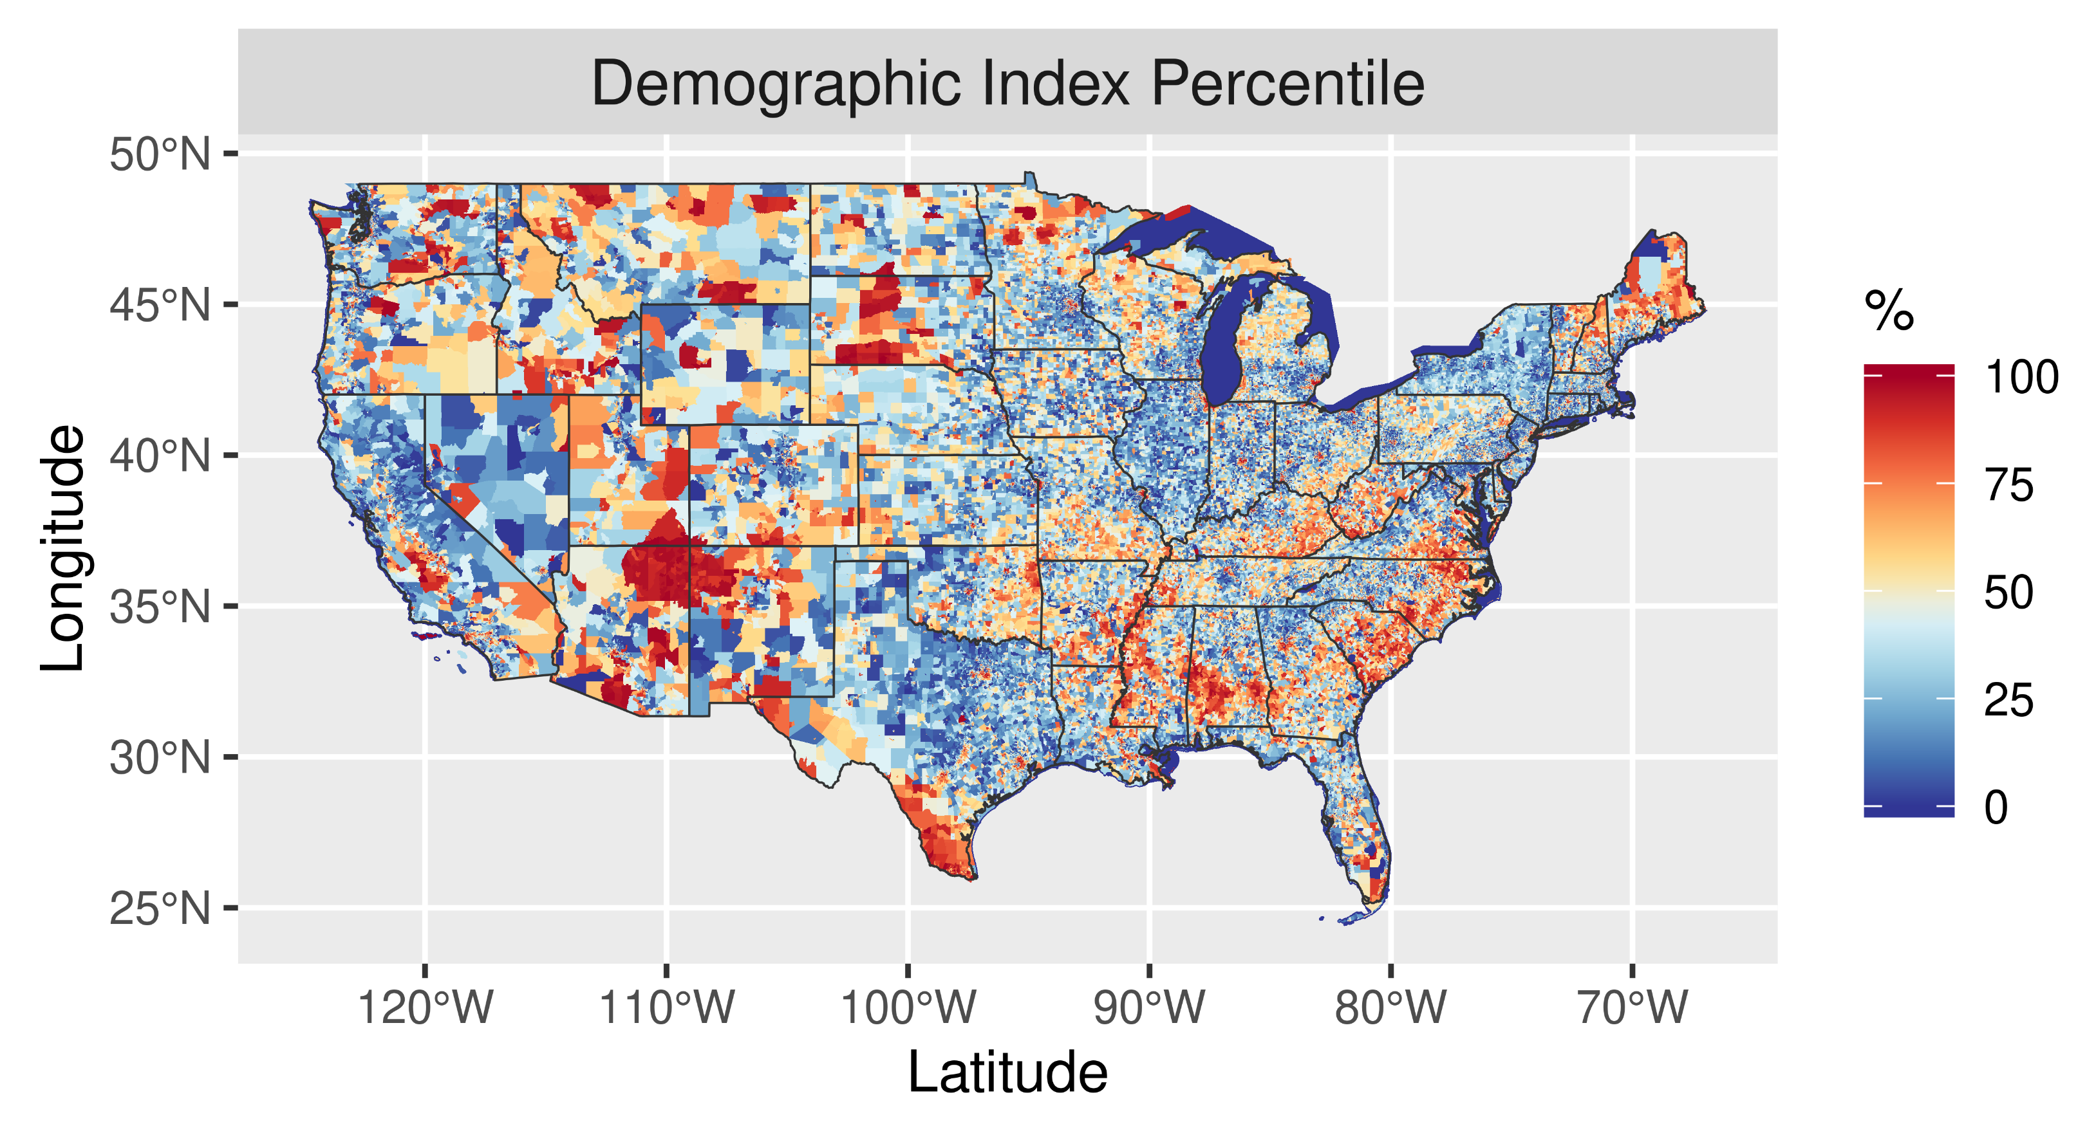
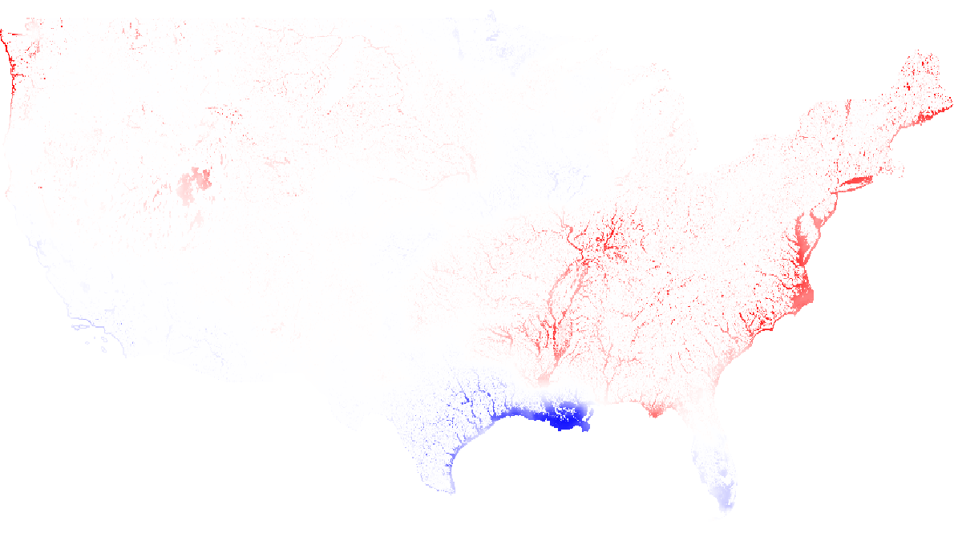
Addition of Policy-Relevant Data Layers / Indices
Combined Climate Indicators
Figure courtesy of J. Kelly

Slide 17
Addition of Policy-Relevant Data Layers / Indices
Combined Climate Indicators
Figure courtesy of J. Kelly

Slide 18
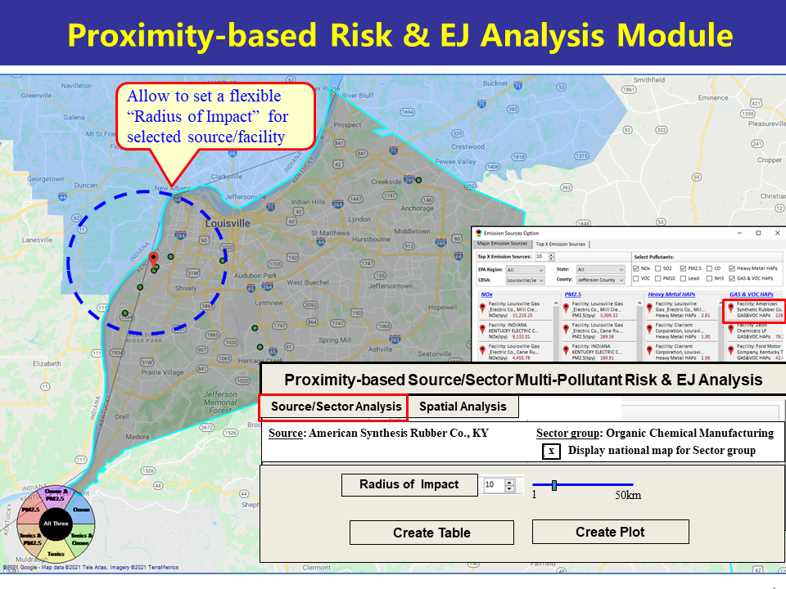
Climate Considerations to Enhance Screening Proximity Analysis
Simultaneously incorporating data layers with information relevant for multipollutant, EJ, and climate considerations offers the opportunity to perform multidimensional screening for risks and vulnerabilities across populations and in different locations
Image courtesy of C. Jang/NEXUS

Slide 19
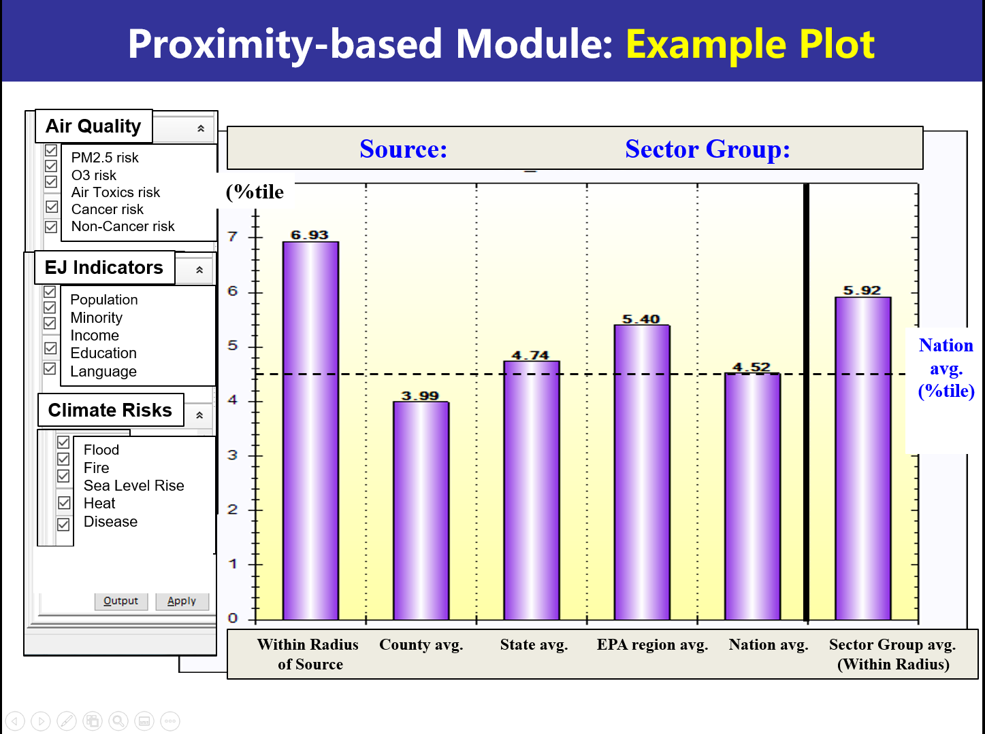
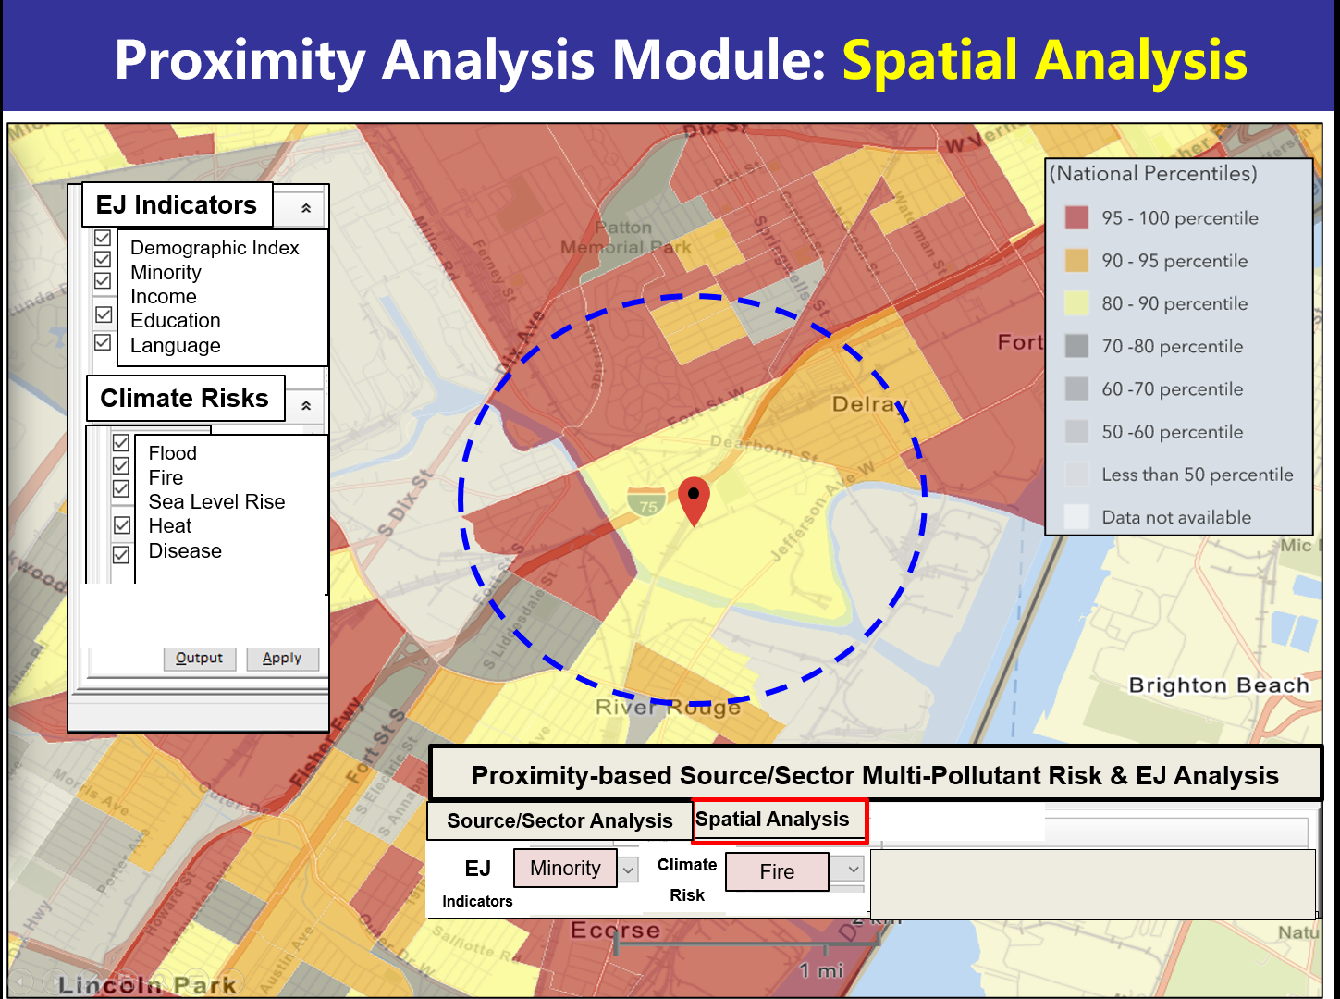
Enhanced Screening Proximity Analysis in NEXUS
Image courtesy of C. Jang/NEXUS

Slide 20
Enhanced Screening Proximity Analysis in NEXUS (cont)
 | Source Name: American Synthesis Rubber Co., Louisville, KY Sector Group Name: Organic Chemical Manufacturing
 |  | Within Radius of Source | County Avg. | State Avg. | EPA Region Avg. | Nation Avg. | Sector Group (within radius) National avg. | Sector Group (within radius) Top 25 MSAs
Population total |  | x,xxx | xx,xxx | xxx,xxx | xxx,xxx | 317,xxx,xxx | xxx,xxx | xxx,xxx
PM2.5 risk (%tile) |  | x% | x% | x% | x% | x% | x% | x%
Ozone risk (%tile) |  | x% | x% | x% | x% | x% | x% | x%
Air Toxics: Cancer risk (%tile) |  | x% | x% | x% | x% | x% | x% | x%
Climate risks: Flood (%tile) |  | x% | x% | x% | x% | x% | x% | x%
Sea level rise (%tile) |  | x% | x% | x% | x% | x% | x% | x%
Fire (%tile) |  | x% | x% | x% | x% | x% | x% | x%
Disease (%tile) |  | x% | x% | x% | x% | x% | x% | x%
EJ: Minority group (%tile) |  | x% | x% | x% | x% | x% | x% | x%
Low-income group (%tile) |  | x% | x% | x% | x% | x% | x% | x%
Demographic Index (%tile) |  | x% | x% | x% | x% | x% | x% | x%
Linguistic Isolation (%tile) |  | x% | x% | x% | x% | x% |  | x%
Example Table:

Slide 21
Potential Questions Related to AQ-Climate Interactions
What emission sectors contribute significantly to both greenhouse gases and local air pollution issues? How feasible are specific combinations of emission control strategies relevant for these sectors? What are the AQ impacts of potential strategies?
We can use NEXUS and our sector-based AQ modeling to identify source/sector contributors and assess impacts for risk and exposure assessments
How robust are future AQ projections, and how well do we understand future responses in AQ to anticipated emissions changes in the face of climate change?
We collaborate with ORD and others to link energy scenario projections with AQ modeling and improve characterization of meteorology, emissions, and chemistry in our future AQ projections
How will future changes in climate/meteorology affect 1) exposure and 2) susceptibility to air pollution?
We have opportunities here for collaboration with HEID and ORD, e.g., provide meteorological data to inform HEID project to assess change in susceptibility due to temperature changes.
What are the costs/benefits of potential AQ-climate strategies (e.g., changes in energy policy)?
We can leverage our reduced form modeling effort (i.e., FAST tool) in collaboration with HEID, OAP and ORD
What is EPA guidance regarding the use of climate and energy projections in SIPs and related modeling demonstrations under the Clean Air Act or NEPA?
Engaging in internal discussions within AQMG and will expand to include Regions, AQPD, and others as implementation program changes and goals become more defined in near future.

Slide 22
Linking Energy Scenario Projections with Air Quality Predictions
Collaborate with ORD and other partners to apply tools like GCAM-USA with the purpose of:
Assessing future air quality under broad energy policy options at regional and national scales
Understanding when/where such policies have significant air quality impacts
These tools could be applied to both 1) produce energy emission scenarios given specific policy plans, and (2) inform the development of policy options based on modeled feasibility of specific scenario components (e.g. what resources would be required to implement the large-scale infrastructure development needed for widespread use of electric vehicles)
Work with ORD/other partners to rigorously evaluate assumptions and outputs from GCAM-USA to assess relevance for policy use
Current discussions with ORD on how to link GCAM-USA with in-house OAQPS tools (e.g. FAST-CE) to estimate air quality endpoints relevant for benefits calculations

Slide 23
Improving characterization of future AQ projections
Variability and long-term changes in meteorological patterns
Long range transport
Precipitation
Changes in cloud cover → photolysis rates relevant for ozone
Variability and long-term changes in emissions:
Climate/Land Use driven:
Wildfires
Dust
Biogenics
Fertilizer application
Residential wood combustion
Policy driven:
Energy scenarios
Mobile emissions
Global emissions → wildfires, global energy demand, methane, etc.
Changes in chemistry-climate interactions:
Methane
Aerosol-cloud feedbacks
Wintertime aerosol formation chemistry

Slide 24
Improving characterization of future AQ projections
Variability and long-term changes in meteorological patterns
Long range transport
Precipitation
Changes in cloud cover → photolysis rates relevant for ozone
Variability and long-term changes in emissions:
Climate/Land Use driven:
Wildfires
Dust
Biogenics
Fertilizer application
Residential wood combustion
Policy driven:
Energy scenarios
Mobile emissions
Global emissions → wildfires, global energy demand, methane, etc.
Changes in chemistry-climate interactions:
Methane
Aerosol-cloud feedbacks
Wintertime aerosol formation chemistry

Slide 25
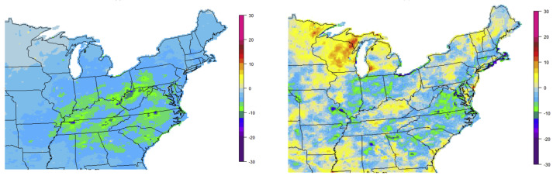
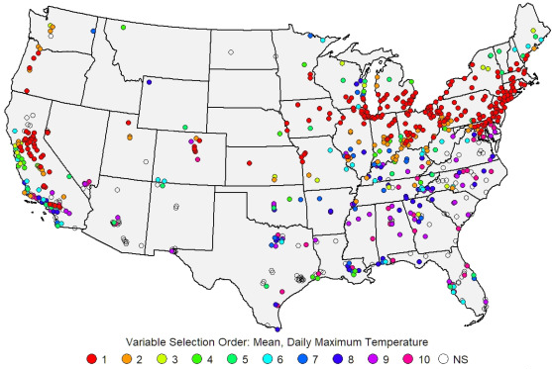
Influence of Meteorology on Design Value Predictions
Previous work by K. Foley/ORD conducted dynamic evaluation of ozone in the Northeast U.S. across 2002-2005 met years by scaling emissions from EGUs and mobile sources
Recent work by B. Wells/AQAG used statistical methods to link peak ozone levels with key meteorological parameters by region
Build on previous analyses by performing sensitivity simulations combining meteorology and emission years to better characterize the influence of meteorology on model-predicted DV calculations for different parts of the country (currently in progress through Global Transport budget item due to relevance for characterization of background ozone/PM)
Synthesis across these and other efforts could help answer questions related to stationarity assumptions in DV projections and how these relationships may (or may not) be expected to evolve in a future climate
ΔOzone: Emissions
ΔOzone: Meteorology
Foley et al., 2015
Wells et al., 2021

Slide 26
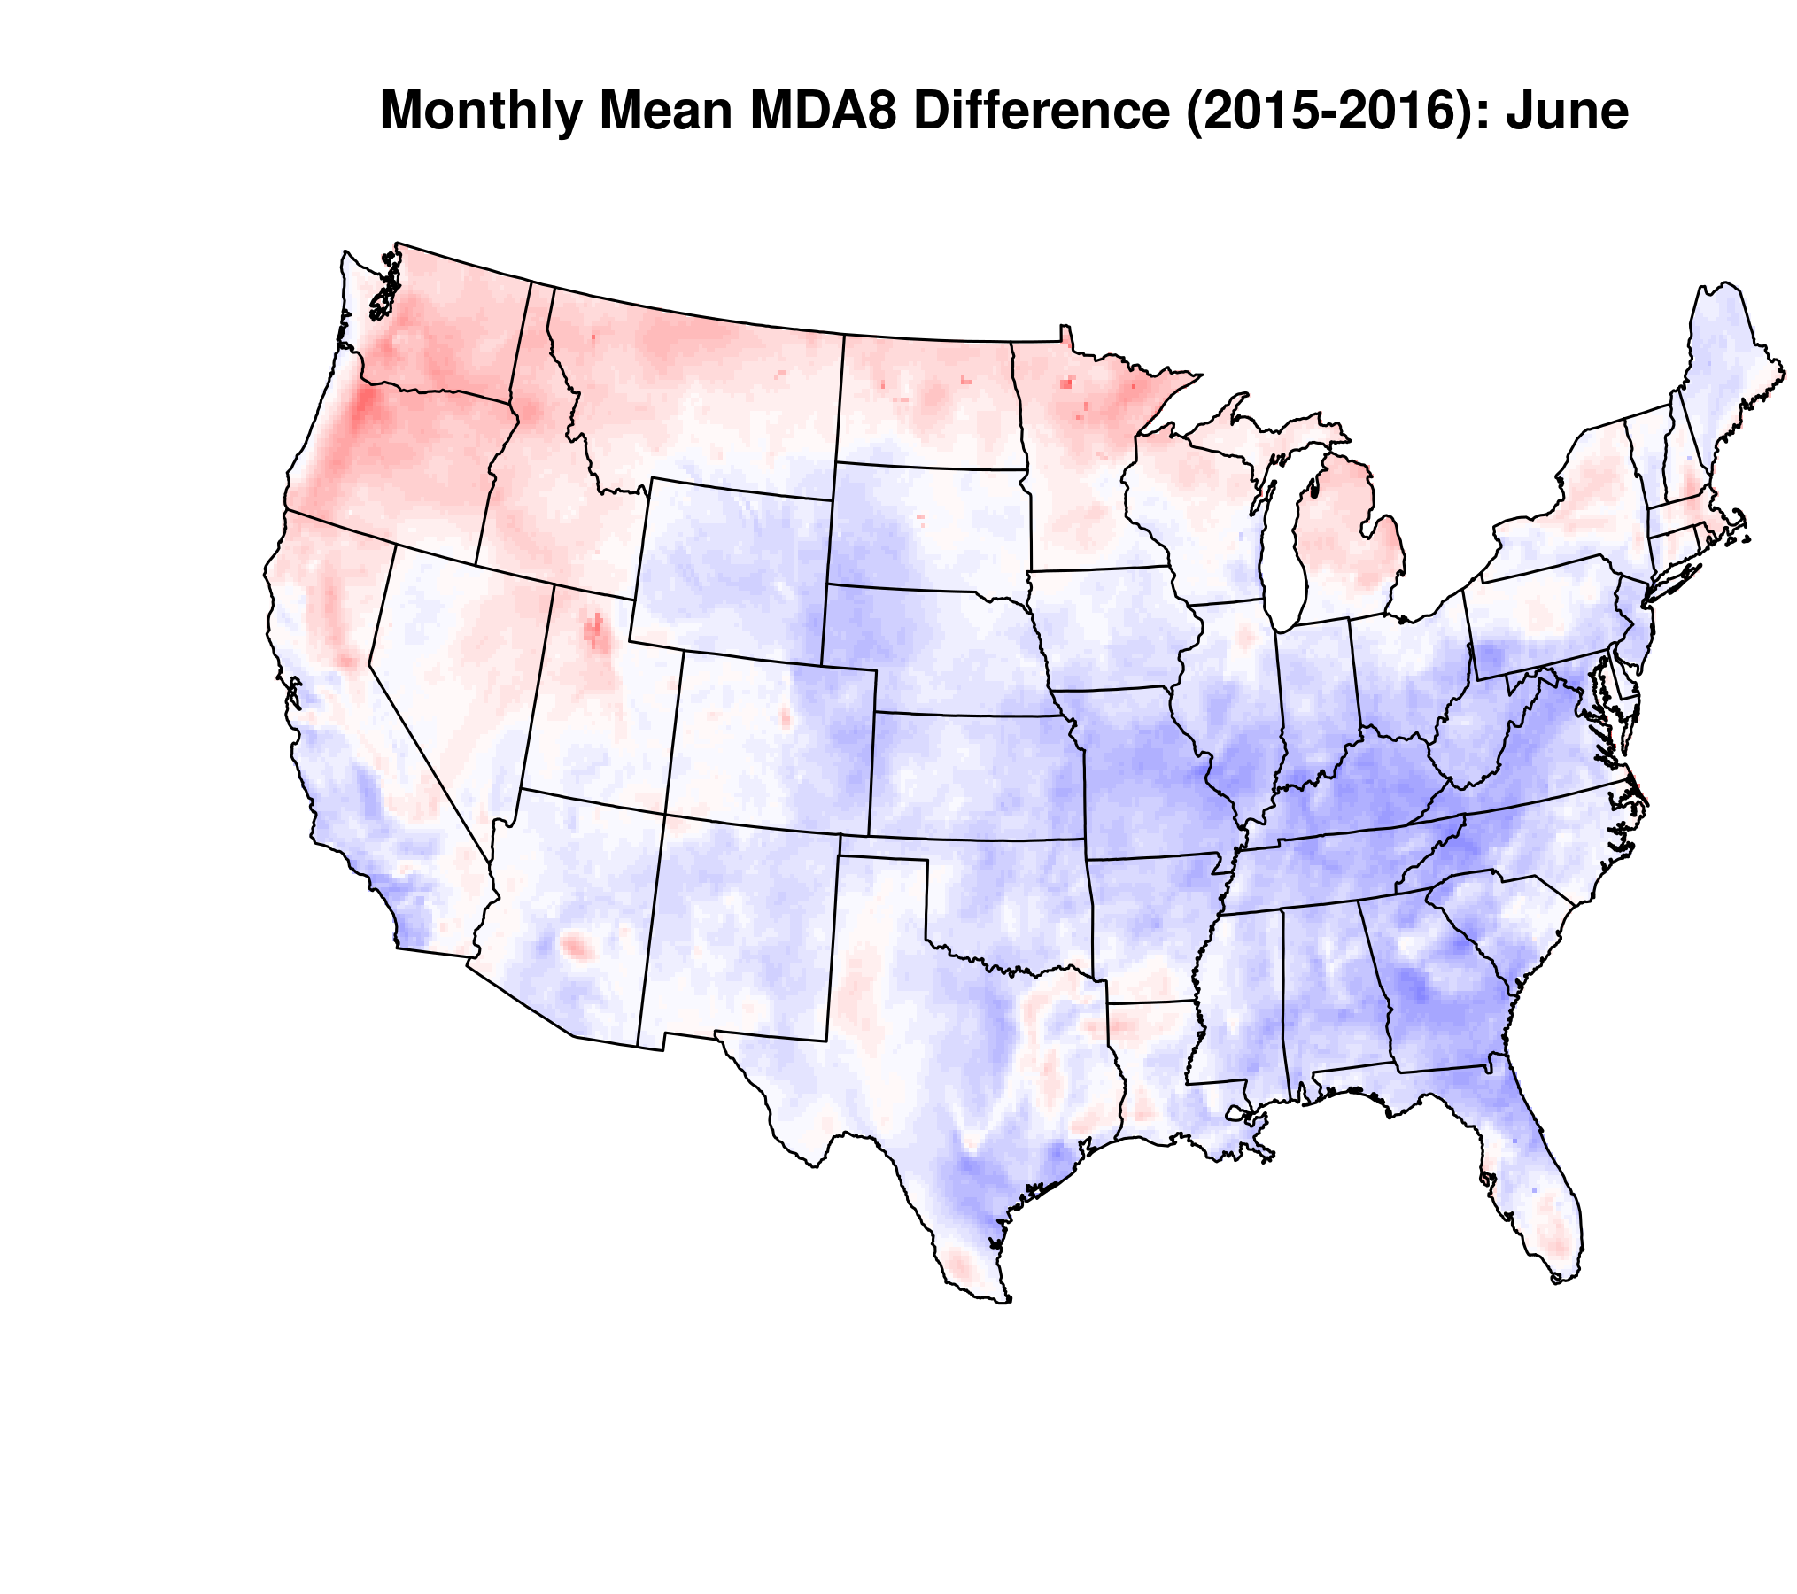
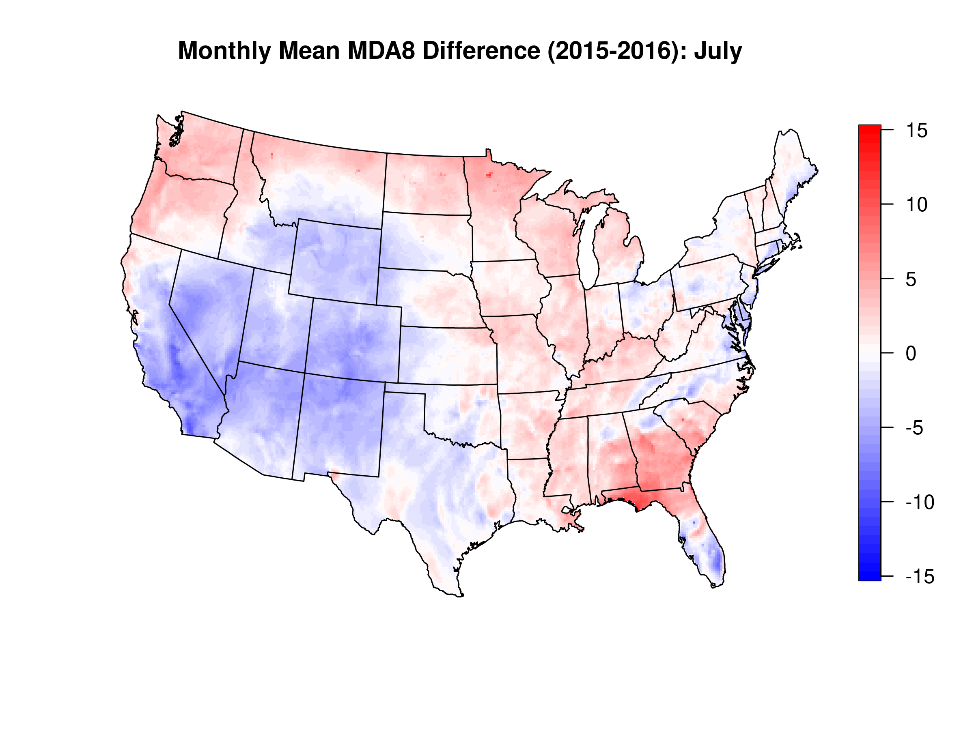
Influence of Meteorology on Design Value Predictions
Preliminary Results:
ppb
Currently testing 2016v1 emissions platform with available meteorological configurations for June/July 2014-2018

Slide 27
Improving characterization of future AQ projections
Variability and long-term changes in meteorological patterns
Long range transport
Precipitation
Changes in cloud cover → photolysis rates relevant for ozone
Variability and long-term changes in emissions:
Climate/Land Use driven:
Wildfires
Dust
Biogenics
Fertilizer application
Residential wood combustion
Policy driven:
Energy scenarios
Mobile emissions
Global emissions → wildfires, global energy demand, methane, etc.
Changes in chemistry-climate interactions:
Methane
Aerosol-cloud feedbacks
Wintertime aerosol formation chemistry

Slide 28
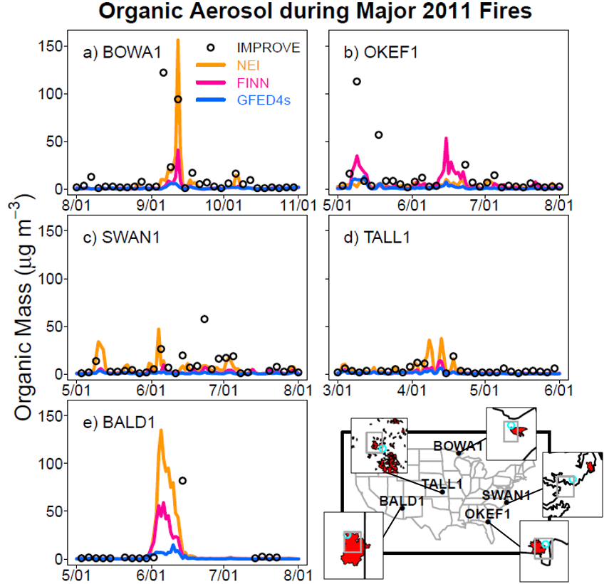
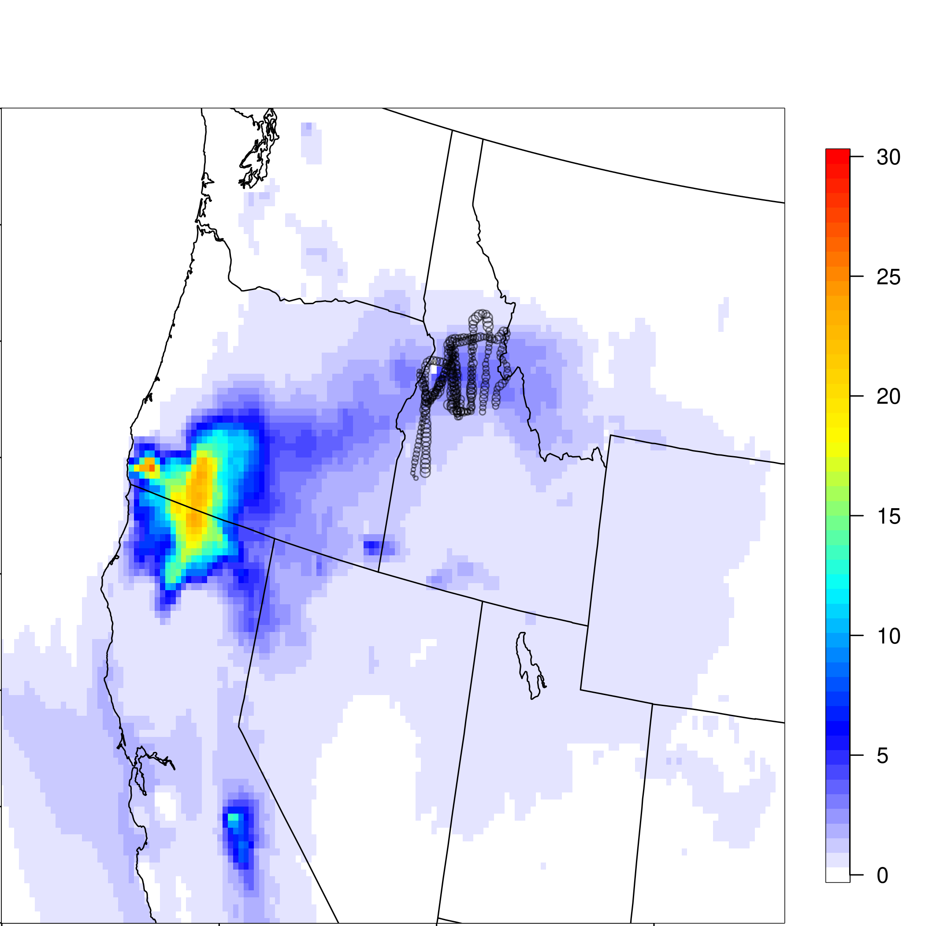
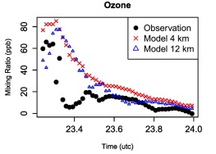
Improving model characterization of smoke informs projections
Evaluation of CMAQ during WECAN
Baker et al., 2018
Koplitz and Baker, ongoing
Koplitz et al., 2018
We are continually evaluating the representation of wildland fire smoke plumes in CMAQ and CAMx to improve model representation of emissions, chemistry, and transport during these extreme events. These evaluations require frequent collaboration with EIAG, ORD, Regions, and external partners.

Slide 29
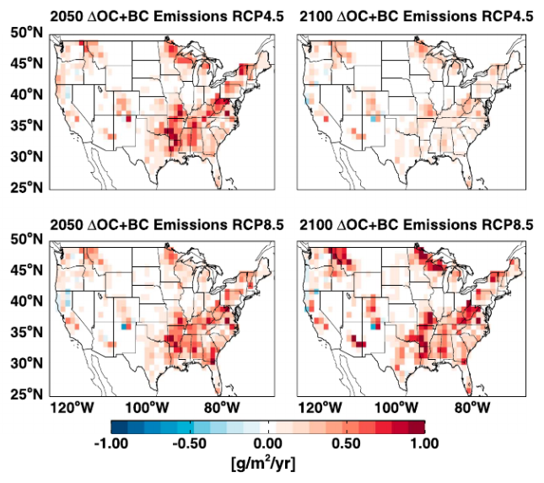
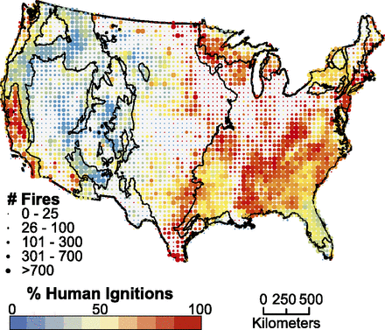
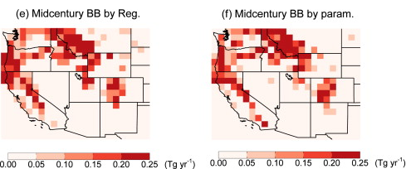
Previous Projections Lack Linkages with Land Management
“Forests are actively managed, and the frequency and severity of wildfire occurrence in the future will not be determined solely by climate factors. Humans affect fire activity in many ways, including increasing ignitions and conducting controlled burns and fire suppression. Forest management decisions may outweigh the impacts of climate change on both forest ecosystems and air quality.” - 4th National Climate Assessment
Historical Fires by Ignition Type
Yue et al., 2013
Balch et al., 2017
Ford et al., 2018
How will future land management decisions affect wildfire occurrence and therefore future smoke prevalence?

Slide 30
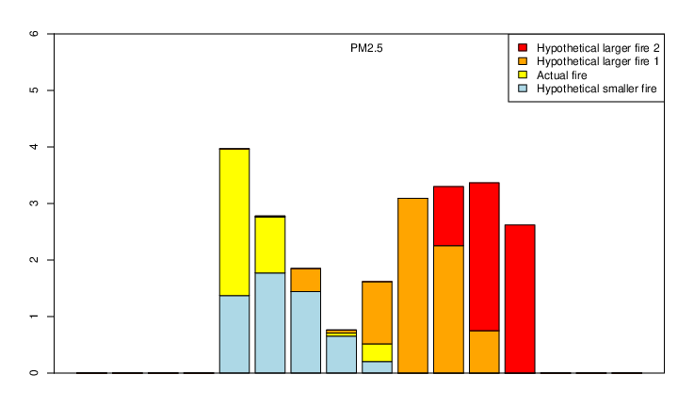
Wildfire and prescribed burn air quality tradeoffs
K. Baker, Modeling Lead on Wildland Fire Leadership Council Project with ORD and HEID
Evaluate air quality tradeoffs of controlled and uncontrolled fires by developing hypothetical land management alternatives for two actual wildfires that occurred, use CMAQ to model compare PM_{2.5} and O₃ produced across scenarios
Partners include EIAG, ORD, Regional Offices, USFS, DOI, BLM
Also working with Sadia Afrin, Fernando Garcia-Menendez at NC State
Actual and hypothetical case study fires Aug 2018
Partnerships and technical approaches developed through these ongoing efforts could offer a path forward for quantitatively characterizing future changes wildfire air quality under different scenarios of land management
(ug/m3)
Figure from K. Baker, WFLC report (draft)

Slide 31
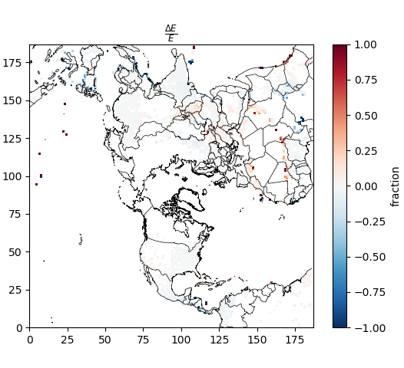
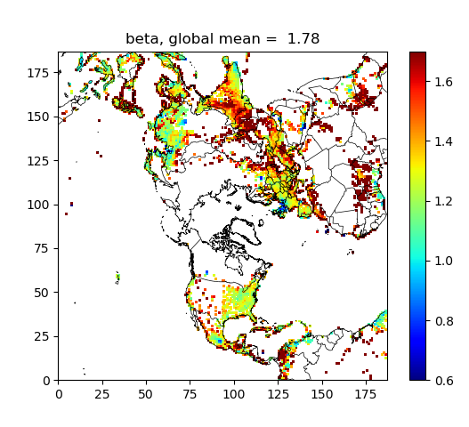
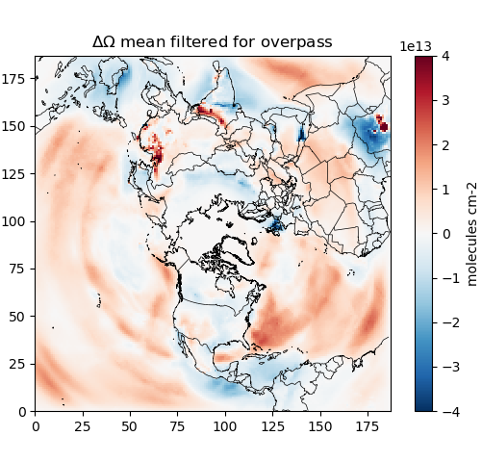
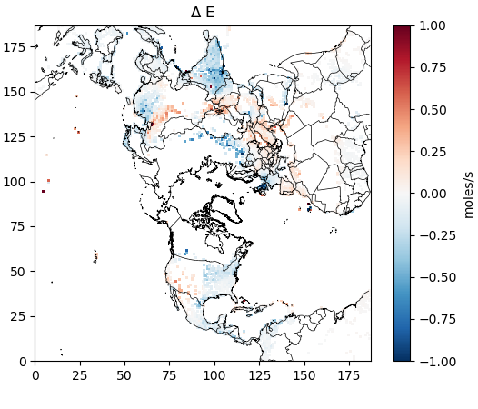
Changing Global Emissions in Response to Evolving Air Quality, Energy and Climate Policies
James East (ORISE Fellow working with B. Henderson, S. Napolenok (ORD) and S. Koplitz)
Developing in-house capacity for data assimilation (as presented to AQAD on 9/24/20)
Possible applications include constraints of global emission fluxes
(Figures from J. East, preliminary results)

Slide 32
Improving characterization of future AQ projections
Variability and long-term changes in meteorological patterns
Long range transport
Precipitation
Changes in cloud cover → photolysis rates relevant for ozone
Variability and long-term changes in emissions:
Climate/Land Use driven:
Wildfires
Dust
Biogenics
Fertilizer application
Residential wood combustion
Policy driven:
Energy scenarios
Mobile emissions
Global emissions → wildfires, global energy demand, methane, etc.
Changes in chemistry-climate interactions:
Methane
Aerosol-cloud feedbacks
Wintertime aerosol formation chemistry

Slide 33
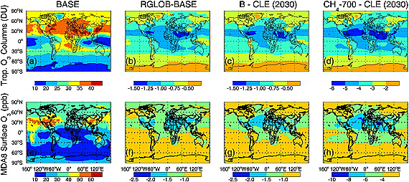
Assessing Air Quality Impacts of Methane Chemistry
Methane affects oxidant budgets and therefore the atmospheric chemical environment relevant for formation of other pollutions (e.g. ozone)
How can we better characterize/bound the impacts of methane chemistry assumptions in existing modeling tools/chemical mechanisms?
How can we improve the characterization of methane in model-ready emission inventories?
How might changes in methane concentrations and other species affecting atmospheric oxidants (e.g. NO_{x}) due to changes in climate/energy policies further affect pollutant distributions?
Fiore et al., 2008

Slide 34
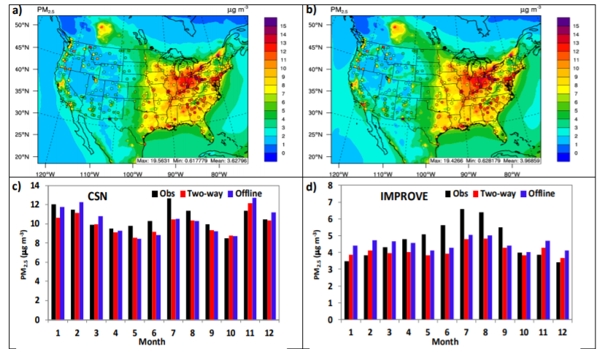
Investigate aerosol feedbacks in coupled air quality models
Coupled models are very computationally expensive and may not generally make a big enough difference to justify the additional computational expense of running routinely for OAQPS purposes
However, these systems could offer an opportunity to investigate in more detail the interactions between changes in pollutant concentrations and regional/national climate
Such analyses could inform cost/benefit assessments of individual policy options or broader strategy options in the context of climate change
K. Wang, … J. Pleim, R. Mathur, J. Kelly et al., 2020
Notes:
E.g. A more thorough investigation of how direct aerosol radiative forcing is being represented/capture in AQ models, what are the implications of changing PM distributions for chemistry-climate feedbacks
Specifically relevant for OAQPS programs – Regional Haze/other visibility cost/benefits

Slide 35
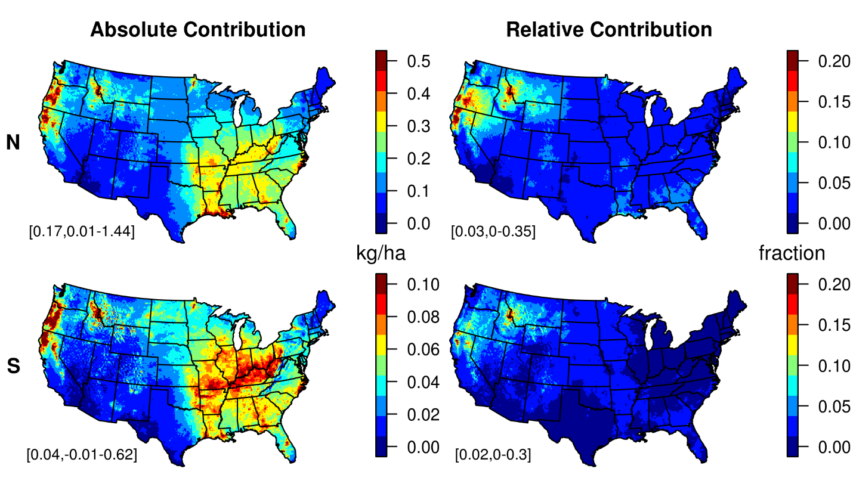
Consideration of Ecosystem Impacts
Relevant for consideration of secondary NAAQS standards
How will future climate change affect sensitive ecosystems also experiencing air pollution effects?
How will changes in emissions under different energy scenarios and climate strategies impact ecosystems?
How will other strategies implemented to combat the consequences of climate change impact ecosystems? E.g., nitrogen impacts from increased prescribed burning to offset increased wildfire severity
Contribution of Wildland Fire Emissions to Nitrogen Deposition
Koplitz et al., 2020 (work done while in ORD)

Slide 36

Connecting to Other In-House Activities/Capabilities
AQAD
Future emissions projections (EIAG)
GHG monitoring (AAMG)
Emission control technologies (MTG)
DV calculations/met adjusted DVs (AQAG)
Future air quality projections (AQMG)
HEID
Identifying vulnerabilities at national to community scales (e.g. Fann et al)
Emission control costs/feasibility
Benmap (co-benefits)
ORD
GCAM USA/energy scenario modeling
Long term time series (EQUATES)
Downscaled climate modeling (e.g. Nolte et al.)
EnviroAtlas layers/team (screening tool development)
OAP
GHG inventory
CIRA climate modeling effort

