Slide 1
Outreach and Information Division Community & Tribal Programs Group
Stakeholder Outreach and Tribal Consultation
Overview
January 27, 2021

Slide 2
Statutory Requirements and Executive Orders
EPA is required to engage with tribes, small businesses and environmental justice (EJ) communities on regulatory and other actions that may impact them
Administrative Procedures and Clean Air Acts
Guarantees public engagement
The Clean Air Act Authority
Section 301(d): Tribal authority
Section 507: Small Business (SB) program requirements
Executive Orders
E.O. 13175: Consultation and Coordination with Tribal Governments
E.O. 12898: Federal Actions to Address Environmental Justice in Minority Populations and Low-Income Populations

Slide 3
OID’s Community and Tribal Programs Group (CTPG) Focus Areas
Our Key Stakeholders
Environmental Justice (EJ) Communities
Low-income, people of color and indigenous peoples
Small Businesses
Small Business Environmental Assistance Program (SBEAP) – State Representatives
Small Business Trade Associations
Industries
Compliance Advisory Panel (CAP)
Small Business Administration (SBA)
Federally Recognized Tribes
Sovereign Nations (Government-to-Government Relationship)
Federal Trust Responsibility
574 tribes of which 229 tribes are in Alaska

Slide 4
Environmental Justice
Executive Order 12898 applies to rules, policies, and guidance that have identified and addressed disproportionately high and adverse human health or environmental effects on minority populations and low-income populations (to include indigenous peoples and tribes as relevant populations).
EPA defines Environmental Justice (EJ) as "the fair treatment and meaningful involvement of all people regardless of race, color, national origin or income with respect to the development, implementation and enforcement of environmental laws, regulations and policies.“
“Fair Treatment” means that no group of people should bear a disproportionate burden of environmental harms and risks, including those resulting from the negative environmental consequences of industrial, governmental and commercial operations or programs and policies.
“Meaningful Involvement” means that:
potentially affected community members have an appropriate opportunity to participate in decisions about a proposed activity that will affect their environment and/or health;
the public's contribution can influence the regulatory agency's decision;
the concerns of all participants involved will be considered in the decision-making process; and
the rule writers and decision-makers seek out and facilitate the involvement of those potentially affected.
EPA’s Guidance on Considering Environmental Justice During the Development of Regulatory Actions (EJ ADP Guide) and EPA’s Technical Guidance for Assessing Environmental Justice in Regulatory Analysis (EJ Technical Guidance) provide guidance on considering and conducting analyses to evaluate potential EJ concerns during the development of regulatory actions.

Slide 5
Small Business
OAQPS Small Business Program: Rhonda Wright, Senior Staff Lead
Serves as a liaison on all small business-related matters
Develops OAQPS’ Small Business Program Plan
Supports rule writers through the rule development process
Ensure there's meaningful engagement
Assist on Small Business Advocacy Review (SBAR) Panel process, which includes assisting on initiating the SBAR panel process, and development of materials (e.g., SBAR panel schedule, informal/formal notification announcements, news release, etc.)
Statutory Mandate for a Small Business Assistance Program
Section 507 of the Clean Air Act (CAA) requires the EPA Administrator to establish a small business stationary source technical and environmental compliance assistance program
Vision
The OAQPS Small Business Program will serve as a central resource for States, EPA Regions and small businesses to obtain information, tools and training about OAQPS rules that impact small businesses. The Program goals will consist of:
Building strong working relationships between OAQPS and small businesses through fostering communication and information sharing on air regulatory actions
Building an infrastructure to re-establish and support OAQPS’ small business program
Developing products and providing technical assistance to implement rule compliance

Slide 6
Small Business Partners
Regional Air Small Business Liaisons
Identify EPA Regional needs for small business engagement.
Participate in quarterly calls with EPA Headquarters (i.e., OAQPS, EPA’s Ombudsman’s office) to coordinate on small business-related topics.
Provide support in the development of compliance assistance tools for small businesses, where appropriate (e.g., RegNav).
Serve as a point of contact for the state’s small business environmental assistance program representatives.
State’s Small Business Environmental Assistance Program (SBEAPs) Representatives will:
Identify needs for small business engagement.
Provide input on training priorities for OAQPS regulatory actions with small business implications. Participate on monthly calls and annual meetings/conferences with OAQPS Small Business Liaison.
Provide support in the development of compliance assistance tools for small businesses, where appropriate (e.g., RegNav).
Additional Partners: EPA's Ombudsman, SBA, OGC, OP, OECA

Slide 7
Federally Recognized Tribes
Consultation
1984 EPA Policy for the Administration of Environmental Programs on Indian Reservations ― Key emphasis is to give special consideration to tribal interests in making Agency policy and ensure the close involvement of tribal governments in making decisions and managing environmental programs affecting Indian country. Remains the cornerstone of EPA’s Tribal Program and was reaffirmed by the Administrator in 2019
Executive Order 13175 ― Policies that have tribal implications (regulations, legislative comments or proposed legislation, or actions) that have substantial direct effects on one or more Indian tribes, or on the relationship between the federal government and Indian tribes, or on the distribution of power and responsibilities between the federal government and Indian tribes
2009 Presidential Memorandum ― Emphasized commitment to “regular and meaningful” consultation and collaboration with tribal officials in policy decisions that have tribal implications through complete and consistent implementation of EO 13175
2011 EPA Policy on Consultation and Coordination with Indian Tribe – Sets a broad standard for when EPA should consider consulting with federally recognized tribal governments based on EO 13175 and the 1984 Indian Policy
OAR Handbook for Interacting with Tribal Governments ― Provides specificity and guidance to OAR staff and managers on how to conduct outreach and government-to-government consultation under the general umbrella of the Agency’s Policy. *Scheduled for update February 2021

Slide 8
Federally Recognized Tribes
Tribal Outreach
Meaningful and timely engagement – preferably pre-proposal
Tribal Consultation
Between tribal leader(s) or designated tribal representative and EPA division director or higher-level manager
Considerations for Working with Tribes
Each tribe is unique and differs in leadership, governmental and economic infrastructure, and culture
Opportunity to listen and gather information from tribes (i.e., perspectives, technical information).Usually with Tribal Environmental Professionals (TEPs)
Outreach activities (i.e., webinars, informational calls, tribal partnership calls, regional tribal calls, and so forth)
Is a government-to-government exchange of information and ideas
Held through teleconference, video-conference or face-to-face meetings
Most Tribal Environmental Professionals (TEPs) work on all aspects of environmental issues (air, water, waste, etc.)
Consultation is not a one-time event, but usually on-going
Perception of encroachment on tribal sovereignty is one of the most significant issues for tribes
Many are short staffed, may not have a staff person dedicated to environmental issues, or only have a part-time person or one staff member.
May be with one tribe or a group consultation
In addition to environmental issues, tribes are also concerned about poverty, unemployment, economic development, education and health issues

Slide 9
RULE DEVELOPMENT

Slide 10
Considerations When Supporting the Rule Development
Identify
Identify the stakeholders and their potential concerns and reaction regarding the rule.
Address
Address how this rule may affect and/or impact stakeholders.
Identify
Identify the appropriate Executive Order template to use and tailor it to the specific rulemaking.
Identify what type of stakeholder outreach/engagement should be done during the rulemaking process.
Identify

Slide 11
CTPG’s Engagement During the Rulemaking Process
Pre-proposal:
CTPG participates in rulemaking workgroup, when needed:
Reviews rules through a triage process on upcoming OAQPS actions to assess the potential impact to our stakeholders.
If impacts are identified, a representative is assigned to the action.
Impacts are determined by screening analysis, prior rulemakings, and stakeholder concerns,
Participates in the proposal development, in coordination with the rule team; and
Identifies and coordinates appropriate stakeholders’ outreach (e.g., informational calls, roundtable discussions, webinars, etc.)
Helps to develop outreach materials to engage meaningfully with the impacted stakeholders (e.g., outreach strategy on 1-BP and OSWI).
If a Small Business Advocacy Review (SBAR) Panel is needed, support rule writer with developing outreach panel materials, and assist with panel meetings, etc. (e.g., EtO)

Slide 12
CTPG’s Engagement During the Rulemaking Process
Proposal
After reviewing the results from the EJSCREEN/proximity analysis and at stakeholders' requests, CTPG does the following:
Notifies impacted stakeholders of the proposed rule.
Works with federal/state small business offices on outreach.
Coordinates outreach activities for communities, tribes, and small businesses (e.g., webinars, informational meetings, calls, etc.).
Coordinate consultation activities.

Slide 13
CTPG’s Engagement During the Rulemaking Process
Proposal: Consultation Process
If the proximity analysis shows that tribal land is within 50 miles of a source, then consultation is offered to the impacted Tribe
Roles and Responsibilities
Rule Lead: Prepares tribal consultation letter. The CTPG tribal contact will provide an example letter (if needed). Note: SPPD has a template letter available for its rule leads
After the division review process and senior manager’s signature, forward an electronic copy to the CTPG tribal contact for processing. Printed letters and envelopes will be returned to the division for mailout. Note: during Covid restrictions, the CTPG tribal contact will distribute letters electronically
CTPG Tribal Contact: Coordinates the consultation event(s) and provides relevant information on tribe (i.e. form of government, leadership, culture, environmental issues/concerns). Confirms tribal and EPA participants, develops consultation scripts, and conducts roll call
Rule Lead: Develops presentation for the consultation (if requested)
Presentation should be high level, not technical. Note: SPPD has a template presentation for its rule leads
Delegate a member of the rule team to take general notes during consultation and prepare a memo for the docket. CPTG tribal contact will assist as needed

Slide 14
CTPG’s Engagement During the Rulemaking Process
Final Rule:
Pre-Signature:
Assists the rule lead in determining which EO template is appropriate as well as review and provide feedback.
Provides and maintains a list of the outreach and consultations held.
Finalize outreach materials in coordination with the division liaison.
Post-Signature:
Notifies stakeholders via EPA Listservs, regional contacts, NTAA, SBEAP.
Per consultation policy, if a tribe requested consultation and submitted comments to the docket, a response to comment (RTC) letter is required.

Slide 15
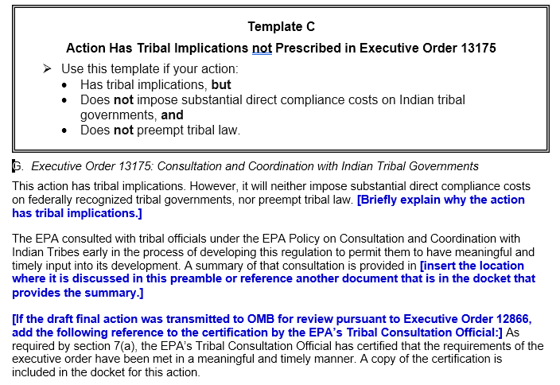
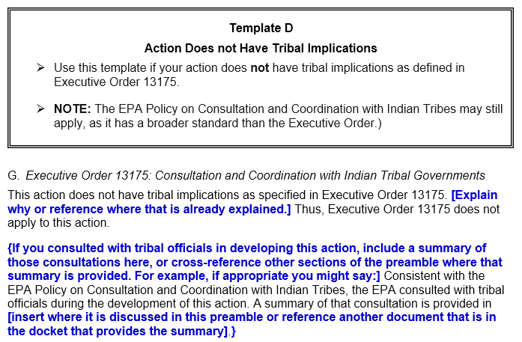
Executive Order 13175 Templates (Most Frequently Used in OAQPS)

Slide 16
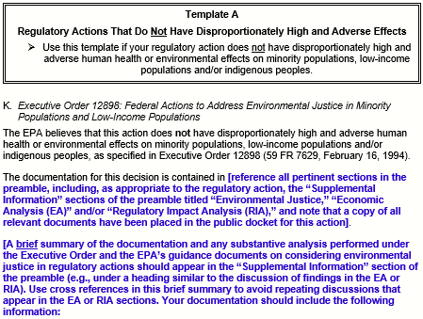
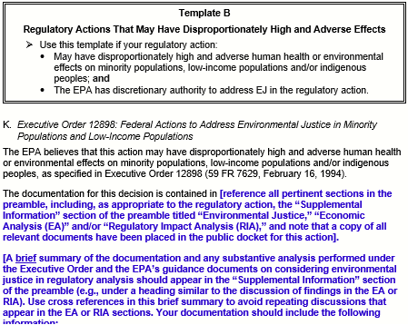
Executive Order 12898 Templates
(Most Frequently Used in OAQPS)

Slide 17
Stakeholder Engagement

Slide 18
Stakeholder Engagement
Proximity and Demographic Analysis
Rule lead provides CTPG with locational information (latitude/longitude) on sources.
CTPG conducts proximity and demographic analyses utilizing GIS and EJSCREEN data to determine which stakeholders may be adversely impacted by the rule.
Tribal lands within 50 miles of a facility.
EJ communities within 5 km of a facility.
HEID conducts risk assessments and characterizations.

Slide 19
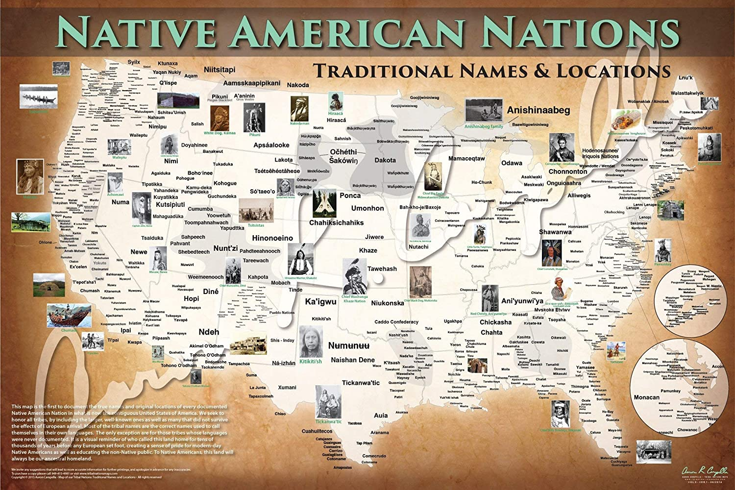
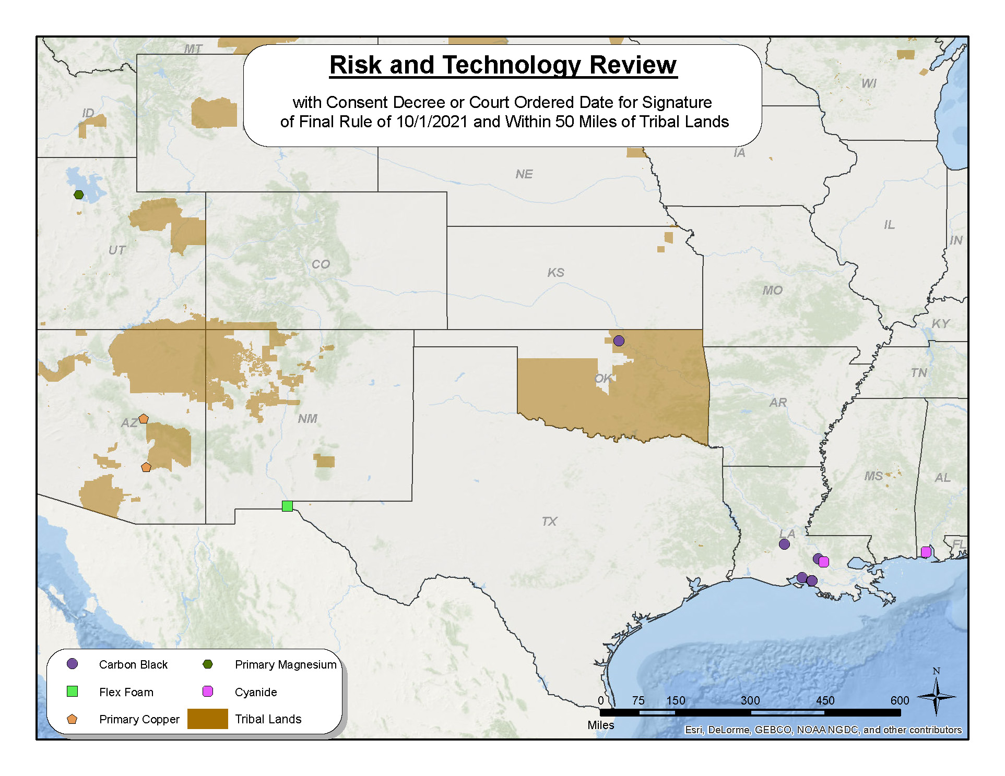
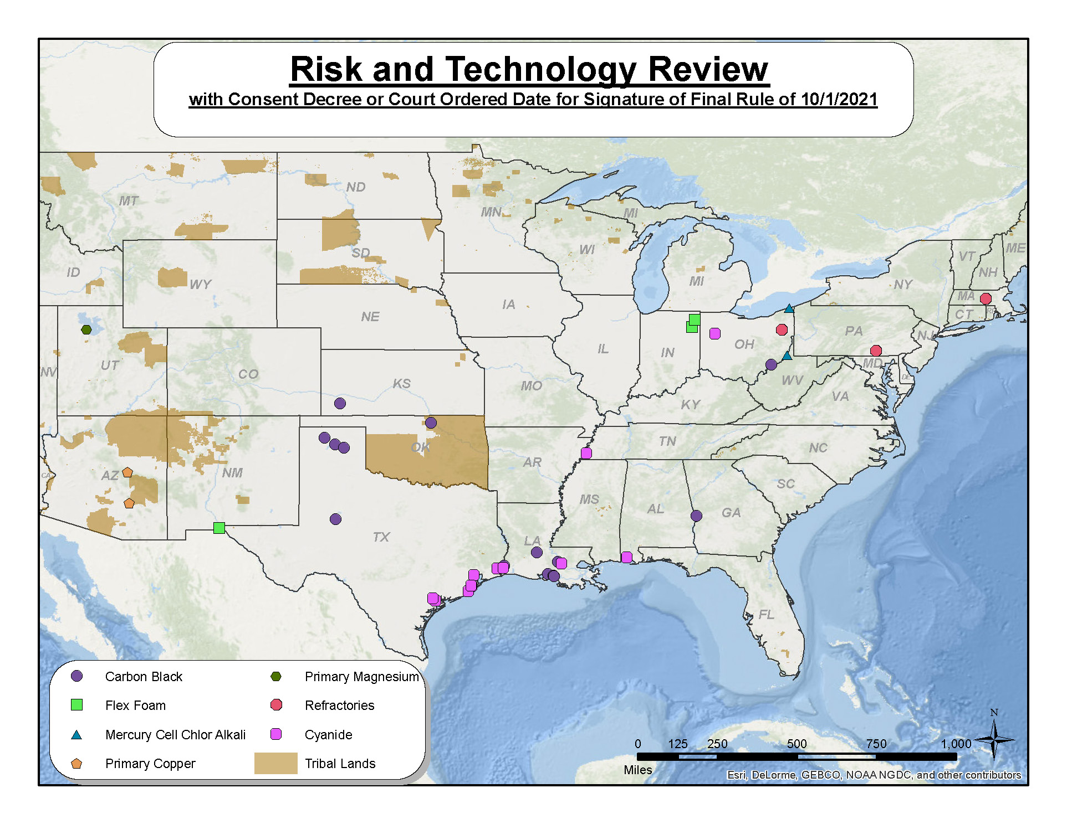
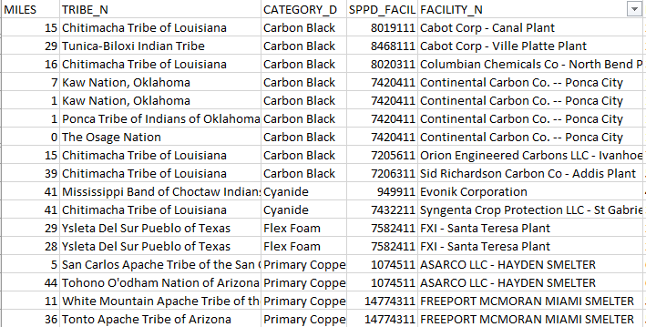
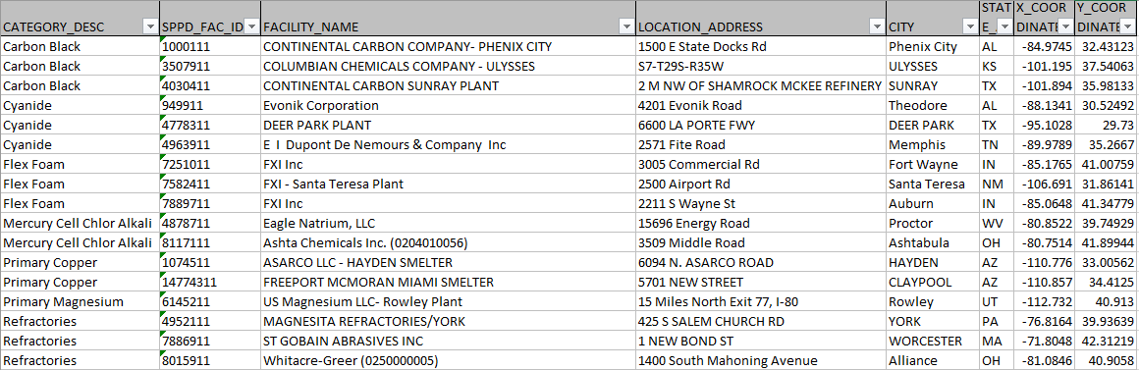
Tribal Proximity Analysis

Slide 20

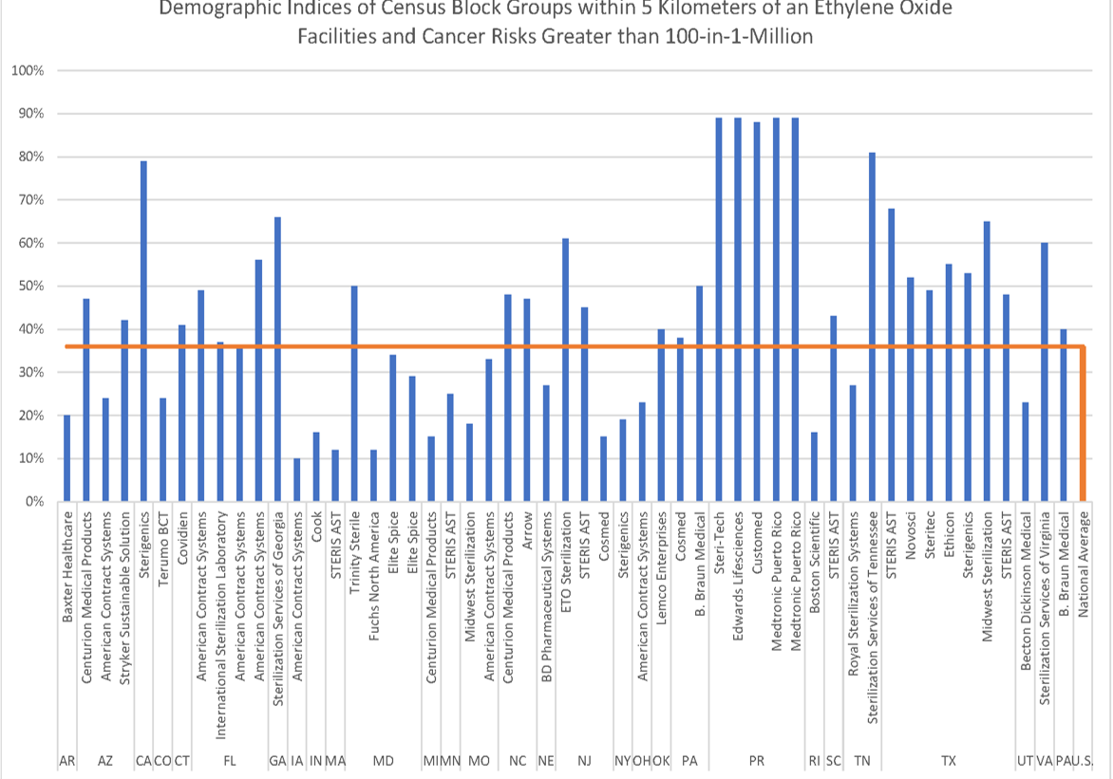
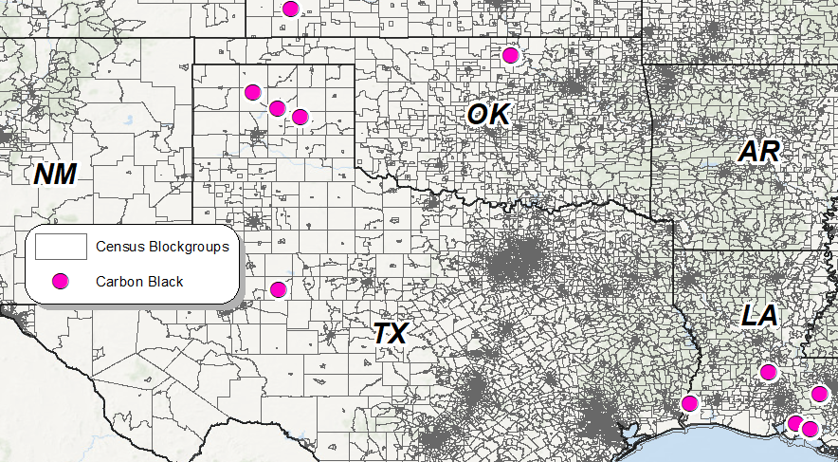
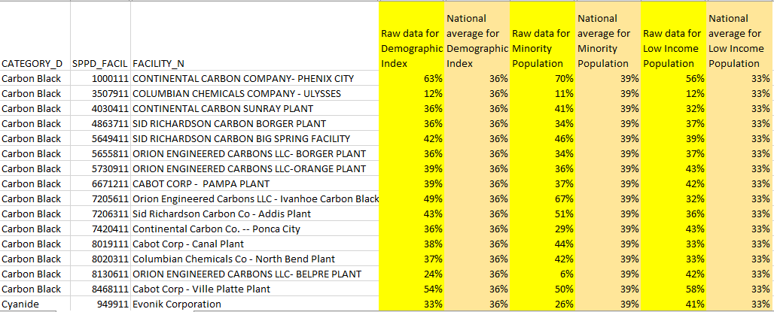
EJ Demographic Analysis

Slide 21
CTPG Outreach Strategy
Main Sections in the Outreach Strategy | Description
Action Objective and Background | A brief overview of the action and history – what has been done in the past
Key Message to Stakeholder | A common message to share with our stakeholders. What should they know
Key Milestones | Important dates such as (signature, published in FR, proposal, public hearing(s), comment period, and final)
Outreach Objectives | Determine level of stakeholder outreach - general or targeted, Tribal consultation
Stakeholder Implications | Determine stakeholders who may be impacted or may have an interest in this action. Identify through proximity analysis and economic analysis.
Outreach Action Plan (Pre-proposal, Proposal, Final) | List of events (dates, event type, participants)
Roles and Responsibilities for CTPG Lead and Division Rule Lead | CTPG - coordination of all outreach and tribal consultation activities including development of webinar/informational call announcements, event logistics, assistance with EO preamble language and identifying the appropriate ADP template for EO 13175 and EO 12898. Rule Lead - provides action overview and response to Q&As during outreach and consultation activities

Slide 22
Stakeholder Engagement
Webinars:
CTPG: Coordinates and oversees all webinar logistics (i.e., scheduling event, development and dissemination of webinar announcements, serves as event moderator, develops and manages the stakeholder registration database).
Rule Lead: Prepares high-level presentation for stakeholders. (Note: a presentation template is available for SPPD rule leads)
Provides an overview of the rule and instructions on how to submit comments to the docket.
Explains how the rulemaking may impact the stakeholders and their concerns.
Gives stakeholders an opportunity to ask questions about the rule.
Participate in existing partnerships groups (i.e., National Tribal Air Association [NTAA], SBEAP)
CTPG: Coordinates these events and invites the rule writer to provide an action overview.
CTPG provides a general overview of the audience and any specific information that the rule lead should be aware of (i.e., issues, concerns).
Rule Lead: Prepares a brief summary or presentation for stakeholder engagement and participate in Q&A sessions.

Slide 23
Tips To Consider When Conducting Stakeholders' Outreach
Become familiar with your stakeholders (e.g., be respectful)
01
Make sure that your presentation is clear and concise (e.g., no abbreviations, plain language, be transparent)
02
Listen to stakeholders’ concerns and encourage participation
03

Slide 24
How CTPG Coordinates Effort Between Divisions (Example: SPPD)
SPPD’s STRATEGIC AREA TWO | HOW CTPG CAN ASSIST
GOAL 1: Identify and communicate emerging air issues and industry trends and build capacity (technical knowledge, expertise) for future actions. | Rule Triage ADP Rule Reports SPPD Rule Listings Develop analysis (e.g., EJ Screen, tribal proximity) CTPG Coordinate Strategy Meetings CTPG and SPPD bi-weekly meetings on upcoming actions CTPG OAQPS Huddles (monthly triage) Support in developing preamble language to address Executive Orders
GOAL 2: Conduct effective engagement with co-regulators and stakeholders to inform work on stationary source air issues and industry trends. | Develops Outreach Strategy Plan for each action Coordinate Stakeholder Outreach Webinars/Trainings, Roundtable Discussions, etc. Participate on monthly stakeholder calls National Tribal Air Association (NTAA), SBEAP, etc. Tribal Consultation

Slide 25
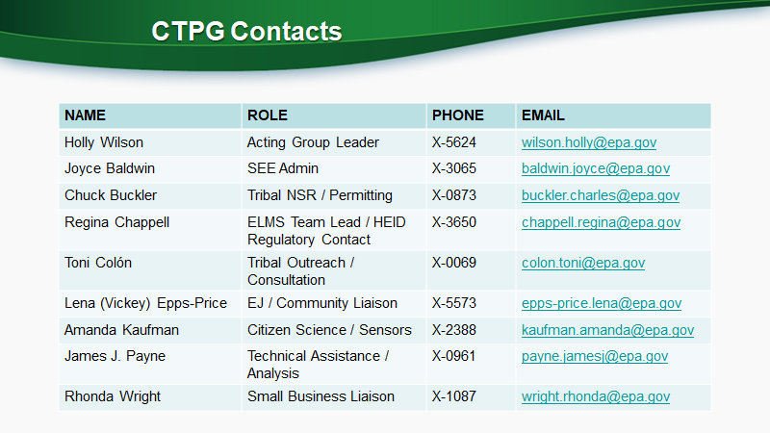

Slide 26
Current Efforts
Drafting an OAQPS EJ Strategy
Drafting an OAQPS Tribal Strategy
Examining our EJ analytical tools
Drafting an OAQPS Small Business Strategy Plan

