Slide 1
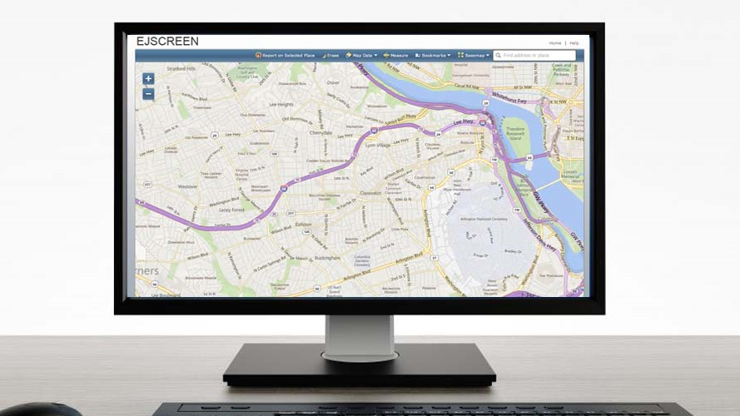

EJSCREEN EPA’s Environmental Justice Screening Tool
Notes:
*Note to facilitator. Please DOWNLOAD this presentation and save it to your own laptop before making any edits. This is the full slide deck – for audiences that might need an overview of EJ, the EJSCREEN training, and will be taking the survey for the EJSCREEN ELMS process. Depending on your audience, you may not need every slide. Delete, edit, add – for what your needs are. Also, if you are new at conducting EJSCREEN training, there are notes that correspond with each slide. Again, you can edit the notes to make them your own. Any notes in italics are for the attention of facilitators. Notes in regular, non-italic font correspond to the content on the slides.
*For the FY21 EJSCREEN ELMS effort we are focusing on 3 things for this training:
Connecting general EJ principles into the use of EJSCREEN (EJ integration at EPA – to ultimately benefit communities)
Training on EJSCREEN – with added encouragement for attendees to practice using EJSCREEN in the context of their programmatic work after the training
Preparing for post training follow-up. Letting attendees know that we will be following up to gather information on their programmatic uses, barriers to using the tool, suggested tool improvements, etc.

Slide 2
Overview of the Training
Goals of EJSCREEN Training
What is Environmental Justice (EJ)?
Introduction to EJSCREEN
EJSCREEN Data
Maps and Reports
EJSCREEN Uses
Future of EJSCREEN
Demonstration of the Tool
Notes:
*Facilitator: These are the topics that you will cover in the presentation. They may need to be adjusted if you pull out certain topics or do not do a demonstration.
This slide can just be read through….

Slide 3
Goals/Objectives and Roadmap of EJSCREEN Training within EPA
Goals/Objectives:
Roadmap:
EPA staff integrate EJSCREEN use in their work
Programmatic uses of EJSCREEN tool are documented
Collect EPA staff feedback on tool gaps/barriers and tool improvements
EJSCREEN data informs decisions and policies that benefit communities with EJ concerns
Decisions and policies lead to improved environmental and health outcomes in communities with EJ concerns
1. Understand EJ
2. Learn EJSCREEN Tool
3. Gather Information via Survey
4. Practice Using Tool
5. Post-training Follow-up
7. Document Programmatic Use
6. Practice Programmatic Use
Notes:
Facilitator: This slide lays out the goals and objectives for the FY21 EJSCREEN ELMS training effort. It also lays out the roadmap (training/survey, practice, follow-up). If you don’t plan on completing the full roadmap, you can edit or delete this slide.
The EJ Program is conducting these training sessions throughout EPA. Our goals and objectives for this training are:
For EPA staff to integrate the use of EJSCREEN into their programmatic work
That we can document these programmatic uses to develop best practices across the agency
For collecting feedback on tool gaps and barriers and tool improvements
That the programmatic use of EJSCREEN data informs decisions and policies that benefit communities with EJ concerns
And that those decisions and policies lead to improved environmental and health outcomes in those communities
We have a roadmap for this effort that includes 7 steps. The session today will cover steps 1-3. We’ll give a high-level overview of what environmental justice is, we’ll train on how to use the EJSCREEN tool, and we’ll offer a training evaluation and survey that will help us to gather the information we need for our goals and objectives. After today, we’ll ask you to go back to your programs and practice using the tool. In a few months, we’ll reach out to you for a post-training follow-up. The follow-up will allow us to collect information about how you’ve been using the tool, the gaps and barriers for using the tool, and recommendations for tool improvements. We’ll ask that you continue to practice the use of the tool within the context of your program, and then we’ll be working to document the programmatic uses of the tool.

Slide 4

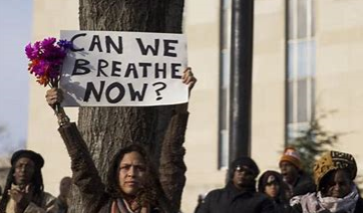
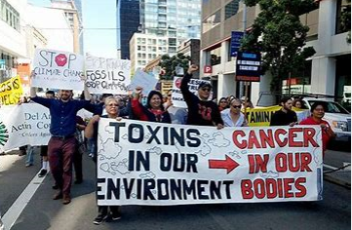
What is Environmental Justice (EJ)?
Notes:
*Facilitators: The next section is for use when the audience has little to no awareness or experience with the basics of EJ. If your audience already has advanced competency in EJ, you can skip this section and remove it from the table of contents.
For the first section of this training, we’re going to provide a high-level overview of what environmental justice is. This will lay the groundwork as to why the EJSCREEN tool exists, and to how it can be used to ultimately benefit the types of communities that are shown in these pictures.

Slide 5
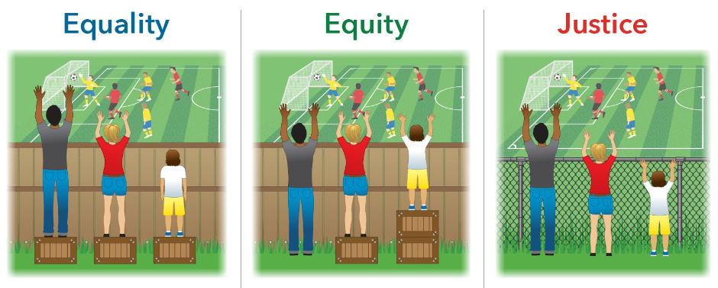
History of Environmental Justice (EJ)
History of EJ
Examples of injustice are embedded throughout the laws, policies, and practices of the government’s structures and systems.
Examples include:
Redlining / segregation
Siting facilities
Access to loans / lack of fair housing practices
Access to education
Lack of voting rights / voter suppression
Assumption: Everyone benefits from the same supports.
Everyone gets the support they need but reasons for inequity are not addressed.
The cause of the inequity was addressed. The systemic barrier removed.
Notes:
Historically, systems of injustice have been embedded within the laws, policies, and practices throughout the structures of government and its systems. These systems of injustice have had long-lasting effects on people of color, indigenous, and low-income populations.
Examples of these systemic injustices include:
the practice of redlining, which led to the segregation of people of color into the most polluted areas of towns and cities
The siting of facilities and industries that emit high levels of pollution and toxics near communities of color
prohibiting access to home loans and other unfair housing practices
lack of access to good schools; hiring practices of teachers
Lack of voting rights and voter suppression
And many more….
Many results of these systemic injustices remain and have created disproportionate impacts on these communities. We will cover more about these disproportionate impacts over the next few slides.
The graphic on the right represents the different ways that these injustices have been addressed. Under ‘Equality’, the assumption is that everyone benefits from the same supports – but in a society where certain populations and communities have been oppressed, we obviously have different needs to achieve equality. As you can see on the graphic under ‘Equality’, each person has the same size step, but this means the shortest person still can’t see over the fence to watch the game. This is where many communities with environmental justice concerns still stand.
Under ‘Equity’, you can see that everyone gets the support they need, so everyone can see over the fence and watch the game, but the reason or barrier for the inequity was not addressed or remedied.
Under ‘Justice’, the fence that was blocking the view is replaced with a fence that everyone can see through; thus, the cause of the inequity is addressed and the systemic barrier removed. It is this section where EJ advocates focus their work – on removing the systemic barrier. Equity options are still necessary and important, but it is crucial that we identify and address the underlying reasons for the injustice. *Note: there are other graphics like this that show the removal of the fence and call it ‘liberation’.

Slide 6
What is an “EJ” Community?
Communities with EJ Concerns
“EJ Community” is shorthand for a more nuanced understanding
People who live, work, play, and pray in the most polluted environments are commonly people of color, indigenous, and low-income.
These communities suffer from disproportionate impacts from interactions of four categories of stress:
Environment
Health
Economic
Social
These impacts are often the result of generations of systemic racism and disinvestment
Lack meaningful public participation
Have poor access to information
Public Participation
Environment
Environmental Justice
Social
Health
Economic
Access to Information
EPA Toolkit for Assessing Potential Allegations of Environmental Injustice
Notes:
What is an EJ community? It is important to understand that the term ‘EJ Community’ is shorthand for a more nuanced understanding. We do not label communities as EJ communities per se, as this is up to each community to determine; however, we do use this shorthand term at times to describe communities that have environmental justice concerns.
In general, people who live, work, play, and pray in the most polluted environments are commonly people of color, indigenous, and low-income. These communities suffer from disproportionate impacts of four categories of stress, as shown in the graphic on the right. As you can see, the four intersecting categories of stress are environment, health, economic, and social.
These impacts are often the result of generations of systemic racism and disinvestment in these communities – as we spoke to in the previous slide. In addition, these communities often have poor access to information and experience a lack of meaningful public participation.
When conducting an analysis or screening of communities with EJ concerns, it is important to understand that environmental issues are part of a larger system that contribute toward disproportionate impacts.

Slide 7
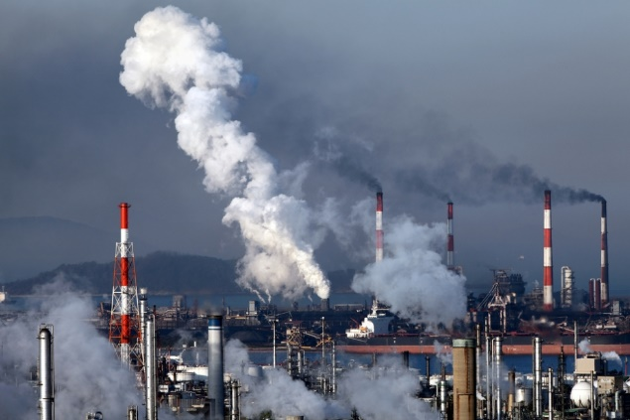

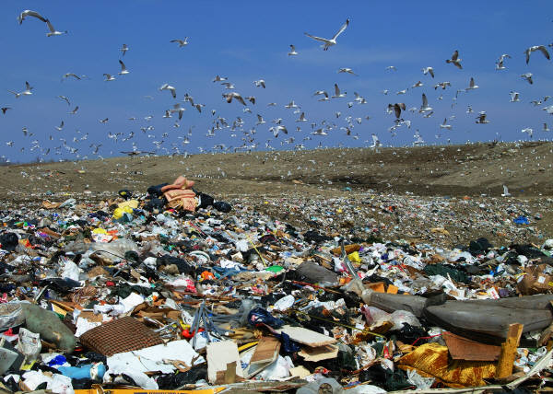

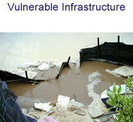
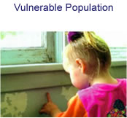
Disproportionate Impacts
Proximity & Exposure to Environmental Hazards
Unique Exposure Pathways
Cumulative & Multiple Environmental Impacts
Lack of Voice & Public Participation
Vulnerable Infrastructure
Vulnerable Population
Notes:
Let’s talk a little more about disproportionate impacts. There are several factors that could indicate a need to analyze whether disproportionately high environmental impacts exist in communities. They may include factors such as:
Proximity and Exposure to Environmental Hazards,
Unique Exposure Pathways,
Multiple and Cumulative Effects,
The inability to Participate in Decision-making Process,
Vulnerable Physical Infrastructures
AND …..Vulnerable Populations
Disproportionate impacts to communities may result from a combination of several, or even all, of these factors. In some circumstances, even one or two or these factors could in and of themselves, disproportionately expose a population to environmental harms and risks.
When conducting our work at EPA, it is crucial to be able to view communities with environmental justice concerns through this wider lens – with multiple stressors, creating disproportionate impacts. Doing this will help to inform our decisions and policies with ‘justice’ for these communities in mind. Fortunately, using the EJSCREEN tool can help to gather data on many of these factors to help inform our work.

Slide 8
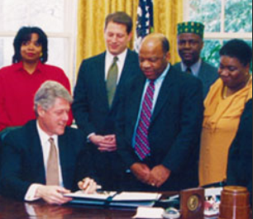
History of Environmental Justice at EPA
History of EJ at EPA
1992: Office of Equity formed at EPA
Feb 16, 1994: President Bill Clinton signs EO12898
1994: Office of Equity becomes Office of Environmental Justice
2010-2016: Plan EJ 2014 implemented as the foundation for integrating EJ in EPA programs, policies and activities
EPA’s Definition of Environmental Justice
EPA defines “environmental justice” as the fair treatment and meaningful involvement of all people regardless of race, color, national origin, or income with respect to the development, implementation, and enforcement of environmental laws, regulations, and policies.
Notes:
Now that we’ve covered some of the basic tenets of environmental justice and EJ communities, let’s look at the history of EJ at EPA.
In 1992, the Office of Equity was created based on the recommendations of the Environmental Equity Workgroup that had been formed at the agency. Then, on February 16, 1994, President Bill Clinton signed Executive Order 12898, titled Federal Actions to Address Environmental Justice in Minority Populations and Low-Income Populations. The purpose of EO12898 is to focus federal attention on the environmental and human health effects of federal actions on minority and low-income populations with the goal of achieving environmental protection for all communities.
Along with EO 12898 in 1994, the Office of Equity expanded to become the Office of Environmental Justice. A lot of substantive groundwork was done over the next 15 years. One of the major milestones occurred from 2010-2016, when Plan EJ 2014 was created and implemented. This document was the foundation for integrating EJ in EPA programs, policies and activities.
EPA’s definition of Environmental Justice covers two core principles.
The first principle is fair treatment – As stated in EO 12898, EPA and other federal agencies are required to “identify and address, as appropriate, disproportionately high and adverse impacts” on low-income, people of color, and indigenous people.
The second principle is meaningful involvement – We want to make sure that the people most likely to be affected by our decisions are well-informed about the agency’s options; and have not only a voice, but a seat at the table whenever possible.
The principle of environmental justice asserts that no people, based on their race or economic status, should be forced to bear a disproportionate burden of environmental risks.

Slide 9
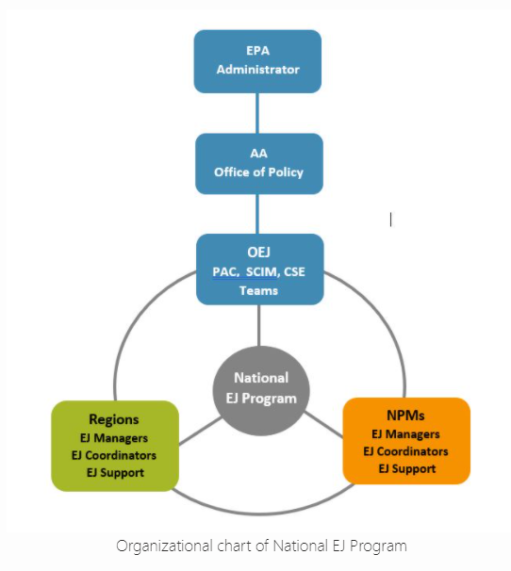
Environmental Justice at EPA NOW
National Cross-cutting EJ Program
Office of Environmental Justice (OEJ)
EJ strategic plans / EJ annual reports
EJ grants and technical assistance
National Environmental Justice Advisory Council (NEJAC)
EJ Interagency Working Group (EJIWG)
EJSCREEN
EJ Hotline
Regions / National Programs
Dedicated EJ Coordinators and support staff
Coordinate/lead on EJ across organizations
Convene meaningful engagement among stakeholders and communities
Build capacity and provide consultation to colleagues
Notes:
Environmental Justice at EPA has come a long way, but we still have a long way to go. We need all hands on deck. To help lead this effort, we have a national cross-cutting EJ Program consisting of staff from the Office of Environmental Justice, and dedicated EJ Coordinators and other support staff from Regions and National Programs.
OEJ provides leadership for the development of EJ strategic plans and annual EJ reports, managing EJ grants and technical assistance, leading the NEJAC and EJIWG, and managing the EJSCREEN tool and EJ Hotline.
Dedicated EJ staff in Regions and National Programs -
coordinate EJ across all organizations within the region/program and provide leadership on EJ issues in all forums and discussions;
they support and convene meaningful engagement among colleagues, partners, stakeholders and communities on EJ issues; and they
build capacity and provide consultation services to colleagues to increase EJ understanding.
In other words, they wear the EJ hat for the region/program.

Slide 10

Environmental Justice at EPA NOW
Goals of EJ Integration at EPA
EJ is integrated in all EPA decisions and policies
‘Doing’ EJ is standard practice in all we do at EPA (e.g. using EJSCREEN to inform decisions and policies, etc.)
Communities with EJ concerns are meaningfully engaged, empowered, and receive fair treatment
Improved environmental and public health outcomes in communities with EJ concerns
Effectively working with partners (e.g. states, tribes) on their EJ integration efforts
Notes:
For the EJ Program, our work continues to be focused on EJ integration at EPA. Our goals include:
the consideration of EJ in all of EPA’s decisions and policies, using existing statutory authorities and through other non-statutory means;
That ‘doing’ EJ is standard practice in all we do at EPA
That communities with EJ concerns are meaningfully engaged and receive fair treatment and justice
And that there are improved environmental and public health outcomes in communities with EJ concerns.
Again, one of the mechanisms to reach these goals as an agency is through the use of the EJSCREEN tool. The rest of this presentation will be dedicated to reviewing what this tool is, and what it can do to further EJ work.

Slide 11
Introduction
to EJSCREEN
EPA’s Environmental Justice Screening
and Mapping Tool

Slide 12

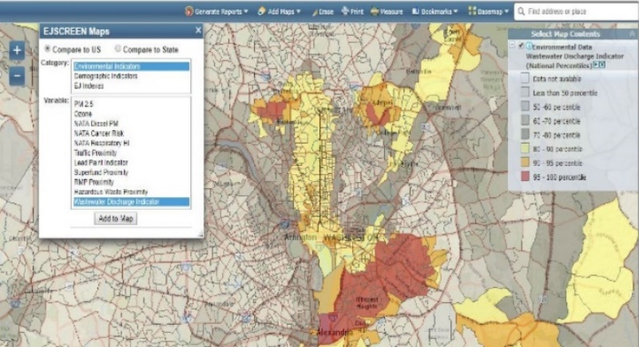
What is EJSCREEN?
EPA’s web-based GIS tool for nationally consistent EJ screening and mapping
Combines environmental and demographic data to highlight areas where vulnerable populations may be disproportionately impacted by pollution
Notes:
EJSCREEN is EPA’s web-based GIS tool that was designed to provide nationally consistent EJ screening and mapping. It combines environmental and demographic data to highlight areas where vulnerable populations may be disproportionately impacted by pollution and other environmental stressors.

Slide 13
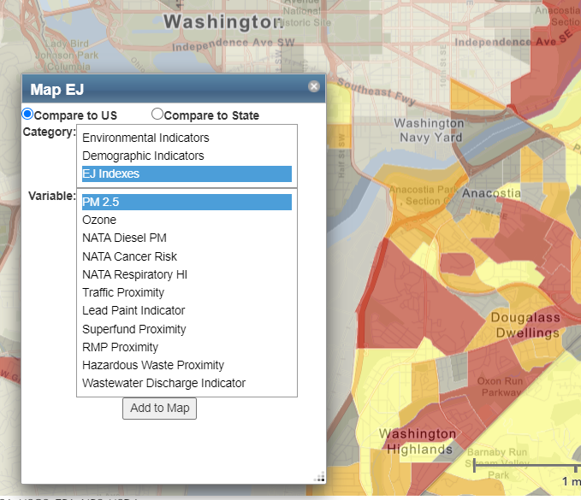
EJSCREEN Key Features
11 EJ Indexes – one for each environmental indicator
Annually updated environmental data when available
Annually updated demographics – from most recent U.S. Census Bureau American Community Survey (ACS)
Highest resolution data available
Ability to download data
Accessibility / ease of use
Notes:
*Note: These are the big things you want participants to understand initially about EJSCREEN.
The functionality that sets EJSCREEN apart from other tools and its main purpose is the EJ indexes. EJ indexes are the combination of demographic and environmental data. Specifically, there are 11 environmental indicators which are combined with low income and people of color data. We will look at this in more detail shortly in the presentation.
Annual updates are important because the demographics in EJ communities change quickly as do the pollutant levels. To keep this as up to date as possible, EJSCREEN has updated the background data annually every year since the release of the tool. The updated demographics come from the most recent US Census Bureau American Community Survey or ACS.
EJSCREEN uses Census block group level data for all the environmental and demographic indicators. This really sets EJSCREEN apart from many of the other mapping tools out there as most are at the Census tract level. We will get into more details about the Census block group level shortly.
With EJSCREEN, you can download data for further evaluation – which is helpful when you are doing a deeper dive on a community with potential EJ concerns.
We built EJSCREEN to be as accessible and intuitive as possible. It is web based so anyone with an internet connection can access it. It is very straight forward to use for anyone that has used any map program, even Google maps. It doesn’t require special software. It is even accessible on your phone or tablet.

Slide 14
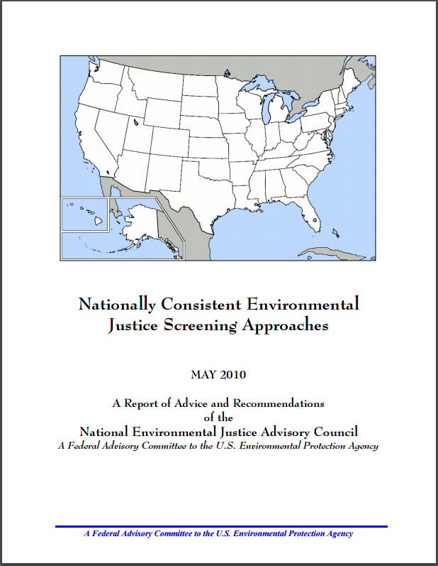
EJSCREEN Background
2010
EPA begins building nationally consistent EJ screening tool
2011
National Environmental Justice Advisory Committee report released on EJ screening methods
2012
EPA begins using EJSCREEN internally
2013
Peer reviewed by experts
2015
Tool released to public
2017
Mobile version of the tool released
2020
Annual update
Click to read the full NEJAC report
Notes:
Prior to EJSCREEN, there were many different ways that regions and programs considered EJ. The former Deputy Administrator at the time felt this didn’t make sense and decided that we should create one EJ tool for the agency. This ended up being a commitment in the former EJ strategic plan, Plan EJ 2014.
Here is a timeline of key milestones on the development and implementation of EJSCREEN:
2010: EPA begins building nationally consistent EJ screening tool – Using the experience of EJ View, earlier tools, and decades of EJ work.
2011: National Environmental Justice Advisory Committee report released on EJ screening methods – It is available on the NEJAC webpage.
2012: EPA begins using EJSCREEN internally – Initially enforcement and compliance was the first big user of the tool, but internal uses have grown over time.
2013: EJSCREEN was peer reviewed by 4 EJ and mapping experts
2015: Draft version of the tool released to the public – This is when EJSCREEN uses really started to grow
2017: Mobile version of the tool was released. This made it easier for people without access to a computer to use the tool
2020: Annual update – Every year since the start of the tool we have updated the environmental and demographic indicators. We also make other changes to the tool during the annual updates.

Slide 15
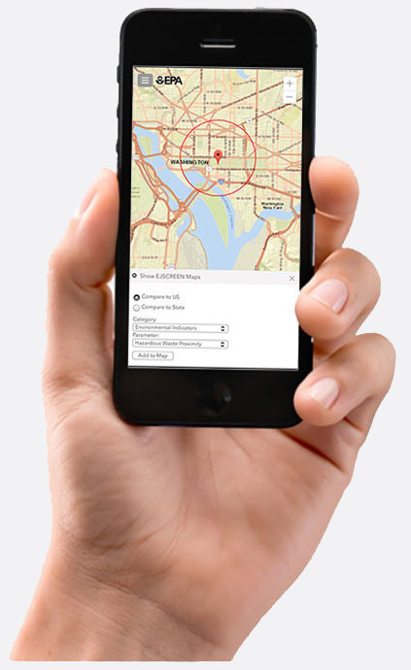
Mobile Version of EJSCREEN
Optimized for phone or tablet
Uses location to generate maps and reports
No app to download
Full version available (if preferred)
Designed to increase tool accessibility
Notes:
As shown on the EJSCREEN timeline, the mobile version of EJSCREEN was released in 2017. This optimized version of the tool was designed to make it easier to access EJSCREEN from your phone or tablet. Many users in EJ communities have different needs for accessing the tool and the data. The mobile version takes our already powerful tool and make it more portable and dynamic. The mobile version can use smartphones location services to pull reports or users can select locations. It does not require downloading an app and it has the ability to transfer to the full version if one prefers.

Slide 16
New EJSCREEN Features
Improved data dictionary for EJSCREEN downloads
Ability to bring in shape files
Downloadable data at the tract level
Improved source data on locations such as Superfund sites
RSEI data as an available map layer
Climate related indicators
Notes:
Do not use this slide until the 2020 version of EJSCREEN is released. Hopefully, that will be in late January 2021.
These are some of the new features we incorporated into the 2020 version of the tool. In the last couple years, we have received more and more technical requests from more proficient users. Many of these changes are designed for those more technical users.
The data dictionary is what allows users that download EJSCREEN data as a CSV file to understand what the different lines mean. It is only important for the more technical users that pull EJSCREEN data into other applications or build it into their own tools.
The ability to bring in shape files allows users to import defined areas into EJSCREEN. This would allow them to use predefined areas without needing to redraw them in EJSCREEN.
The downloadable tract level data is designed to assist states and other organizations using our data. Prior to this year we only processed EJSCREEN data at a block group level (we’ll cover mover about the data levels shortly). For others to use our data at a tract level, they would need to reprocess all of the data. By pre-running it at the tract level, outsiders using this data in a tract-level tool will not have to go through as much work in order to use the data.
We have changed the information that will appear when users click on EPA sites on the map. This was redesigned to bring up the most relevant information instead of random information that users don’t really need.
EPA's Risk-Screening Environmental Indicators (RSEI) model helps policy makers, researchers and communities explore data on releases of toxic substances from industrial facilities. This data was always available in EJSCREEN via the GeoPlatform if users knew how to find it. However, we felt it was important enough information that it needed to be built in as an additional environmental map layer. Please note, this is not the same as an environmental indicator.
Finally, one of the changes we are most proud of for this year is that we started to build climate change-related data into EJSCREEN. This year we are building in data on sea level rise and flooding. But we have been working with a cross agency team to identify additional map layers on this topic and hope to expand the climate related layers in the next couple years. The new layers are based on NOAA and FEMA datasets.
We’ll be covering EJSCREEN data next, so some of these features will make more sense as we move through the presentation.

Slide 17
EJSCREEN Data

Slide 18
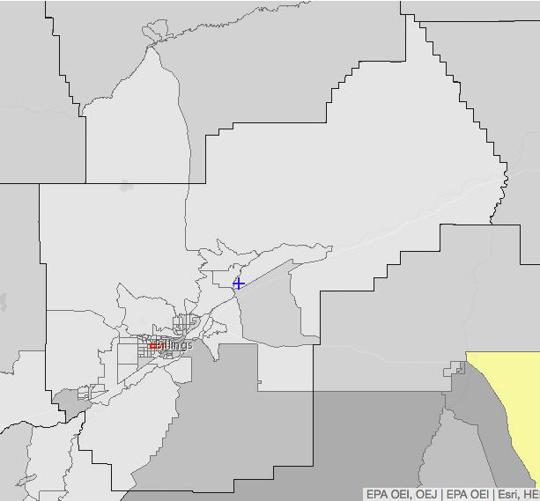
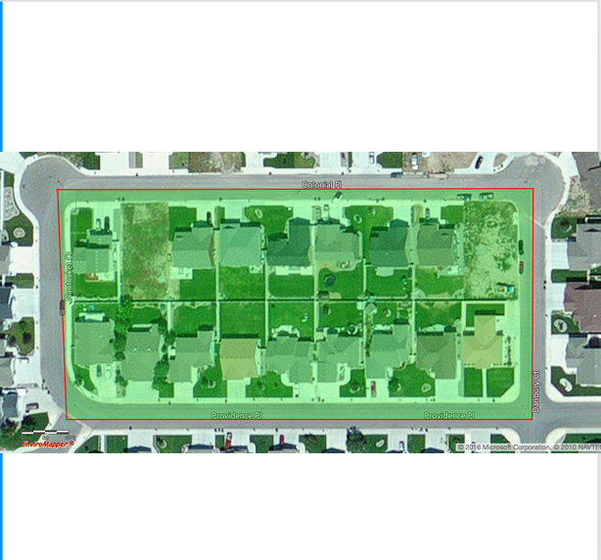
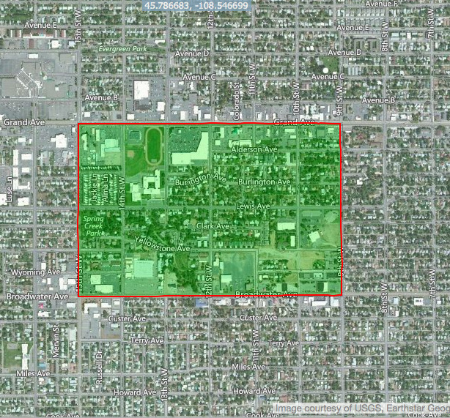
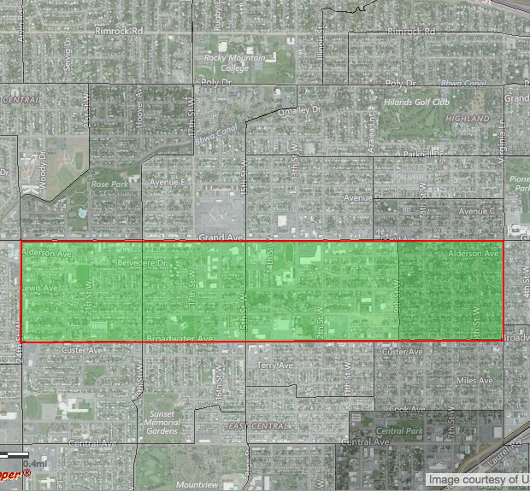
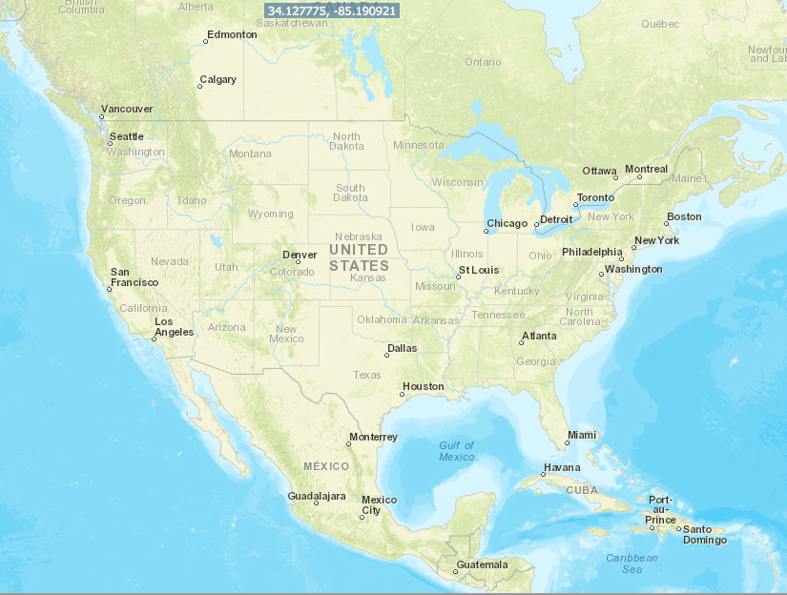
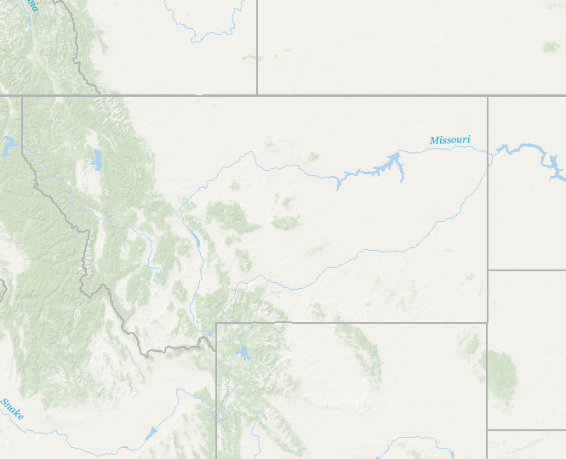
UNITS OF ANALYSIS
United States
State
primary governmental divisions of the United States.
County
Largest divisions within states.
Census Tract
Collection of Census block groups, mostly between 1,200 and 8,000 people.
Block Group
Collection of residential blocks, mostly, between 600 and 3,000 people.
Block
Residential block, bounded on all sides by streets.
Notes:
*Important: This slide is heavily animated – so be aware! A representation of each unit of analysis will pop up as you click through the slide.
Block - Block level data is the finest level that the Census maps in. However, we are not allowed to share data at this level due to privacy concerns. Because it is literally a city block in many cases, if you have the average income for that block, you may not know exactly what a given person earns per year, but you could probably guess pretty close.
Block Group - In EJSCREEN we use a level up from the block level, called the block group level. This is a collection of Census blocks and are generally between 600 and 3000 people. There are over 217,000 block groups in the U.S., with an average of about 1,400 residents in each. Some things to note: there are some exceptions where you have dense populations that they can’t break up such as military bases and universities. Also, the block groups are much bigger in less densely populated areas. But we really focused on getting the finest level of resolution in EJSCREEN because so many EJ concerns are at the neighborhood level and for consideration of these issues, granularity matters.
Census Tract – These are the next level up from Block Group. It is the resolution that many of the other EJ and mapping tools use. It is a bit more coarse but can still provide good information. EJSCREEN also processes our data at the tract level to help States and other organizations that are building tools at this level.
County – Everyone should know county level data. While it is good to have data at this level, it doesn’t shine light on the smaller scale EJ issues. Many data sets, including much of the health data, is only available at this level.
Beyond that is state and country level data.

Slide 19
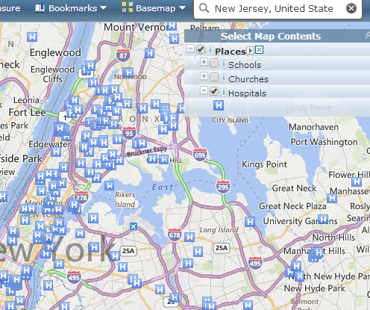
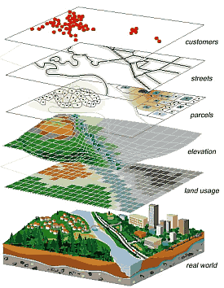

EJSCREEN Data
EJSCREEN adds many types of data
by overlaying various datasets called “layers”
Sites and Places
Boundaries
Tribal Land
Nonattainment Areas
Layer from the Web
Other Information
Notes:
EJSCREEN includes many additional data sets that users can add as layers onto their EJSCREEN maps.
It is important to know that these “other” data sources or map layers are not used in calculating existing EJ indexes and can not be used to calculate additional EJ indexes. But they can help add more context when conducting an analysis of the community.

Slide 20
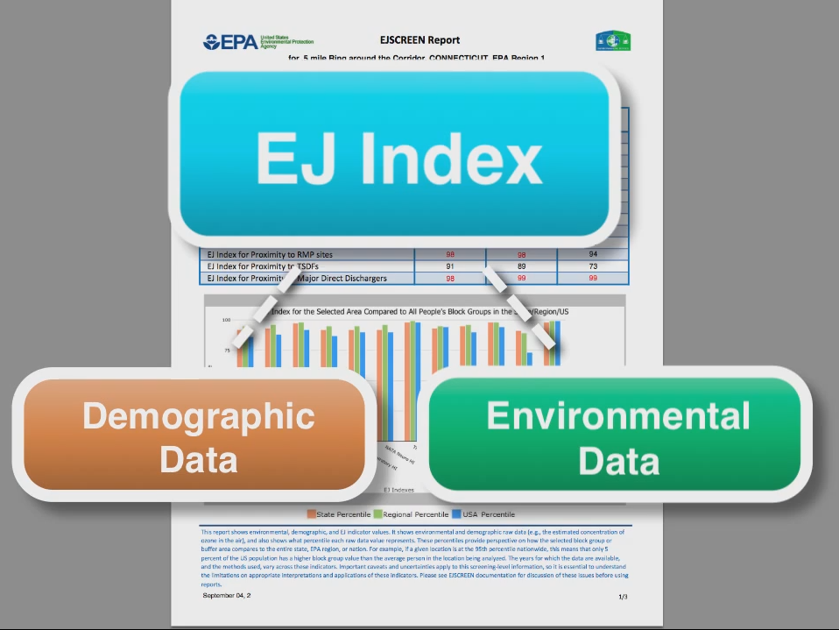
Types of Data in EJSCREEN
Primary EJSCREEN Datasets
Demographic (6 indicators)
Environmental (11 indicators)
EJ Indexes (11 indicators)
Additional Environmental Data
Additional Demographic Data
Other Data Sources
Notes:
These are the key EJSCREEN datasets and this is what makes the tool unique. I will get into the exact datasets on the next few slides but first it is important to understand how this data is combined.
We include 6 demographic indicators in EJSCREEN as proxies for vulnerable populations. Two of these indicators, low income and people of color are averaged to create the demographic index. This provides the basis for our EJ calculations and indexes.
There are 11 environmental indicators that are important for their various impacts to communities. There are many other environmental datasets available in EJSCREEN, but these 11 are the key ones that we map out as percentiles. Percentiles help us to interpret the data.
The EJ indexes combine a given environmental indicator with the demographic index. It maps out the intersection of an environmental indicator – for example, proximity to Superfund sites, with the demographic index – which is low-income communities and communities of people of color. It then ranks these locations.
The next slide will go over the meaning of EJ indexes more comprehensively.

Slide 21
What does the EJ Index mean?
EJSCREEN calculates the EJ Index by multiplying together three items:
(The Environmental Indicator) X (Demographic Index for Block Group – Demographic Index for US) X (Population count for Block Group)
It helps identify areas that may have higher pollution burdens and vulnerable populations present
Notes:
To calculate a single EJ Index, EJSCREEN uses a formula to combine a single environmental factor with the demographic indicator. It considers how much the local demographics are above the national average. It does this by looking at the difference between the demographic composition of the block group, as measured by the Demographic Index, and the national average (which is approximately 35%). It also considers the population size of the block group, although most block groups are similar in population size.
Mathematically, EJSCREEN calculates the EJ Index by multiplying together three items:
(The Environmental Indicator) X (Demographic Index for Block Group – Demographic Index for US) X (Population count for Block Group)
We combine demographic and environmental information because we want to know where people are most vulnerable or likely to be exposed to different types of pollution. And we know that low income and communities with people of color are disproportionately located in areas with greater environmental burdens and pollution problems.
*Note to facilitators: the rest of these notes are for doing a deeper dive into EJ indexes. Depending on your audience or how much time you have, you may or may not choose to use the rest of these notes.
Additionally, low income and minority communities may be more susceptible, or at risk, to a given level of exposure to environmental pollutants. For example, research shows individuals may be more susceptible when they are already in poor health, have increased stress levels, have reduced access to care, lack resources or language skills or education that would help them avoid exposures or obtain treatment, or are at susceptible life stages.
The EJ indexes help us identify areas where there are the highest potential for exposure to different types of pollution and increased potential for those people to be more susceptible to exposures. It helps us better understand areas in need of environmental protection, health care access, housing, infrastructure improvement, community revitalization and climate resilience.
So, for example, let’s say you know there is a disparity in environmental indicator scores for lead paint, meaning that low income / minority residents on average have a higher lead paint score than the rest of the US population.
Let’s say you had limited resources and could only “clean up” a certain number of homes and you wanted those resources to go to homes that had a high chance of containing lead and the most vulnerable people living in them.
If you started with the top 1% as ranked by the lead paint EJ index, that strategy would have the biggest possible impact on reducing the existing demographic disparity in those average environmental indicator scores.
Obviously there are many other considerations in the real world, such as the cost of any actions, the true risks rather than the indicator scores, the importance of places with very high environmental scores regardless of demographics, etc. But the EJ index gives you a lot of different pieces of information very quickly and easily to start with.

Slide 22
Caveats & Limitations
Environmental indicators are mostly screening-level proxies for actual exposure or risk
Indicators vary in vintage
EJSCREEN does not cover all environmental or EJ issues
Census data has limitations and can obscure small communities
Results should always be verified on the ground when possible
EJSCREEN does not identify EJ communities
*It helps identify areas that may have higher pollution burdens and vulnerable populations present.
Notes:
Environmental indicators are mostly screening-level proxies for actual exposure or risk – The 11 environmental indicators in EJSCREEN vary in how well they represent actual risk. Some are complete proxies for risk such as our lead paint indicator which looks at pre1960 housing. Prior to 1960 lead paint was commonplace. However, this does not indicate whether the house has properly covered over the lead paint or remediated it. Another example are the proximity indicators which simply look at the distance to facilities such as Superfund or Treatment Storage and Disposal Facilities. Other indicators such as the three National Air Toxics Assessment indicators do a very good job looking at risk through a combination of monitored and modeled air pollution levels.
Indicators vary in vintage – The various environmental and demographic indicators are not all updated annually. The demographic indicators are updated with the most recent Census ACS data every year. And any of the environmental indicators that we can update are also updated at that time. However, some of the indicators such as the National Air Toxics Assessment indicators only come out a few years due to the work it takes to create this dataset. All of the vintages are listed on the EJSCREEN webpage.
EJSCREEN does not cover all environmental or EJ issues. This is due to the data not being available for the entire country at a fine resolution. We would love to include data on issues like pesticide application or drinking water impairment, but we do not have publicly available datasets for these issues.
Census data has limitations and can obscure small communities – While we are using the finest level of data that we are allowed to use in EJSCREEN, it does still have some issues. In rural areas where the populations are very spread out, EJSCREEN can miss small pockets of EJ communities. This is due to the entire area, which can be quite large in sparsely populated areas, receiving one score.
Results should be verified on the ground when possible – This is something that I always emphasize, EJSCREEN is simply a screening tool. Getting out into the communities will give you more and better information than EJSCREEN does. Supplementing EJSCREEN with local data is also a very good idea. We’ll show an example of this on the next slide.
EJSCREEN does not identify EJ communities – EPA is not in the business of defining the boundaries of a “community” and also does not define what are and are not EJ. That is up to the individual community to decide for themselves. EJSCREEN likewise does not define where EJ communities are or are not. It shows areas with higher pollution burdens and vulnerable populations.

Slide 23
Demographic Indicators
Indicator | Definition
Low-Income | Household income is less than or equal to twice the federal “poverty level”
Minority (People of color) | Individuals who list their racial status as a race other than white alone and/or list their ethnicity as Hispanic or Latino
Less than high school education | People age 25 or older whose education is short of a high school diploma
Linguistic isolation | Households in which all members age 14 years speak English less than “very well” (have difficulty with English)
Individuals under age 5 | People in a block group under the age of 5
Individuals over age 64 | People in a block group over the age of 64
Demographic index | (Low income + minority) / 2
*Note: All demographic datasets are from the 2013 – 2017 Census ACS
Notes:
*Note to OEJ: This slide needs to be updated when the 2020 version is released
This slide lists the 6 types of demographic indicators reported for specific areas of interest plus the Demographic Index.
% Low-Income is the percent of a census block group’s population living in households where the household income is less than or equal to twice the federally-defined poverty level.
% Minority (people of color) is the percent of individuals in a census block group who self-identify their race as something other than “white alone” (“alone” means only one race) and/or identify their ethnicity as Hispanic or Latino.
% less than high school is as a % of those age 25 plus.
% Linguistic isolation is the percent of people in a census block group living in a household where all members age 14 years and over speak a non-English language and also have difficulty with English.
% under age 5 and % over 64 represent a part of the population that we know are more sensitive to environmental pollutants
The demographic index combines data from the low-income indicator and the minority population indicator.

Slide 24
Environmental Indicators
Indicator | Description | Year
NATA cancer risk | Lifetime cancer risk from inhalation of air toxics | 2014
NATA respiratory hazard index | Air toxics respiratory hazard index (ratio of exposure concentration to health-based reference concentration) | 2014
NATA diesel particulate matter | Diesel particulate matter level in air | 2014
Particulate matter 2.5 | Annual average of PM 2.5 levels in the air | 2016
Ozone | Ozone summer seasonal avg. of daily maximum | 2016
Traffic proximity and volume | Count of vehicles on major roads, divided by distance in meters | 2017
Notes:
*Note to OEJ: This slide needs to be updated when the 2020 version is released
Now let’s look at the environmental indicators in EJSCREEN. The first six environmental indicators are measures of air toxic pollutants, those pollutants known to cause or suspected of causing cancer or other serious health problems. Many are known to have respiratory, neurological, immune, or reproductive effects, particularly for more susceptible or sensitive populations such as children. Most air toxics originate from mobile sources (e.g., cars, trucks, buses), stationary sources (e.g., factories, refineries, power plants), as well as indoor sources (e.g., some building materials and cleaning solvents). You will notice that we have more air related indicators than other medias in EJSCREEN. This is because we have more air data for the entire country than for other media, such as pesticides and water. It is important to note that these indicators are estimated air concentrations, not actual measurements of air concentrations.
The 1st three air indicators are a part of EPA’s National Air Toxics Assessment, which is produced every three years.
*Note to facilitators: the rest of the notes provide much more detail about the risks associated with each pollutant. Depending on the audience and the time allotted for the presentation, you may or may not want to cover the notes below.
Air Toxics Cancer Risk
The air pollutants in NATA is cancer risk, which is estimated from exposure to carcinogens such as formaldehyde, benzene, and many others. The Air toxics cancer risk environmental indicator estimates the probability of contracting cancer over the course of a lifetime.
Respiratory Hazard Index
The 2nd NATA indicator is for air toxics respiratory hazard index, which estimates the risk associated with negative health effects on the respiratory system, such as asthma or allergies, based on estimated continuous inhalation exposure to certain air toxics.
Diesel particulate matter (PM) level in air, µg/m3
The 3rd indicator is diesel particulate matter, which is a mixture of particles that is a component of diesel exhaust. EPA lists diesel exhaust as a mobile-source air toxic due to the cancer and non-cancer health effects on the respiratory system associated with exposure to diesel exhaust. Acute exposure to diesel exhaust may cause irritation to the eyes, nose, throat and lungs, some neurological effects such as lightheadedness.
PM2.5
PM 2.5 is particulate matter that comes from emissions include power plants and industrial facilities, as well as mobile sources like traffic. Exposure to particulate matter can lead to elevated risk of premature mortality from cardiovascular diseases or lung cancer, and increased health problems such as asthma attacks. People with heart or lung diseases, children, and older adults are the most likely to be affected by particle pollution exposure.
Ozone
Ozone is created at ground level by a chemical reaction between oxides of nitrogen (NOx) and volatile organic compounds (VOCs) in the presence of sunlight. Breathing ozone can trigger a variety of health problems including chest pain, coughing, throat irritation, and airway inflammation. It also can reduce lung function and harm lung tissue. Ozone can worsen bronchitis, emphysema, and asthma, leading to increased medical care.
Traffic Proximity
A substantial fraction of the U.S. population lives in close proximity to traffic, and the number of vehicle miles traveled has grown 40% from 1990 to 2010. Proximity to motor vehicle traffic is associated with increased exposures to ambient noise, and toxic gases that can contain benzene or other carcinogens. Residential proximity to traffic has been shown to have various health impacts, particularly with asthma exacerbation and increased risk of cancer.

Slide 25
Environmental Indicators (cont’d)
Indicator | Description | Year
Lead paint indicator | Percent of housing units built pre-1960, as indicator of potential lead paint exposure | 2013 - 2017
Proximity to Risk Management Plan sites | Count of RMP (potential chemical accident management plan) facilities within 5 km, each divided by distance in kilometers | 2019
Proximity to Hazardous Waste Facilities | Count of hazardous waste facilities (TSDFs and LQGs) within 5 km, each divided by distance in kilometers | 2019
Proximity to National Priorities List sites | Count of proposed or listed NPL - also known as Superfund - sites within 5 km, each divided by distance in kilometers | 2019
Wastewater Discharge Indicator | RSEI modeled Toxic Concentrations at stream segments within 500 meters, divided by distance in kilometers | 2019
Notes:
*Note to OEJ: This slide needs to be updated when the 2020 version is released
Lead Paint *Note – you can choose how much of this description you’d like to cover.
Our next indicator is for lead paint. A key source of exposure to lead for many Americans is through lead paint and lead-containing dust that accumulates indoors in homes. Recent research has demonstrated that children can experience neurological damage even at low levels of exposure to lead. No data has been collected at a national level to document which older housing contains lead paint, so we chose stock of housing pre-1960 as a proxy for increased likelihood for exposure. Housing that is built before 1960 is nine times more likely to have lead paint hazards, and so that was the rationale for choosing this as the indicator.
The rest of the environmental indicators are estimates of proximity or potential risk. As a quick note, it’s important to understand proximity does not equal risk. In other words, just because you live close to a superfund site, or live in older housing, does not mean there is exposure to pollution. But, it is a way of estimating an increased likelihood of exposure or risk.
The proximity indicators cover risk management plan sites, hazardous waste facilities, NPL or superfund sites and areas of wastewater discharge.
*Note to facilitators: the rest of the notes provide much more detail about the proximity risks. Depending on the audience and the time allotted for the presentation, you may or may not want to cover the notes below.
Proximity to RMP Sites
The environmental indicator for “RMP facilities” is for facilities required to file risk management plans. The regulations under CAA establishes a list of substances regulated because of acute toxicity or because of their flammable or explosive potential. Populations living in close proximity to RMP facilities may be more vulnerable to accidental releases of toxic substances and incidents involving fires and explosions.
Proximity to Hazardous Waste Facilities
Originally, this indicator was only for Treatment, Storage or Disposal Facilities or TSDFs. These are large permitted facilities that maintain and transport volumes of municipal and industrial solid waste generated nationwide. However, a few years ago we revised this to include Large Quantity Generators of hazardous waste as well, or LQGs. LQGs pose a potential risk to human health and the environment from improper management of hazardous waste.
Proximity to Superfund Sites
The next indicator is proximity to superfund, or sites on the National Priorities List (NPL). The NPL is a list of the most serious superfund sites identified for long-term cleanup. These sites could be abandoned mines, contaminated groundwater or soil resulting from environmental emergencies, oil spills and natural disasters or many other causes.
Wastewater Discharge Indicator
The wastewater discharge indicator takes the pollutant discharge information reported from facilities to EPA and assigns it to the streams and rivers which receive those discharges. This complex mapping process includes toxicity-weighted results, or giving more weight to the pollutants which have greater impact on human health. It also must account for dilution as these pollutants move downstream. Following this, the indicator ranks Census block groups based on the proximity to these stream segments and the toxicity-weighted pollutant discharge.

Slide 26
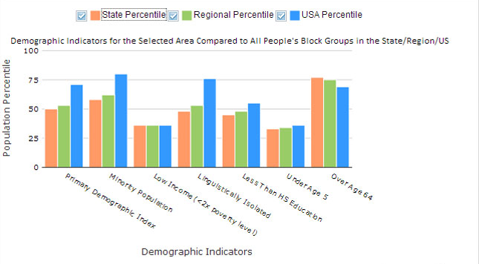
Results are Ranked as Percentiles
Percentiles put indicators into common units of 0 – 100.
A place at the 80th percentile nationwide means 20% of the US population has a higher value.
Ranking values as percentiles allows comparison of indicators measured with different units. It does not mean the risks are equal or comparable.
Notes:
The environmental indicators, demographic indicators, and EJ Indexes are presented as a percentile ranking of all the block groups in the U.S. which puts them into common units of 0 to 100. This allows us to compare relative differences in different data sets with different units of measure.
Putting values into common units also helps compare the area you are studying to different geographic locations. For example, you can compare your area of investigation to the state or region it is in or compare it to the rest of the country. A place at the 80th percentile nationwide means that 20% of the US population has a higher value.
If two indexes are at the same percentile, it simply means those two scores are equally common (or equally rare) in the United States. It does not mean the risks are comparable – EJSCREEN does not weight for risk of the different environmental issues that are represented. It is therefore critical when interpreting EJSCREEN percentiles to also look at the actual raw numbers for the environmental and demographic indicators.
The graph shows a comparison of state, regional, and US percentiles across the different demographic indicators for a specified place.

Slide 27
Additional EJSCREEN Data
EPA Sites: Superfund, Brownfields, nonattainment areas, etc…
Places: Parks, schools, churches, hospitals, airports, etc…
Demographics: Access to a wealth of Census data on education, income, languages spoken, population, housing, etc…
EJ Considerations: Tribal areas, public housing, prisons, etc…
Outside maps: Ability to bring in outside maps
Notes:
In addition to the primary environmental and demographic indicators, and the EJ indexes, EJSCREEN contains a host of other maps which are important to EJ communities. One of the most used functions in EJSCREEN outside of the primary indicators, are the additional demographics. This widget features a wealth of Census data in various categories such as education, income, languages spoken, population, housing, etc.. Many users find this information especially helpful for outreach and community engagement efforts.
EJSCREEN features other data on EPA regulated sites. These various maps link directly to EPA databases which can be very helpful. For instance, if a user is looking at a Brownfield site in EJSCREEN, the user can click on a link which will take them to the webpage that contains all the cleanup information for that site.
EJSCREEN also includes places that are important to a community, such as parks, schools, churches, hospitals, airports, and other locations. These layers help to provide a better understanding of the neighborhood.
We include maps on other areas of special EJ consideration, such as tribal lands. Additionally, we have built in layers such as public housing and prisons to examine how these factors affect EJ considerations.
The final function of mapping that really strengthens the capabilities of EJSCREEN, is the ability to bring in outside maps. This can be done either through EPA’s GeoPlatform or via map services.

Slide 28
Maps & Reports

Slide 29
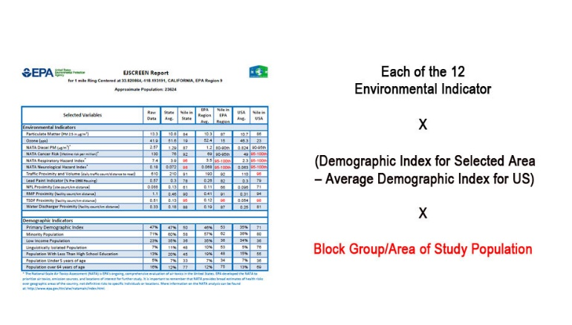
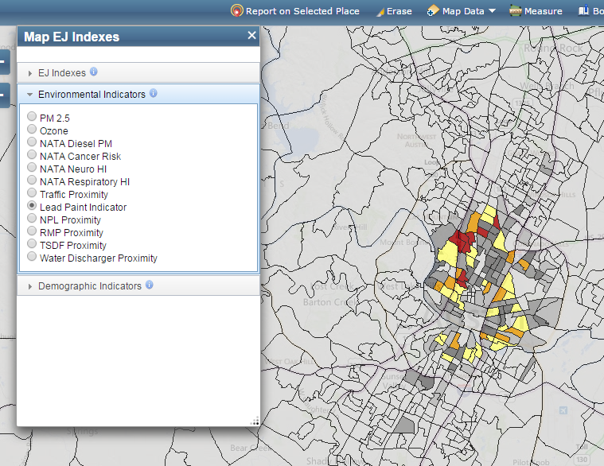
Viewing EJSCREEN Data
You can view all of the indicators in EJSCREEN within reports or on maps.
A standard report gives you all the indicators at once for a single specified location
A map gives you one indicator at a time, for each of the block groups within a wider area (e.g. across several miles)
Notes:
In EJSCREEN, you can view all of the environmental and demographic indicators within reports or on maps.
A standard report gives you all of the indicators at once for a single specified location, along with the selected buffer area. EJSCREEN maps are the perfect companion to the standard EJSCREEN reports. The maps allow you to look at the color-coded percentiles of the individual block groups within your buffer area for each type of index and indicator data. In addition, the maps allow you to see the values in all of the block groups that are adjacent to the area you selected to determine if other nearby areas warrant further investigation.

Slide 30
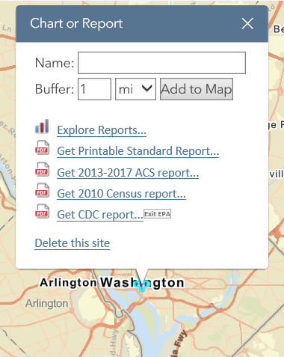
EJSCREEN Reports
Multiple reports available in EJSCREEN
Printable Standard Report
Sharable analysis of the selected location
Complete with maps, graphs, EJ indices, and raw values
Census Reports
Utilize ACS or decennial census data
Demographic analysis of the selected location
Health Data
Available at the county level via CDC reports
Notes:
EJSCREEN has multiple reporting formats to gather information on the selected locations. These reports summarize different data from various map layers in one convenient location.
The most commonly used report is the Printable Standard Report. This three-page report contains the percentiles for all the EJ indexes, bar graphs, a map of the selected location, and raw data and percentiles for all of the demographic and environmental indicators. It is printable and downloadable as a PDF which makes it very easy to share with others.
The Census reports are another very useful function. These are available for the decennial census or the American Community Survey census. They contain much more in depth data on population, race, languages spoken, and income than is available through the key EJSCREEN demographic indicators. These are especially useful for outreach and community engagement efforts.
In addition to these powerful reports, EJSCREEN also contains a quick explore reports function that produces quick customizable bar graphs and the ability to link to CDC’s Environmental Public Health Tracking Network for county level health and environmental data in easy-to-understand infographics.

Slide 31
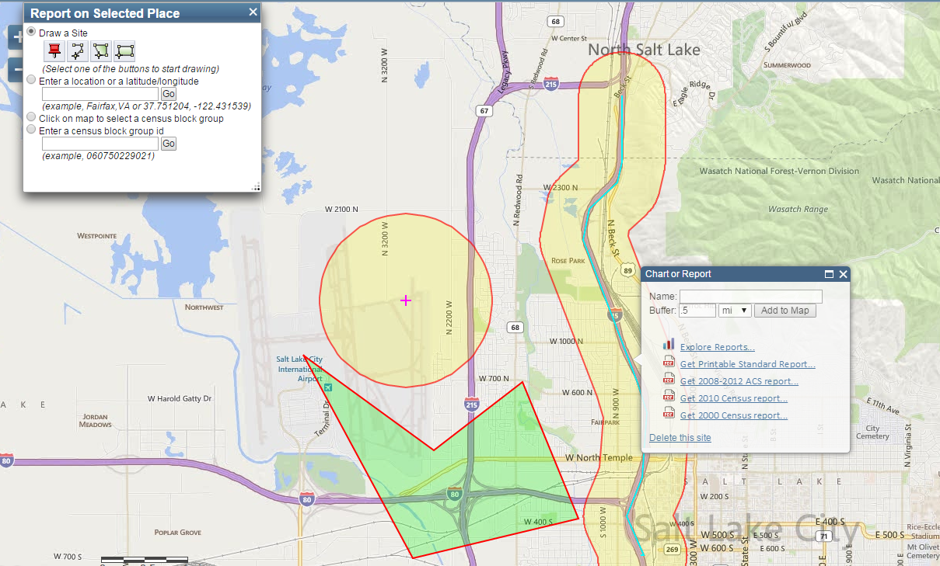
EJSCREEN Reports (cont’d)
You Can Specify User-Defined Areas to Generate Standard Reports
Notes:
EJSCREEN summarizes data for all residents within a user-defined area.
You can define a single area to generate a report in a number of different ways:
You can click on an individual block group.
You can lay down a circular buffer of a point and specify the radius. Here, in this example we laid down a 1-mile buffer.
If you know the specific parameters of the area you are studying, you can make irregular polygons, like the shape below our circular buffer.
Additionally if you are studying an area along a river or a highway, you can also lay down a line with a buffer on each side, as seen on the example
All of these options give you the ability to generate bar graphs, standard reports, and other reports for your specified area around a facility, a road, or a community that you have defined. Remember because demographic information is based on survey information try not to use data for a single block group for a comparison because this is less certain than for a “buffer area” that covers multiple block groups.

Slide 32
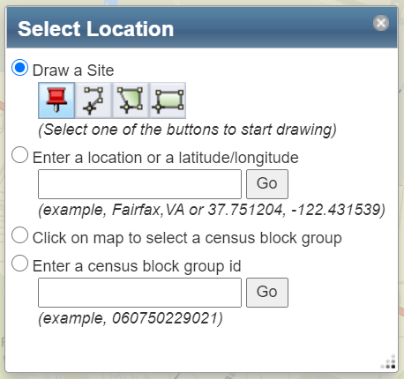
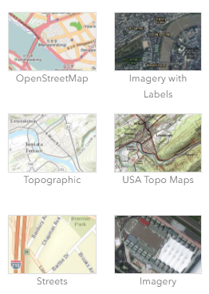
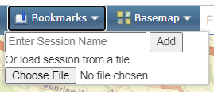
Mapping Considerations
Flexibility in how you select your area of analysis
Ability to use various base maps
Ability to bookmark locations for future analysis
Save focus communities
Save locations of potential projects
Notes:
EJSCREEN is designed to give users various ways to examine the maps and select the areas for analysis.
There is a huge amount of flexibility in how users select an area of analysis. Users can type in an address, drop points on the map and define a buffer size, or even draw out the boundaries of the area they would like to look at. One could use latitude and longitude coordinates or type in the name of landmarks to find a location. Finally, users can also select an entire town, city or even country as the area of analysis.
The tool has various base maps so users can switch to satellite maps to zoom in on a facility, use topographic maps to understand the terrain, or simply use street maps for a more recognizable view. The graphic on this slide shows just a few of the many types of base maps that can be used.
Users can also bookmark locations that they are looking at so they can come back to the exact same location with the exact same boundaries at a future time.

Slide 33
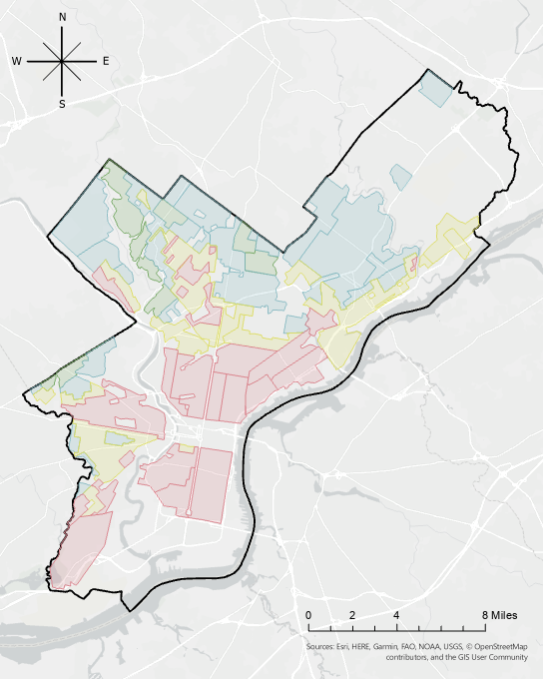
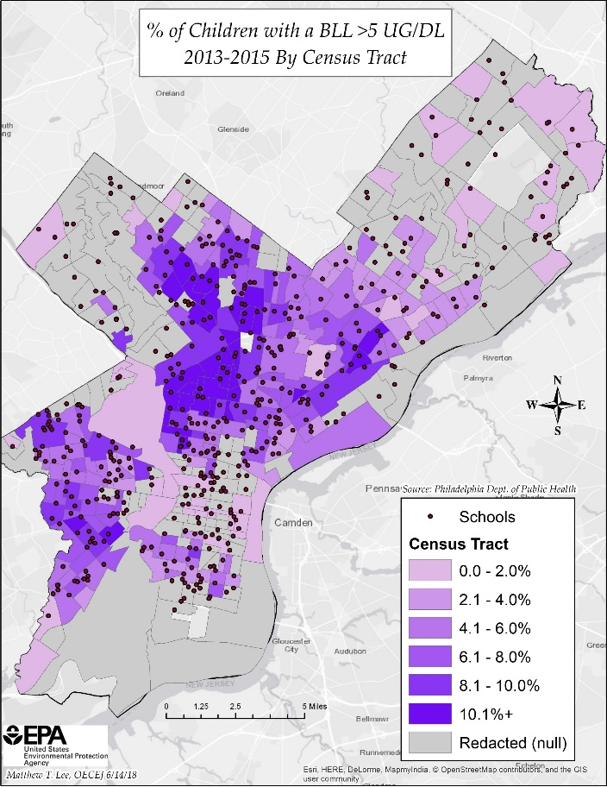
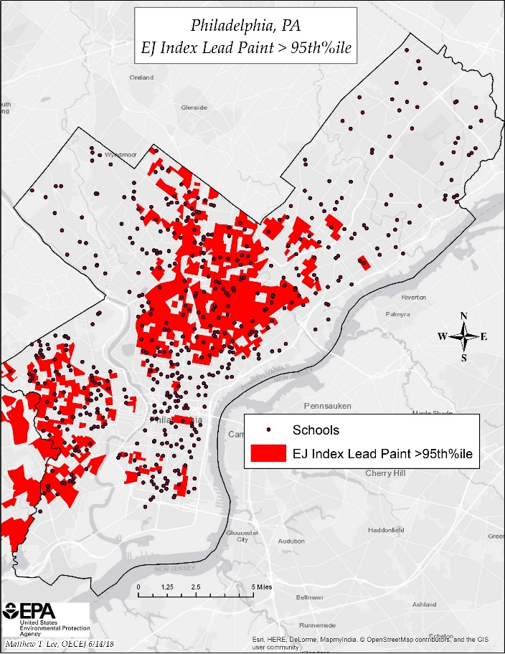
Enhancing/Supplementing EJSCREEN Info
Baseline screening should be supplemented with additional data, local information and experience.
1938 “Redlining” Map
Child BLL Map
EJSCREEN Map
Notes:
Depending on the type of analysis you are conducting on a location, it is a good practice to supplement EJSCREEN information with additional data layers. This slide shows an example of this. On the right is a snapshot of an EJSCREEN map in which the environmental indicator of lead paint was pulled, along with mapping schools. The middle map shows percentages of children with elevated blood lead levels. And the map on the left shows a historical redlining map. This practice is helpful in getting a fuller picture of environmental and public health burdens within a community, but again, the best practice is to verify results by getting into the communities themselves. Another term for this is ‘ground-truthing’.

Slide 34
EJSCREEN
Uses

Slide 35


EJSCREEN in Action at EPA
EPA uses EJSCREEN in the following ways:
for public outreach and engagement
enforcement targeting
inclusion in inspection reports
permitting and NEPA reviews
reviews of grant projects
other placed-based initiatives
inclusion in CCDS/ICIS
retrospective reporting
Notes:
Here are many of the ways that EPA is using EJSCREEN:
for public outreach and engagement
enforcement targeting
inclusion in inspection reports
permitting and NEPA reviews
reviews of grant projects
other placed-based initiatives
inclusion in Case Conclusion Data Sheets (CCDS) in the Integrated Compliance Information System (ICIS)
retrospective reporting

Slide 36

EJSCREEN Uses: Internal EPA
Enforcement & Compliance:
OECA requires an EJSCREEN review for civil enforcement cases when the case is initiated
If 11 EJ indicators are at or above 80th percentile, the case must undergo additional review for EJ concerns
OECA uses EJSCREEN to:
Assure that EPA enforcement personnel are aware of the potential EJ concerns in a community
Allows OECA to measure its enforcement work in areas with potential EJ concerns
Notes:
The office of Enforcement and Compliance Assurance was the first major use for EJSCREEN and is still the single biggest use of the tool inside the Agency. OECA EJSCREEN reviews take place in all regions and at headquarters.
Here are some of the ways that OECA uses EJSCREEN:
An EJSCREEN review is required for all civil enforcement cases when initiated
If 11 EJ indicators are at or above the 80th percentile, the case must undergo additional review for EJ concerns
OECA also uses EJSCREEN so enforcement personnel are aware of EJ concerns in a community they are working in, and so they can measure their work in those areas with potential EJ concerns.

Slide 37
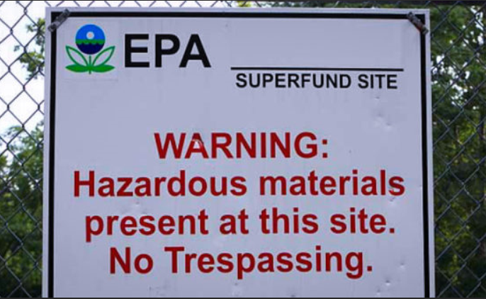
EJSCREEN Uses: Internal EPA
Superfund:
OSRTI uses EJSCREEN in their Community Profile Tool to describe the community affected by a Superfund site
Summarizes demographic information: significant populations, languages spoken, etc.
Addresses if community bears disproportionate burden of exposure or environmental health effects
Superfund has used EJSCREEN in their Congressional Justifications to better characterize demographics and environmental burden in affected populations around sites
Remedial program has used EJSCREEN to provide information when developing site characterization forms for locations being considered for proposal to the National Priorities List
Notes:
Another place within the Agency that EJSCREEN is used in a methodical manner is the Superfund program. The Superfund program has built the use of EJSCREEN into how they look at communities. Additionally, they have found other ad hoc uses of the tool:
OSRTI uses EJSCREEN in their Community Profile Tool to describe the community affected by the Superfund site
EJSCREEN has been used in congressional justifications
And the remedial program uses the tool to provide information on site characterization forms for locations being considered for the NPL

Slide 38
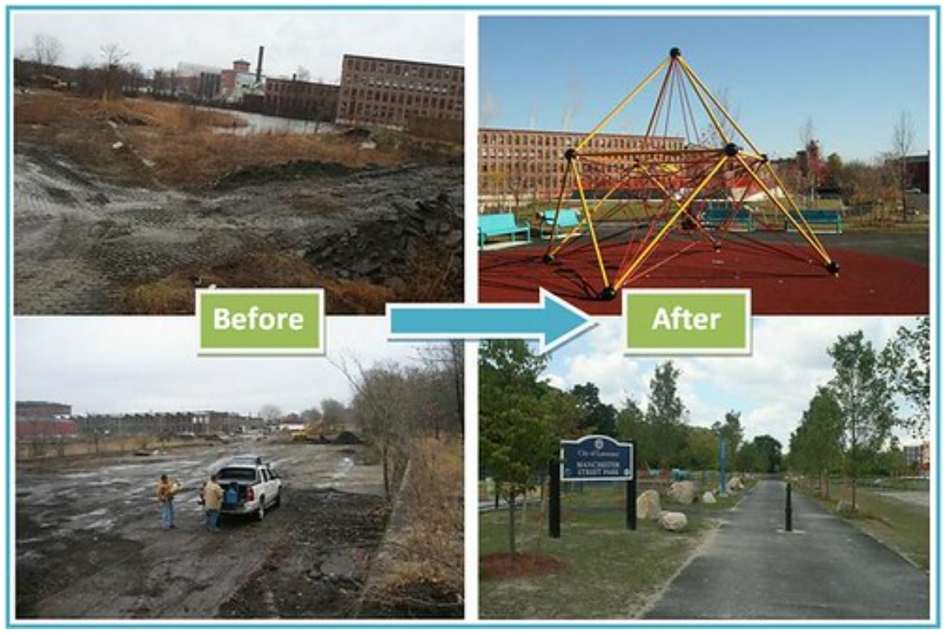
EJSCREEN Uses: Internal EPA
Brownfields:
Encourage Brownfields grant applicants to use EJSCREEN to better understand their communities’ EJ concerns
Helps inform site selection process
Identify Regional Focus Communities
Identify Targeted Brownfield Assessment (TBA) recipients
Helps with community engagement for residents in more challenged areas
Target areas for outreach on program resources
Notes:
The Brownfields Program also uses EJSCREEN in a variety of ways. They encourage Brownfields grant applicants to use EJSCREEN to better understand their communities’ EJ concerns; they use it to help inform site selection processes; to identify Regional Focus Communities and to identify Targeted Brownfield Assessment (TBA) recipients. They also use the tool to help with community engagement for residents in more challenged areas and to target areas for outreach on program resources.

Slide 39
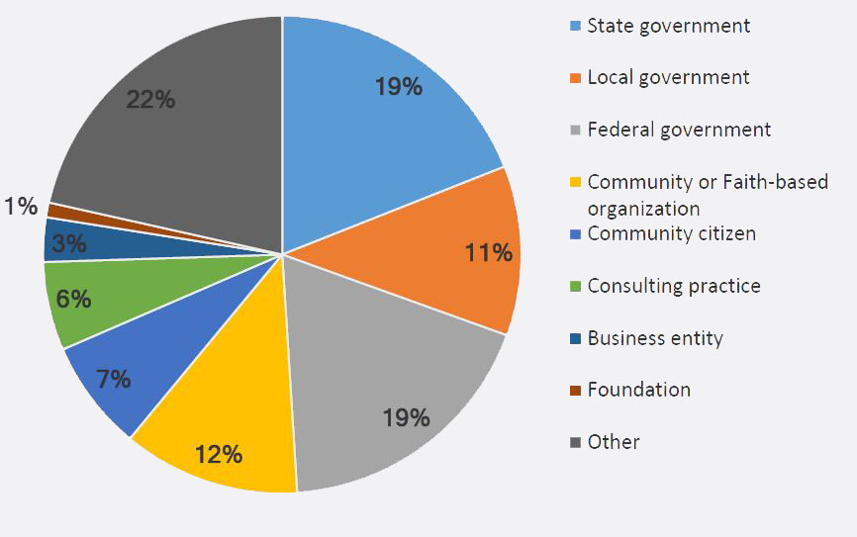
EJSCREEN in Action: External Users
Who is using EJSCREEN?
EJ analyses
Community outreach
Prioritization
Retrospective reports
Environmental analysis
Education and teaching
Research
Notes:
The list of EJSCREEN users keeps growing. Outside of the agency we are starting to see some very creative and dynamic uses of the tool and the data.
Some of the big categories of uses include:
EJ analysis or using the data to identify areas for potential EJ concerns
Community outreach using the demographic data is another very common use of the tool
Prioritization of projects and funding based on those most in need
Retrospective reports that look at the demographic or other factors for the locations that programs have worked in
Environmental analysis using the various EPA data sources in the tool to gain a better understanding of the pollutants impacting a given community
Using EJSCREEN to teach about environmental justice and mapping
Research has become another big focus of EJSCREEN users. Both through the existing tool and downloading the data to create new applications for the information
The pie chart is from a 2016 survey of 200 EJSCREEN users outside of the EPA. It shows which sectors are using EJSCREEN most. As you can see federal, state and local government account for about 50% of our users. Another large user which wasn’t captured in this survey and makes up some of the dark gray ”other” section is academia.

Slide 40



EJSCREEN: External Uses
Federal Government:
DOT, ACE, FEMA, and others use in their programs
State Governments:
Many states are building their own EJ tools based on EJSCREEN
This allows them to incorporate state specific information and other datasets
Local and Tribal Governments:
Use to implement environmental programs and regulations
Rely on EJSCREEN data as they often don’t have the resources to build their own tools
Notes:
As we saw in the pie chart earlier, other branches of government make up a large percentage of EJSCREEN users. We are constantly working with our governmental partners to help them better understand the tool and incorporate uses.
Many federal agencies such as DOT, ACE (Army Corps of Engineers), FEMA, and others have incorporated the use of EJSCREEN into their programs. We have worked with them to build out uses and ensure the data that they need is included in the tool.
State governments are another important user. We have consulted with states looking to develop their own state-specific tools and helped them understand how to import state data into EJSCREEN.
Local and tribal government have used EJSCREEN to implement their environmental programs and regulations and to map out demographics. They often rely on EJSCREEN data as they often don’t have the resources to build their own tools.

Slide 41
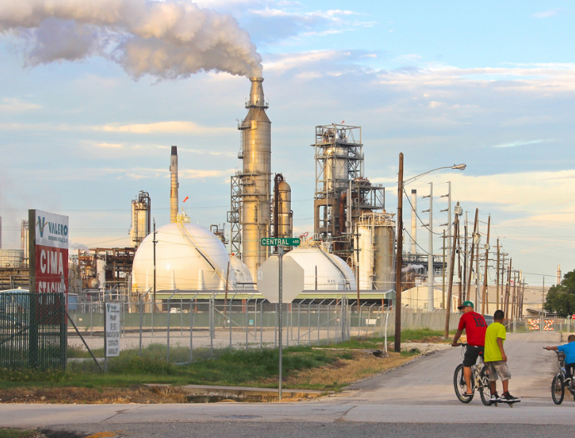

EJSCREEN: External Uses
Communities:
Identifying potential issues
Grant writing
Comparing environmental burdens
Academic:
Teaching about environmental justice
Research
Notes:
One issue that we have is getting better data on how users actually use EJSCREEN and its data. This is especially true with communities. We do know however, that many communities are using EJSCREEN to explore the local environmental issues and to see how the pollutants compare to other areas in the country. In this way, we are empowering communities with hard data that they can use to tell their story or advocate for more resources. One place we have seen a whole lot of use of EJSCREEN is in our EJ grant applications.
As I mentioned earlier, academia is another growing use of the tool. We are seeing classes taught using EJSCREEN from the grade school level up to the college level. In fact, last year OEJ partnered with ORD to develop a case study lesson plans for classrooms using both EJSCREEN and EnviroAtlas, an ecosystems services tool out of ORD. We plan to expand the education resources related to EJSCREEN in coming years.

Slide 42
Future of
EJSCREEN

Slide 43
Future of EJSCREEN
Continued incorporation into EPA programs and activities
Support of partners using EJSCREEN to consider EJ
Continued public engagement and evaluation
Improved training and access to learning materials
Improved usability and accessibility
Expansion of map layers relevant to EJ communities
Notes:
We are constantly looking for ways we can improve and expand EJSCREEN. We have had a lot of interest related to EJSCREEN from political leaders, press, and many others. For this reason, we are constantly trying to improve the tool based on the feedback that we receive.
One big focus is to continue to develop programmatic uses of EJSCREEN within EPA’s programs. There are many ad hoc uses of EJSCREEN across the agency, but we are looking to standardize those uses and develop program guidance to ensure they are fully integrated into the programs.
Another area that we will continue to work on is supporting our partners use of EJSCREEN. This is an important part of our focus as we are seeing many great and innovative uses of EJSCREEN and its data outside of the Agency.
We want to continue working with the public and with communities to build on their uses of the tool. Additionally, we want to continue to get feedback about how we can improve the tool and make it more useful for all.
We would like to improve our training resources and learning materials. This is both focused on making it easier for the new user to get basic information on how to start using the tool and also on creating more resources for classrooms and more formal learning settings.
We would like to do more work to ensure the tool is as user friendly and streamlined as possible. To that goal we are looking at performing some user interface/user experience testing on the tool in the coming year.
Finally, we are always looking to expand the map layers in the tool to better reflect the issues confronting EJ communities.
As we mentioned at the beginning of the training, we are relying on your help to develop programmatic uses of the tool for increased EJ integration at EPA. We are also relying on your feedback to continue improving the tool, improve training resources, etc. Again, we will be giving a training evaluation and survey at the end to start gathering information that will help with this effort.

Slide 44
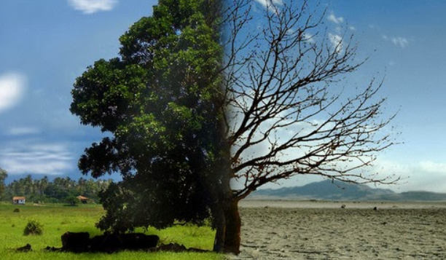

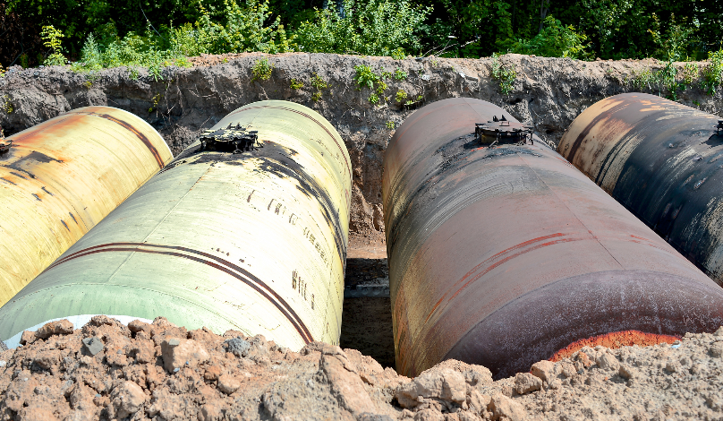
Expanding EJSCREEN Data
Continuously looking for EJ relevant data to incorporate
Criteria for inclusion of indicators
Environmental indicators:
Climate change indicators
Drinking water, pesticides, etc.
Underground storage tanks
Other indicators:
Health data
Amenities such as access to grocery stores
Notes:
The search for new and better data to incorporate into EJSCREEN is something we are constantly doing. We have known since the beginning of the tool that we have some great data but that there are many other critical important issues that are absent from the tool.
One of the difficulties with adding data into the tool is that we do have some important criteria. First, the data needs to have national coverage. There are many datasets that have data for most states but lack states and territories such as Alaska, Hawaii, the US Virgin Islands and Puerto Rico. We also strive to incorporate data at the block group level. Many datasets are not available at this fine resolution and incorporating them may be challenging.
We have a list of some important environmental issues that we have not yet been able to build into EJSCREEN as we have not been able to get the data at the level we need. Issues like pesticides, drinking water, CAFOs, and many others.
We are planning to expand the climate indicators in EJSCREEN in the coming years. We also are working to build in a new EJSCREEN environmental indicator on underground storage tanks using a new dataset developing by ORD and OLEM. Another exciting project we are working on is building US Virgin Islands data into EJSCREEN. Puerto Rico data has been included in the tool for a few years.
We have also been considering how we can build health data into EJSCREEN. This would be challenging due to the resolution of the health data but it is an important piece of the puzzle when considering vulnerability - making it a priority for the EJSCREEN team. We have also been discussing other amenities data such as access to grocery stores and public transportation.

Slide 45
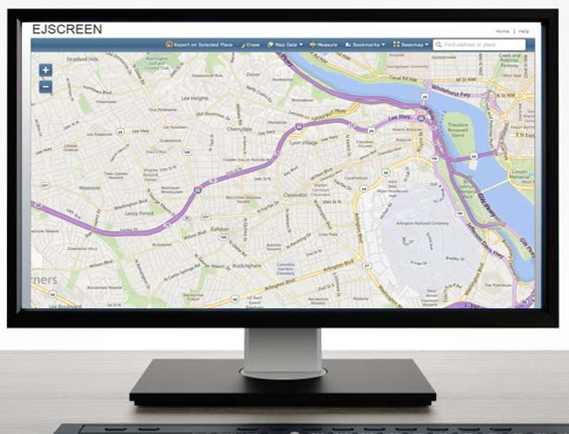
EJSCREEN Tool Learning Resources
EJSCREEN Website
Guidance Documents
Video Tutorials
Technical Information
Understanding Results
Other tools and resources
Click to access EJSCREEN Website
Notes:
We are going to do a live demo of the tool shortly but wanted to let you know that there is a compendium of learning resources available on the EJSCREEN website. There are guidance documents, video tutorials, technical information, more information about interpreting and understanding the data, and other tools and resources – including information on additional EPA mapping tools.

Slide 46
Questions?
Contact Information
XXXXX
Your office
XXXX@epa.gov
Notes:
*Note to facilitator - insert your contact info on this slide before you present!
Before we get to the demo, I wanted to give you my contact information. If you have any questions about EJSCREEN, feel free to reach out to me.

Slide 47

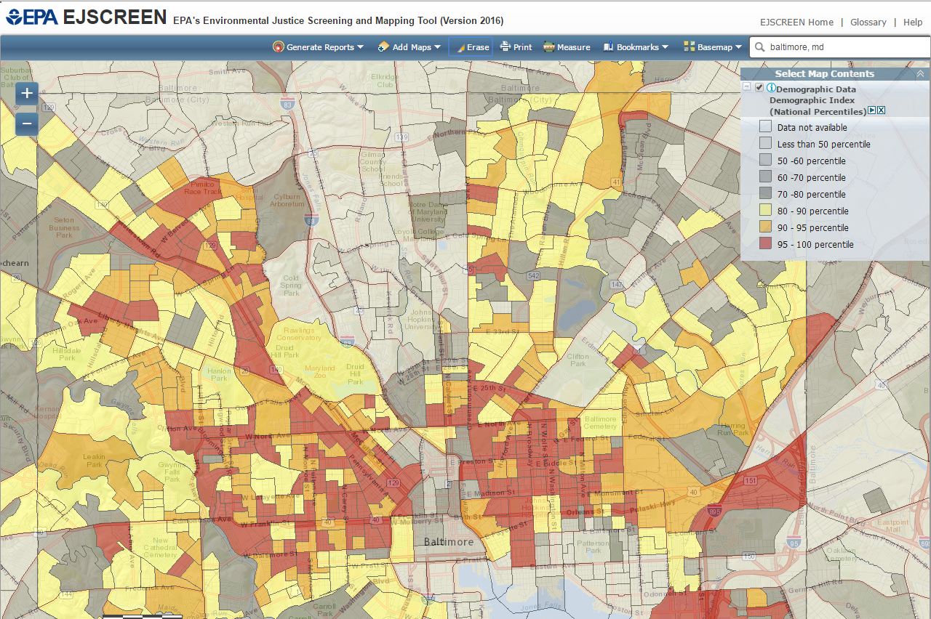
LIVE DEMO
Live Demo
Click to access EJSCREEN Tool
Notes:
I’m going to go ahead and do a live demo of the tool for you. And then I’m going to save the last 5-10 minutes for you to take an online training evaluation and survey.
*Note to facilitator: the link to the survey is on the final slide. You will want to copy and paste the link to the survey into the chat box for participants to click on and take after the live demo. If you run out of time in the training, you can email the link to participants after the training and ask them to complete the survey as soon as they can. The assumption is that more surveys will be completed if they are a captive audience at the end of the training. ☺

Slide 48
EJSCREEN Training Evaluation and Survey
Please take 5-10 minutes to complete the
EJSCREEN Training Evaluation and Survey
Notes:
Facilitator:
You can copy and paste the link on this slide for the EJSCREEN Training Evaluation and Survey into the chat box in the Teams environment.

