Slide 1
Conceptual Plan to Incorporate Air Toxics into an Annual Multi-Pollutant Platform
Briefing for OTAQ
November 5, 2020

Slide 2
Purpose
Present approach to develop an annual multi-pollutant emissions/modeling platform that incorporates air toxics
Leverage ongoing O3 and PM2.5 annual platform development already done
Similar to current emissions and modeling platform developed and applied for OTAQ rule RIAs that include mobile HAPs
As done for criteria pollutants for decades, it would provide analytical foundation for air toxics assessments that can support the OAQPS air toxics strategy and associated programs
More routine development on a recurring annual basis allows OAQPS to be more aware and expert in our nation's air toxics issues, similar to criteria pollutants

Slide 3
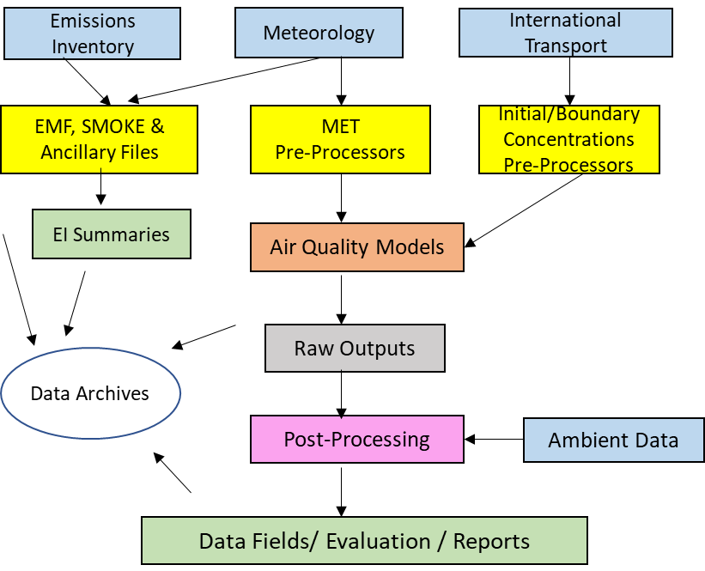
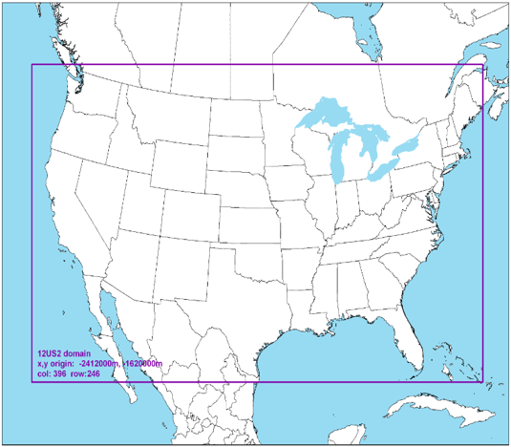
What is a Multi-Pollutant Platform?
Structured system of connected emissions, air quality modeling data and tools applied to a current year that provides a consistent and transparent basis for assessing the air quality response to changes in emissions and/or meteorology
Ultimate goal is a single, “harmonized” emissions and modeling platform for assessments of criteria pollutants (e.g., ozone and PM) and hazardous air pollutants (HAPs)

Slide 4
Benefits of an Annual MP Platform
Framework that provides a consistent, transparent, and state of science basis for a variety of technical assessments across the Office and programs
Better understanding of air toxics issues by providing for more routine, periodic technical assessments, as done for criteria pollutants
Allows us to identity issues earlier for air toxics and, in conjunction with other tools that could be developed to be more responsive in assessing implications of expected or potential changes
Supports our ability to conduct trends analyses for air toxics and evaluate success of our programs
Supports MP considerations and approaches to address area and community AQ issues, including Environmental Justice considerations
Promotes continual improvement in these platform data that strengthens the information generated to inform our programs and policies across pollutants
Platform data may be made available for EPA, states/local/tribal air agencies and others to use in a consistent, transparent, and more streamlined manner

Slide 5
What Questions Can an Annual Platform Help Inform?
In addition to O3 and PM2.5, what areas of the country have potentially highest exposures for HAPs?
What sectors/sources/pollutants contribute most to these concentrations/exposures?
Where might EPA and states need to consider deploying additional HAP monitors?
Which Sectors/Pollutants have changed over time and why? Are our programs effective at reducing air pollutant exposures?
How might areas consider multi-pollutant approaches to address regional, state, and local air quality issues? And harmful exposures to disadvantaged populations?
In addition to O3 and PM2.5, which HAPs have best/poorest model performance when compared to available ambient data?
Accounting for HAPs, what are the priorities for improving data quality across the emissions and modeling platform?

Slide 6
Adapting the Existing Annual Platform
For over a decade, we have developed an annual platform to characterize O3 and PM2.5 in collaboration with CDC
CDC platform completed about 2 ½ years after inventory year
2017 CDC in May 2020
We can leverage CDC effort* and include air toxics for an annual HAP+CAP platform
Include HAPs in the emissions and AQM CONUS runs
Add AERMOD emissions/modeling and hybrid approach for HAPs
Add Non-CONUS runs – AK, HI, PR/VI (separate model domains)
Keep working to get even more efficient over time as we have done with CAP-only for CDC and for air toxics for NATA
* "leverage" pertains to internal technical operations & CDC resources only not providing toxics data to CDC

Slide 7
Elements of the Annual MP Platform Plan
Overview
Products
Inventory Approach
Modeling Approach
Timing
Costs

Slide 8
Overview: HAP+CAP modeling platform
CMAQ Multipollutant – 12 CMAQ runs (4 domains; 1 base and 2 zero outs)
50 HAPs (including EtO)+ diesel PM, based on NEI
All 50 states, PR/VI (4 total model domains: CONUS, AK, HI, PR/VI)
Grid: 12-km CONUS, 9-km AK, 3-km HI & PR/VI
Two sets of zero outs: biogenics and fires (source apportionment when available)
AERMOD – All anthropogenic sources
185 HAPs + diesel PM, based on NEI
All 50 states, PR/VI
Gridded, block and monitoring site receptors
Source attribution (about 30 source groups)
Additional - point-only AERMOD run for point inventory QA
Hybrid approach: Combine CMAQ and AERMOD results to get finer scale annual average concentration for each HAP
Produce this every year, beginning 2017, and consider periodic updates for 1 or 2 historical years

Slide 9
Planned Platform Products
Emissions summaries
Model-ready emissions files for EPA Regions, MJOs, state/local/tribal agency use
Gridded emissions maps of CMAQ HAPs by modeling sector and total
Point source emission summaries
Modeled concentrations (gridded, tract level and census block for point sources)
CMAQ - Gridded concentrations of the 50 CMAQ HAPs, ozone and PM2.5 for all 50 states, PR/VI
CONUS at 12-km
Non-CONUS at 9-km for AK, 3-km for HI, and 3-km for PR/VI
AERMOD – Discrete receptor concentrations for 185 HAPs & diesel PM for all 50 states, PR/VI
Facility-level census block centroid receptor concentrations
Cumulative facility concentrations at census block centroid receptors
Hybrid – Annual average census tract concentrations by pollutant/source group
Consider option to apply for PM2.5 to provide more spatially resolved concentration estimates

Slide 10
Planned Platform Products (cont)
Fused Concentration Surfaces
O3 and PM2.5 fused concentration fields for CONUS and Non-CONUS
Air toxics concentration fields provided by hybrid approach (no data fusion product given very sparse measurement data)
Trends story maps (concentrations) -- reflecting the chosen historical years that we update periodically for purposes of tracking trends
Model evaluation for all HAPs (in addition to standard photochemical model evaluation of O3 and PM2.5)
CMAQ only
AERMOD only
Hybrid approach

Slide 11
Technical Approach for Emissions
The following approach meets the needs for both annual CDC and annual air toxics
Sector / group | Timing for input into SMOKE (triennial year*) | Approach
Point (includes airports) | MET Year + 1.5 (2020 in June 2022) | Use annual NEI & CEMS data, projections using activity data for non-triennial years for airports and railyards
Onroad/Nonroad | MET Year + 1.75 (2020 in September 2022) | MOVES with VMT and inputs based on triennial-submitted data or projections for non-triennial years
CMV | MET Year + 1.75 (2020 in September 2022) | Projection from triennial OR approach to use AIS year-specific data if can further automate process
Fires | Met Year + 1.75 (2020 in September 2022) | Default approach for non-NEI year has been to use a small subset of national activity data to estimate fires. We are recommending using entire national activity data suite that is used for NEI for ALL years. No SLT data for non-NEI years is planned.
One-time event | Fit in, as necessary | Non-CONUS – Hawaii volcano in 2018 Collaborate with ORD
Oil and gas | MET Year + 1.75 (2020 in September 2022) | Oil and gas tool run or projections. If run tool, also produce year-specific surrogates and temporal profiles.
Nonpoint (includes rail) | Met Year + 2.25* (2020 in March 2023) | Triennial or non-triennial year projections
Biogenics | Year-specific | Year-specific
Speciation | No later than latest inventory piece | Use HAP emissions for explicit CB6 species: naphthalene, benzene, acetaldehyde, formaldehyde and methanol

Slide 12
Air Quality Modeling Approach
MET data from Weather Research Forecast (WRF) model
CONUS typically generated for CDC, other regulatory projects, and for permitting
Separate WRF runs for non-CONUS domains
MMIF outputs for AERMET pre-processing needed for AERMOD
Multi-Pollutant version of CMAQ
ORD provides MP version for our CONUS and Non-CONUS simulations
Boundary conditions from most recent hemispheric run and remote concentration estimates
HAP Zero-out runs for fires and biogenics (facilitates hybrid approach)
Latest regulatory version of AERMOD run at NCC
Model unit emissions rate / apply post processing
Gridded, block and monitor receptors
Urban/rural using population (or land use)
Hybrid approach combining CMAQ and AERMOD results
Compute census tract average concentrations

Slide 13
Timing of Annual Platform
Link to annual CDC product (CONUS) = MET year + 2.5, add time for non-CONUS
CONUS CMAQ simulations
Emissions in April (e.g., 2018 completed April 2021)
Modeling in June (e.g., 2018 completed June 2021)
Non-CONUS CMAQ simulations
Emissions in April (e.g. 2018 completed April 2021)
Air Quality in July (e.g., 2018 completed July 2021)
CMAQ Zero outs simulations (2 per domain, 2 x 4 = 8)
CONUS in July
Non-CONUS in August
AERMOD simulations
CONUS and Non-CONUS conducted at NCC in parallel with CMAQ simulations
Hybrid approach results
1 month after CMAQ & AERMOD simulations complete

Slide 14
Costs: Leveraging CDC & Other Existing Projects
Currently can leverage CDC Phase project & other work efforts:
CMAQ and AERMOD MET Inputs (for CONUS)
Year-specific Inventories
SMOKE runs
CMAQ CONUS simulation (year-specific)
Added for this approach so need recurring resources:
Non-CONUS MET
Non-CONUS CMAQ simulations
CMAQ Zero-outs: HAP Source attribution
CONUS & Non-CONUS AERMOD model-ready emissions and model simulations
Hybrid approach for HAP concentration estimates

Slide 15
Resources: Costs and FTE
Item | CMAQ, AERMOD & Hybrid
 |  | $ Needed (k) | $ Leveraged (k) | FTE | Comments
MET (WRF/MMIF) | CONUS |  | 40
 | Non-CONUS | 50
MOVES run |  |  | 20
Oil and Gas run |  | 30 |  |  | Sometimes paid for by NEI
SMARTfire run |  |  | 10
CMAQ emissions | CONUS |  | 25
 | Non-CONUS | 20
AERMOD emissions |  | 20
CMAQ Modeling | CONUS base |  | 15
 | Non-CONUS base (3 domains) | 45 |  |  | Estimate - need to get 2017 actuals
 | Zero outs (4 domains) | 75 |  |  | Estimate - need to get 2017 actuals
AERMOD Modeling |  | 0 |  | x
Hybrid approach |  | 0 |  | x
O3 and PM2.5 spatial conc. fields |  | 0 |  | x
Model Evaluation (HAPs, O3, PM2.5) |  | 0 |  | x
Outstanding funding need |  | 240
CONUS/Non-Conus |  | 125/115
Notes:
What we expect to pay each year moving forward. Assumes recent NEI is available upon which the non-NEI year can be based. (including tool inputs for oil and gas, such as speciation and slight adjustment of MOVES inputs for the non-NEI year as opposed to gathering new inputs). Does not cover updating our methods.

Slide 16
Next steps
Continue to engage across OAQPS and OTAQ to gain feedback on the potential use of this MP platform for air toxics (and beyond)
Can inform those discussions by using 2017 HAP+CAP results to illustrate how we can inform desired assessments
Engage with OTAQ on expanded partnership
Support for MP Platform and willingness to help fund?
Re-engage with CDC on current agreement at OAQPS level per products and funding
Are they interested in HAPs, non-CONUS, tract level, source attribution?
Request increase of funding from CDC?
Current funding from CDC has remained constant for ~4 years but our costs have increased
We can improve approach for annual (non-triennial) inventories for fires, oil and gas, other sectors
Discuss Research Needs with ORD
Continue to incorporate ORD research on ETO, PFAS and other air toxics
Status of CMAQ HAPs
Development of source apportionment for toxics

