Slide 1
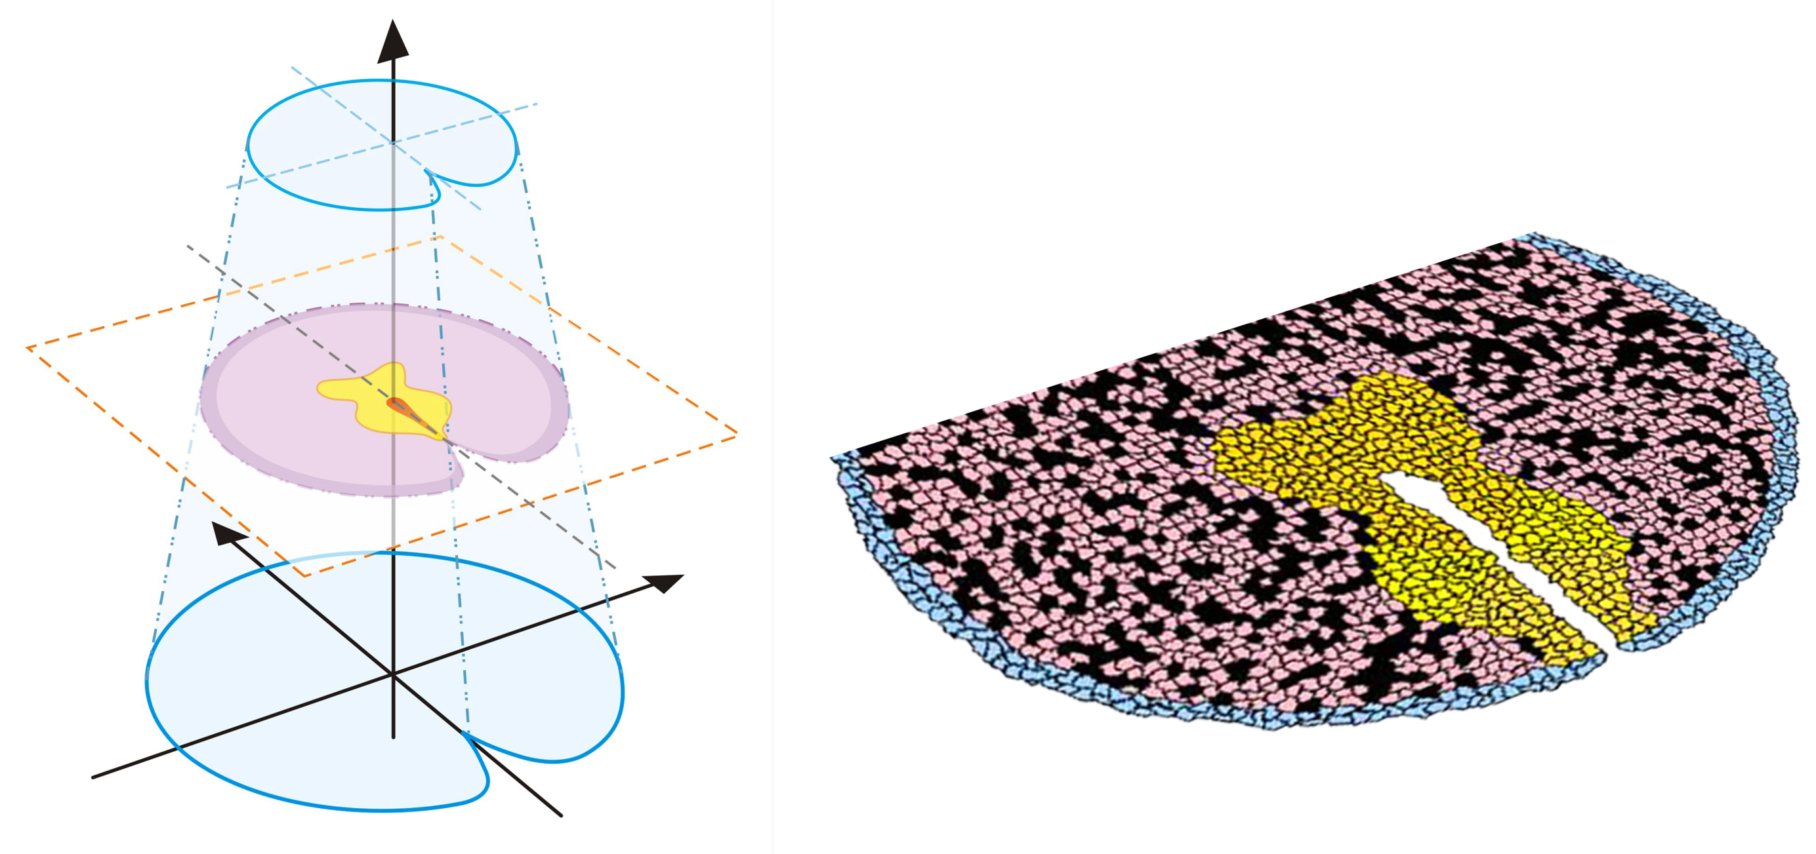
Distal
Urethral plate endoderm (UPE)
Core mesenchyme
Extracellular matrix
Dorsal
Lateral
Proximal
Ectoderm
Preputial mesenchyme
Lateral
Ventral
Excluded UPE
Lumen
Fig. 1

Slide 2
Apoptosis
Growth
only for eUPE
UPE/eUPE
GLI1/2/3
SMO
PTCH1
AR
FGFR2IIIb
SHH
FGF10
Androgen
PTCH1
SMO
GLI1/2/3
FGFR1
CM/PM
AR (only for PM)
only for CM
Apoptosis
Growth
Fig. 2

Slide 3
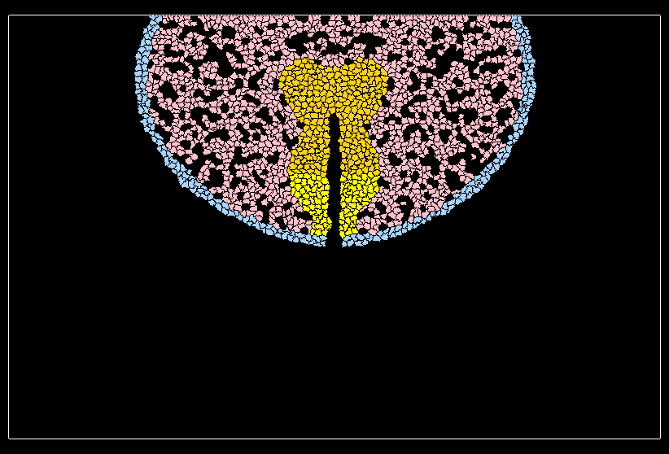
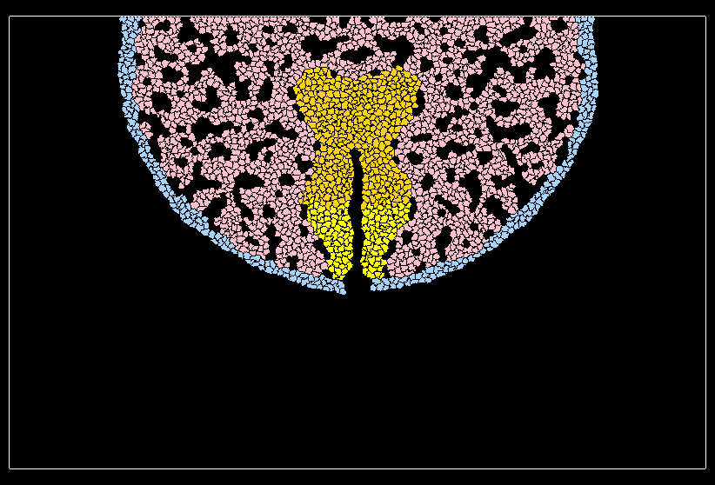
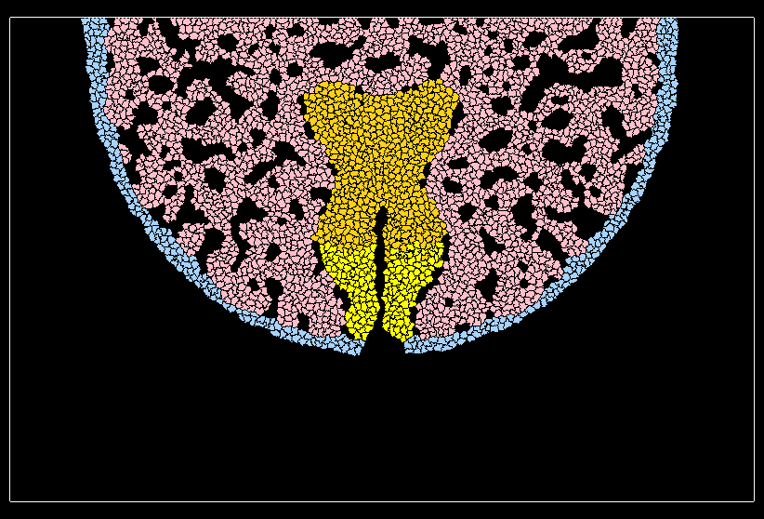
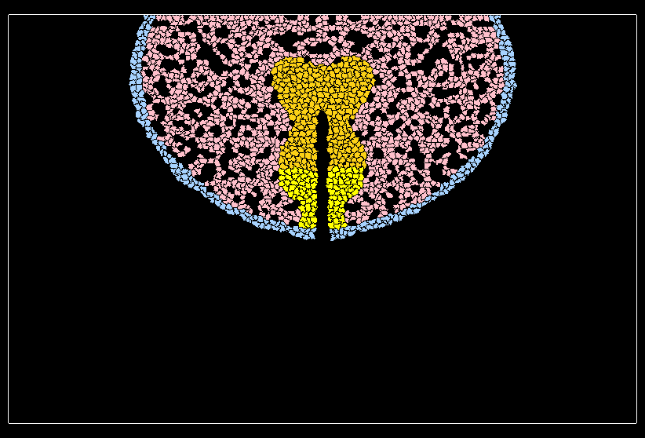
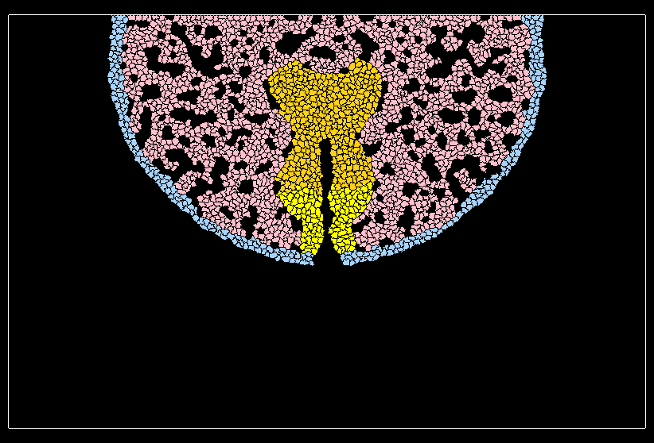
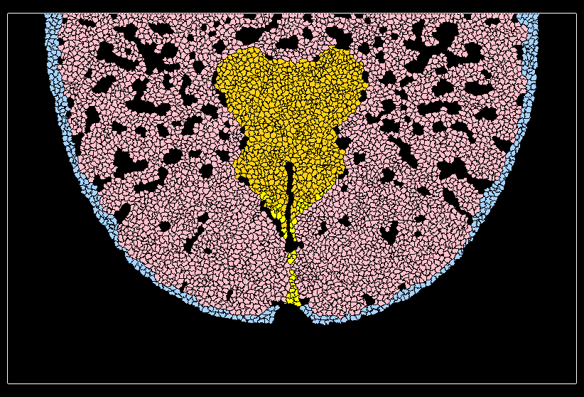
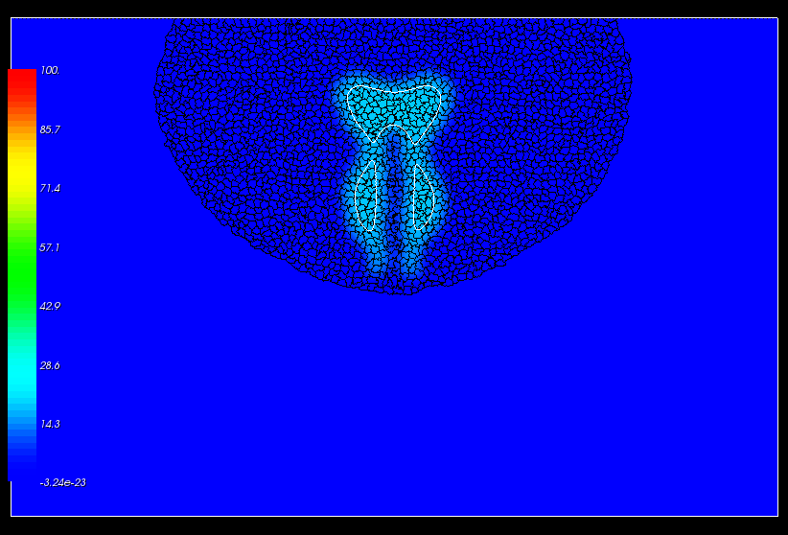
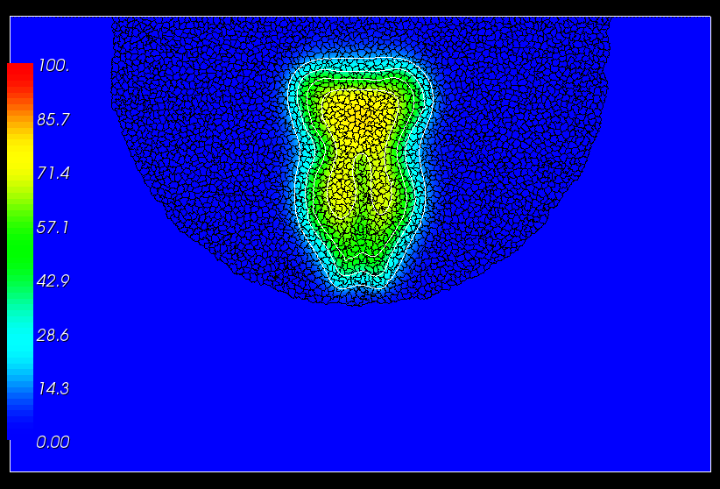
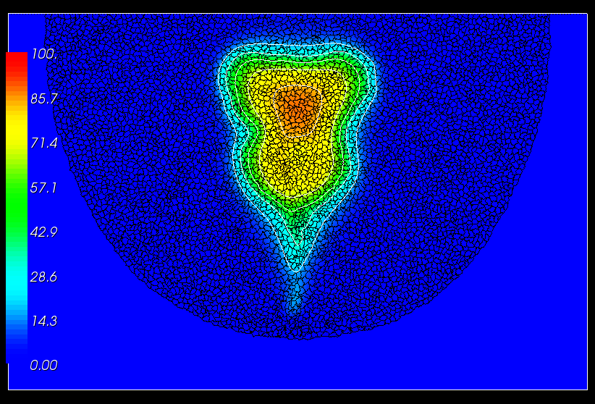
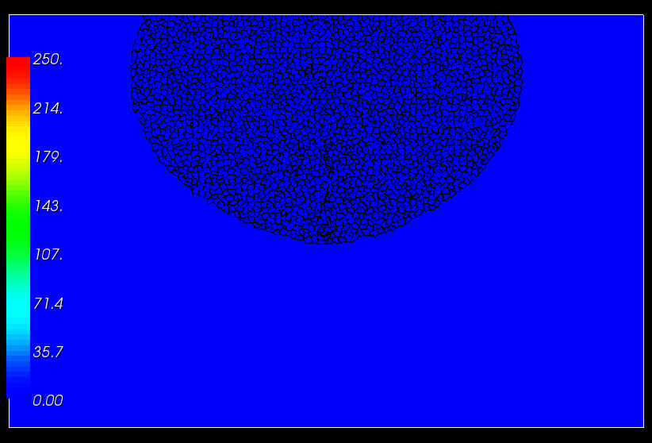
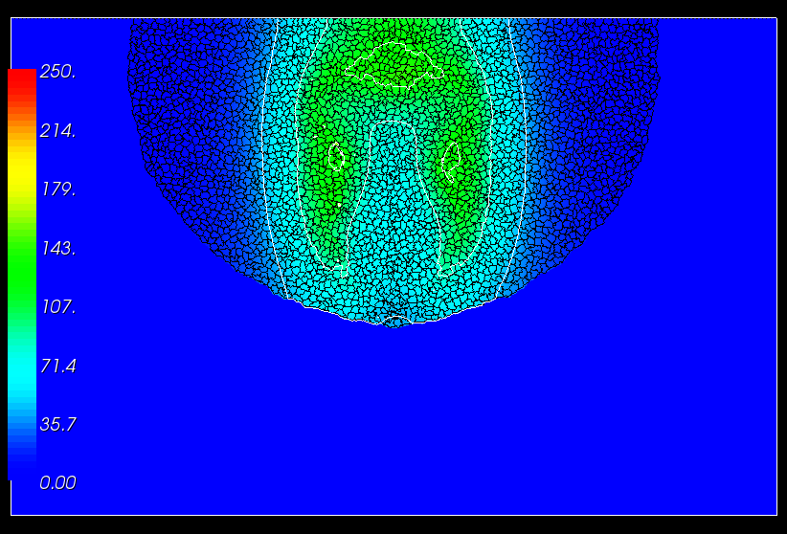
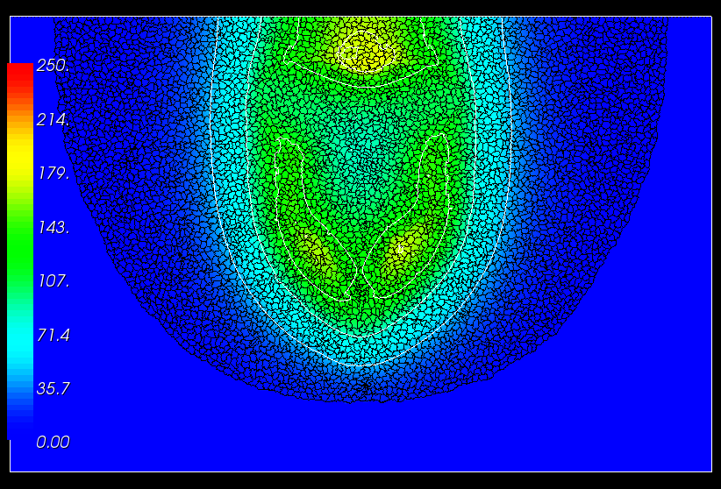
Gestation Day
E13.5
E15.5
E17.5
Female
Cells
Cells
Male
SHH
Fig. 3
FGF10

Slide 4
2500
2000
1500
1000
500
0
Androgenization in males
Cell Number
Sex
CM
Male
Female
PM
UPE
EC
eUPE
MCS
Gestation Day
0 1000 2000 3000 4000
E13.5 E15.5 E17.5
Fig. 4

Slide 5
A
B
eUPE
Fold Change of Cell Number
Fold Change of Cell Number
EC
CM
CM
EC
eUPE
UPE
UPE
PM
PM
% SHH function
% AR function
Fig. 5

Slide 6
AR
Onset of Androgenization
A
B
Condensation
Fusion
Septation
% Incidence by E17.5
% Incidence by E17.5
E15.5 E16.5 E17.5
% AR function
Gestational days
Fig. 6

Slide 7
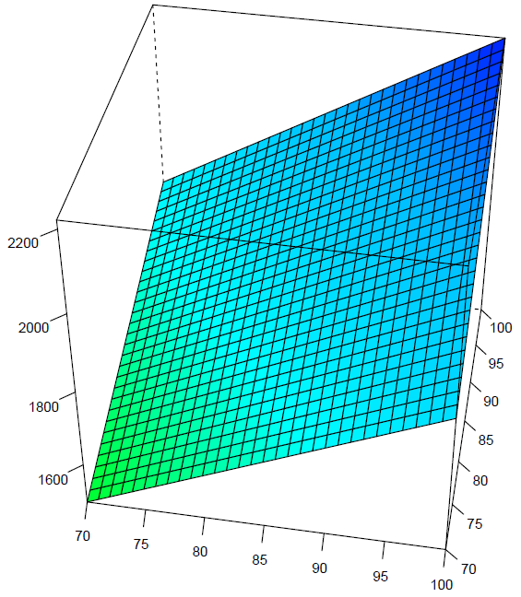
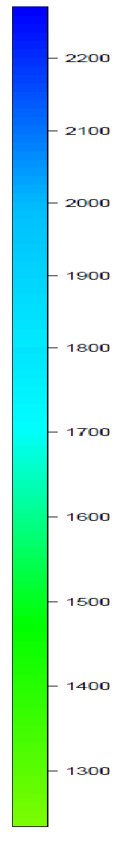
2200
Cell Number of Preputial Mesenchyme
1700
2200
Hypospadias threshold
2000
100
95
1800
90
1300
85
1600
80
% FGF10 function
70
75
80
75
85
90
95
100
70
% AR function
Fig. 7

