Slide 1
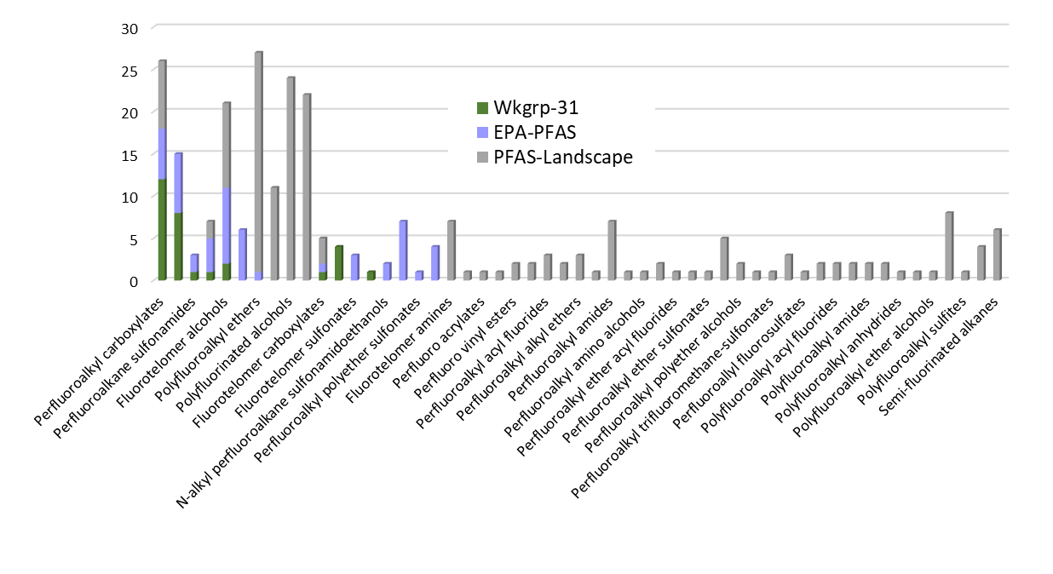
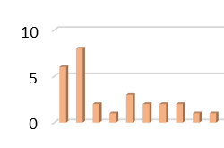
Data collection;
Pre-defined structural categories
Maximizing Read-across
Capturing Structural Diversity
On Wkgrp-31 list;
Availability of in vivo data
On EPA-PFAS list;
Availability of in vivo data
Availability of in vivo data
EPA interest
in vivo data lacking
Characterizing the PFAS Landscape
Step 0: Characterizing the PFAS library
Step 1: Select substances from categories of greatest interest to the Agency
Step 2: Select substances from categories of interest to the Agency
Step 3: Select substances from remaining categories with in vivo data
Step 4: Select substances from categories of interest to the Agency
Step 5: Select substances from remaining categories
53 substances: 12 categories
5 structural categories
+6 structural categories*
+2 structural categories
+5 structural categories
+10 structural categories
Agency interest
*2 categories contained only 1 chemical, so were not included
9 substances:
6 categories
Availability of in vivo data
13 substances
10 categories
53 structural categories

Slide 2
EPA interest; Value for read-across
In vivo data
Data lacking; capturing structural diversity
Workflow Step:
1: Wkgrp-31
2
3
4: EPA-PFAS
5: PFAS-Landscape Categories
(c) Final Chemical Count
Final 75 PFAS Selection
(b) ToxVal Record Count
(a) Total Chemical Count
PFAS-Landscape
PFAS Categories

