Slide 1

Linking in vivo toxicity data to ToxCast/Tox21 in vitro assay data
Richard Judson
U.S. EPA, National Center for Computational Toxicology
Office of Research and Development
EuroTox Bratislava, September 2017
The views expressed in this presentation are those of the author and do not necessarily reflect the views or policies of the U.S. EPA

Slide 2
Biological Modeling: From Society to Sequences
Society puts T tons of chemical X into the environment
Person P is exposed to Y amount
Can we predict T, Y?
Can we predict the effect on P at the level of molecules, cells, tissues, organs?
Need to model biology that is multiscale, complex, non-linear, in the presence of noise and variability
Specific Prediction Goals
  How much is a person exposed to?
  What is the minimum exposure required to trigger adversity (POD)?
  What adverse outcome is triggered at those doses?

Slide 3
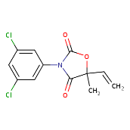
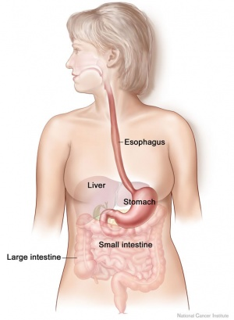
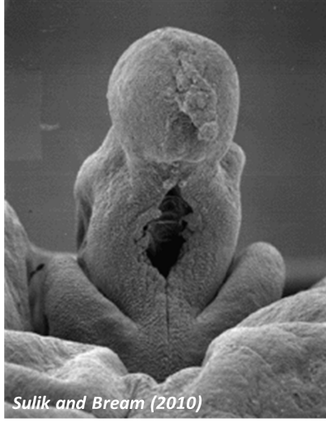
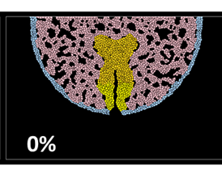
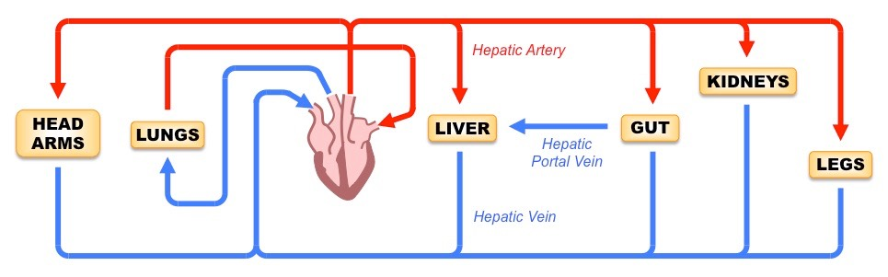
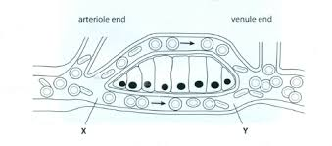
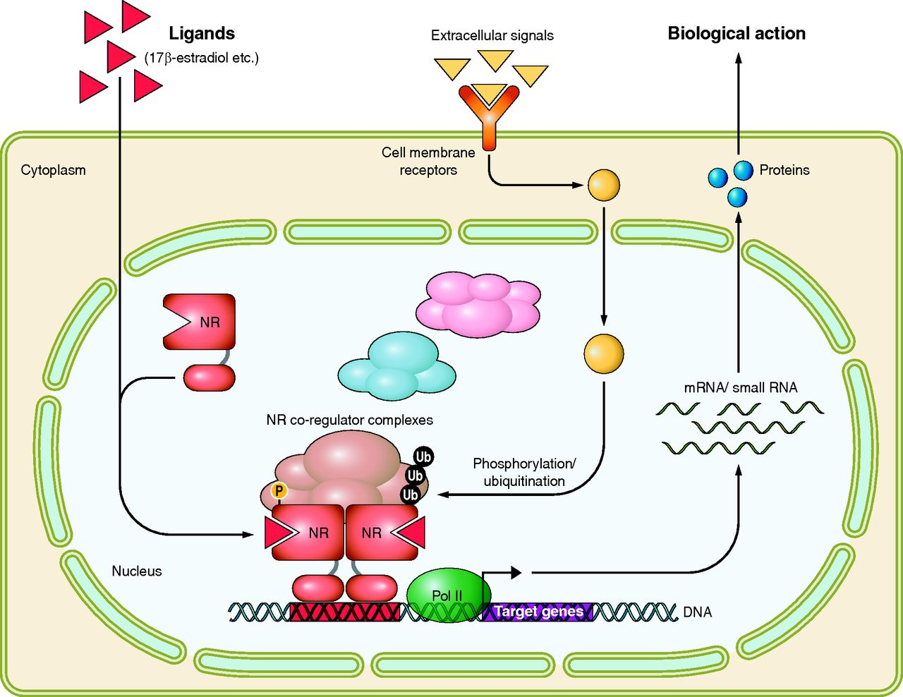
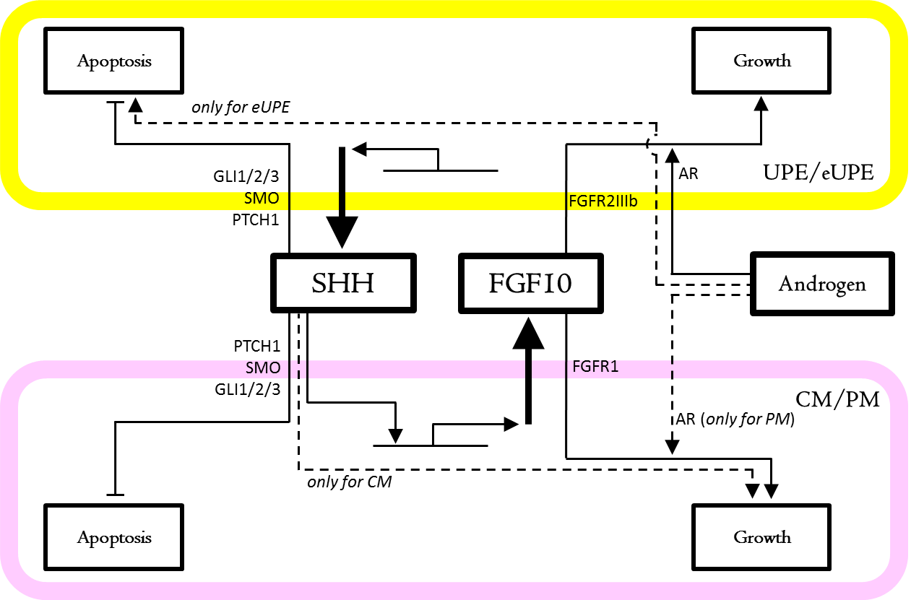
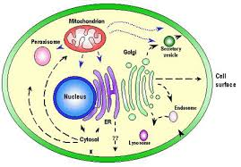
Multiscale
Chemical
Mouth
GI Tract
Blood
Liver
Tissues
Cells
Proteins/DNA
Molecular Circuits
Cells
Tissue
Organ
Organism
Kinetics
Dynamics

Slide 4
Key Issue with predictive modeling:
In Vivo data itself is uncertain
Qualitative Concordance Across Studies for Anemia
Species / study 1 | Species / study 2 | Concordant | Not Concordant | Fraction Concordant
rat SUB | rat CHR | 18 | 2 | 0.90
rat CHR | dog CHR | 13 | 2 | 0.87
rat CHR | rat SUB | 18 | 4 | 0.82
rat SUB | rat SUB | 16 | 4 | 0.80
rat SUB | dog CHR | 11 | 4 | 0.73
mouse CHR | rat CHR | 11 | 4 | 0.73
mouse CHR | rat SUB | 13 | 7 | 0.65
dog CHR | rat SUB | 11 | 6 | 0.65
dog CHR | rat CHR | 13 | 8 | 0.62
rat CHR | mouse CHR | 11 | 11 | 0.50
mouse CHR | dog CHR | 6 | 6 | 0.50
rat SUB | mouse CHR | 13 | 14 | 0.48
dog CHR | mouse CHR | 6 | 8 | 0.43
mouse CHR | mouse CHR | 2 | 3 | 0.40
Judson et al. Reg. Tox. Pharm (2017) “Retrospective Mining of Toxicology Data to Discover Multispecies and Chemical Class Effects: Anemia as a Case Study”.

Slide 5
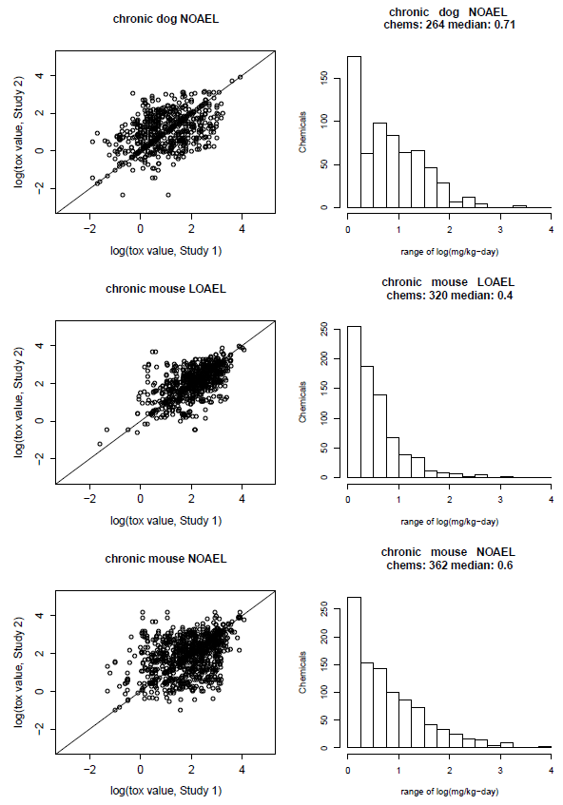
Quantitative uncertainty affects accuracy of POD estiamtes
EPA ToxVal Database gathers POD information from multiple sources
ToxRefDB
ECHA
EFSA
COSMOS
ATSDR
IRIS / PPRTV
eTox (future)
…
Allows comparisons of multiple studies for the same chemical

Slide 6
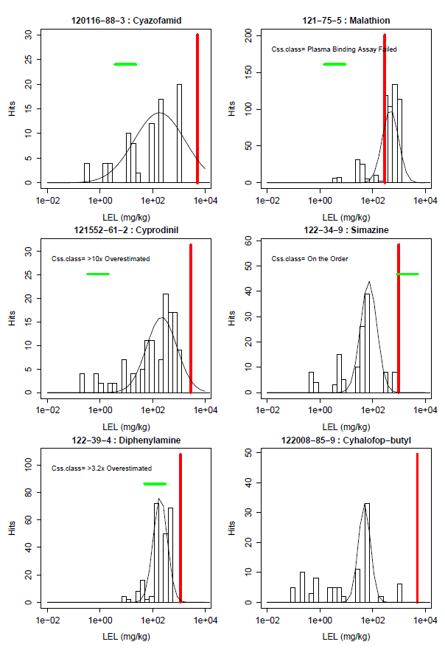
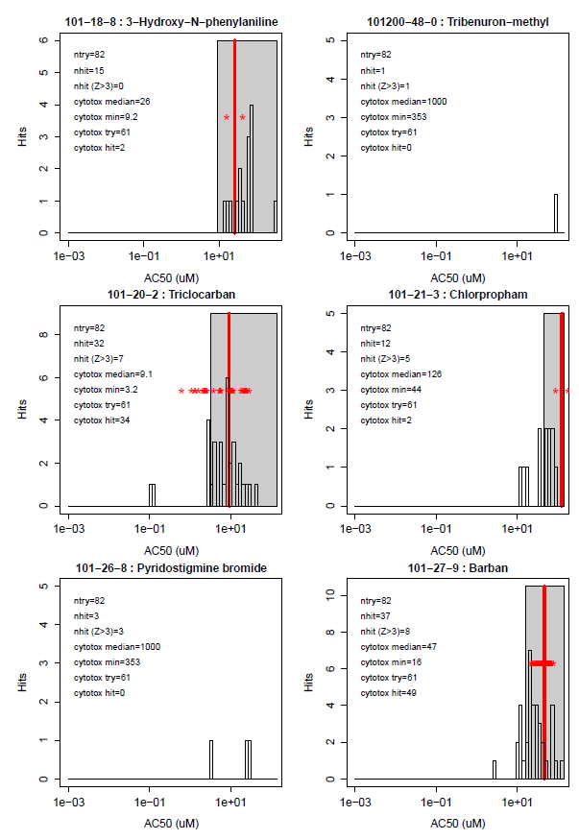
Most activity comes at high doses
Indicates non-specific effects
In vivo
In vitro

Slide 7
Sources of Uncertainty / Variability In Vivo
Experimental variability
  Species, strain, dose range, dose spacing
Statistical power issues
  Too few animals to see weak or rare effect
Reporting bias
  Was an effect negative or not looked for?
Observer bias
  Less severe phenotypes not reported when more severe ones are present
Diagnostic terminology drift
Data assimilation and analysis
  Typos, incomplete transcription

Slide 8
In Vitro to In vivo Toxicity Model Examples
Quantitative Point of Departure Prediction
  IVIVE ab initio
  QSAR / QBAR by analogy
Virtual Tissue Prediction of Developmental Phenotypes
  In vitro to in vivo ab initio with detailed mechanism
Tipping Point Prediction of Adversity Threshold
  In vitro used to infer in vivo adversity dose

Slide 9
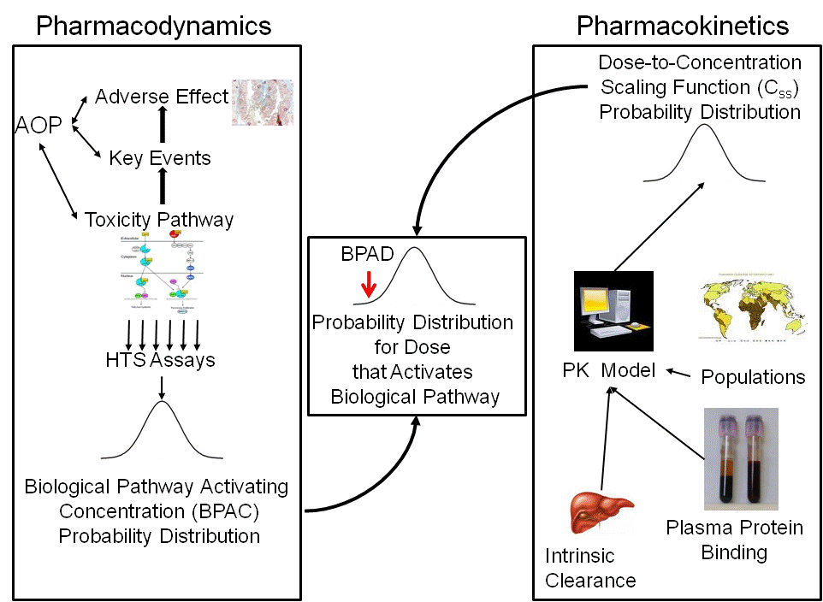
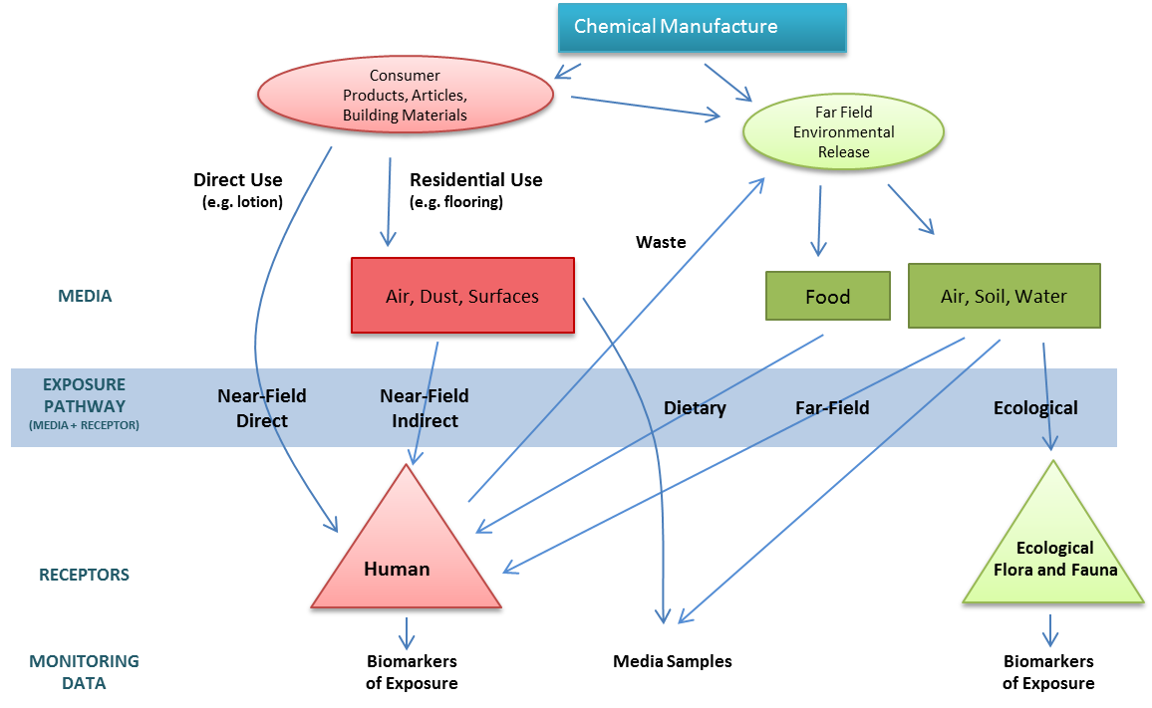
HTRA – High-Throughput Risk Assessment
High-throughput Hazard and Kinetics
+
High-throughput Exposure

Slide 10
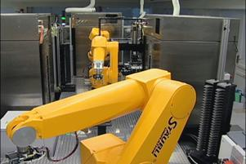
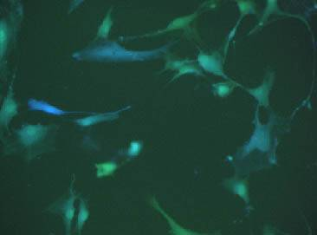
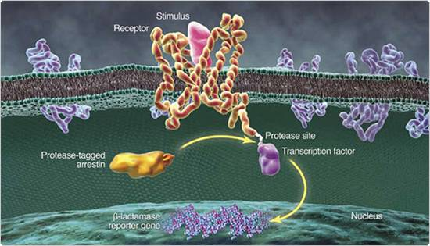
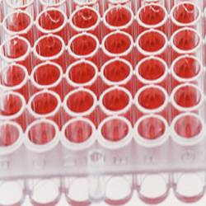
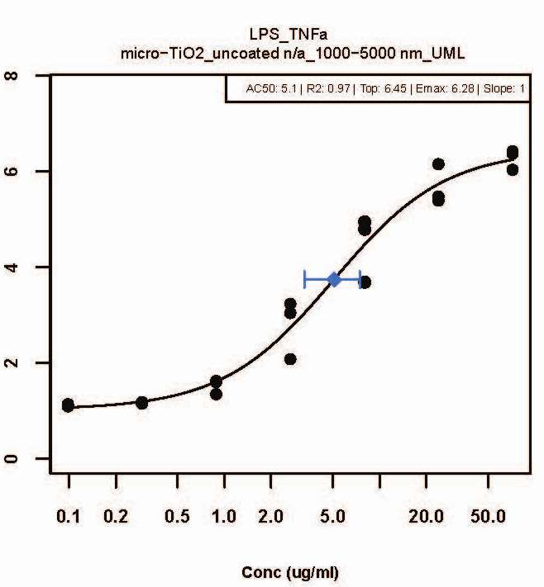
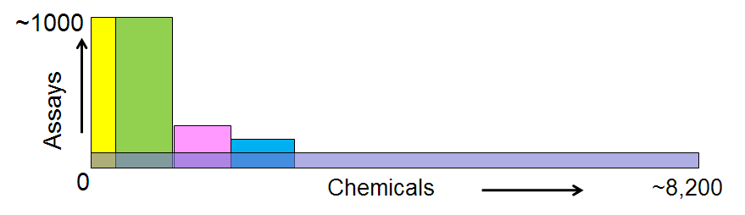
High-Throughput Screening 101 (HTS)
Robots
Cell Population
Target Biology (e.g., Estrogen Receptor)
Output is AC50 (μM)
96-, 384-, 1536 Well Plates
Chemical Exposure
Emax
Response
LEC
AC50
Conc (uM)
10

Slide 11
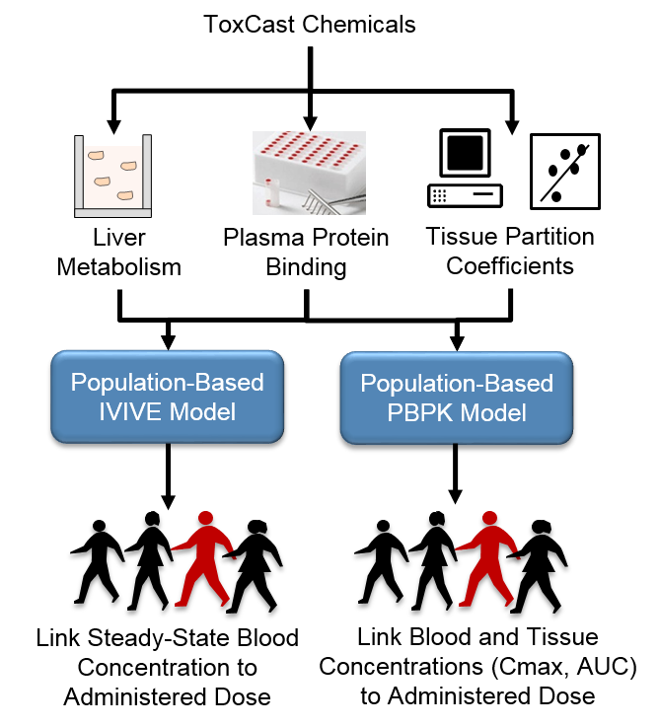
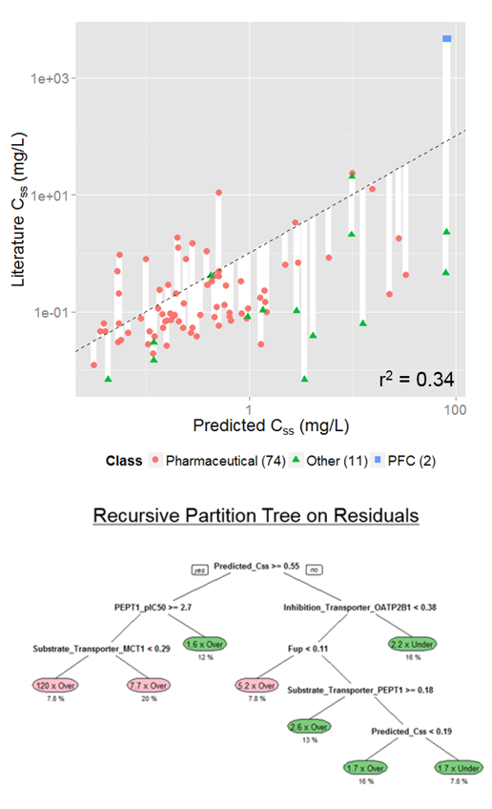
Toxicokinetics Modeling
Incorporating Dosimetry and Uncertainty into In Vitro Screening
Outcome = Css (Concentration at Steady State given a 1 mg/kg/day dose)
Wetmore, Rotroff, Wambaugh et al., 2013, 2014, 2015
Notes:
I think we have heard yesterday, how important TK is in interpreting the results from NAMs. This includes both read across and the in vitro testing. However, first, we need to have an in vitro and in silico approach to generate the TK data that we need and we need to be rigorous in characterizing the uncertainty around whatever approach we develop.

Slide 12
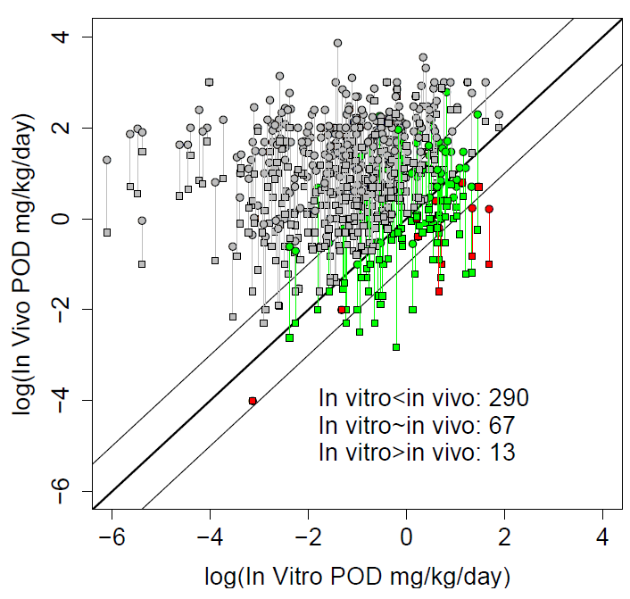
Predict POD using in vitro POD, Toxicokinetics and Uncertainty
POD(IVIVE) = AC50(min) / Css(HTTK)
~4% have in vitro POD consistently greater than in vivo values (health protective)
Issue: what is the correct in vitro POD assay?
min?
min associated with AOP?
cytotoxicity?

Slide 13
Predict POD using Machine Learning Combining
Chemical Descriptors + In vitro data
Truong et al. In revision
Accuracy somewhat limited by
underlying data uncertainty

Slide 14
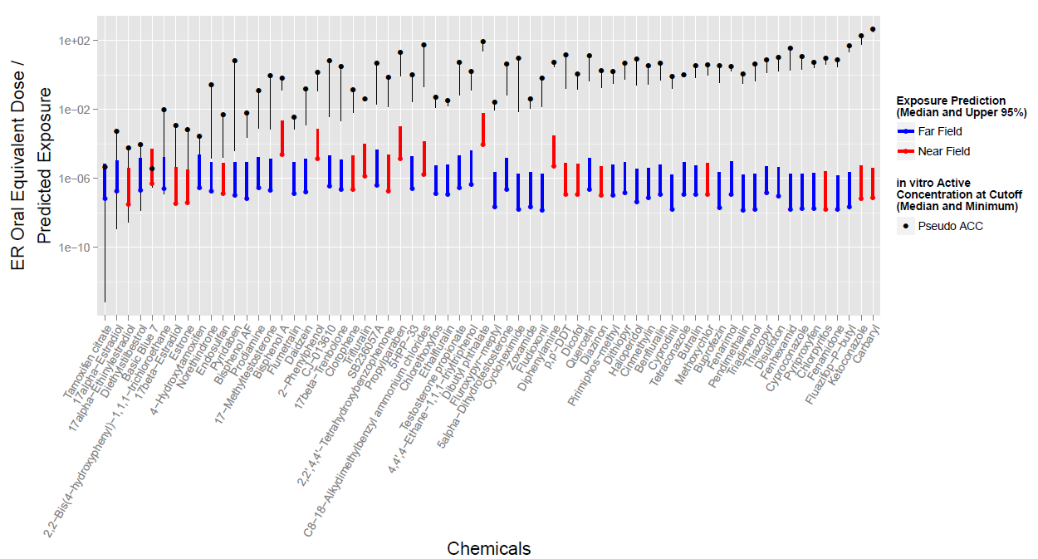
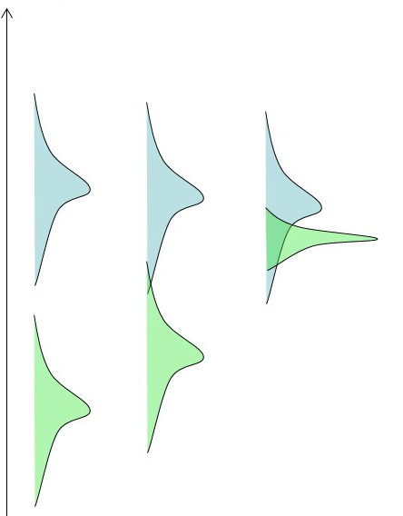
Compare Estrogen Receptor POD with
Predicted Exposure
Hazard
Exposure

Slide 15
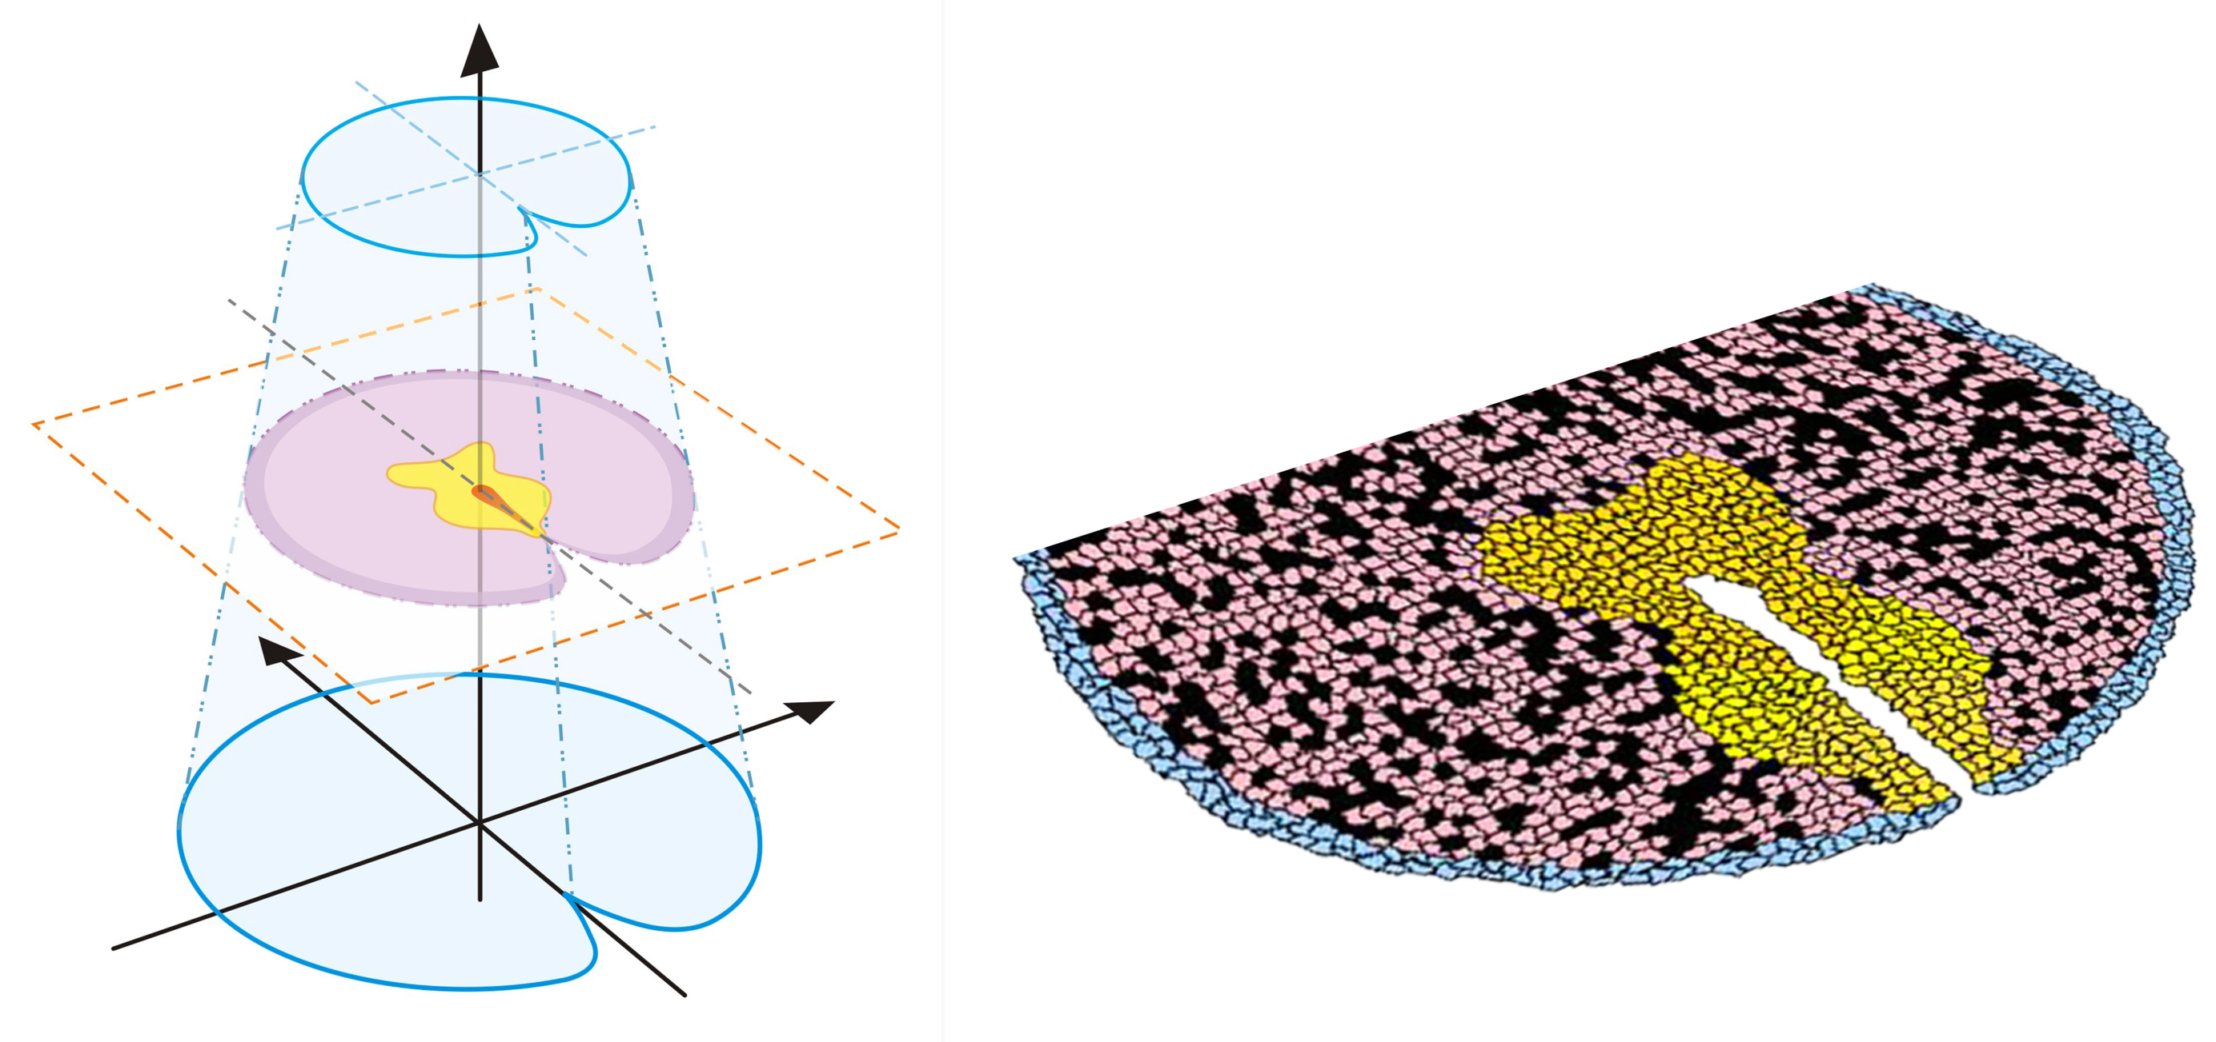
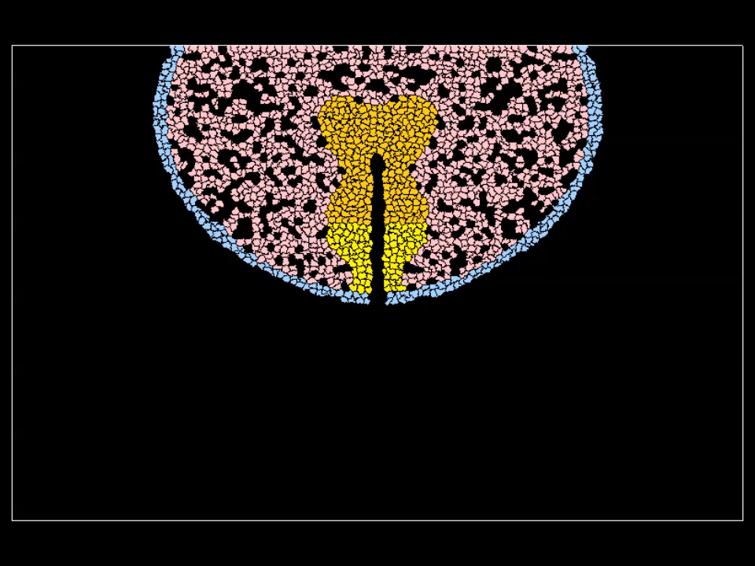
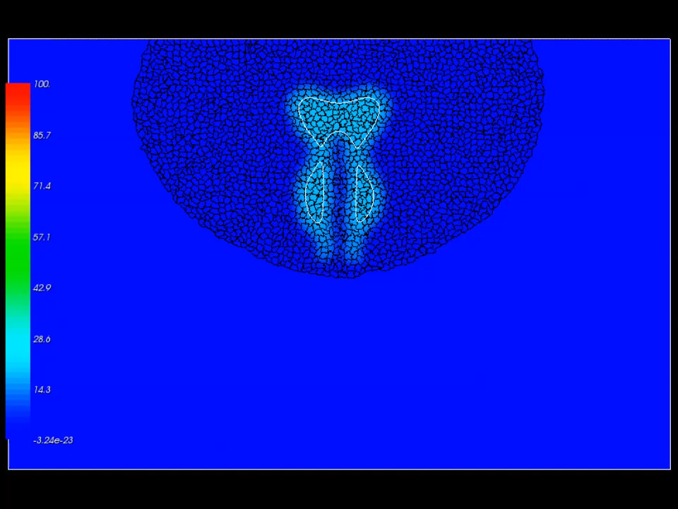
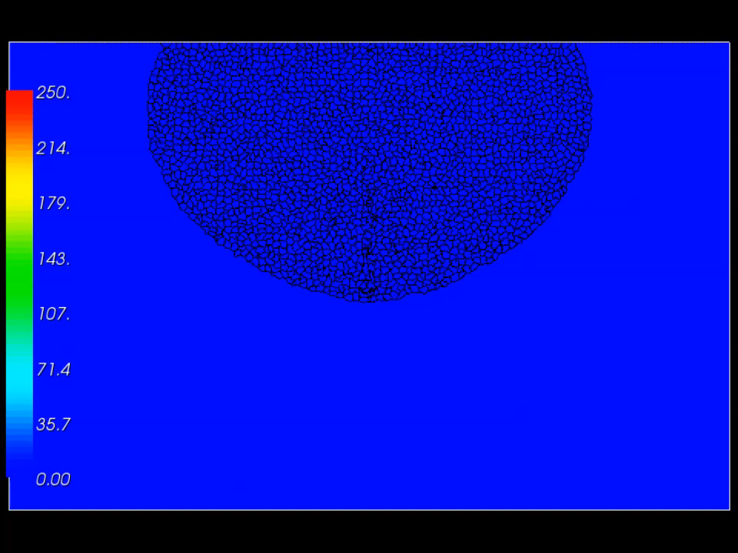
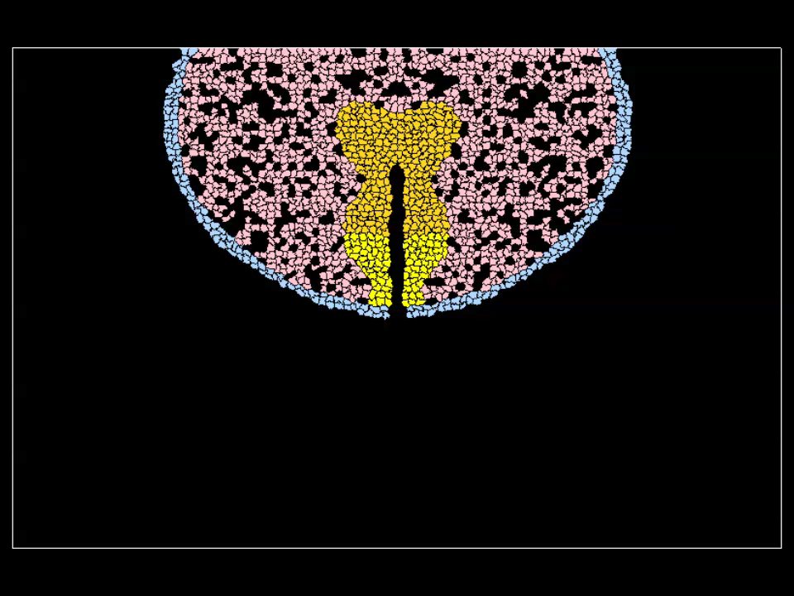

Model Genital Differentiation
Agent-based models: CompuCell3D
Agent=Cell with internal control network
Genital tubercle (GT) Control Network (mouse)
ABM simulation for sexual dimorphism (mouse GD13.5 – 17.5)
androgen
SHH field
FGF10 field
no androgen
15
SOURCE: Leung et al. (2016) Reprod Tox
Common Pathway for Fusion: Hypospadias, Cleft Palette, Spina Bifida
Knudsen and coworkers

Slide 16
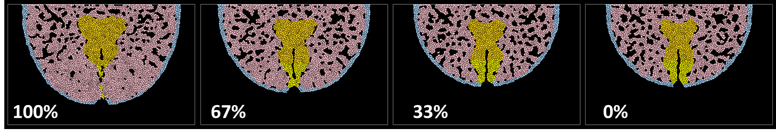
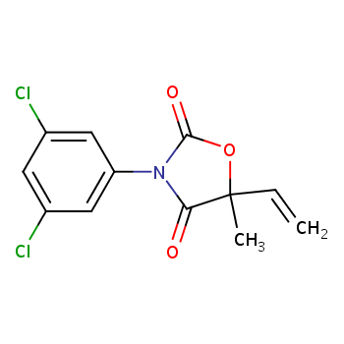
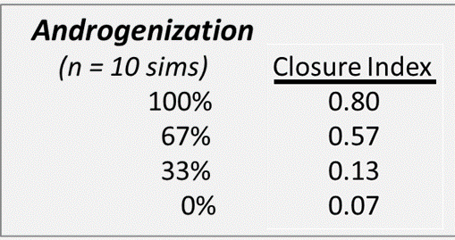
Apply model to chemical insult: Vinclozolin and Hypospadias
Chemical-dependent parameters come from in vitro assays
Driven by urethral endoderm (contact, fusion apoptosis) and androgen-dependent effects on preputial mesenchyme (proliferation, condensation, migration) via FGFR2-IIIb.
androgen
vinclozolin
SHH
FGF
Common Pathway for Fusion: Hypospadias, Cleft Palette, Spina Bifida

Slide 17
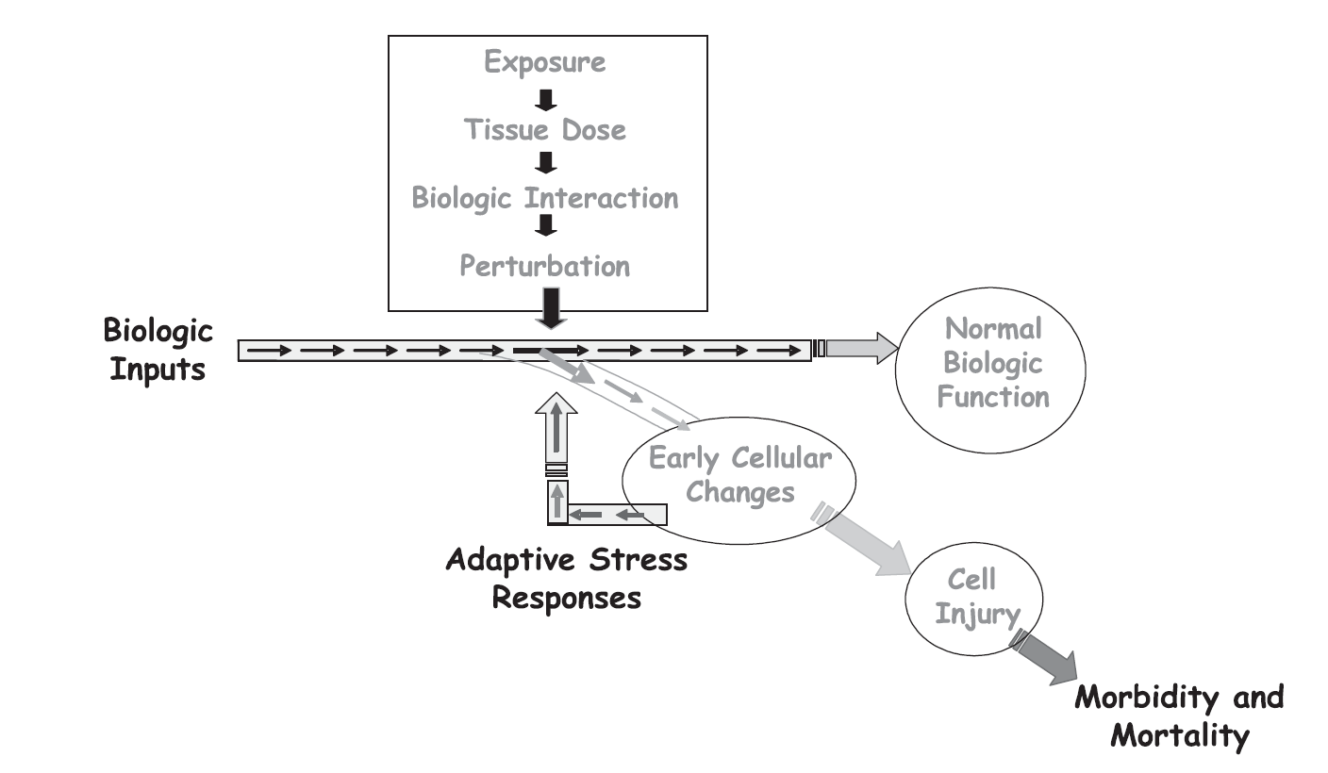
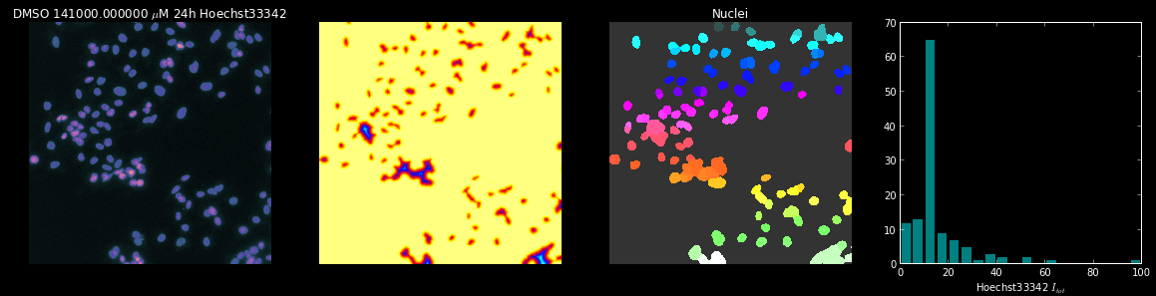
What is Adverse?
Discriminating between compensatory changes and changes that will lead to adverse outcomes
Tipping Point: Threshold between adaptation and adversity
Use ToxCast High Content Imaging (HCI) data to identify Tipping Points
967 chemicals (ToxCast)
HepG2 cells culture
10 concentrations
3 Time points
10 HCI Assays
400 plates
100,000 wells
2,400,000 images
Imran Shah group, EPA NCCT

Slide 18
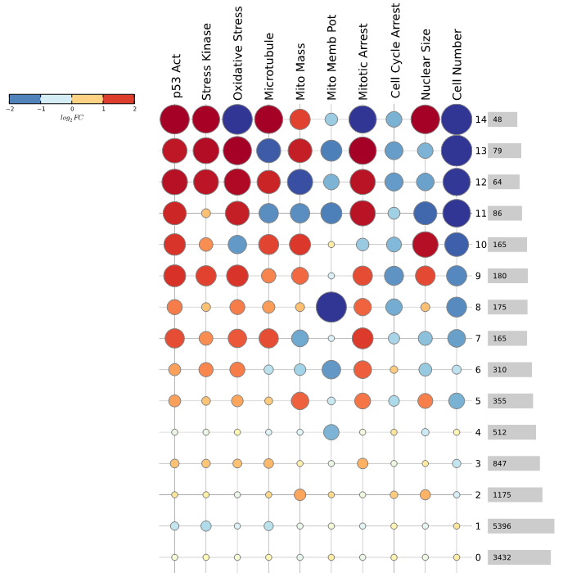
In Vitro High-content imaging data mapped to phenotypic states
Derive “phenotypic “states” of HepG2 cells across all chemicals and concentrations
Phenotypic states approximate canonical behaviors of cells
State transitions indicate dynamic responses to chemicals
More adverse
“States” of HepG2 Cells
Less
adverse

Slide 19
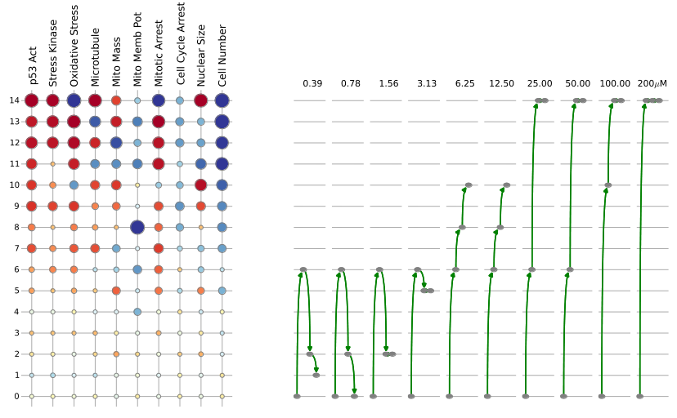
Tipping point analysis shows that both time and dose matter
Tipping Point
Time-dependent trajectories
0-72 hours
Cell State
Increasing Dose

Slide 20
Summary of Modeling Approaches
Multiple models use in vitro data to predict in vivo hazard
  POD (IVIVE, QBAR, machine-learning read-across)
  Target organs (machine-learning read-across, virtual tissues)
Model can be ab initio or statistical / machine learning
Model accuracy will be limited by:
  Uncertainty in in vivo data
  Uncertainty in in vitro data
  Uncertainty in kinetics data, kinetics model (e.g. microdosimetry)
  No/few chemicals near the target chemical in descriptor space
Models are being improved through:
  Testing addition chemicals in additional assays (e.g. whole genome transcriptomics)
  Improved model realism (kinetics and dynamics)

