Slide 1


Computational embryology as an integrative platform for predictive DART
Thomas B. Knudsen, PhD
Developmental Systems Biologist
US EPA, National Center for Computational Toxicology
knudsen.thomas@epa.gov
ORCID 0000-0002-5036-596x
Symposium: Update on Integrated Approaches to Testing and Assessment (IATA) for DART 45th Conference of the European Teratology Society, September 7, 2017, Budapest
DISCLAIMER: The views expressed are those of the presenter and do not reflect Agency policy.

Slide 2
Mechanistically-informed IATAs for DART: opportunities and challenges
Advances in biomedical, engineering, and computational sciences enable rapid and cost-effective profiling of large chemical libraries.
Considerable mechanistic knowledge exists about embryogenesis but must be collected, synopsized, and assimilated into AOPs.
AOP-based IATAs will have a well-defined endpoint, purpose, rationale, information stream, organization, and uncertainty.
Computational models to support regulatory application: weight-of-evidence and guidance to hypothesis-based data generation.

Slide 3
IATA: computational synthesis and integration
bioactivity profiles
DART
HTS
HTE
SAR
HTK
AOP
ABM
computational
dynamics
exposure
models
pathways
& networks
computational
chemistry
kinetics & dosimetry

Slide 4
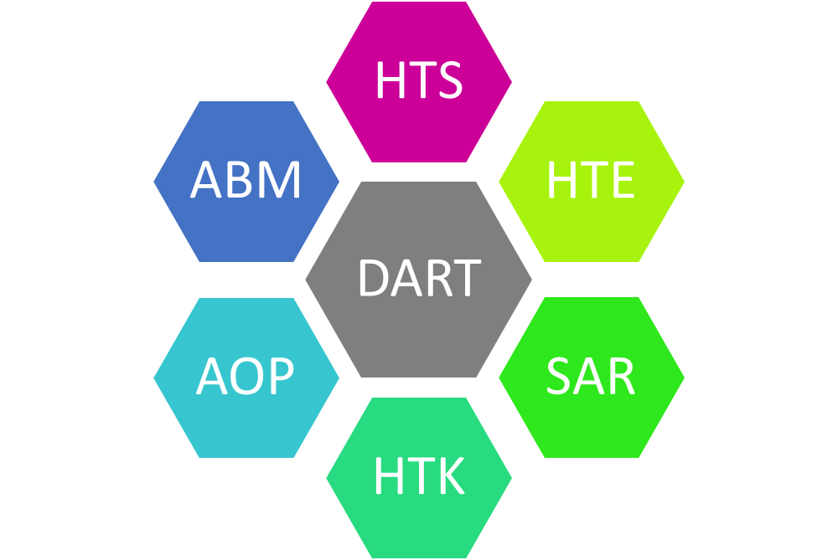

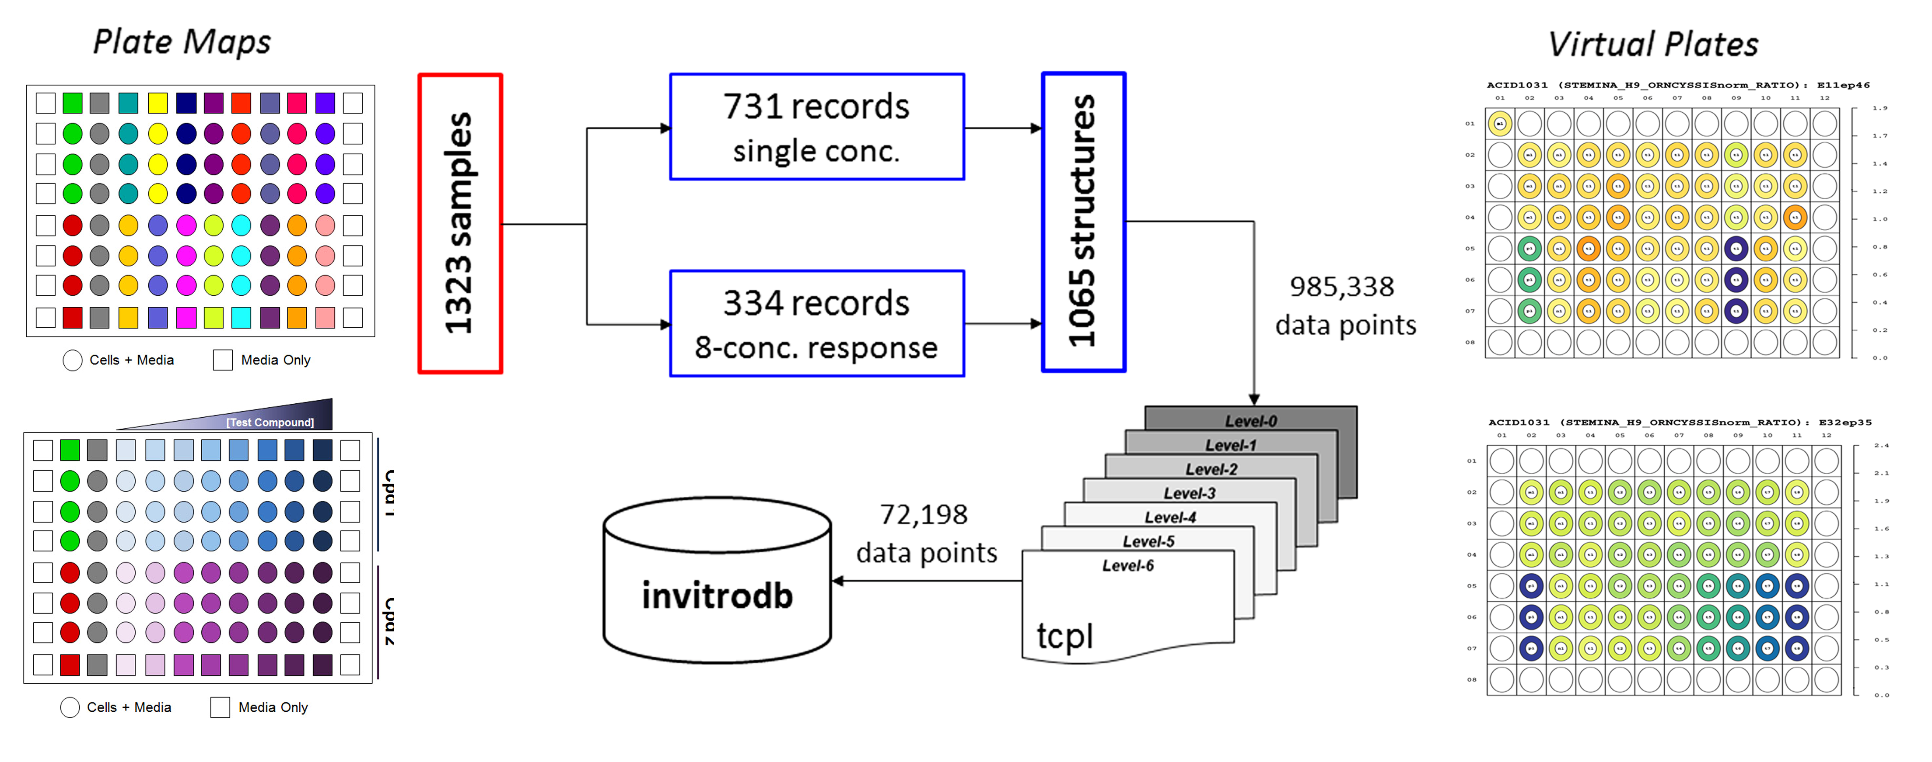
High-throughput screening
Large data streams from high-throughput profiling
of chemicals for in vitro bioactivity (ToxCast/Tox21).
https://actor.epa.gov/dashboard/#Chemicals
New platform: ToxCast library (1065 chemicals) tested in a pluripotent H9 human embryonic stem cell assay.
4
4

Slide 5
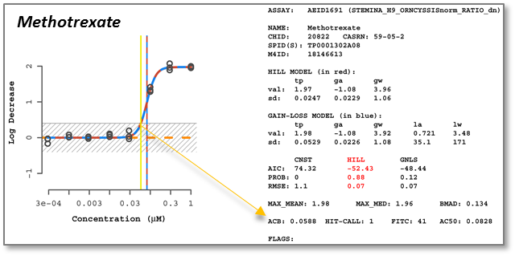
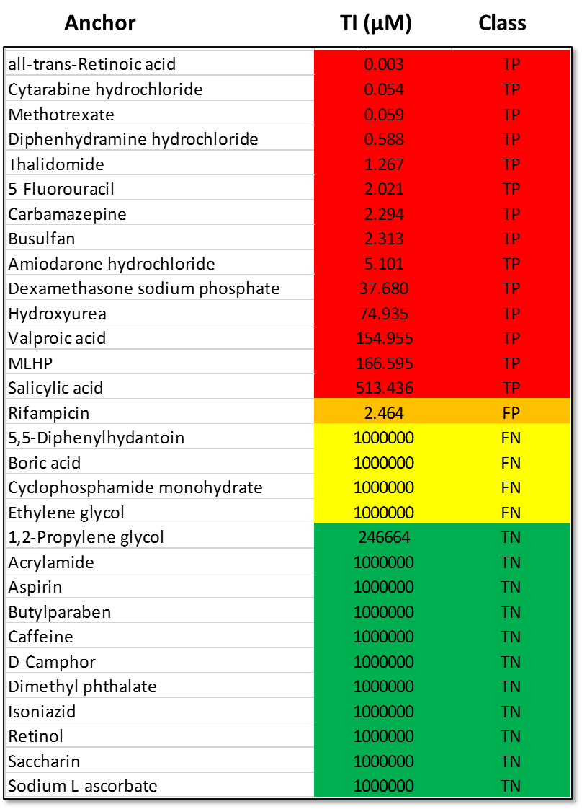
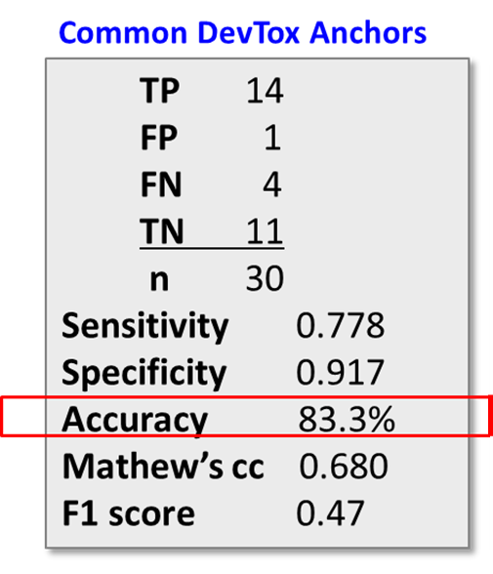
ToxCast STM platform
INPUT: ratio of ornithine secreted to cystine utilized, by LC-MS-MS.
OUTPUT: exposure-based ‘Teratogen Index’ (TI) = 0.06 µM for MTX.
181 of 1065 ToxCast chemicals (17% tested) gave a positive ‘hit’.
83% accurate classifying conventional DevTox anchors (n = 30).
Knudsen et al. (2017) manuscript in preparation

Slide 6
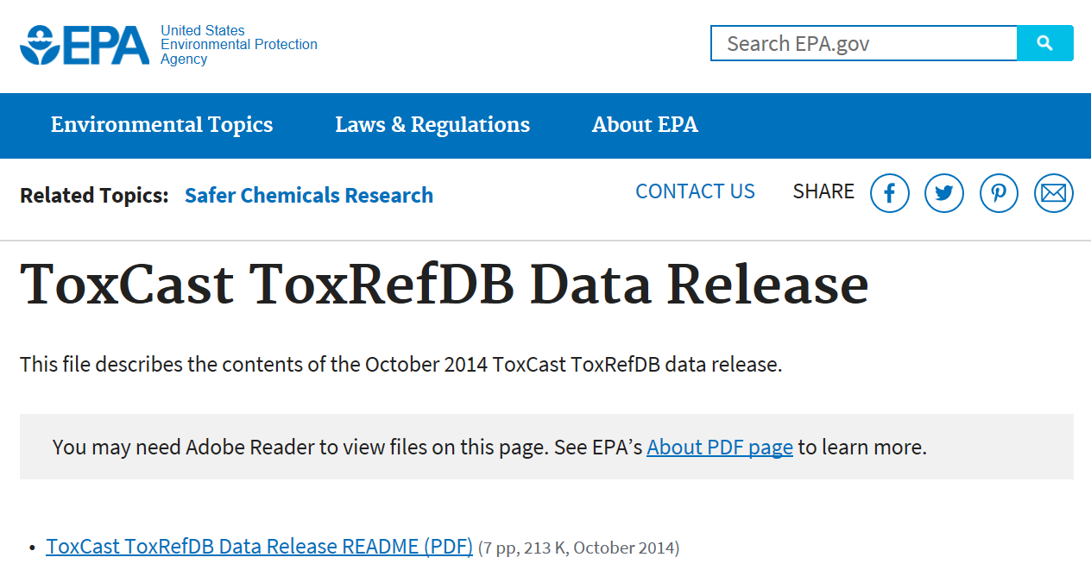
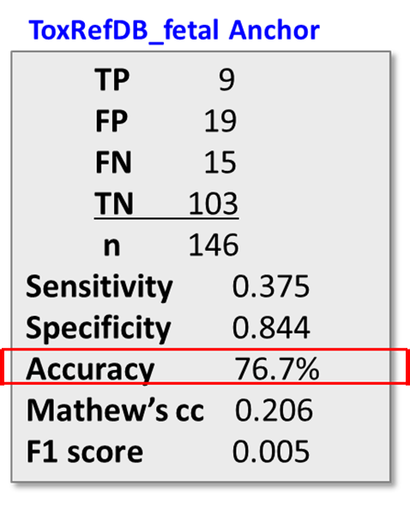
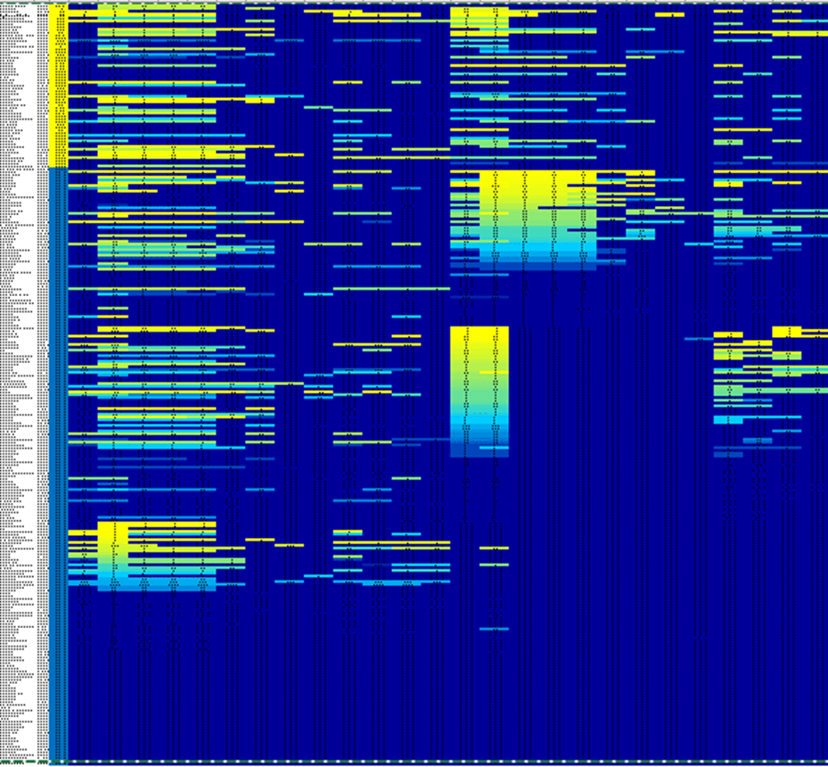
Performance of STM vs ToxRefDB fetal endpoints
https://www.epa.gov/chemical-research/toxcast-toxrefdb-data-release
INPUT: concordance anchor for 272 chemicals tested in pregnant rats & rabbits
positives = dLEL < 125 mg/kg/d in both species
negatives = no dLEL > 1000 mg/kg/d in both species
n = 146 compounds
OUTPUT:
77% accurate classifying 146 compounds concordant in rat-rabbit studies.
Strong NPV (high specificity) but weak PPV (low sensitivity).
Machine learning with 865 ToxCast assays to find missing sensitivity?
6
Knudsen et al. (2017) manuscript in preparation
6

Slide 7
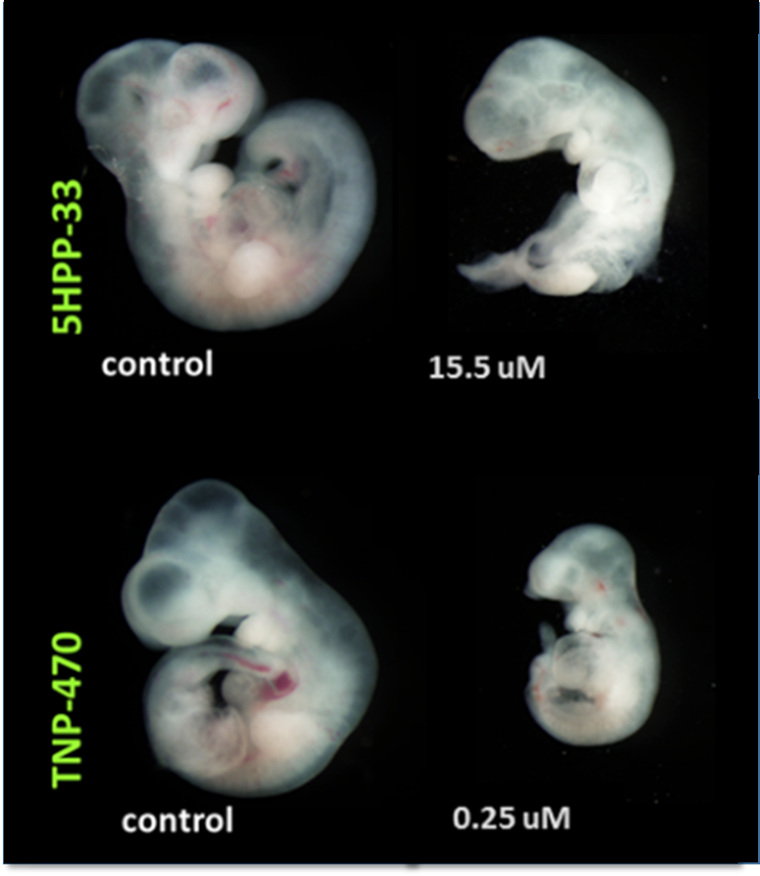
Vascular Disruption (pVDCs)
INPUT: exposure-based TI predicted by the STM assay.
OUTPUT: margin between hazard prediction and rat WEC effect.
AC50 (embryolethality) = 21.2 µM
5HPP-33
TI = 10.48 µM
TNP-470
TI = 0.017 µM
AC50 (dysmorphogenesis) = 0.038 µM
Ellis-Hutchings (2017) Reprod Toxicol.

Slide 8
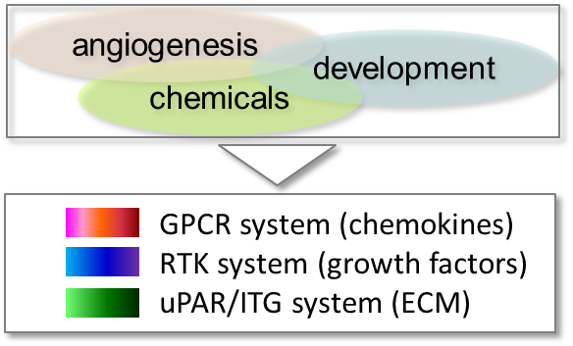
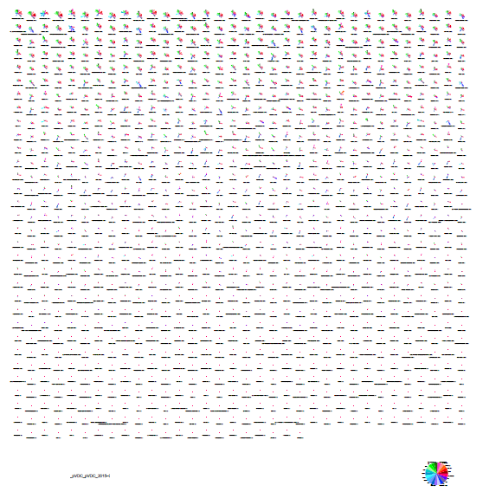
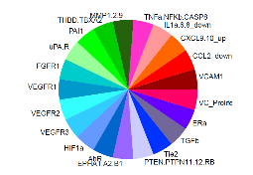
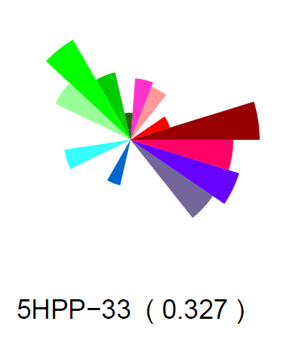
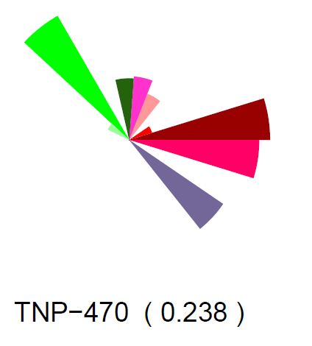
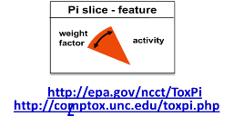
AOP-based chemical prioritization
Knudsen and Kleinstreuer (2011) Birth Defects Res C

Slide 9

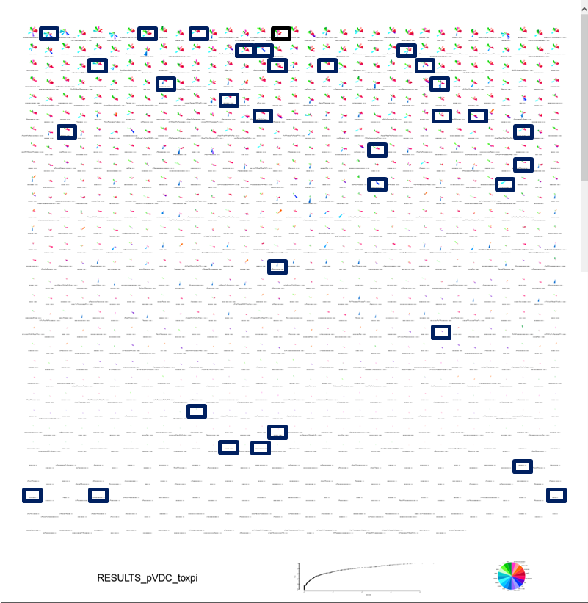
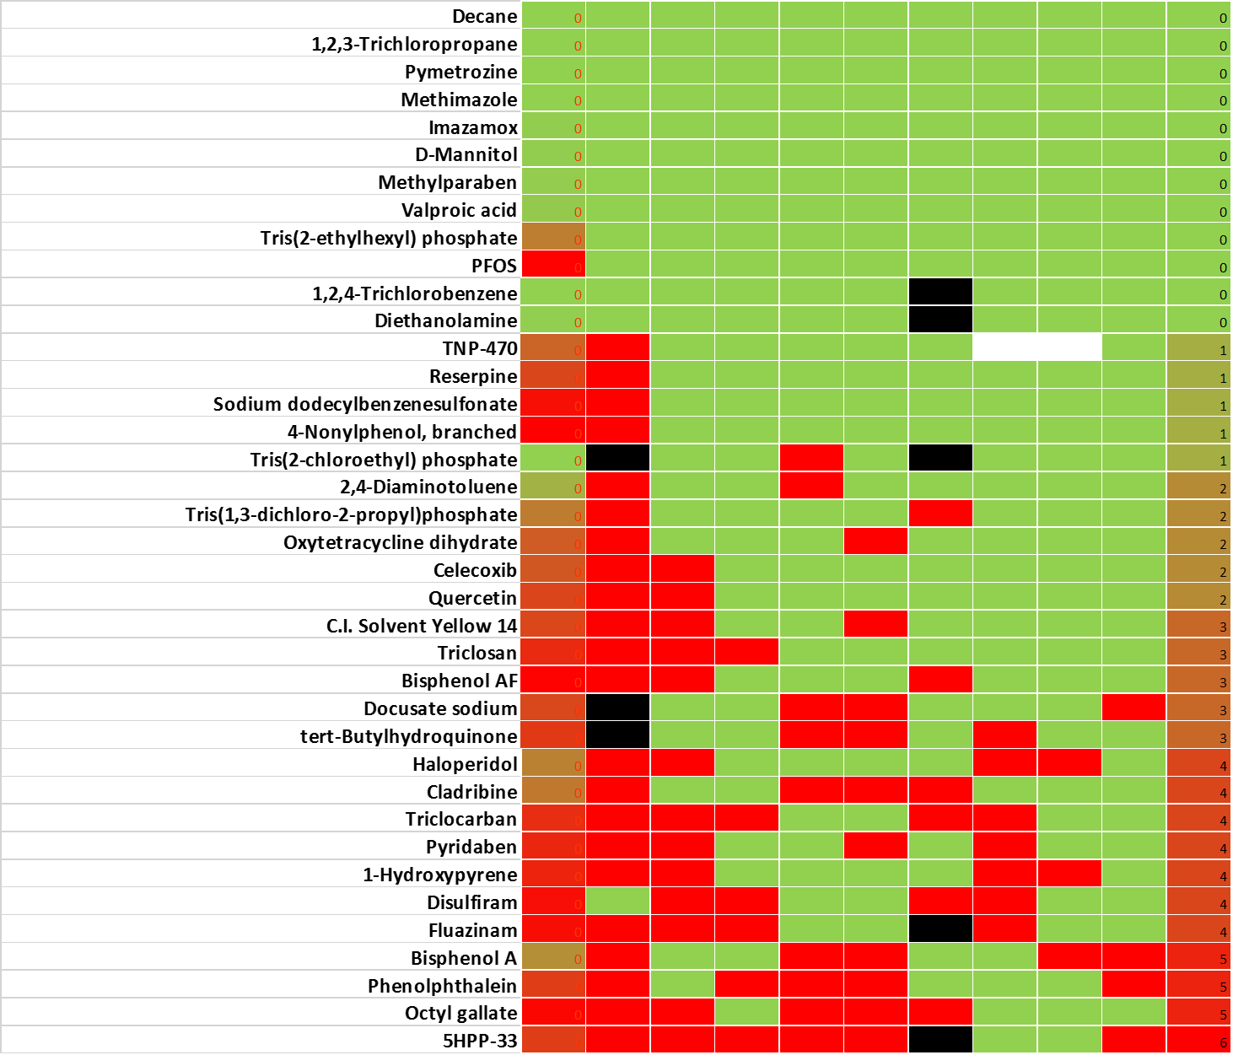
Qualification against 8 diverse angiogenesis platforms
J
A ToxPi [1]
B FICAM tubulogenesis [2]
C Synthetic tubulogenesis [3]
D Matrigel tubulogenesis [3]
E nuCTNB [4] F EC migration [4]
G angiogenic sprouting [5]
H TG-zebrafish [1]
I Vala tubulogenesis [2]
J aggregate (B to I)
inactive
active
Predicted (ToxCast)
Empirical (angiogenesis)
[1] Tal et al. Reprod Toxicol (2017); [2] Knudsen et al., in prep; [3] Nguyen et al. Nature Bioengineering (2017); [4] Belair et al. (2016) Acta Biomaterialia.

Slide 10
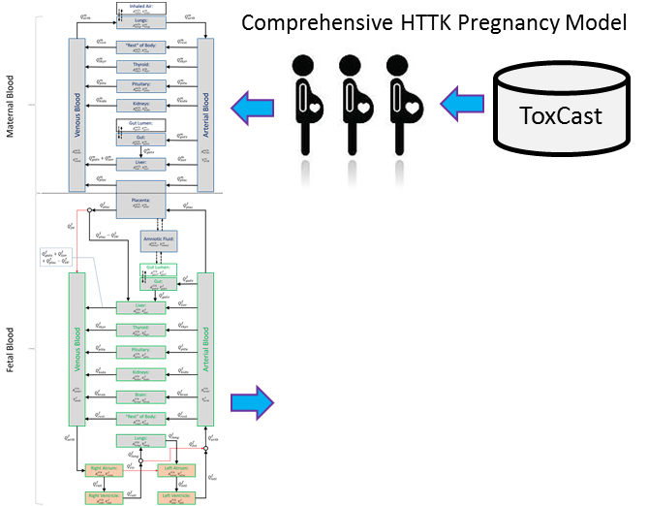
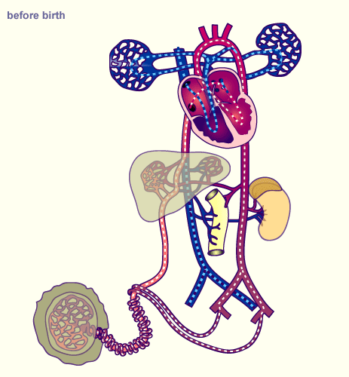
High-throughput kinetics
INPUT: metrics from human pregnancy (> 1st trimester), SBML solver in Tellurium.
OUTPUT: parameterized to run 585 ToxCast chemicals for fetal dosimetry.
Kapraun et al. (2017) (manuscript in preparation).

Slide 11
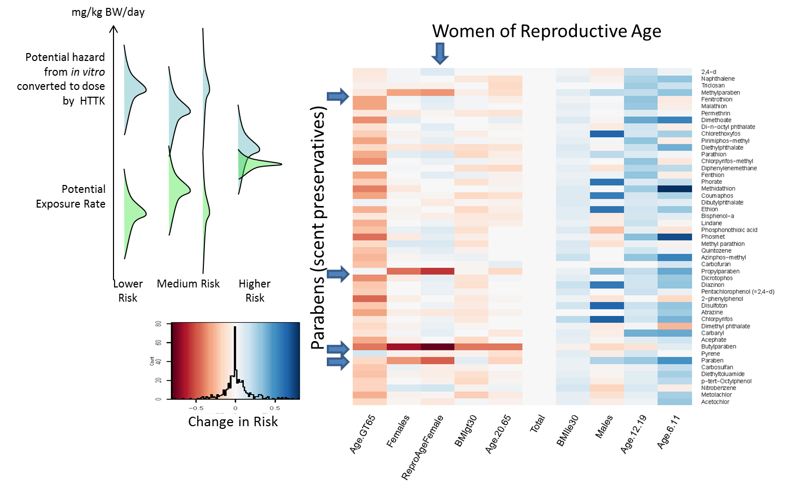
High-throughput exposure ratio
INPUT: HTS data on bioactivity profiles (eg, AC50) and exposure for specific subpopulations.
OUTPUT: margin between bioactivity and exposure for WOCBP.
Ring et al. (2017) Environment International

Slide 12
Structure-activity relationships
INPUT: 716 chemicals with DART endpoints grouped into receptor binding and chemical domains (example – 5 parabens).
OUTPUT: classification tree based on whether or not a chemical has receptor-binding properties and structural features consistent with known DART.
Wu et al (2013) Chem Res Toxicol

Slide 13
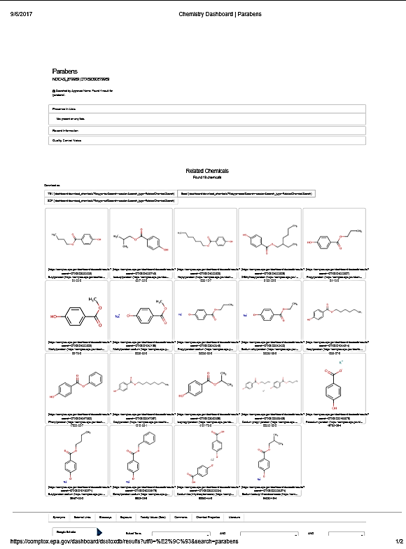
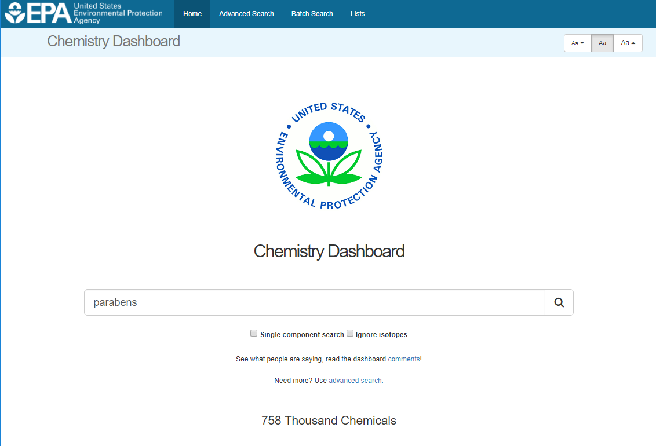
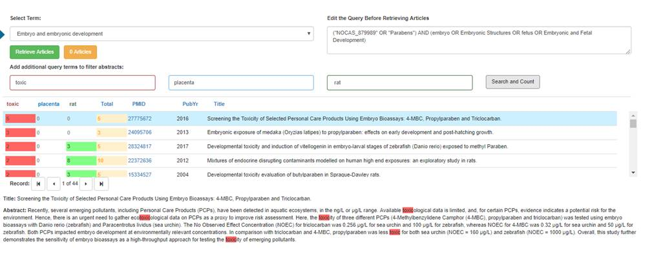
Mining the literature landscape for SAR information
INPUT: ‘parabens’
https://comptox.epa.gov/dashboard
OUTPUT: all literature on 19
‘parabens’ and ‘embryotoxicity’
Baker et al. (2017) submitted

Slide 14
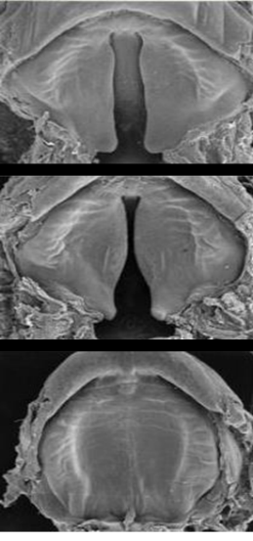
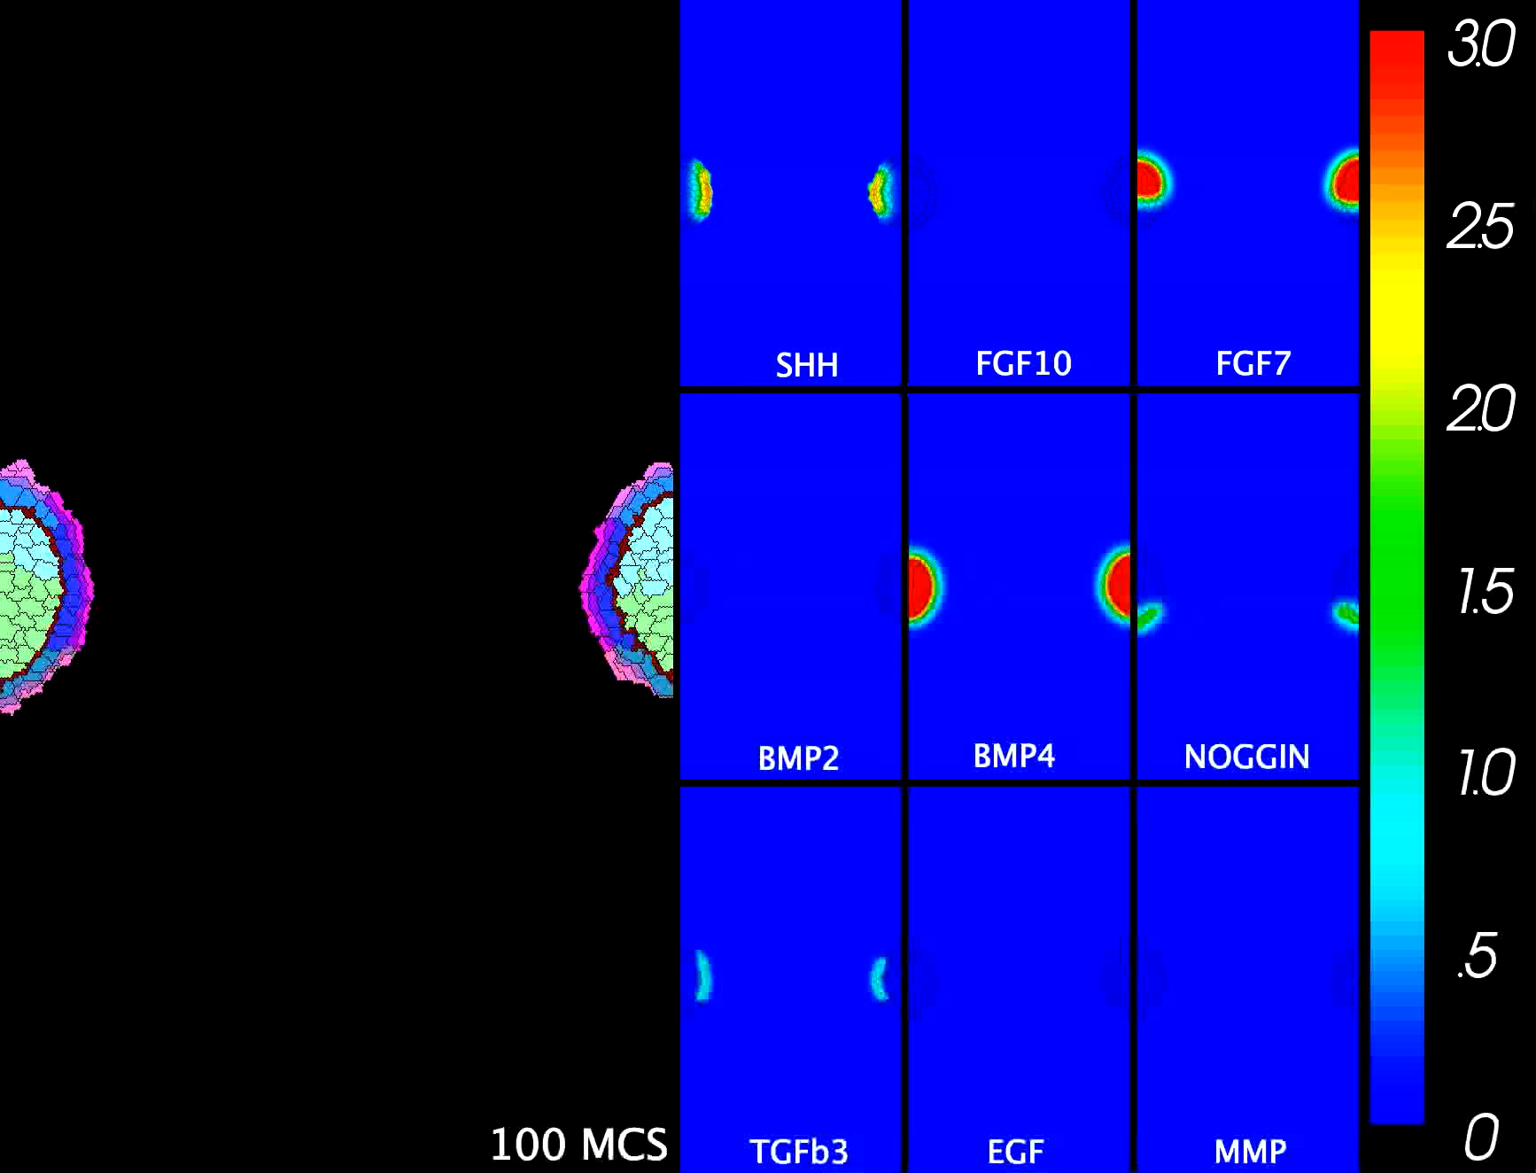
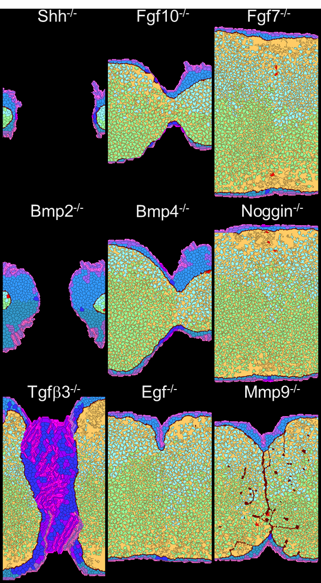
Agent-Based Models
Executed with CompuCell3D.org modeling environment
reconstruct development cell-by-cell, interaction-by-interaction
pathogenesis following electronic knockdown (cybermorphs)
impute ToxCast data into a computer simulation (example – palate)
return quantitative predictions of where, when and how the defect arises.
Palatal fusion in a virtual system
Cybermorphs
SEMs of human palate by K Sulik, UNC
Hutson et al. (2017) Chem Res Toxicol

Slide 15
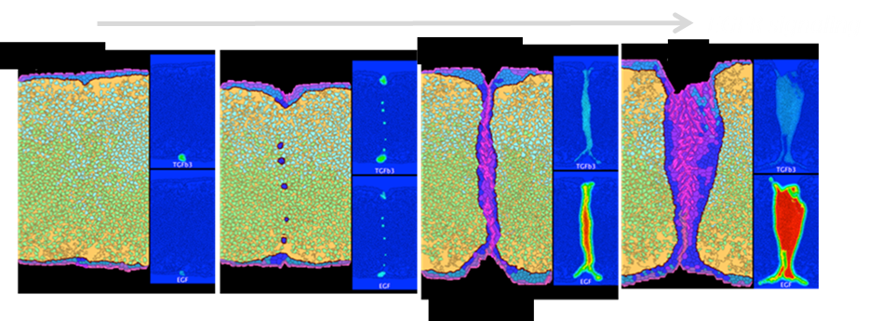
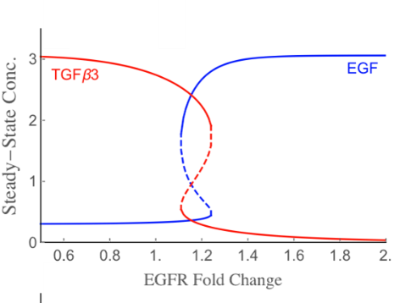
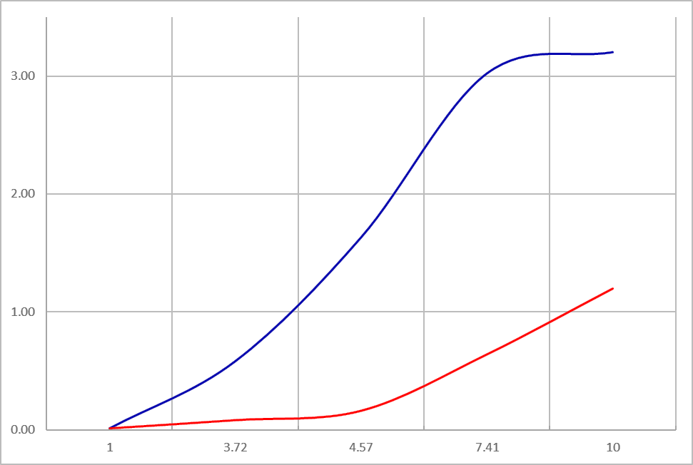
Imputing ToxCast data
Captan → cleft palate
ToxRefDB NOAEL = 10 mg/kg/day
(rabbit) LOAEL = 30 mg/kg/day
INPUT: ToxCast HTS data
Switch dynamics
ToxCast dose response
fusion
no fusion
Assay response
⬆ EGF
HTTK predicts 2.39 mg/kg/day human exposure would be required to achieve steady state concentration of 4 µM in fetal plasma
⬇ TGFb
µM concentration
virtual tipping point ~1.2x EGFR
OUTPUT: tipping point predicted by
computational dynamics
(hysteresis switch)
OUTPUT: tipping point mapped to
ToxCast concentration response
(4 µM for Captan)

Slide 16
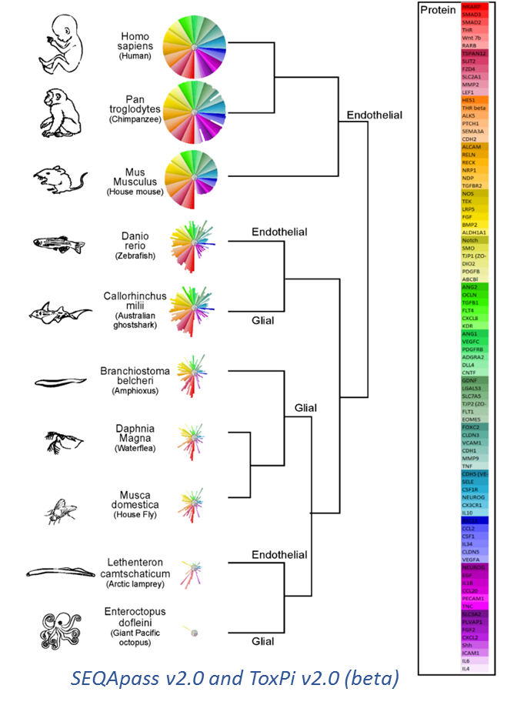
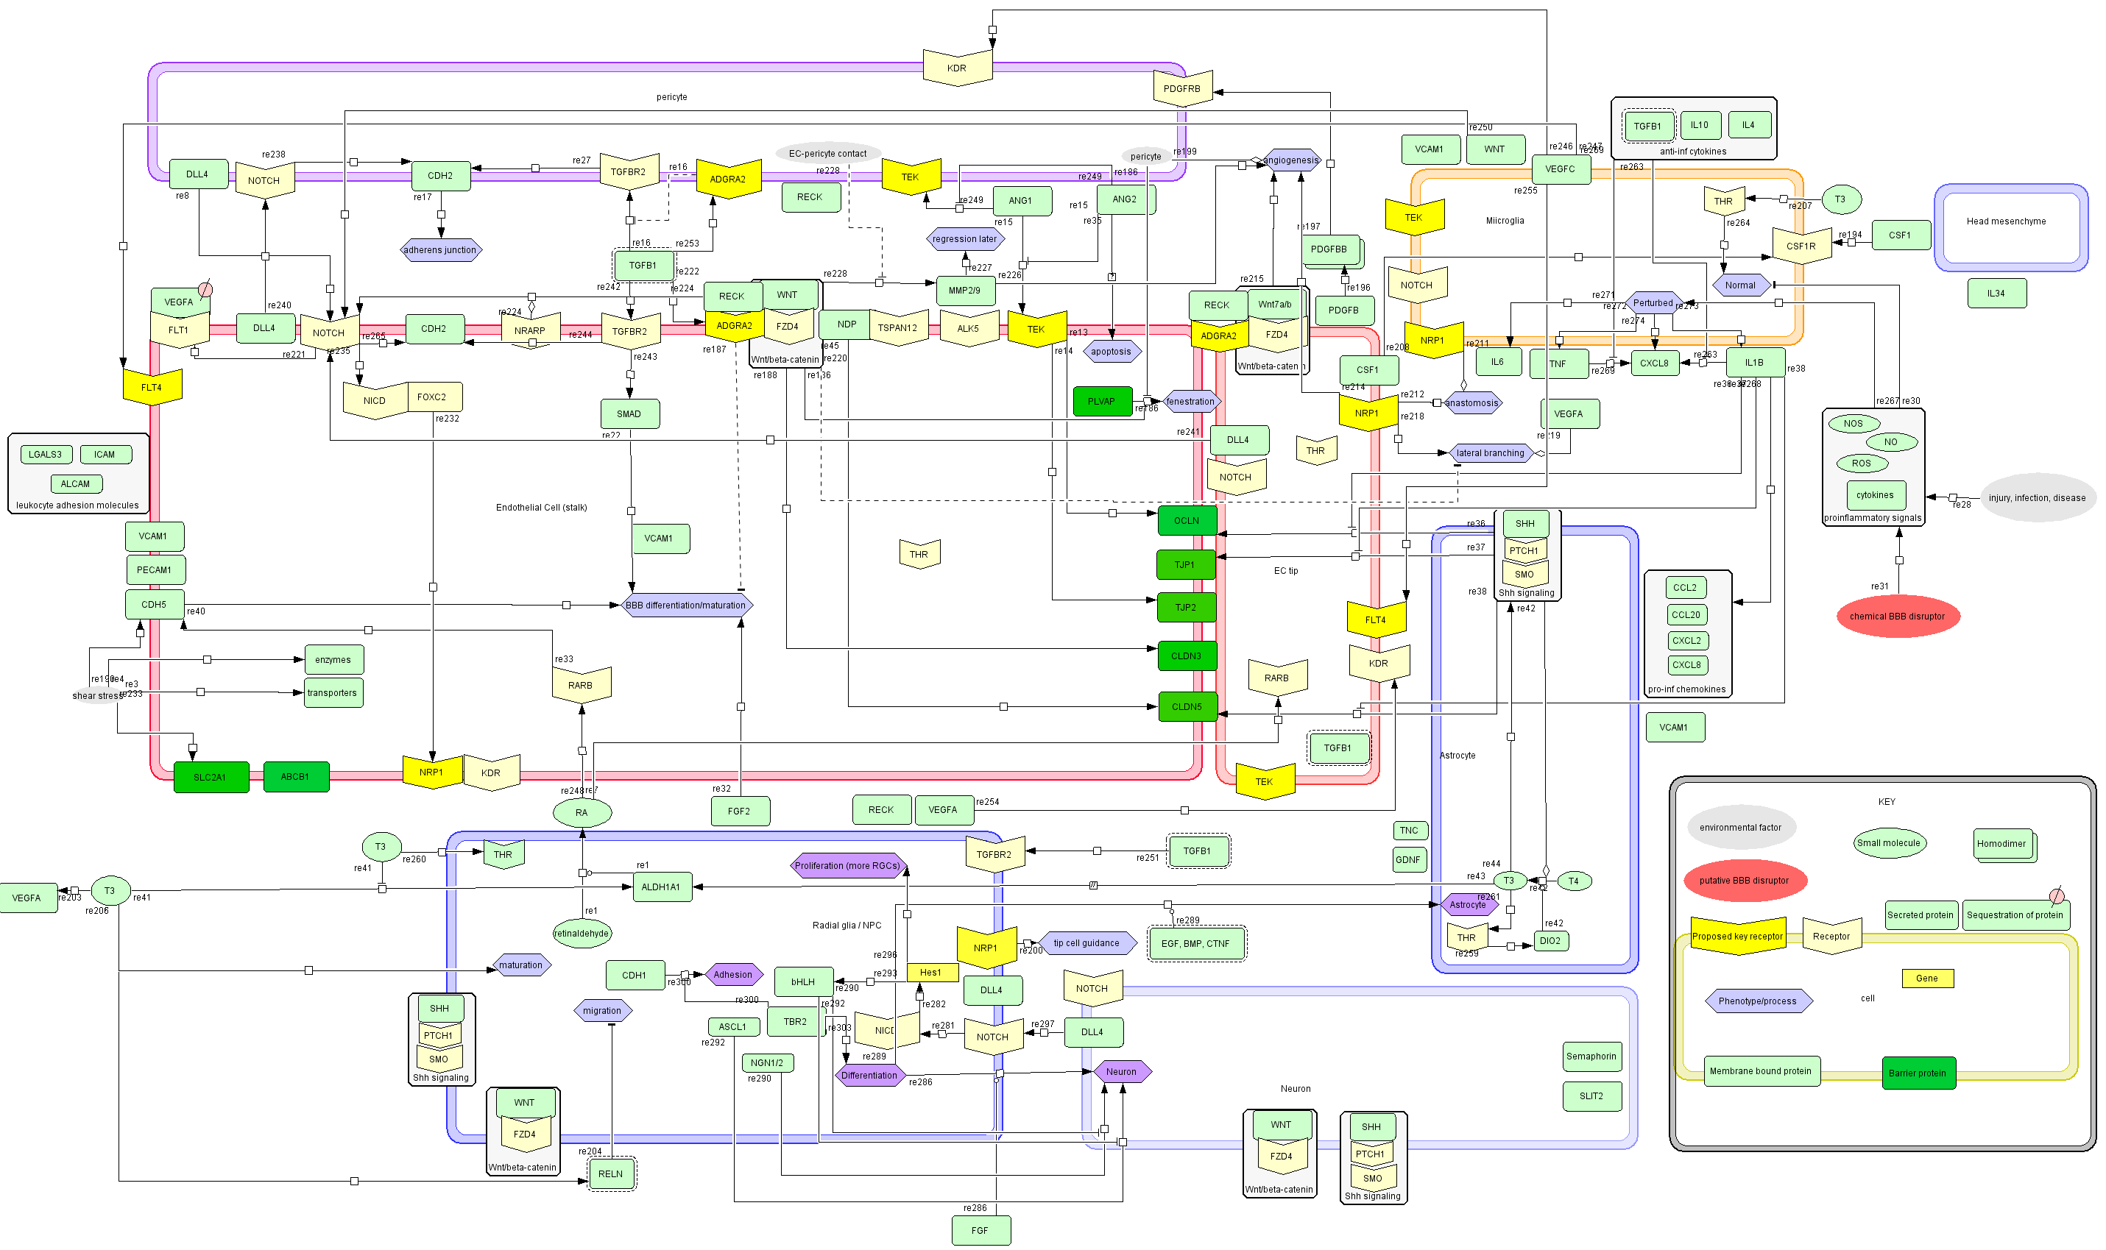
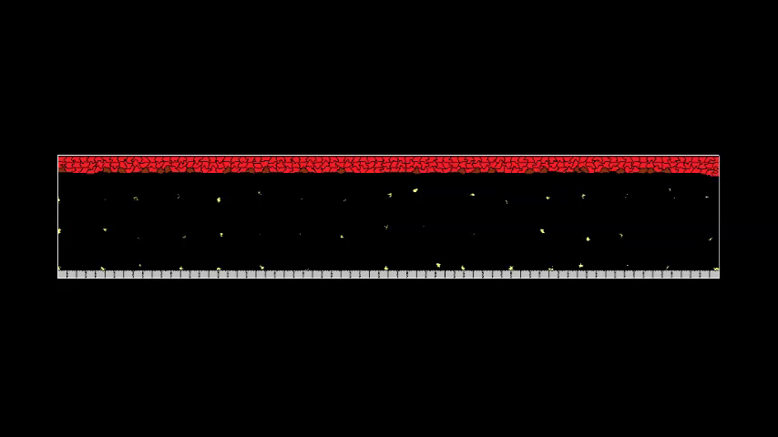
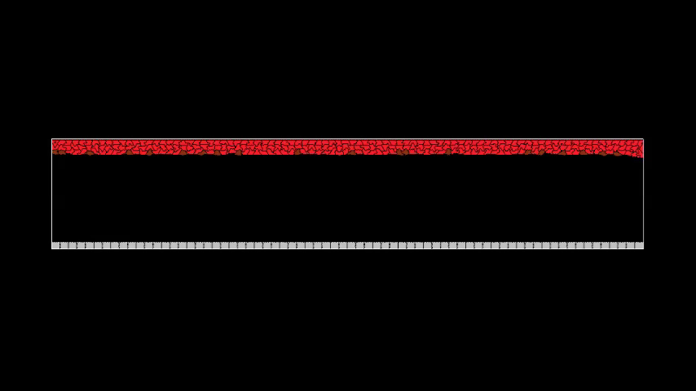
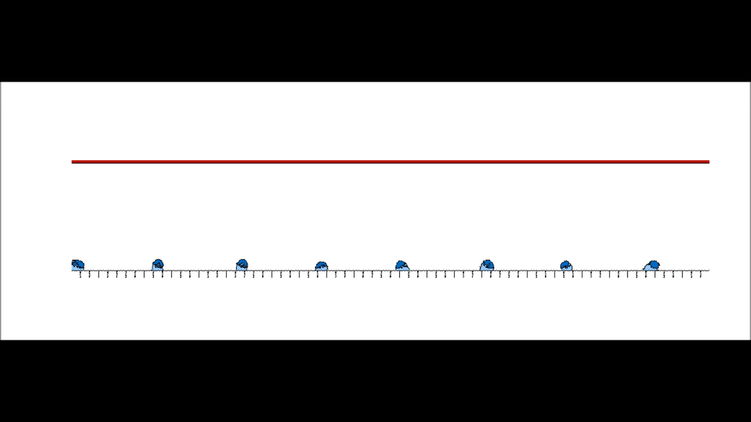
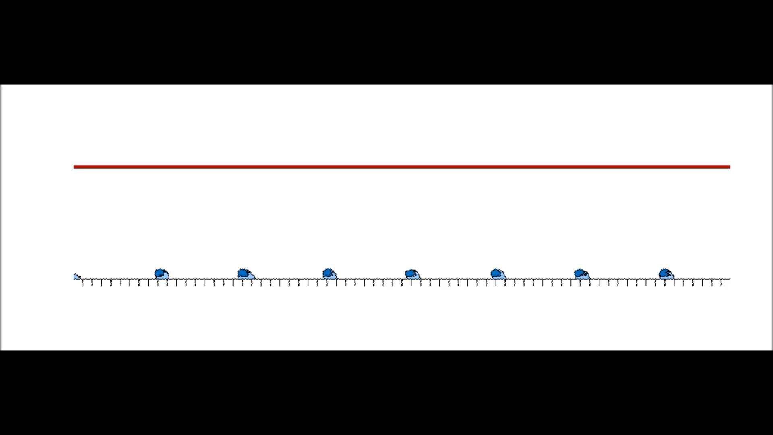
In silico framework for hypothesis-based testing
Blood-brain-barrier (BBB) development
driven by >90 genes and > 5 cell types
BBB Phylogeny
BBB Ontogeny
Brain angiogenesis
Brain neurogenesis
We are building and testing computer models formulated around novel hypotheses such as ‘chemical disruption of microglia perturb neurovascular development’.
16
Saili et al. (2017) manuscript in preparation; Zurlinden et al. (2017) in preparation

Slide 17
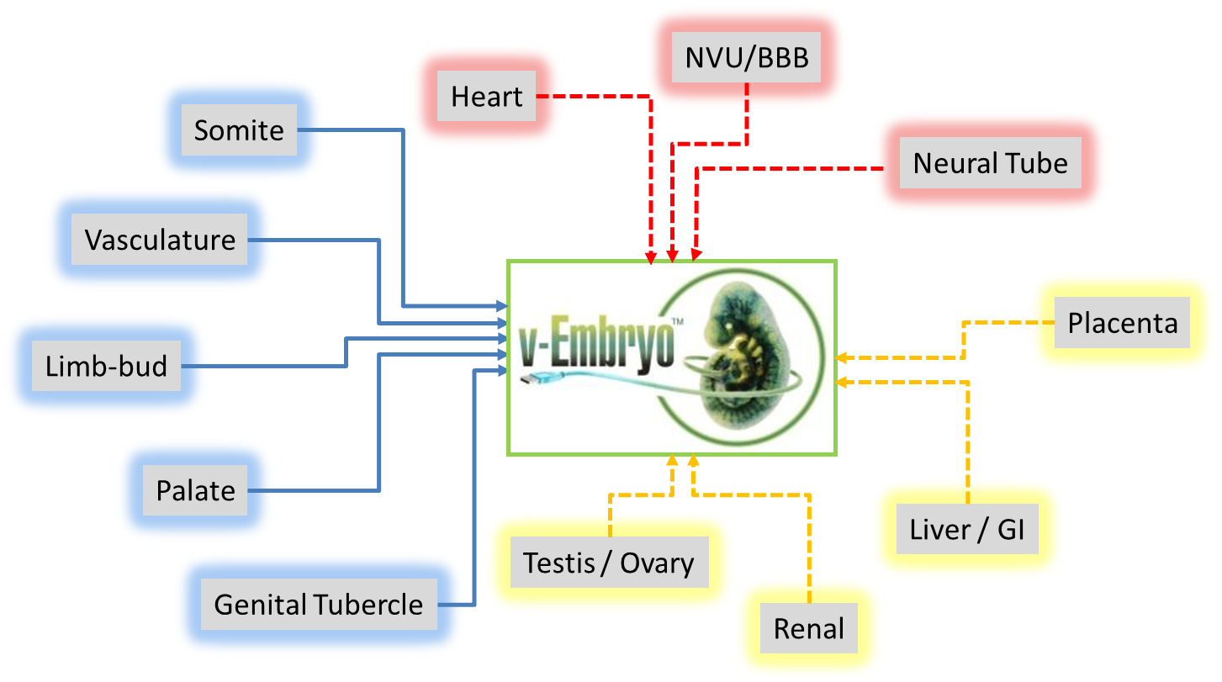
Grand Challenge: a predictive virtual embryo
how far must ‘computational embryology’ advance to
predict developmental toxicity in lieu of animal testing?

Slide 18
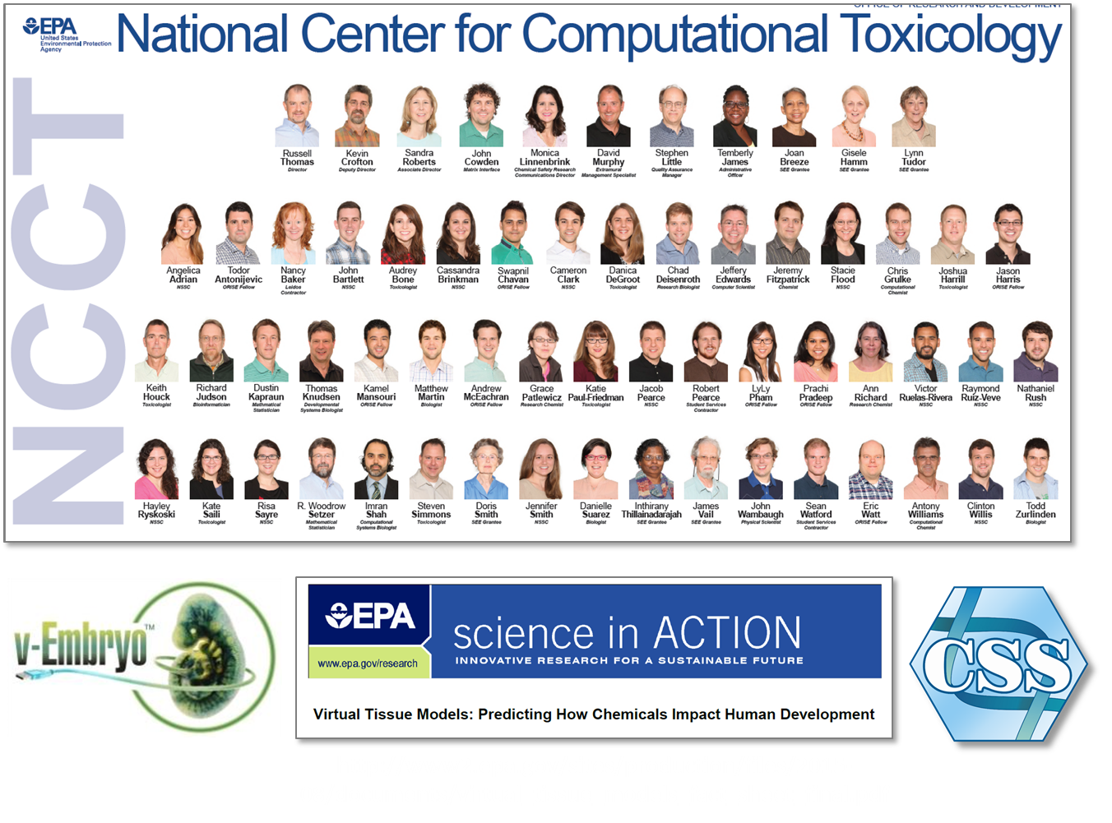
18

