Slide 1

Identify and Translate Learnings from On-Going Assay Validation Efforts into Standard HTS Testing Practice
Richard Judson
U.S. EPA, National Center for Computational Toxicology
Office of Research and Development
Workshop: State of the Science on Alternatives to Animal Testing and Integration of Testing Strategies for Food Safety Assessments
28 Feb 2017, College Park MD
The views expressed in this presentation are those of the author and do not necessarily reflect the views or policies of the U.S. EPA

Slide 2
Financial Disclosure
I have no financial conflicts. All work presented here was funded by the US EPA

Slide 3
Overview
Goal: assure that food-use chemicals are safe
How would we construct a cost-effective testing scheme to meet this goal?
How would we validate this approach?
What are (remaining) uncertainties?

Slide 4
Risk-based Approach Hazard + Exposure
mg/kg BW/day
Semi-quantitative
In Vitro to In Vivo
Approach
Potential Hazard:
In Vitro + HTTK
Potential Exposure:
ExpoCast
Low
Priority
Medium
Priority
High
Priority

Slide 5
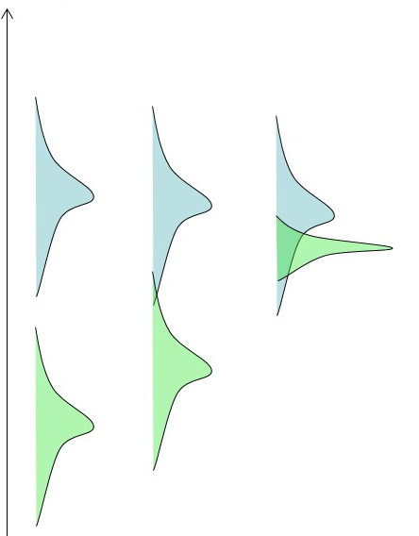
Tools / Models / Data needed
Exposure information or model
Quantify in mg/kg/day
Include uncertainties
Hazard information or model
Start in vitro
Quantify in uM required to trigger bioactivity
Include uncertainties
Toxicokinetics
Use to convert between external dose and internal concentration
Include uncertainties

Slide 6
Population and Exposure Modeling
Estimating Exposure and Associated Uncertainty with Limited Data
(Bio) Monitoring
e.g., CDC NHANES study
Calibrate models
Inferred Exposures
Pharmacokinetic Models
Dataset 1
Dataset 2
…
Estimate Uncertainty
Inferred Exposure
Predicted Exposures
Use
Production Volume
Predicted Exposure
…
Wambaugh et al., 2014
Notes:
I know that this workshop is primarily focused on NAMs in relation to hazard characterization, but I think that if we are talking more holistically about applying NAMs for regulatory decision making, we also need to incorporate approaches to estimate exposure in order to put the NAM data into context.

Slide 7
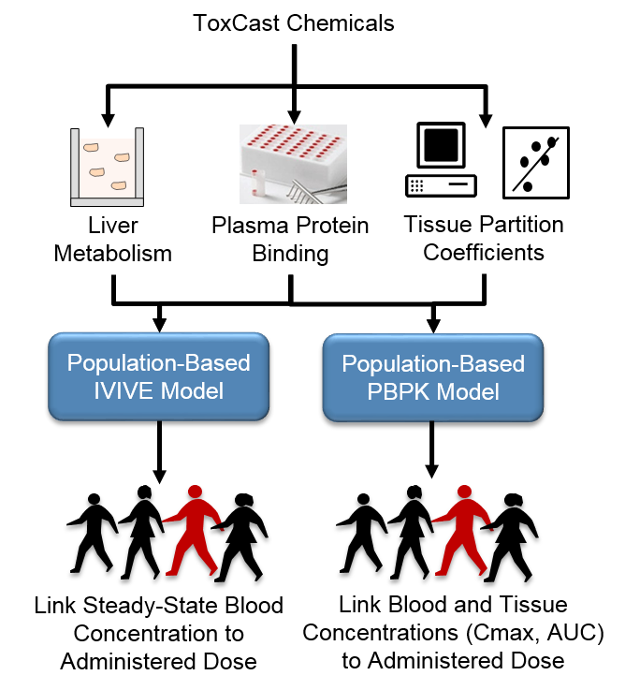
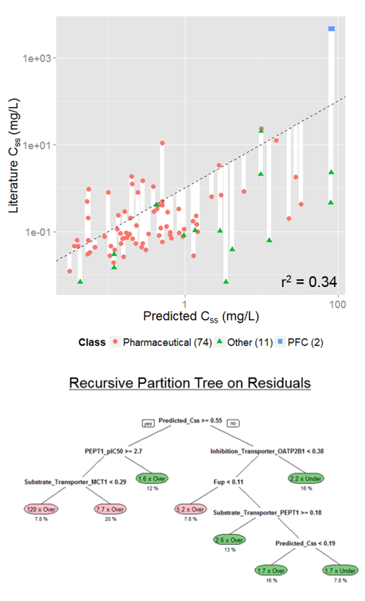
Toxicokinetics Modeling
Incorporating Dosimetry and Uncertainty into In Vitro Screening
Wambaugh et al., 2015
Notes:
I think we have heard yesterday, how important TK is in interpreting the results from NAMs. This includes both read across and the in vitro testing. However, first, we need to have an in vitro and in silico approach to generate the TK data that we need and we need to be rigorous in characterizing the uncertainty around whatever approach we develop.

Slide 8
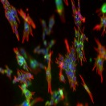
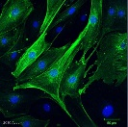

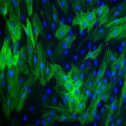
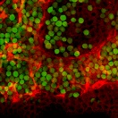
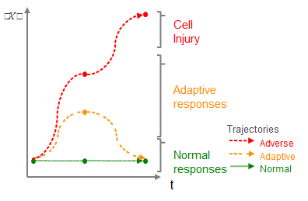
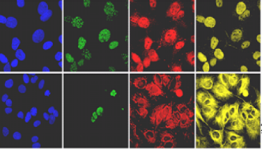
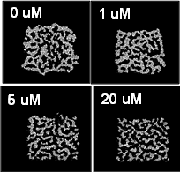

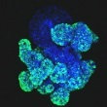
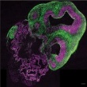
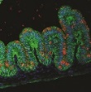
The “Minimal Hazard Battery”
Comprehensive transcriptomic screening
+
cell-stress / cytotoxicity battery
Multiple Human Cell Types
Comprehensive Characterization
Verification of Affected Processes/ Pathways and Temporal Evaluation
Focused
in vitro assays
Time Course High Content Assays
Computational and Statistical Modeling
Interpretation of Affected Process/ Pathways and Population Variability
Organs-on-a-Chip
Organotypic and Organoid Models
Notes:
Technologies from human genome project have become so cheap and efficient, now just beginning to be deployed at a scale that allows evaluating perturbation in all genes of the genome in multiple tissues, and at multiple concentrations
Point out crypts in stomach organoid model

Slide 9
The “Minimal Hazard Battery”
Still in exploratory stage
Tier 1 provides
in vitro LOAEC / NOAEC
Survey of perturbed pathways
Concentrations where cell stress may interfere with assays giving false positive signals
If expected doses overlap with cell-stress concentrations, then the chemical is probably dangerous
Tier 2
Confirmation of pathways perturbed
Tier 3
More in vivo-like context around findings

Slide 10
First test: Can the battery predict in vivo POD?
Spanned 38 In Vivo Endpoints across Multiple Tissues, Organ Systems, and Study Types (Repro, Chronic, and Dev)
Start with battery of in vitro assays
Convert to dose with HT toxicokinetics
94% of chemicals have a health-protective prediction of POD
But: How golden is the gold-standard?
5.7% below line
Wetmore et al., Tox Sci., 2013

Slide 11
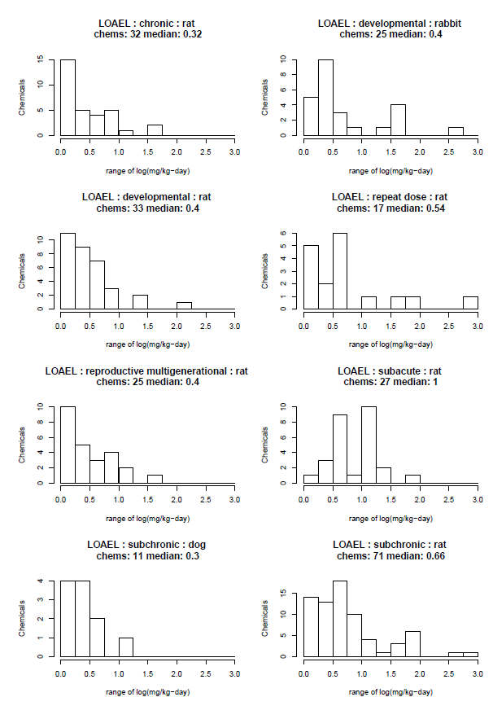
How golden is the goal standard?
PODs vary from one lab to the next
Median span from lowest LOAEL to highest is 0.3 to 1.0 log units
Data taken from EPA ToxValDB

Slide 12
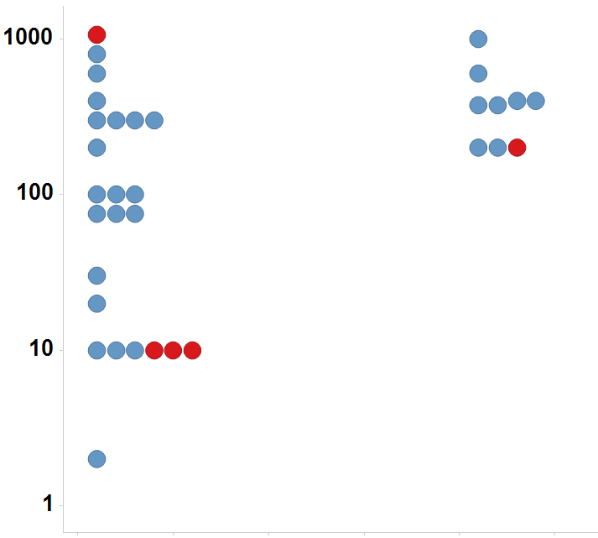
Uterotrophic guideline study uncertainty 26% of chemicals tested multiple times in the uterotrophic assay gave discrepant results
Immature Rat: BPA
LEL or MTD (mg/kg/day)
Uterotrophic
Active
Inactive
Injection
Oral
Kleinstreuer et al: “A Curated Database of Rodent Uterotrophic Bioactivity” EHP (2015)

Slide 13
Anemia concordance results
Species / study 1 | Species / study 2 | Concordant | Not Concordant | Fraction Concordant
rat SUB | rat CHR | 18 | 2 | 0.90
rat CHR | dog CHR | 13 | 2 | 0.87
rat CHR | rat SUB | 18 | 4 | 0.82
rat SUB | rat SUB | 16 | 4 | 0.80
rat SUB | dog CHR | 11 | 4 | 0.73
mouse CHR | rat CHR | 11 | 4 | 0.73
mouse CHR | rat SUB | 13 | 7 | 0.65
dog CHR | rat SUB | 11 | 6 | 0.65
dog CHR | rat CHR | 13 | 8 | 0.62
rat CHR | mouse CHR | 11 | 11 | 0.50
mouse CHR | dog CHR | 6 | 6 | 0.50
rat SUB | mouse CHR | 13 | 14 | 0.48
dog CHR | mouse CHR | 6 | 8 | 0.43
mouse CHR | mouse CHR | 2 | 3 | 0.40
Judson et al. Reg. Tox. Pharm (2017) “Retrospective Mining of Toxicology Data to Discover Multispecies and Chemical Class Effects: Anemia as a Case Study”.

Slide 14
Sources of Variability
Experimental variability
Species, strain, dose range, dose spacing
Statistical power issues
Too few animals to see weak or rare effect
Reporting bias
Was an effect negative or not looked for?
Observer bias
Less sever phenotypes not reported when more severe ones are present
Diagnostic terminology drift
Data assimilation and analysis
Typos, incomplete transcription

Slide 15
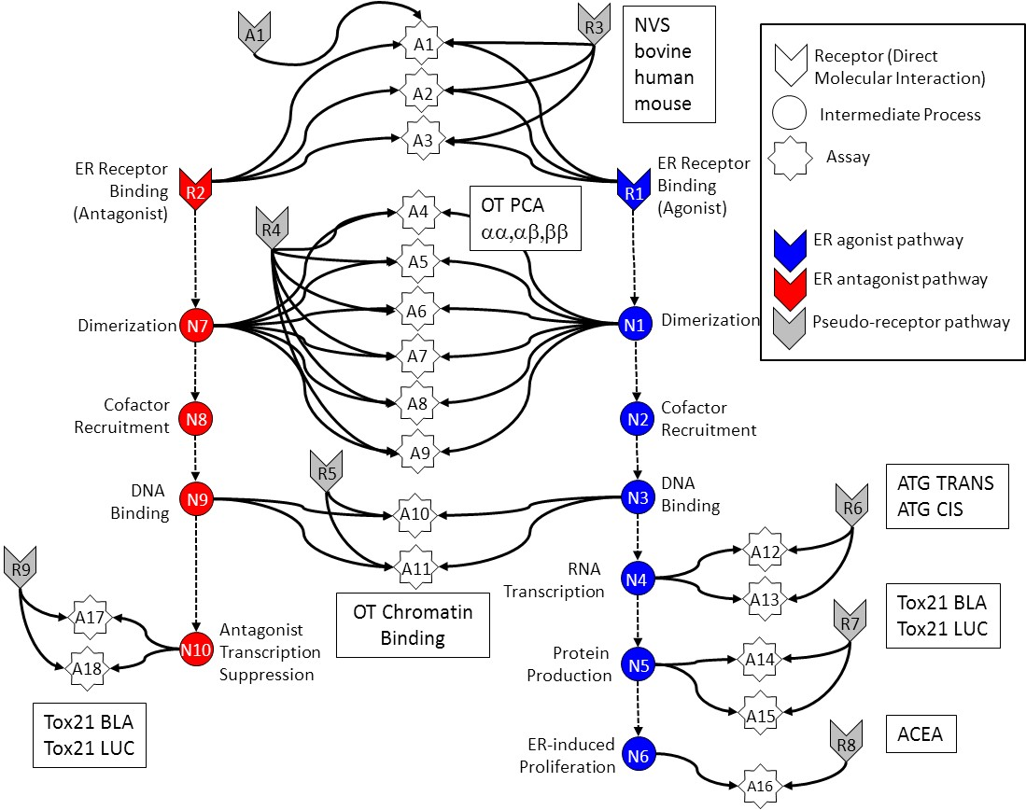
In Vitro Estrogen Receptor Model
Use multiple assays per pathway
Different technologies
Different points in pathway
No assay is perfect
Assay Interference
Noise
Use model to integrate assays
Evaluate model against reference chemicals
Methodology being applied to other pathways
Judson et al: “Integrated Model of Chemical Perturbations of a Biological Pathway
Using 18 In Vitro High Throughput Screening Assays for the Estrogen Receptor” (EHP 2015)

Slide 16
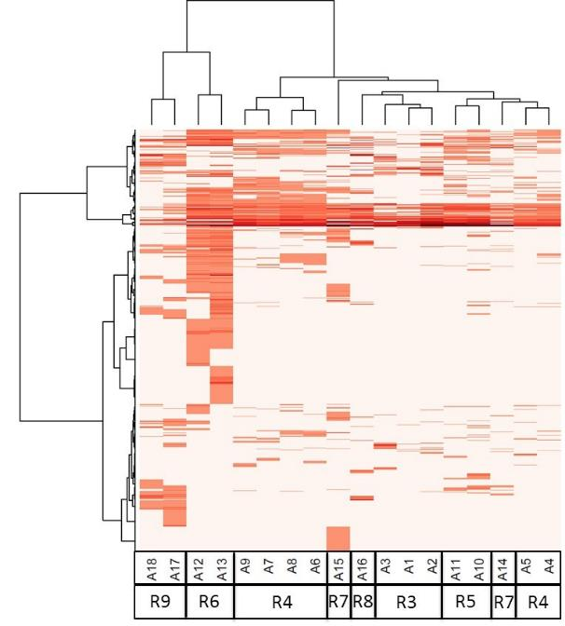
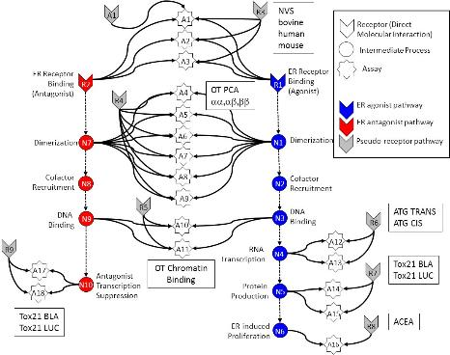
In vitro assays also have false positives and negatives
Much of this “noise” is reproducible
“assay interference”
Result of interaction of chemical
with complex biology in the assay
Chemical universe is structurally diverse
Solvents
Surfactants
Intentionally cytotoxic compounds
Metals
Inorganics
Pesticides
Drugs
Assays cluster by technology,
suggesting technology-specific non-ER bioactivity
Chemicals
Assays
Judson et al: ToxSci (2015)

Slide 17
Most chemicals display a “burst” of potentially non-selective bioactivity near cytotoxity concentration
Concentration Space
Z- Space
Tested Concentration Range
Cytotoxicity
Range
3 MAD
Burst
Region
Cytotoxicity
Range
3 MAD
Burst
Region
Number of Hits
Number of Hits
0.1
1
10
100
1000
21 18 15 12 9 6 3 0 -3 -6 -9
AC50 (μM)
Bioactivity inferred
Z
Judson et al. Tox.Sci. (2016)

Slide 18
Schematic explanation of the burst
Specific
Non-specific
Oxidative Stress
DNA Reactivity
Protein Reactivity
Mitochondrial stress
ER stress
Cell membrane disruption
Specific apoptosis
…

Slide 19
A1
R3
NVS
bovine
human
mouse
A1
Receptor (Direct Molecular Interaction)
A2
Intermediate Process
A3
Assay
ER Receptor Binding
(Antagonist)
ER Receptor Binding
(Agonist)
R2
OT PCA
αα,αβ,ββ
R1
A4
R4
ER agonist pathway
A5
ER antagonist pathway
Dimerization
N7
A6
N1
Dimerization
Pseudo-receptor pathway
A7
Cofactor
Recruitment
N8
A8
N2
Cofactor
Recruitment
A9
DNA
Binding
R5
DNA
Binding
ATG TRANS
ATG CIS
N9
A10
N3
R6
RNA
Transcription
A12
R9
A11
N4
OT Chromatin
Binding
A13
Tox21 BLA
Tox21 LUC
A17
Antagonist
Transcription
Suppression
R7
N10
Protein
Production
N5
A14
A18
Tox21 BLA
Tox21 LUC
A15
ER-induced
Proliferation
R8
ACEA
N6
A16

Slide 20
A1
A1
R3
Receptor (Direct Molecular Interaction)
A2
Intermediate Process
A3
Assay
ER Receptor Binding
(Antagonist)
ER Receptor Binding
(Agonist)
R2
R1
A4
R4
ER agonist pathway
A5
ER antagonist pathway
Dimerization
N7
A6
N1
Dimerization
Pseudo-receptor pathway
A7
Cofactor
Recruitment
N8
A8
N2
Cofactor
Recruitment
A9
DNA
Binding
R5
DNA
Binding
N9
A10
N3
R6
RNA
Transcription
A12
R9
A11
N4
A13
A17
Antagonist
Transcription
Suppression
R7
N10
Protein
Production
N5
A14
A18
A15
ER-induced
Proliferation
N6
R8
A16

Slide 21
A1
A1
R3
Receptor (Direct Molecular Interaction)
A2
Intermediate Process
A3
Assay
ER Receptor Binding
(Antagonist)
ER Receptor Binding
(Agonist)
R2
R1
A4
R4
ER agonist pathway
A5
ER antagonist pathway
Dimerization
N7
A6
N1
Dimerization
Pseudo-receptor pathway
A7
Cofactor
Recruitment
N8
A8
N2
Cofactor
Recruitment
A9
DNA
Binding
R5
DNA
Binding
N9
A10
N3
R6
RNA
Transcription
A12
R9
A11
N4
A13
A17
Antagonist
Transcription
Suppression
R7
N10
Protein
Production
N5
A14
A18
A15
ER-induced
Proliferation
N6
R8
A16

Slide 22
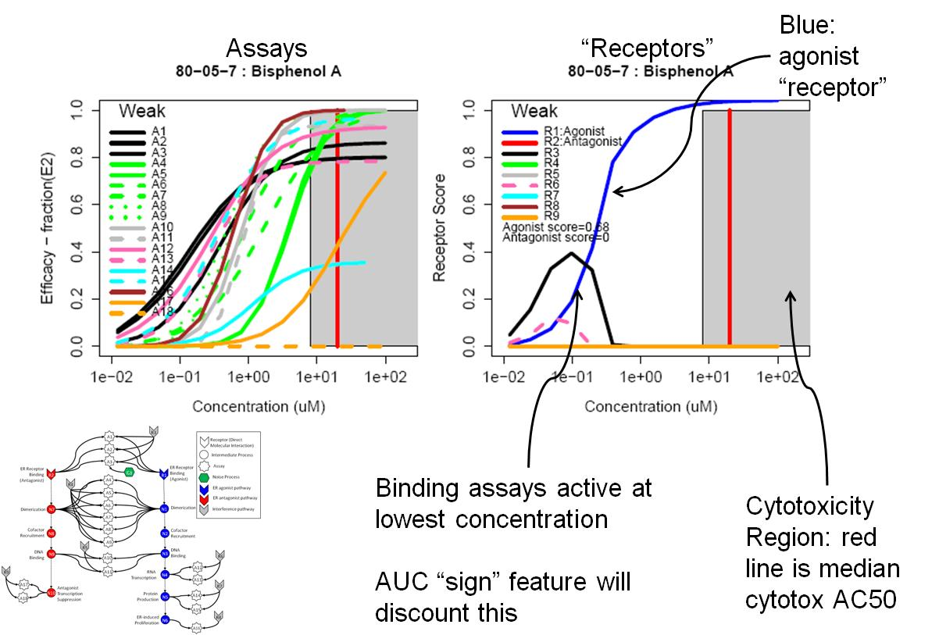
Example 1 – BPA: true agonist (AUC=0.66)

Slide 23
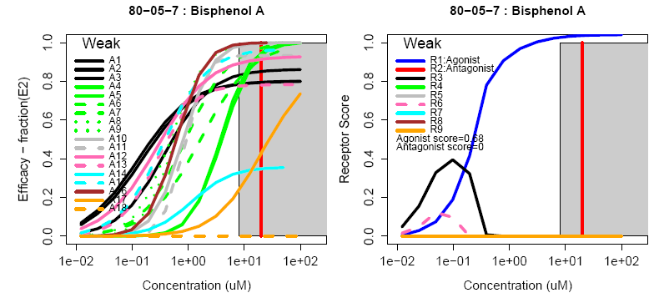
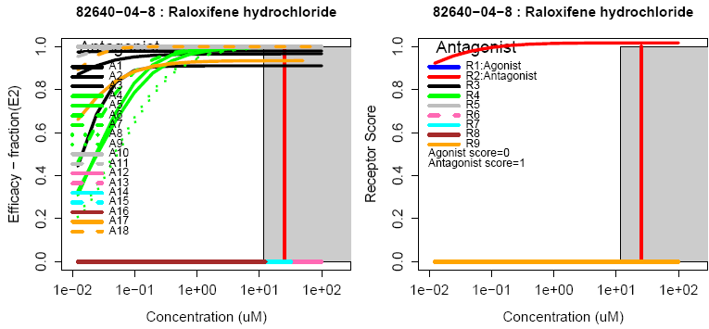
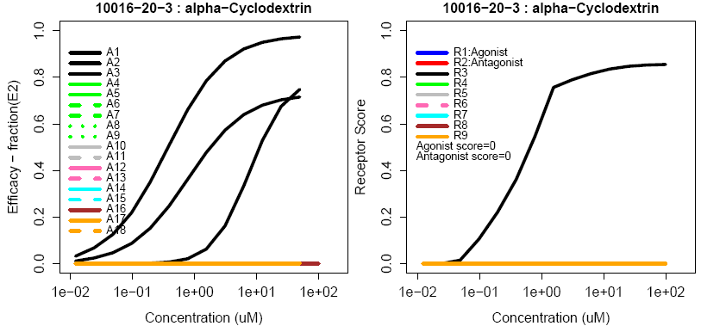
Example curves
True Agonist
True Antagonist
Assay Interference Example “R3”

Slide 24
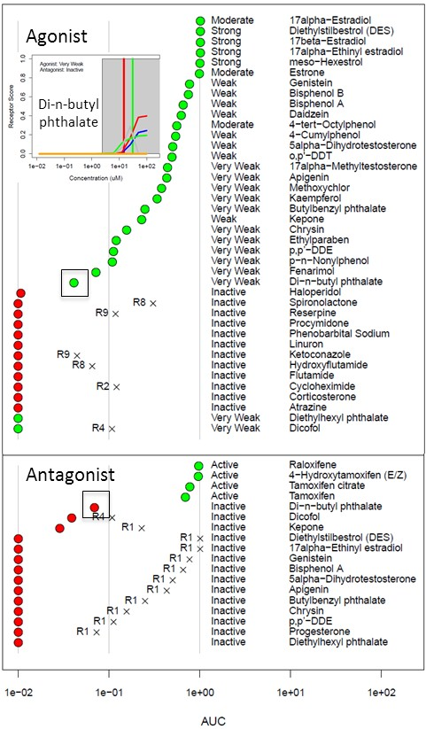
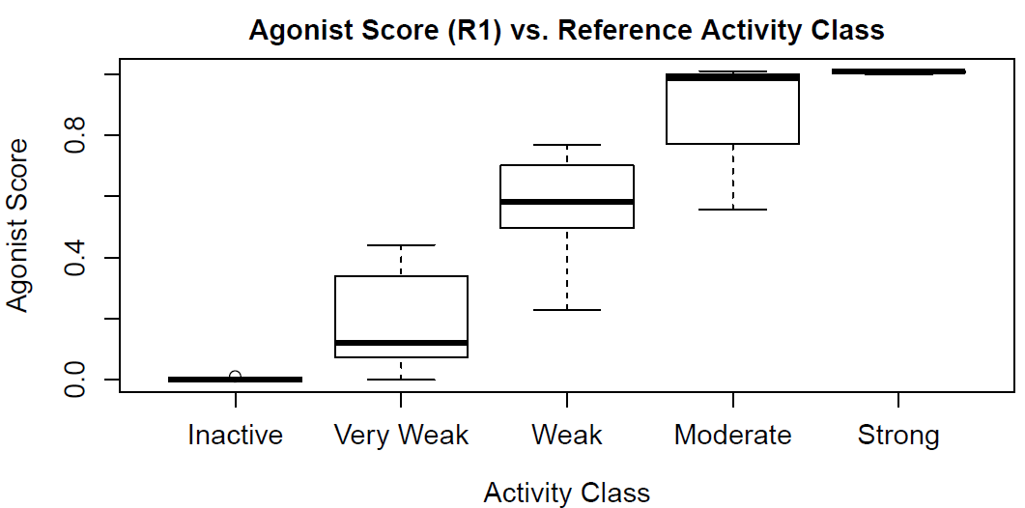
In Vitro Reference Chemical Performance
By using battery of assays and model of noise, we can accurately predict activity

Slide 25
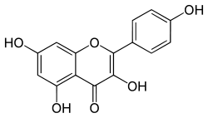
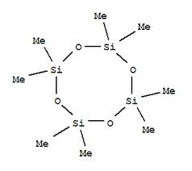
Model predicts in vivo uterotrophic assay as well as uterotrophic predicts uterotrophic
Restrict to chemicals with consistent results from the literature
True Positive | 29
True Negative | 50
False Positive | 1
False Negative | 1
Accuracy | 0.97
Sensitivity | 0.97
Specificity | 0.98
ER Agonist AUC
Kaempferol
Uterotrophic
Inactive
D4
Active
Rank Order (ER Agonist AUC)
Browne et al. ES&T (2015)

Slide 26
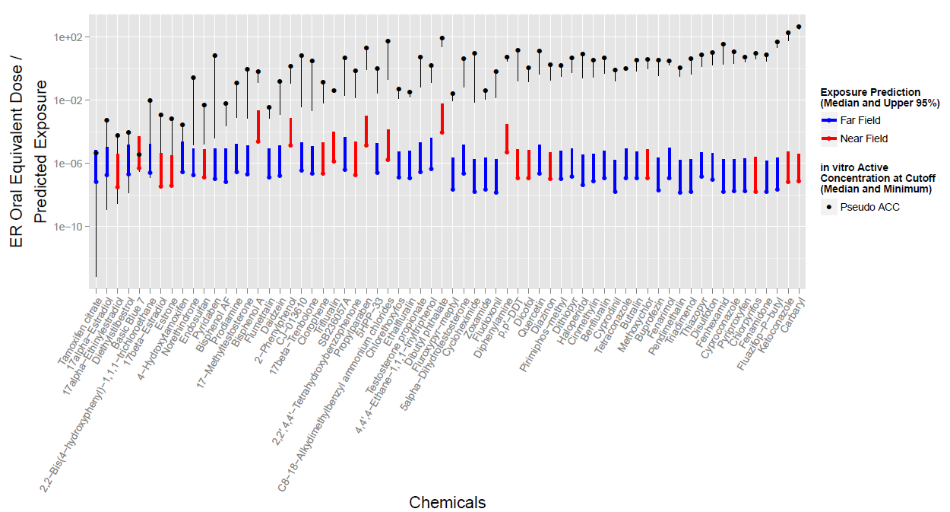
Prioritization (Replacement) Example Compare predicted exposure and hazard POD
Compare estrogen receptor assay battery and exposure model

Slide 27
Moving Towards Regulatory Acceptance From FIFRA SAP, December 2014
Can the ER Model be used for prioritization?
“… the ER AUC appears to be an appropriate tool for chemical prioritization for … the EDSP universe compounds.”
Can the ER model substitute for the Tier 1 ER in vitro and uterotrophic assays?
“… replacement of the Tier 1 in vitro ER endpoints …with the ER AUC model will likely be a more effective and sensitive measure for the occurrence of estrogenic activity …”
“… the Panel did not recommend that the uterotrophic assay be substituted by the AUC model at this time. The Panel suggested that the EPA considers: 1) conducting limited uterotrophic and other Tier 1 in vivo assay testing, using the original Tier 1 Guidelines (and/or through literature curation)”
Based on follow-up presented here (FR notice, June 18 2015) …
“EPA concludes that ER Model data are sufficient to satisfy the Tier 1 ER binding, ERTA and uterotrophic assay requirements.”

Slide 28
Summary
We are developing a minimal hazard battery
In combination with in vitro TK it can provide
in vitro LOAEC/NOAEC
In vivo POD estimate
Information on pathways perturbed above POD
Initial example is validated, based on:
Comparison with reference chemicals
Accounting for uncertainty in both in vitro and in vivo data
Uncertainty in both can be quantitative (POD value)
Uncertainty in both can be qualitative (active / inactive)

