Slide 1
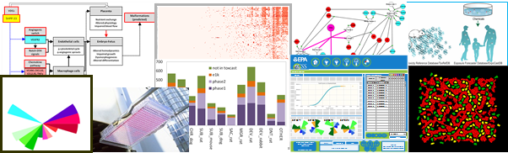
Innovations in Toxicology
Improving Our Understanding of Chemical Hazard
AAAS
February 16, 2018
Richard Judson
National Center for Computational Toxicology
The views expressed in this presentation are those of the presenter and do not necessarily reflect the views or policies of the U.S. EPA

Slide 2
Regulatory Agencies Make a Broad Range of Decisions on Chemicals…
Multiple drivers shape type of decision
Statutory requirements
Economic considerations
Multiple applications
Chemical decisions are a continuum
Prioritization (e.g., EDSP, PMN, SNUR, TSCA)
Screening-level assessments (e.g., CCL, GreenChem)
Provisional assessments (e.g., PPRTVs)
Toxicity assessments (e.g., IRIS)
Risk assessments (e.g., MCLs, pesticides)
Prioritization
Time/Data/Cost
Risk Assessments

Slide 3


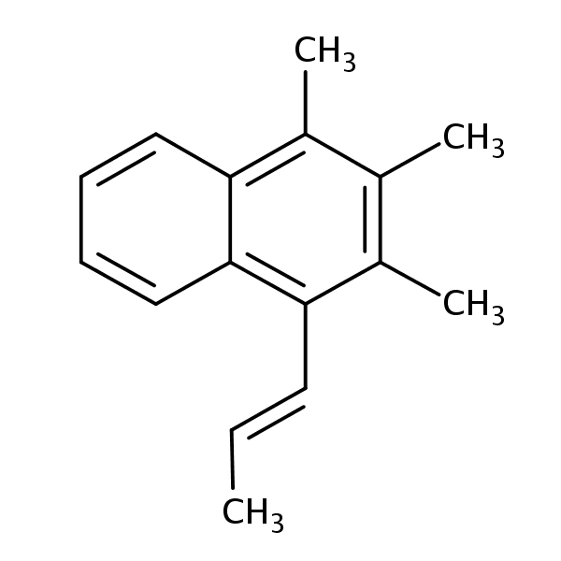


Regulatory Agencies Make a Broad Range of Decisions on Chemicals…
Number of Chemicals /Combinations
Lack of Data
Number of chemicals and combinations of chemicals is extremely large (>20,000 substances on active TSCA inventory)
Due to historical regulatory requirements, most chemicals lack traditional toxicity testing data
Traditional toxicology testing is expensive and time consuming
Traditional animal-based testing has issues related to ethics and relevance
Modified from Judson et al., EHP 2010
Ethics/Relevance Concerns
Economics

Slide 4

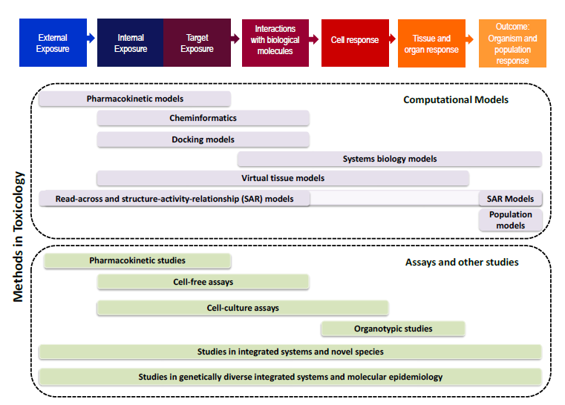
Toxicology Moving to Embrace 21st Century Methods

Slide 5
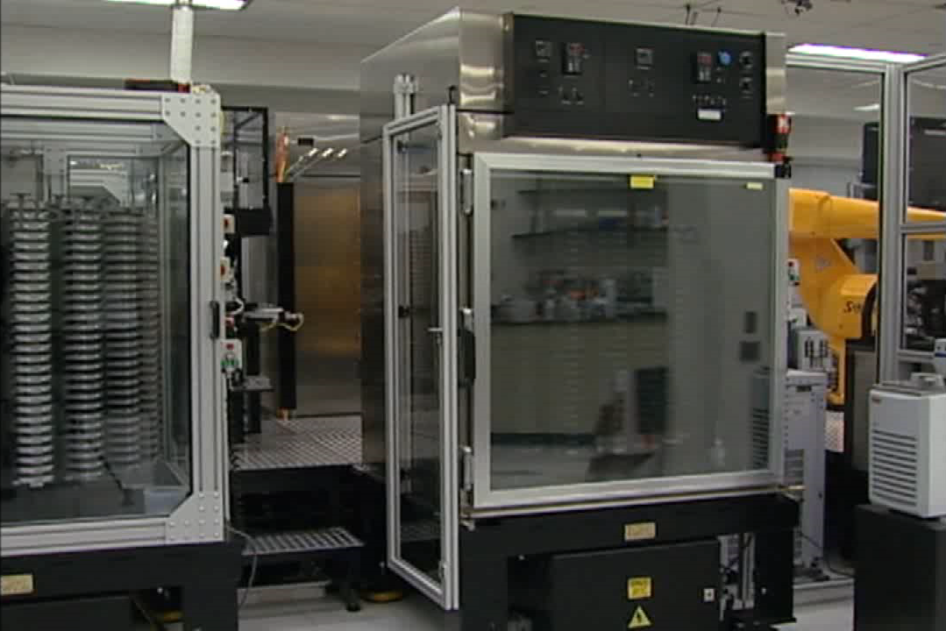
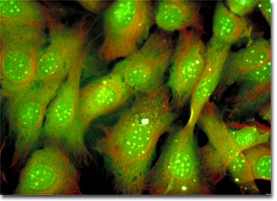
High-Throughput Assays Used to Screen Chemicals for Potential Toxicity
Hundreds High-Throughput ToxCast/Tox21 Assays
Thousands of Chemicals
Targets
Pathways
Mode of Action
Dose-response
Understanding of what cellular processes/pathways may be perturbed by a chemical
Understanding of what amount of a chemical causes these perturbations
Response
Concentration

Slide 6
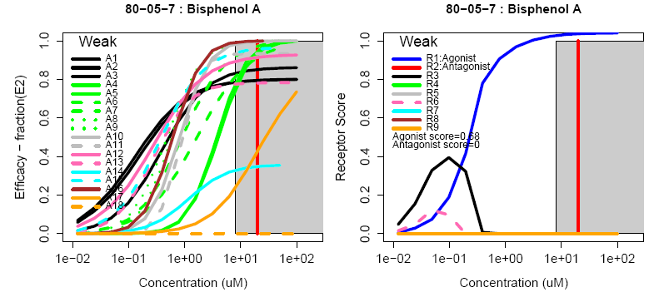
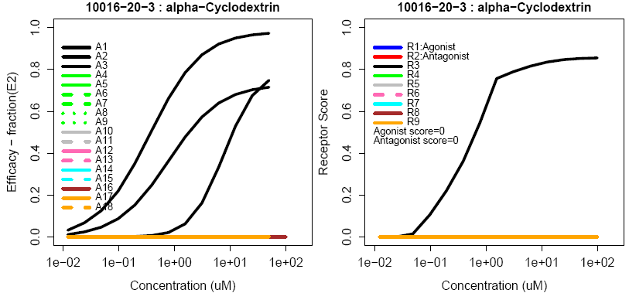
Application of High-Throughput Assays to Identify Potential Endocrine Disrupting Chemicals
18 In Vitro Assays Measure ER-Related Activity
Judson et al., Tox Sci. 2015
Browne et al., ES&T. 2015
Kleinstreuer et al., EHP 2016

Slide 7
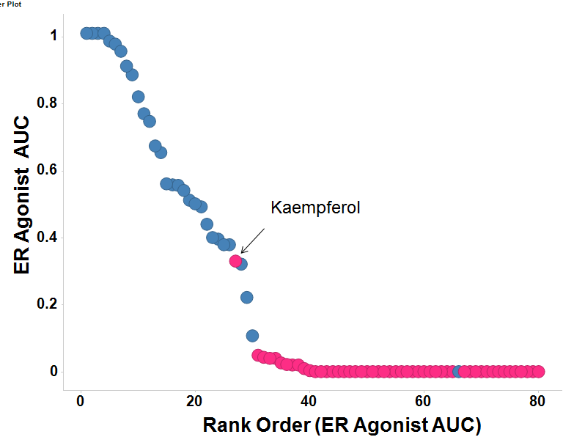
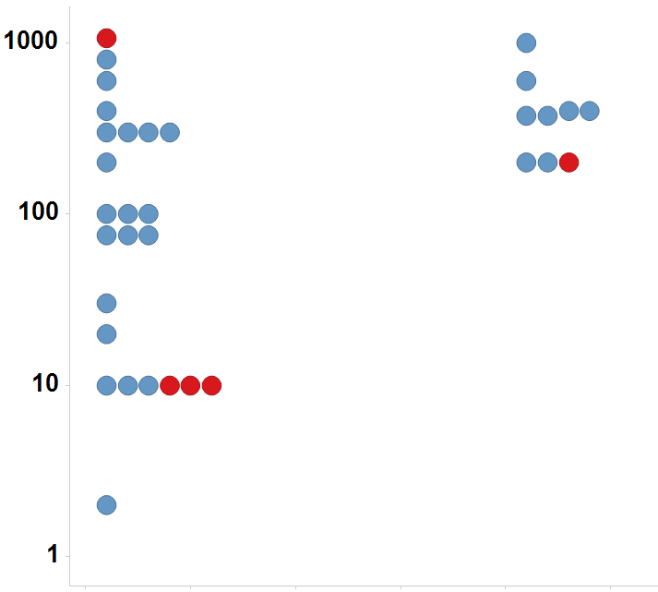

Comparison of High-Throughput Assays with Traditional In Vivo Tests
Concordance between Model and Uterotrophic Studies
Concordance between Uterotrophic Studies
LEL or MTD (mg/kg/day)
Uterotrophic
Active
Inactive
Injection
Oral
Immature Rat: BPA
Kleinstreuer et al., EHP 2016
Predictive Performance for In Vivo Uterotrophic Studies
Accuracy | 0.86 (0.95)
Sensitivity | 0.97 (0.97)
Specificity | 0.67 (0.89)
Kleinstreuer et al., EHP 2016
Browne et al. ES&T 2016
*Values in parentheses exclude inconclusive chemicals

Slide 8
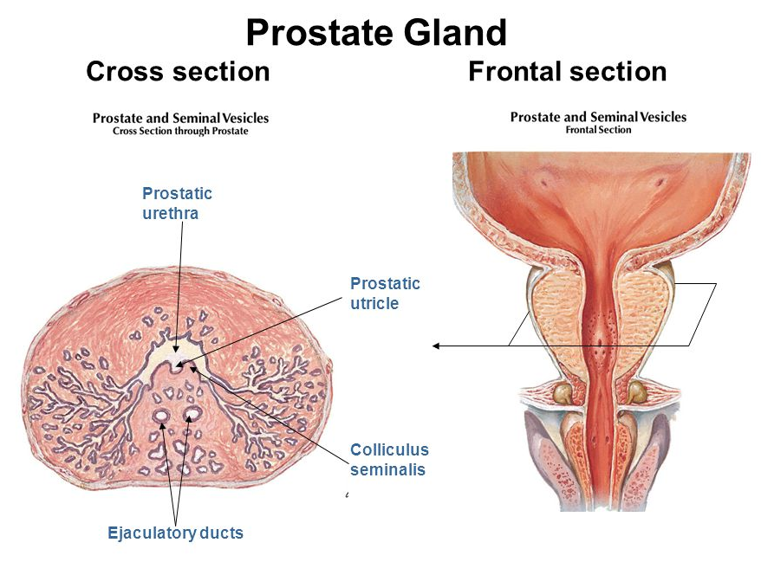
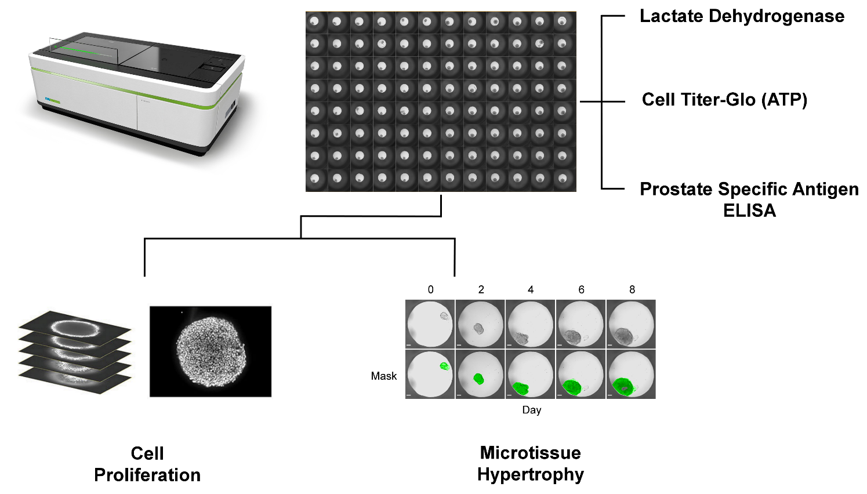
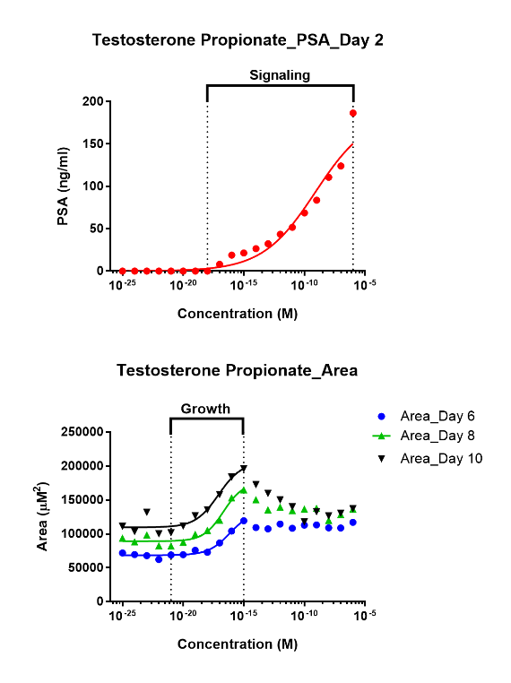
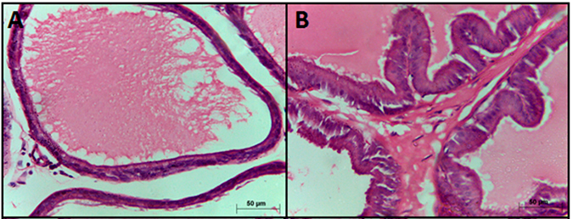
Developing More Sophisticated Organotypic Assays to Mimic Tissue-Related Behavior
Organotypic Assay to Mimic Prostate Epithelial Response
Castrate Control Testosterone Propionate
Sci Rep. 2015 Oct 23;5:15639

Slide 9
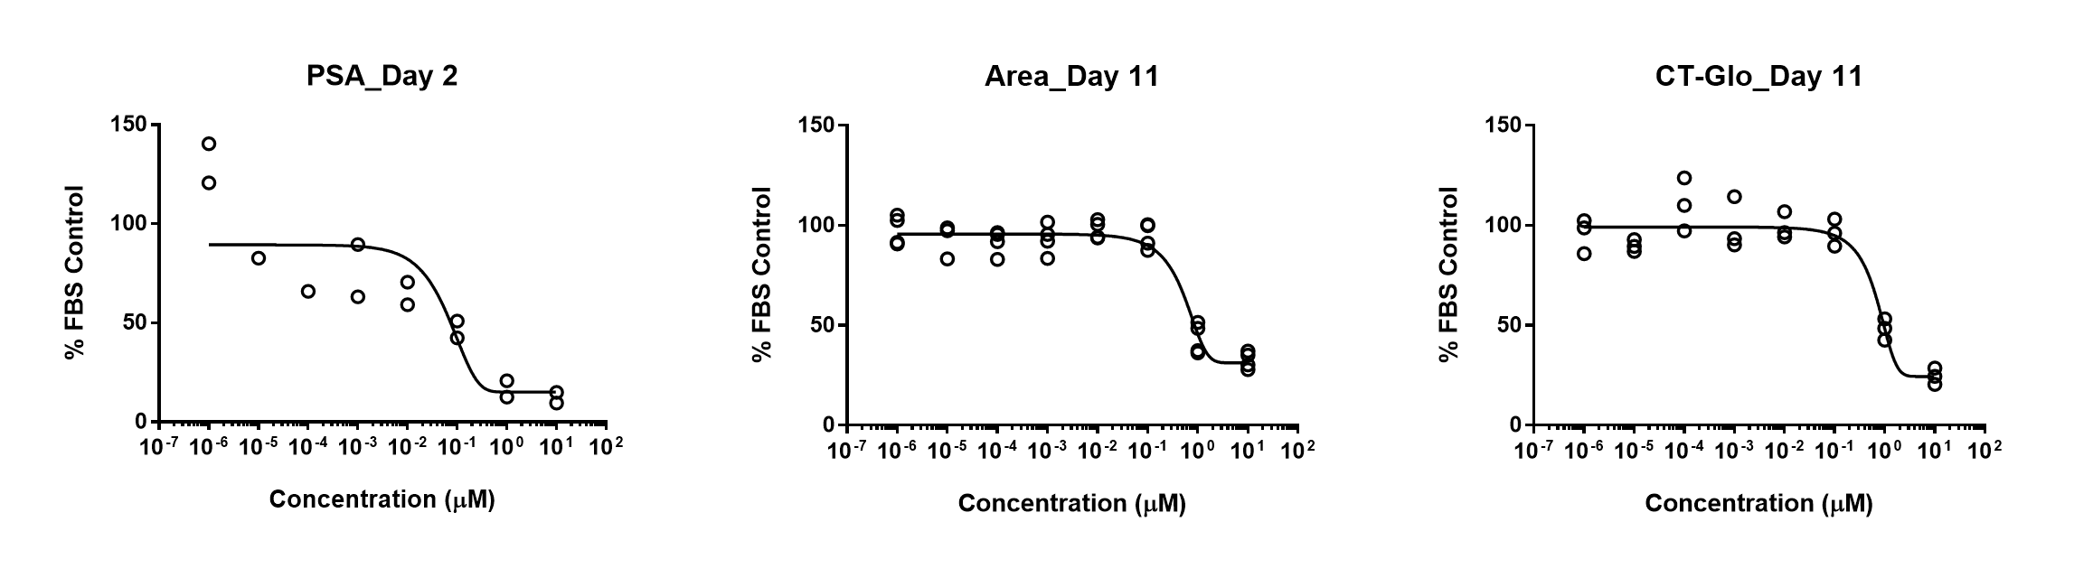
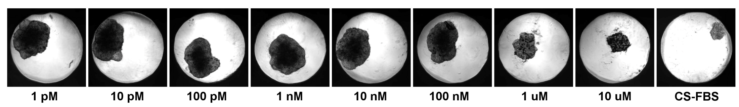
Identifying Disruptors of Androgen Signaling Using Organotypic Models of Prostate Epithelium
MOA: Irreversible inhibitor of 5α-reductase Isozyme 1 and 2 (2>1)
Class: 4-azasteroid
IC50: Isozyme 1 (360 nM), Isozyme 2 (69 nM)
Finasteride
Endpoint | Day | IC50 (µM)
PSA | 2 | 0.31
LDH | 2 | ND
Area | 11 | 1.63
Proliferation | 11 | ND
CT-Glo | 11 | 3.27
Deisenroth and coworkers

Slide 10
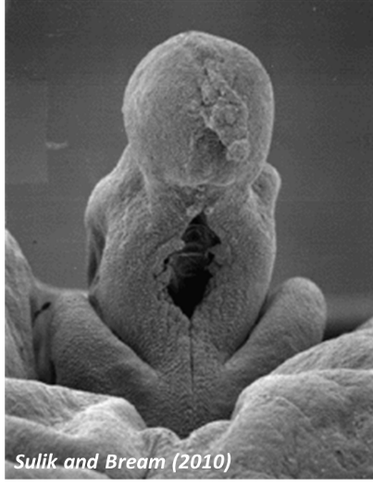
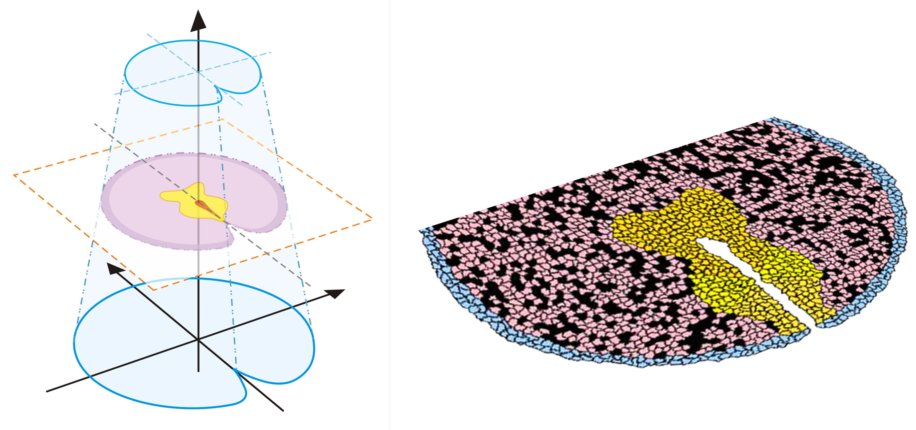
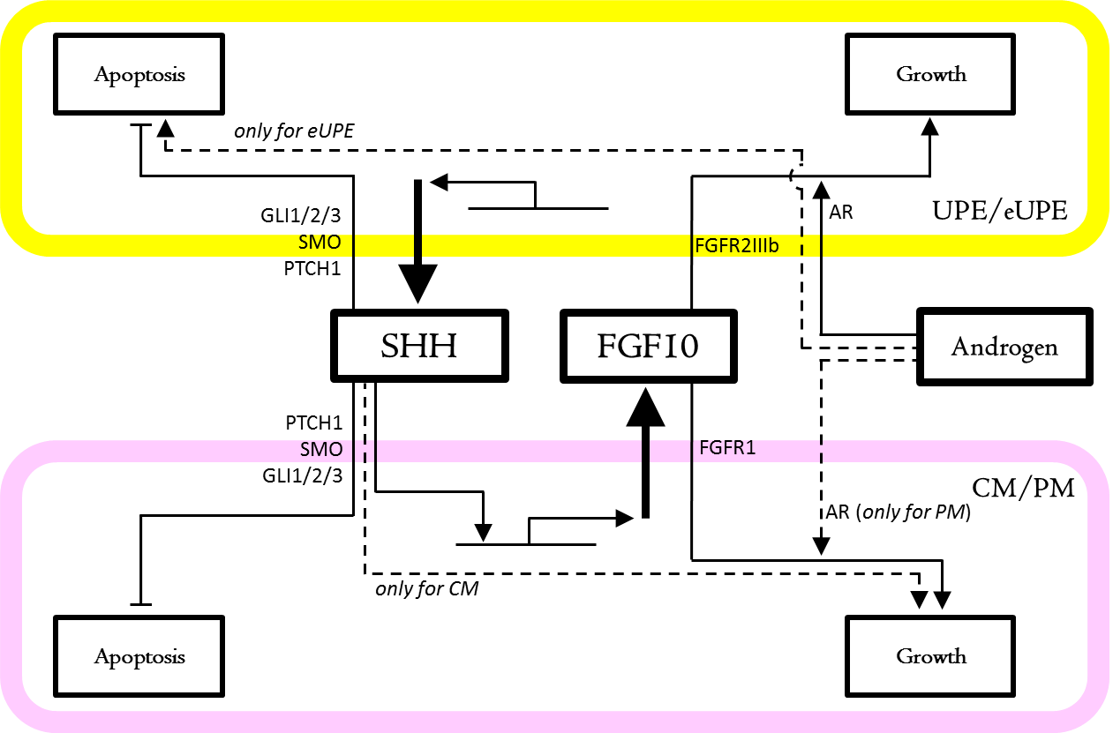
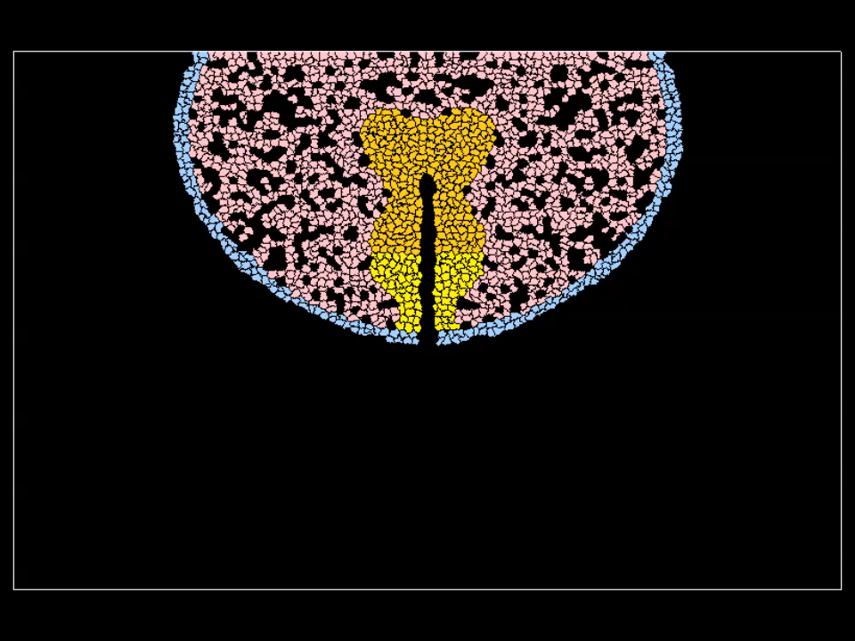
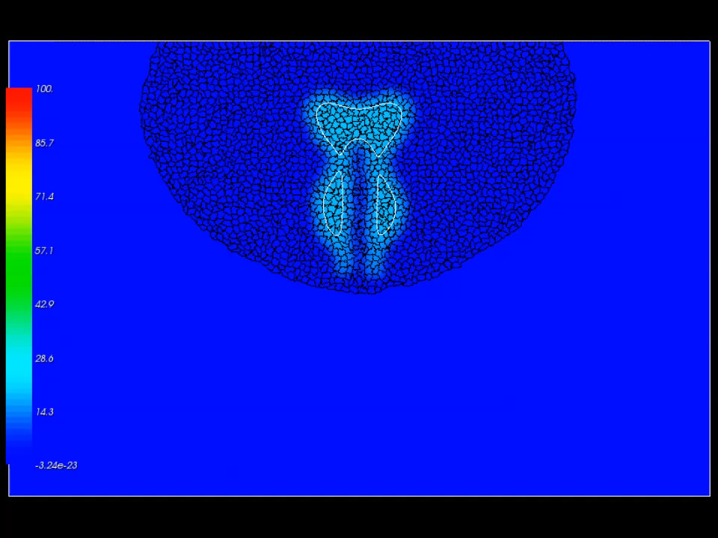
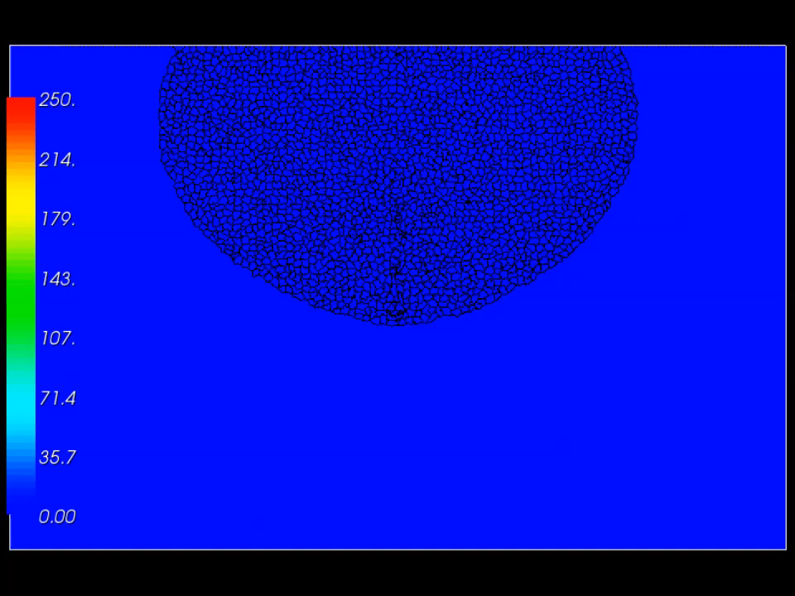
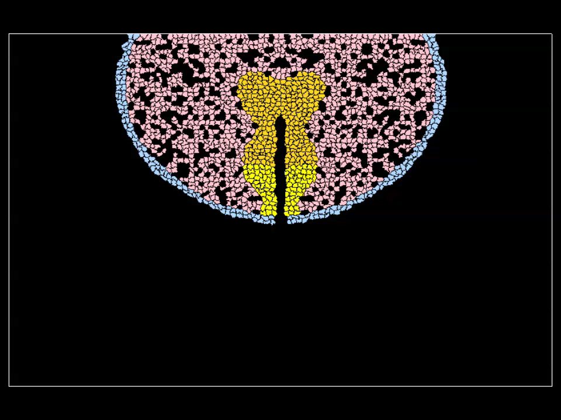


Developing Virtual Tissue Models to Simulate Tissue and Organ Development and Function
Genital tubercle (GT) Control Network (mouse)
Simulation for sexual dimorphism (mouse GD13.5 – 17.5)
androgen
SHH field
FGF10 field
no androgen
Knudsen and coworkers
Leung et al., Repro Toxicol, 2016

Slide 11
Zebrafish and Developmental Toxicology
Goal: Use zebrafish as an in vivo model of vertebrate developmental toxicity
Build in vitro to in vivo models using ~700 human assays
~1000 Chemicals
pharmaceuticals, pesticides, industrial chemicals, personal care product chemicals and food ingredients
Can we combine with ToxCast to determine ZF MOA?
Padilla and coworkers

Slide 12
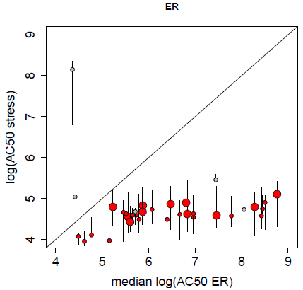
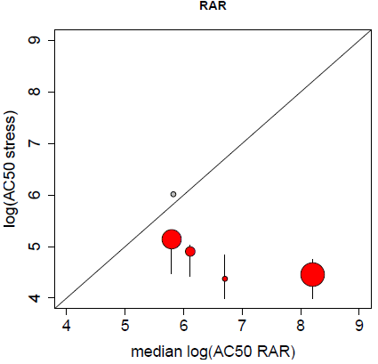
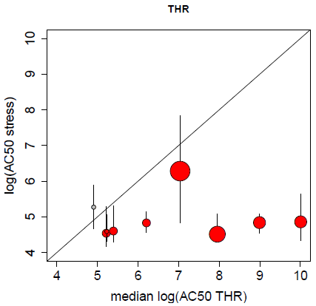
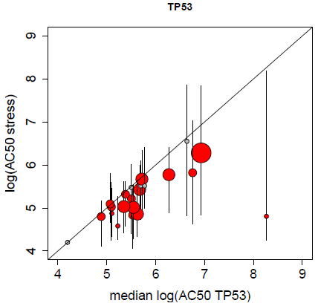
Proposed Mode of Action
Much of developmental toxicity is due to cell stress and cytotoxicity
Use other in vitro assays to find specific MOA
Estrogen Receptor
86% active
(30 / 35)
Retinoic Acid Receptor
83% active
(5 / 6)
Δ
Thyroid Hormone Receptor
90% active
(9 / 10)
TP53
77% active
(17 / 22)

Slide 13
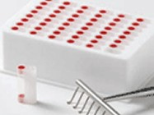
Putting High Throughput Assay Results in a Dose and Exposure Context
Environmental/ Commercial Chemicals
In Vitro
Bioactivity
~700 In Vitro Screening Assays
Human Liver Metabolism
Human Plasma Protein Binding
Least Sensitive Assay
Assay AC₅₀ Value
Oral Equivalent Dose (mg/kg/day)
Population-Based IVIVE Model
?
Oral Dose Required to Achieve Steady State Plasma Concentrations Equivalent to In Vitro Bioactivity
?
Plasma Concentration
What are humans exposed to?
Most
Sensitive Assay
Oral Exposure
Upper 95th Percentile Css Among 100 Healthy Individuals of Both Sexes from 20 to 50 Yrs Old
?
Reverse Dosimetry
Chemical
Rotroff et al., Tox Sci., 2010
Wetmore et al., Tox Sci., 2012

Slide 14
Comparing Assay Bioactivity with Exposure Provides Risk Context
Majority of chemicals have exposure well below threshold for bioactivity for
non-intentional exposure scenarios
Assay Bioactivity
Exposure Range
Wetmore et al., Tox Sci., 2012

Slide 15
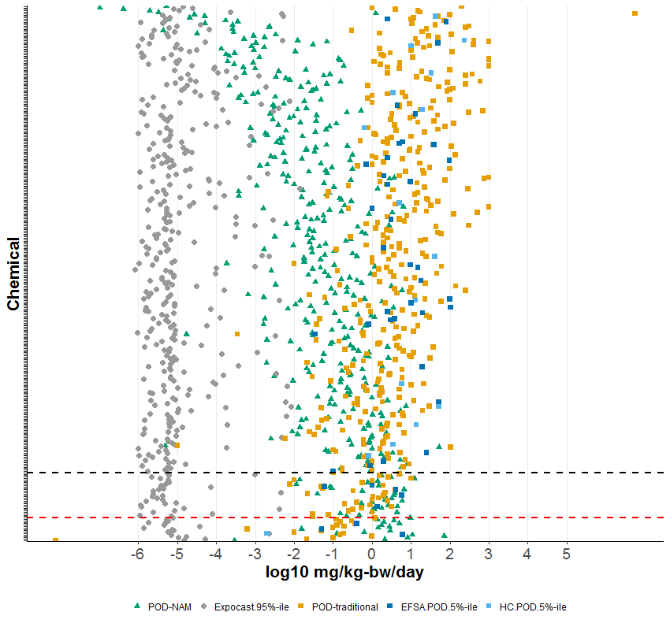
High Throughput Assays Provide a Conservative Estimate of a No/Low Effect Dose from a Traditional Animal Test
POD_{ToxCast} < ExpoCast 95%
Total =
380 chemicals
POD_{ToxCast} = conservative
For ~91.3% of the chemicals, HT assays provided conservative estimate of in vivo effect levels.
(~130-fold with human HT
~40-fold with rat TK)
Exposure Models
HT Assays
Traditional Tox Studies
POD_{trad} < POD_{ToxCast}
Missing an important component of biology?

Slide 16
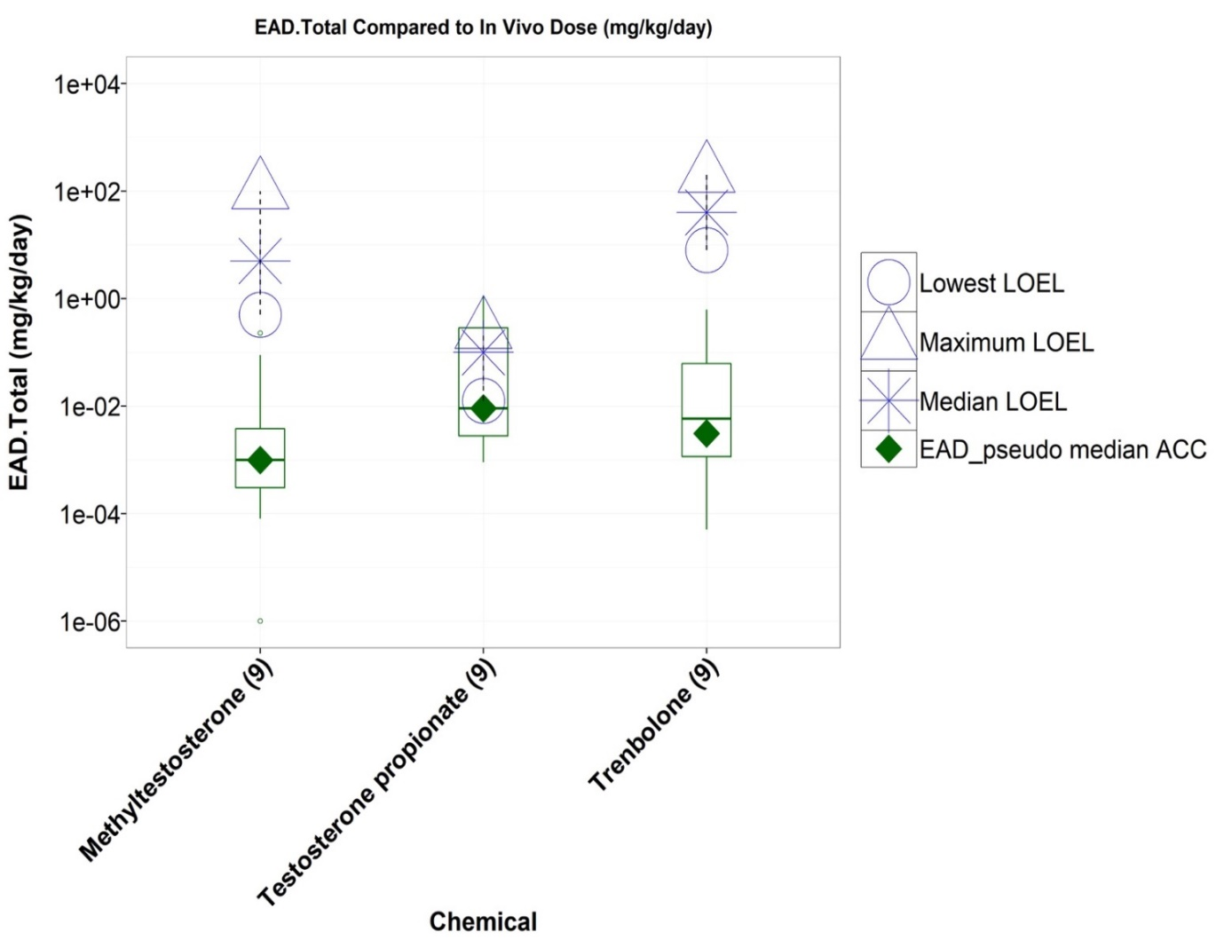
A challenge is predicting the correct dose where specific effects are seen
Example of predicting ER-induced accessory sex organ weight changes induced by androgens
In vitro + PK < in vivo
Work-in-progress, species extrapolation still to be done
Kleinstreuer, Browne and coworkers

Slide 17
Take Home Messages…
There are a broad spectrum of decisions that regulatory agencies need to make about chemical safety
The data landscape for commercial and environmental chemicals is data poor:
Limits the decisions regulatory agencies can make
Incorporating innovative technologies allows more rapid and inexpensive screening of chemicals for potential adverse biological effects
Incorporating dosimetry and exposure provide important dose and exposure contexts
Comparisons of high-throughput in vitro results with traditional animal tests suggests:
The in vitro results generally provide a conservative estimate of in vivo doses for general toxicity
Good concordance for specific modes-of-action

Slide 18
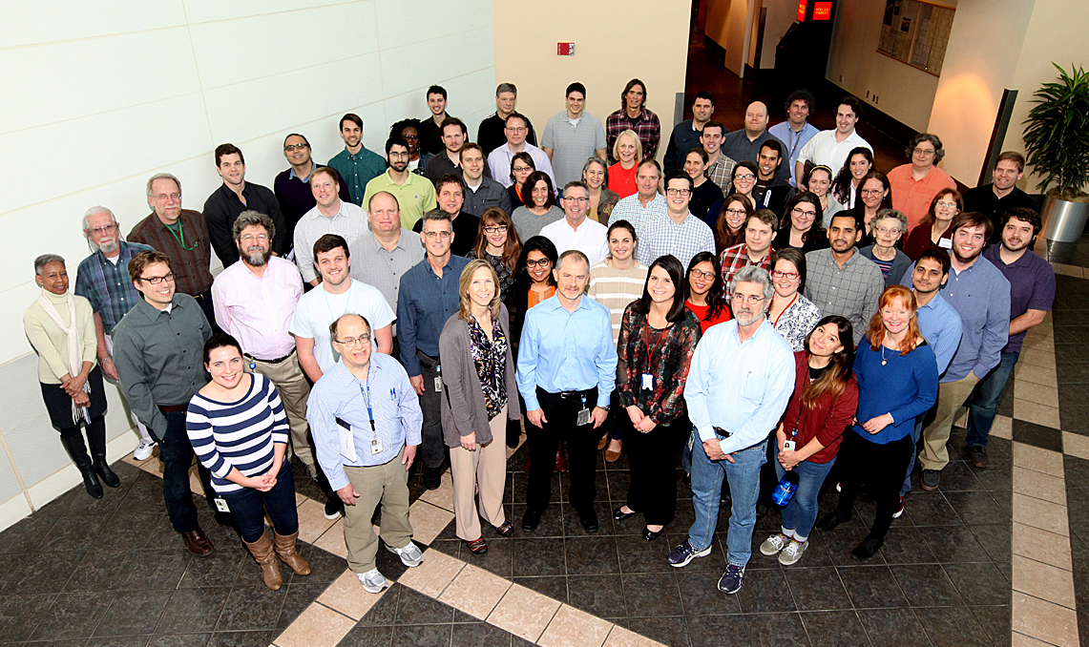
Acknowledgements and Questions
EPA’s National Center for Computational Toxicology
Tox21 Colleagues:
NTP
FDA
NCATS
EPA Colleagues:
NERL
NHEERL
NCEA
Collaborative Partners:
Unilever
A*STAR
ECHA
EFSA
Health Canada

