Slide 1

Computational Toxicology
Richard Judson
The views expressed in this presentation are those of the author[s] and do not necessarily reflect the views or policies of the U.S. Environmental Protection Agency.
UNC, November 2015

Slide 2
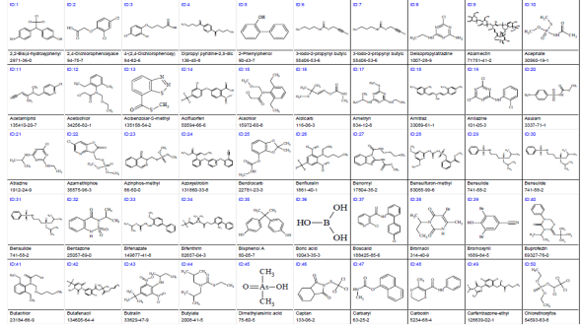
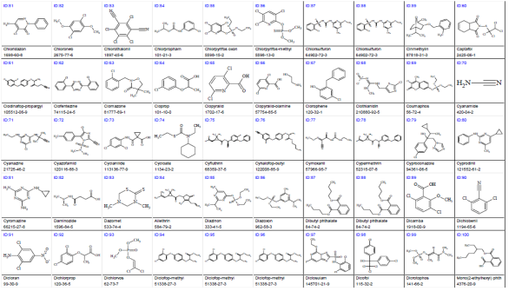
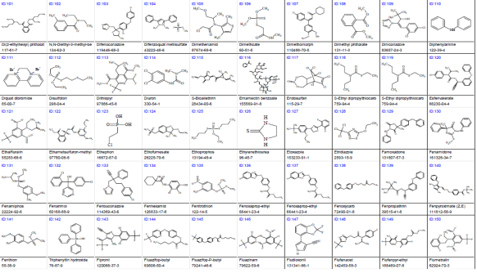

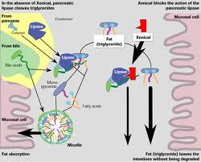
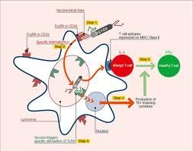
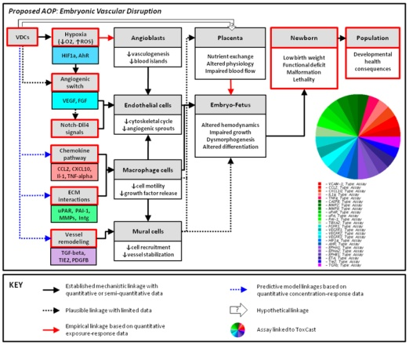
Problem Statement
Too many chemicals to test with standard animal-based methods
  Cost, time, animal welfare
  Exposure is as important as hazard
Need for better mechanistic data
- Determine human relevance
- What is the relevant Mode of Action (MOA) or Adverse Outcome Pathway (AOP)?

Slide 3
Issues to Consider
Our first goal is prediction
  What is the highest safe dose of a chemical?
  What types of harm would a chemical cause above that dose?
Predictions are based on models
  Computational, statistical, “mental”
All models are based on data
Data is always subject to noise, variability
Therefore, all predictions are subject to uncertainty
Our second goal is estimating how uncertain our predictions are

Slide 4
Predictive Toxicity Models
Purely statistical
  Look for significant associations between HTS data and in vivo tox data (ToxRefDB)
Purely hypothesis driven
  Build a model based on prior knowledge (e.g. and Adverse Outcome Pathway or AOP) and then see if HTS input predicts in vivo output
Mixed model
  Use statistical associations to inform AOP development

Slide 5
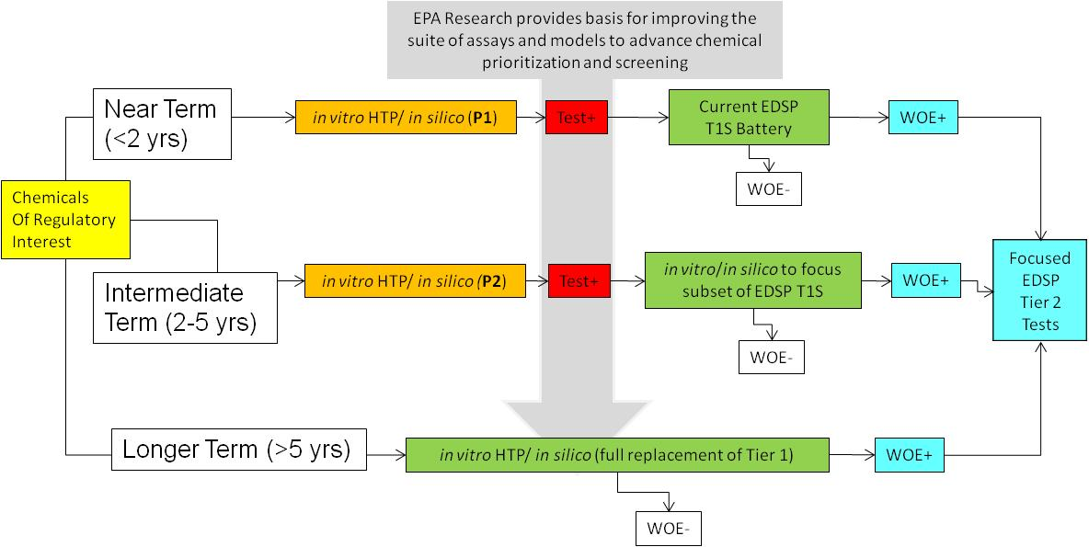
Initial Prioritization Application: EDSP21
Use high-throughput in vitro assays and modeling tools to prioritize chemicals for EDSP Tier 1 screening assays

Slide 6
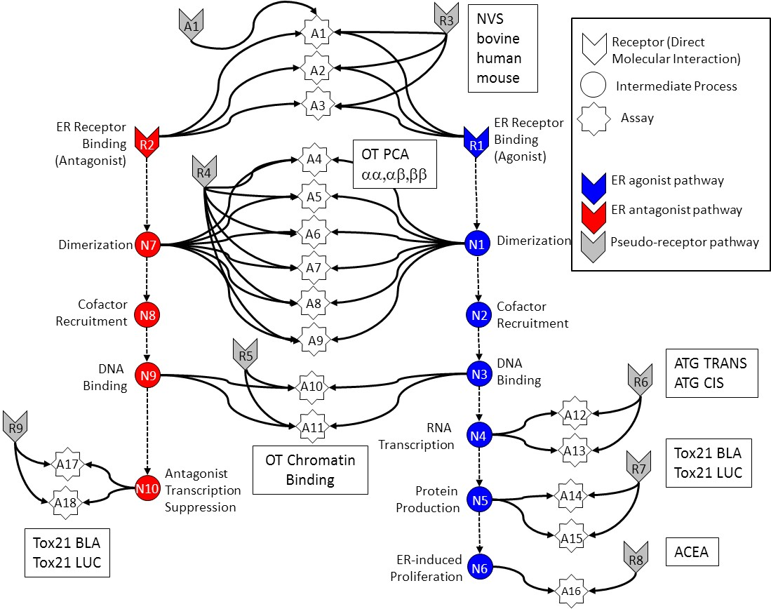
In Vitro Estrogen Receptor Model
Combines results from multiple in vitro assays
Use multiple assays per pathway
  Different technologies
  Different points in pathway
No assay is perfect
  Assay Interference
  Noise
Use model to integrate assays
Evaluate model against reference chemicals
Methodology being applied to other pathways

Slide 7



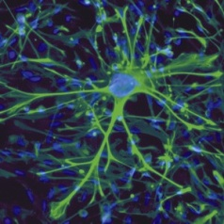
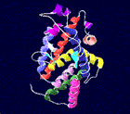
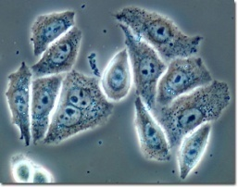

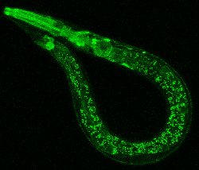
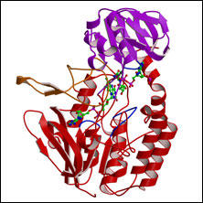
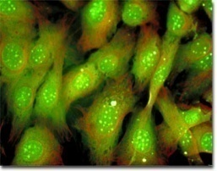

High-Throughput Screening Assays
batch testing of chemicals for pharmacological/toxicological endpoints using automated liquid handling, detectors, and data acquisition
LTS
MTS
HTS
uHTS
Gene-expression
1000s/day
10s-100s/yr
10,000s-100,000s/day
10s-100s/day
Human Relevance/ Cost/Complexity
Throughput/ Simplicity

Slide 8
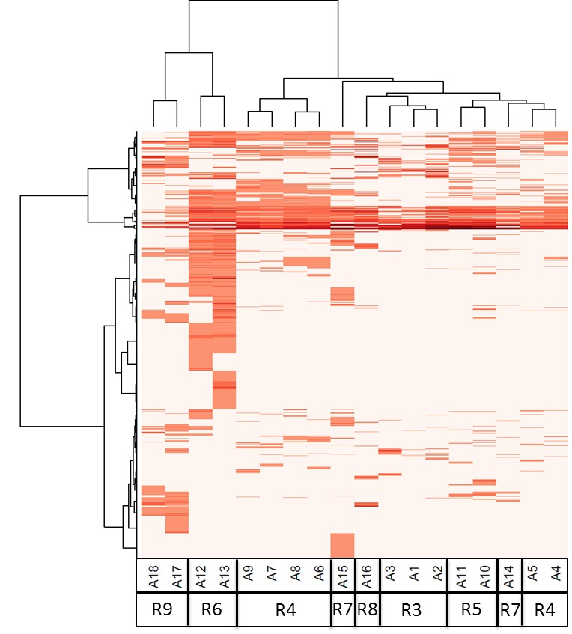
Assay Bioactivity Patterns Track with Technology
Drives need for model to separate ER from off-target bioactivity
Many assays are active
One or a few assays active

Slide 10
Computational Model
A_{i} is the efficacy of the assay at a given concentration
R_{j} is the “true” efficacy which is unobservable
F links receptors to assays
Solve a constrained least-squares problem to minimize difference between the measured and predicted assay values
Penalty enforces physical assumption
that chemical will not hit many targets simultaneously
AUC Summarizes results

Slide 11
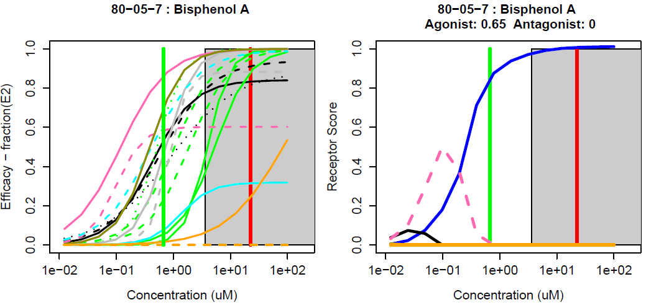
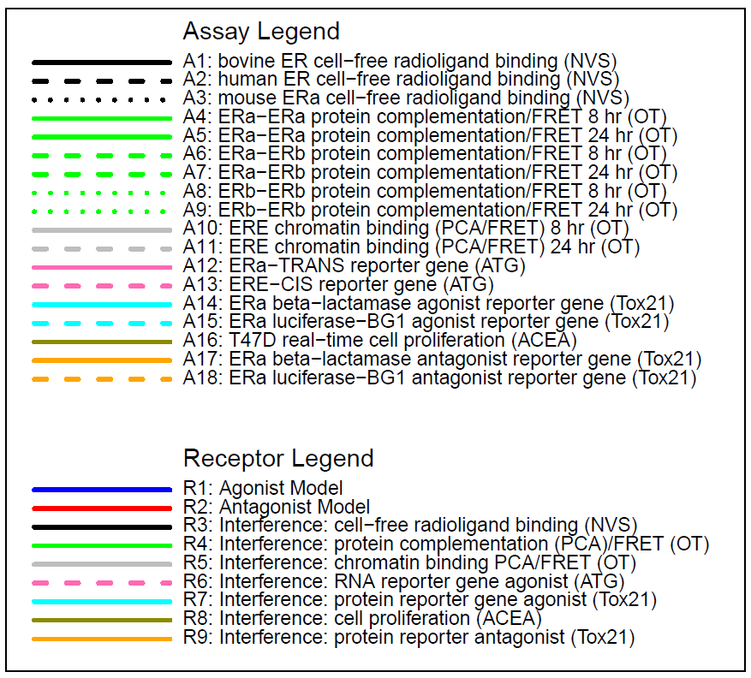
Example 1 – BPA – true agonist (AUC=0.65)
Assays Receptors
Blue: agonist “receptor”
Binding assays active at lowest concentration
AUC “sign” feature will discount this
Cytotoxicity Region: red line is median cytotox AC50

Slide 12
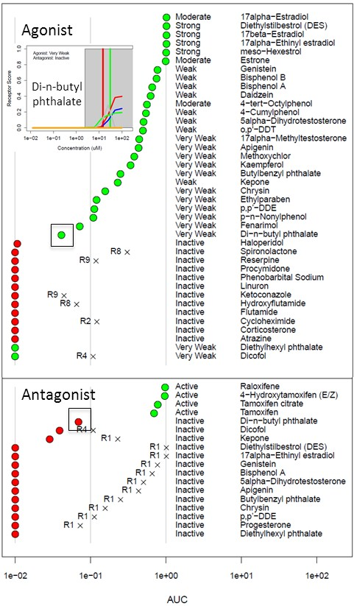
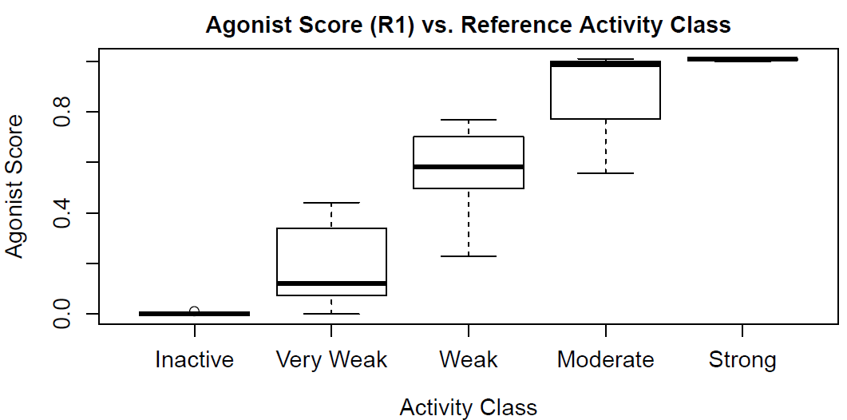
Reference Chemical Performance

Slide 13
Most chemicals display a “burst” of potentially non-selective bioactivity near cytotoxity concentration
Concentration Space
Z- Space
Tested Concentration Range
Cytotoxicity
Range
3 MAD
Burst
Region
Cytotoxicity
Range
3 MAD
Burst
Region
Number of Hits
Number of Hits
0.1
1
10
100
1000
21 18 15 12 9 6 3 0 -3 -6 -9
AC50 (μM)
Bioactivity inferred
Z

Slide 14
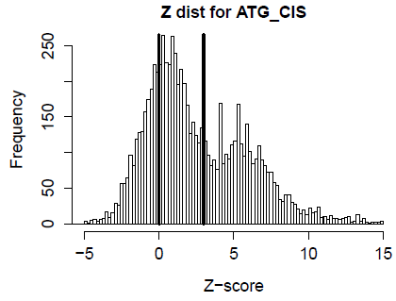
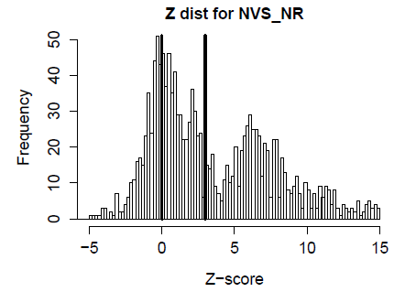
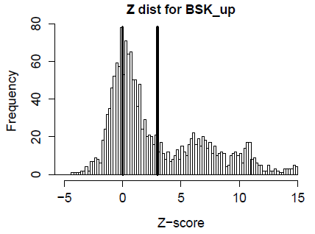
Burst is seen across technologies
Cell-free Biochemical
Cell line (HepG2)
Human Primary Cells
Bimodal

Slide 15
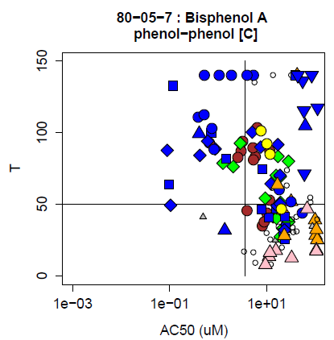
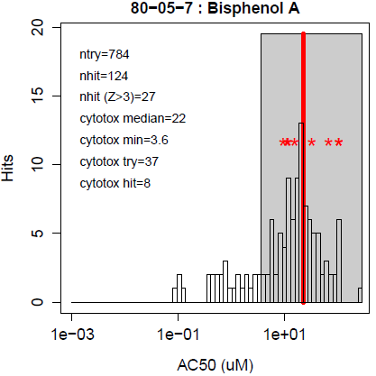
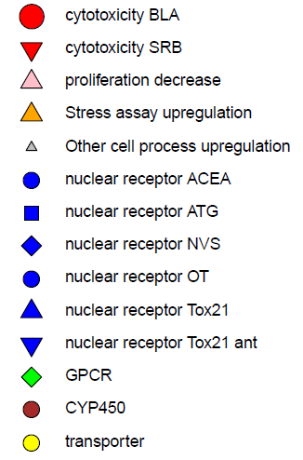
Example of burst bioactivity by chemical
Cytotoxicity assays

Slide 16
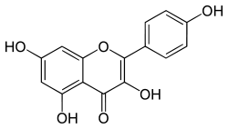
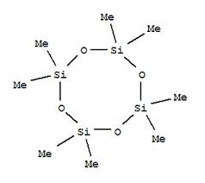
ER Agonist AUC vs. Uterotrophic Outcomes
True Positive | 29
True Negative | 50
False Positive | 1
False Negative | 1
Accuracy | 0.97
Sensitivity | 0.97
Specificity | 0.98
Uterotrophic
Inactive
Active
ER Agonist AUC
Kaempferol
D4
Rank Order (ER Agonist AUC)
Browne et al. Screening chemicals for estrogen receptor bioactivity using a computational model (ES&T in press)

Slide 17
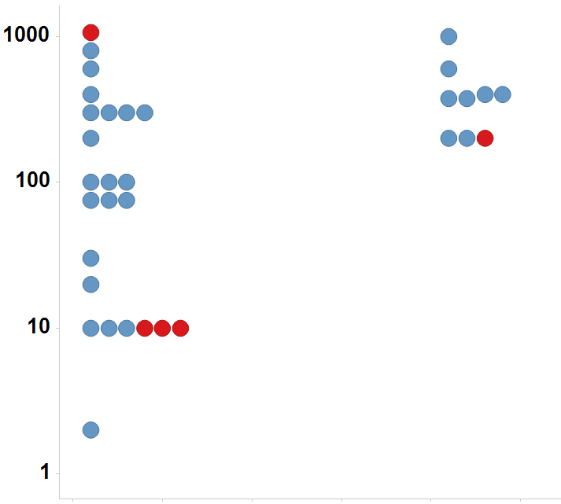
In vivo guideline studies have the same types of uncertainty as in vitro
Immature Rat: BPA
LEL or MTD (mg/kg/day)
Uterotrophic
Active
Inactive
Injection
Oral

Slide 18
Risk-based Prioritization
Hazard + Exposure
mg/kg BW/day
Semi-quantitative
In Vitro to In Vivo
Approach
Potential Hazard:
In Vitro + HTTK
Potential Exposure:
ExpoCast
Low
Priority
Medium
Priority
High
Priority

Slide 19
High-Throughput Risk Assessment (HTRA)
Risk assessment approach
  Estimate upper dose that is still protective
  RfD, BMD are standard, animal-based quantities
  Compare to estimated steady state exposure levels
Contributions of high-throughput methods
  Focus on molecular pathways whose perturbation can lead to adversity
  Screen hundreds to thousands of chemicals in in vitro assays for those targets
  Estimate oral dose using H-T pharmacokinetic modeling
Incorporate population variability and uncertainty

Slide 20
HTRA Basic Outline
Define molecular pathways linked to adverse outcomes
Measure activity in vitro in concentration-response (PD)
Estimate external dose to internal concentration scaling (PK)
Estimate dose at which pathway is perturbed in vivo
Estimate population variability and uncertainty in PK and PD
Estimate lower end of dose range for perturbation of pathway

Slide 21
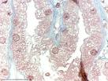
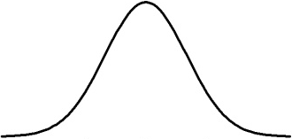
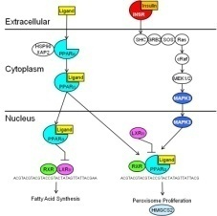


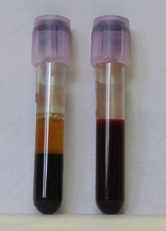

Pharmacodynamics
Pharmacokinetics
Dose-to-Concentration
Scaling Function (C_{ss})
Probability Distribution
Adverse Effect
MOA
Key Events
Toxicity Pathway
BPAD
Probability Distribution
for Dose
that Activates
Biological Pathway
HTS Assays
PK Model
Populations
Biological Pathway Activating
Concentration (BPAC)
Probability Distribution
Plasma Protein
Binding
Intrinsic
Clearance

Slide 22
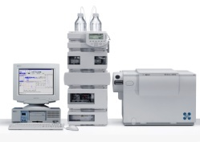
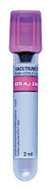
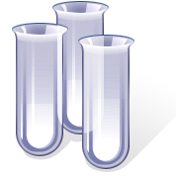
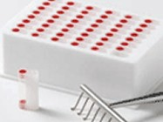
Adding Pharmacokinetics:
High-Throughput ToxicoKinetics (HTTK)
Human
Hepatocytes
(10 donor pool)
Add Chemical
(1 and 10 μM)
Remove Aliquots at 15, 30, 60, 120 min
Analytical Chemistry
Hepatic Clearance
Plasma Protein Binding
Human
Plasma
(6 donor pool)
Add Chemical
(1 and 10 μM)
Equilibrium
Dialysis
Analytical Chemistry
Combine experimental data w/ PK Model to estimate dose / concentration scaling
Bioactivity Dose = Bioactivity Concentration / Css

Slide 23
ExpoCast Exposure Modeling
Output: Estimate of exposure (w/ confidence interval)

Slide 24
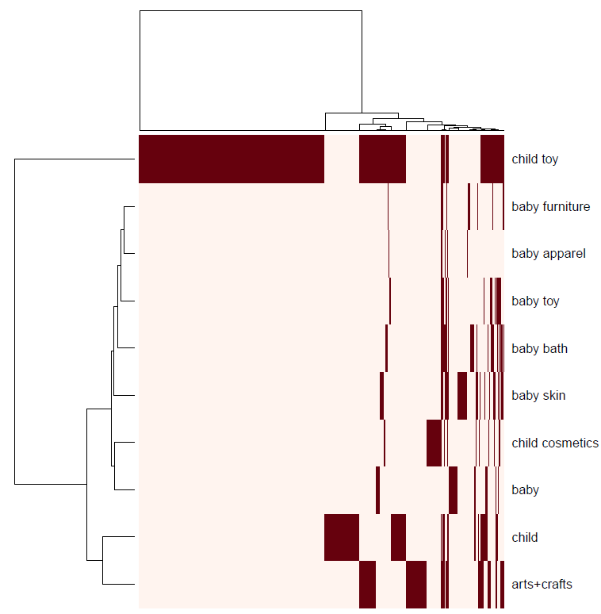
Use CPCat to enumerate chemicals for exposure scenarios
Example: children’s exposure
Relevant CPCat categories
1,344 chemicals

Slide 25
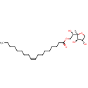

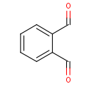
Mapping Chemicals to
Use Categories
Many sources of information on chemical use, mapped to categories
Chemical to Product
Then
Product to Category
Chemical
To
Category
Laundry detergent, industrial solvent, baby care
Category hierarchy

Slide 26
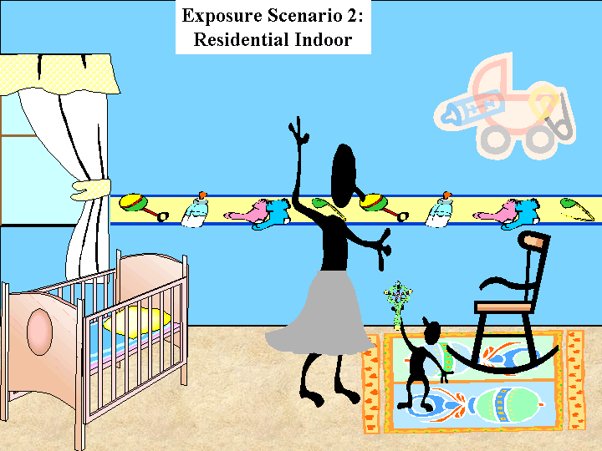
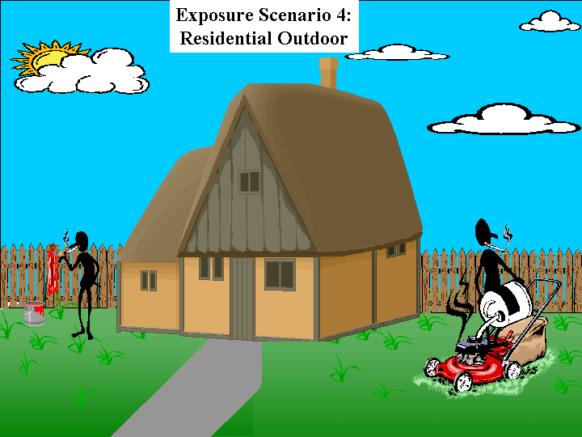
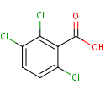
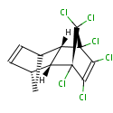
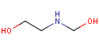
Mapping Use Categories to Scenarios
Map to Exposure Scenarios
Map to Exposure Scenario Concepts
Paint
Pesticide
Food Additive
Baby
Adult
Garage
Kitchen
Multiple Category Hierarchies

Slide 27
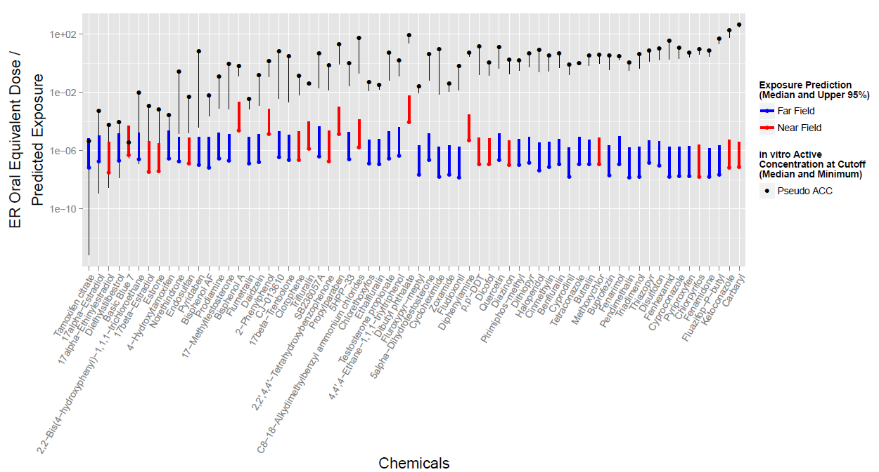
Comparing Exposure and Activity Doses for Estrogen Receptor Activity

Slide 28
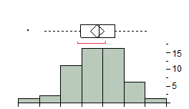
Region of No Biological Activity Provides a Conservative POD
Spanned 38 In Vivo Endpoints across Multiple Tissues, Organ Systems, and Study Types (Repro, Chronic, and Dev)
10⁻² 10⁻¹ 10⁰ 10¹ 10² 10³ 10⁴ 10⁵
Log Ratio ToxRef Min LEL:ToxCast
Min Oral Equivalent Dose
Distribution Summary Statistics
Median 1.82 (66.07)
Upper Quartile 2.55 (354.81)
Lower Quartile 0.95 (8.91)
5.7% below line
Wetmore et al., Tox Sci., 2013

Slide 29
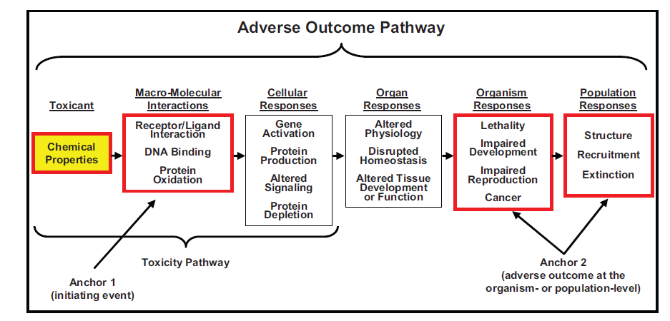
AOP / MOA Development
International workgroups developing frameworks and models
  OECD – AOP
  WHO – MOA
Key Concepts
  Molecular Initiating Events or Key Events – measureable in vitro
  Causal evidence for downstream effects
  AOP includes effects up to the population level
Ankley et al. 2010

Slide 30

Proposed AOP: Embryonic Vascular Disruption
Knudsen and Kleinstreuer. Birth Def Res C. 2012
Notes:
The proposed AOP figure includes a ToxPi consisting of the 25 assay targets associated with abnormal embryonic vascular development and mapped to previously-identified critical pathways (hypoxia/growth factor signaling, chemokine networks, ECM interactions and vessel remodeling/stabilization) based on the gene ontology browser from the mouse genome informatics database. The sectors are color-coded by the respective pathway that each target infers.

Slide 31
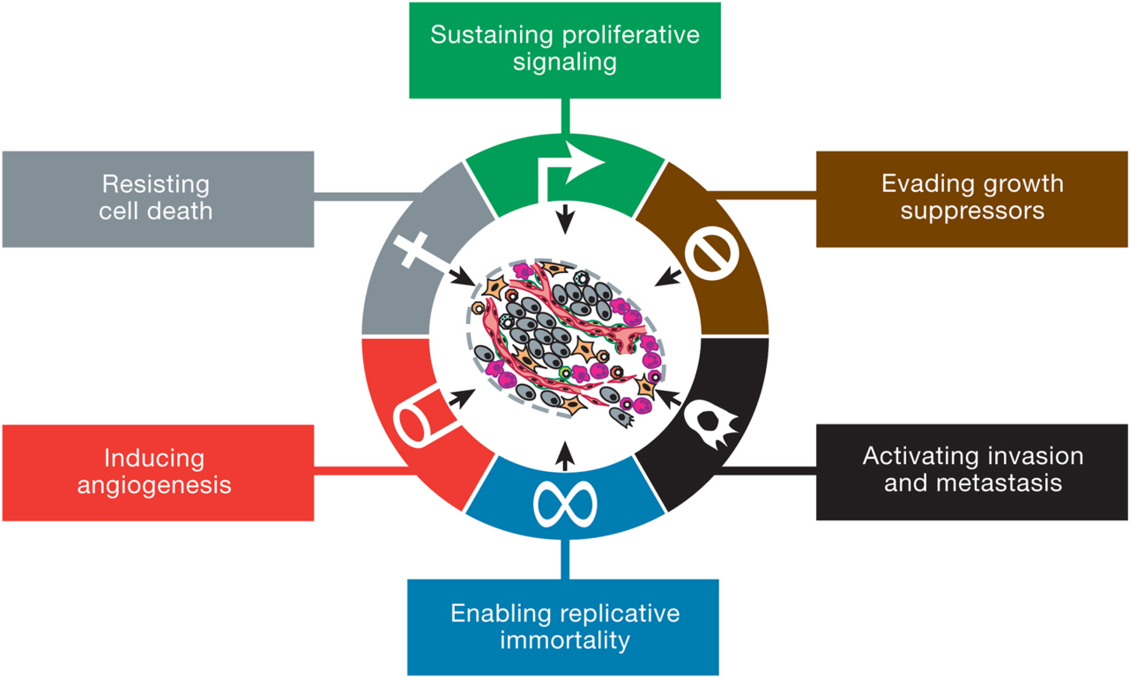
Hallmarks of Cancer
Hanahan and Weinberg (2000)
PPARα
p53
CCL2
ICAM1

Slide 32
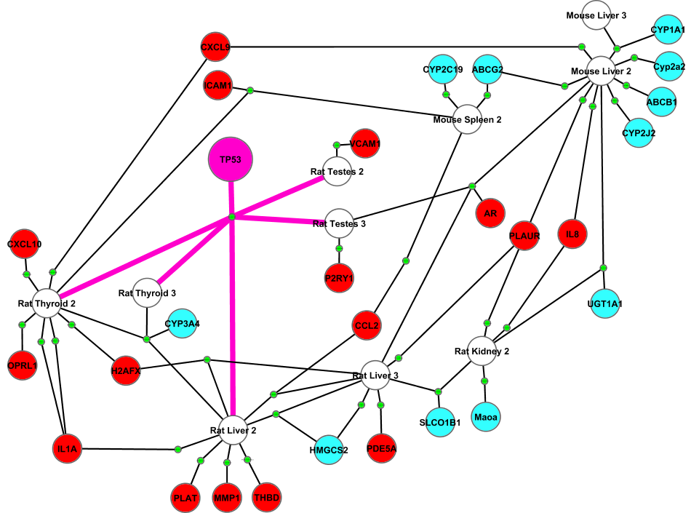
Pathway Hits Raise Risk of Multiple Cancer Types
Level 2: Preneoplastic
Level 3: Neoplastic
Hallmark-related
ADME-related
Endpoint

Slide 33
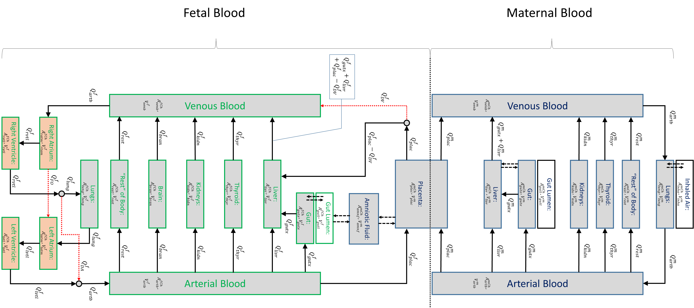
Maternal/Fetal PBPK Model
Model accounts for development of fetus, weeks 12 to term
Parameters for ~500 chemicals
Kapraun, Watt in prep
Notes:
This slide shows the PBPK model schematic: (1) describes mother and fetus, (2) blood flows represented by arrows and labeled with Qs, (3) red dotted line arrows indicate “special” blood flow routes, (4) maternal and fetal compartments represented by rectangles, (5) associated with each compartment is a volume (time-dependent) and an amount of substance.

Slide 34


Prioritizing Chemicals Using the PBPK Model
PTU and BPA both target TPO (thyroid peroxidase)
But … effect of 1 mg/kg/day is much different
PTU
BPA
Chemical
concentration
Lowest Effect Concentration
with uncertainty range
Chemical
concentration
Kapraun, Watt in prep

Slide 35

Modeling Zebrafish Toxicity
- example of current CompTox research problem
Simple vertebrate model of development, systemic toxicity
High-throughput (96-well, multiple doses, hundreds of chemicals at a time)
Different protocols can be tested
Day Dose (EPA) Dose (Oregon St.)
0 X X
1 X
2 X
3 X
4 X
5 Assess
6 Assess
Dechorionation
EPA: No
Oregon State: Yes
Phenotype:
LEL of developmental defects and mortality

Slide 36
Modeling Zebrafish Toxicity
Hypothesis
Much of Zebrafish toxicity is generalized cytotoxicity, cell stress
Use in vitro assays to predict this, then find chemicals still not explained
Many factors to consider: physchem properties, reactivity, molecular interactions
All Chemicals
Both Inactive
ZF < Stress
ZF ~ Stress
ZF > Stress
Bioactivation
Reactive in vivo
Bioaccumulation
Specific target (e.g. RAR)
Bioinactivation
Degradation
Stress Explains

Slide 37



Compare protocols vs. logP
EPA
Different protocols correlated but toxic doses can differ by 10X or more
High logP
Low logP
logP
Oregon State
Oregon St. log(LEL)
EPA log(LEL)
logP

Slide 38

Compare different measures of stress in vitro

Slide 39


Evaluating the model

Slide 40
Issues to Consider
Our first goal is prediction
  What is the highest safe dose of a chemical?
  What types of harm would a chemical cause above that dose?
Predictions are based on models
  Computational, statistical, “mental”
All models are based on data
Data is always subject to noise, variability
Therefore, all predictions are subject to uncertainty
Our second goal is estimating how uncertain our predictions are

Slide 41
Understanding Success and Failure
Why In vitro to in vivo can work:
  Chemicals cause effects through direct molecular interactions that we can measure with in vitro assays
Why in vitro to in vivo does not always work:
  Pharmacokinetics issues: biotransformation, clearance (FP, FN)
  Assay coverage: don’t have all the right assays (FN)
  Tissue issues: may need multi-cellular networks and physiological signaling (FN)
  Statistical power issues: need enough chemicals acting through a given MOA to be able to build and test model (FN)
  Homeostasis: A multi-cellular system may adapt to initial insult (FP)
  In vitro assays are not perfect! (FP, FN)
  In vivo rodent data is not perfect! (FP, FN)
Systems
Models

