Slide 1

Toxicology and In Vitro Alternative Methods:
Analyzing Effects of Oil Spill Dispersants Using Rapid,
In Vitro Tests for Endocrine and Other Biological Activity
Richard Judson
EPA National Center for Computational Toxicology
National Academies of Sciences, Engineering and Medicine
Committee on Evaluation of the use of Chemical Dispersants in Oil Spill Response
New Orleans, January 31, 2018
The views expressed in this presentation are those of the author and do not necessarily reflect the views or policies of the U.S. EPA

Slide 2
Outline
Introduce Rapid Risk Assessment
Details on work on dispersants
Broader RapidTox approach

Slide 3
RapidTox: Supporting Rapid Risk Assessment
There are 50K-100K unique chemicals in commerce to which we are exposed
  ~5000 (<10%) have repeat-dose animal toxicity studies
  ~1500 have risk assessments – e.g. “safe levels” defined
  IRIS level risk assessment takes 3-10 years
This drives the need for rapid “screening-level” risk assessments using “New Approach Methods” (NAM)
  Available in vivo data
  In vitro assay data
  Models
    Analogy models (QSAR, Read-across) – does my chemical look like some other chemicals with data?
    Ab initio – in vitro to in vivo extrapolation

Slide 4
Gulf Oil Spill EPA R&D Charge
Dispersants were going to be used and EPA was in charge of authorizing which one(s) to use
Ideally, use the most effective formulation with the lowest toxicity
Toxicity metrics
  LC50 for mysid shrimp and silverside minnow
  LC50 for cell culture (human)
  Endocrine effects (estrogen, androgen, thyroid receptors: ER, AR, TR) – relevant to fish and humans
  Broad in vitro activity screen
Return results in < 6 weeks

Slide 5
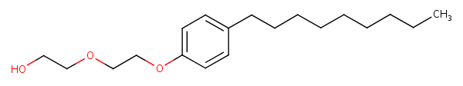
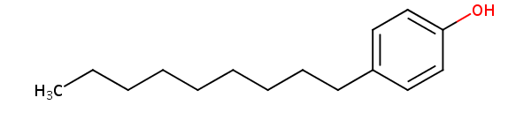
Why worry about ER activity?
Some dispersants were rumored to contain nonylphenol ethoxylate (NPE)
Environmental breakdown product is nonylphenol – a weakly potent estrogen mimic
Large quantities in coastal aquatic breeding grounds could have population-wide effects on reproduction
Nonylphenol ethoxylate (NPE)
Nonylphenol

Slide 6
Constraints
Dispersant formulations are proprietary
Manufacturers did not make them public. EPA regulatory offices knew basics of formulations but could not legally let researchers know any of this information
Manufacturers sent samples to EPA, but EPA was not allowed to send to other parties to test (e.g. universities)
Google searching uncovered a page suggesting one dispersant contained NPE

Slide 7
The Dispersants (spill started April 20)
Sample Name | Volume Received | Comments | Date Received | Manufacturer/ Source
Corexit 9500 | 1 L | hazy yellow | 11-May-10 | Nalco
JD 2000 | 10 ml | clear yellow | 27-May-10 | Ethox Chemicals, LLC
DISPERSIT SPC 1000 | 10 ml | clear amber | 27-May-10 | Polychem
Sea Brat #4 | 10 ml | hazy yellow | 27-May-10 | Alabaster Corp
Nokomis 3-AA | 10 ml | clear light color | 27-May-10 | MAR-LEN Supply inc.
Nokomis 3-F4 | 10 ml | clear light color | 27-May-10 | MAR-LEN Supply inc.
ZI-400 | 25 ml | clear yellow | 29-May-10 | ZI Chemical
SAF-RON GOLD | 500 ml | silver iridescent | 4-June-10 | Sustainable Environmental Technologies, Inc.

Slide 8
In Vitro Assay Technologies Used
Competitive binding (Novascreen)
  Cell-free
  Dispersants seem to have denatured proteins, given non-specific results
ER/AR reporter-gene assays (NIH NCATS / NCGC)
  Agonist and antagonist mode
  Quantitative cytotoxicity
Collection of 81 nuclear-receptor-related assays (Attagene)
  Includes AR, ER, TR
  Other xenobiotic response pathways
  Quantitative cytotoxicity
  HepG2 (liver) cell line
  CIS and TRANS modes (TRANS is more sensitive)

Slide 9
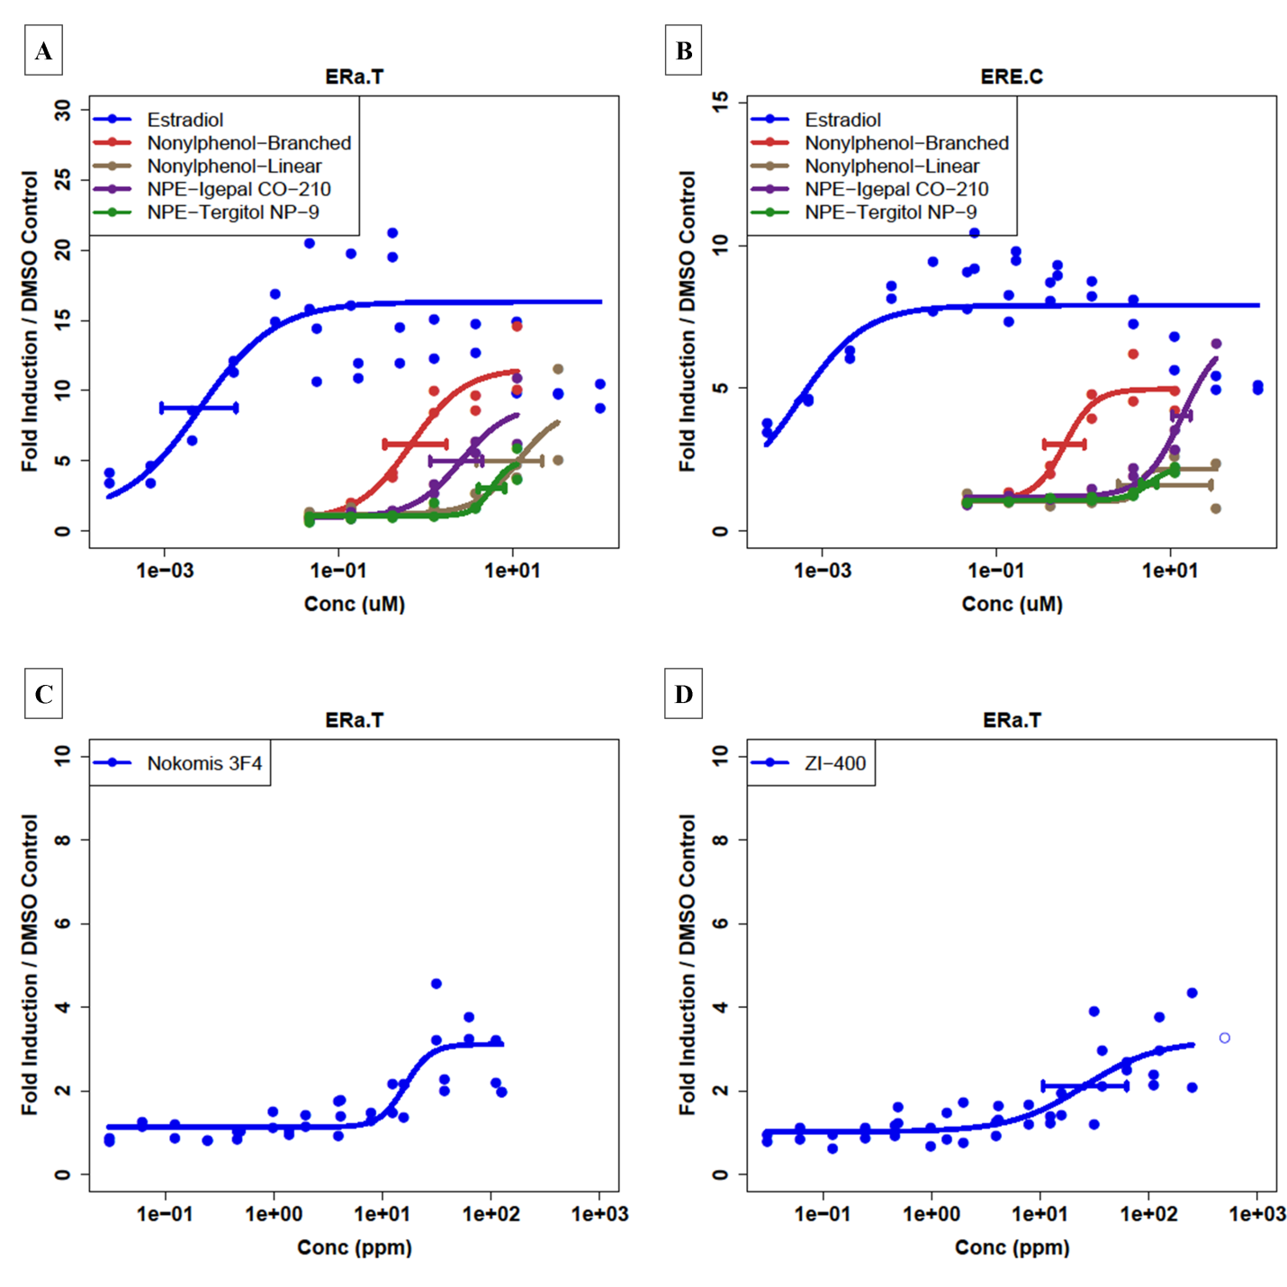
Concentration-Response Profiles
Control Data
Igepal and Tergitol are
non-ionic surfactants
ERa.T=Attagene ERa TRANS
ERE.C=Attagene ERa CIS
CIS efficacy less than
half TRANS efficacy for
reference compounds
Dispersant Test Data
TRANS assay efficacy near
detection threshold for these
dispersants, and CIS is below

Slide 10
Further Nuclear Receptor Analysis
Attagene runs 81 nuclear receptor-related endpoints in 2 multiplexed assays
Relatively quick and inexpensive
Many related to xenobiotic response
  ER/AR/TR
  PPAR(a,d,g)
  CAR / PXR / RXR
  AHR

Slide 11
Nuclear Receptor Results
Multi-assay pile-up
Indication of generalized cell stress
Prelude to cytotoxicity
Little specific activity seen except for PXR/ PPAR
Consistent with Xeno-sensing

Slide 12
Dispersant Cytotoxicity Results
Attagene: HepG2
NCGC: Bla ER/AR
NHEERL: T47D, MDA, CV1
ER AC50
Mysid shrimp
Silverside minnow
More potent
Less potent

Slide 13
Dispersant Conclusions
Weak evidence of ER activity in 2 dispersants
  Seen in single, perhaps over-sensitive assay (1 of 6)
  Not of biological significance
  Consistent with presence of NPE
  Activity only at concentrations >> seen in Gulf after dilution
No AR activity
No ER activity seen in Corexit 9500
Corexit is in the middle of the pack for cytotoxicity
No worrisome activity seen in other NR assays

Slide 14
Broader Rapid Risk Assessment Applications
Prioritization
  Endocrine Disruptor Screening Program – 10,000 chemicals to be screened for endocrine activity
  TSCA inventory – 25,000 chemicals to be prioritized for detailed risk assessment
Rapid Risk Assessment Potential Opportunities
  2014 Elk River spill 4-methylcyclohexanemethanol: What effects might this have, and what is the safe level for drinking water?
  Superfund sites – EPA finds 10s-100s of chemicals without risk assessment values – what chemical(s) should drive the cleanup?
  Developing concerns over perfluorinated compounds in the environment

Slide 15
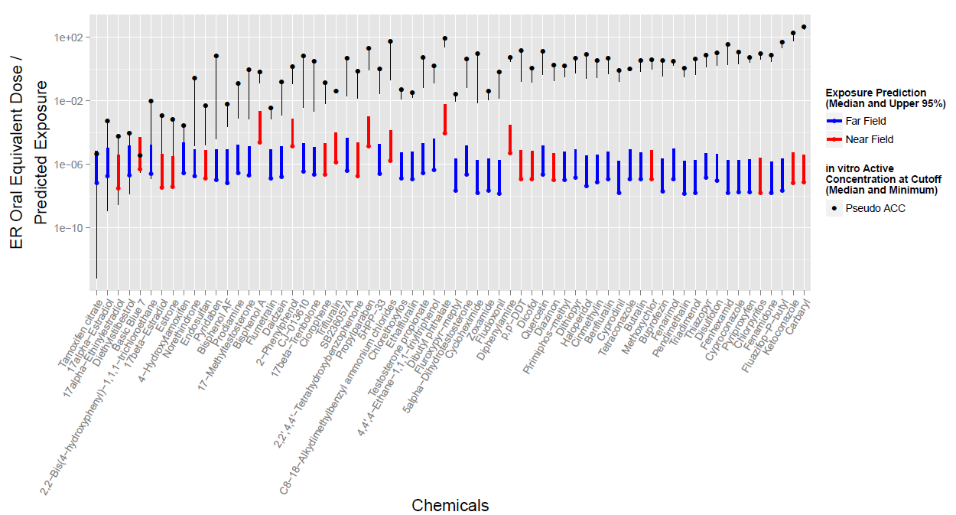
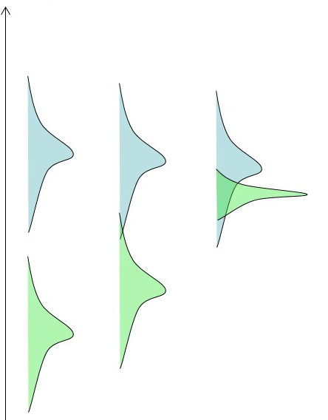
Example of using predicted hazard and exposure to prioritize further testing: ER activity
Hazard
Exposure

Slide 16
Tools of RapidTox
Large databases of public in vivo data (ToxRefDB, ToxValDB)
In vitro data on ~10,000 chemicals of environmental interest (ToxCast)
In vitro toxicokinetic data to convert in vitro potencies to in vivo “points of departure”
Databases of exposure-related information
  Biomonitoring
  Environmental monitoring
  Chemical formulation and chemical-product use data
Multiple models of hazard, exposure and toxicokinetics
Public dashboards
  https://comptox.epa.gov
  https://actor.epa.gov
Expertise to use all of these tools in rapid response situations

Slide 17
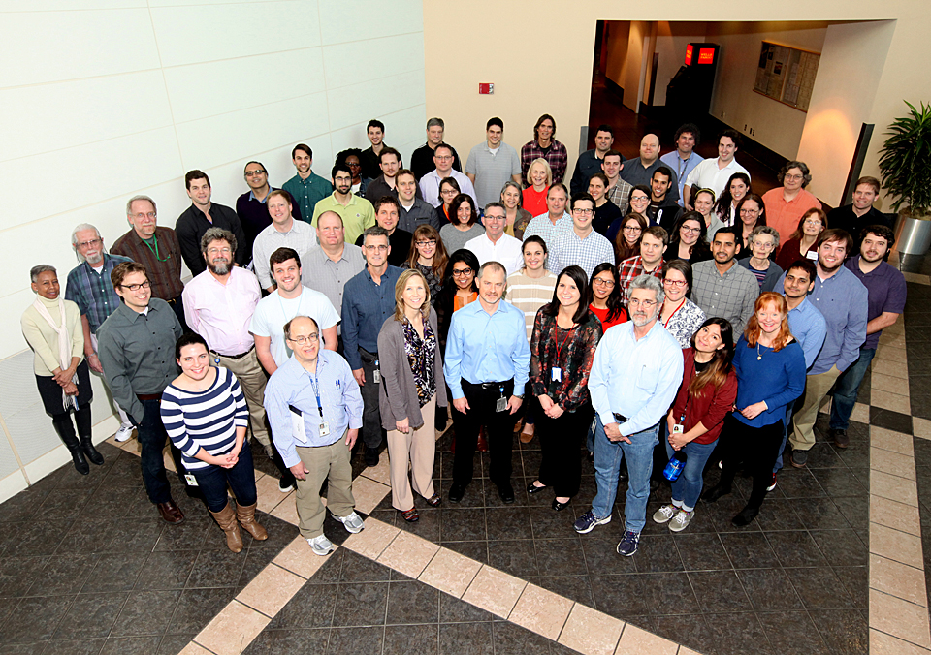
National Center for Computational Toxicology
NCCT Staff
Rusty Thomas
Kevin Crofton
Keith Houck
Ann Richard
Richard Judson
Tom Knudsen
Matt Martin*
Grace Patlewicz
Woody Setzer
John Wambaugh
Tony Williams
Steve Simmons
Chris Grulke
Katie Paul-Friedman
Jeff Edwards
Chad Deisenroth
Joshua Harrill
Rebecca Jolley
Jeremy Dunne
NCCT Postdocs
Todor Antonijevic
Audrey Bone
Swapnil Chavan
Kristin Connors*
Danica DeGroot
Jeremy Fitzpatrick
Dustin Kapraun*
Agnes Karmaus*
Max Leung*
Kamel Mansouri*
Andrew McEachran
LyLy Pham
Prachi Pradeep
Caroline Ring*
Kate Saili
Eric Watt*
Todd Zurlinden
NCCT
Nancy Baker
Dayne Filer*
Parth Kothiya*
Sean Watford
Indira Thillainadarajah
Robert Pearce
Danielle Suarez
Doris Smith
Jamey Vail
Risa Sayre
Nathan Rush
NTP Collaborators
Warren Casey
Nicole Kleinstreuer
Mike Devito
Dan Zang
Rick Paules
Nisha Sipes
NIH/NCATS Collaborators
Menghang Xia
Ruili Huang
Anton Simeonov
* Graduates

