Slide 1

Rapid Toxicity Screening of Chemicals Combining In Vitro High-throughput Transcriptomics, Toxicokinetics and Exposure Estimates
Richard Judson
U.S. EPA, National Center for Computational Toxicology
Office of Research and Development
Eurotox 2018, Brussels
3 September 2018
The views expressed in this presentation are those of the author and do not necessarily reflect the views or policies of the U.S. EPA

Slide 2
Themes
Too many chemicals:
  Can’t test all chemicals in animal studies
  Need alternative method (New Approach Methods / NAMs)
  Goal: Replacement or Prioritization
NAMs need to cover lots of biology
  Many biological domains, require many individual in vitro assays or models (e.g. QSAR)
  High-throughout whole genome transcriptomics is now practical
Think about Risk
  In vitro assays need to predict dose values (mg/kg/day)
  Need to compare hazard with exposure

Slide 3
Risk-based Approach
Hazard + Exposure + Uncertainty
mg/kg BW/day
Semi-quantitative
In Vitro to In Vivo
Approach
Potential Hazard:
In Vitro + HTTK
Potential Exposure:
ExpoCast
Low
Priority
Medium
Priority
High
Priority

Slide 4
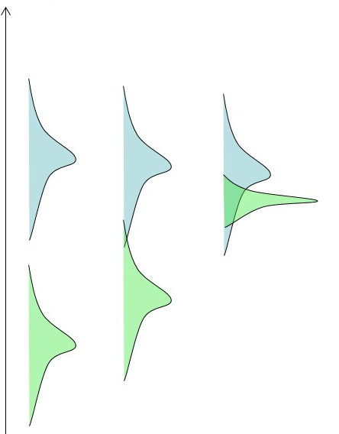
Tools / Models / Data needed
Hazard information or model
  Start with in vitro data
  Quantify concentration (μM) required to trigger bioactivity
Toxicokinetics
  Use to convert between external dose and internal concentration
Exposure information or model
  Quantify in mg/kg/day
Include uncertainties everywhere

Slide 5
Hazard Approach where Animal Data is Lacking
Goals:
  Quantitative point of departure (POD) (e.g. NOAEL)
  Estimate of what effects will be seen (e.g. liver hypertrophy)
Experimental approaches
  Battery of in vitro assays (ToxCast), one per target / pathway
  High-throughput whole genome transcriptomics
  Yield POD and MOA / AOP / mechanism information
Modeling approaches
  QSAR models
  Read-across
  TTC
  Better at POD estimation than mechanism prediction

Slide 6
Population and Exposure Modeling
Estimating Exposure and Associated Uncertainty with Limited Data
(Bio) Monitoring
e.g., CDC NHANES study
Calibrate models
Inferred Exposures
Pharmacokinetic Models
Dataset 1
Dataset 2
…
Estimate Uncertainty
Inferred Exposure
Predicted Exposures
Use
Production Volume
Predicted Exposure
…
Wambaugh et al., 2014
Notes:
I know that this workshop is primarily focused on NAMs in relation to hazard characterization, but I think that if we are talking more holistically about applying NAMs for regulatory decision making, we also need to incorporate approaches to estimate exposure in order to put the NAM data into context.

Slide 7
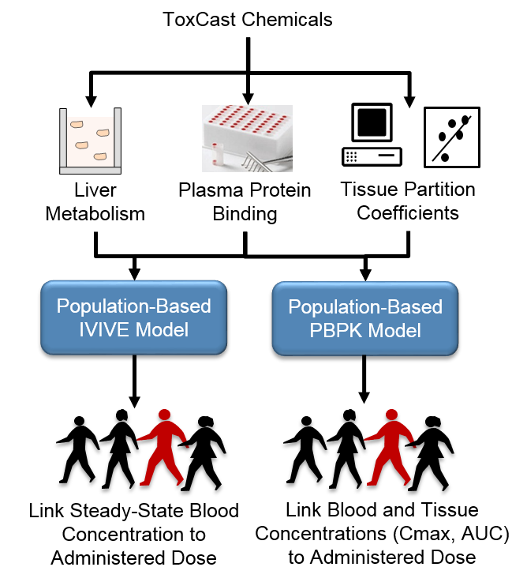
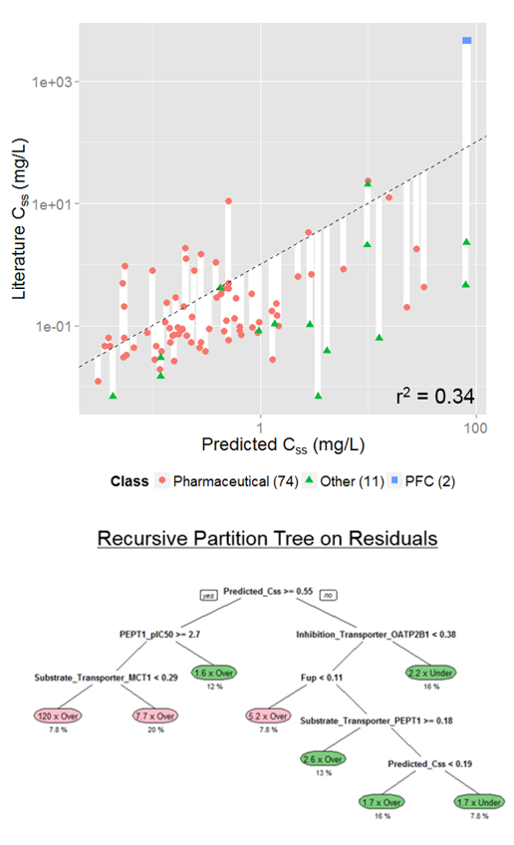
Toxicokinetics Modeling
Incorporating Dosimetry and Uncertainty into In Vitro Screening
Wetmore et al.
Wambaugh et al., 2015
Notes:
I think we have heard yesterday, how important TK is in interpreting the results from NAMs. This includes both read across and the in vitro testing. However, first, we need to have an in vitro and in silico approach to generate the TK data that we need and we need to be rigorous in characterizing the uncertainty around whatever approach we develop.

Slide 8
Putting it all together
In vitro assays yield POD in μM
  Select the minimum “relevant” in vitro POD
TK yields in vitro to in vivo conversion factor
  “Concentration at Steady State”, C_{ss}
  Blood concentration for a 1 mg/kg/day steady-state dose
IVIVE POD (“oral equivalent dose”) = in vitro POD / C_{ss}
Exposure model yields estimate of exposure (mg/kg/day)
BER: Bioactivity to Exposure Ratio
  IVIVE POD / Exposure estimate
  BER >> 1 implies low concern for risk

Slide 9
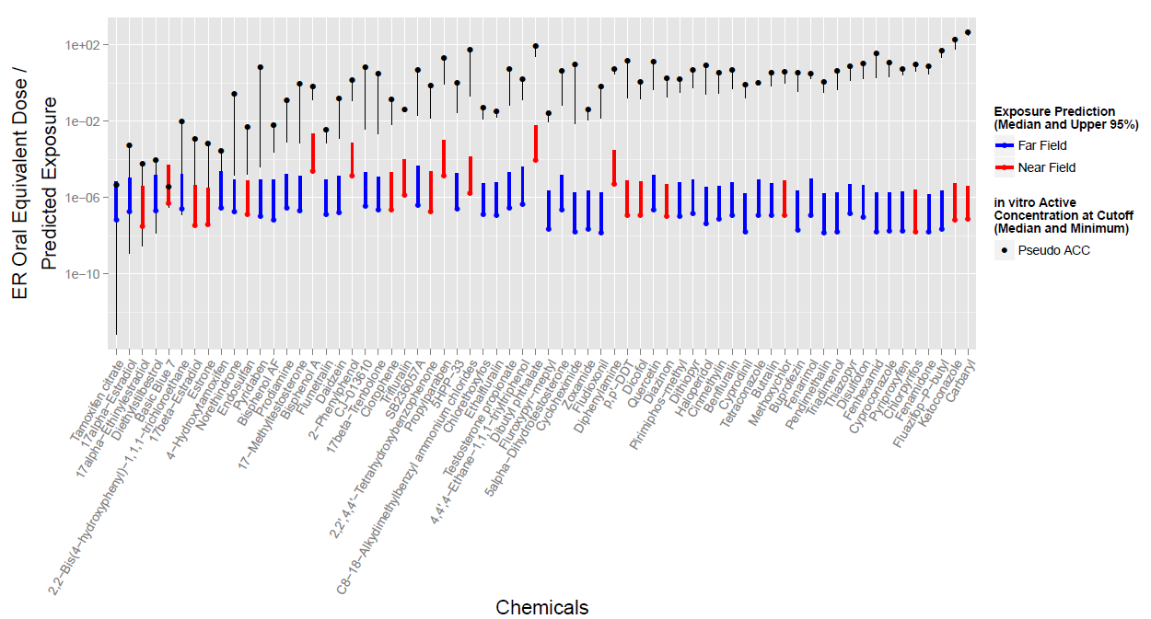
Prioritization (Replacement) Example
Compare predicted exposure and hazard POD
Compare estrogen receptor assay battery and exposure model

Slide 10
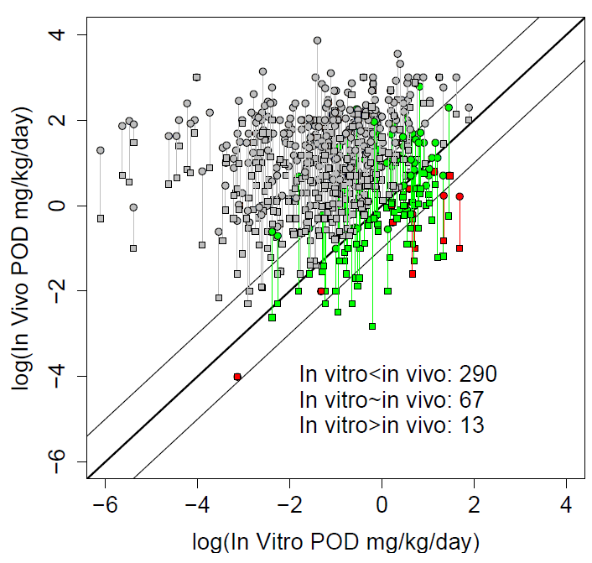
IVIVE PODs tend to provide low (protective) POD estimates: BERs are conservative
Only ~4% have in vitro POD consistently greater than in vivo values
Issue: what is the correct in vitro POD assay?
Bioactivity vs. adversity
Work in progress: comparison of results taking into account both in vivo and in vitro uncertainties
IVIVE

Slide 11
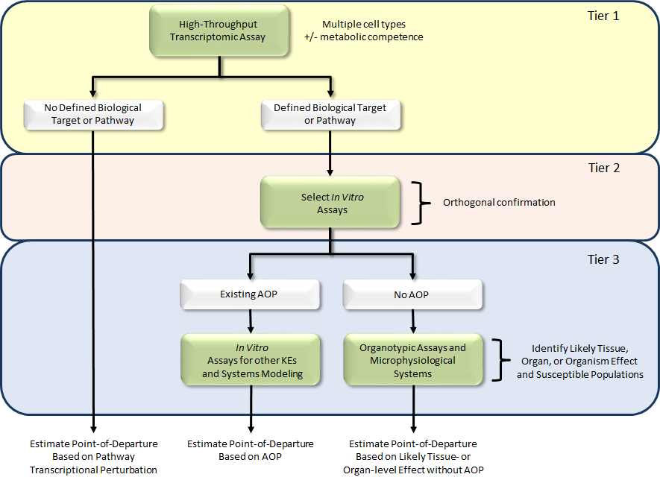
Adding a Transcriptomics Front End
Broad Coverage,
High Content Assay(s)

Slide 12
BioSpyder TempO-Seq Technology Overview
Technology
The TempO-Seq human whole transcriptome assay measures the expression of greater than 20,000 transcripts.
Requires only picogram amounts of total RNA per sample.
Compatible with purified RNA samples or cell lysates.
Transcripts in cell lysates generated in 384-well format are barcoded according to well position and combined in a single library for sequencing using industry standard instrumentation.
Scalable, targeted assay:
  1) Measures transcripts of interest
  2) Greater throughput and requires lower read depth than RNA-Seq
  3) Ability to attenuate highly expressed genes
Per sample fastq files are generated and aligned to BioSpyder sequence manifest to generate integer count tables.
TempO-Seq Assay Illustration

Slide 13
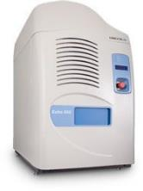
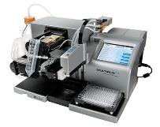
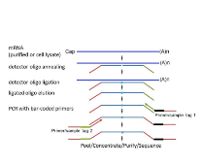

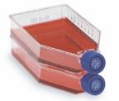

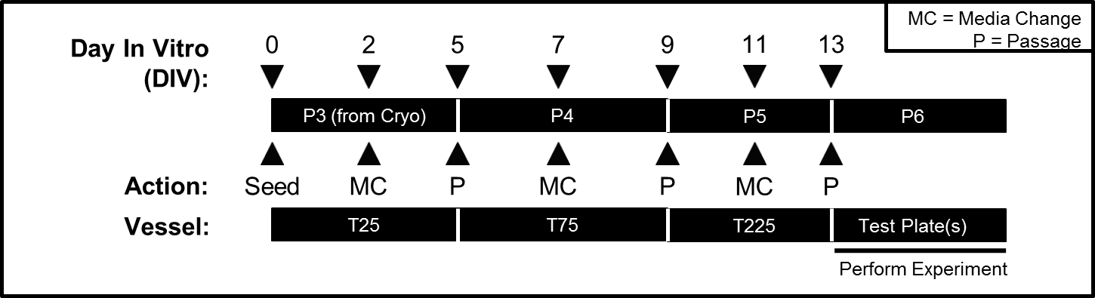

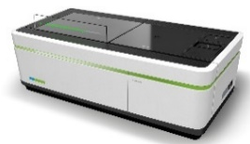
Experimental Workflow
Dispensing Test Chemicals
Track 1: Targeted RNA-Seq
Cryopreserved
Cell Stocks
Cell Expansion
Cell Plating
Generating Cell Lysates
TempO-Seq WT
BioTek
MultiFlo TM FX
LabCyte Echo® 550 Liquid Handler
Track 2: Apoptosis / Cell Viability
Standardized Expansion Protocol
Reagent Dispensing
High Content Imaging
Perkin Elmer
Opera PhenixTM
High Content Screening System
Josh Harrill

Slide 14
HTTr MCF-7 Screen: Experimental Design
Parameter | Multiplier | Notes
Cell Type(s) | 1 | MCF-7 (ATCC® HTB-22TM)
Culture Condition | 1 | DMEM + 10% HI-FBS
Chemicals | 2,112 | ToxCast ph1, ph2 Nominated chemicals from e1k / ph3
Time Points: | 1 | 6 hours
Assay Formats: | 2 | TempO-Seq HCI Cell Viability & Apoptosis
Concentrations: | 8 | 3.5 log₁₀ units; semi log₁₀ spacing
Biological Replicates: | 3 | --
Total number of samples: 54,432
Total number of endpoint readouts: 1.15x10⁹
Total size of fastq files: 32.5 TB
ª MCF-7 cells cultured in DMEM + 10% HI-FBS was selected as the test system to facilitate comparability to the Broad Institute Connectivity Map (CMAP) database (http://portals.broadinstitute.org/cmap/).

Slide 15
Analysis Approaches
Gene level vs. Pathway Level
Concentration-response modeling
Different modeling approaches
  Count-level: BMD Express, in-house methods
  Log2 fold-change level: ToxCast Pipeline
Statistical issues being investigated

Slide 16
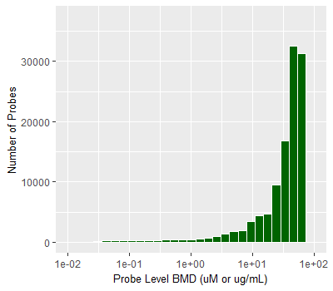
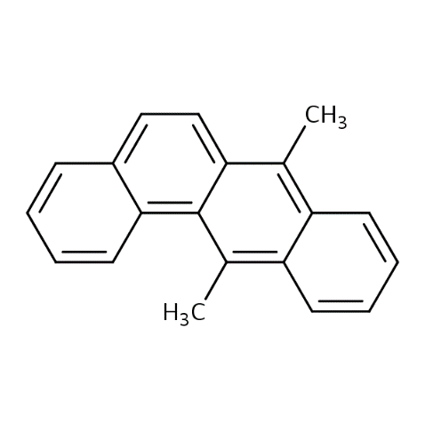
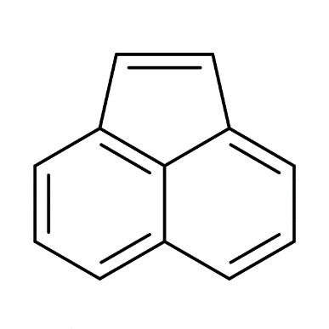
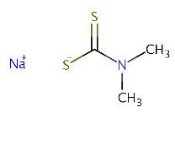
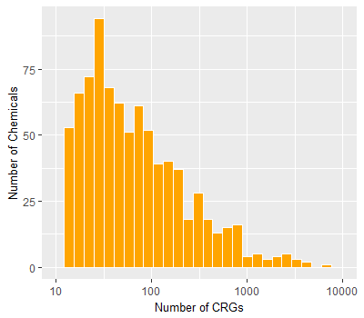
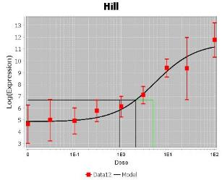
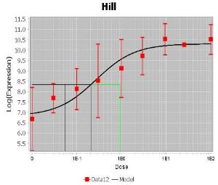
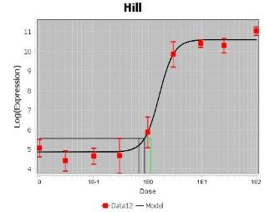
Benchmark Dose Modeling Summary & Inducible Genes - BMDExpress
Expected genes show clean concentration-response
CYP1A1_10775
(n = 473)
CYP1B1_17315
(n = 279)
HMOX1_3041
(n = 174)
Sodium
dimethyldithiocarbamate
128-04-1 | DTXSID6027050
Acenaphthylene
208-96-8 | DTXSID3023845
7,12-Dimethylbenz(a)anthracene
57-97-6 | DTXSID1020510
CYP1A1_10775
BMD = 2.04 µM
HMOX1_3041
BMD = 0.87 µM
CYP1B1_17315
BMD = 0.28 µM
Notes:
(400 x 350)
(300 x 700)
PLACEHOLDER
HISTOGRAMS OF:
# OF CONCENTRATION-RESPONSIVE GENES
# OF AFFECTED PATHWAYS
CONCENTRATION-RESPONSE CURVES FOR REPRESENTATIVE GENES (CYP1A1, HMOX1)
ACCUMULATION PLOTS FOR ACTIVE CHEMICALS.

Slide 17
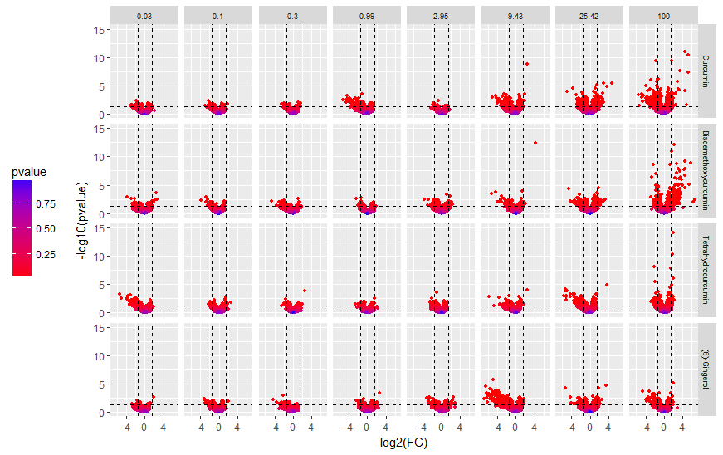
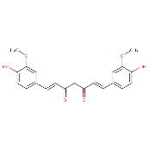

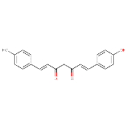
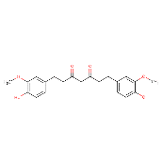
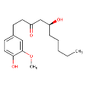
Evaluating Structurally Related Chemicals at the Multi-Gene Level
Curcumin |
DTXSID8031077
Bisdemethoxycurcumin |
DTXSID00872663
-Log10(p-value)
Tetrahydrocurcumin |
DTXSID30865801
(6)-Gingerol |
DTXSID3041035
Log2(fold-change)
Concentration
Notes:
(1000 x 600)

Slide 18
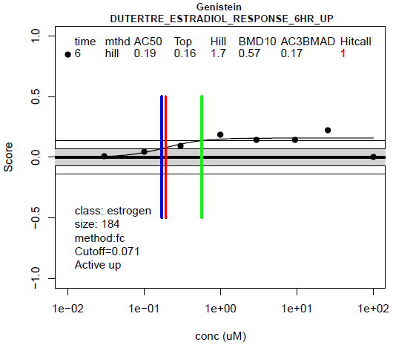
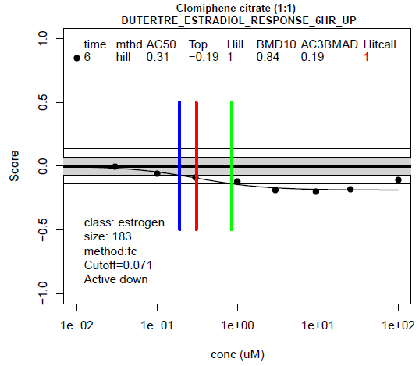
Specific Pathway Concentration-Response (6-hour data)
Example is an estrogen-receptor responsive pathway
Relevant for MCF7 cells
Individual genes have only small fold-change
Pathway integration allows for signal to be seen
Agonist
Antagonist

Slide 19
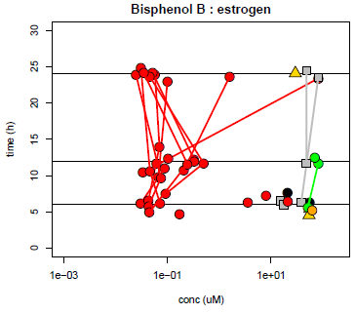
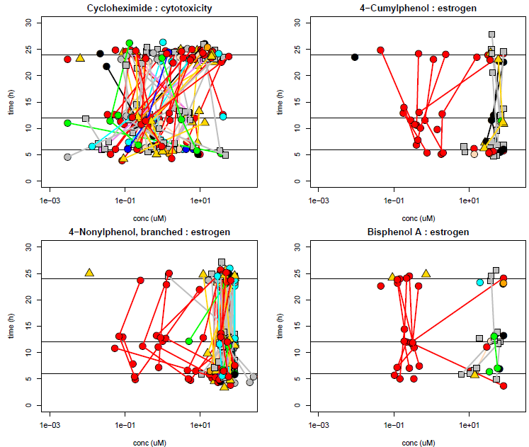
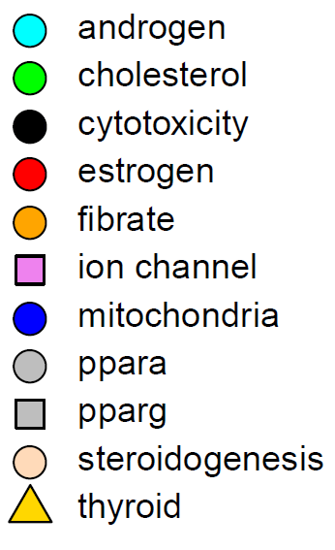
Pathway results across multiple times
Multiple estrogen pathways
Points are AC50 values for pathway response

Slide 20
Summary
Have overall process for predicting BER
  Bioactivity (Toxicity) to Exposure Ratio (like margin of exposure)
  Using in vitro (ToxCast) and modeled input
  Can run on thousands of chemicals
  Limitation: ToxCast covers a small part of biological space
High-throughput transcriptomics has potential advantages over ToxCast
  Larger biological space (10000 genes vs. 300)
  No special cell engineering, can run on any cell type
  Amenable to adding metabolic competence (see Steve Simmons talk)
  Limitation: not complete, still need functional readout assays

Slide 21

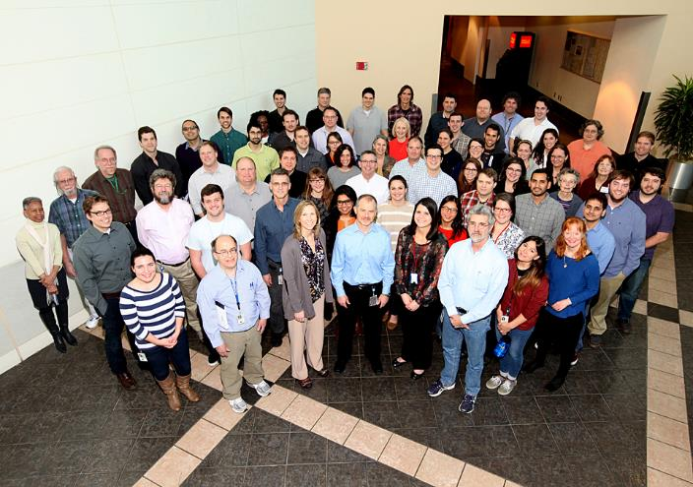
Acknowledgments
National Center for Computational Toxicology
Imran Shah
Woody Setzer
Derik Haggard
Richard Judson
Rusty Thomas
Clinton Willis
John Wambaugh
Katie Paul Friedman

