Slide 1

EPA's RapidTox Tool,
Including the updated chemical dashboard
Richard Judson
U.S. EPA, National Center for Computational Toxicology
Office of Research and Development
FSTRAC
February 2018
The views expressed in this presentation are those of the author and do not necessarily reflect the views or policies of the U.S. EPA

Slide 2
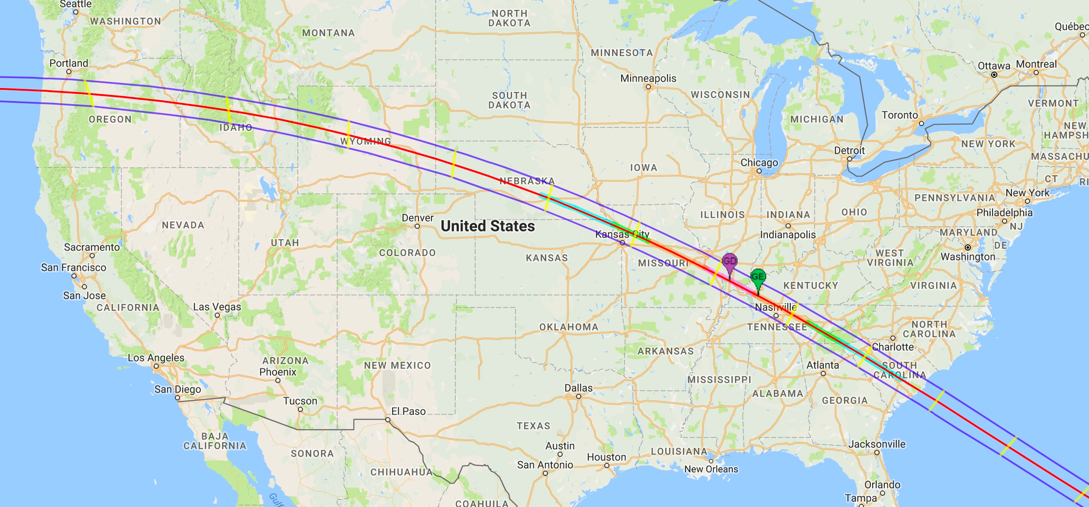
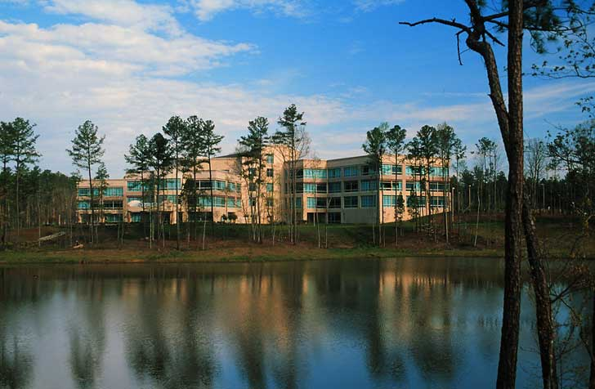
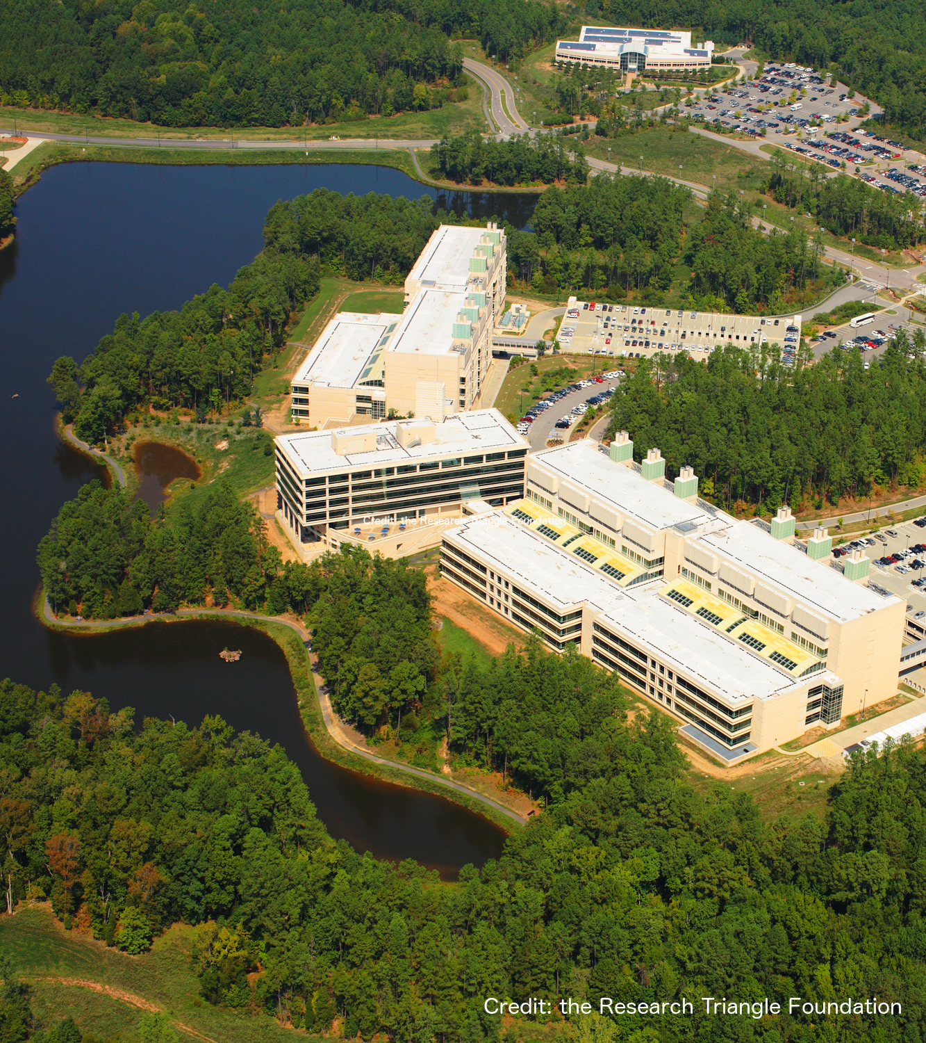
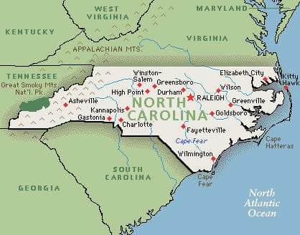
National Center for Computational Toxicology
National Center for Computational Toxicology established in 2005 to integrate:
  High-throughput and high-content technologies
  Modeling and data mining
  Modern molecular biology
  Computational biology and chemistry
Currently staffed by ~60 employees
  PIs, Postdocs, grad students, support staff
EPA’s Office of R&D

Slide 3
What is RapidTox?
Goal: Provide tools to allow risk assessors to perform first-order (rapid, screening level ,…) risk assessments on one or many chemicals relatively rapidly
Tools:
  Data, models, workflows, dashboards
Models can be used to:
  Fill data gaps
  Integrate different kinds of models (e.g. prioritization)

Slide 4
Project Goals
Provide easy access to high-quality (high-tier) data as inputs to risk assessments, when available
Provide lower tier data when higher-tier is not available
Develop and provide modeled inputs when even lower-tier data in not available
All data and models will be made available through the RapidTox Dashboard
Types of data / models to be provided is client-dependent

Slide 5
Current Project Examples
OLEM / Superfund
  Provide access to data on thousands of chemicals that are found at superfund sites
OPP
  Prioritize a set of inert ingredients for potential risk assessments
  List is driven by environmental group petitioners
TSCA
  “Pre-prioritization” – help select High and Low priority chemicals
  Start with the TSCA Active inventory

Slide 6
Data Domains
Human hazard
  Mammalian toxicology studies (ToxValDB, ToxRefDB)
  Models predicting PODs and organ effects
Ecological hazard
  Environmental species (ECOTOX)
  Models predicting PODs
Exposure estimates
  Models for humans and aquatic species
Physchem properties
  Persistence and bioaccumulation

Slide 7
Superfund Use Case
Sites often contain many chemicals without risk assessments
To complete an assessment, risk assessor needs
  Screening levels (cleanup levels)
  Other hazard information (carcinogenicity, corrosivity, etc.)
  Fate and transport information
  Ecotoxicology information
What happens when data is not readily available?
RapidTox dashboard provides easy access to high-tier data, and fills data gaps

Slide 8
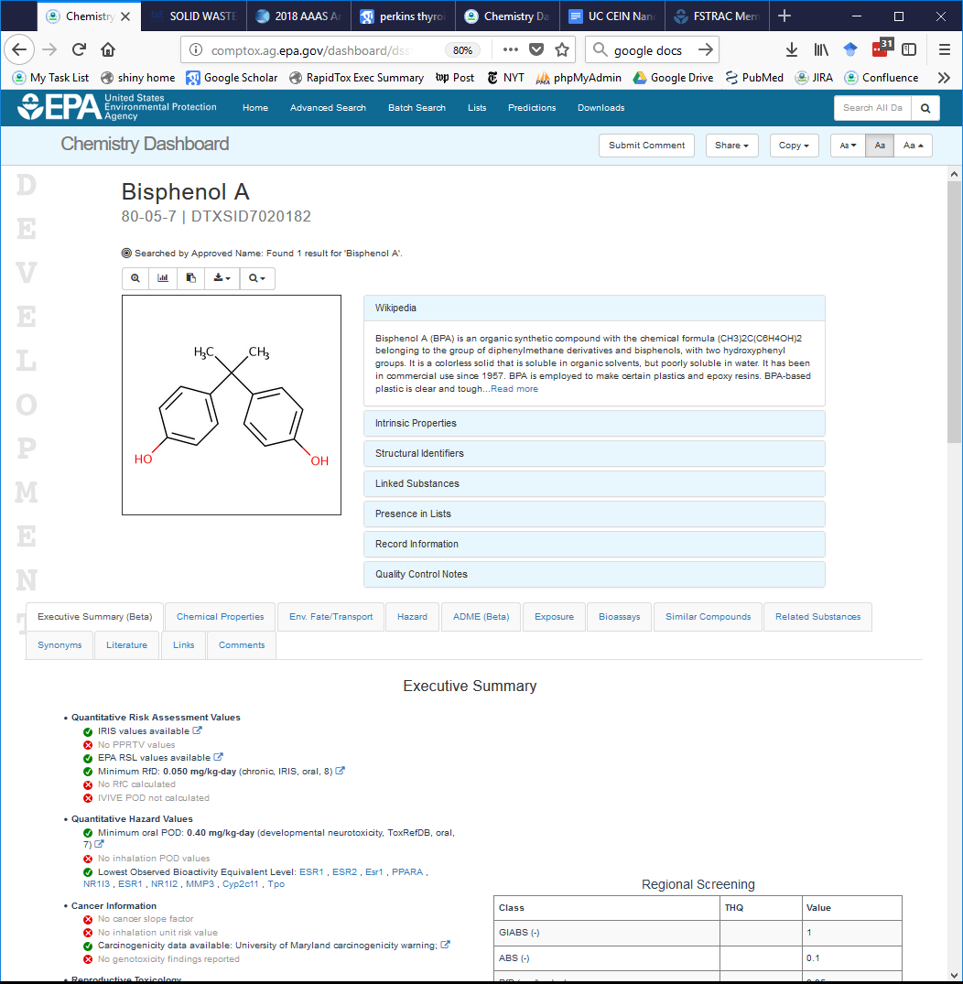
Comptox Dashboard
Designed for OLEM application
Quick view of available data

Slide 9
TSCA Pre-prioritization use case
Thousands of chemicals need to be considered for the regulatory TSCA prioritization process
Domains:
  Human and ecological hazard and exposure, physchem, use
  Data: ToxRefDB, ToxValDB, ToxCast, ExpoCast, CPCat/CPDat
  Models: EDSP21, DevTox, NeuroTox, Functional Use, Exposure
Product: Web-based pre-prioritization dashboard
Process: Initial prototype developed from 2012 TSCA protocol, user feedback coming soon

Slide 10
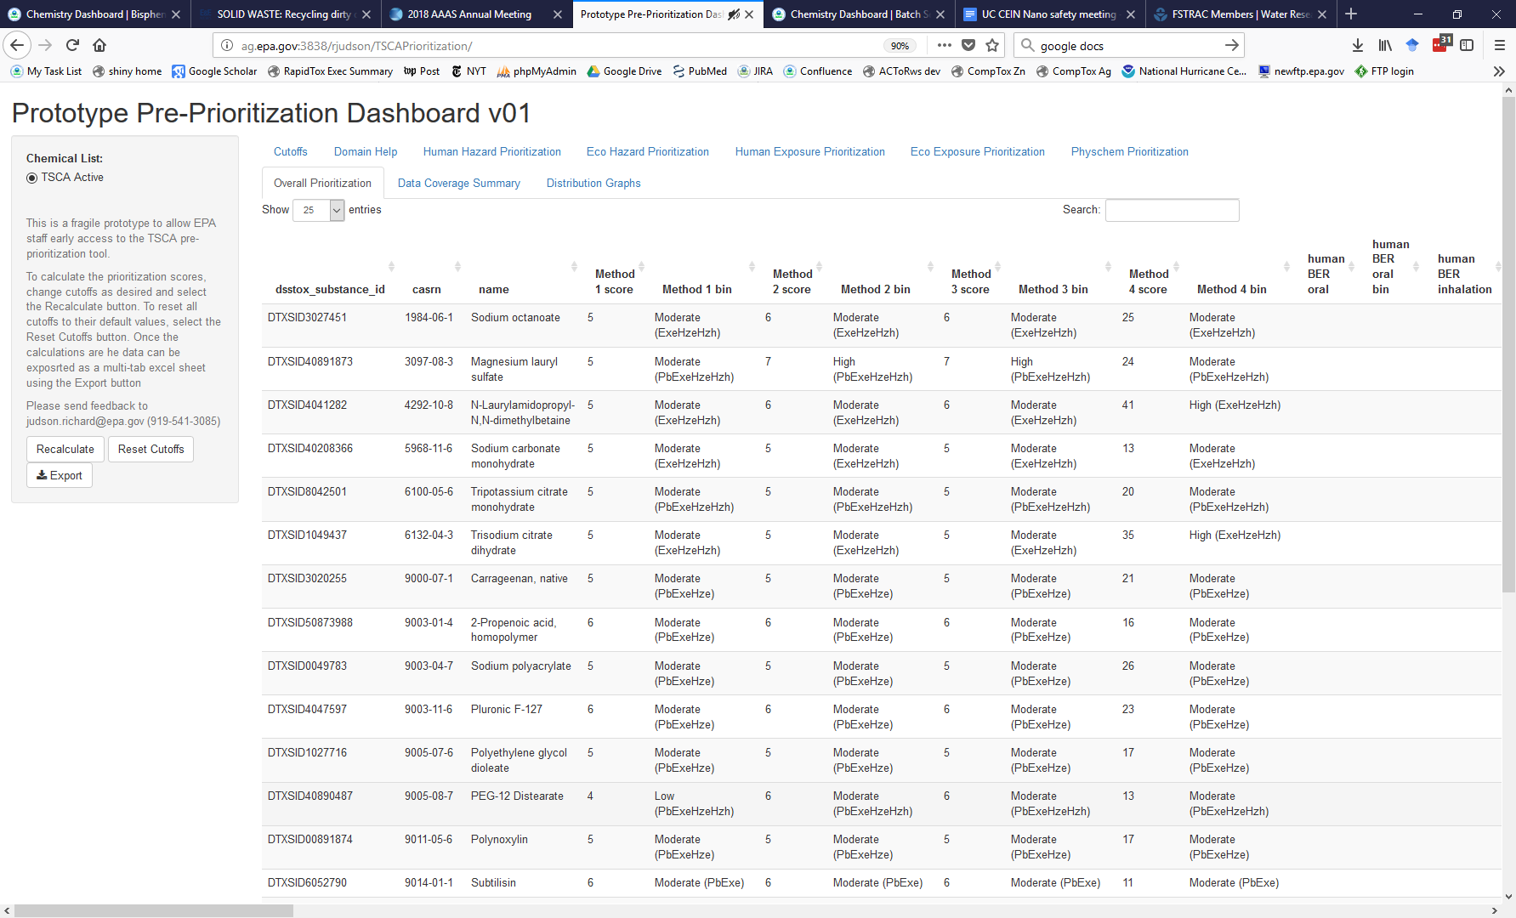
TSCA Pre-Prioritization Workflow
Provides multiple rankings of TSCA Active Inventory

Slide 11
Live Demos
Comptox Dashboard (RapidTox)
  Demo of version to be released in 1-2 weeks
  URL: https://comptox.epa.gov
Prioritization Dashboard (TSCA)
  Currently internal version only
Contact information
  Richard Judson
  Judson.richard@epa.gov
  919-541-3085

Slide 12
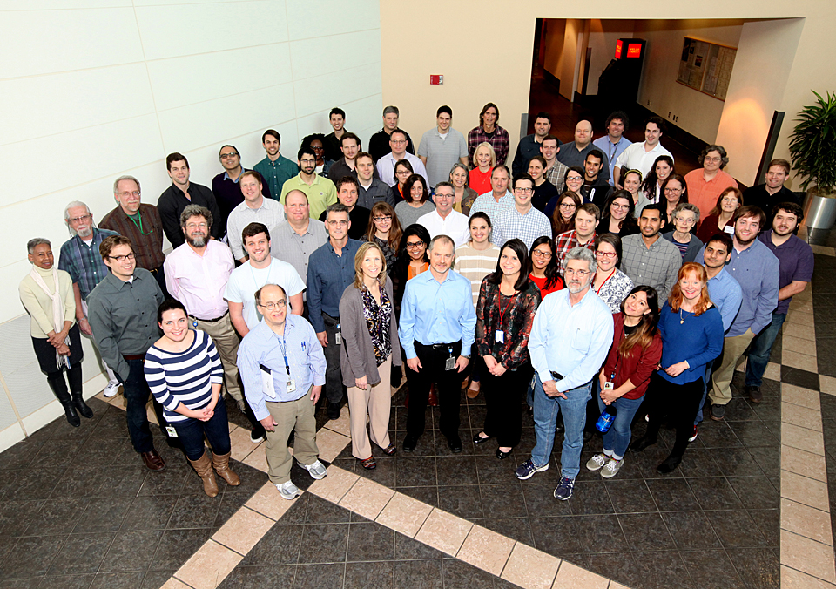
National Center for Computational Toxicology
NCCT Staff
Rusty Thomas
Kevin Crofton
Keith Houck
Ann Richard
Richard Judson
Tom Knudsen
Matt Martin*
Grace Patlewicz
Woody Setzer
John Wambaugh
Tony Williams
Steve Simmons
Chris Grulke
Katie Paul-Friedman
Jeff Edwards
Chad Deisenroth
Joshua Harrill
Rebecca Jolley
Jeremy Dunne
NCCT Postdocs
Todor Antonijevic
Audrey Bone
Swapnil Chavan
Kristin Connors*
Danica DeGroot
Jeremy Fitzpatrick
Dustin Kapraun*
Agnes Karmaus*
Max Leung*
Kamel Mansouri*
Andrew McEachran
LyLy Pham
Prachi Pradeep
Caroline Ring*
Kate Saili
Eric Watt*
Todd Zurlinden
NCCT
Nancy Baker
Dayne Filer*
Parth Kothiya*
Sean Watford
Indira Thillainadarajah
Robert Pearce
Danielle Suarez
Doris Smith
Jamey Vail
Risa Sayre
Nathan Rush
NTP Collaborators
Warren Casey
Nicole Kleinstreuer
Mike Devito
Dan Zang
Rick Paules
Nisha Sipes
NIH/NCATS Collaborators
Menghang Xia
Ruili Huang
Anton Simeonov
* Graduates

