Slide 1

Large-scale Screening of Chemicals for Estrogen Receptor Activity: What have we learned?
Richard Judson
U.S. EPA, National Center for Computational Toxicology
Office of Research and Development
SOT 2018
San Antonio, March 2018
The views expressed in this presentation are those of the author and do not necessarily reflect the views or policies of the U.S. EPA

Slide 2
EDSP21 Project: Major Points
EDSP: Endocrine Disruptor Screening Program
Mandated by U.S. Congress
“Tier 1 battery” – 11 in vitro and in vivo assays (estrogen, androgen, thyroid)
EDSP has a mismatch between resources needed for Tier 1 and number of chemicals to be tested
~10,000 chemicals in EDSP Universe
~$1M per chemical for Tier 1, 50-100 year backlog
Demonstrate new approach: Estrogen Receptor (ER)
Multiple high-throughput in vitro assays
Prioritize chemicals and replace selected Tier 1 assays

Slide 3
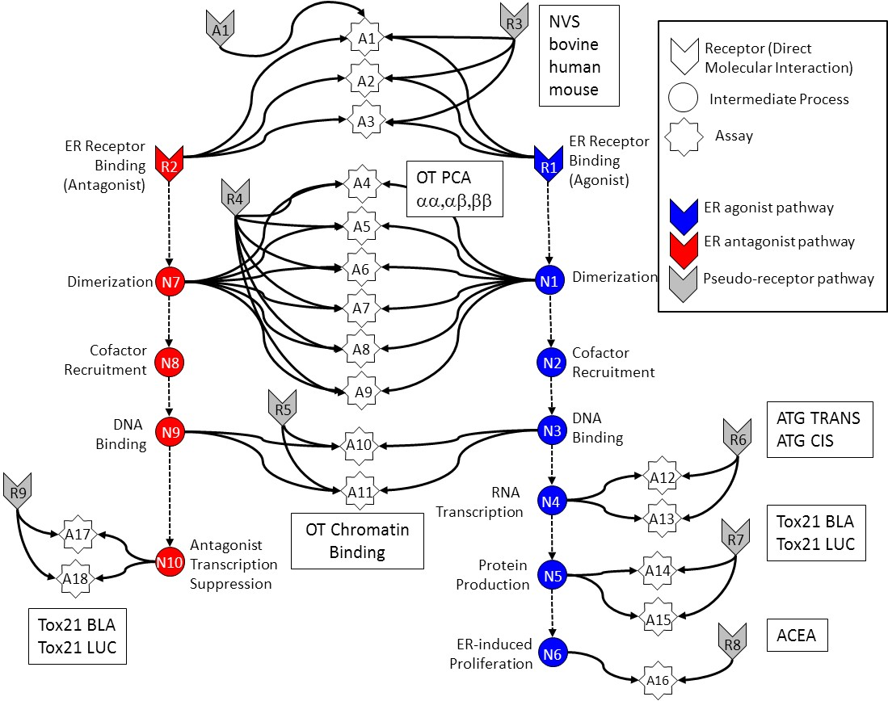
In Vitro Estrogen Receptor Model
Use multiple assays per pathway
Different technologies
Different points in pathway
No assay is perfect
Assay Interference
Noise
Use model to integrate assays
Evaluate model against reference chemicals
Methodology being applied to other pathways
Judson et al: “Integrated Model of Chemical Perturbations of a Biological Pathway
Using 18 In Vitro High Throughput Screening Assays for the Estrogen Receptor” (EHP 2015)

Slide 4
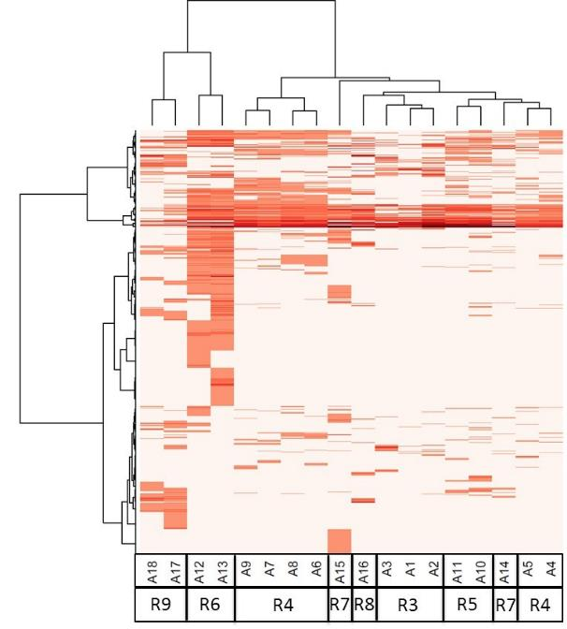
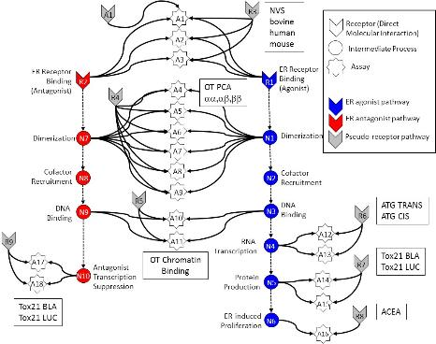
All In vitro assays have false positives and negatives
Much of this “noise” is reproducible
“assay interference”
Result of interaction of chemical
with complex biology in the assay
EDSP chemical universe is structurally diverse
Solvents
Surfactants
Intentionally cytotoxic compounds
Metals
Inorganics
Pesticides
Drugs
Assays cluster by technology,
suggesting technology-specific non-ER bioactivity
Chemicals
Assays
Judson et al: ToxSci (2015)

Slide 5
Most chemicals display a “burst” of potentially non-selective bioactivity near cytotoxity concentration
Concentration Space
Z- Space
Tested Concentration Range
Cytotoxicity
Range
3 MAD
Burst
Region
Cytotoxicity
Range
3 MAD
Burst
Region
Number of Hits
Number of Hits
0.1
1
10
100
1000
21 18 15 12 9 6 3 0 -3 -6 -9
AC50 (μM)
Bioactivity inferred
Z
Judson et al. Tox.Sci. in press (2016)

Slide 6
Schematic explanation of the burst
Specific
Non-specific
Oxidative Stress
DNA Reactivity
Protein Reactivity
Mitochondrial stress
ER stress
Cell membrane disruption
Specific apoptosis
…
Section 2.1

Slide 7
A1
R3
NVS
bovine
human
mouse
A
A1
Receptor (Direct Molecular Interaction)
A2
Intermediate Process
A3
Assay
ER Receptor Binding
(Antagonist)
ER Receptor Binding
(Agonist)
R2
OT PCA
αα,αβ,ββ
R1
A4
R4
ER agonist pathway
A5
ER antagonist pathway
Dimerization
N7
A6
N1
Dimerization
Pseudo-receptor pathway
A7
Cofactor
Recruitment
N8
A8
N2
Cofactor
Recruitment
A9
DNA
Binding
R5
DNA
Binding
ATG TRANS
ATG CIS
N9
A10
N3
R6
RNA
Transcription
A12
R9
A11
N4
OT Chromatin
Binding
A13
Tox21 BLA
Tox21 LUC
A17
Antagonist
Transcription
Suppression
R7
N10
Protein
Production
N5
A14
A18
Tox21 BLA
Tox21 LUC
A15
ACEA
ER-induced
Proliferation
N6
R8
A16

Slide 8
A1
A1
R3
Receptor (Direct Molecular Interaction)
A2
Intermediate Process
A3
Assay
ER Receptor Binding
(Antagonist)
ER Receptor Binding
(Agonist)
R2
R1
A4
R4
ER agonist pathway
A5
ER antagonist pathway
Dimerization
N7
A6
N1
Dimerization
Pseudo-receptor pathway
A7
Cofactor
Recruitment
N8
A8
N2
Cofactor
Recruitment
A9
DNA
Binding
R5
DNA
Binding
N9
A10
N3
R6
RNA
Transcription
A12
R9
A11
N4
A13
A17
Antagonist
Transcription
Suppression
R7
N10
Protein
Production
N5
A14
A18
A15
ER-induced
Proliferation
N6
R8
A16

Slide 9
A1
A1
R3
Receptor (Direct Molecular Interaction)
A2
Intermediate Process
A3
Assay
ER Receptor Binding
(Antagonist)
ER Receptor Binding
(Agonist)
R2
R1
A4
R4
ER agonist pathway
A5
ER antagonist pathway
Dimerization
N7
A6
N1
Dimerization
Pseudo-receptor pathway
A7
Cofactor
Recruitment
N8
A8
N2
Cofactor
Recruitment
A9
DNA
Binding
R5
DNA
Binding
N9
A10
N3
R6
RNA
Transcription
A12
R9
A11
N4
A13
A17
Antagonist
Transcription
Suppression
R7
N10
Protein
Production
N5
A14
A18
A15
ER-induced
Proliferation
N6
R8
A16

Slide 10
A1
A1
R3
Receptor (Direct Molecular Interaction)
A2
Intermediate Process
A3
Assay
ER Receptor Binding
(Antagonist)
ER Receptor Binding
(Agonist)
R2
R1
A4
R4
ER agonist pathway
A5
ER antagonist pathway
Dimerization
N7
A6
N1
Dimerization
Pseudo-receptor pathway
A7
Cofactor
Recruitment
N8
A8
N2
Cofactor
Recruitment
A9
DNA
Binding
R5
DNA
Binding
N9
A10
N3
R6
RNA
Transcription
A12
R9
A11
N4
A13
A17
Antagonist
Transcription
Suppression
R7
N10
Protein
Production
N5
A14
A18
A15
ER-induced
Proliferation
N6
R8
A16

Slide 11
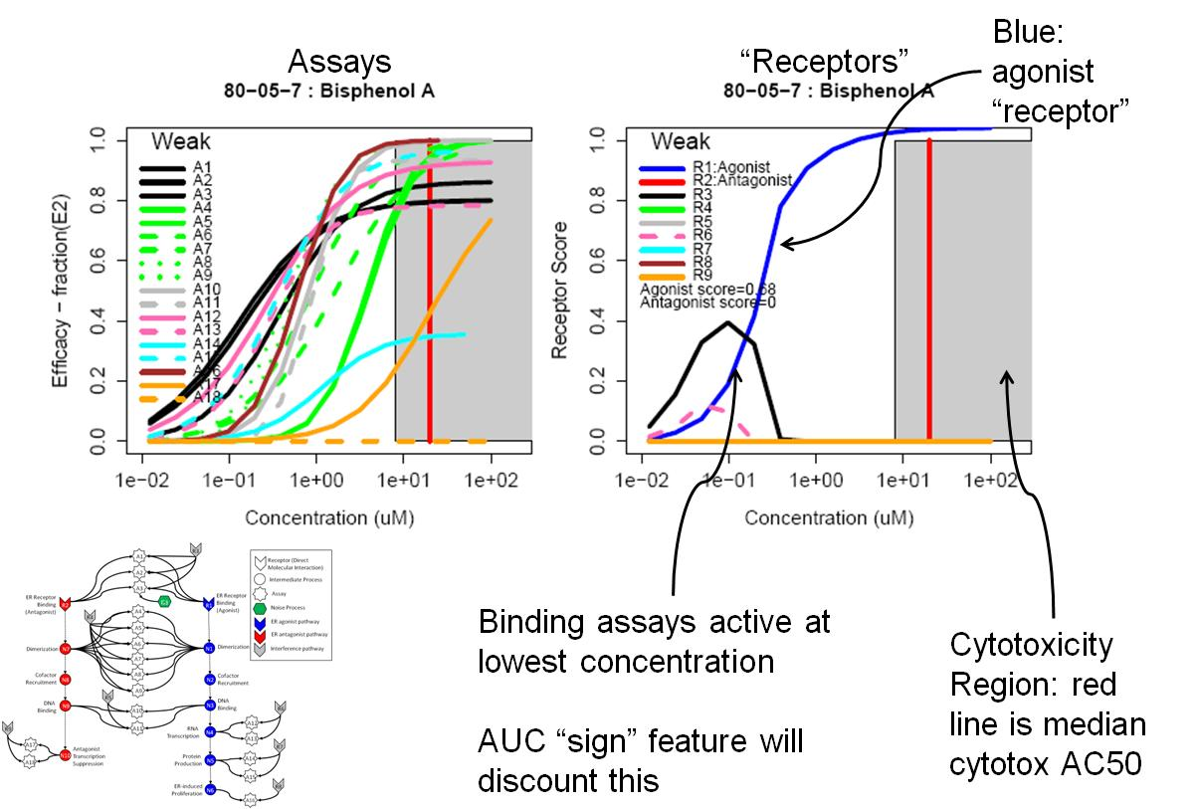
Example 1 – BPA: true agonist (AUC=0.66)

Slide 12
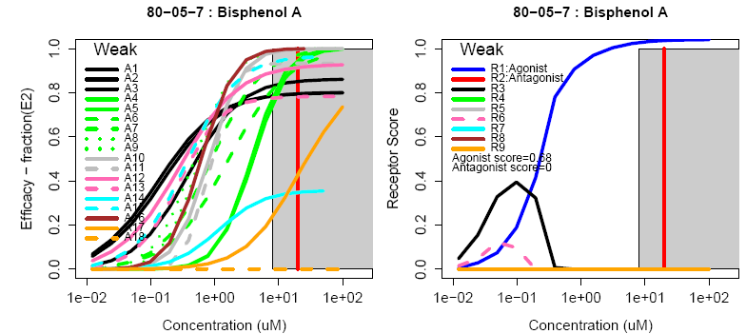
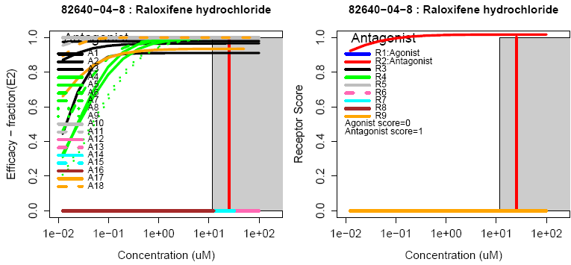
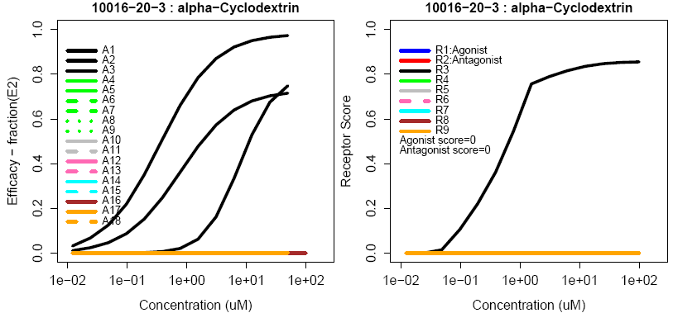
Example curves
True Agonist
True Antagonist
Assay Interference Example “R3”

Slide 13
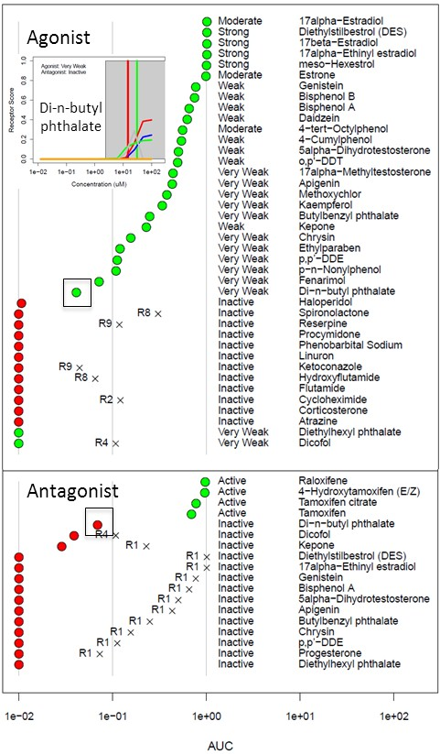
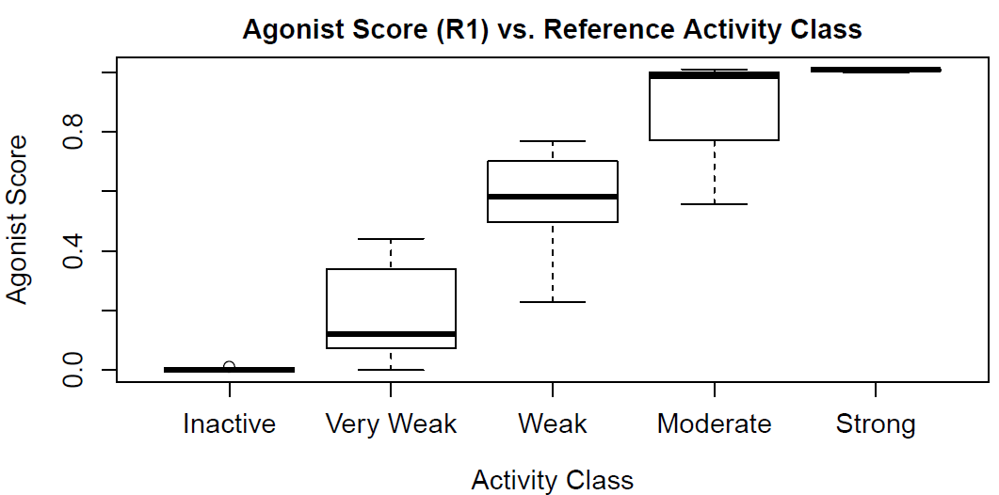
In Vitro Reference Chemical Performance

Slide 14
In vivo validation: Identifying Uterotrophic Reference Chemicals from the Literature
High-Level
Filter
Literature Searches:
1800 Chemicals
Data Review:
700 Papers, 42 Descriptors, x2
6 Minimum Criteria
“Guideline-Like”
(GL)
Uterotrophic Database
98 Chemicals
442 GL uterotrophic bioassays
Selection Criteria
In Vivo ER Reference Chemicals
30 Active, 13 Inactive
Kleinstreuer et al: “A Curated Database of Rodent Uterotrophic Bioactivity” (EHP 2016)

Slide 15
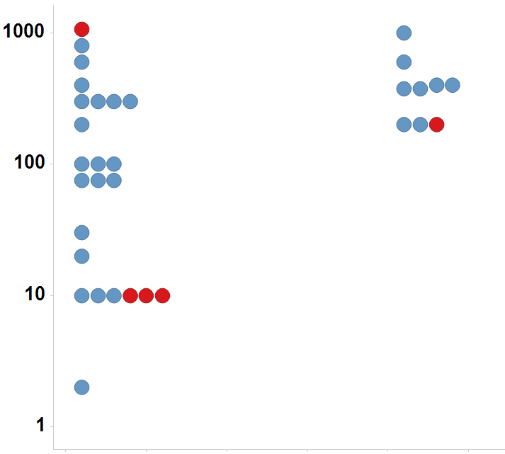
In vivo guideline study uncertainty 26% of chemicals tested multiple times in the uterotrophic assay gave discrepant results
Immature Rat: BPA
Anemia
species / study 1 | species / study 2 | Reproduce | Does Not Reproduce | Fraction Reproduce
rat SUB | rat CHR | 18 | 2 | 0.90
rat CHR | dog CHR | 13 | 2 | 0.87
rat CHR | rat SUB | 18 | 4 | 0.82
rat SUB | rat SUB | 16 | 4 | 0.80
rat SUB | dog CHR | 11 | 4 | 0.73
mouse CHR | rat CHR | 11 | 4 | 0.73
mouse CHR | rat SUB | 13 | 7 | 0.65
dog CHR | rat SUB | 11 | 6 | 0.65
dog CHR | rat CHR | 13 | 8 | 0.62
rat CHR | mouse CHR | 11 | 11 | 0.50
mouse CHR | dog CHR | 6 | 6 | 0.50
rat SUB | mouse CHR | 13 | 14 | 0.48
dog CHR | mouse CHR | 6 | 8 | 0.43
mouse CHR | mouse CHR | 2 | 3 | 0.40
LEL or MTD (mg/kg/day)
Uterotrophic
Active
Inactive
Injection
Oral
Kleinstreuer et al. EHP 2016

Slide 16
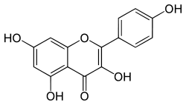
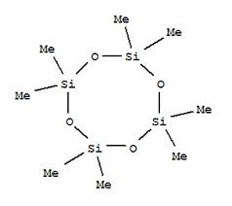
Model predicts uterotrophic assay as well as uterotrophic predicts uterotrophic
Restrict to chemicals with consistent results from 2 or more labs
True Positive | 29
True Negative | 50
False Positive | 1
False Negative | 1
Accuracy | 0.97
Sensitivity | 0.97
Specificity | 0.98
ER Agonist AUC
Kaempferol
Uterotrophic
Inactive
D4
Active
Rank Order (ER Agonist AUC)
Browne et al. ES&T (2015)

Slide 17
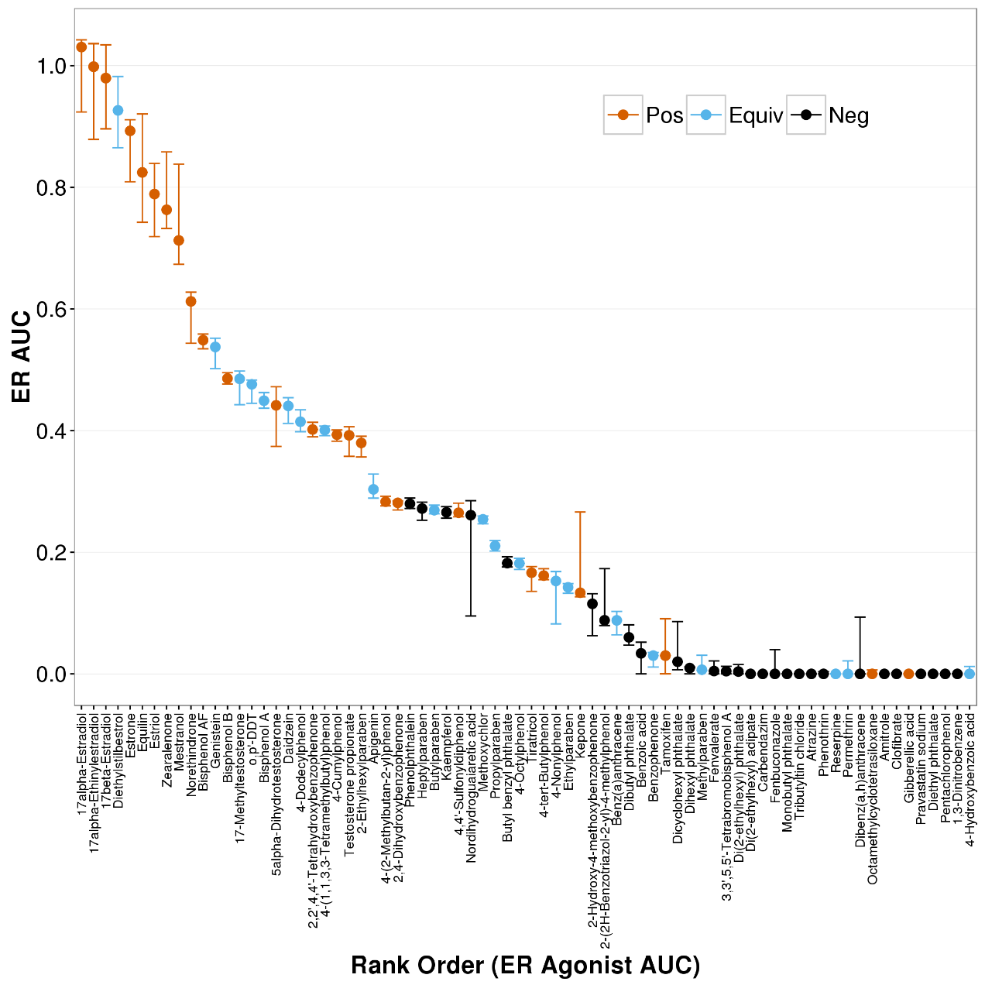
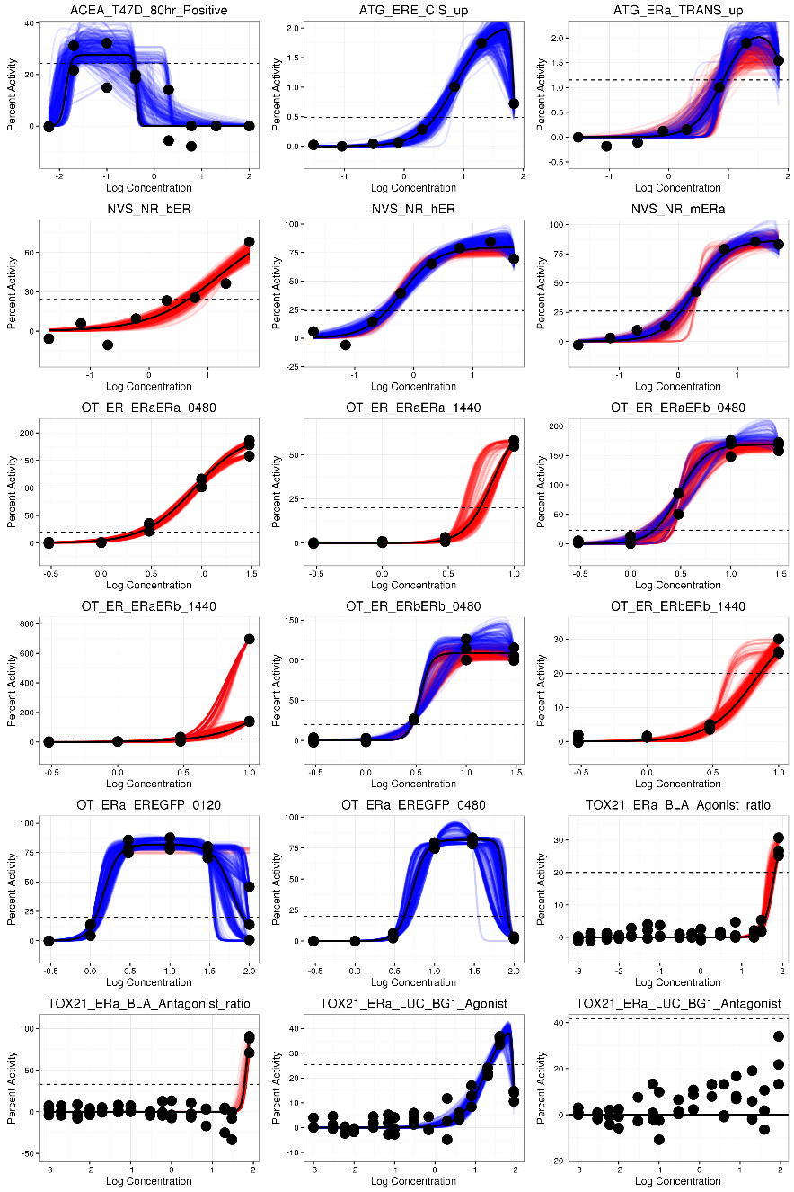
Add Uncertainty to In Vitro Assay Data
Watt et al. (in prep)

Slide 18
Moving Towards Regulatory Acceptance From FIFRA SAP, December 2014
Can the ER Model be used for prioritization?
“… the ER AUC appears to be an appropriate tool for chemical prioritization for … the EDSP universe compounds.”
Can the ER model substitute for the Tier 1 ER in vitro and uterotrophic assays?
“… replacement of the Tier 1 in vitro ER endpoints …with the ER AUC model will likely be a more effective and sensitive measure for the occurrence of estrogenic activity …”
“… the Panel did not recommend that the uterotrophic assay be substituted by the AUC model at this time. The Panel suggested that the EPA considers: 1) conducting limited uterotrophic and other Tier 1 in vivo assay testing, using the original Tier 1 Guidelines (and/or through literature curation)”
Based on follow-up presented here (FR notice, June 18 2015) …
“EPA concludes that ER Model data are sufficient to satisfy the Tier 1 ER binding, ERTA and uterotrophic assay requirements.”

Slide 19
Risk-based Prioritization Hazard + Exposure
mg/kg BW/day
Semi-quantitative
In Vitro to In Vivo
Approach
Potential Hazard:
In Vitro + HTTK
Potential Exposure:
ExpoCast
Low
Priority
Medium
Priority
High
Priority

Slide 20


High Throughput Dosimetry and Exposure
High throughput pharmacokinetic (HTPK) in vitro methods have been developed by pharmaceutical industry for predicting efficacious doses in clinical trials
In Wetmore et al. (2012) the same methods are used to approximately convert ToxCast in vitro bioactive concentrations (µM) into daily doses needed to produce similar levels in a human (mg/kg BW/day)
These doses can then be directly compared with exposure data, where available
Egeghy et al. (2012) and National Academy Report: “Exposure Science in the 21st Century” points out that not much exposure information is out there
mg/kg BW/day
Potential Hazard from ToxCast with Reverse Toxicokinetics
Potential Exposure from ExpoCast
Low
Risk
Med
Risk
High
Risk
e.g. Judson et al., (2011)

Slide 21
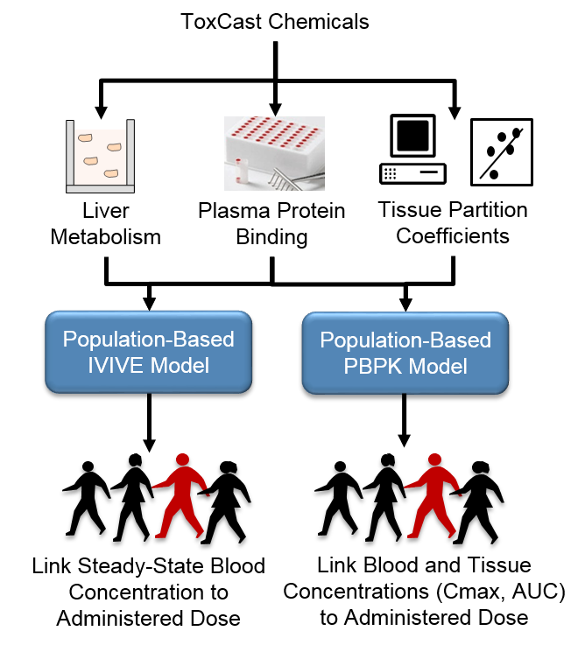
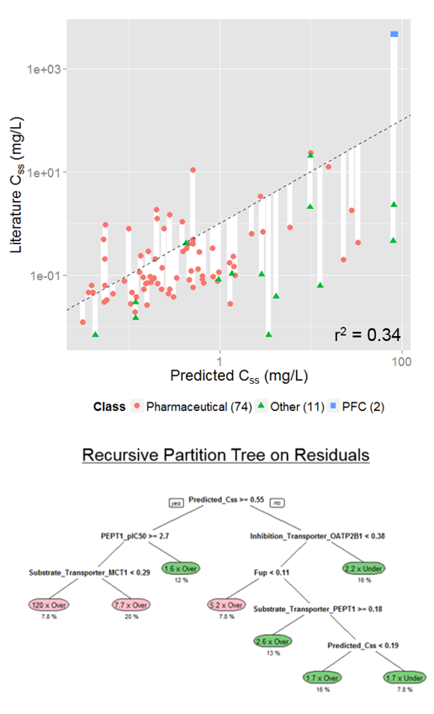
Toxicokinetics Modeling
Incorporating Dosimetry and Uncertainty into In Vitro Screening
Wambaugh et al., 2015
Notes:
I think we have heard yesterday, how important TK is in interpreting the results from NAMs. This includes both read across and the in vitro testing. However, first, we need to have an in vitro and in silico approach to generate the TK data that we need and we need to be rigorous in characterizing the uncertainty around whatever approach we develop.

Slide 22
Population and Exposure Modeling
Estimating Exposure and Associated Uncertainty with Limited Data
(Bio) Monitoring
e.g., CDC NHANES study
Calibrate models
Inferred Exposures
Pharmacokinetic Models
Dataset 1
Dataset 2
…
Estimate Uncertainty
Inferred Exposure
Predicted Exposures
Use
Production Volume
Predicted Exposure
…
Wambaugh et al., 2014
Notes:
I know that this workshop is primarily focused on NAMs in relation to hazard characterization, but I think that if we are talking more holistically about applying NAMs for regulatory decision making, we also need to incorporate approaches to estimate exposure in order to put the NAM data into context.

Slide 23
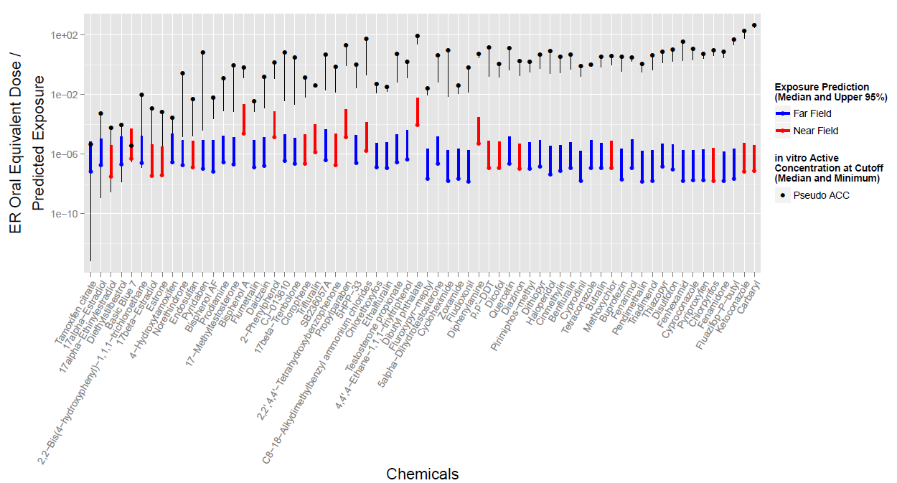
High-throughput Risk Assessment for ER 290 chemicals with ER bioactivity

Slide 24
CERAPP: using QSAR for further prioritization
Collaborative Estrogen Receptor Activity Prediction Project
Goals:
Use ToxCast ER score (or other data) to build many QSAR models
Use consensus of models to prioritize chemicals for further testing
Assumptions
ToxCast chemicals cover enough of chemical space to be a good “global” training set
Consensus of many models will be better than any one individually
Process
Curate chemical structures
Curate literature data set
Build many models
Build consensus model
Evaluate models and consensus
Mansouri et al: “CERAPP: Collaborative Estrogen Receptor Activity Prediction Project” EHP (2016)

Slide 25
CERAPP Consensus evaluation
Key point: As greater consistency is required from literature sources, QSAR consensus model performance improves
Total Database
Binders: 3961
Agonists: 2494
Antagonists: 2793

Slide 26
CERAPP Summary
EDSP Universe (10K)
Chemicals with known use (40K) (CPCat & ACToR)
Canadian Domestic Substances List (DSL) (23K)
EPA DSSTox – structures of EPA/FDA interest (15K)
ToxCast and Tox21 (In vitro ER data) (8K)
~32,000 unique structures evaluated
5-10% predicted to be ER-active
Prioritize for further testing
26

Slide 27
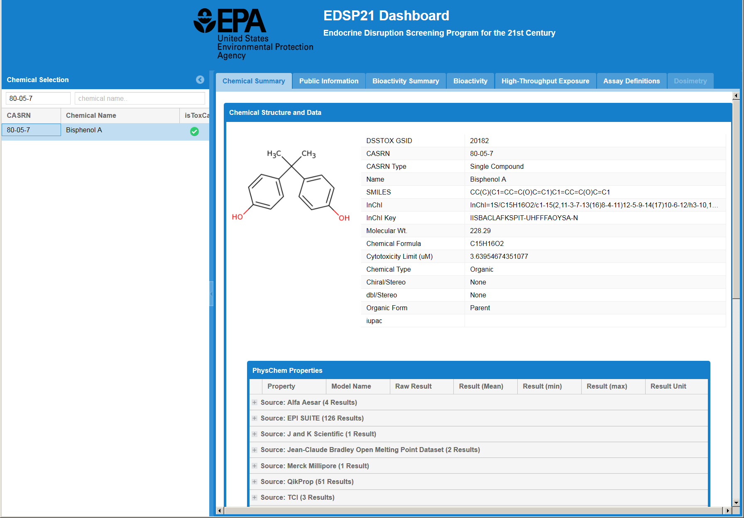
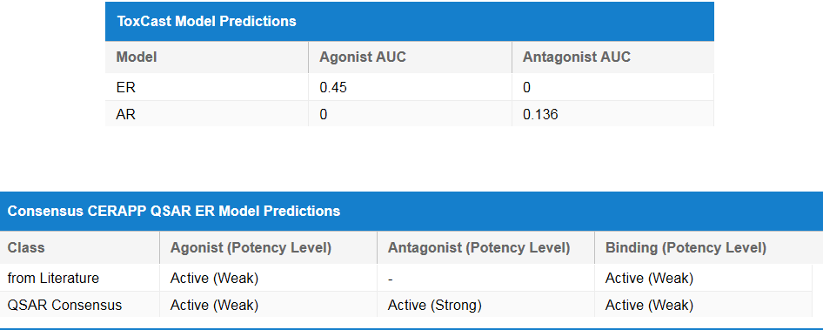
Data Transparency: EDSP21 Dashboard
Goal: To make EDSP21 data easily available to all stakeholders
Assay-by-assays concentration-response plots
Model scores – AUC agonist and antagonist
ER QSAR calls
Other relevant data
https://actor.epa.gov/edsp21

Slide 28
Summary
EDSP is in need of new approach to handle large testing universe
Reduce cost, speed throughput
Estrogen receptor model is first example of this
54 chemicals in low-throughput Tier 1 assays
1800 chemicals tested and published in high-throughput
1000 more in queue – 2016 planned release
Other endocrine pathways underway
Androgen receptor – Kleinstreuer, Browne, et al.
Steroidogenesis – Karmaus, Haggard, Paul Friedman, et al.
Thyroid (THR, TPO, deiodinases, ...) Paul Friedman, Simmons, Hornung, Laws, Stoker, et al.

Slide 29
Visit EPA’s Exhibit Booth #1643
Demos by Our Scientists
ECOTOX
SeqAPASS
HTTK Package
AOP Wiki
CompTox Chemistry Dashboard
GenRA
Meet the Directors Sessions
EPA Lab, Center and Office Directors
Informal 1 Hour Sessions
Visit Epa.gov/research/sot
For full list of events and materials

Slide 30
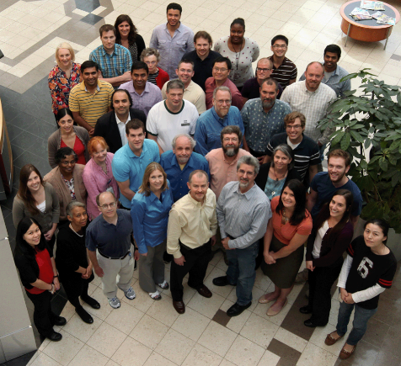
Acknowledgements
NCCT Staff Scientists
Rusty Thomas
Kevin Crofton
Keith Houck
Ann Richard
Richard Judson
Tom Knudsen
Matt Martin
Grace Patlewicz
Woody Setzer
John Wambaugh
Tony Williams
Steve Simmons
Chris Grulke
Jim Rabinowitz
Jeff Edwards
NCCT Postdocs
Todor Antonijevic
Audrey Bone
Kristin Connors
Danica DeGroot
Jeremy Fitzpatrick
Jason Harris
Dustin Kapraun
Agnes Karmaus
Max Leung
Kamel Mansouri
LyLy Pham
Prachi Pradeep
Caroline Ring
Eric Watt
Kamel Mansouri
Nicole Kleinstreuer
Eric Watt
Prachi Pradeep
Patience Browne
NCCT
Nancy Baker
Dayne Filer
Parth Kothiya
Doris Smith
Jamey Vail
Sean Watford
Indira Thillainadarajah
NIH/NCATS
Menghang Xia
Ruili Huang
Anton Simeonov
NTP
Warren Casey
Nicole Kleinstreuer
Mike Devito
Dan Zang

