Slide 1
Characterization of Uncertainty in In Silico, In Vitro assay, and High-Throughput Toxicokinetics Data and Their Combination, and Comparison with In Vivo Data Uncertainties
Richard Judson
US EPA
ORD, NCCT
Research Triangle Park, NC
919-541-3085
judson.richard@epa.gov

Slide 2
Conflict of Interest Statement
The author declares no conflicts of interest
Disclaimer: The views expressed in this presentation are those of the author and do not necessarily reflect the views or policies of the U.S. EPA

Slide 3
Outline
New methods and their combination for chemical hazard and risk assessment: need for new uncertainty assessment methods
Methods to quantify uncertainty in individual inputs to risk assessment
Methods to combine uncertainty across all inputs
Comparison of uncertainty/variability with those in the in vivo databases that are used as benchmarks

Slide 4
Alternative Chemical Risk Assessment Methods
Multiple alternative chemical risk assessment methods address backlog of chemicals requiring assessments, and desire to reduce use of animals in toxicity testing.
Methods combine in silico and in vitro methods and high-throughput toxicokinetics approaches to predict hazard ID, and to provide quantitative estimates of effect levels. These data are then combined into models to predict in vivo effect levels (such as LOAELs).

Slide 5
Need for New Uncertainty Quantification Methods
The introduction of new methods requires the corresponding introduction of new uncertainty quantification methods for individual inputs
In vitro assays and toxicokinetic assays
Methods to combine uncertainties across all inputs in the final models.

Slide 6
Uncertainty and Variability of In Vivo Data
It is important to better quantify uncertainties including variability, in the in vivo databases that are used to test the new in vitro to in vivo (IVIVE) models.

Slide 7
What is the Goal?
Develop, evaluate and use NAM “New Approach Methods”
NAM uses:
In vitro data
In silico modeling
May be an n:1 replacement for an animal model (e.g. POD)
May provide other data (does the chemical trigger an AOP?)
Quantitative and Qualitative
Users need to understand uncertainty in the NAM results

Slide 8
Some (Eccentric) Definitions
Variability
Population variability – different people respond differently to a chemical
Experimental variability – two labs running the “same” experiment may get different answers
Uncertainty
A model gives a result (e.g. a POD), but this is an estimate of the “true” value
We are uncertain about what the true value is
Parameter uncertainty – mathematical models can quantitatively estimate how uncertain we are about the value of a parameter (or provide the range of the parameter)
Model uncertainty – we may be using the wrong model (always true)

Slide 9
Consequences of In Vivo Uncertainty for NAM
Models can be built 2 ways
“Ab initio” – start from first principles (IVIVE)
By analogy – QSAR, read-across
In both cases, NAM models will be evaluated against the (noisy) in vivo data
Analogy models will also be built using the (noisy) in vivo data
Uncertainty in the evaluation data will lead to uncertainty in the model and our estimate of its quality

Slide 10
Understanding Uncertainty in Traditional Animal Data
NAM are sometimes held to a higher standard
They are expected to be “as good as” traditional in vivo animal tests
However, there is significant variability lab-to-lab in results of animal studies (as with in vitro studies)
E.g. in POD (LOAEL, NOAEL, etc.) values

Slide 11
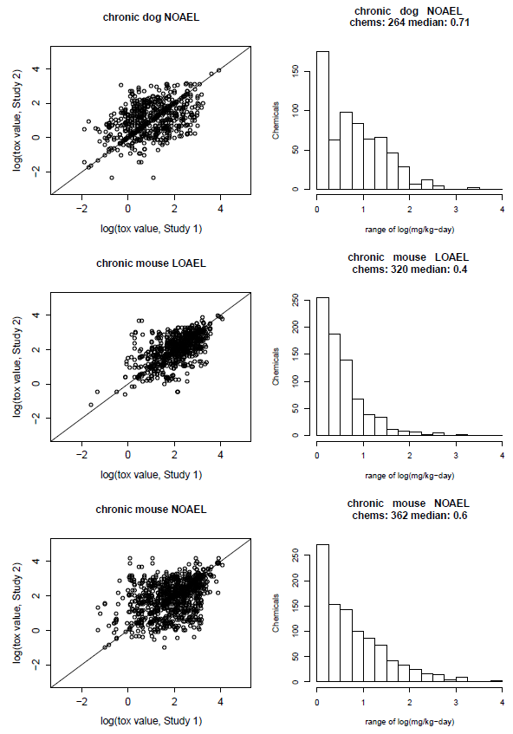
Example 1 of In Vivo Variability
Source of Data: ToxValDB, combines
ECHA
EFSA
COSMOS
IRIS
PPRTV
ToxRefDB
Etc.
Each point is one chemical, one study protocol, one species, one POD type run in two labs
Many instances of PODs differing by 1-2 orders of magnitude

Slide 12
Example 2 of In Vivo Variability
Source of Data: ToxRefDB
Compare pairs of studies: same chemical, study protocol, species, run in two labs.
First lab reports anemia
How often does the second lab also report anemia?
Concordance can be low
CHR=chronic
SUB=subchronic
Species / study 1 | Species / study 2 | Concordant | Not Concordant | Fraction Concordant
rat SUB | rat CHR | 18 | 2 | 0.90
rat CHR | dog CHR | 13 | 2 | 0.87
rat CHR | rat SUB | 18 | 4 | 0.82
rat SUB | rat SUB | 16 | 4 | 0.80
rat SUB | dog CHR | 11 | 4 | 0.73
mouse CHR | rat CHR | 11 | 4 | 0.73
mouse CHR | rat SUB | 13 | 7 | 0.65
dog CHR | rat SUB | 11 | 6 | 0.65
dog CHR | rat CHR | 13 | 8 | 0.62
rat CHR | mouse CHR | 11 | 11 | 0.50
mouse CHR | dog CHR | 6 | 6 | 0.50
rat SUB | mouse CHR | 13 | 14 | 0.48
dog CHR | mouse CHR | 6 | 8 | 0.43
mouse CHR | mouse CHR | 2 | 3 | 0.40
Judson et al. Reg. Tox. Pharm (2017) “Retrospective Mining of Toxicology Data to Discover Multispecies and Chemical Class Effects: Anemia as a Case Study”.

Slide 13
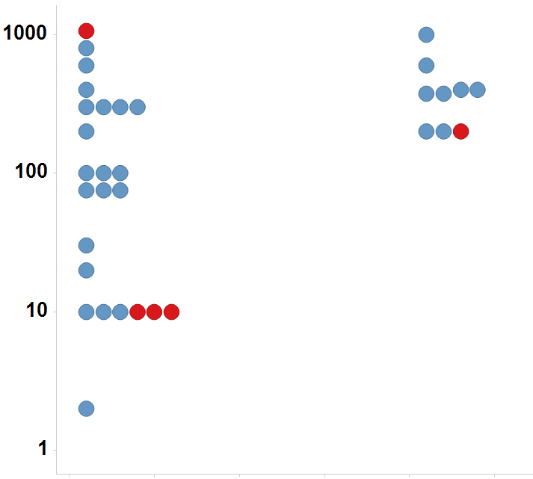
Example 3 of In Vivo Variability
Immature Rat: Bisphenol A
Source of Data: Literature compilation of guideline uterotrophic data
Finding 1:
26% of chemicals tested multiple times in the uterotrophic assay gave discrepant results
Lab 1=positive, lab 2=negative
Finding 2:
Data for BPA shows wide variability in POD, and in active / inactive finding
LEL or MTD (mg/kg/day)
Uterotrophic
Active
Inactive
Injection
Oral

Slide 14
Sources of Uncertainty / Variability In Vivo (and In Vitro)
Experimental variability
Species, strain, dose range, dose spacing
Experimental error
Statistical power issues
Too few animals to see weak or rare effect
Reporting bias
Was an effect negative or not looked for?
Observer bias
Less severe phenotypes not reported when more severe ones are present
Diagnostic terminology drift
Data assimilation and analysis
Typos, incomplete transcription

Slide 15
Ab Initio NAM – IVIVE
Only look at data for the chemical of interest
Goal 1 is to predict a POD
Goal 2 is to predict a “mode of action”
Use in vitro data
Pharmacodynamics
Pharmacokinetics

Slide 16
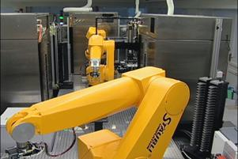
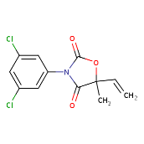
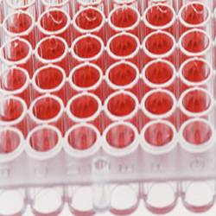
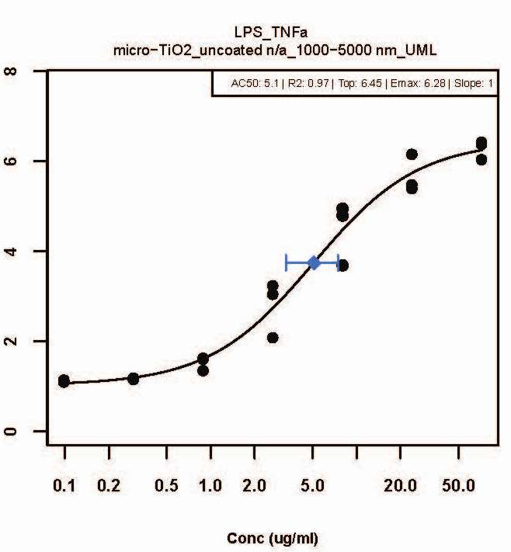
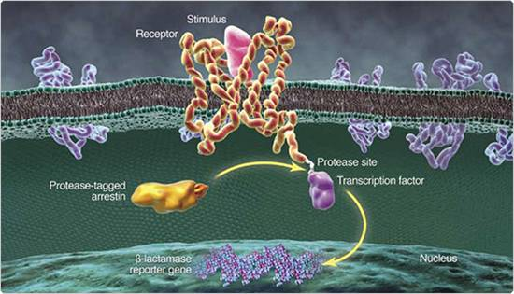
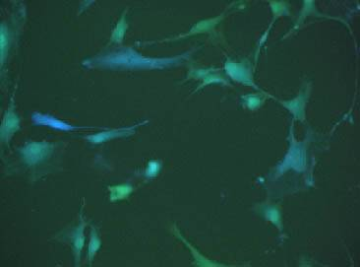
In Vitro POD Data Generation
Screen one or many chemicals in concentration-response
Output is POD AC50 (μM)
What is uncertainty in
Hit probability?
POD?
Robots
Chemical Exposure
96-, 384-, 1536 well plates
Emax
Response
Target Biology
(e.g. estrogen receptor)
LEC
AC50
Cell Population
Conc (uM)

Slide 17
Issues for Uncertainty in In Vitro Data
Data may be noisy – is it a hit or not?
It is a hit, but where is the AC50?
Does in vivo effect start at the AC50 or AC50 (90, …)?
Different assays give different results
What assay is “right”?
Is metabolism important?
Does the assay consistently yield false positive / negative results for some chemicals?
Assay interference
Does hitting this target cause adversity?
Emax
Response
LEC
AC50
Conc (uM)
Parameter uncertainty
Model uncertainty

Slide 18
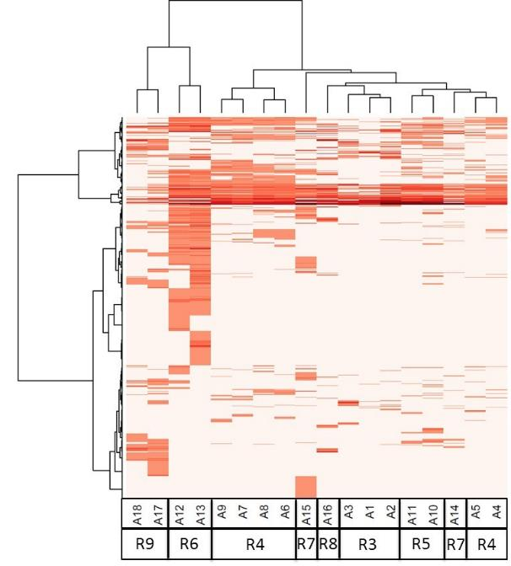
In Vitro Assays Have False Positives and Negatives
Illustration of variability in hit call assay-to-assay across 18 Estrogen Receptor assays.
In heatmap, red=hit, white=no hit
Much of this “noise” is reproducible
“assay interference”
Result of interaction of chemical with complex biology in the assay
Solvents
Surfactants
Intentionally cytotoxic compounds
Metals
Inorganics
Pesticides
Drugs
Chemicals
Assays

Slide 19
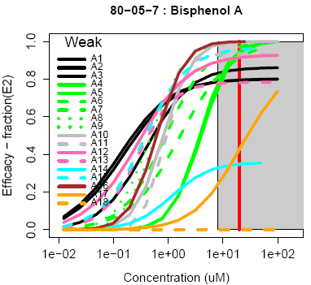
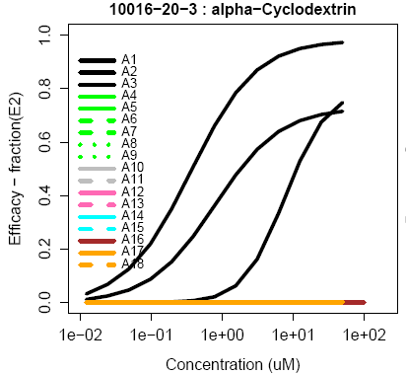
Variability and Uncertainty In Vitro
True Agonist: All agonist assays are turned on, but potency varies by as much as 10-fold (variability)
“True” in vivo potency can only be estimated
Quantitative uncertainty
False positive: This chemical causes protein denaturation in cell-free radioligand binding assays, but not in any cell-based assay.
Qualitative uncertainty

Slide 20
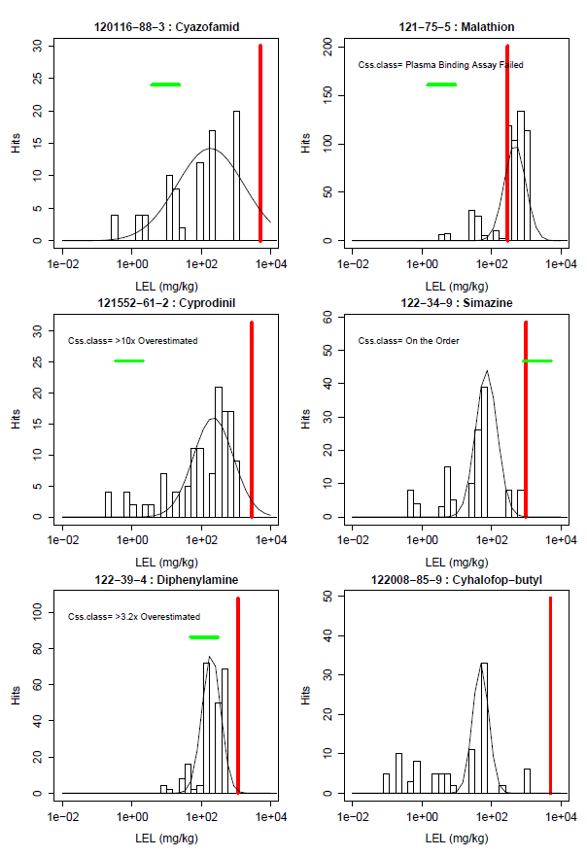
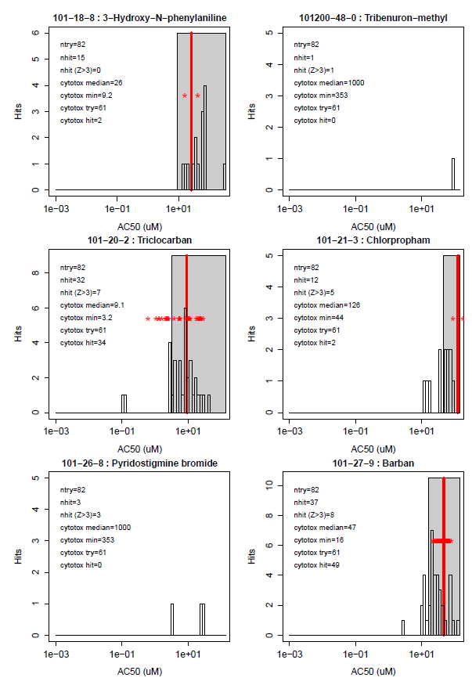
Most Activity Comes at High Doses / Concentrations
In vivo
In vitro
Different kind of uncertainty:
Does the effect come from a primary interaction of the chemical with a target, or is it a secondary effect of cell stress, cytotoxicity?
High-dose / high-concentration effects are often the most prevalent
A kind of model uncertainty

Slide 21
Most chemicals display a “burst” of potentially non-selective bioactivity near cytotoxity concentration
Concentration Space
Z- Space
Tested Concentration Range
Cytotoxicity
Range
3 MAD
Burst
Region
Cytotoxicity
Range
3 MAD
Burst
Region
Number of Hits
Number of Hits
0.1
1
10
100
1000
21 18 15 12 9 6 3 0 -3 -6 -9
AC50 (μM)
Bioactivity inferred
Z

Slide 22
Schematic Explanation of the Burst
Specific
Non-specific
Oxidative Stress
DNA Reactivity
Protein Reactivity
Mitochondrial stress
ER stress
Cell membrane disruption
Apoptosis
Saturation of metabolic pathways
…

Slide 23
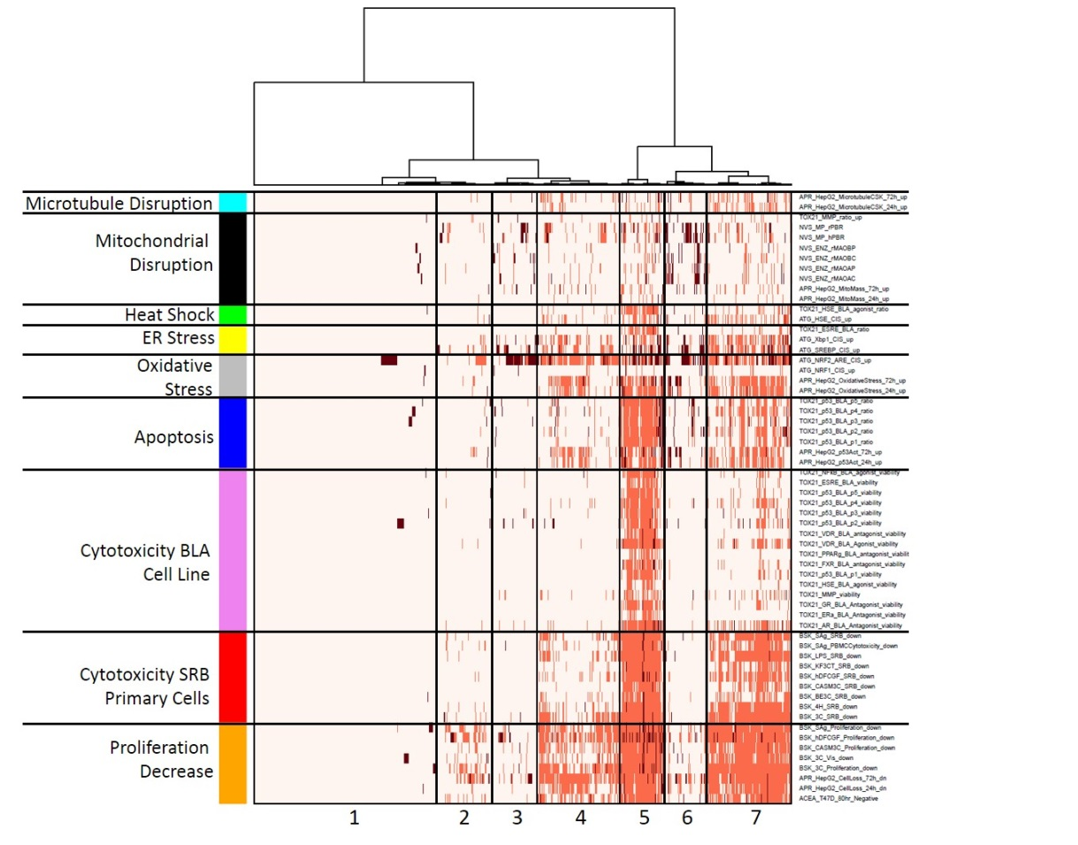
Heatmap of Stress and Cytotoxicity Assays
Cell stress and cytotoxicity can manifest themselves differently based on:
Cell type
Cell lines
Primary cells
Cell origin / tissue
Readout technology
Heat map shows potency across 1000 chemicals with a collection of
Cell stress and cytotoxicity assays
Chemicals

Slide 24
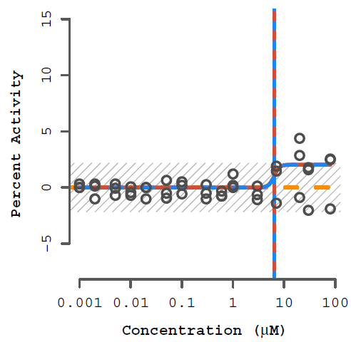
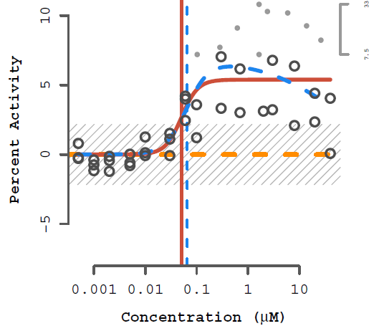
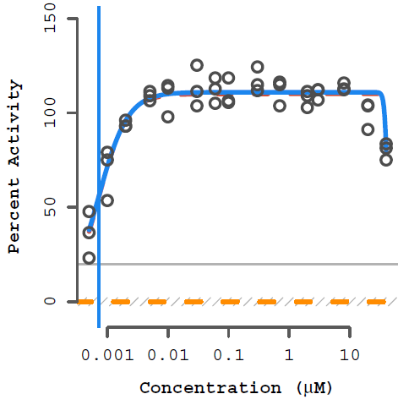
Quantitative Estimates from In Vitro Data
Is the chemical a hit?
The chemical is a hit but there’s lots of noise in the data: What is the AC50, Top
The chemical is a hit and there’s not too much noise, but still: What is the AC50, Top

Slide 25
Estimating Parameter Uncertainty in In Vitro Data
Standard way to estimate confidence intervals is to use bootstrapping
Randomly select subsets of the data, refit
Generate hit call, AC50, Top, slope
Generate confidence intervals using the distribution
Bootstrap can be with and without replacement, with and without added variability

Slide 26
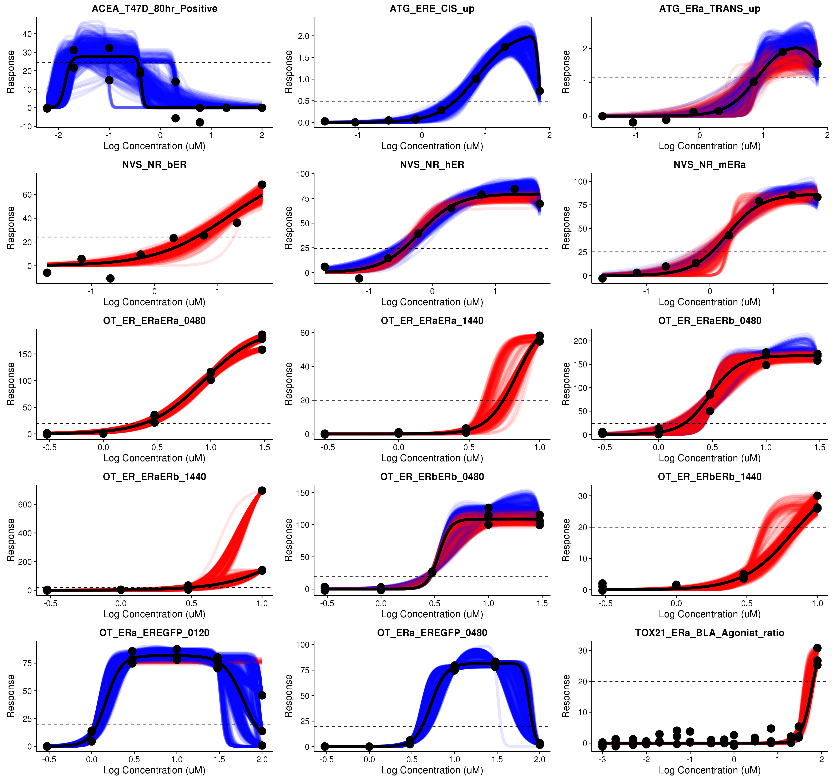
Bootstrap Example Curves
Each plot is a different assay for one chemical
Curves can be Hill (Red) or Gain-loss (Blue)
Top left has the most uncertainty

Slide 27
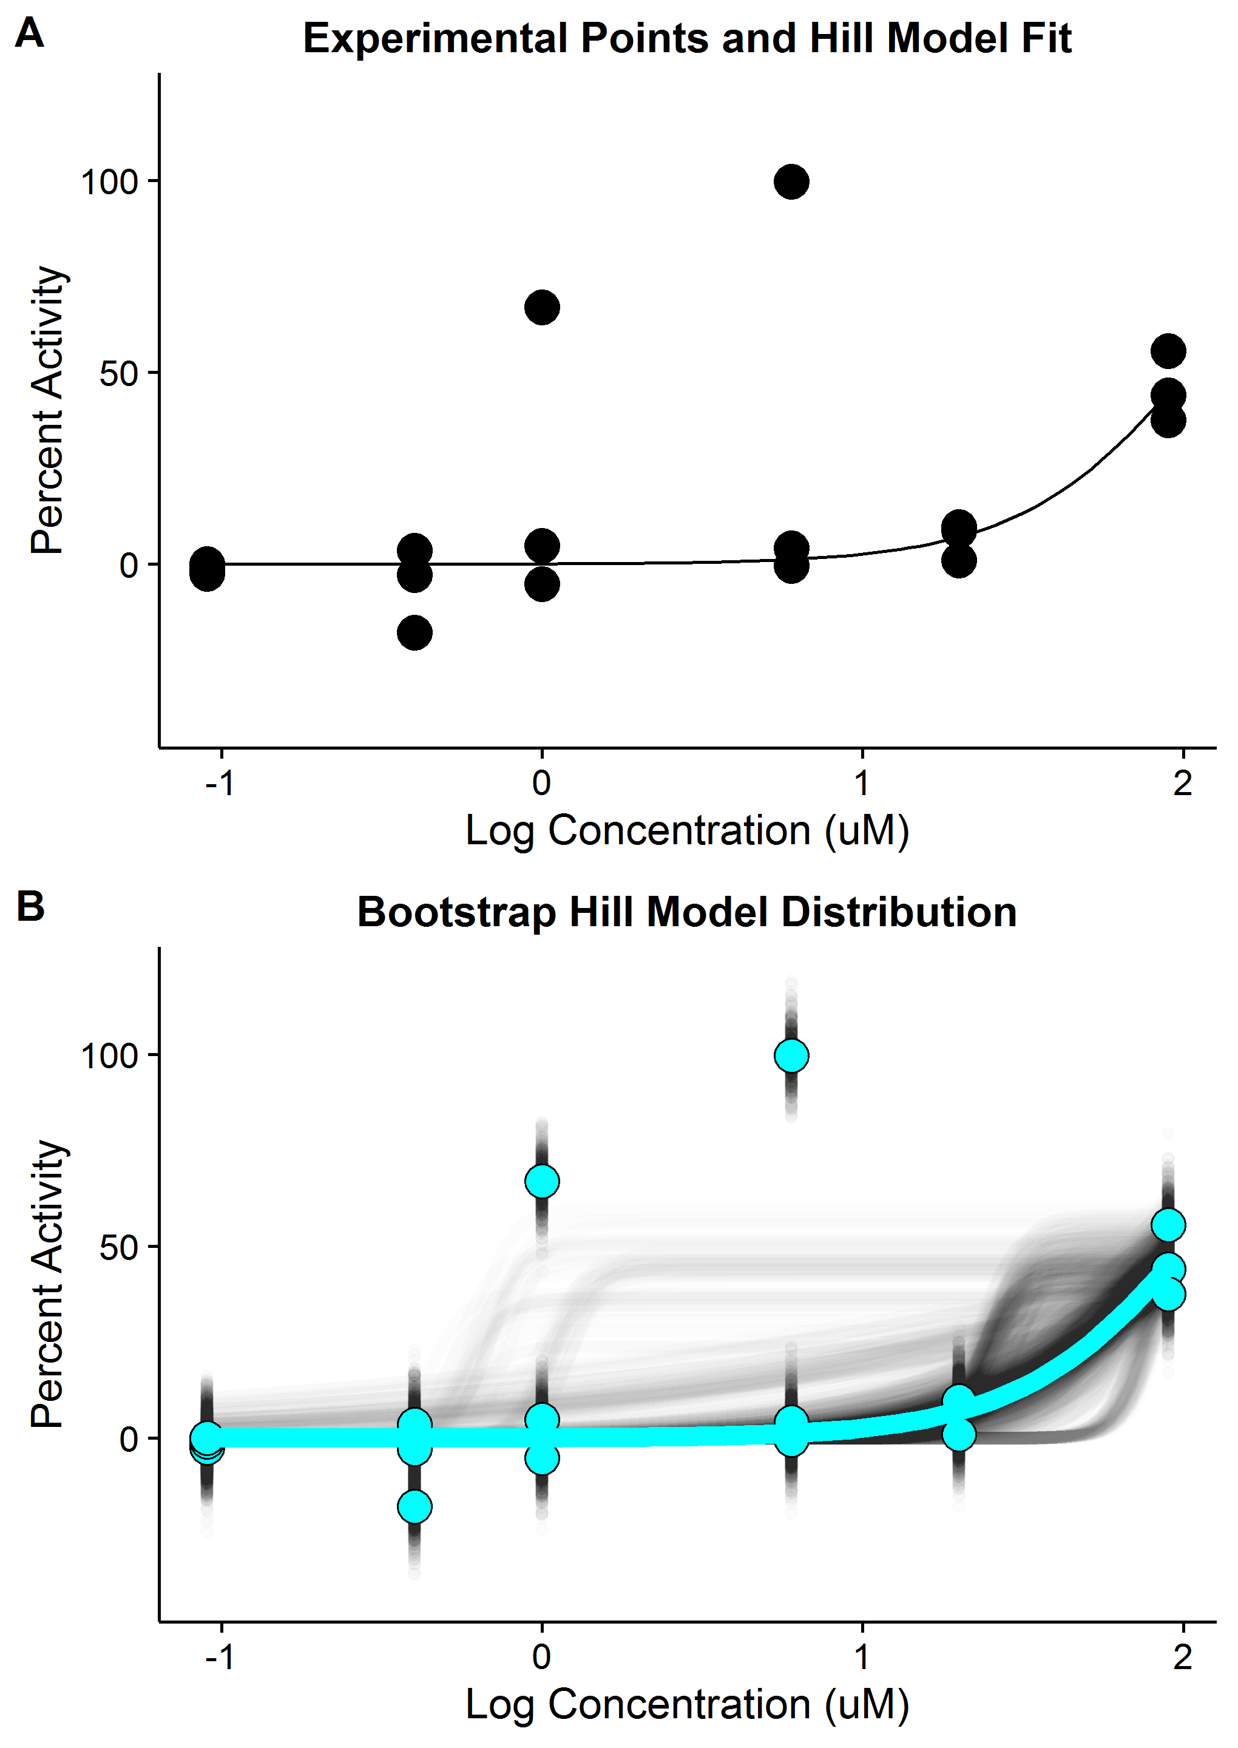
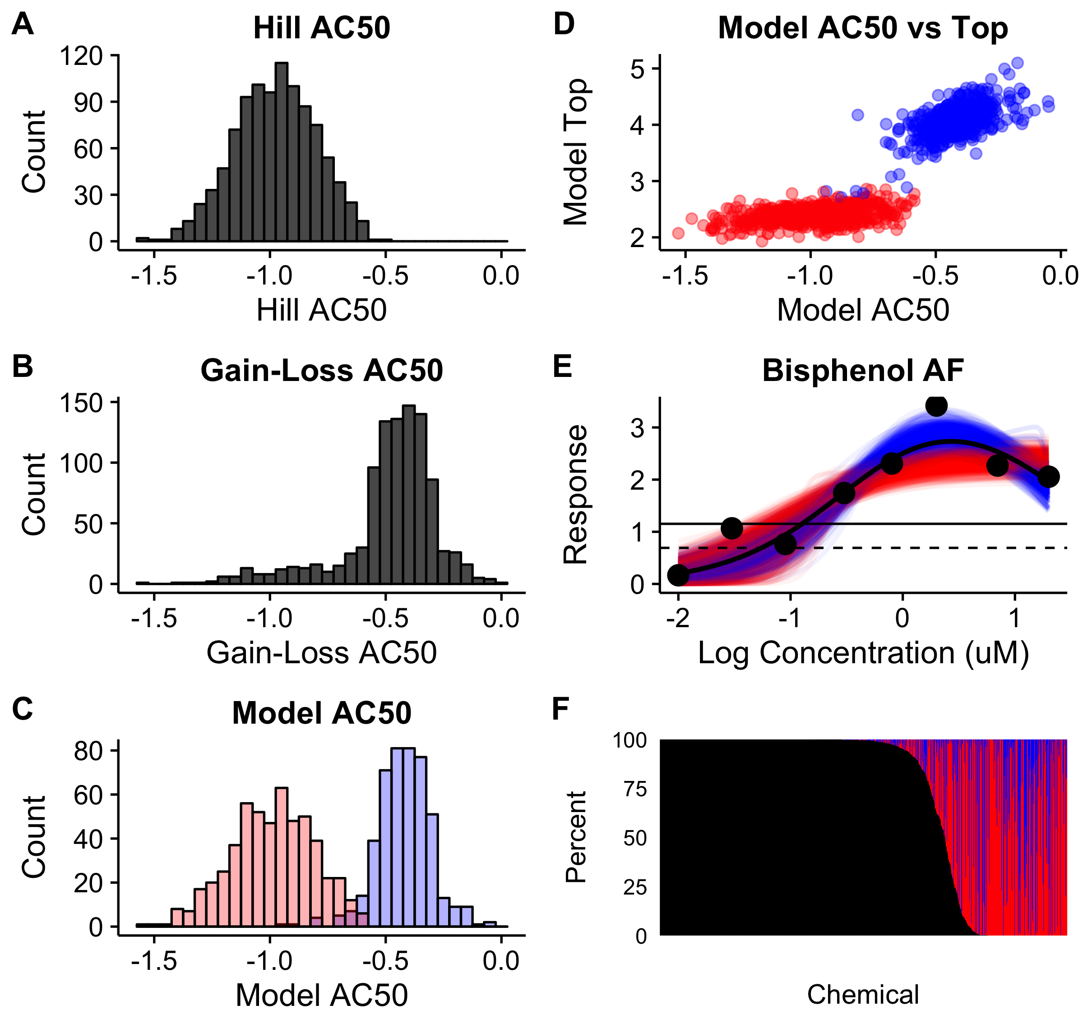
Details of Generating Confidence Intervals
Start with raw data
Draw many bootstrap samples
Fit curves many (e.g. 1000) times
Calculate fit parameters
Generate distribution
Get confidence intervals

Slide 28
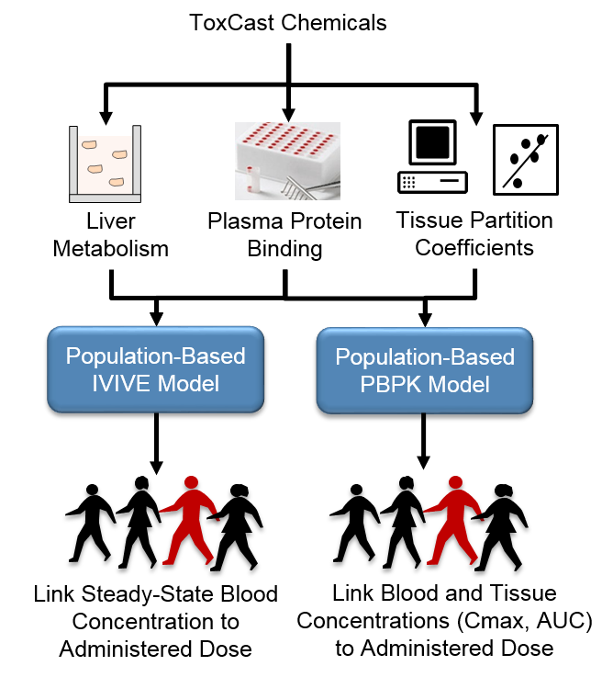
In Vitro PK Data Generation
Measure liver metabolism (intrinsic clearance) in human hepatocytes
Measure plasma protein binding using human plasma
Use these quantities in a PBPK model with estimated human population variability
Result is a quantity called Concentration at Steady State (Css)
Expected free concentration in blood or tissue for a 1 mg/kg/day steady-state dose

Slide 29
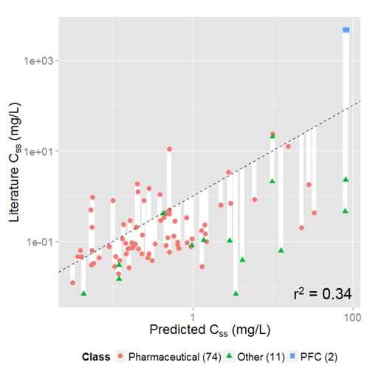
In Vitro PK Uncertainties
Quantitative, parameter uncertainty
Plasma protein binding
Intrinsic clearance
Partition coefficient (QSAR estimate)
How does population variability affect these?
Model uncertainties
Is renal clearance the major route?
Is a steady-state approximation appropriate?
Are there active transport processes?
Is 100% oral absorption correct?
About 2/3 of chemicals are within 10x of experimental values.
Errors tend to be on heath-conservative side

Slide 30
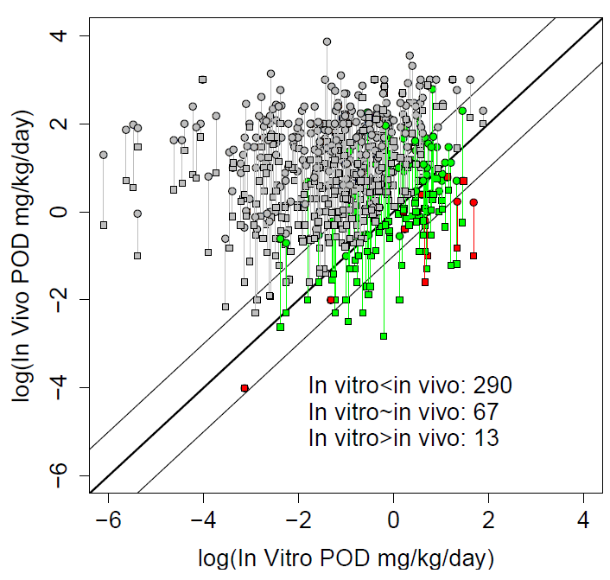
Ab Initio Test: Can We Predict In Vivo POD?
Calculate IVIVE POD (~LOAEL) using formula:
POD = AC50 / Css
Make conservative assumptions
Use lowest AC50 (efficacy vs. toxicity)
Use lower confidence interval for AC50
Use upper confidence interval for Css
Result: ~4% have in vitro POD consistently greater than in vivo values
Plot shows uncertainties in in vivo POD
Over-estimation of effect accounting for multiple uncertainties is related in spirit to adding UF in RfD calculation

Slide 31
Reasoning By Analogy: PODs from QSAR
What are the best analogues?
Similarity is based on “descriptors”
Chemical properties (e.g. molecular weight, logP)
Chemical descriptors (chemotypes, electronic properties, …)
In vitro assay measurements (ToxCast, Tox21)
Number of chemicals << number of descriptors
Any model is underdetermined – many models can fit the same data

Slide 32
Typical Analog Approach
Start with set of experimental data –“endpoint”
Noisy, quantitatively uncertain
Describe chemicals using “descriptors”
May or may not capture essential properties related to effect being modeled
Use algorithm (e.g. machine learning or read-across) to create formula to predict endpoint from descriptors
Estimate accuracy (uncertainty) of model using an external training set

Slide 33
Example Results: LOAEL model
Model Performance
Cross validation vs. External
Compare with underlying data uncertainty

Slide 34
Ab Initio Model vs. Analogy: Model Uncertainty
Ab initio
First principles, No fitting
Analogy Machine Learning (ML) model
Fit using weighted descriptors
Ab initio is nice because it is easy to understand, while ML model is at least a gray box
Ab initio is conservative, but ML could have safety factors added
ML could be more white box: create in stages (kinetics and dynamics as separate models)

Slide 35
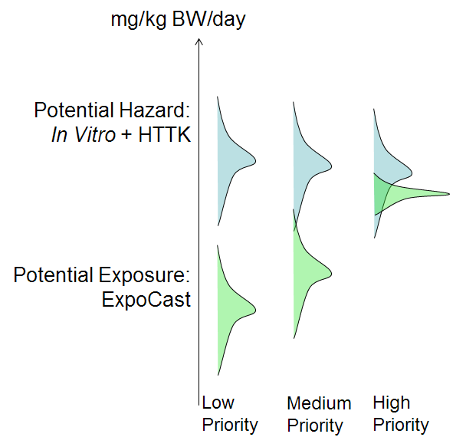
Given all the Uncertainty, is Modeling Futile?
Not in risk assessment
What’s important is the difference between hazard and exposure
Hazard model:
In vitro AC50 (μM) with uncertainty
Use toxico / pharmacokinetic model to convert to mg/kg/day (with added uncertainty)
Exposure models also have uncertainties
Compare ranges for margin of exposure
In practice many chemicals with “accidental exposure” seem to have large margins of exposure

Slide 36
Summary
All data is uncertain
Biological Variability
Experimental Variability
Noise
Traditional toxicology methods have developed ways to quantify uncertainties
New approach methods (NAM) are just starting to develop equivalent uncertainty quantification approaches
This is a key challenge in replacing tradition in vivo studies

