Slide 1

Alternative Approaches to Chemical Risk Assessment: Assays, Databases, Models
Richard Judson
U.S. EPA, National Center for Computational Toxicology
Office of Research and Development
Michigan State Dept. of Pharmacology and Toxicology
29 March 2017
The views expressed in this presentation are those of the author and do not necessarily reflect the views or policies of the U.S. EPA

Slide 2
We’re all just cyborgs really, random clanking assemblages inserted in circuits way beyond our understanding
Jenny Turner

Slide 3
Algorithms embedded in silicon and metal will replace algorithms embedded in flesh, which is what biology and computer science tells us is all we are anyway
Steven Shapin

Slide 4
The boundaries between animals, machines and social systems will dissolve; These will all come to be seen as algorithmic processing systems
We will worship Information and our hearts will belong to Data
Steven Shapin

Slide 5
Essences and Accidents

Slide 6
Applied Bioinformatics (?)
Does transcription factor X control gene Y?
What is the effect of dosing a person with X amount of chemical Y?
Complexity
Non-linearity
Noise
Unknown sources of variation

Slide 7
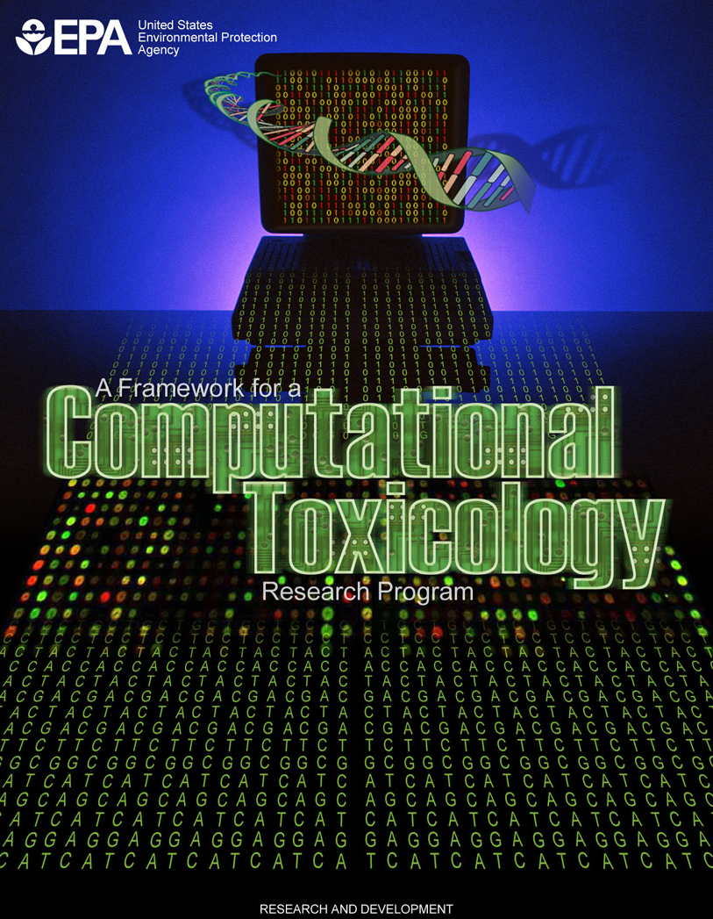
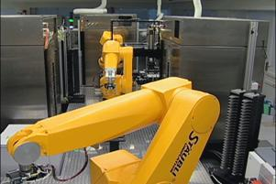
National Center for Computational Toxicology
National Center for Computational Toxicology established in 2005 to integrate
High-throughput and high-content technologies
Modern molecular biology
Data mining and statistical modeling
Computational biology and chemistry
Currently staffed by ~60 employees
Exists within the EPA’s Office of Research and Development
Home of the ToxCast and ExpoCast research efforts
Key partner in U.S. Tox21 federal consortium

Slide 8
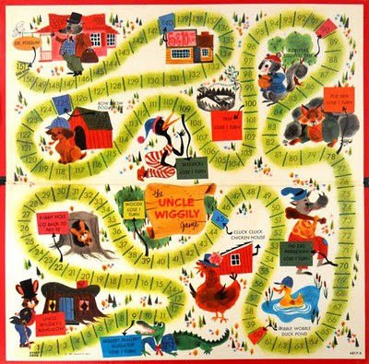
Problem Formulation
Exposure
Point of Departure
Toxicokinetics
Mode of Action
Identification
Uncertainty
Public Access

Slide 9
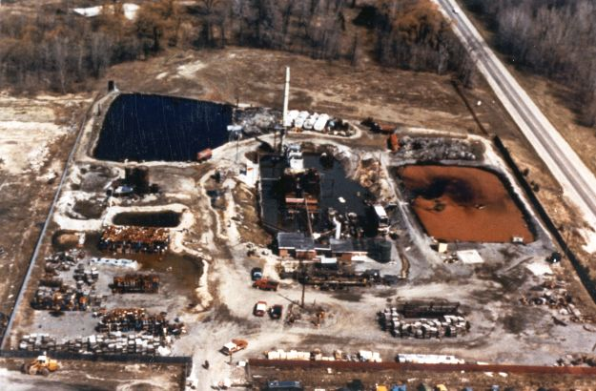
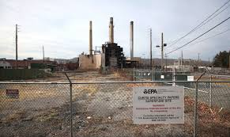
Typical Problem #1
At SuperFund site, EPA has identified 600 unique chemicals
300 of these have “good” reference doses / concentration (RfD / RfC), but 300 do not
Can we determine “good enough” RfD/RfC to aid in cleanup planning?
Can we do in it a few months?

Slide 10

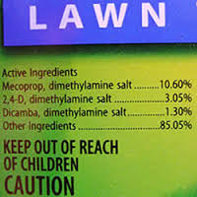
Typical Problem #2
Office of Pesticide Programs (OPP) has been petitioned to perform risk assessments on hundreds of pesticidal “inert ingredients”
Companies have not typically been required to submit in vivo data on individual inerts
Can we prioritize which of these chemicals should be the focus of detailed risk assessments?

Slide 11
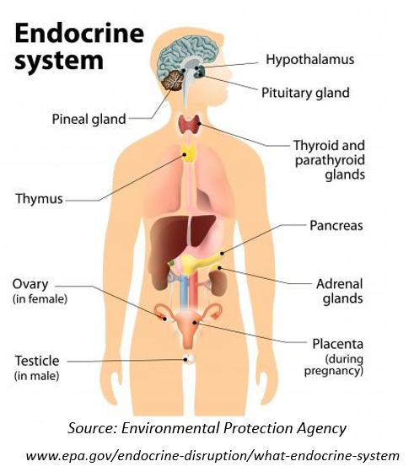

Typical Problem #3
The Endocrine Disruptor Screening Program (EDSP) is required to test an unknown number of chemicals as potential endocrine disruptors
The EDSP Tier 1 screening battery costs ~$1M per chemical and has a throughput of 100 chemicals every few years
Can we define the chemical universe subject to EDSP? (yes: ~10,000 chemicals)
Can we develop approaches to prioritize chemicals and streamline Tier 1?

Slide 12
Common Themes
Many chemicals (100s to 1000s)
Many of these are data poor
People, fish frogs, … are currently exposed
Decision-makers need tools they can use today
They have a willingness to try new approaches
Evaluation of new methods can occur in real time on real-world problems
Evaluation needs to account for uncertainties in both new and old tools

Slide 13
Computational Toxicology
Identify biological pathways of toxicity (AOPs)
Develop high-throughput in vitro assays
Test “Human Exposure Universe” chemicals in the assays
Develop models that link in vitro to in vivo hazard
Use pharmacokinetic models to predict activating doses
Develop exposure models
Add uncertainty estimates
Create high-throughput risk assessments

Slide 14
Risk-based Approach Hazard + Exposure
mg/kg BW/day
Semi-quantitative
In Vitro to In Vivo
Approach
Potential Hazard:
In Vitro + HTTK
Potential Exposure:
ExpoCast
Low
Priority
Medium
Priority
High
Priority

Slide 15
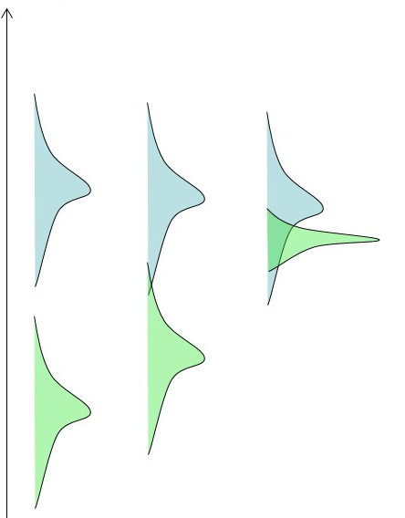
Tools / Models / Data needed
Exposure information or model
Quantify in mg/kg/day
Include uncertainties
Hazard information or model
Start in vitro
Quantify in uM required to trigger bioactivity
Include uncertainties
Toxicokinetics
Use to convert between external dose and internal concentration
Include uncertainties

Slide 16
Population and Exposure Modeling
Estimating Exposure and Associated Uncertainty with Limited Data
(Bio) Monitoring
e.g., CDC NHANES study
Calibrate models
Inferred Exposures
Pharmacokinetic Models
Dataset 1
Dataset 2
…
Estimate Uncertainty
Inferred Exposure
Predicted Exposures
Use
Production Volume
Predicted Exposure
…
Wambaugh et al., 2014
Notes:
I know that this workshop is primarily focused on NAMs in relation to hazard characterization, but I think that if we are talking more holistically about applying NAMs for regulatory decision making, we also need to incorporate approaches to estimate exposure in order to put the NAM data into context.

Slide 17
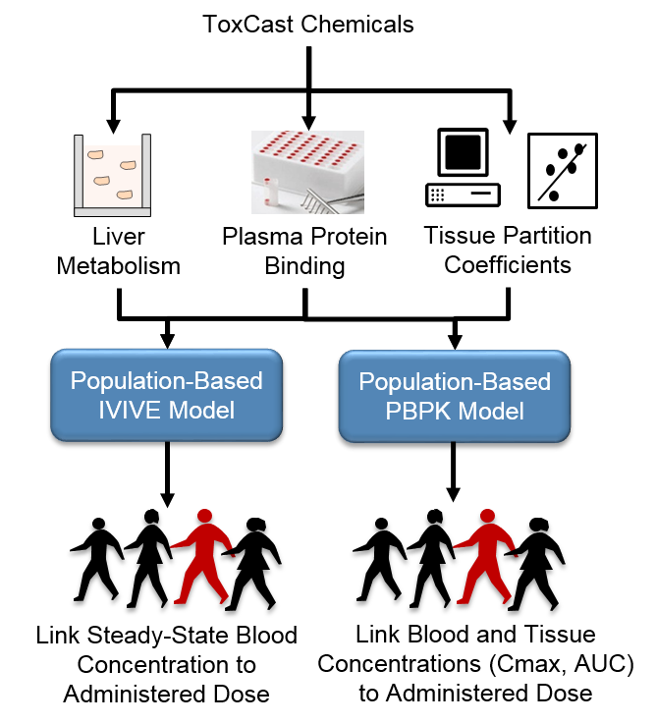
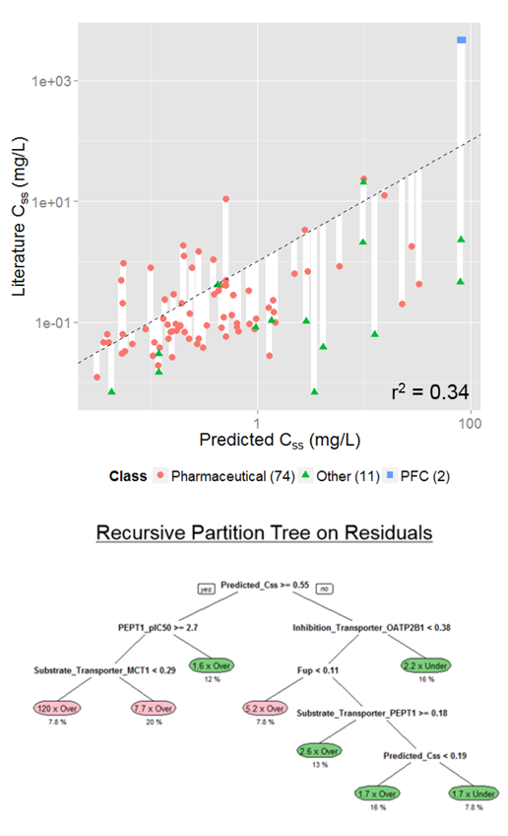
Toxicokinetics Modeling
Incorporating Dosimetry and Uncertainty into In Vitro Screening
Wetmore et al.
Wambaugh et al., 2015
Notes:
I think we have heard yesterday, how important TK is in interpreting the results from NAMs. This includes both read across and the in vitro testing. However, first, we need to have an in vitro and in silico approach to generate the TK data that we need and we need to be rigorous in characterizing the uncertainty around whatever approach we develop.

Slide 18
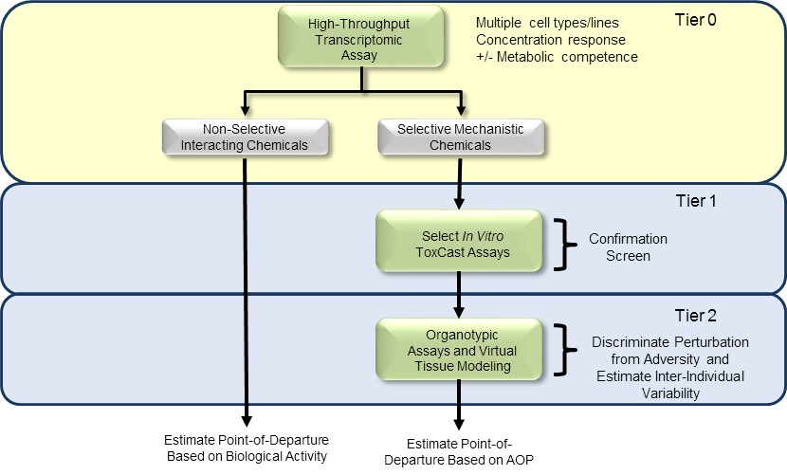
The “Minimal Hazard Battery”

Slide 19
The “Minimal Hazard Battery”
Tier 1 provides
in vitro LOAEC / NOAEC
Survey of perturbed pathways
Concentrations where cell stress may interfere with assays giving false positive signals
If expected doses overlap with cell-stress concentrations, then the chemical is probably dangerous
Tier 2
Confirmation of pathways perturbed
Tier 3
More in vivo-like context around findings
Still in exploratory stage

Slide 20
First test: Can the battery predict in vivo POD?
Spanned 38 In Vivo Endpoints across Multiple Tissues, Organ Systems, and Study Types (Repro, Chronic, and Dev)
Start with battery of in vitro assays
Convert to dose with HT toxicokinetics
94% of chemicals have a health-protective prediction of POD
But: How golden is the gold-standard?
5.7% below line
Wetmore et al., Tox Sci., 2013

Slide 21
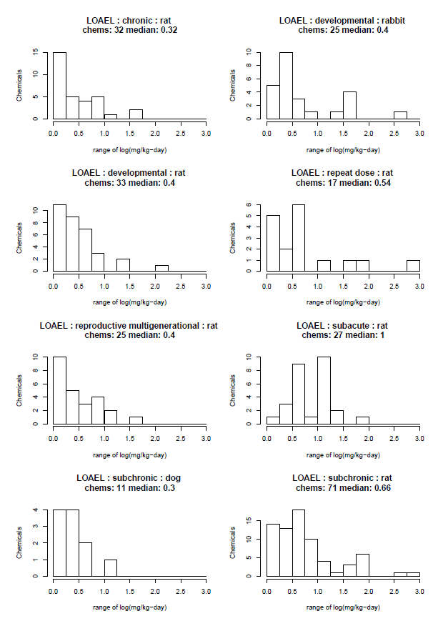
How golden is the gold standard?
PODs vary from one lab to the next
Median span from lowest to highest LOAEL is 0.3 to 1.0 log units
Data taken from EPA ToxValDB

Slide 22
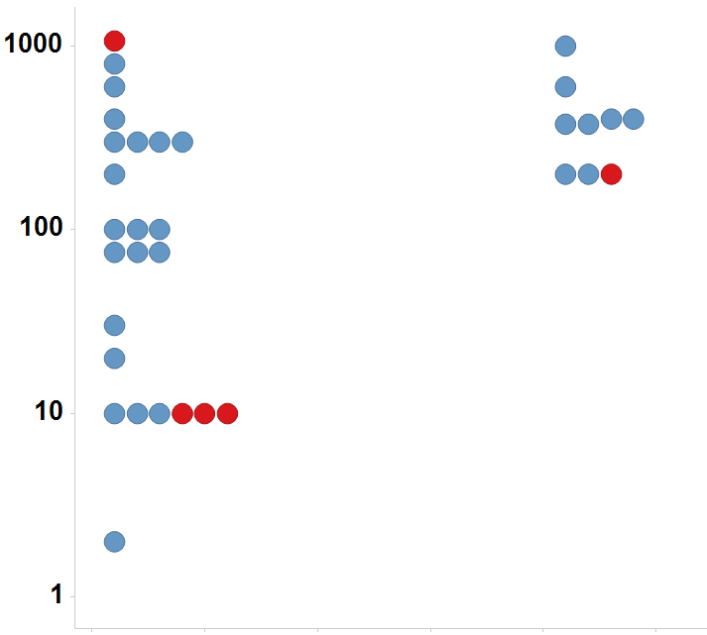
Uterotrophic guideline study uncertainty 26% of chemicals tested multiple times in the uterotrophic assay gave discrepant results
Immature Rat: BPA
LEL or MTD (mg/kg/day)
Uterotrophic
Active
Inactive
Injection
Oral
Kleinstreuer et al: “A Curated Database of Rodent Uterotrophic Bioactivity” EHP (2015)

Slide 23
Anemia concordance results
Species / study 1 | Species / study 2 | Concordant | Not Concordant | Fraction Concordant
rat SUB | rat CHR | 18 | 2 | 0.90
rat CHR | dog CHR | 13 | 2 | 0.87
rat CHR | rat SUB | 18 | 4 | 0.82
rat SUB | rat SUB | 16 | 4 | 0.80
rat SUB | dog CHR | 11 | 4 | 0.73
mouse CHR | rat CHR | 11 | 4 | 0.73
mouse CHR | rat SUB | 13 | 7 | 0.65
dog CHR | rat SUB | 11 | 6 | 0.65
dog CHR | rat CHR | 13 | 8 | 0.62
rat CHR | mouse CHR | 11 | 11 | 0.50
mouse CHR | dog CHR | 6 | 6 | 0.50
rat SUB | mouse CHR | 13 | 14 | 0.48
dog CHR | mouse CHR | 6 | 8 | 0.43
mouse CHR | mouse CHR | 2 | 3 | 0.40
Judson et al. Reg. Tox. Pharm (2017) “Retrospective Mining of Toxicology Data to Discover Multispecies and Chemical Class Effects: Anemia as a Case Study”.

Slide 24
Sources of Uncertainty / Variability In Vivo
Experimental variability
Species, strain, dose range, dose spacing
Statistical power issues
Too few animals to see weak or rare effect
Reporting bias
Was an effect negative or not looked for?
Observer bias
Less severe phenotypes not reported when more severe ones are present
Diagnostic terminology drift
Data assimilation and analysis
Typos, incomplete transcription

Slide 25
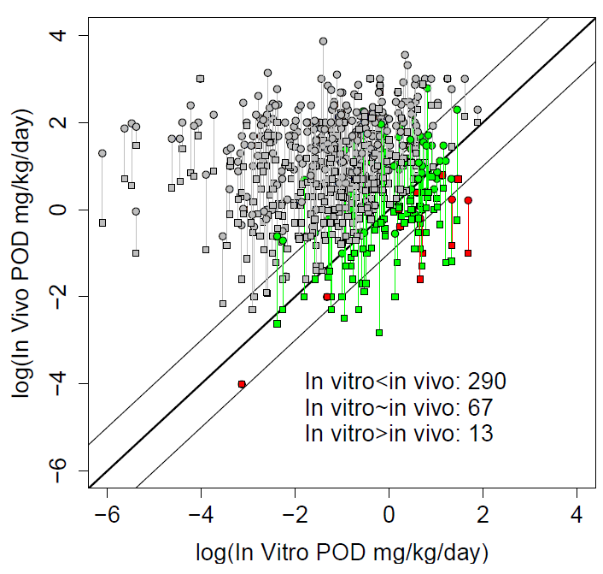
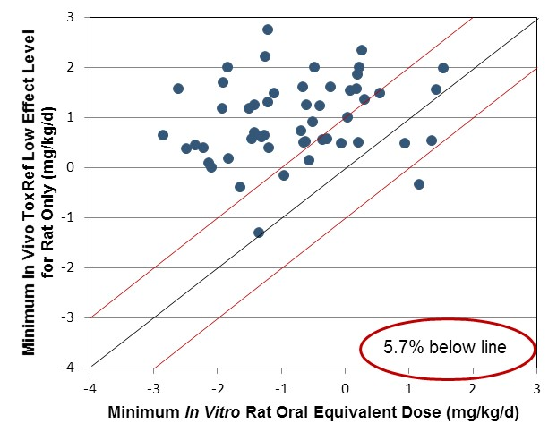
Updated IVIVE, accounting for uncertainty
Larger set of chemicals with in vivo, in vitro, TK
~4% have in vitro POD consistently greater than in vivo values
Issue: what is the correct in vitro POD assay?
- Bioactivity vs. adversity
Unpublished

Slide 26
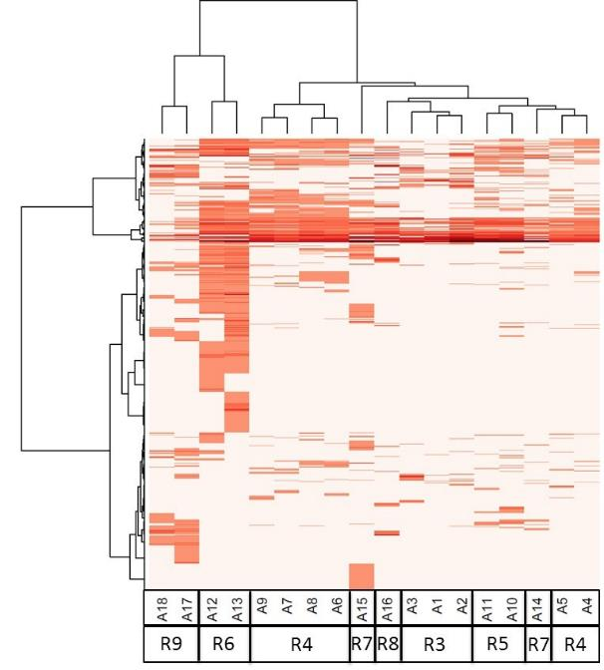
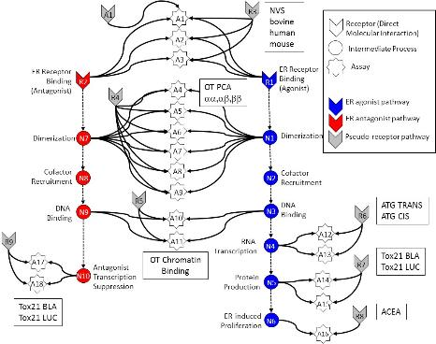
In vitro assays also have false positives and negatives
Much of this “noise” is reproducible
“assay interference”
Result of interaction of chemical
with complex biology in the assay
Chemical universe is structurally diverse
Solvents
Surfactants
Intentionally cytotoxic compounds
Metals
Inorganics
Pesticides
Drugs
Assays cluster by technology,
suggesting technology-specific
non-ER bioactivity
Chemicals
Assays
Judson et al: ToxSci (2015)

Slide 27
Most chemicals display a “burst” of potentially non-selective bioactivity near cytotoxity concentration
Concentration Space
Z- Space
Tested Concentration Range
Cytotoxicity
Range
3 MAD
Burst
Region
Cytotoxicity
Range
3 MAD
Burst
Region
Number of Hits
Number of Hits
0.1
1
10
100
1000
21 18 15 12 9 6 3 0 -3 -6 -9
AC50 (μM)
Bioactivity inferred
Z
Judson et al. Tox.Sci. (2016)

Slide 28
Schematic explanation of the burst
Specific
Non-specific
Oxidative Stress
DNA Reactivity
Protein Reactivity
Mitochondrial stress
ER stress
Cell membrane disruption
Specific apoptosis
…

Slide 29
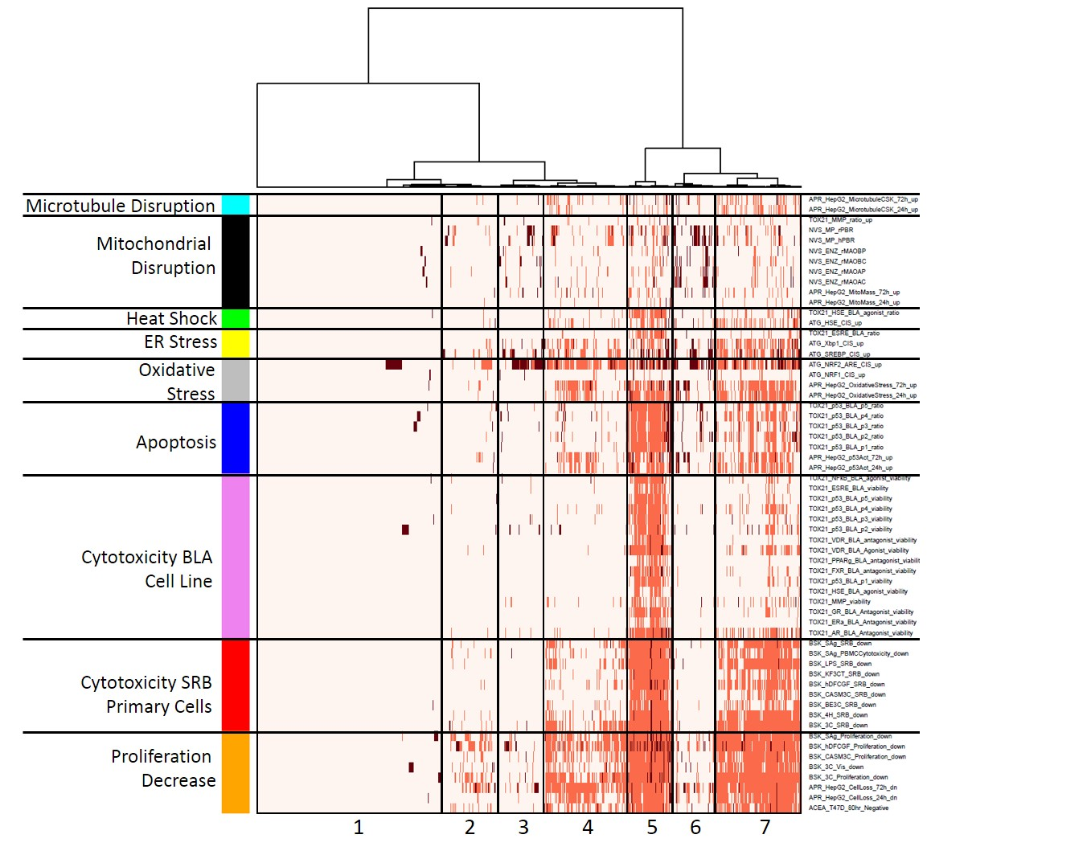
Heatmap of stress and cytotoxicity assays in 1000 chemicals
Chemicals
Judson et al. ToxSci (2016)

Slide 30
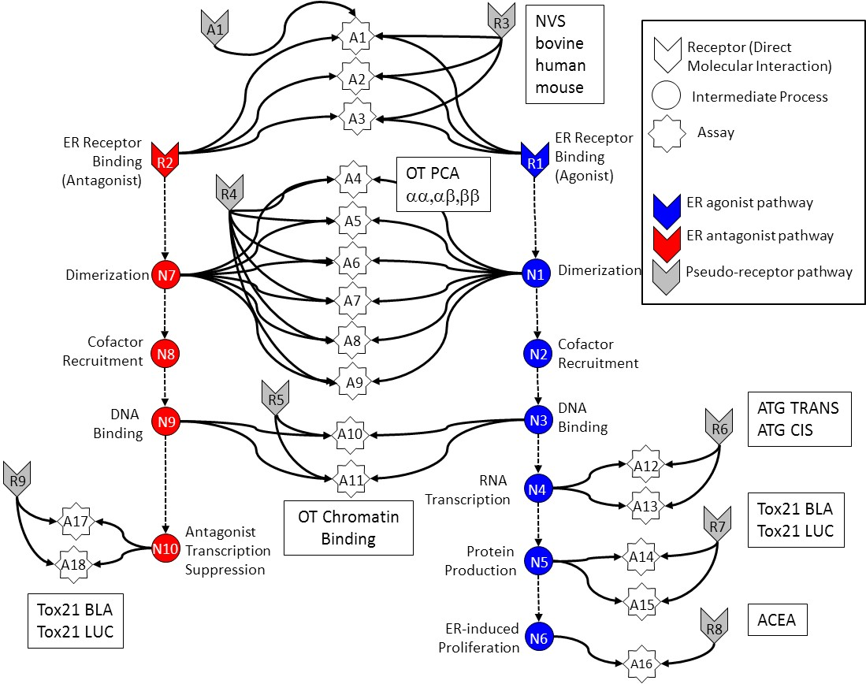
In Vitro Estrogen Receptor Model
Use multiple assays per pathway
Different technologies
Different points in pathway
No assay is perfect
Assay Interference
Noise
Use model to integrate assays
Evaluate model against reference chemicals
Methodology being applied to other pathways
Judson et al: “Integrated Model of Chemical Perturbations of a Biological Pathway
Using 18 In Vitro High Throughput Screening Assays for the Estrogen Receptor” (EHP 2015)

Slide 31
A1
R3
NVS
bovine
human
mouse
A1
Receptor (Direct Molecular Interaction)
A2
Intermediate Process
A3
Assay
ER Receptor Binding
(Antagonist)
ER Receptor Binding
(Agonist)
R2
OT PCA
αα,αβ,ββ
R1
A4
R4
ER agonist pathway
A5
ER antagonist pathway
Dimerization
N7
A6
N1
Dimerization
Pseudo-receptor pathway
A7
Cofactor
Recruitment
N8
A8
N2
Cofactor
Recruitment
A9
DNA
Binding
R5
DNA
Binding
ATG TRANS
ATG CIS
N9
A10
N3
R6
RNA
Transcription
A12
R9
A11
N4
OT Chromatin
Binding
A13
Tox21 BLA
Tox21 LUC
A17
Antagonist
Transcription
Suppression
R7
N10
Protein
Production
N5
A14
A18
Tox21 BLA
Tox21 LUC
A15
ER-induced
Proliferation
R8
ACEA
N6
A16

Slide 32
A1
A1
R3
Receptor (Direct Molecular Interaction)
A2
Intermediate Process
A3
Assay
ER Receptor Binding
(Antagonist)
ER Receptor Binding
(Agonist)
R2
R1
A4
R4
ER agonist pathway
A5
ER antagonist pathway
Dimerization
N7
A6
N1
Dimerization
Pseudo-receptor pathway
A7
Cofactor
Recruitment
N8
A8
N2
Cofactor
Recruitment
A9
DNA
Binding
R5
DNA
Binding
N9
A10
N3
R6
RNA
Transcription
A12
R9
A11
N4
A13
A17
Antagonist
Transcription
Suppression
R7
N10
Protein
Production
N5
A14
A18
A15
ER-induced
Proliferation
N6
R8
A16

Slide 33
A1
A1
R3
Receptor (Direct Molecular Interaction)
A2
Intermediate Process
A3
Assay
ER Receptor Binding
(Antagonist)
ER Receptor Binding
(Agonist)
R2
R1
A4
R4
ER agonist pathway
A5
ER antagonist pathway
Dimerization
N7
A6
N1
Dimerization
Pseudo-receptor pathway
A7
Cofactor
Recruitment
N8
A8
N2
Cofactor
Recruitment
A9
DNA
Binding
R5
DNA
Binding
N9
A10
N3
R6
RNA
Transcription
A12
R9
A11
N4
A13
A17
Antagonist
Transcription
Suppression
R7
N10
Protein
Production
N5
A14
A18
A15
ER-induced
Proliferation
N6
R8
A16

Slide 34
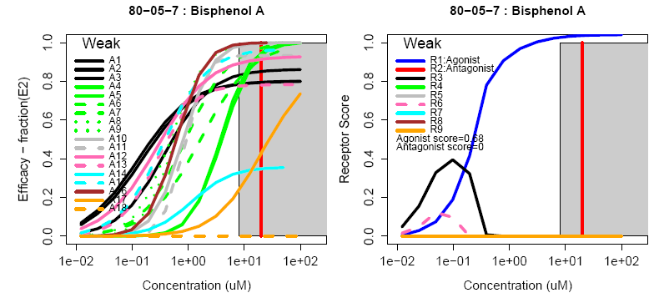
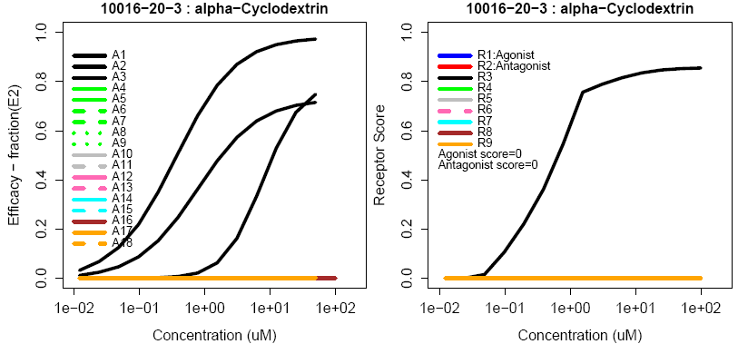
Example curves
True Agonist
Assay Interference Example “R3”

Slide 35
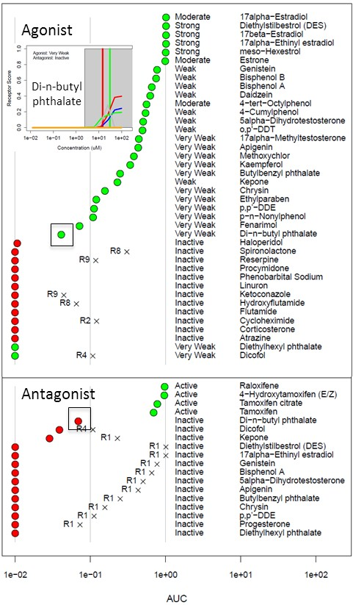
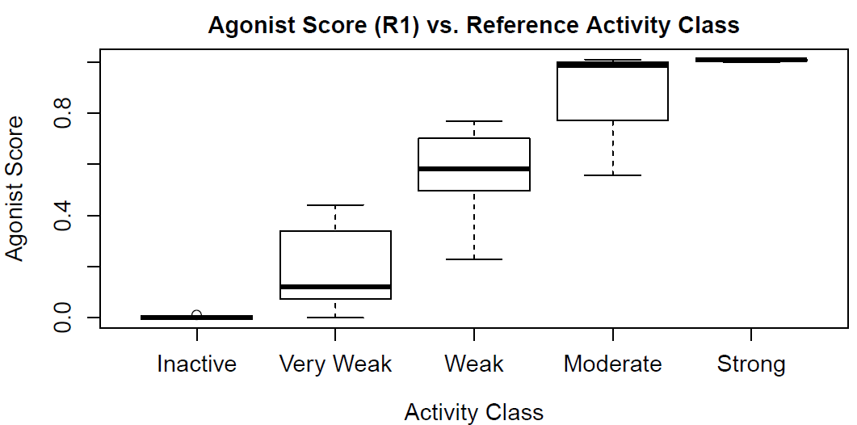
In Vitro Reference Chemical Performance
By using battery of assays and model of noise, we can accurately predict activity

Slide 36
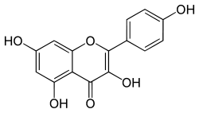
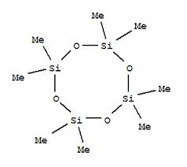
Model predicts in vivo uterotrophic assay as well as uterotrophic predicts uterotrophic
Restrict to chemicals with consistent results from the literature
True Positive | 29
True Negative | 50
False Positive | 1
False Negative | 1
Accuracy | 0.97
Sensitivity | 0.97
Specificity | 0.98
ER Agonist AUC
Kaempferol
Uterotrophic
Inactive
D4
Active
Rank Order (ER Agonist AUC)
Browne et al. ES&T (2015)

Slide 37
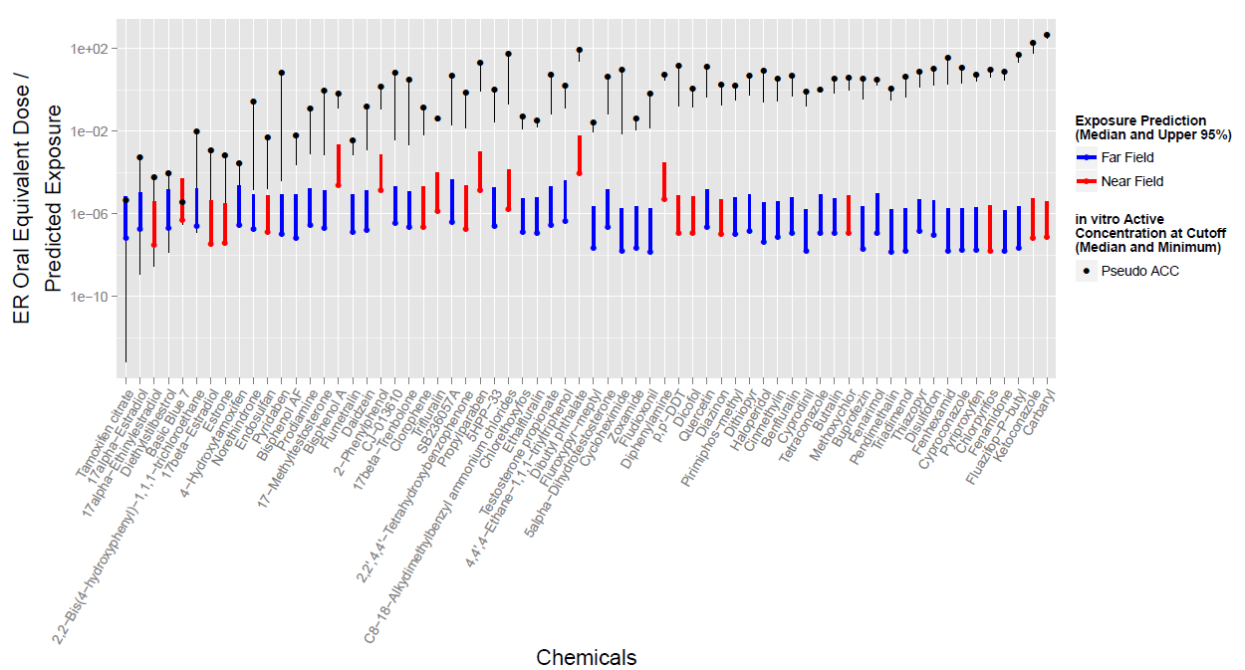
Prioritization (Replacement) Example Compare predicted exposure and hazard POD
Compare estrogen receptor assay battery and exposure model

Slide 38
Moving Towards Regulatory Acceptance From FIFRA SAP, December 2014
Can the ER Model be used for prioritization?
“… the ER AUC appears to be an appropriate tool for chemical prioritization for … the EDSP universe compounds.”
Can the ER model substitute for the Tier 1 ER in vitro and uterotrophic assays?
“… replacement of the Tier 1 in vitro ER endpoints …with the ER AUC model will likely be a more effective and sensitive measure for the occurrence of estrogenic activity …”
“… the Panel did not recommend that the uterotrophic assay be substituted by the AUC model at this time. The Panel suggested that the EPA considers: 1) conducting limited uterotrophic and other Tier 1 in vivo assay testing, using the original Tier 1 Guidelines (and/or through literature curation)”
Based on follow-up presented here (FR notice, June 18 2015) …
“EPA concludes that ER Model data are sufficient to satisfy the Tier 1 ER binding, ERTA and uterotrophic assay requirements.”

Slide 39
Zebrafish and Developmental Toxicology
Goal: Use zebrafish as an in vivo model of vertebrate developmental toxicity
Build in vitro to in vivo models using ~700 human assays
~1000 Chemicals
pharmaceuticals, pesticides, industrial chemicals, personal care product chemicals and food ingredients
Can we combine with ToxCast to determine ZF MOA?
Padilla et al., 2015, 2016, in preparation

Slide 40
Zebrafish Imaging and scoring
Deal et al. J Applied Tox. 2016

Slide 41
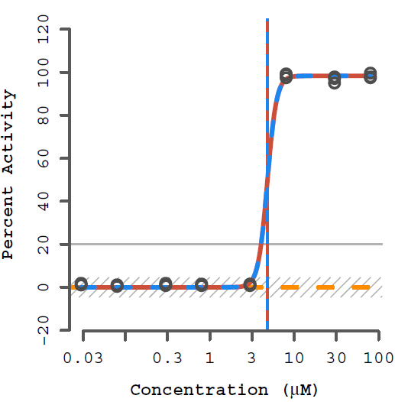
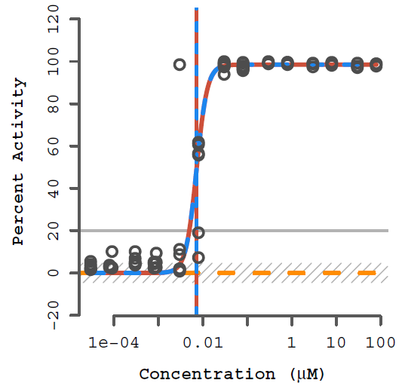
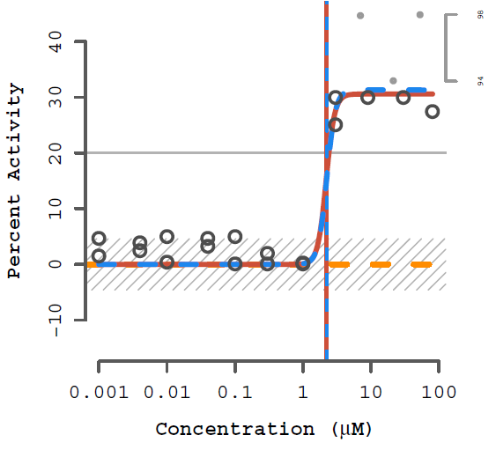
Zebrafish Example Chemicals
DES
Lovastatin
Permethrin
100% = death
<100% = malformations

Slide 42
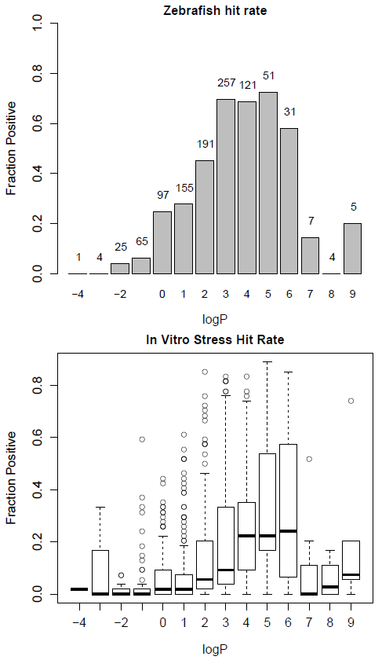
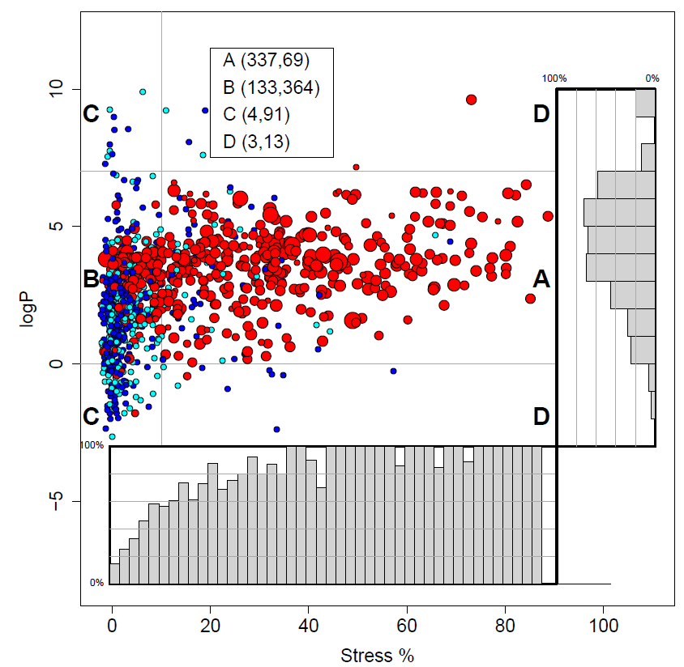

Stress, logP and zebrafish toxicity are related

Slide 43
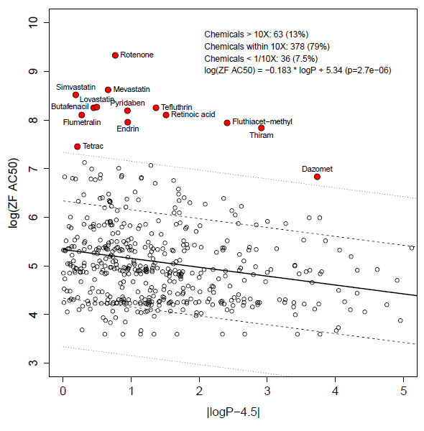
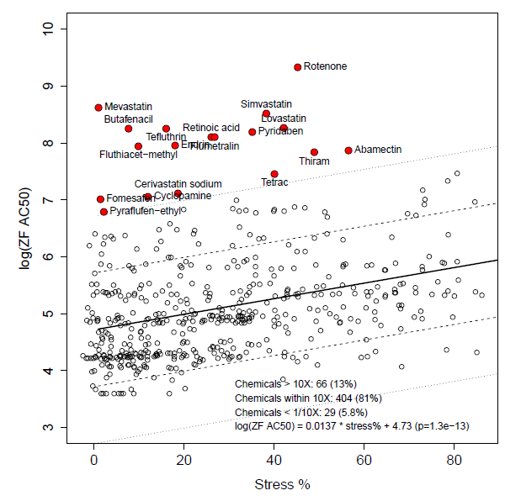
Subset of chemicals are more potent than expected from stress or logP
Chemical showing “excess” toxicity

Slide 44
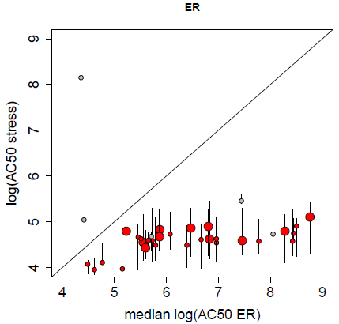
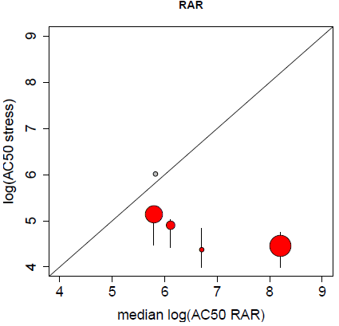
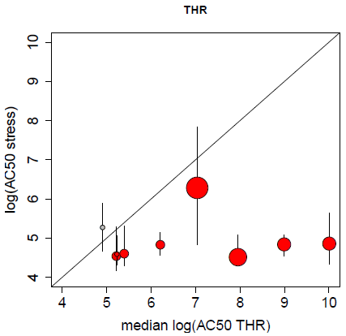
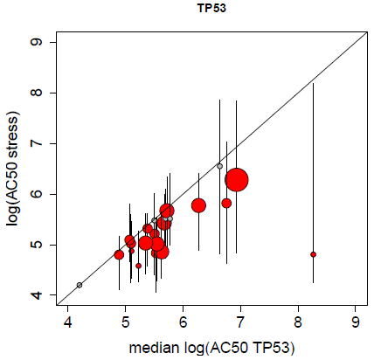
Proposed Mode of Action
Are target+ chemicals highly likely to be ZF+?
Does target activity occur below cell stress and cytotoxicity?
Estrogen Receptor
86% active
(30 / 35)
Retinoic Acid Receptor
83% active
(5 / 6)
Δ
Thyroid Hormone Receptor
90% active
(9 / 10)
TP53
77% active
(17 / 22)

Slide 45
MOA with in vitro support
Target | Description | Target-active chemicals | Zebrafish and Target active chemicals | Fraction positive
ADRB | Beta adrenergic receptors | 6 | 6 | 1.00 [*]
AR | Androgen receptor | 18 | 15 | 0.83 [**]
CYP1 | CYP450, family 1 | 4 | 4 | 1.00 [*]
CYP2 | CYP450, family 2 | 13 | 13 | 1.00 [***]
CYP3 | CYP450, family 3 | 24 | 22 | 0.92 [***]
DRD | Dopamine receptors | 15 | 12 | 0.80 [*]
ER | Estrogen receptors | 35 | 30 | 0.86 [***]
mitochondria | Mitochondria targeting | 4 | 3 | 0.75
NR1I3 | Constitutive androstane receptor (CAR) | 13 | 12 | 0.92 [**]
PPARG | Peroxisome proliferating receptor gamma | 14 | 11 | 0.78 [*]
RAR | Retinoic acid receptor | 6 | 5 | 0.83
THR | Thyroid hormone receptor | 10 | 9 | 0.90 [**]
TP53 | p53, apoptosis | 22 | 17 | 0.77 [**]

Slide 46
MOA from literature targets
Target | Description | Target-active chemicals | Zebrafish and Target active chemicals | Fraction positive
ACCase | Plant Acetyl CoA Carboxylase (lipid synthesis inhibitors) | 11 | 10 | 0.91[**]
ACHE | Acetylcholinesterase | 55 | 41 | 0.75 [***]
AR | Androgen receptor | 14 | 12 | 0.86 [**]
ER | Estrogen receptor | 29 | 25 | 0.86 [***]
HMGCR | HMG-coA reductase | 8 | 6 | 0.75
HTR2A | Serotonin receptor 2A | 5 | 4 | 0.80
ion channel | General ion channels | 33 | 27 | 0.82 [***]
ion channel (Na) | Sodium ion channels | 22 | 19 | 0.86 [***]
lipid synthesis | Lipid synthesis targeting (includes sterol synthesis) | 38 | 30 | 0.79 [***]
microtubule | Microtubule-targeting | 20 | 18 | 0.90 [**]
mitochondria | Mitochondria targeting | 21 | 21 | 1.00 [***]
PGR | Progesterone receptor | 5 | 4 | 0.80
PPO | Plant Protoporphyrinogen Oxidase (lipid membrane disruption) | 13 | 11 | 0.85 [**]
sterol synthesis | Sterol synthesis targeting | 24 | 23 | 0.96 [***]
THR | Thyroid hormone receptor | 4 | 4 | 1.00 [*]
tubulin | Tubulin (microtubule) targeting | 7 | 7 | 1.00 [**]

Slide 47
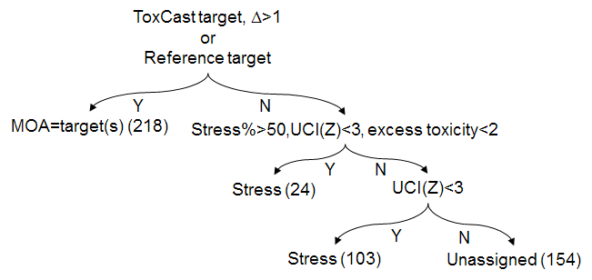
Common MOA Classes
Endocrine Pathways
Lipid synthesis (cell membrane) disruptors
HMGCR
PPO inhibitors (disrupts plant cell membranes)
ACHE
Ion channel blockers
Mitochondrial disruptors
Microtubule disruptors
Chemicals reacting with protein SH groups

Slide 48
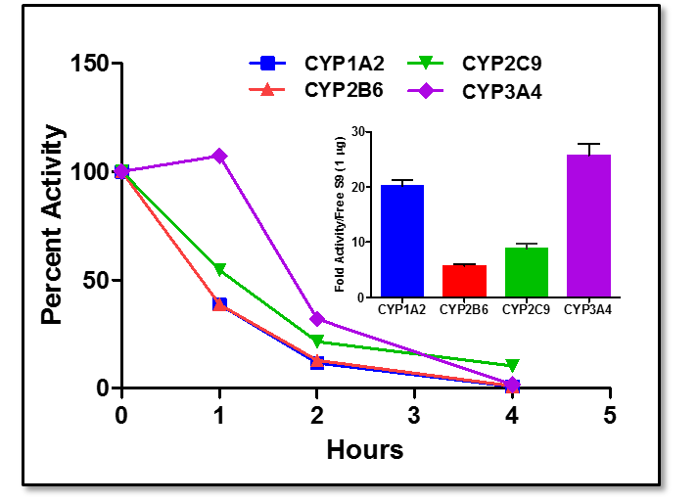
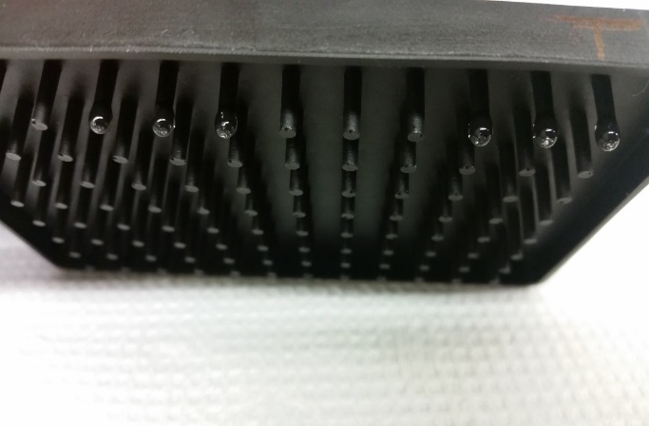

Efforts to Address Metabolism Challenge
DeGroot and Simmons, Unpublished

Slide 49
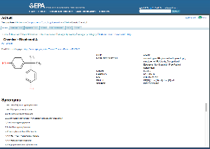
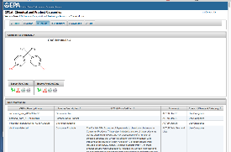
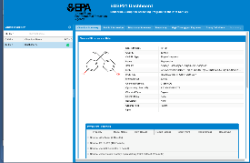
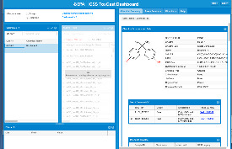
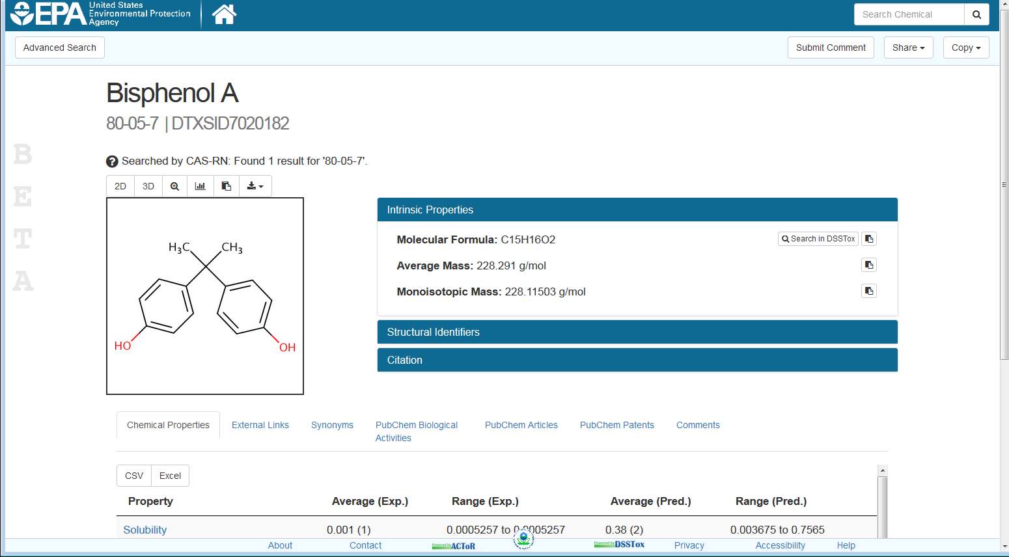
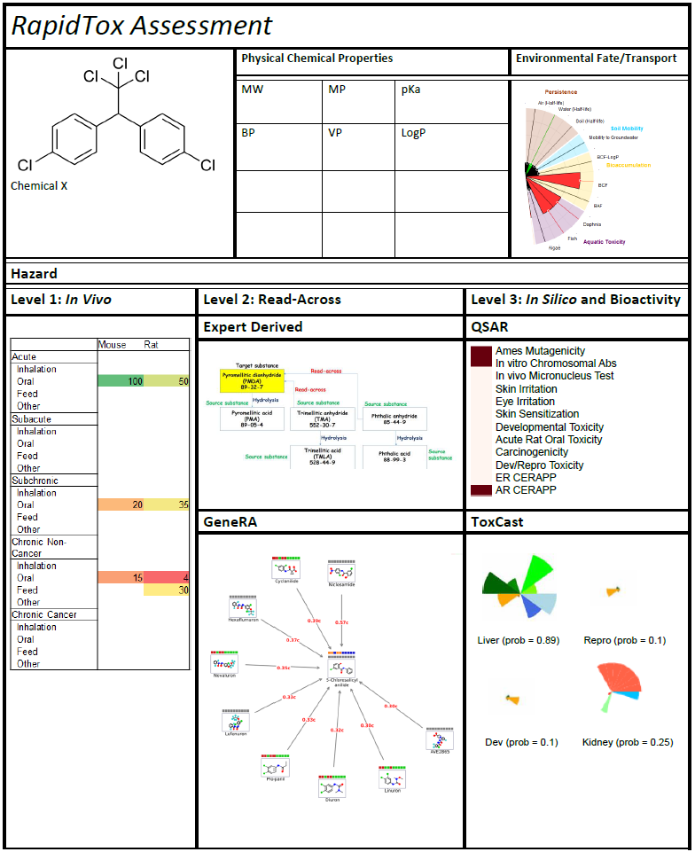
NCCT Software Architecture
Dashboards
ACToR
Databases
DSSTox: Chemistry
PhysChemDB
ToxRefDB: Hazard Details
ToxValDB: Hazard Summary
InVitroDB: ToxCast
ScrubChem: PubChem
ExpoCastDB: Exposure
CPCat: Chemical Use
ACToR: Multiple Types
PKDB: Toxicokinetics
LitDB: Open Literature
CPCat/CPDat
Web Services
EDSP21
ToxCast
Models
Physchem
Exposure
Bioactivity
Pharmacokinetics
Chemistry
RapidTox

Slide 50
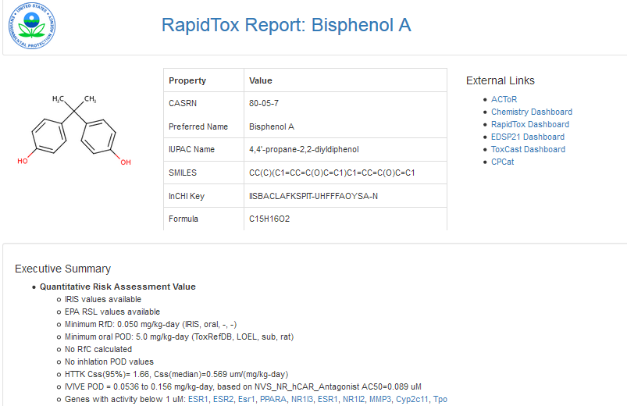
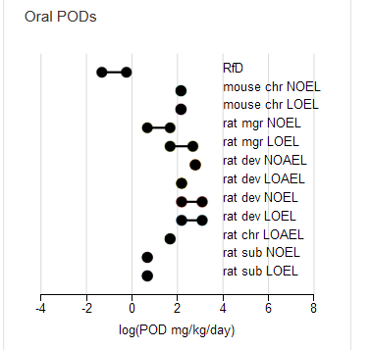
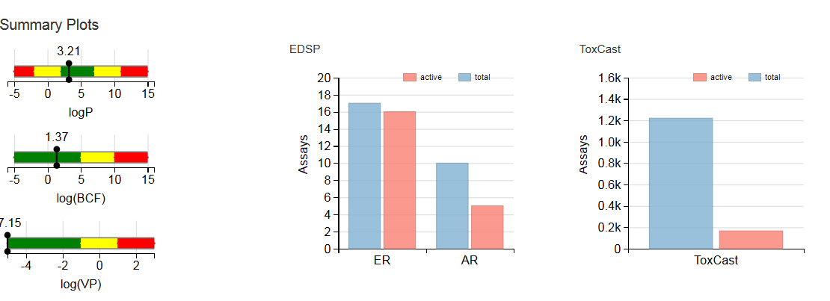
RapidTox Dashboard: Risk Assessment Tool

Slide 51
Ongoing Challenges
Technical limitations/obstacles associated with each technology (e.g., metabolism, volatiles, etc.)
Moving from an apical to a molecular paradigm and defining adversity
Predicting human safety vs. toxicity
Combining new approaches to have adequate throughput and sufficiently capture higher levels of biological organization
Systematically integrating multiple data streams from the new approaches in a risk-based, weight of evidence assessment
Quantifying and incorporating uncertainty and variability
Dealing with validation
Defining a fit-for-purpose framework(s) that is time and resource efficient
Performance-based technology standards vs. traditional validation
Role of in vivo rodent studies and understanding their inherent uncertainty
Legal defensibility of new methods and assessment products

Slide 52
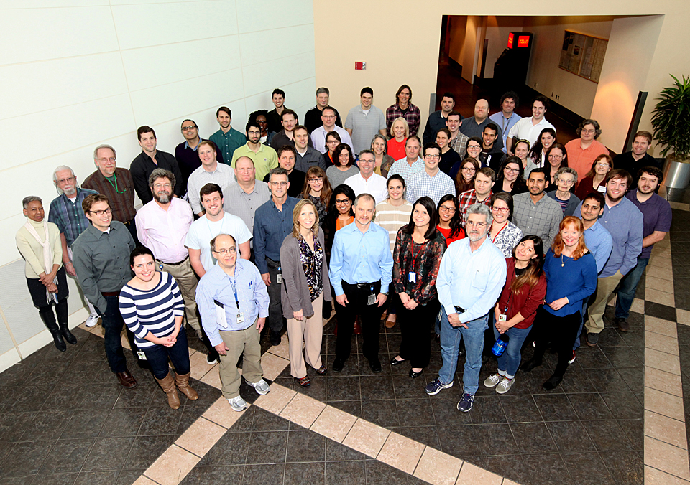
National Center for Computational Toxicology
NCCT Staff
Rusty Thomas
Kevin Crofton
Keith Houck
Ann Richard
Richard Judson
Tom Knudsen
Matt Martin*
Grace Patlewicz
Woody Setzer
John Wambaugh
Tony Williams
Steve Simmons
Chris Grulke
Katie Paul-Friedman
Jeff Edwards
Chad Deisenroth
Joshua Harrill
NCCT Postdocs
Todor Antonijevic
Audrey Bone
Swapnil Chavan
Kristin Connors*
Danica DeGroot
Jeremy Fitzpatrick
Jason Harris
Dustin Kapraun*
Agnes Karmaus*
Max Leung*
Kamel Mansouri
Andrew McEachran
LyLy Pham
Prachi Pradeep
Caroline Ring*
Kate Saili
Eric Watt*
Todd Zurlinden
NCCT
Nancy Baker
Dayne Filer*
Parth Kothiya*
Sean Watford
Indira Thillainadarajah
Robert Pearce
Danielle Suarez
Doris Smith
Jamey Vail
Risa Sayre
Nate Rush
NTP
Warren Casey
Nicole Kleinstreuer
Mike Devito
Dan Zang
Rick Paules
NIH/NCATS
Menghang Xia
Ruili Huang
Anton Simeonov
* Graduates

Slide 53
NCCT Models Modeling physchem properties based on a curated version of PHYSPROP DB
Kamel Mansouri

Slide 54
EPI Suite Properties
Water solubility
Melting Point
Boiling Point
LogP (KOWWIN: Octanol-water partition coefficient)
Atmospheric Hydroxylation Rate
LogBCF (Bioconcentration Factor)
Biodegradation Half-life
Ready biodegradability
Henry's Law Constant
Fish Biotransformation Half-life
LogKOA (Octanol/Air Partition Coefficient)
LogKOC (Soil Adsorption Coefficient)
Vapor Pressure

Slide 55
Summary:
Property | Initial file flagged | Updated 3-4 STAR | Curated QSAR ready
AOP | 818 | 818 | 745
BCF | 685 | 618 | 608
BioHC | 175 | 151 | 150
Biowin | 1265 | 1196 | 1171
BP | 5890 | 5591 | 5436
HL | 1829 | 1758 | 1711
KM | 631 | 548 | 541
KOA | 308 | 277 | 270
LogP | 15809 | 14544 | 14041
MP | 10051 | 9120 | 8656
PC | 788 | 750 | 735
VP | 3037 | 2840 | 2716
WF | 5764 | 5076 | 4836
WS | 2348 | 2046 | 2010

Slide 56
Development of a QSAR model
Curation of the data
Flagged and curated files available for sharing
Preparation of training and test sets
Inserted as a field in SDFiles and csv data files
Calculation of an initial set of descriptors
PaDEL 2D descriptors and fingerprints generated and shared
Selection of a mathematical method
Several approaches tested: KNN, PLS, SVM…
Variable selection technique
Genetic algorithm
Validation of the model’s predictive ability
5-fold cross validation and external test set
Define the Applicability Domain
Local (nearest neighbors) and global (leverage) approaches

Slide 57

QSARs for regulatory purposes

Slide 58
The 5 OECD principles:
The conditions for the validity of QSARs
Principle | Description
1) A defined endpoint | Any physicochemical, biological or environmental effect that can be measured and therefore modelled.
2) An unambiguous algorithm | Ensure transparency in the description of the model algorithm.
3) A defined domain of applicability | Define limitations in terms of the types of chemical structures, physicochemical properties and mechanisms of action for which the models can generate reliable predictions.
4) Appropriate measures of goodness-of-fit, robustness and predictivity | The internal fitting performance of a model the predictivity of a model, determined by using an appropriate external test set.
5) Mechanistic interpretation, if possible | Mechanistic associations between the descriptors used in a model and the endpoint being predicted.

Slide 59
NCCT models
Prop | Vars | 5-fold CV (75%) |  | Training (75%) |  |  | Test (25%)
 |  | Q2 | RMSE | N | R2 | RMSE | N | R2 | RMSE
BCF | 10 | 0.84 | 0.55 | 465 | 0.85 | 0.53 | 161 | 0.83 | 0.64
BP | 13 | 0.93 | 22.46 | 4077 | 0.93 | 22.06 | 1358 | 0.93 | 22.08
LogP | 9 | 0.85 | 0.69 | 10531 | 0.86 | 0.67 | 3510 | 0.86 | 0.78
MP | 15 | 0.72 | 51.8 | 6486 | 0.74 | 50.27 | 2167 | 0.73 | 52.72
VP | 12 | 0.91 | 1.08 | 2034 | 0.91 | 1.08 | 679 | 0.92 | 1
WS | 11 | 0.87 | 0.81 | 3158 | 0.87 | 0.82 | 1066 | 0.86 | 0.86
HL | 9 | 0.84 | 1.96 | 441 | 0.84 | 1.91 | 150 | 0.85 | 1.82

Slide 60
NCCT models
Prop | Vars | 5-fold CV (75%) |  | Training (75%) |  |  | Test (25%)
 |  | Q2 | RMSE | N | R2 | RMSE | N | R2 | RMSE
AOH | 13 | 0.85 | 1.14 | 516 | 0.85 | 1.12 | 176 | 0.83 | 1.23
BioHL | 6 | 0.89 | 0.25 | 112 | 0.88 | 0.26 | 38 | 0.75 | 0.38
KM | 12 | 0.83 | 0.49 | 405 | 0.82 | 0.5 | 136 | 0.73 | 0.62
KOC | 12 | 0.81 | 0.55 | 545 | 0.81 | 0.54 | 184 | 0.71 | 0.61
KOA | 2 | 0.95 | 0.69 | 202 | 0.95 | 0.65 | 68 | 0.96 | 0.68
 |  | BA | Sn-Sp |  | BA | Sn-Sp |  | BA | Sn-Sp
R-Bio | 10 | 0.8 | 0.82-0.78 | 1198 | 0.8 | 0.82-0.79 | 411 | 0.79 | 0.81-0.77

Slide 61
Octanol-water partition coefficient
Prop | Vars | 5-fold CV (75%) |  | Training (75%) |  |  | Test (25%)
 |  | Q2 | RMSE | N | R2 | RMSE | N | R2 | RMSE
LogP | 9 | 0.85 | 0.69 | 10531 | 0.86 | 0.67 | 3510 | 0.86 | 0.78

Slide 62
Bio-concentration factor
Prop | Vars | 5-fold CV (75%) |  | Training (75%) |  |  | Test (25%)
 |  | Q2 | RMSE | N | R2 | RMSE | N | R2 | RMSE
BCF | 10 | 0.84 | 0.55 | 465 | 0.85 | 0.53 | 161 | 0.83 | 0.64

Slide 63
Boiling point
Prop | Vars | 5-fold CV (75%) |  | Training (75%) |  |  | Test (25%)
 |  | Q2 | RMSE | N | R2 | RMSE | N | R2 | RMSE
BP | 13 | 0.93 | 22.46 | 4077 | 0.93 | 22.06 | 1358 | 0.93 | 22.08

Slide 64
Melting point
Prop | Vars | 5-fold CV (75%) |  | Training (75%) |  |  | Test (25%)
 |  | Q2 | RMSE | N | R2 | RMSE | N | R2 | RMSE
MP | 15 | 0.72 | 51.8 | 6486 | 0.74 | 50.27 | 2167 | 0.73 | 52.72

Slide 65
Vapor pressure
Prop | Vars | 5-fold CV (75%) |  | Training (75%) |  |  | Test (25%)
 |  | Q2 | RMSE | N | R2 | RMSE | N | R2 | RMSE
VP | 12 | 0.91 | 1.08 | 2034 | 0.91 | 1.08 | 679 | 0.92 | 1

Slide 66
Atmospheric Hydroxylation Rate
Prop | Vars | 5-fold CV (75%) |  | Training (75%) |  |  | Test (25%)
 |  | Q2 | RMSE | N | R2 | RMSE | N | R2 | RMSE
AOH | 13 | 0.85 | 1.14 | 516 | 0.85 | 1.12 | 176 | 0.83 | 1.23

Slide 67
Biodegradation Half-life
Prop | Vars | 5-fold CV (75%) |  | Training (75%) |  |  | Test (25%)
 |  | Q2 | RMSE | N | R2 | RMSE | N | R2 | RMSE
BioHL | 6 | 0.89 | 0.25 | 112 | 0.88 | 0.26 | 38 | 0.75 | 0.38

Slide 68
Henry's Law Constant
Prop | Vars | 5-fold CV (75%) |  | Training (75%) |  |  | Test (25%)
 |  | Q2 | RMSE | N | R2 | RMSE | N | R2 | RMSE
HL | 9 | 0.84 | 1.96 | 441 | 0.84 | 1.91 | 150 | 0.85 | 1.82

Slide 69
Fish Biotransformation Half-life
Prop | Vars | 5-fold CV (75%) |  | Training (75%) |  |  | Test (25%)
 |  | Q2 | RMSE | N | R2 | RMSE | N | R2 | RMSE
KM | 12 | 0.83 | 0.49 | 405 | 0.82 | 0.5 | 136 | 0.73 | 0.62

Slide 70
Octanol/Air Partition Coefficient
Prop | Vars | 5-fold CV (75%) |  | Training (75%) |  |  | Test (25%)
 |  | Q2 | RMSE | N | R2 | RMSE | N | R2 | RMSE
KOA | 2 | 0.95 | 0.69 | 202 | 0.95 | 0.65 | 68 | 0.96 | 0.68

Slide 71
Soil Adsorption Coefficient
Prop | Vars | 5-fold CV (75%) |  | Training (75%) |  |  | Test (25%)
 |  | Q2 | RMSE | N | R2 | RMSE | N | R2 | RMSE
KOC | 12 | 0.81 | 0.55 | 545 | 0.81 | 0.54 | 184 | 0.71 | 0.61

Slide 72
Water solubility
Prop | Vars | 5-fold CV (75%) |  | Training (75%) |  |  | Test (25%)
 |  | Q2 | RMSE | N | R2 | RMSE | N | R2 | RMSE
WS | 11 | 0.87 | 0.81 | 3158 | 0.87 | 0.82 | 1066 | 0.86 | 0.86

Slide 73
Ready biodegradability
Training set
Training set
 | Pred RB | Pred NRB
Obs RB | 558 | 125
Obs NRB | 108 | 407
 | Pred RB | Pred NRB
Obs RB | 187 | 44
Obs NRB | 42 | 138
Prop | Vars | 5-fold CV (75%) |  | Training (75%) |  |  | Test (25%)
 |  | BA | Sn-Sp |  | BA | Sn-Sp |  | BA | Sn-Sp
R-Bio | 10 | 0.8 | 0.82-0.78 | 1198 | 0.8 | 0.82-0.79 | 411 | 0.79 | 0.81-0.77

Slide 74
Standalone application:
Input:
MATLAB .mat file, an ASCII file with only a matrix of variables
SDF file or SMILES strings of QSAR-ready structures. In this case the program will calculate PaDEL 2D descriptors and make the predictions.
The program will extract the molecules names from the input csv or SDF (or assign arbitrary names if not) As IDs for the predictions.
Output
Depending on the extension, the can be text file or csv with
A list of molecules IDs and predictions
Applicability domain
Accuracy of the prediction
Similarity index to the 5 nearest neighbors
The 5 nearest neighbors from the training set: Exp. value, Prediction, InChi key

Slide 75

Read-across Model for ESTROGENICITY Prediction (HINDERED PHENOL CASE STUDY)
Method: Systematic analysis and screening of analogs selected via various descriptor methods for Read-across Estrogenicity prediction
Explore the use of different structure-based approaches for identification of source analogs and evaluation of their validity for reading across Estrogenicity.
Characterization of properties of ortho positioned hindering R-groups that contribute to the ER binding ability of a target hindered phenol (E.g. principal component analysis).
Utilize chemical level and R-group properties, data quality measures and available HTS data streams in conjunction with various structure descriptor methods to screen relevant analogs.
DATASET Target: 462 hindered phenols
Inventory of Source Analogs: 719 phenols
Analog Selection Method
Descriptor Approach | Basis
Pubchem (P) | 881 bits fingerprints
MoSS MCSS (M) | Size of most common substructure
Chemotyper (C) | Chemical substructures fingerprint with pre-defined chemotypes
Number Assay | Hindered |  | Non-hindered
 | Total | Actives | Total | Actives
Binding | 462 | 207 | 257 | 155
Agonist | 396 | 45 | 204 | 96
Antagonist | 360 | 46 | 169 | 14
Underlying basis for each of the three chemical descriptor approaches
Distribution of hindered and non-hindered phenols with data in the source analog dataset

Slide 76


ALGORITHM
SELECT
Hindered & Non-hindered analogs using:
EVALUATE
Concordance in ER binding between each target-analog pair using:
READ ACROSS
Majority Vote Prediction
Tanimoto similarity cut-off (0.1 – 0.9)
Number of analogs (1-10)
Each descriptor approach
Combination of descriptor approaches
10 closest analogs
FILTER
1. Chemical level properties
2. R-group properties
REPEAT ONCE AFTER FILTERING
TARGET
Filtering 1
(Physchem Properties)
LogK_{ow} within +/- 2 units of the target
Filtering 2
(Data Quality)
Number of literature data sources >= 3
Molecular volume within +/- 50% of the target
Filtering 1
(R-group analysis)
XLogP within +/- 2 units of the target
Filtering 2
(Data Quality)
Number of literature data sources >= 3
Volume within +/- 100% of the target
R1
REPEAT ONCE AFTER FILTERING
R2
ANALOG

Slide 77




READ-ACROSS PREDICTIONS
Read-across Accuracy and Balanced Accuracy (E.g. PubChem)
Chemical level
Physchem Properties
No. of phenols predicted
No Filtering: 462
Filtering 1: 458
Filtering 2: 333
R-group Properties
No. of phenols predicted
No Filtering: 462
Filtering 1: 456
Filtering 2: 332

Slide 78







ONGOING: Chemical level + R-group analysis
Chemical + R3 + R4
Volume
R3 + R4 – Corr and PCA
NOT Trivial!
R3 + R4 Volume
Chemical level + R3 + R4 – Corr and PCA
E_{homo}, E_{lumo}

