Slide 1
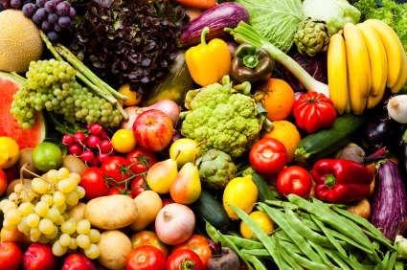
All About FOOD!

Slide 2
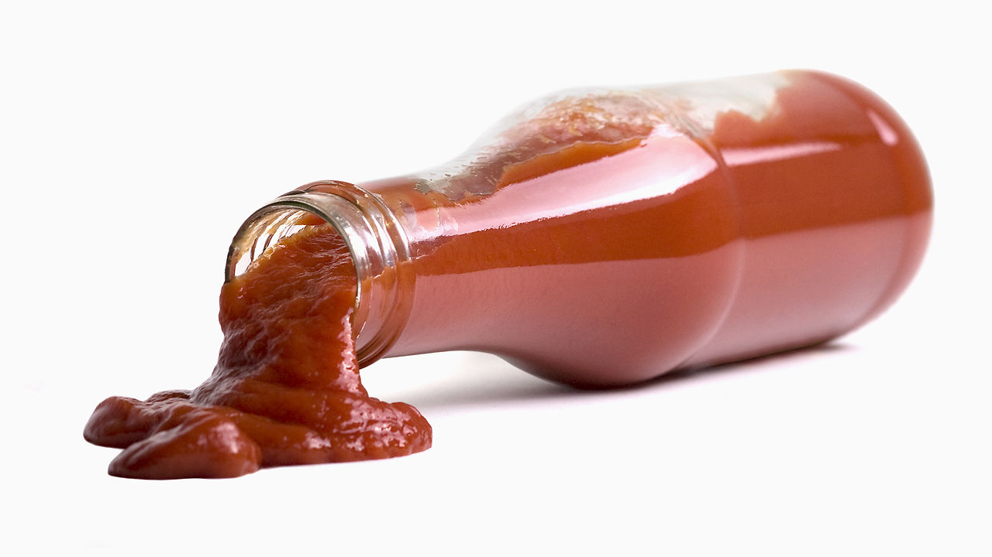
What is this?
Notes:
What is this? That’s right! This is ketchup!

Slide 3
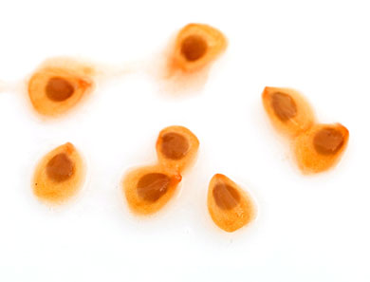
What is this?
Notes:
What are these? These are tomato seeds! These little guys are the reason we all have ketchup!

Slide 4
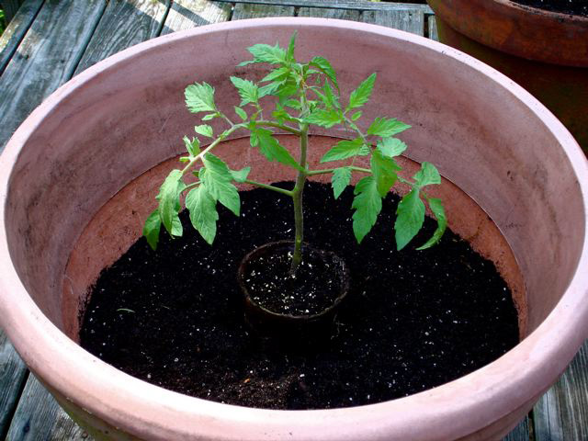
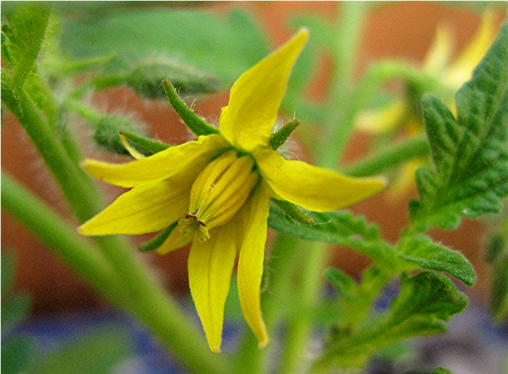
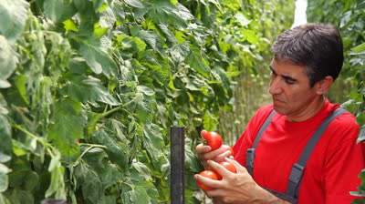
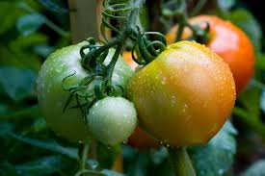
Where ketchup comes from
Notes:
The plant starts to grow
The plant flowers
These flowers turn into tomatoes
The tomatoes are ripe for the picking!

Slide 5
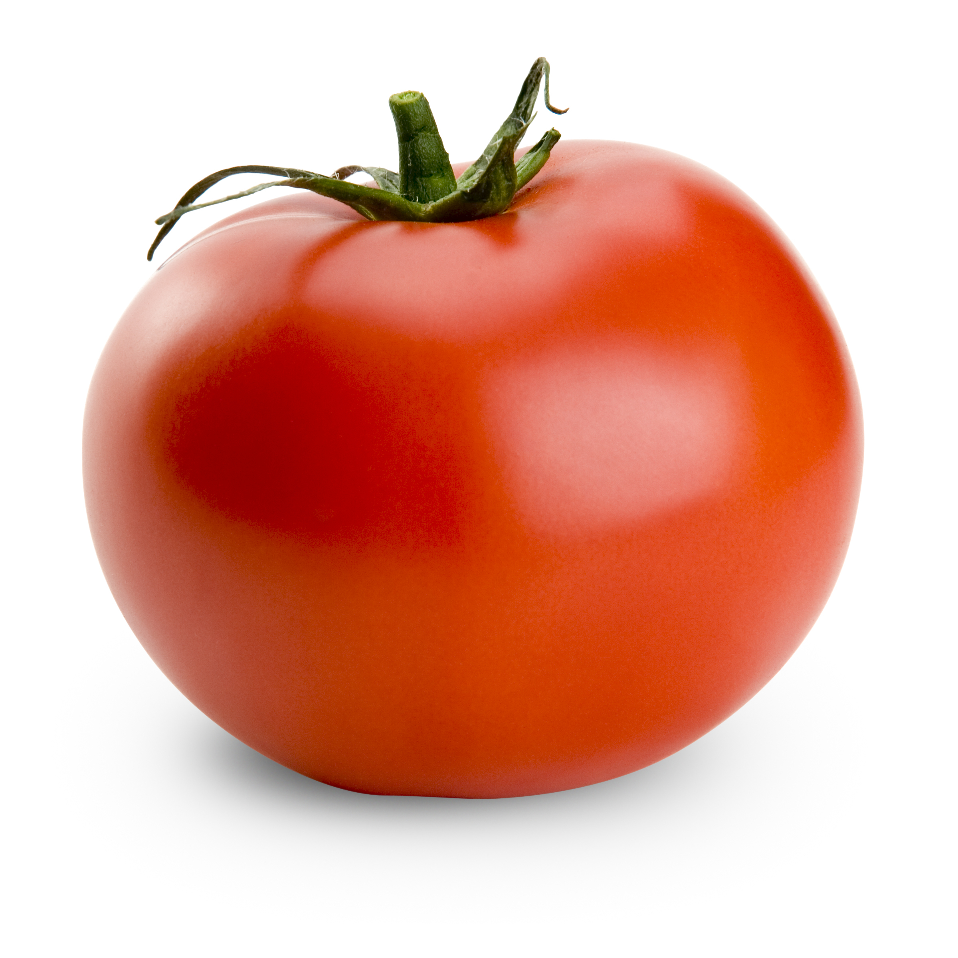
Where ketchup comes from

Slide 6
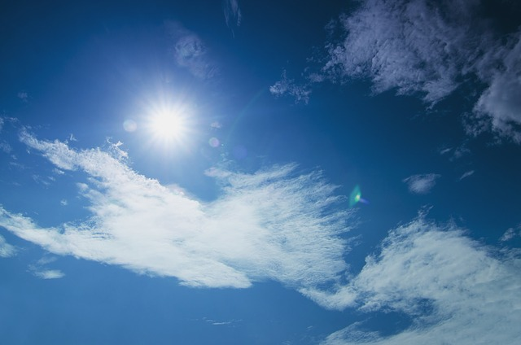
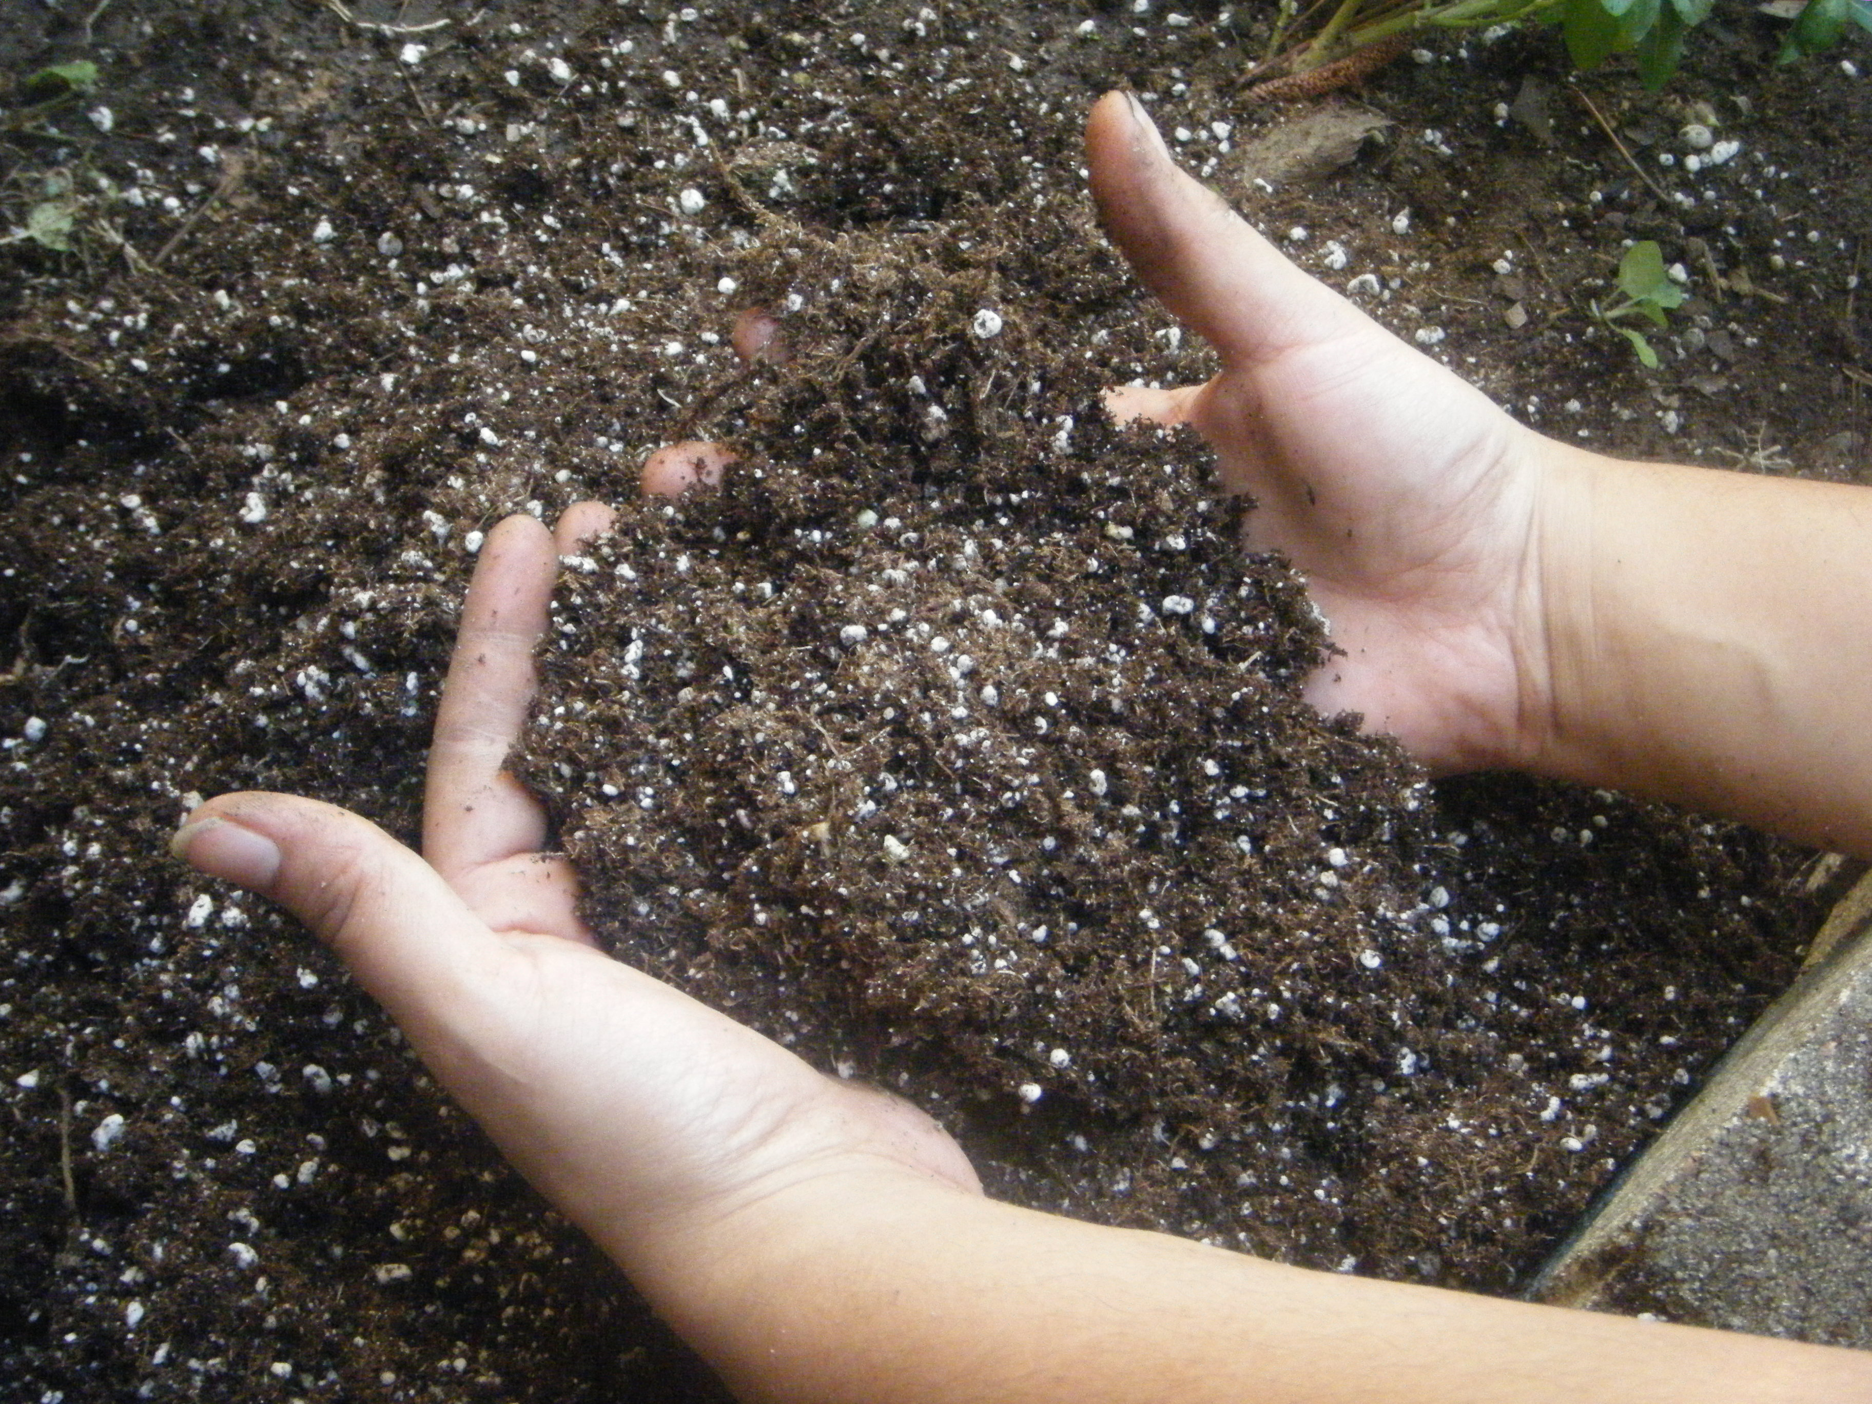
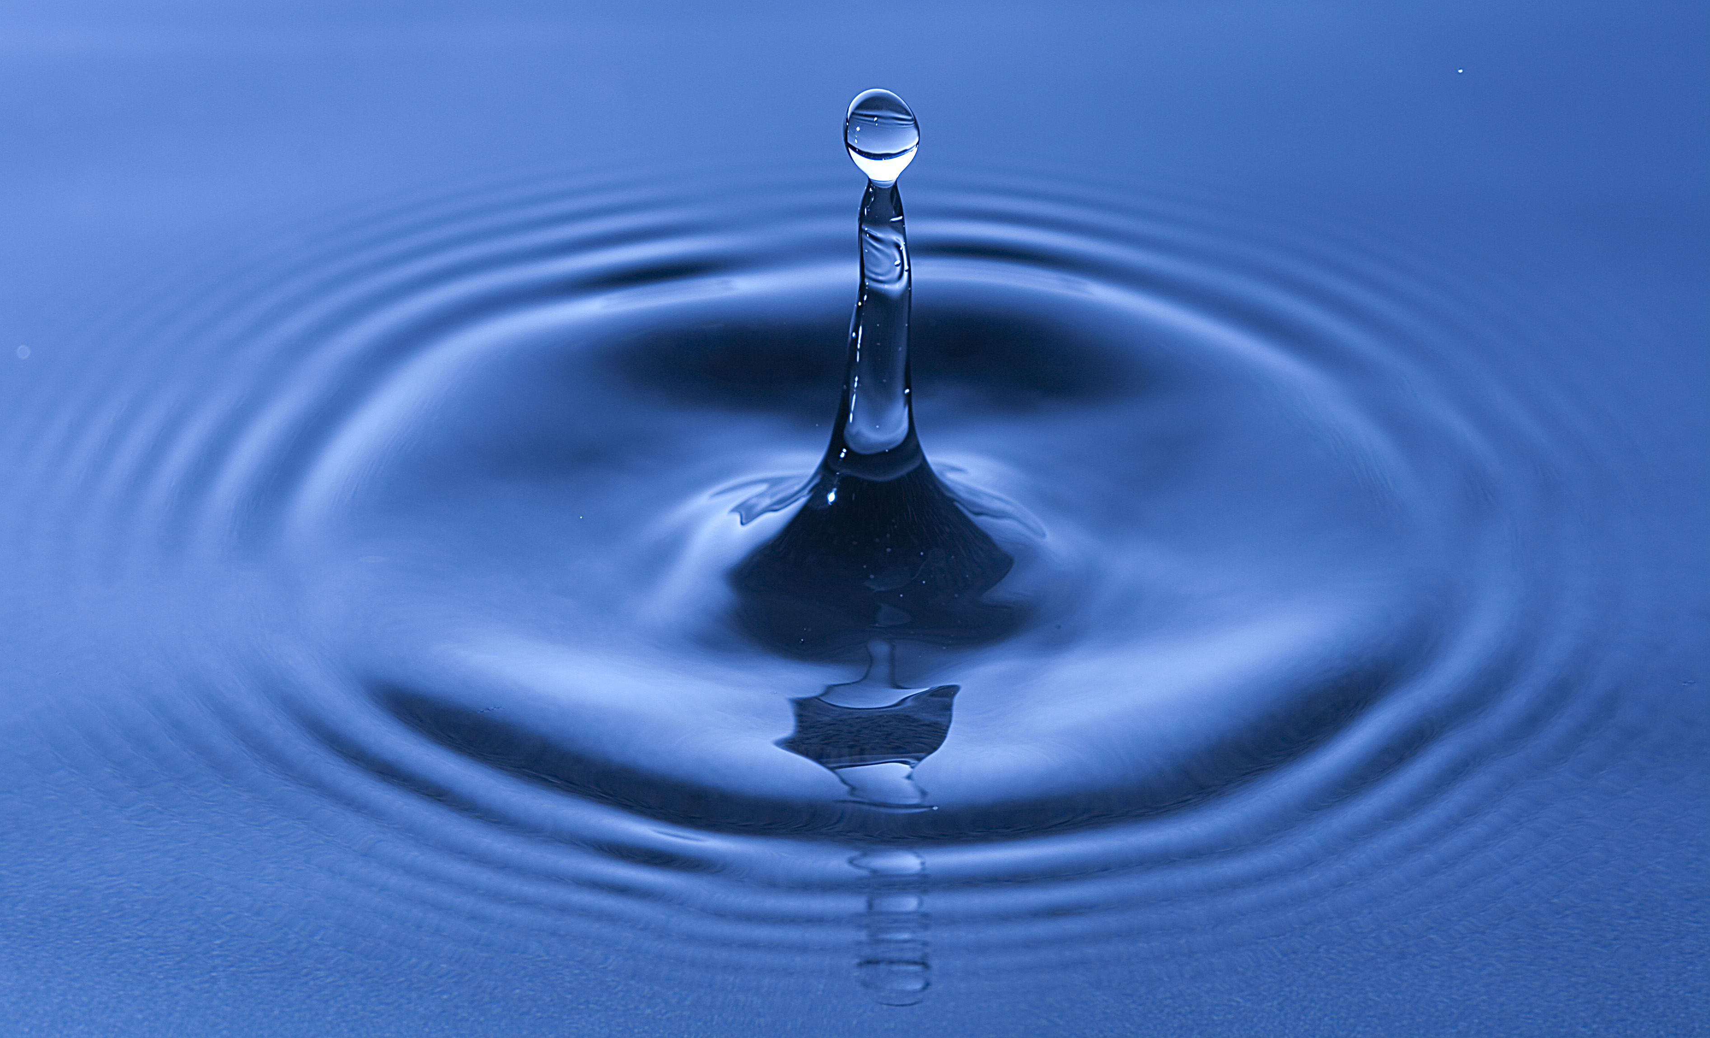
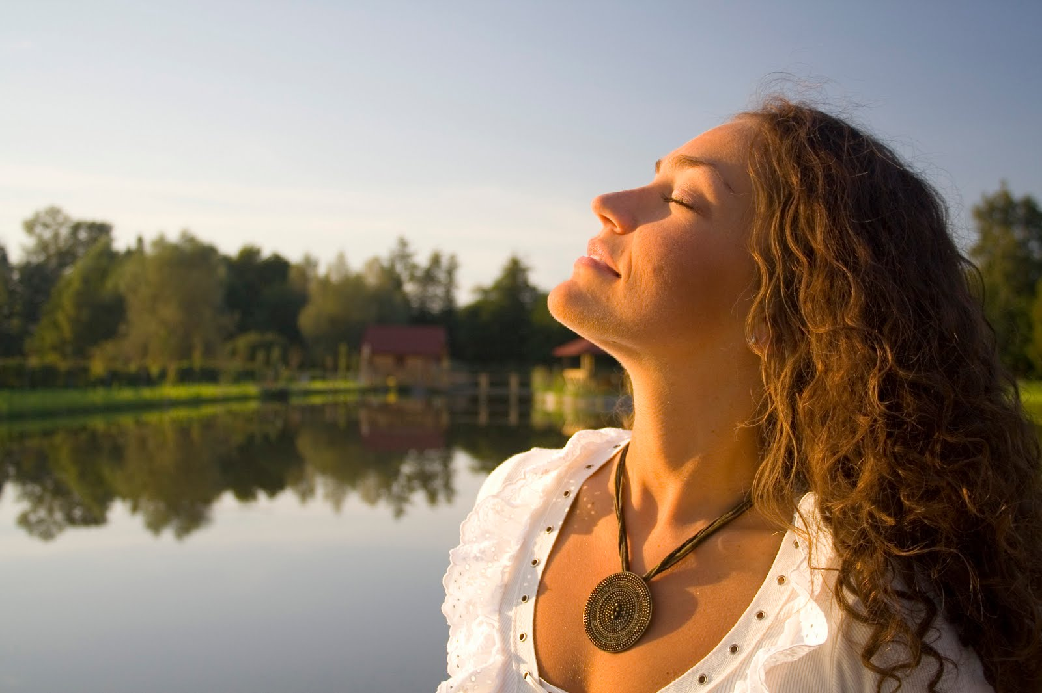
What does a plant need?
Notes:
Plants need lots of sunlight, clean soil, pure water, and fresh air in order to grow!

Slide 7

Today’s Lesson!
All of our favorite foods depend on a healthy planet!

