Slide 1
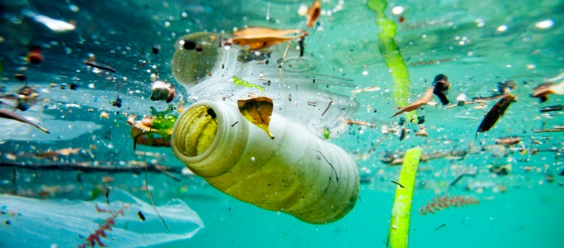

Preschool
Marine Debris
Learn what we can do to keep our waterways clean.
US EPA
Region 10
EcoLearn
Notes:
Source: http://www.infrastructurene.ws/2018/03/22/plastic-biggest-ocean-waste-offender-report/

Slide 2
Today you will learn…
Notes:
Today, we will learn about trash in our waterways, also how to prevent it. Aquatic trash kind of trash that has made its way to our oceans, rivers, lakes, and other water sources - such as plastic bags, bottles, or other kinds of litter. Our goal is to have TRASH FREE WATERS.
Sources: http://thankyouocean.org/threats/marine-debris/

Slide 3
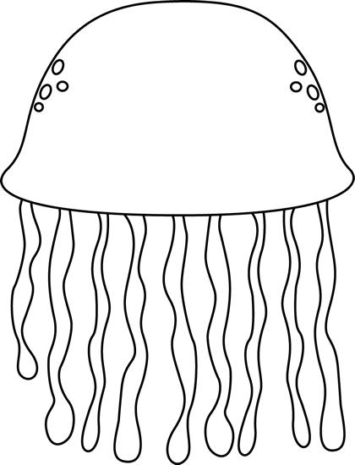



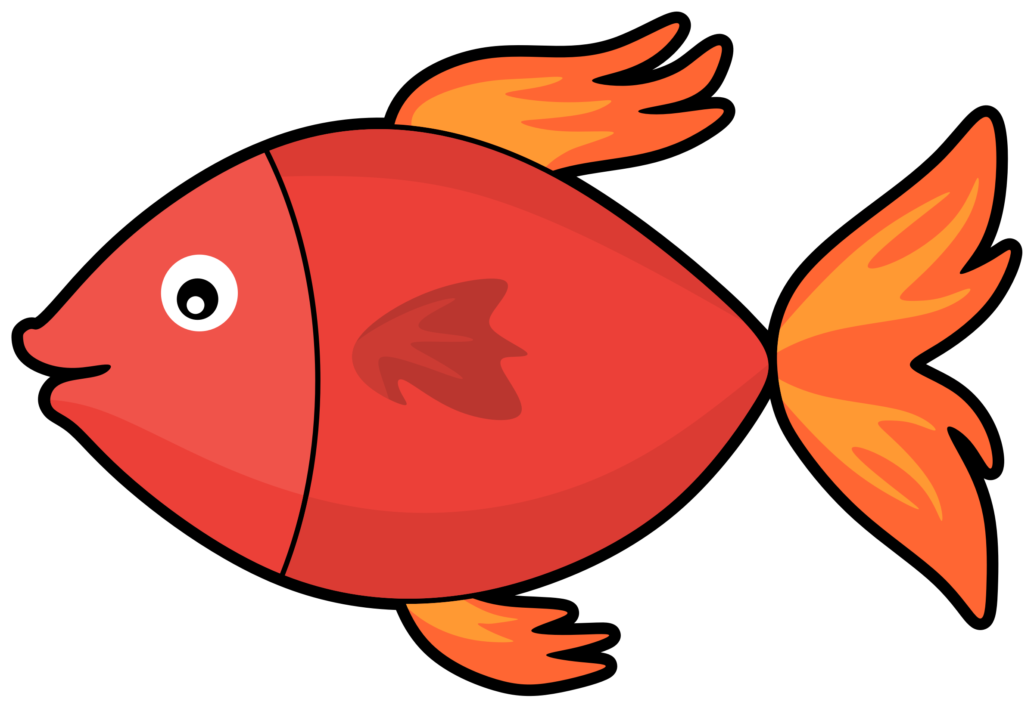
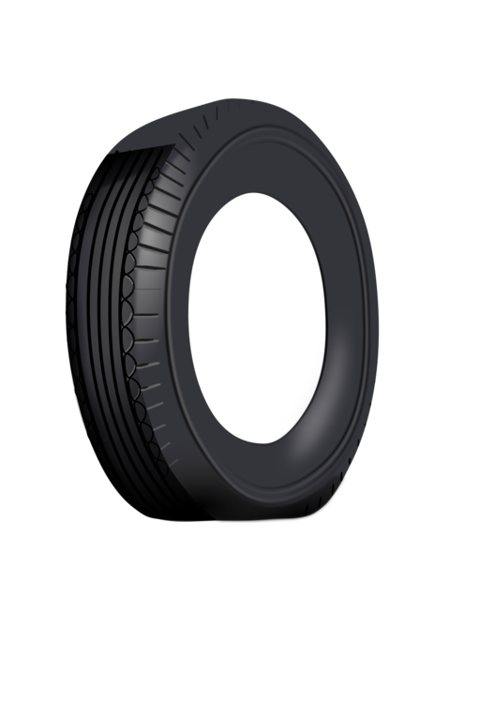
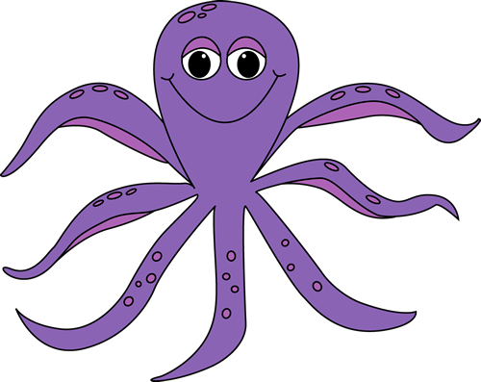


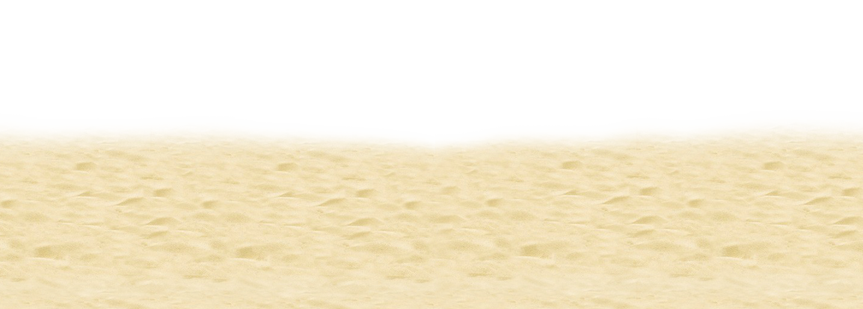
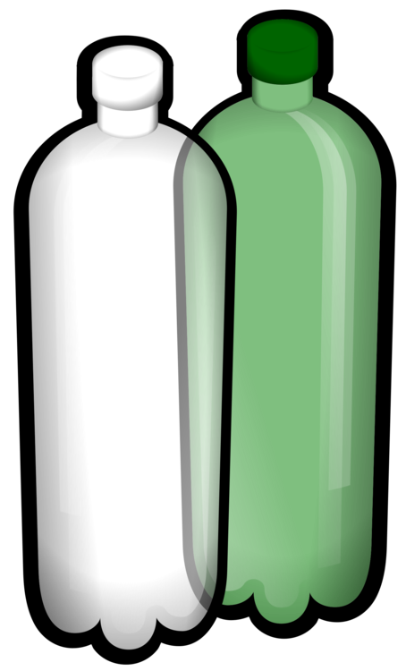

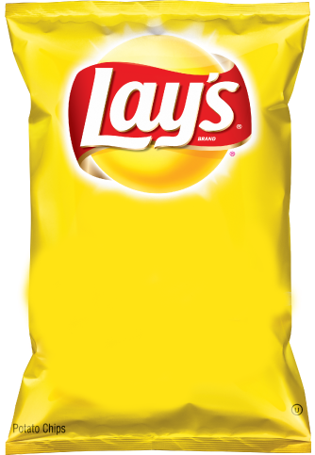
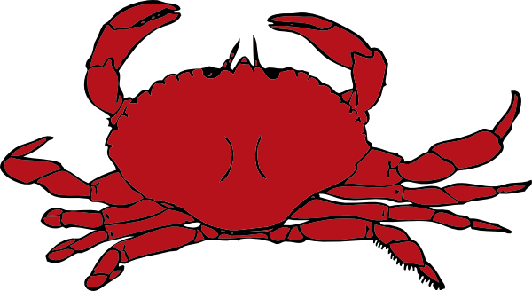
Notes:
DO NOW:
Can you tell me what belongs in the water? What lives in the water and what doesn’t? What grows in the water and what doesn’t? What in this picture doesn’t belong?
Instructions: There is a print out version of this activity that you can pass out. Have them circle or color in the items the don’t belong. Once the students are done, you can flip to the next slide to go over the answers.
Fish: https://requestreduce.org/categories/images-of-fish-clipart.html
Octopus: https://www.mycutegraphics.com/graphics/letter/octopus.html
Starfish: https://clipartpng.com/?1439,starfish-png-clip-art
Shell: https://gallery.yopriceville.com/Free-Clipart-Pictures/Summer-Vacation-PNG/Sea_Shell_PNG_Clip_Art_Image
Crab: http://www.clipartpanda.com/categories/crab-clip-art-cartoon
Coral: http://worldartsme.com/coral-free-clipart.html#gal_post_52417_coral-free-clipart-1.jpg
Seaweed: http://clipart-library.com/seaweed-cliparts.html
Plastic Bottle: https://www.kisscc0.com/clipart/plastic-bag-fizzy-drinks-plastic-bottle-water-bott-3v81ct/
Plastic Bag: https://openclipart.org/detail/303136/plastic-shopping-bag
Tire: https://www.kisscc0.com/clipart/car-a-rubber-tire-download-duesi-tire-12zmst/
Fishing Net: https://clipart.wpblink.com/wallpaper-4864769
Jellyfish: https://www.pinterest.com/pin/119626933828969334/
Sand: http://clipart-library.com/beach-sand-cliparts.html

Slide 4
Notes:
DO NOW:
Answers.
FOLLOW UP: How do you think that these items got here?
Fish: https://requestreduce.org/categories/images-of-fish-clipart.html
Octopus: https://www.mycutegraphics.com/graphics/letter/octopus.html
Starfish: https://clipartpng.com/?1439,starfish-png-clip-art
Shell: https://gallery.yopriceville.com/Free-Clipart-Pictures/Summer-Vacation-PNG/Sea_Shell_PNG_Clip_Art_Image
Crab: http://www.clipartpanda.com/categories/crab-clip-art-cartoon
Coral: http://worldartsme.com/coral-free-clipart.html#gal_post_52417_coral-free-clipart-1.jpg
Seaweed: http://clipart-library.com/seaweed-cliparts.html
Plastic Bottle: https://www.kisscc0.com/clipart/plastic-bag-fizzy-drinks-plastic-bottle-water-bott-3v81ct/
Plastic Bag: https://openclipart.org/detail/303136/plastic-shopping-bag
Tire: https://www.kisscc0.com/clipart/car-a-rubber-tire-download-duesi-tire-12zmst/
Fishing Net: https://clipart.wpblink.com/wallpaper-4864769
Jellyfish: https://www.pinterest.com/pin/119626933828969334/
Sand: http://clipart-library.com/beach-sand-cliparts.html

Slide 5
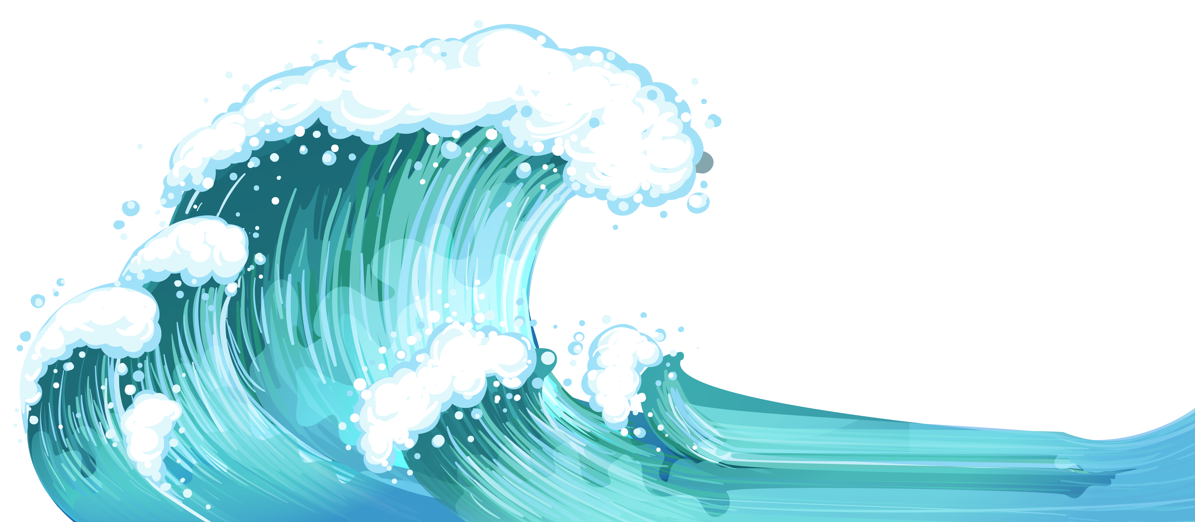

Discuss
Click for audio.
Notes:
Discussion Questions:
What is trash in our waterways?
How does this impact our water and beaches?
Sources:
Ocean: http://clipart-library.com/waves-cliparts-transparent.html

Slide 6

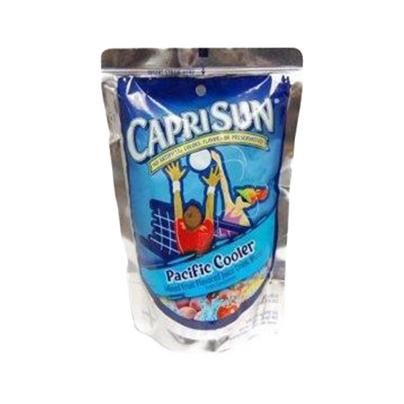
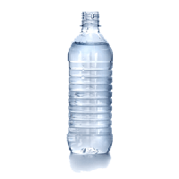
Discuss
Click for audio.
Notes:
Answer: Plastic and other garbage can enter our water ways and pollute our ocean!
Sources:
Ocean: http://clipart-library.com/waves-cliparts-transparent.html
https://etownpubliclibrary.org/event/wild-wednesday-copy-copy-copy/
http://pluspng.com/plastic-bottles-png-170.html
https://yocartdelivery.com/products/capri-sun-pacific-cooler-6oz

Slide 7
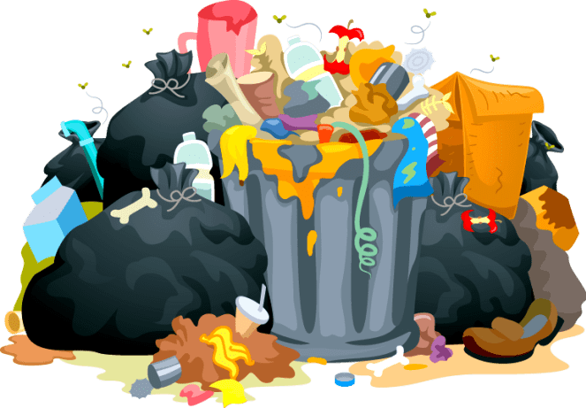
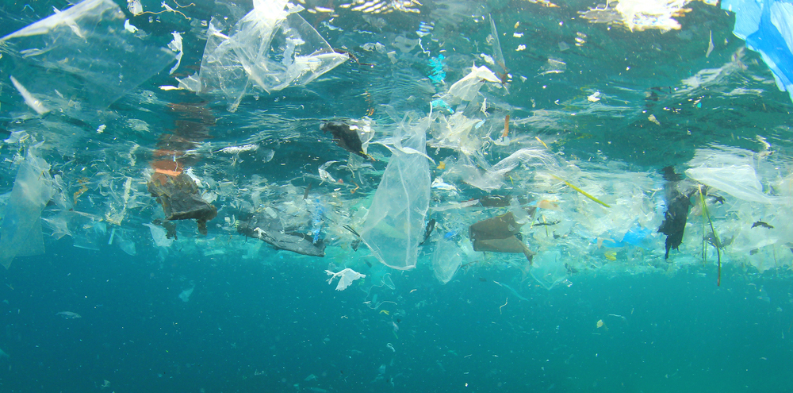

Keywords
Notes:
Waste
Trash in our waterways – TRASH FREE WATERs
Reduce
Reuse
Recycle
For today’s lesson, we will learn the following key words. Accumulate: to build up over time. Marine Debris: any piece of solid trash that enters the marine environment. Pollution: contamination to air, water, or soil by things that are harmful to living things. It can happen in nature, like by a volcanic eruption, or by humans, like smoke from factories.
Source: https://www2.padi.com/blog/2016/09/27/truth-about-great-pacific-garbage-patch/

Slide 8
The 4 R’s
R
R
R
R
Notes:
The 4 Rs: Today, we are going to learn about plastics, trash, and our big waste problem. Have you ever seen trash that isn’t in trash cans? Where? Trash can accidentally flow into our streams, rivers, and oceans, which upsets our animal friends. Some times, trash can leak nasty chemicals into the soil. It’s important to follow the four Rs – refuse, reduce, reuse, and recycle – as much as we can.
Refuse means that you can choose not to use or buy something in the first place!
Reduce means using less stuff in general.
Reuse means trying to use something until it can’t be used any more.
Recycle means properly disposing of plastics, metals, and other recyclable materials so they can be made into other things.
8 million metric tons of garbage end up in the ocean every year. This is the same as a garbage truck dumping its trash into the ocean every minute of every day for a whole year! Almost all of this trash, 88%, is plastic. Plastics don’t break down, or biodegrade, like apples or other products, but instead break into tinier and tinier pieces that can stick around for thousands of years! Litter is ugly, can hurt animals, and costs people billions of dollars every year. Let’s play a game called “how long til it’s gone?”

Slide 9

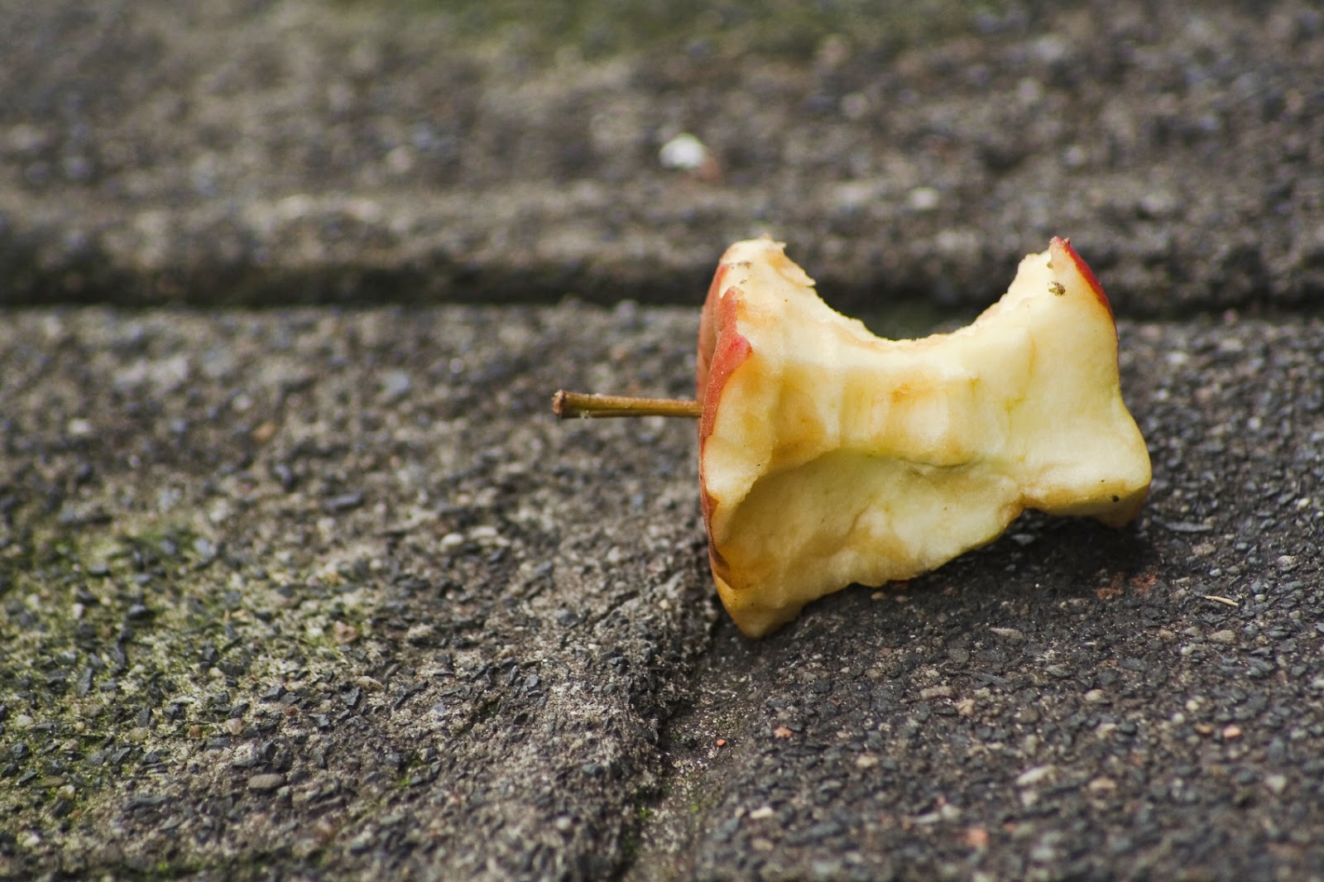
How long ‘til its gone?
Click for audio.
Notes:
Have you seen trash that isn’t in trash cans? Where? Trash can accidentally flow into our streams, rivers, and oceans, which upsets our animal friends. It can also take a REALLLY long time to decompose, or go away. 8 million metric tons of garbage enter the world’s oceans each year. This is the equivalent to a garbage truck unloading its contents into the ocean every minute of every day for the entire year. 88% of this garbage entering the ocean is made up of plastic. Plastics are especially frightening because they do not biodegrade like apples and other products but instead break into smaller and smaller pieces persisting in the environment for thousands of years. Litter on land is ugly, harmful to animals and their habitats, and cost humans billions of dollars annually.
Let’s play a game called “how long ‘til it’s gone!” (On PowerPoint)
How long until an apple is gone?
Source: http://worldartsme.com/free-apple-clipart.html#gal_post_13723_free-apple-clipart-1.jpg

Slide 10

How long ‘til its gone?
Months
Click for audio.
Notes:
An apple is gone in 2 Months!
Source: http://clipart-library.com/birthday-cliparts-number-2.html

Slide 11
How long ‘til its gone?
Notes:
How long ‘till a plastic bag breaks down?

Slide 12
How long ‘til its gone?
0+
Years
Notes:
It takes anywhere from 20-1000 years for a plastic bag to break down.

Slide 13
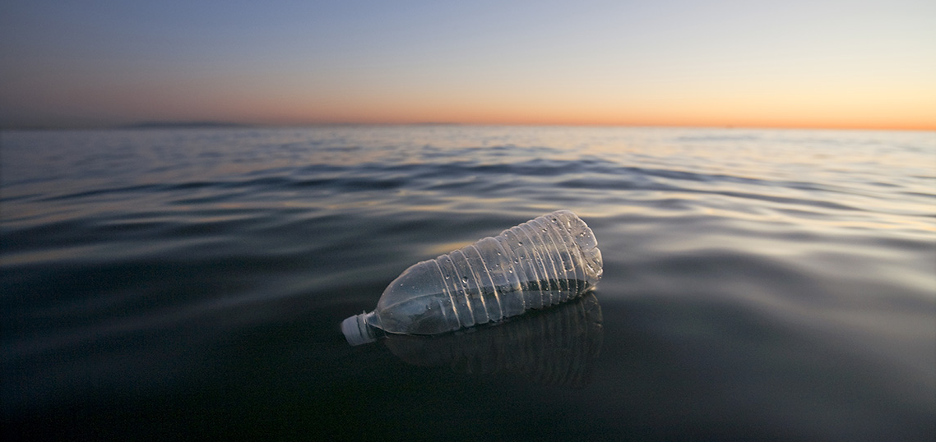
How long ‘til its gone?
Click for audio.
Notes:
How long ‘till a plastic bottle is gone?

Slide 14
How long ‘til its gone?
450
Years
Click for audio.
Notes:
It takes 450 years for a plastic bottle to break down!

Slide 15
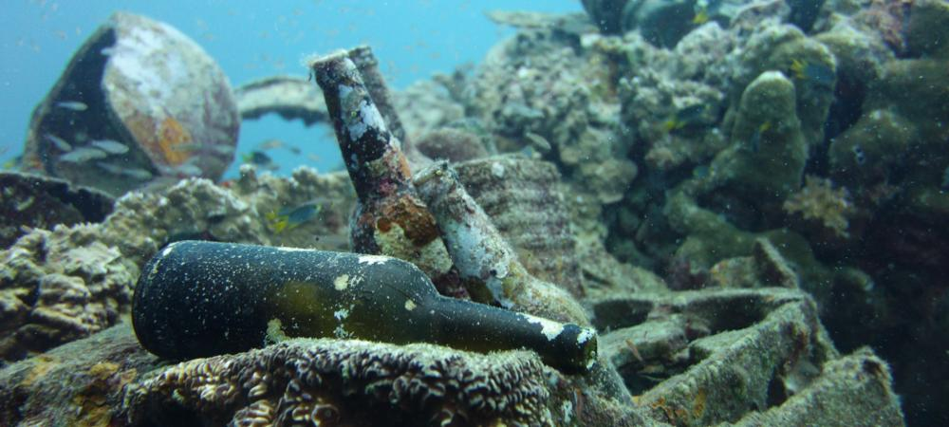
How long ‘til its gone?
Click for audio.
Notes:
How long ‘till a glass bottle is gone?

Slide 16
How long ‘til its gone?
1,000,000
Years
Click for audio.
Notes:
It takes one *million* years for a glass bottle to break down!

Slide 17
What in this Picture Doesn’t Belong?
Click for audio.
Notes:
Introduce the Activity:
If trash doesn't end up in our trash cans, it can end up in our waterways and oceans. In each of these pictures, there is a piece of trash that doesn’t belong. Can you find the item that doesn’t belong?
What in this picture doesn’t belong?
Answer: The green plastic bottle.
Source: http://www.infrastructurene.ws/2018/03/22/plastic-biggest-ocean-waste-offender-report

Slide 18
What in this Picture Doesn’t Belong
Notes:
Answer: The plastic bag!
Source: https://washedashore.org/marine-debris/

Slide 19
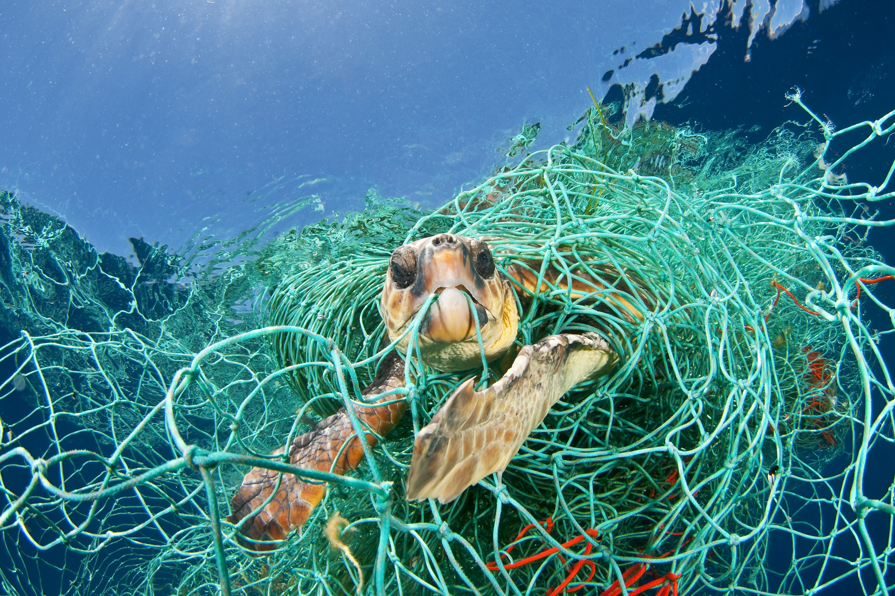
What in this Picture Doesn’t Belong
Notes:
Answer: Fishing net!
Source: https://us.whales.org/issues/man-made-marine-debris

Slide 20
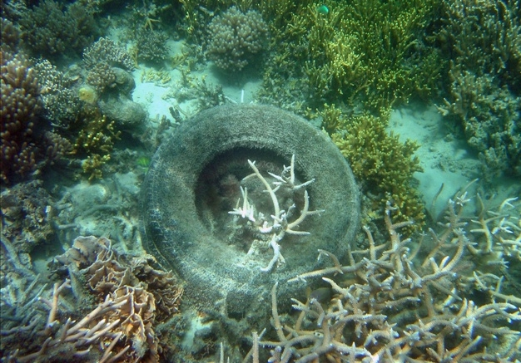
What in this Picture Doesn’t Belong
Notes:
Answer: The tire!
Source: https://www.winknews.com/2015/05/18/divers-removing-thousands-of-tires-from-failed-ocean-reef/

Slide 21
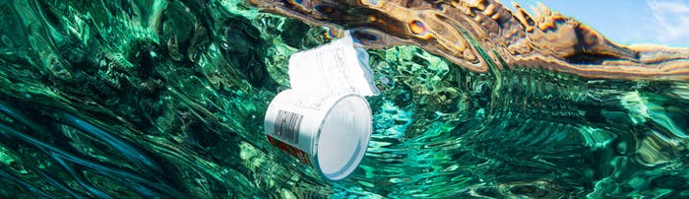
What in this Picture Doesn’t Belong
Notes:
Answer: The yogurt cup!
Source: https://www.pacificwhale.org/conservation/marine-debris/

Slide 22
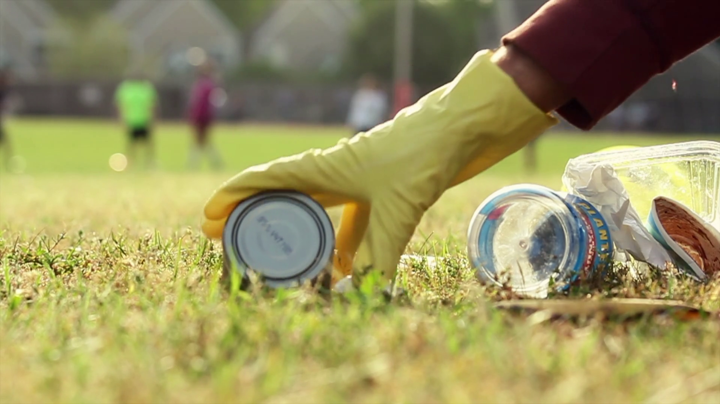
How Can we Help?
Notes:
How can we help? These issues may seem huge and scary, but there are things all of us can do to help keep our oceans clean and our animals safe. Let’s brainstorm ways we can help. Why is there trash in the water? Why does it keep happening? What are steps you can take at school or at home to help?
Consider the 4 R’s. Refuse, Reduce, Reuse Recycle.
***Go with you parents and pick up three things and put them in a trash can.
Source: https://www.videoblocks.com/video/picking-up-trash-in-park-r7cd_w9nxix15ycz5

Slide 23
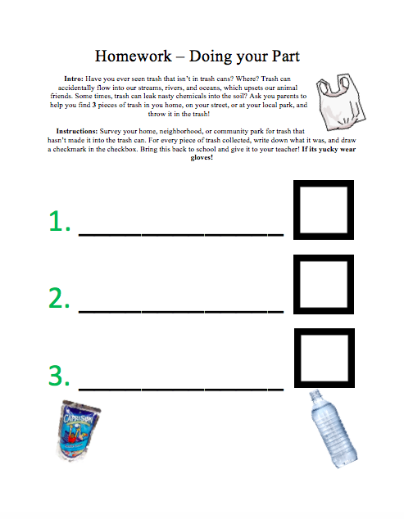
Homework!
Notes:
The homework for the Preschool students will be to go home, and with their parents, safely, pick up 3 pieces of trash that they find around their home and throw them in the trash. This could be in their home, backyard, on their street, at their local park, or generally just somewhere trash shouldn’t be. Make sure they know to avoid sharp items and if it is “yucky” to use gloves or have the parent pick it up. Their job is to find 3 pieces of trash, check off the boxes, and write in the lines what the piece of trash they found was.

Slide 24
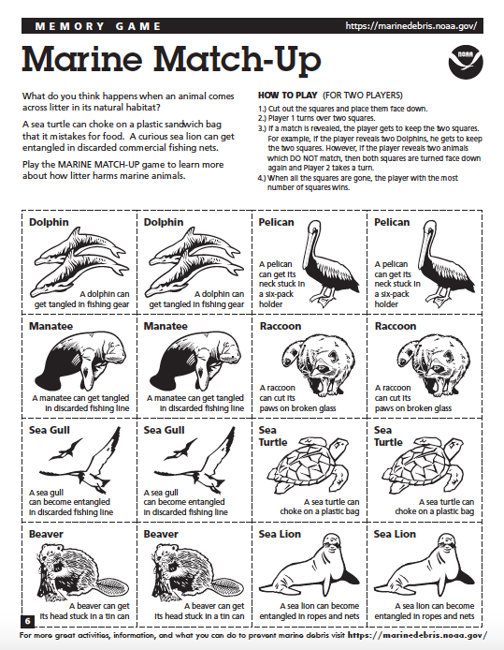
Additional Activity - Marine
Match Up
Notes:
If the students haven’t completely lost interest at this point, you can either facilitate this matching game, or give the kids copies to take home to do with their parents! Facilitate the Marine Match Up game. It is just a memorization matching game. The words underneath will go over the younger grades’ heads, so focus solely on the matching activity. The next few slides will have pictures of animals coming in contact with trash as suggested in activity.
HOW TO PLAY (FOR TWO PLAYERS)
1.) Cut out the squares and place them face down.
2.) Player 1 turns over two squares.
3.) If a match is revealed, the player gets to keep the two squares. For example, if the player reveals two Dolphins, he gets to keep the two squares. However, if the player reveals two animals which DO NOT match, then both squares are turned face down again and Player 2 takes a turn.
4.) When all the squares are gone, the player with the most number of squares wins.

Slide 25
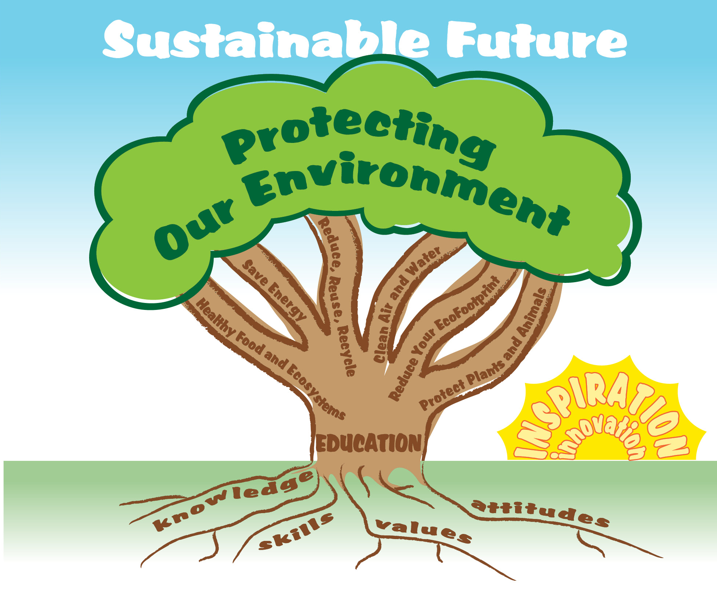
EcoLearn
Developed by the Environmental Protection Agency
With support from Department of State
Virtual Students of Federal Service Interns
https://www.epa.gov/education
US EPA
Region 10
EcoLearn
For more information: hanft.sally@epa.gov or salazar.viccy@epa.gov

