Slide 1

Kindergarten
Animals
US EPA
Region 10
EcoLearn
Learn to respect and understand animals
Notes:
Source: http://g02.a.alicdn.com/kf/HTB1eG_JIpXXXXbFXVXXq6xXFXXXh/Custom-papel-DE-parede-infantil-forest-small-animal-murals-for-children-room-the-bedroom-sofa-wall.jpg

Slide 2

Today you will learn…
There are many animals in the world and they all have feelings
Click for audio.
Notes:
Source: http://cdn.renewcanceltv.com/wp-content/uploads/2015/09/muppetssadf.jpg

Slide 3
Keywords
Animals
Shelter
Food
Water
Air
Click for audio.
Notes:
Source: http://stjohnsweldonspring.org/wp-content/uploads/2015/06/Giraffe.png

Slide 4
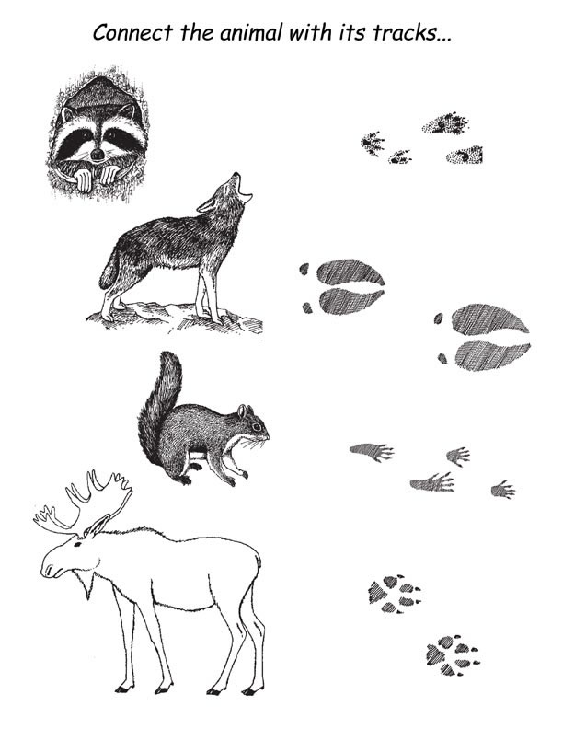
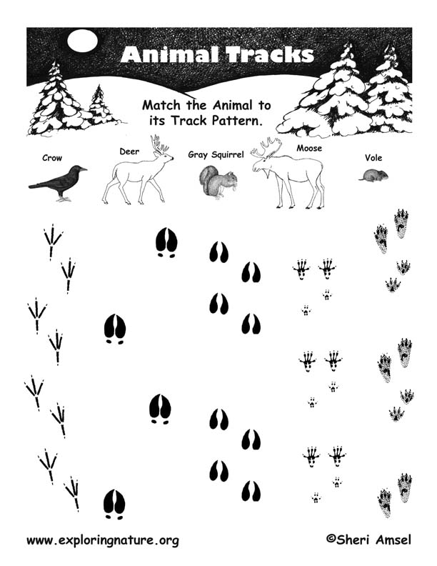

Do Now
Look at the handout!
Match the animal with the footprint!
Click for audio.
Notes:
Source: http://www.kodeescanoe.com/wp-content/uploads/2012/07/Kodees-Canoe-Footprints_Path_Bear.png

Slide 5
Class Review
What does a chicken’s footprint look like?
Click for audio.
Notes:
Source;http://vignette4.wikia.nocookie.net/hayday/images/a/a3/Chicken.png/revision/latest?cb=20150713091518
Foot print: http://www.clker.com/cliparts/f/t/c/k/P/s/bird-footprints-hi.png

Slide 6
Class Review
What does a chicken’s footprint look like?
Notes:
Source;http://vignette4.wikia.nocookie.net/hayday/images/a/a3/Chicken.png/revision/latest?cb=20150713091518
Foot print: http://www.clker.com/cliparts/f/t/c/k/P/s/bird-footprints-hi.png

Slide 7
What can we learn about animals?
All animals are different! Some live in the desert where it is hot and dry. Others like to live in the snow!
Click for audio.
Notes:
Source: http://m.jumpstart.com/JumpstartNew/Dreamworks/Images/MAD_Bio_Images/Alex_bio_01.png
http://www.pngall.com/wp-content/uploads/2016/03/Penguin-Download-PNG.png
http://vignette2.wikia.nocookie.net/p__/images/3/3e/Rico.png/revision/latest?cb=20150911140708&path-prefix=protagonist
http://madagascar.dreamworks.com/images/uploads/characters/mort_action.png

Slide 8
What can we learn about animals?
Everyone is different and special in some way. Animals are the same! Animals have personalities and should be treated with kindness.
Click for audio.
Notes:
Source:http://itsyourright.ie/wp-content/uploads/2015/07/OCO_2_small.png

Slide 9
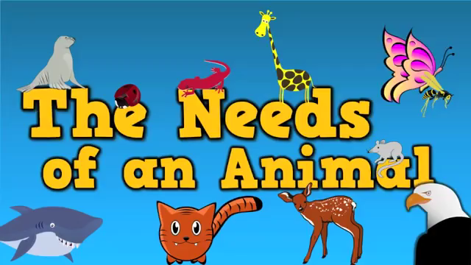
“The Needs of an Animal” Song

Slide 10
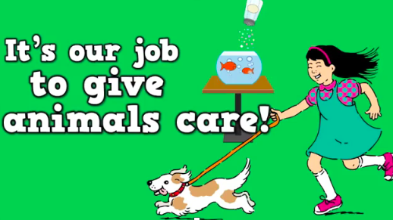
“The Needs of an Animal” Song
What did you hear in the song?
What do animals need?
They need food, shelter, water, air:
What kind of food does a bear eat? Where does a wolf live? Where do animals get their water?
They breathe the same air we do!
Click for audio.

Slide 11

“Brown Bear, Brown Bear, What do you see?” by Bill Martin Jr. and Eric Carle

Slide 12
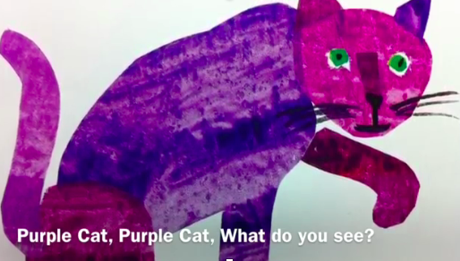
“Brown Bear, Brown Bear, What do you see?” by Bill Martin Jr. and Eric Carle
What kind of animals did you see?
What are the differences?
Click for audio.

Slide 13
Care for an animal friend!
Pick an animal friend!
Color your animal!
Put them up on the wall!
Name your animal!
Click for audio.
Notes:
Source: https://img.clipartfest.com/9cf3a82e03799b8cb165c54be251397d_-dog-animal-lemmling-hunky-clipart-animals-png_555-744.png

Slide 14
Closure
What kind of animals do you see everyday?
Can you see birds in your backyard?
What about small animals?
Share what you find with your class!
Click for audio.
Notes:
Source:
Pig: https://s-media-cache-ak0.pinimg.com/originals/a0/a3/72/a0a3729b207cdc5a340ba3f33c878540.png
Bear: https://s-media-cache-ak0.pinimg.com/originals/0f/96/10/0f96105f812780c5ebea8f994c5572d4.png
Turtle: http://www.downloadclipart.net/large/5940-cartoon-turtle-design.png
Zebra: https://cdn.pixabay.com/photo/2012/04/18/15/50/zebra-37396_960_720.png

Slide 15
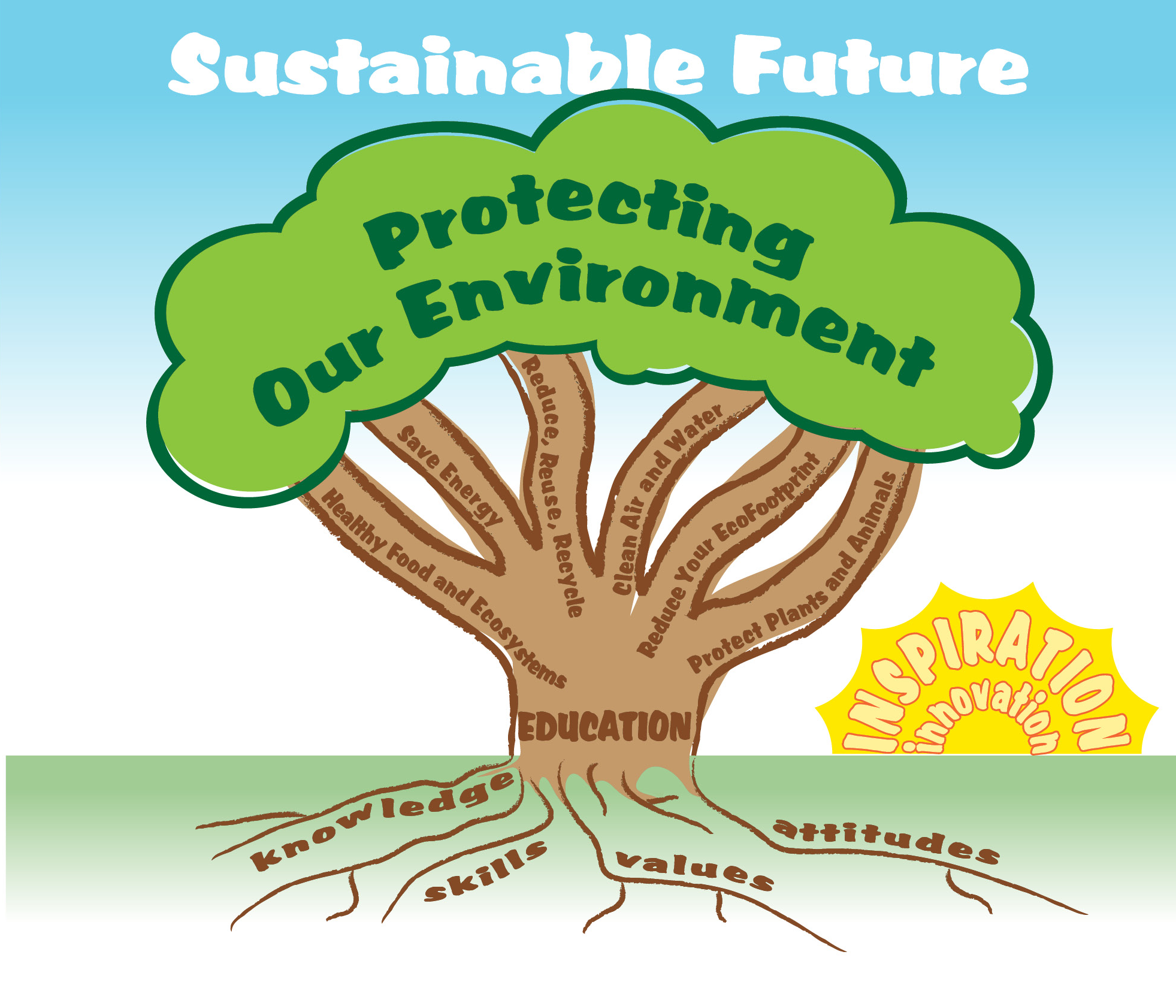
EcoLearn
Developed by the Environmental Protection Agency
With support from Department of State
Virtual Students of Foreign Service Interns
https://www.epa.gov/education
US EPA
Region 10
EcoLearn
For more information: hanft.sally@epa.gov or salazar.viccy@epa.gov

