Slide 1
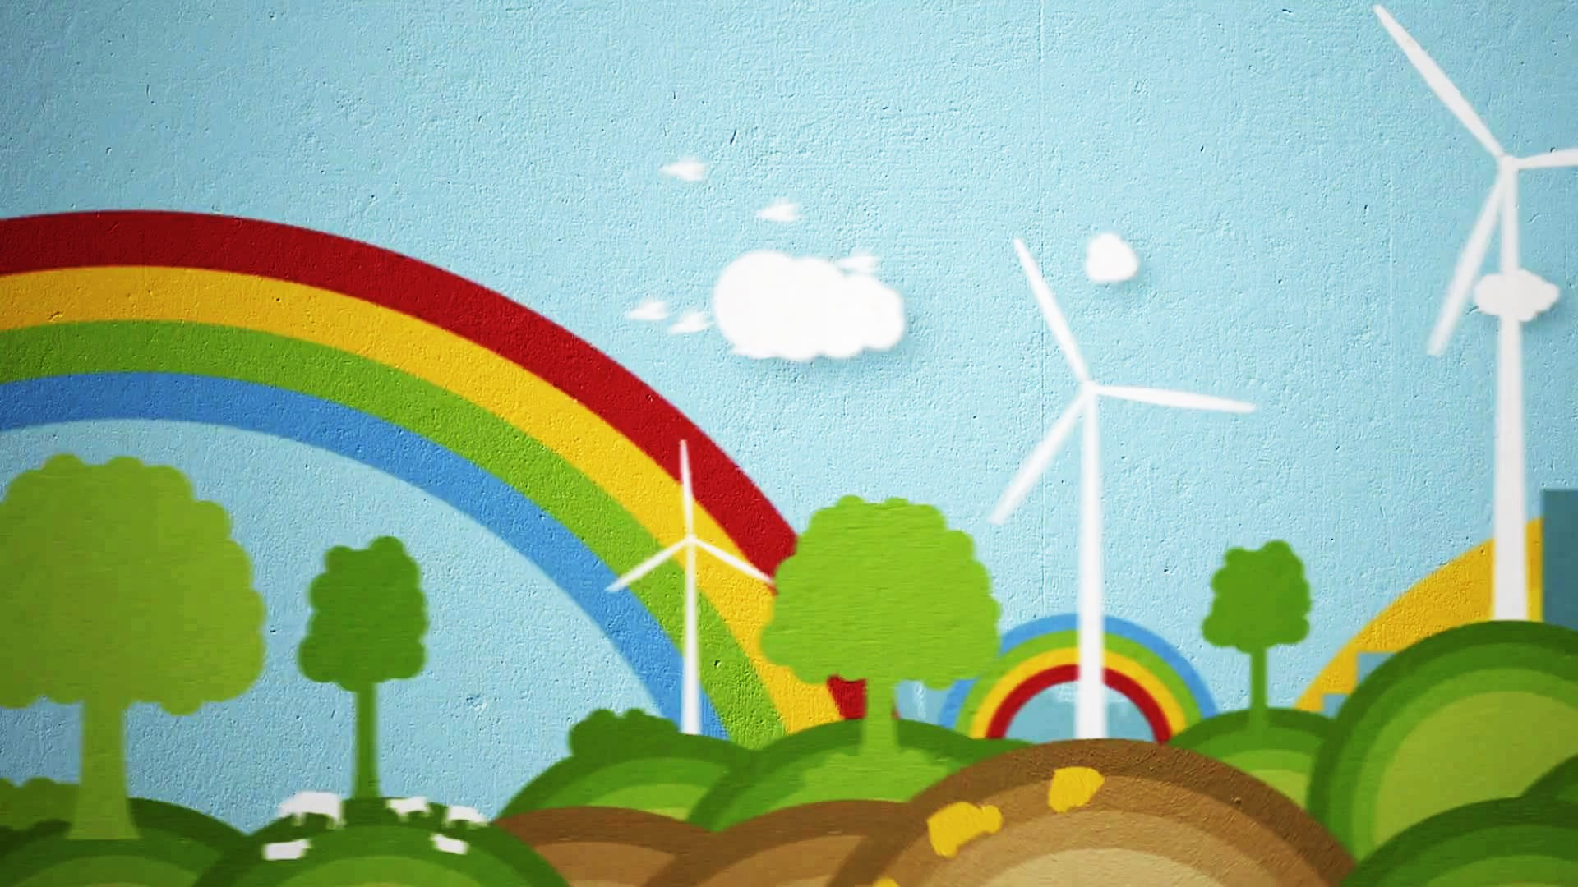

Kindergarten
Energy
Learn how energy relates to the environment and how to be energy-savers!
US EPA
Region 10
EcoLearn
Learn how energy relates to the environment and how to be energy-savers!
Notes:
Source Image: http://thekidshouldseethis.com/wp/wp-content/uploads/2014/04/2612.jpg

Slide 2

Today you will learn…
Energy and electricity
How energy affects our environment
How energy is made and used
Click for audio.
Notes:
Image source: https://img.clipartfest.com/26cccd25d6191c5a61f15b1dadb5957b_light-bulb-clipart-clipart-clip-art-of-light-bulb_996-1000.png

Slide 3
Keywords
Electricity
Energy
Light
Pollute
Pollution
Click for audio.
Notes:
Source: https://i.ytimg.com/vi/ai1lmvfh0r8/hqdefault.jpg

Slide 4
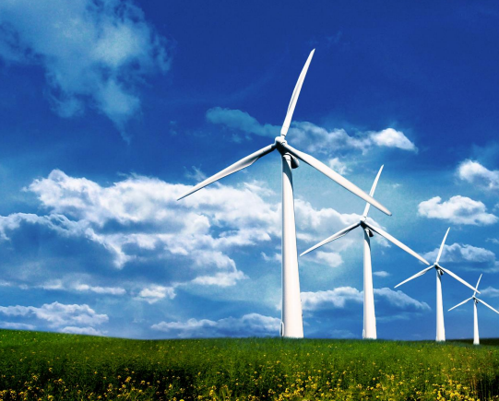
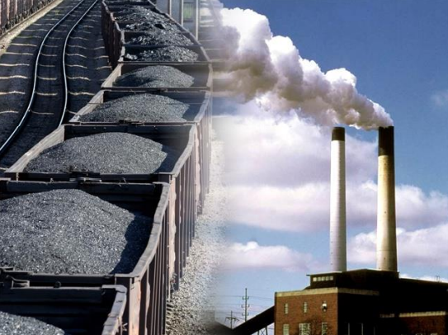
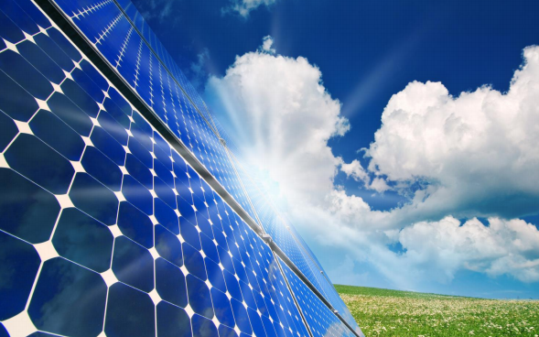
Do Now
Have you seen these before? What are they?
Click for audio.

Slide 5
Do Now
Wind Turbines
Coal Plant
Solar Panels
Click for audio.

Slide 6
What is Energy?
Energy is being able to do work or tasks. Energy can be found in many different forms!
Click for audio.
Notes:
Source Image: http://activeforlife.com/wp/wp-content/uploads/2014/05/group-of-kids-running.jpg

Slide 7
Energy
The most common forms of energy are light, heat, sound, and motion!
Click for audio.
Notes:
Source: https://encrypted-tbn2.gstatic.com/images?q=tbn:ANd9GcRIalEAtL5LE42JFzbo25wxcf5tK54pOF2OLTxWtSOi2mjbcglM

Slide 8
How do we make light energy?
Electricity is the light energy that helps us see!
We make energy by burning coal, oil, and gas.
BUT… we can also make electricity using water, wind, or the Sun!
Click for audio.
Notes:
Source: https://img.clipartfest.com/28fef2516efd9bc419a127384f401cb9_light-bulb-clip-art-for-kids-clipart-for-kids-light-bulb_1955-2400.png

Slide 9
All of these things give us energy…
However, whenever we burn coal, oil, or gas, we pollute the environment! A clean environment is important to humans, plants, and animals.
Click for audio.
Notes:
Source: http://www.sunstoneoutdoorkitchens.com/images/GASVSCHARCOAL/GrillMates.jpg

Slide 10
Meet LED Lucy!
What do you think Lucy is?
Click for audio.
Notes:
Source Image: http://www.touchstoneenergy.com/wp-content/uploads/2013/01/led-lucy.jpg

Slide 11
Meet LED Lucy!
Lucy is an LED light bulb, which means that she is very bright and powerful!
She can light a room for 8 hours a day for many years!
LED light bulbs like Lucy are great for our environment because they don’t use very much energy!
Click for audio.
Notes:
Source Image: http://www.touchstoneenergy.com/wp-content/uploads/2013/01/led-lucy.jpg

Slide 12
Maze Activity – Saving Energy
Switchy has the power to turn the lights on and off. Switchy’s job is important because when we turn off lights, we save a bunch of energy!
Let’s help Charlie get through the maze so that we can get to Switchy and save some energy!
Click for audio.

Slide 13
Saving energy protects our environment and makes our planet a nicer place for people and animals to live.
Remember to turn the lights off whenever you leave a room people aren’t using!
Click for audio.
Notes:
Source: https://www.google.com/url?sa=i&rct=j&q=&esrc=s&source=images&cd=&cad=rja&uact=8&ved=0ahUKEwikoO6x6cDSAhUB5yYKHSegASYQjRwIBw&url=http%3A%2F%2Falternatehomeenergy.org%2Ftag%2Fsaving-energy-at-home-facts%2F&psig=AFQjCNGLunAHBh1iuzx33NJ-bWu51Pfelg&ust=1488853429525215

Slide 14
Pledge
How can we save energy? Let’s all pledge to turn off lights when they’re not being used!
Pledge: I pledge to turn off lights when they’re not being used and I will encourage my family to do the same.
Click for audio.
Notes:
Source: http://www.communication4all.co.uk/Screen%20Shot%20Images/save%20energy.png

Slide 15
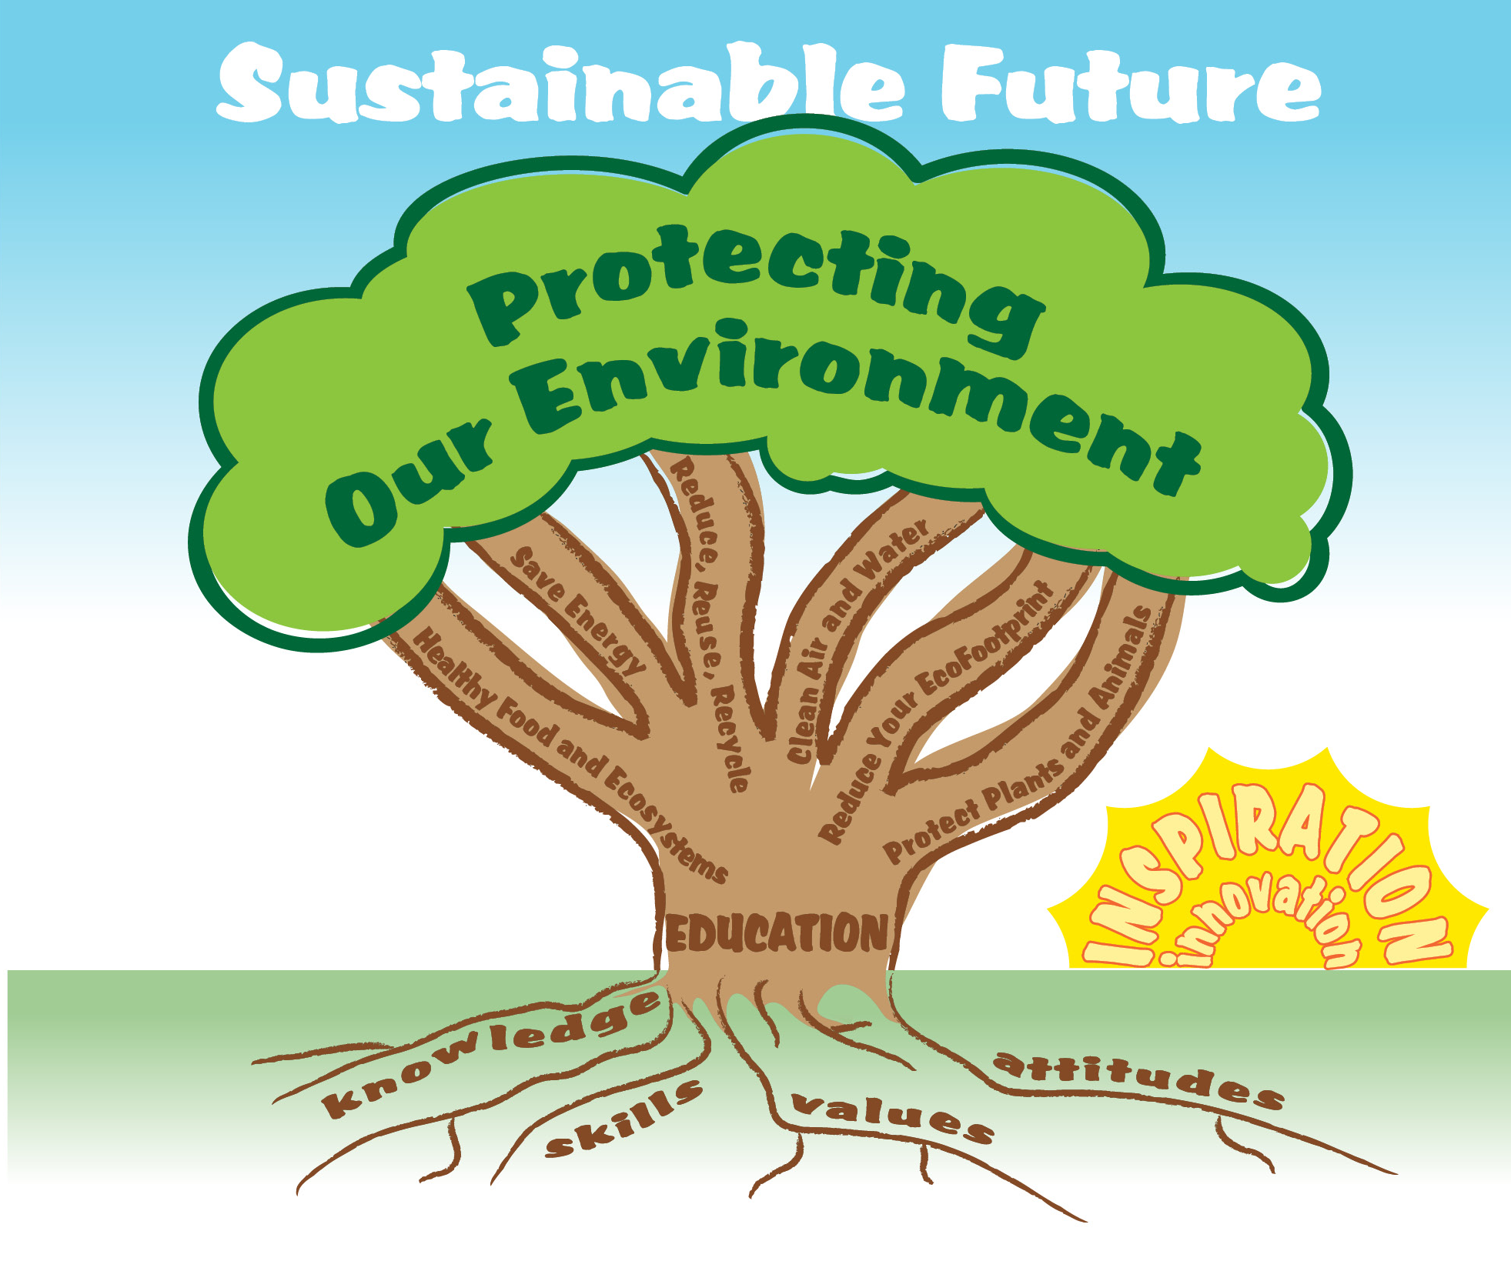
EcoLearn
For more information:
hanft.sally@epa.gov or
salazar.viccy@epa.gov
Developed by the Environmental Protection Agency
With support from Department of State
Virtual Students of Foreign Service Interns
https://www.epa.gov/education
US EPA
Region 10
EcoLearn

