Slide 1
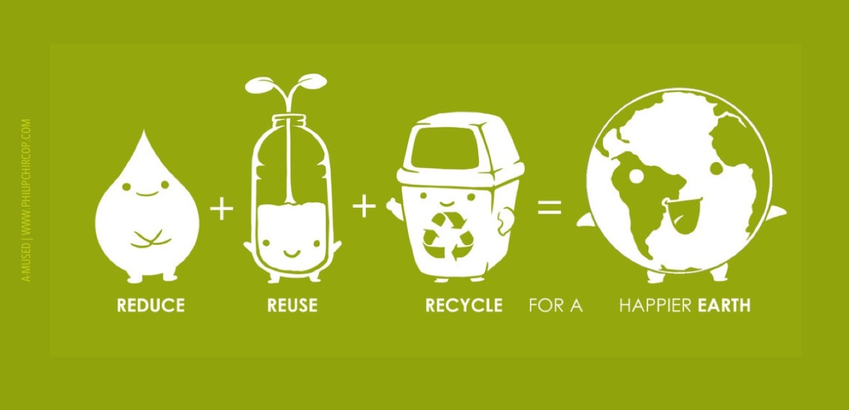

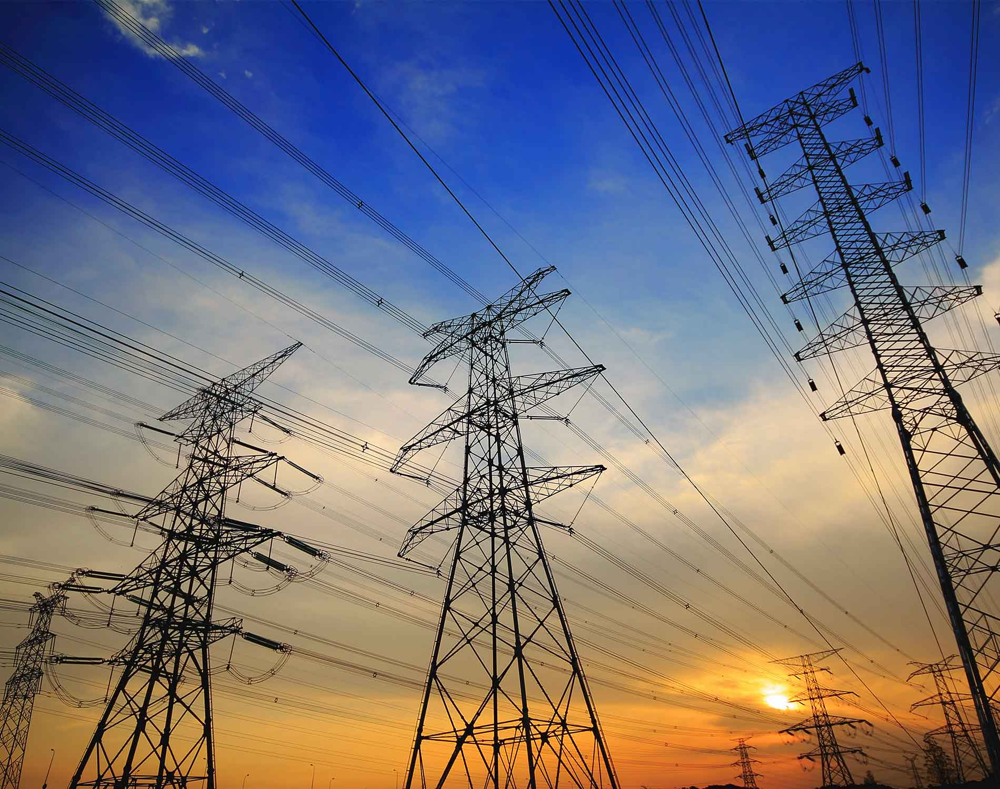
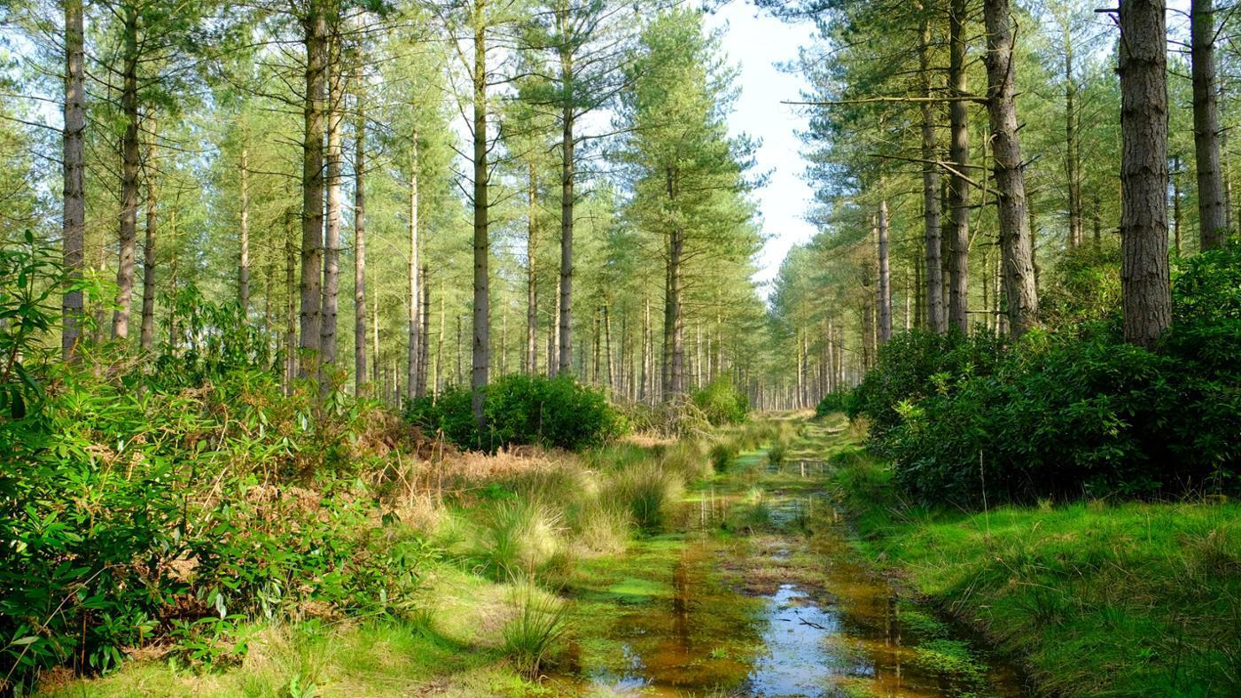


Energy
USA EPA,
Region 10
EcoLearn
1st Grade: Energy and the Environment
Notes:
http://www.philipchircop.com/post/117077877097/reduce-reuse-recycle-today-the-22nd-of-april

Slide 2

Today:
Today you will learn:
    What energy is, where it comes from, and how we can conserve it.
Keywords:
  Types of energy
  Energy generation
  Energy sources
  Fossil fuels
  Nonrenewable energy
  Renewable energy
  Power
Notes:
http://rifreedom.org/category/issues/nergy/

Slide 3
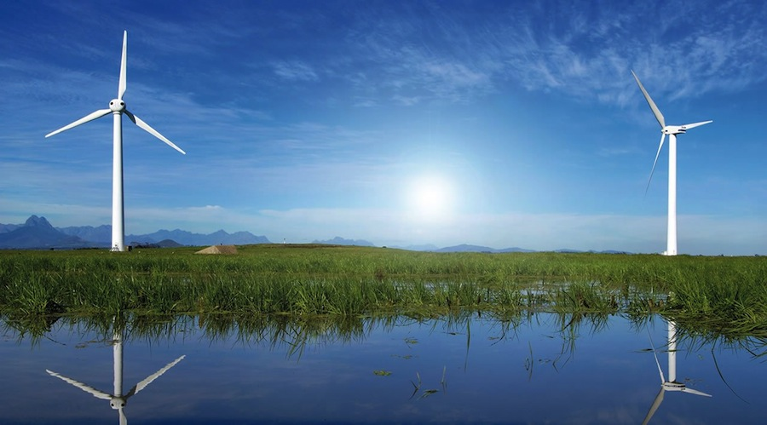
Students will gain an understanding of why energy matters to us and our environment, and why they should try to conserve energy.

Slide 4


Do Now:
1. Ten jumping jacks.
2. Rapidly rub your palms together.
Notes:
http://best-lucid-dreaming-techniques.com/rubbing-your-hands.html
https://www.shutterstock.com/image-vector/boy-doing-jumping-jacks-vector-49901830

Slide 5
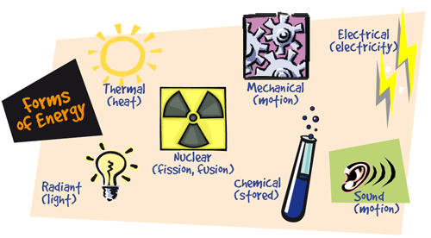
What is Energy?
Energy is the ability to do work or perform tasks.
Energy can be found in many different forms.
    The most common forms of energy are light, heat, sound, and motion.
Notes:
https://www.proprofs.com/flashcards/story.php?title=7-forms-of-energy_2

Slide 6

Forms of Energy: Light
Where can I find energy in the form of light?
What makes light?
Do you see sources of light around you now?
Notes:
https://mohansuniverse.wordpress.com/2014/03/19/mohanjis-light-guidance/

Slide 7
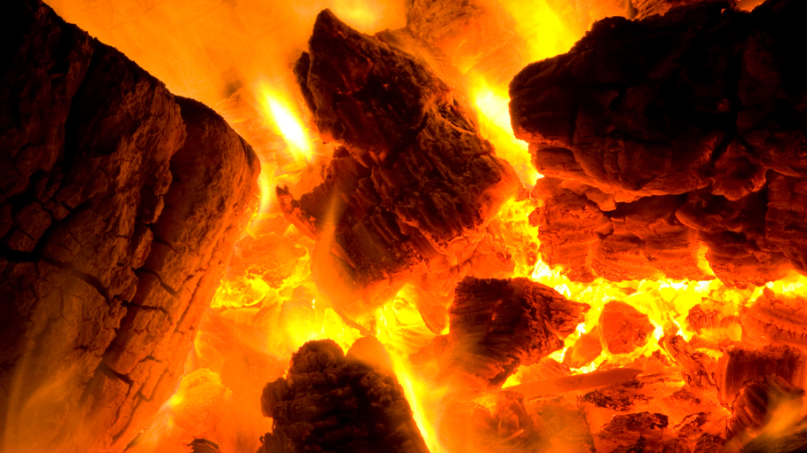
Forms of Energy: Heat
What about heat?
What gives off heat?
What happened when you did your jumping jacks? Did your body feel warmer?
Did you know that when our bodies move, they give off heat? That’s why you feel warm when you exercise!
Notes:
https://www.thinglink.com/scene/522407565867352064

Slide 8

Forms of Energy: Sound
What about sound?
What makes sound?
Notes:
http://www.instructables.com/id/How-Sound-Works/

Slide 9

Forms of Energy: Motion
Where do we see motion?
What happened when you rubbed your palms together?
Did your hands feel warmer? That’s energy!
Notes:
https://www.mos.org/live-presentations/balance-and-motion

Slide 10
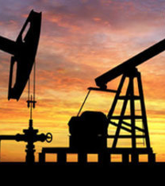
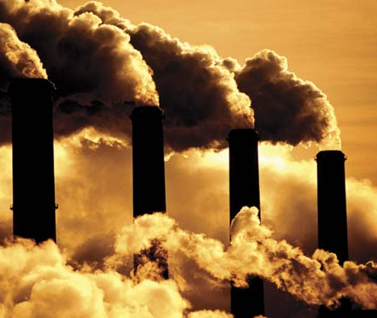
Where Does Energy Come From?
It takes energy to make electricity.
We often get that energy by burning coal, oil, and gas – which are called fossil fuels – in a power plant.
Notes:
http://www.kidzworld.com/article/1423-fossil-fuel-energy
https://www.britannica.com/science/fossil-fuel
We often get that energy by burning coal, oil, and gas – which are called fossil fuels – in a power plant to heat water.
The hot water turns into steam and forces a machine called a turbine to turn. The turbine powers a generator, which makes electricity. This electricity is sent through power lines to provide energy for buildings and homes.

Slide 11
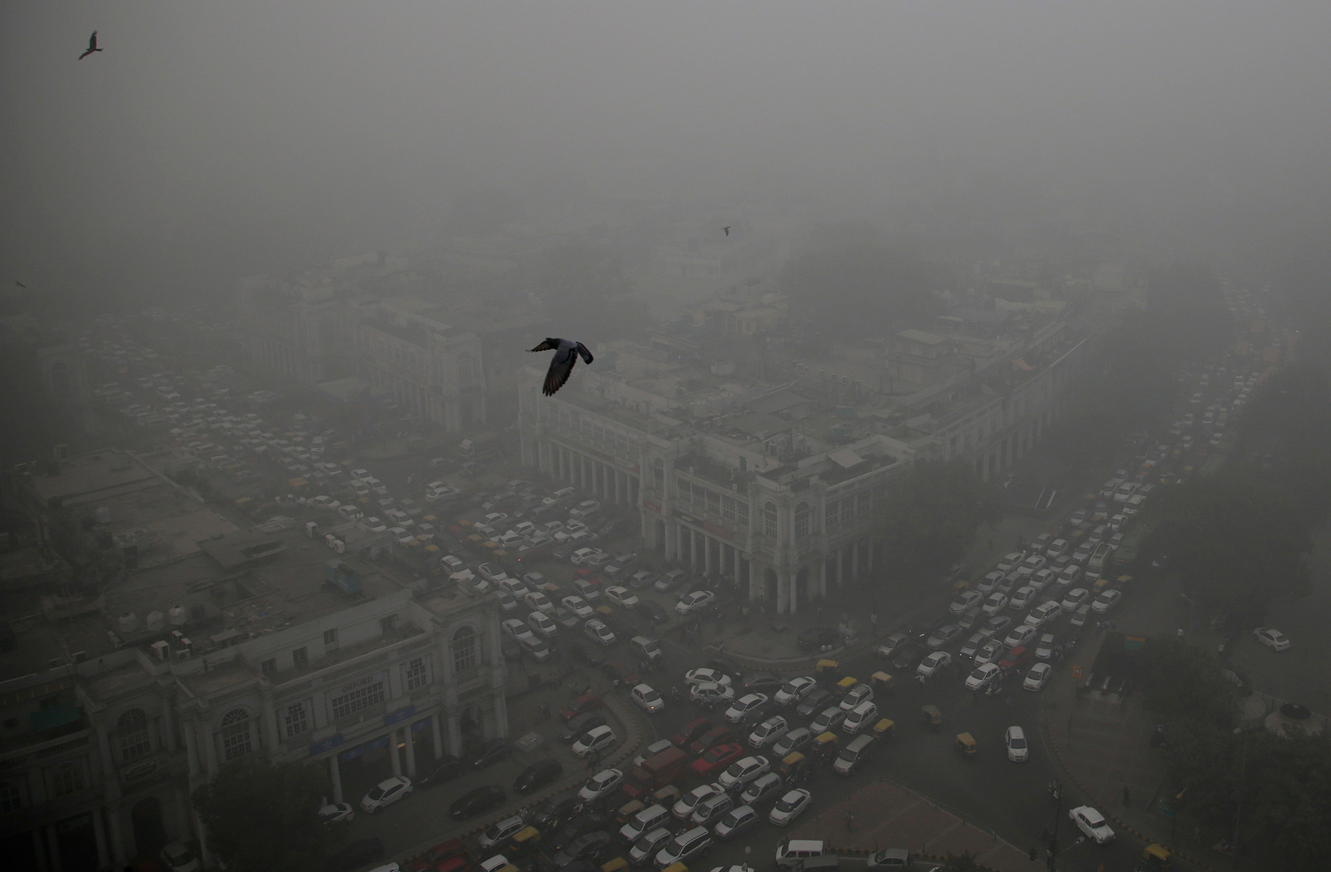
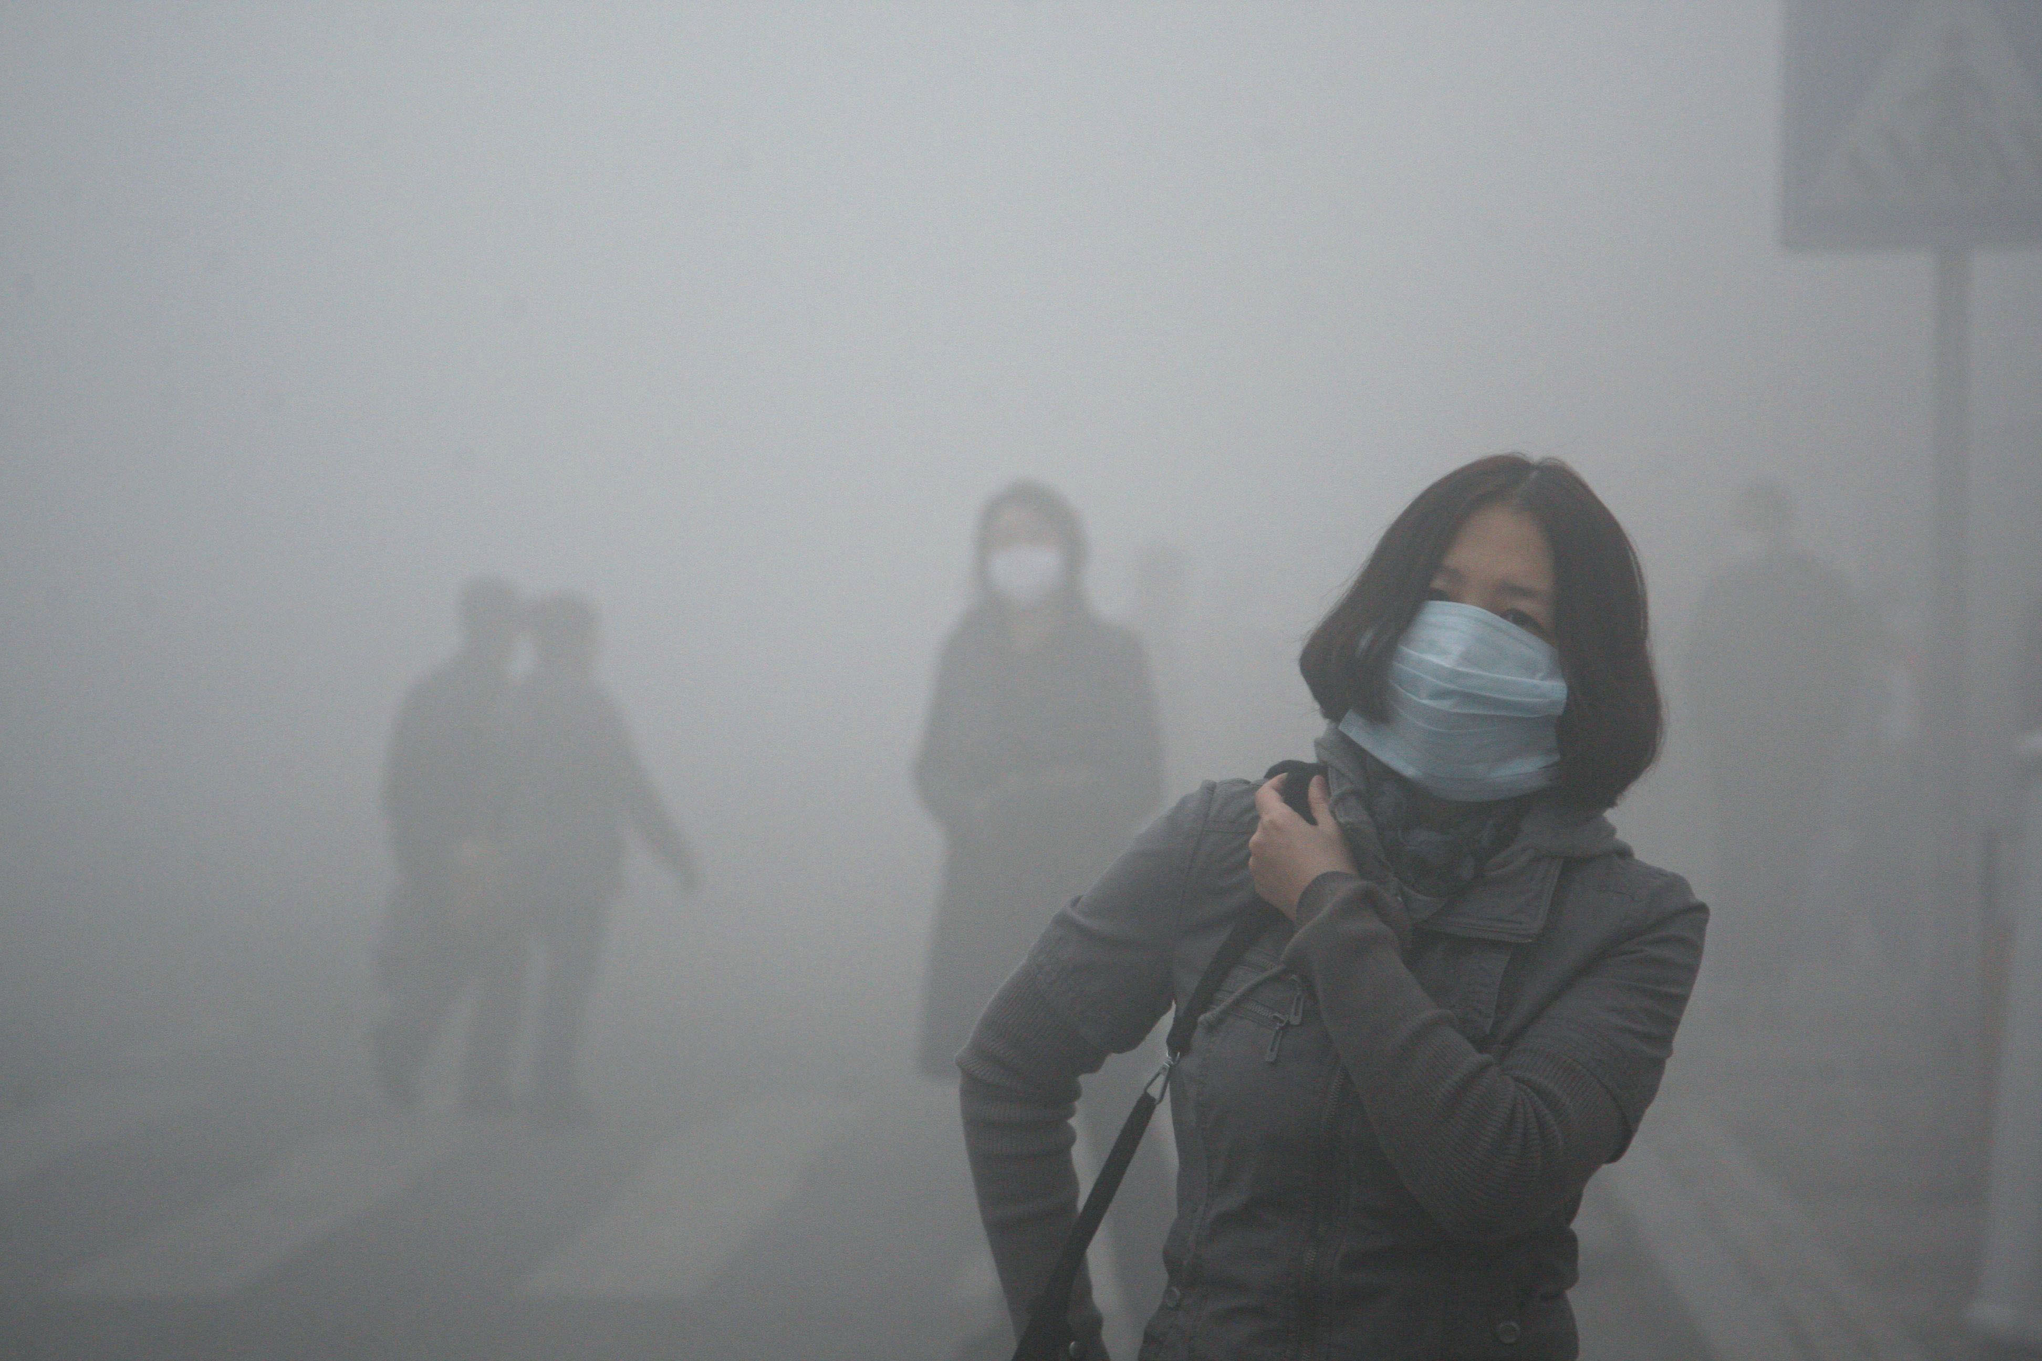
When we use fossil fuels to make energy, we also create air pollution.
Smog, a thick, brown haze is formed when exhaust from cars and buses mix with sunlight.
Notes:
http://news.nationalgeographic.com/2016/11/new-deli-india-smog-photos-pollution/
http://www.theverge.com/2016/12/20/14021722/china-smog-red-alert-beijing-pollution

Slide 12
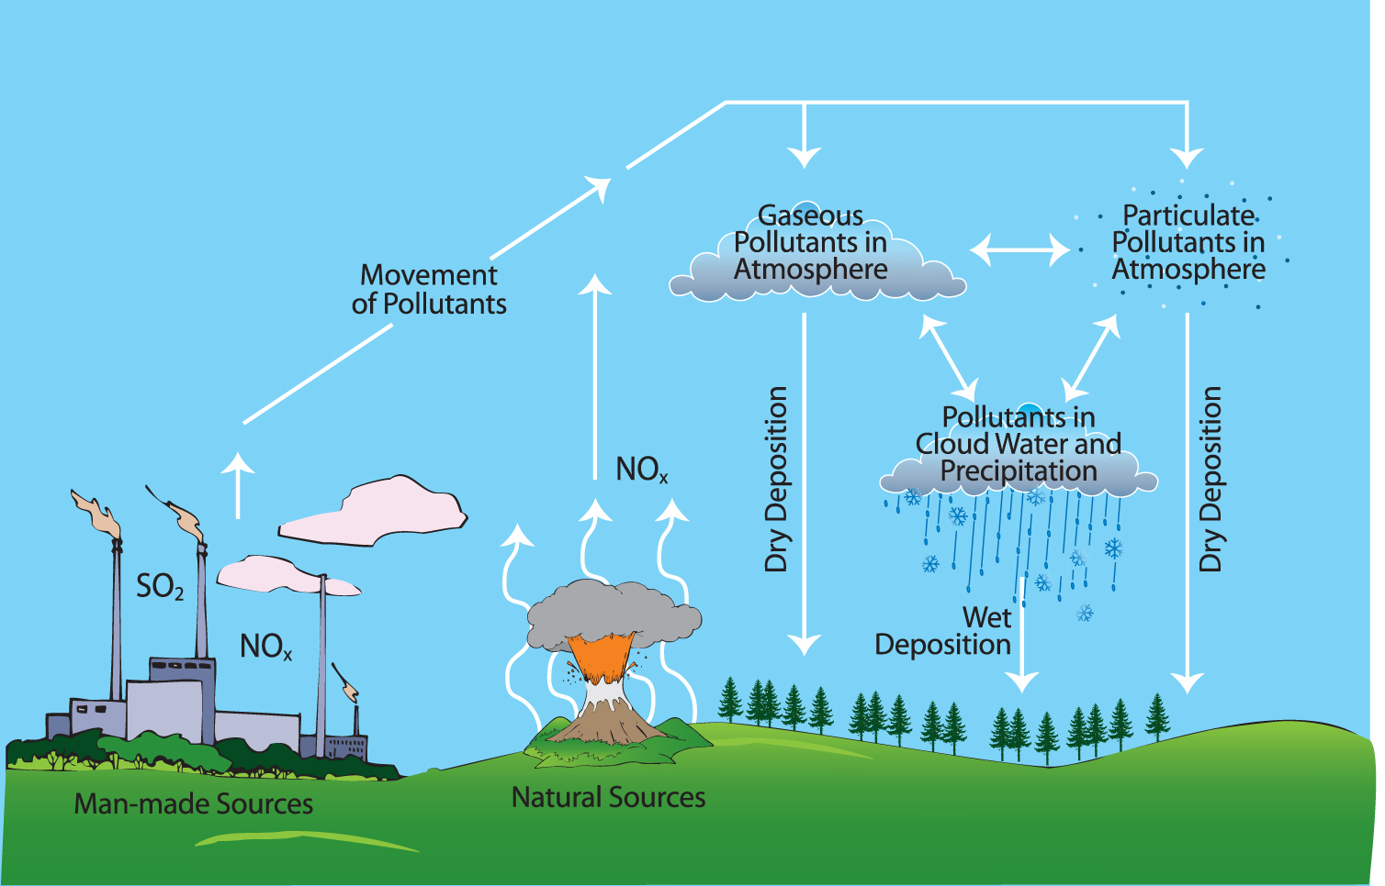
Burning coal to generate electricity releases sulfur, which mixes with water and falls to the ground as acid rain.
The acid in acid rain is like the acid in lemon juice or vinegar, and it damages buildings, trees, and crops.
Notes:
http://edu.glogster.com/glog/acid-rain/146sjdkfpek

Slide 13
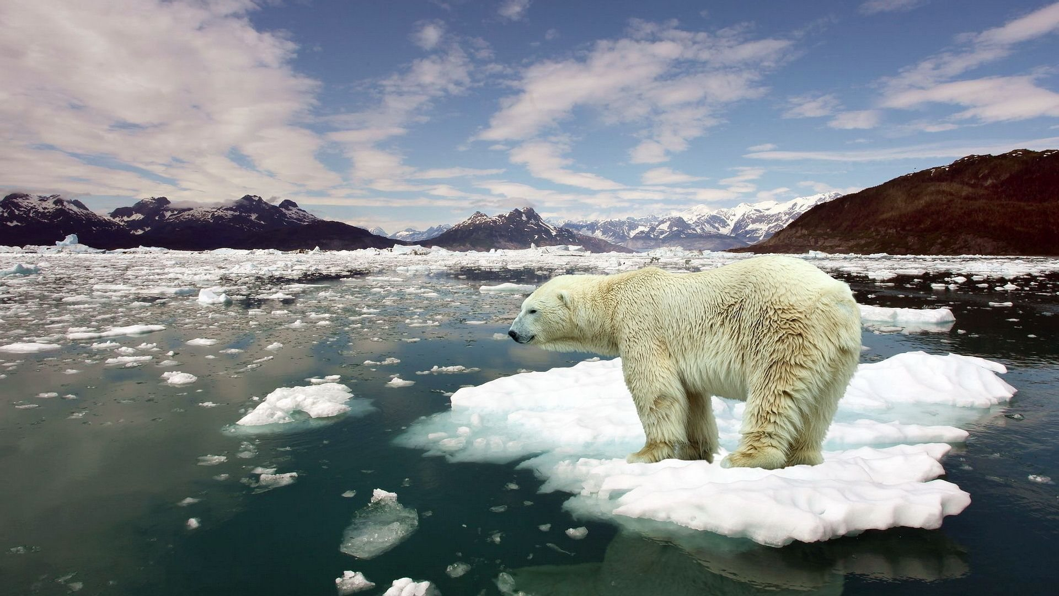

When we burn fossil fuels, we also add more carbon dioxide to the atmosphere, which causes the Earth to get warmer.
Notes:
http://www.dinosaurfact.net/extinction/carbondioxide.php
http://www.theblackvault.com/documentarchive/global-warming-climate-change/

Slide 14
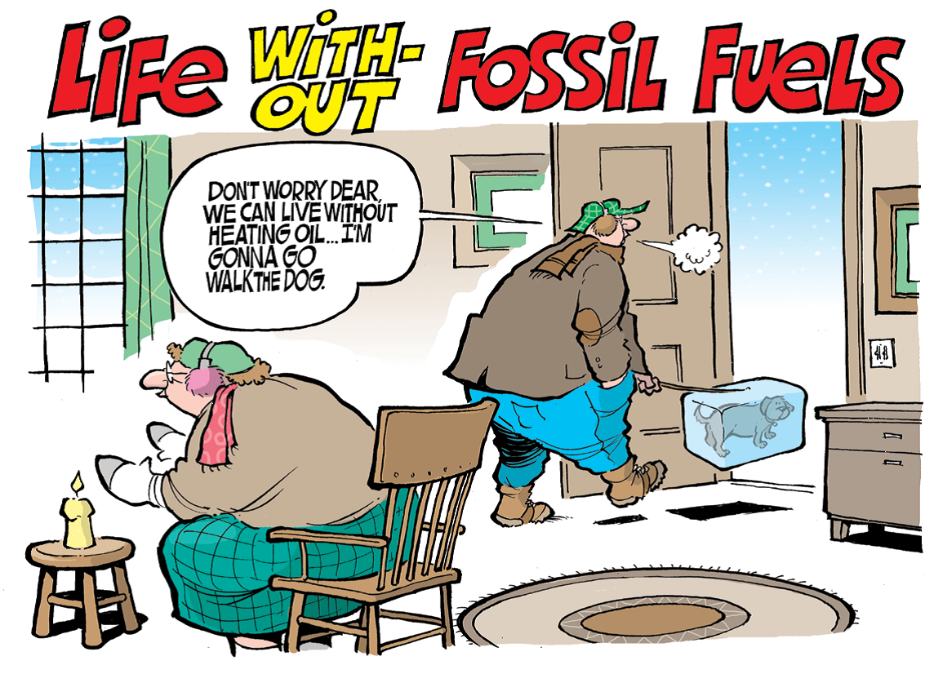
Modern life depends heavily on fossil fuels, but burning these fuels damages our environment.
We also don’t have an endless supply, and eventually they could run out.

Slide 15

For these reasons, it’s important for us to use as little energy as we can and, when possible, to switch to renewable energy.

Slide 16
What is Renewable Energy?
It’s natural energy that that never runs out.
These forms of renewable energy are less harmful to our environment:
  Solar energy
  Wind energy
  Hydropower
  Geothermal energy
  Waves and tides
  Biomass

Slide 17
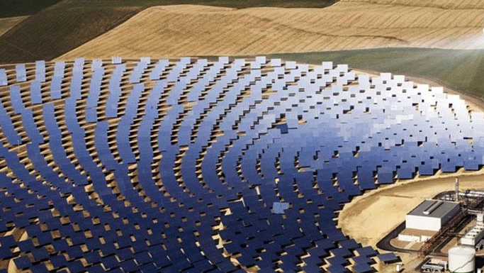
Solar Energy
Uses the sun

Slide 18

Wind Energy
Uses wind

Slide 19
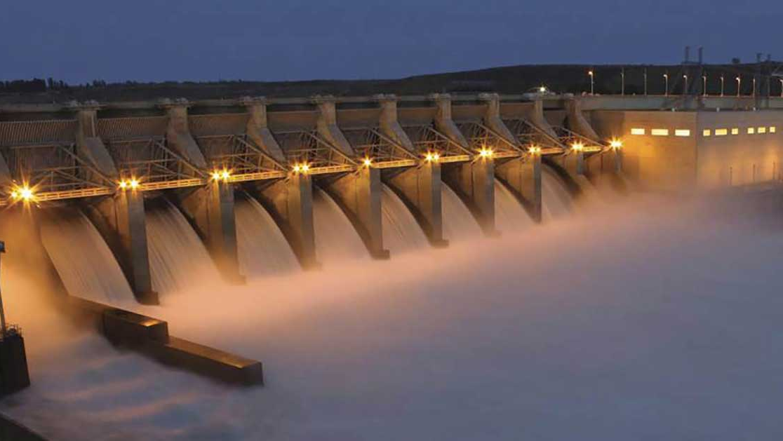
Hydropower
Uses water
Notes:
https://www.americanrivers.org/threats-solutions/energy-development/hydropower/

Slide 20
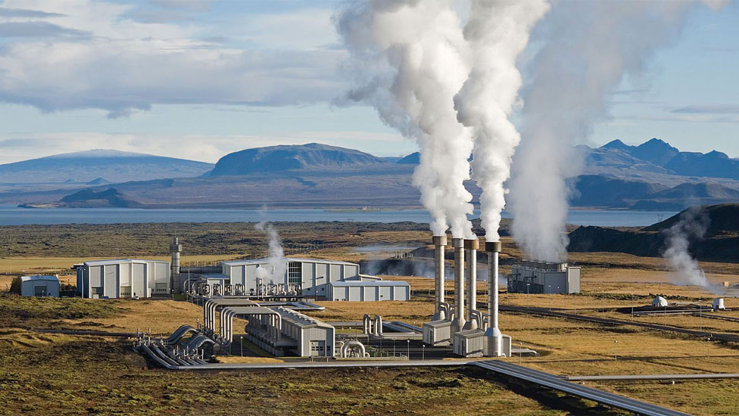
Geothermal Energy
Uses heat and steam from below the Earth's surface
Notes:
http://www.ucsusa.org/clean_energy/our-energy-choices/renewable-energy/how-geothermal-energy-works.html#.WQDL9IjytPY

Slide 21
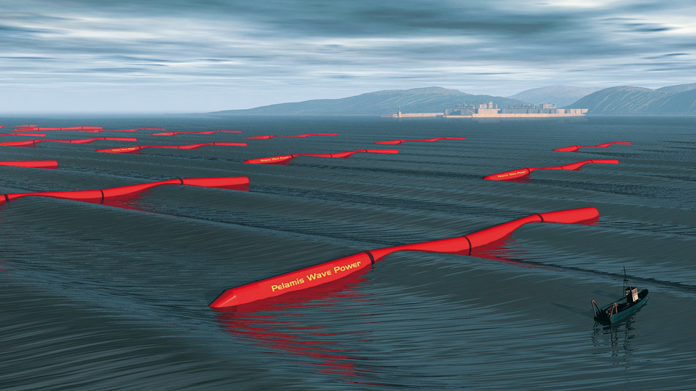
Waves and Tides
Uses ocean waves and tides
Notes:
http://worldoceanreview.com/en/wor-1/energy/renewable-energies/

Slide 22

Biomass
Uses living materials or decayed waste
Notes:
http://www.renewableenergyworld.com/articles/2015/10/biomass-energy-potential-far-from-being-fully-exploited-in-china.html

Slide 23
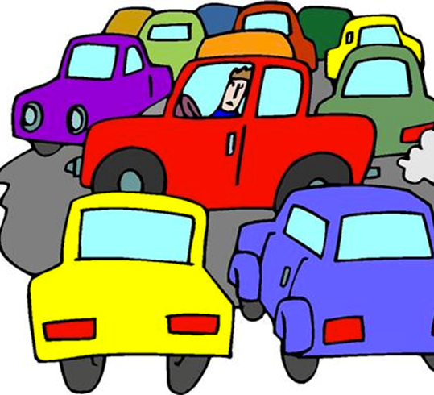
What Can We do to Save Energy?

Slide 24

Long Hot Shower!
What can we do to prevent this energy waster?

Slide 25

No one’s home!
What can we do to prevent this energy waster?

Slide 26

Who left the TV on?
What can we do to prevent this energy waster?

Slide 27
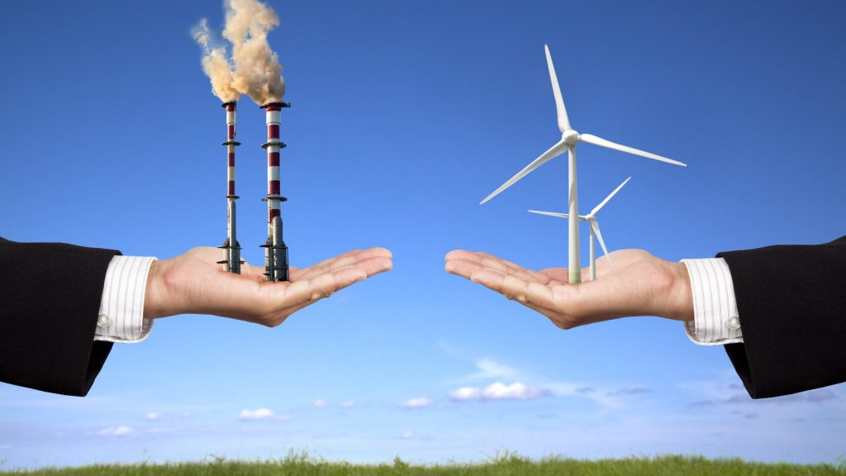
Questions:
Why is it important not to waste energy?
The amount of fossil fuels is limited and burning fossil fuels damages our environment.
It is important to save energy – and to use renewable resources to meet our energy needs when we can.
Notes:
http://www.zmescience.com/ecology/climate/how-much-renewable-energy/

Slide 28

How can you save energy?
Saving energy will cut down on pollution and help our fossil fuels last longer.
Here are some energy-saving tips that students should know:
Turn off the radio and television when not in use.​
Turn off the lights when you are not using them.​
Use a sweater to stay warm in the winter instead of turning up the thermostat.​
Use a compact fluorescent light bulb (CFL) instead of an incandescent one.​

Slide 29

Homework:
Complete the Energy Saver Questionnaire at home with their parents or guardians.
Parents or guardians should sign the questionnaire for verification of completeness.

Slide 30


EcoLearn
Developed by the Environmental Protection Agency
With support from Department of State
Virtual Students of Foreign Service Interns
https://www.epa.gov/education
US EPA
Region 10
EcoLearn
For more information: hanft.sally@epa.gov or salazar.viccy@epa.gov

