Slide 1
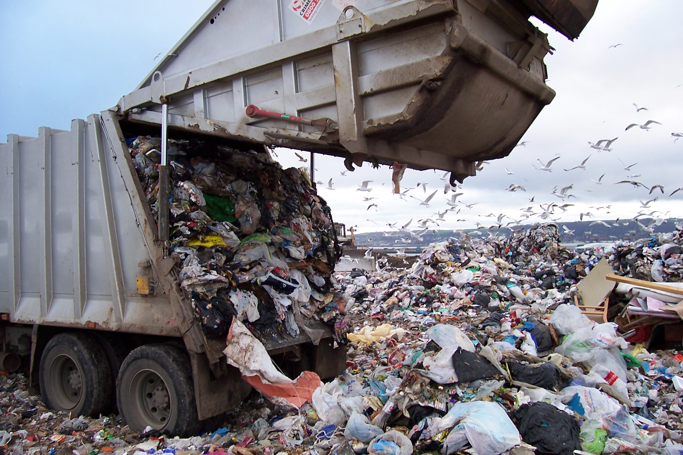
Source: http://www.corvallisadvocate.com/wp-content/uploads/2013/01/Landfill-For-Interior.jpg

Slide 2
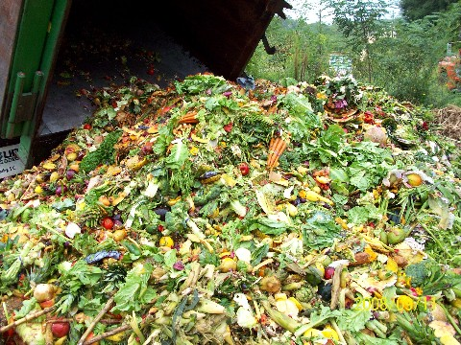
Source: http:///www.triplepundit.com/2010/11/uk-businesses-hoping-to-help-the-planet-and-themselves-join-the-clean-plate-club

Slide 3
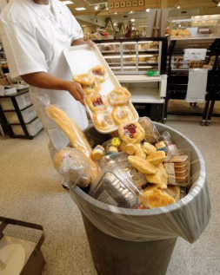
Source: Triple Pundit http://www.triplepundit.com/2011/05/food-waste-information-technology/

Slide 4
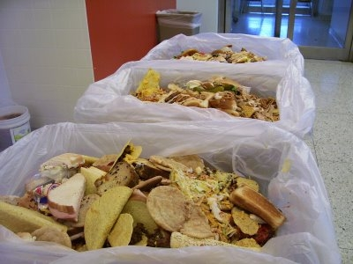
Source: Quiet Environmentalist http://quiet-environmentalist.com/wp-content/uploads/2010/08/Food-Waste-Images.jpg

Slide 5
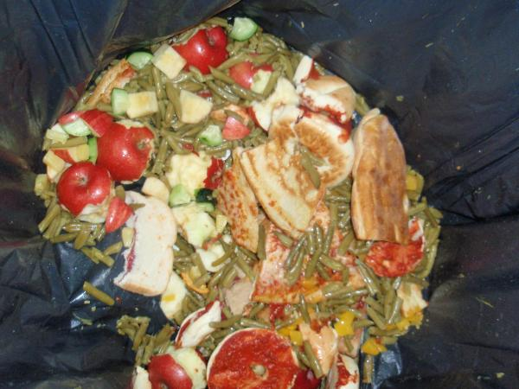
Source: Oneida-Herkimer Solid Waste Authority http://www.ourgreenteam.org/assets/_resampled/resizedimage600450-NYMillsandMohawk-028.jpg

Slide 6
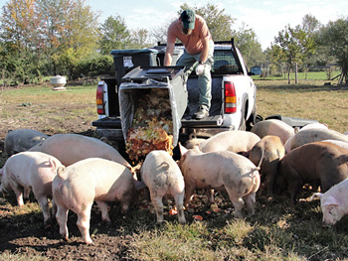
Source: http://reason.kzoo.edu/reason/images/330710.jpg

Slide 7
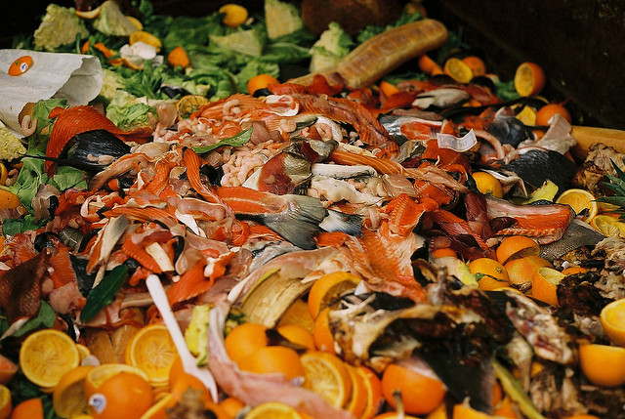
Source: Smart Planet http://www.smartplanet.com/blog/the-big-story/for-business-food-waste-a-ripe-opportunity-for-savings/

Slide 8
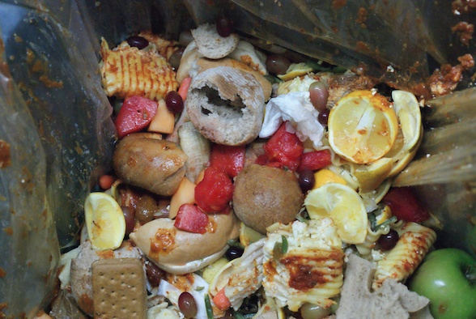
Source: Domaphile http://domaphile.com/2013/03/05/school-lunch-confidential-inside-cafeteria-composting/

