Slide 1
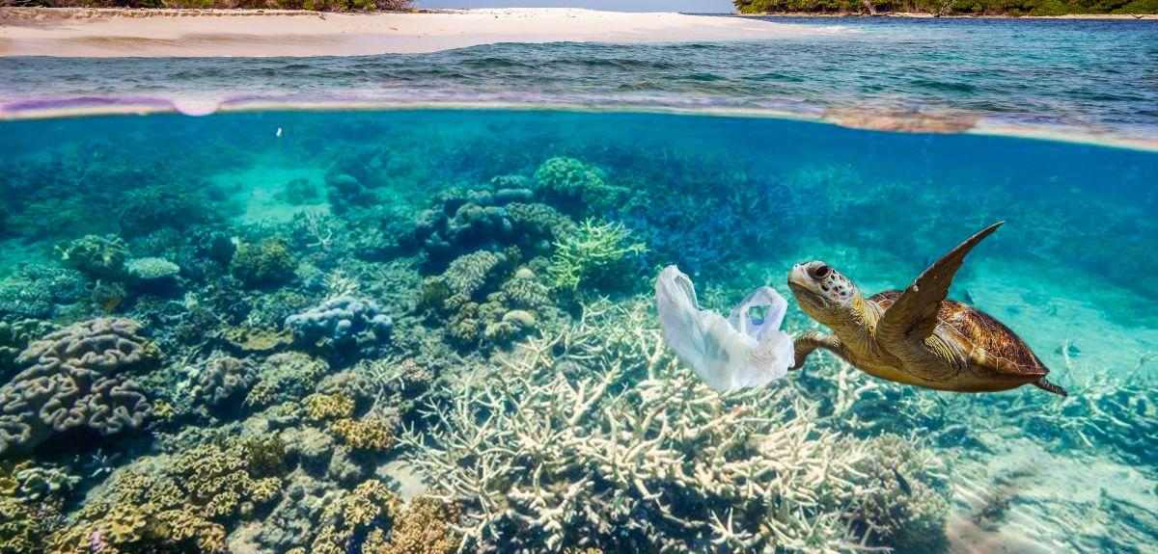

1st Grade
Marine Debris
Learn what we can do to keep our oceans clean.
US EPA
Region 10
EcoLearn
Notes:
https://phys.org/news/2017-07-urgently-oceans-scientists.html

Slide 2
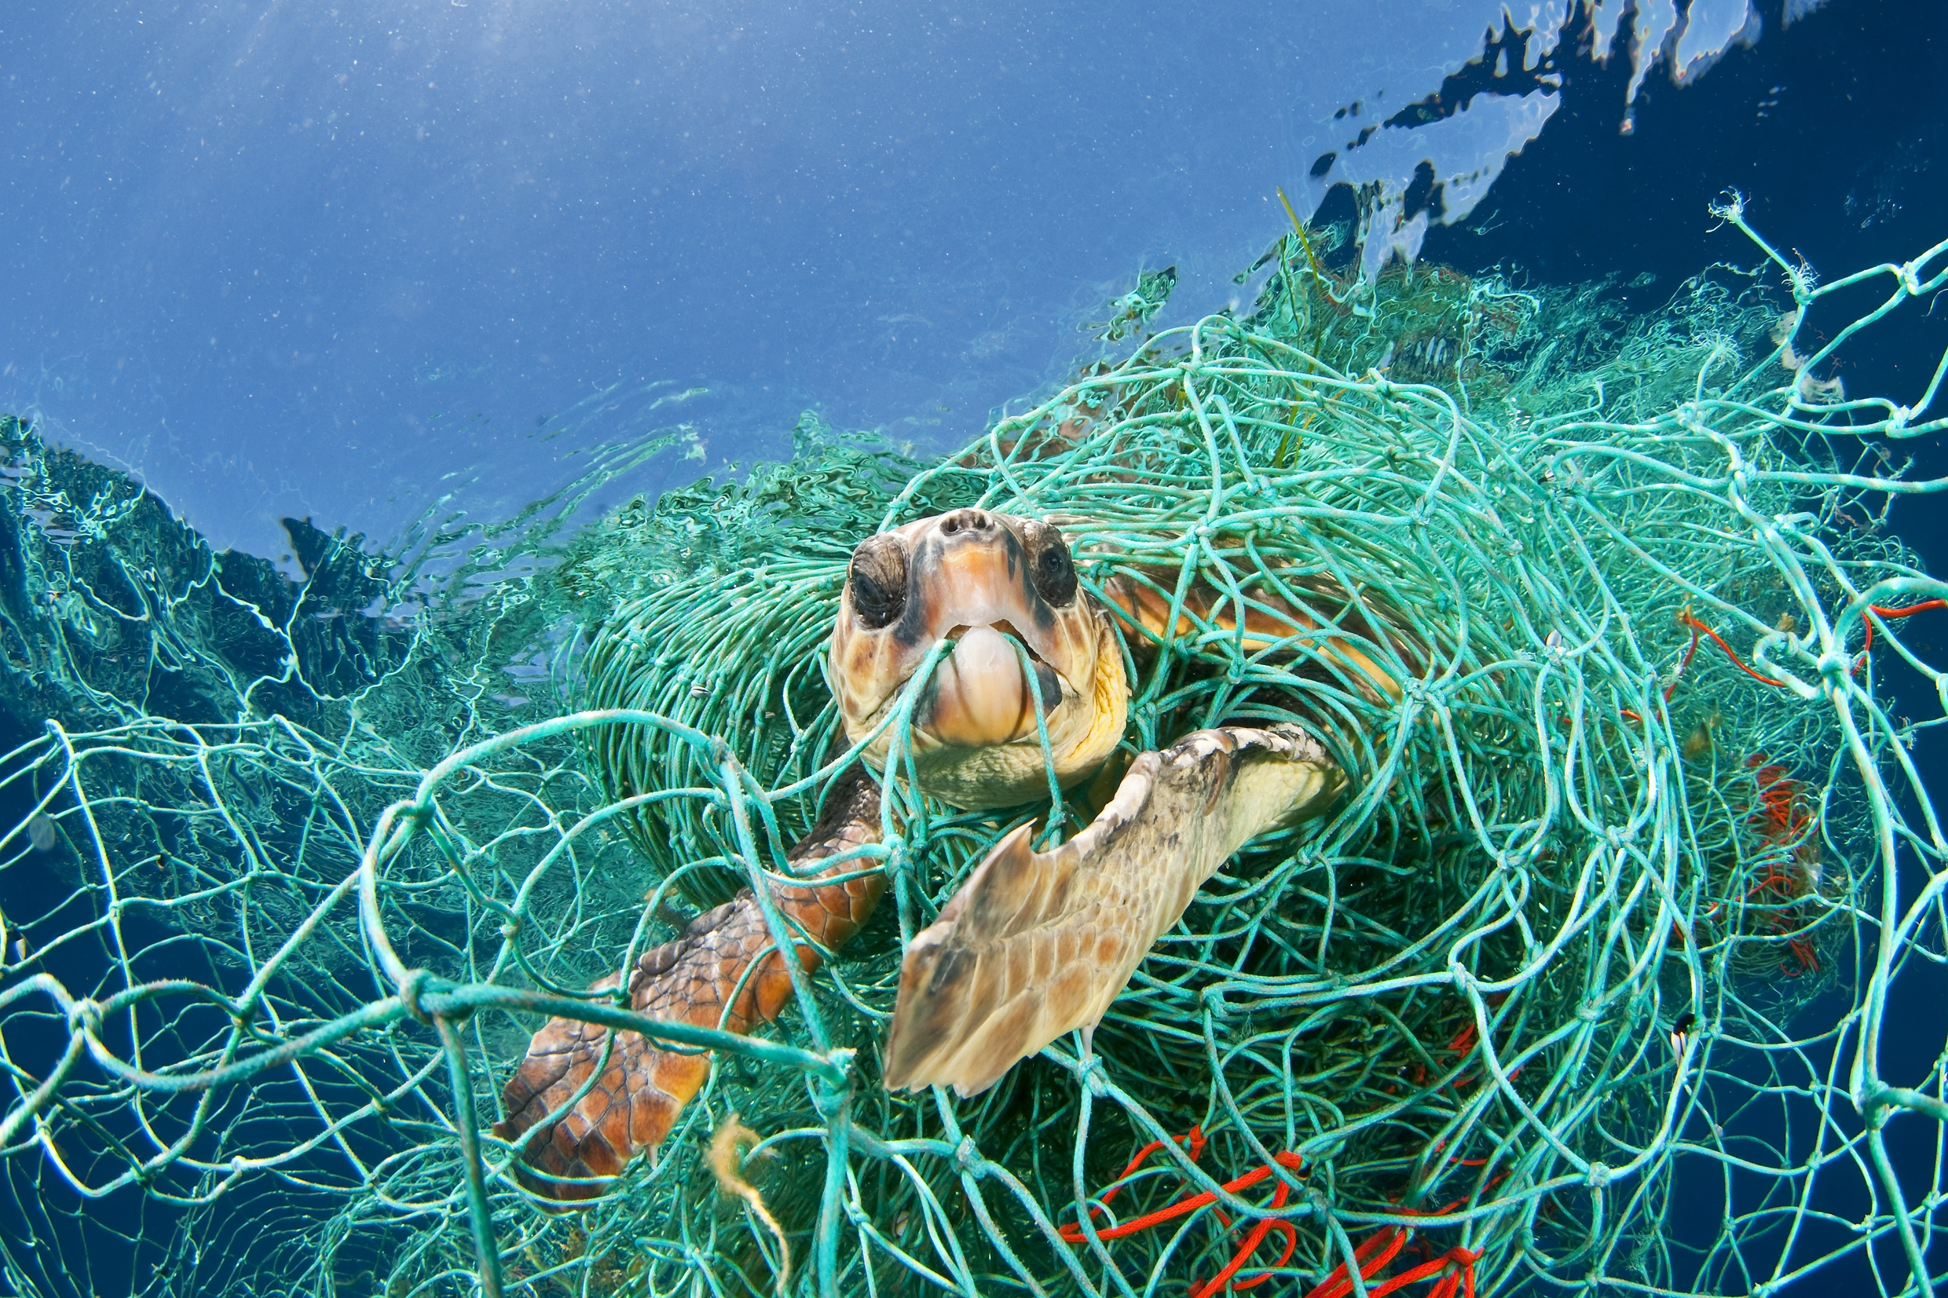
Marine Debris
Notes:
Source: https://teenkidsnews.com/tkn-news/science/marine-debris-a-legacy-of-litter/
Today, we will learn about marine debris, also called aquatic trash. Marine debris is any kind of trash that has made its way to the ocean, such as plastic bags, bottles, or other kinds of litter.

Slide 3






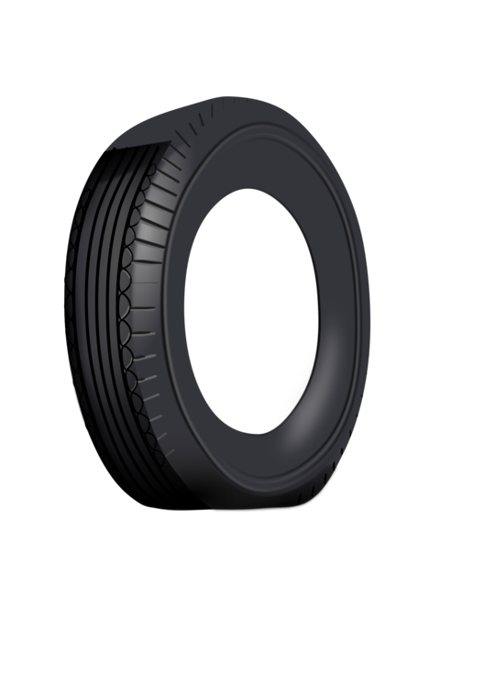


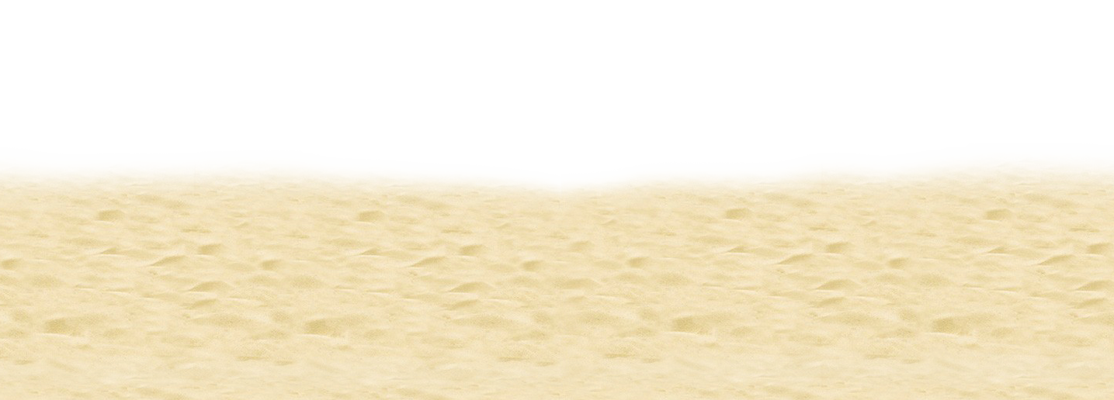

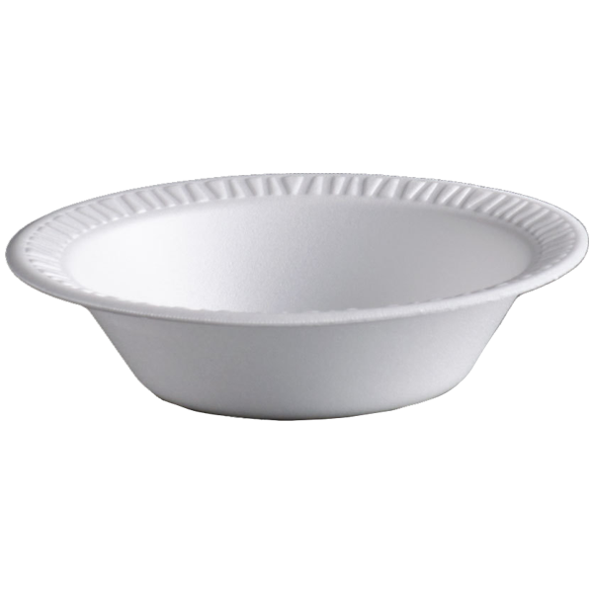
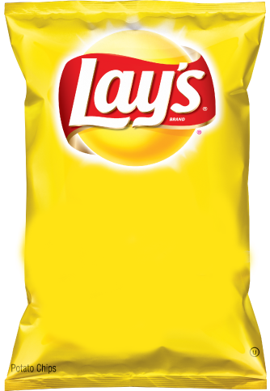
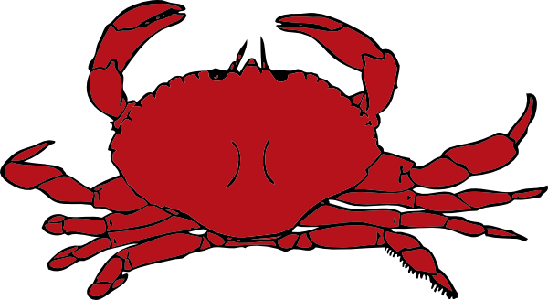


Notes:
DO NOW:
Can you tell me what belongs in the ocean? What lives in the ocean and what doesn’t? What grows in the ocean and what doesn’t? What in this picture doesn’t belong?
Fish: https://requestreduce.org/categories/images-of-fish-clipart.html
Octopus: https://www.mycutegraphics.com/graphics/letter/octopus.html
Starfish: https://clipartpng.com/?1439,starfish-png-clip-art
Shell: https://gallery.yopriceville.com/Free-Clipart-Pictures/Summer-Vacation-PNG/Sea_Shell_PNG_Clip_Art_Image
Crab: http://www.clipartpanda.com/categories/crab-clip-art-cartoon
Coral: http://worldartsme.com/coral-free-clipart.html#gal_post_52417_coral-free-clipart-1.jpg
Seaweed: http://clipart-library.com/seaweed-cliparts.html
Plastic Bottle: https://www.kisscc0.com/clipart/plastic-bag-fizzy-drinks-plastic-bottle-water-bott-3v81ct/
Plastic Bag: https://openclipart.org/detail/303136/plastic-shopping-bag
Tire: https://www.kisscc0.com/clipart/car-a-rubber-tire-download-duesi-tire-12zmst/
Fishing Net: https://clipart.wpblink.com/wallpaper-4864769
Jellyfish: https://www.pinterest.com/pin/119626933828969334/
Sand: http://clipart-library.com/beach-sand-cliparts.html

Slide 4
Notes:
Here are the answers!
Follow Up Question: How do you think these items got here?
Fish: https://requestreduce.org/categories/images-of-fish-clipart.html
Octopus: https://www.mycutegraphics.com/graphics/letter/octopus.html
Starfish: https://clipartpng.com/?1439,starfish-png-clip-art
Shell: https://gallery.yopriceville.com/Free-Clipart-Pictures/Summer-Vacation-PNG/Sea_Shell_PNG_Clip_Art_Image
Crab: http://www.clipartpanda.com/categories/crab-clip-art-cartoon
Coral: http://worldartsme.com/coral-free-clipart.html#gal_post_52417_coral-free-clipart-1.jpg
Seaweed: http://clipart-library.com/seaweed-cliparts.html
Plastic Bottle: https://www.kisscc0.com/clipart/plastic-bag-fizzy-drinks-plastic-bottle-water-bott-3v81ct/
Plastic Bag: https://openclipart.org/detail/303136/plastic-shopping-bag
Tire: https://www.kisscc0.com/clipart/car-a-rubber-tire-download-duesi-tire-12zmst/
Fishing Net: https://clipart.wpblink.com/wallpaper-4864769
Jellyfish: https://www.pinterest.com/pin/119626933828969334/
Sand: http://clipart-library.com/beach-sand-cliparts.html

Slide 5
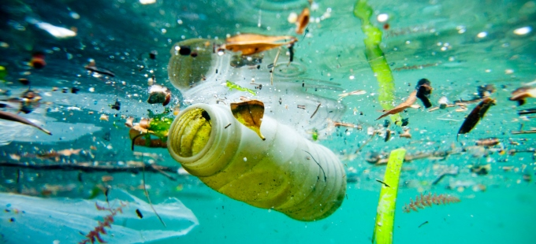
Discuss
Notes:
Discussion Questions:
What is aquatic trash or trash in our water?
How does this impact our water and beaches?
Answer: Plastic and other garbage can enter our water ways and pollute our ocean! Here is a nice woman collecting trash from the ocean.
Source: http://www.rona.unep.org/news/2015/biodegradable-plastics-are-not-answer-reducing-marine-litter-says-un

Slide 6
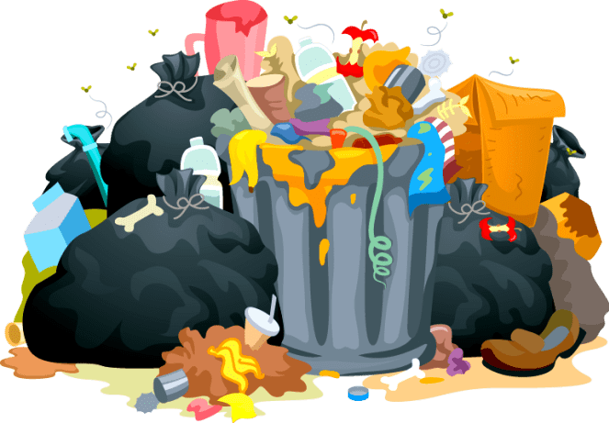
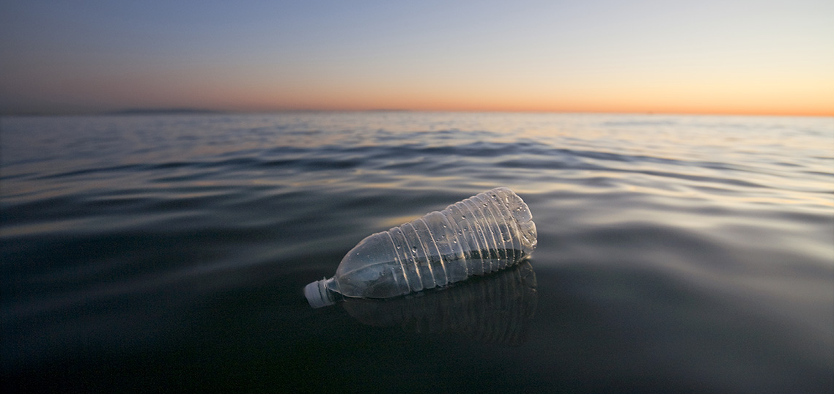

Keywords
Click for audio.
Notes:
For today’s lesson, we will learn the following key words.
Trash in Our Water: any piece of solid trash that enters the marine environment.
Pollution: contamination to air, water, or soil by things that are harmful to living things. It can happen in nature, like by a volcanic eruption, or by humans, like smoke from factories.
The 4 R’s: Reduce, Reuse, Recycle, and Refuse! We’ll talk more about this on the next slide.

Slide 7
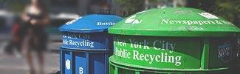


The 4 Rs
Click for audio.
Notes:
https://www.epa.gov/sites/production/files/styles/large/public/2013-06/recycle.jpg
The 4 Rs: Today, we are going to learn about plastics, trash, and our big waste problem. Have you ever seen trash that isn’t in trash cans? Where? Trash can accidentally flow into our streams, rivers, and oceans, which upsets our animal friends. Sometimes, trash can leak nasty chemicals into the soil. It’s important to follow the four Rs – refuse, reduce, reuse, and recycle – as much as we can.
Refuse means that you can choose not to use or buy something in the first place!
Reduce means using less stuff in general.
Reuse means trying to use something until it can’t be used any more.
Recylce means properly disposing of plastics, metals, and other recyclable materials so they can be made into other things.
8 million metric tons of garbage end up in the ocean every year. This is the same as a garbage truck dumping its trash into the ocean every minute of every day for a whole year! Almost all of this trash, 88%, is plastic. Plastics don’t break down, or biodegrade, like apples or other products, but instead break into tinier and tinier pieces that can stick around for thousands of years! Litter is ugly, can hurt animals, and costs people billions of dollars every year. Let’s play a game called “how long til it’s gone?”
Source: http://brucemctague.com/wp-content/uploads/2016/01/dirty-water-clean-water.jpg

Slide 8
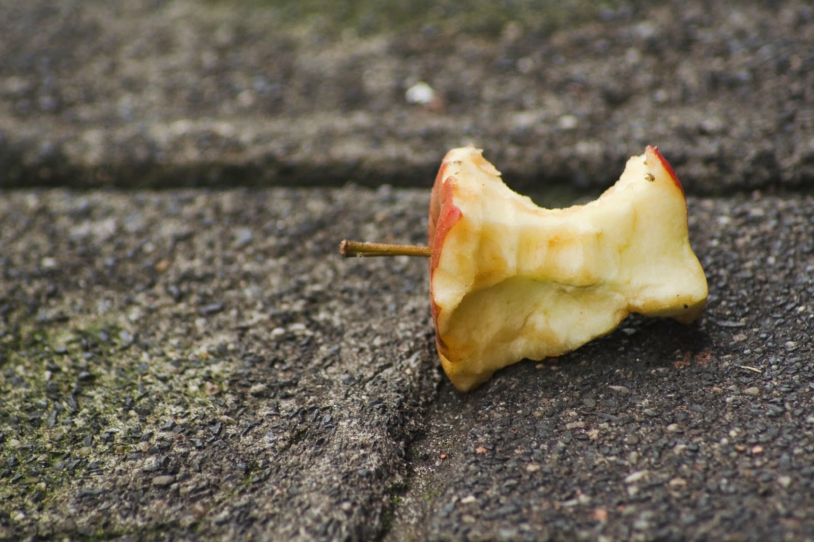
How Long ‘till it’s GONE?
Click for audio.
Notes:
How long till an apple is gone?

Slide 9
How Long ‘till it’s GONE?
2 months
Click for audio.
Notes:
An apple will break down in about 2 months!

Slide 10
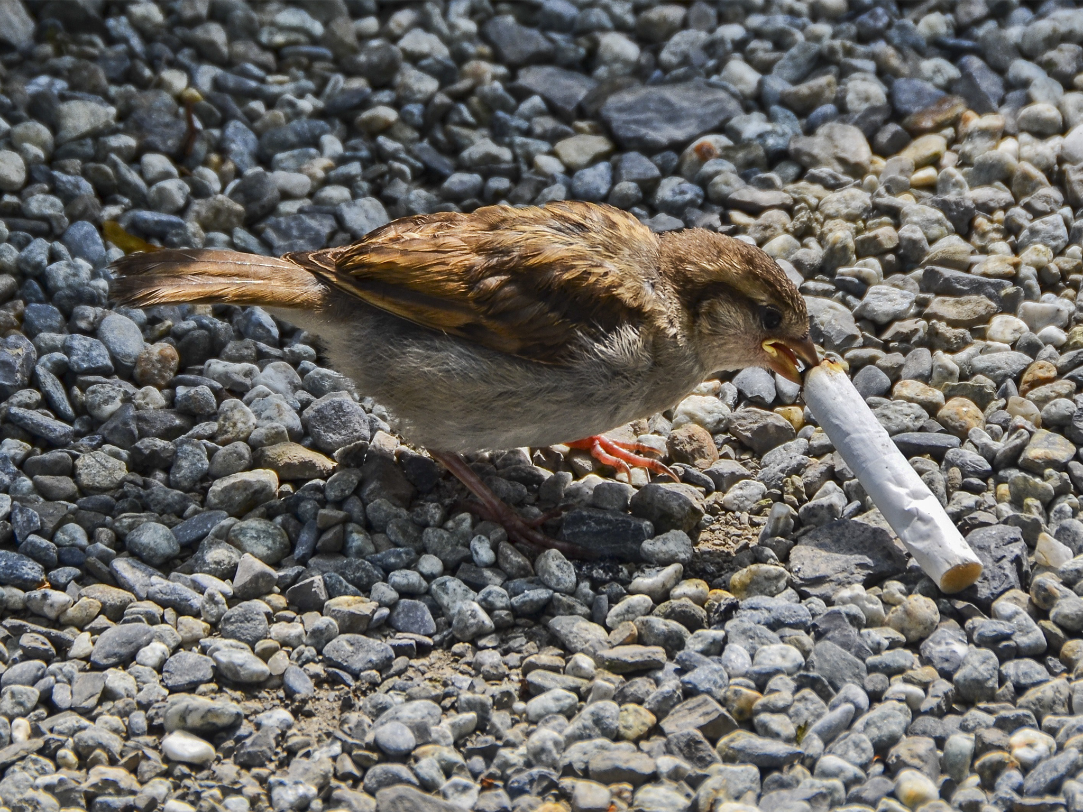
How Long ‘till it’s GONE?
Click for audio.
Notes:
How long until a cigarette is gone?

Slide 11
How Long ‘till it’s GONE?
5 years
Click for audio.
Notes:
A cigarette won’t break down for 5 years!

Slide 12
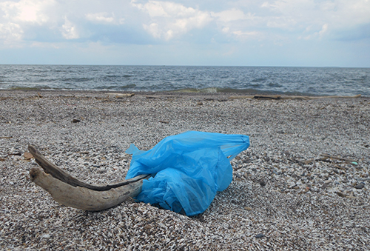
How Long ‘till it’s GONE?
Click for audio.
Notes:
How long does it take for a plastic bag to break down?

Slide 13
How Long ‘till it’s GONE?
20-1000
years
Click for audio.
Notes:
Answer: 20 years.
20-1000

Slide 14
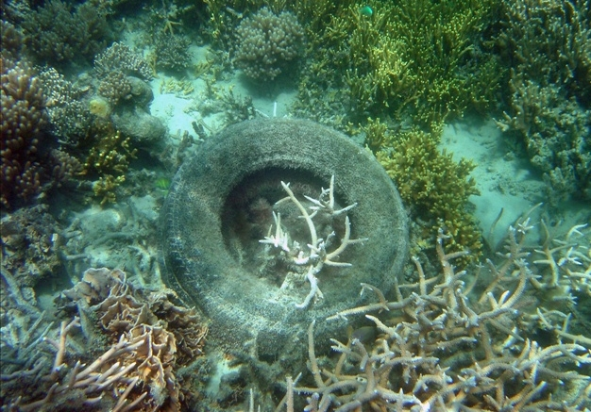
How Long ‘till it’s GONE?
Click for audio.
Notes:
How long ‘till a tire breaks down?

Slide 15
How Long ‘till it’s GONE?
80 years
Click for audio.
Notes:
Answer: 80 years!

Slide 16
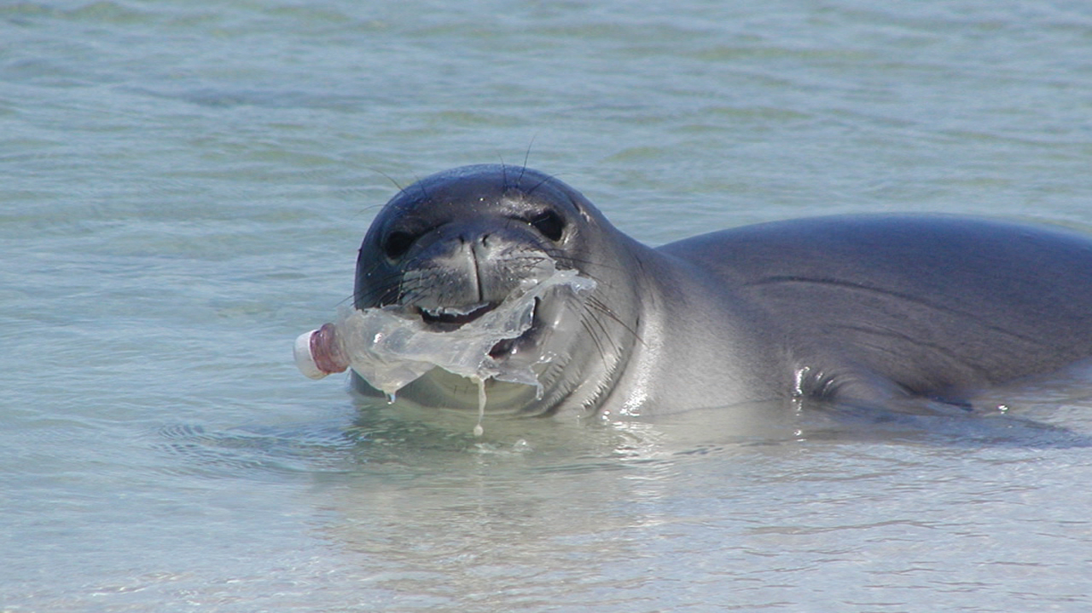
How Long ‘till it’s GONE?
Click for audio.
Notes:
How long ‘till a plastic bottle is gone?

Slide 17
How Long ‘till it’s GONE?
450 years
Click for audio.
Notes:
It takes 450 years for a plastic bottle to break down!

Slide 18
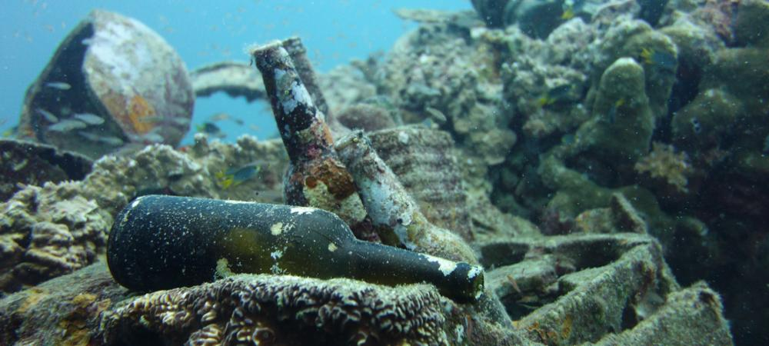
How Long ‘till it’s GONE?
Click for audio.
Notes:
How long ‘till a glass bottle is gone?

Slide 19
How Long ‘till it’s GONE?
1,000,000 years!
Click for audio.
Notes:
It takes one *million* years for a glass bottle to break down!

Slide 20
What in this picture doesn’t belong?
Click for audio.
Notes:
A little bit of practice: “What in this Picture Doesn’t Belong” (5 min)
Facilitate, “What in this Picture Doesn’t Belong.” You can use the powerpoint slides or print out the paper version that can be found in the EcoLearn Files under “1st Grade Marine Debris.”
Introduce the Activity:
If trash doesn't end up in our trash cans, it can end up in our waterways and oceans. In each of these pictures, there is a piece of trash that doesn’t belong. Can you find the item that doesn’t belong?
Have the students look at the pictures on either the slides or the worksheet, and identify which items in the pictures do not belong. The best way to do this will be to print out copies of the activity, have them circle the items on their sheet, and then follow up with the presentation and go through their answers on the big screen.
Source: https://washedashore.org/marine-debris/

Slide 21
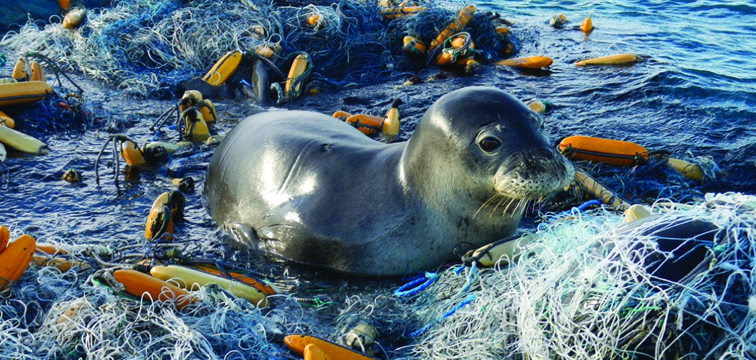
What in this picture doesn’t belong?
Click for audio.
Notes:
If trash doesn't end up in our trash cans, it can end up in our waterways and oceans. In each of these pictures, there is a piece of trash that doesn’t belong. Can you find the item that doesn’t belong?
Source: https://www.noaa.gov/explainers/what-is-marine-debris

Slide 22
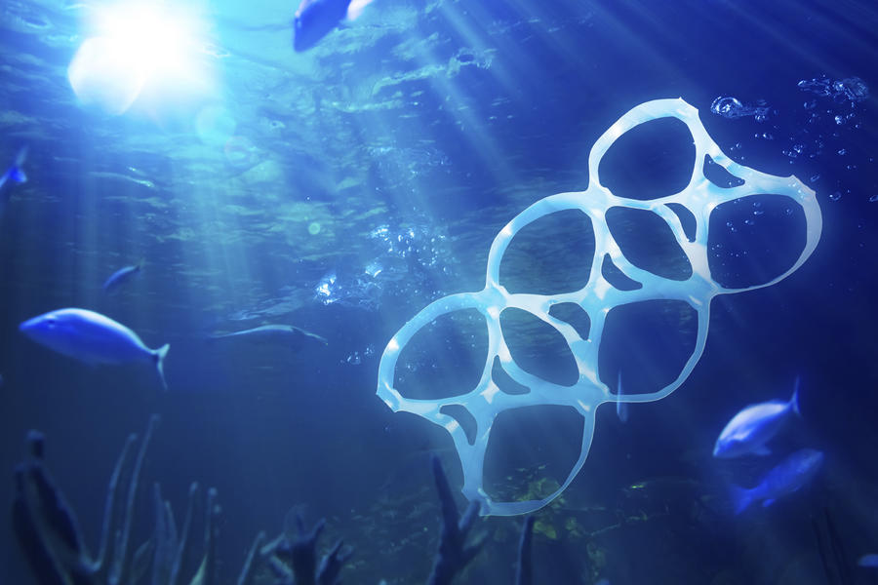
What in this picture doesn’t belong?
Click for audio.
Notes:
If trash doesn't end up in our trash cans, it can end up in our waterways and oceans. In each of these pictures, there is a piece of trash that doesn’t belong. Can you find the item that doesn’t belong?
https://www.packworld.com/article/sustainability/waste-reduction/chinese-plastics-associations-join-effort-reduce-marine

Slide 23
What in this picture doesn’t belong?
Click for audio.
Notes:
If trash doesn't end up in our trash cans, it can end up in our waterways and oceans. In each of these pictures, there is a piece of trash that doesn’t belong. Can you find the item that doesn’t belong?
Source: https://us.whales.org/issues/man-made-marine-debris

Slide 24
How can we help?
Click for audio.
Notes:
How can we help? These issues may seem huge and scary, but there are things all of us can do to help keep our oceans clean and our animals safe. Let’s brainstorm ways we can help. Why is there trash in the water? Why does it keep happening? What are steps you can take at school or at home to help?

Slide 25
Click for audio.
Notes:
Answer? Reduce, Reuse, Recycle and Refuse!
If we don’t need an extra bottle of sunscreen, we should do what? We should refuse it! If we only need one paper plate at our beach picnic, we should do what? We should reduce how many we use! If we have an empty water bottle, we should do what? Refill it and reuse it! If we eat a snack at the beach and have trash, we should do what? We should put the trash in the right bin and recycle it!

Slide 26
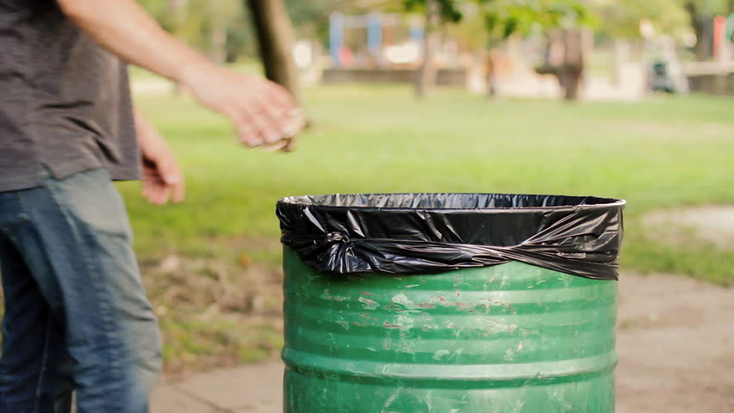
How Can We Help?
Click for audio.
Notes:
You can also help by simply throwing your trash away! Which leads us to our final activity.
https://www.shutterstock.com/video/clip-10758917-throwing-away-garbage-public-trash-can

Slide 27
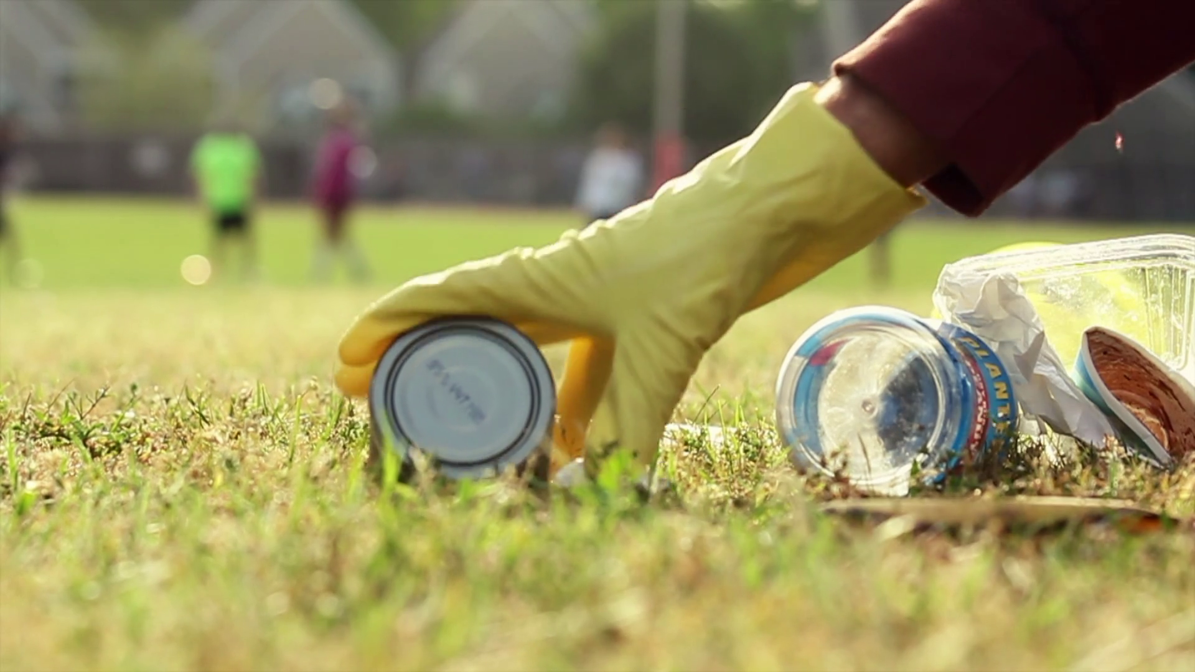
Trash Tracking
Click for audio.
Notes:
Trash Tracking: Let’s do an activity. This activity happens outdoors.
Pollution that comes from our rivers and streams usually goes into the ocean. To see this ourselves, we will be going outside to observe the places trash comes from, and the damage it can cause! For today’s assignment we will be counting pollution as all litter or trash we can see easily – these things that can become marine debris. It is important to avoid any sharp items, like broken glass, and to wear gloves during this assignment.
Source: https://www.videoblocks.com/video/picking-up-trash-in-park-r7cd_w9nxix15ycz5

Slide 28

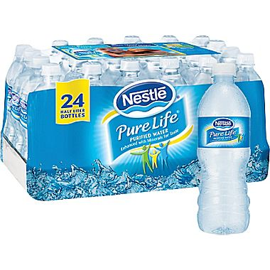
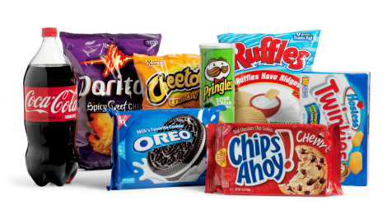
Trash Tracking Predictions
Click for audio.
Notes:
Let’s make predictions. What do you think you will find outside? What types of trash will you find most? Where will you find the most trash? At the end of this activity, you will each pick one piece of trash that stands out to you for any reason.

Slide 29
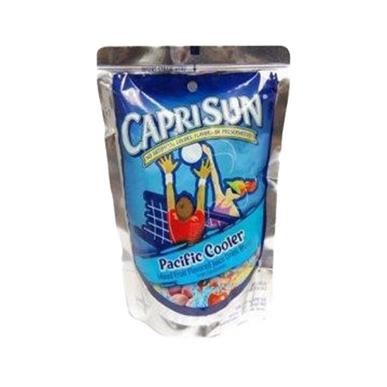
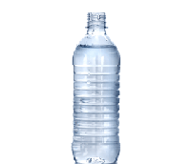


Trash Tracking Conclusions
Notes:
Let’s reflect. What did you find when looking for litter outside? What type of trash did you find most? What was the one piece of trash you found that stands out to you, and why?
Source: https://etownpubliclibrary.org/event/wild-wednesday-copy-copy-copy/
http://pluspng.com/plastic-bottles-png-170.html
https://yocartdelivery.com/products/capri-sun-pacific-cooler-6oz
https://unixtitan.net/explore/straw-clipart-png/

Slide 30
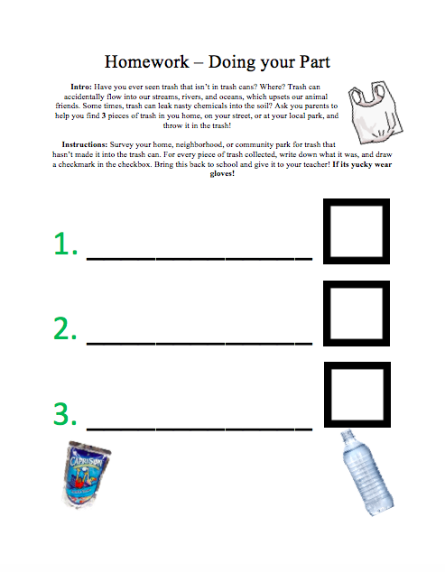
Homework
Notes:
Print out enough copies of the “Trash Checklist” and pass them out to students to take home with them.
Have you ever seen trash that isn’t in trash cans? Where? Trash can accidentally flow into our streams, rivers, and oceans, which upsets our animal friends. Some times, trash can leak nasty chemicals into the soil? Ask you parents to help you find 3 pieces of trash in you home, on your street, or at your local park, and throw it in the trash!
Instructions: Survey your home, neighborhood, or community park for trash that hasn’t made it into the trash can. For every piece of trash collected, write down what it was, and draw a checkmark in the checkbox. Bring this back to school and give it to your teacher! If its yucky wear gloves!

Slide 31
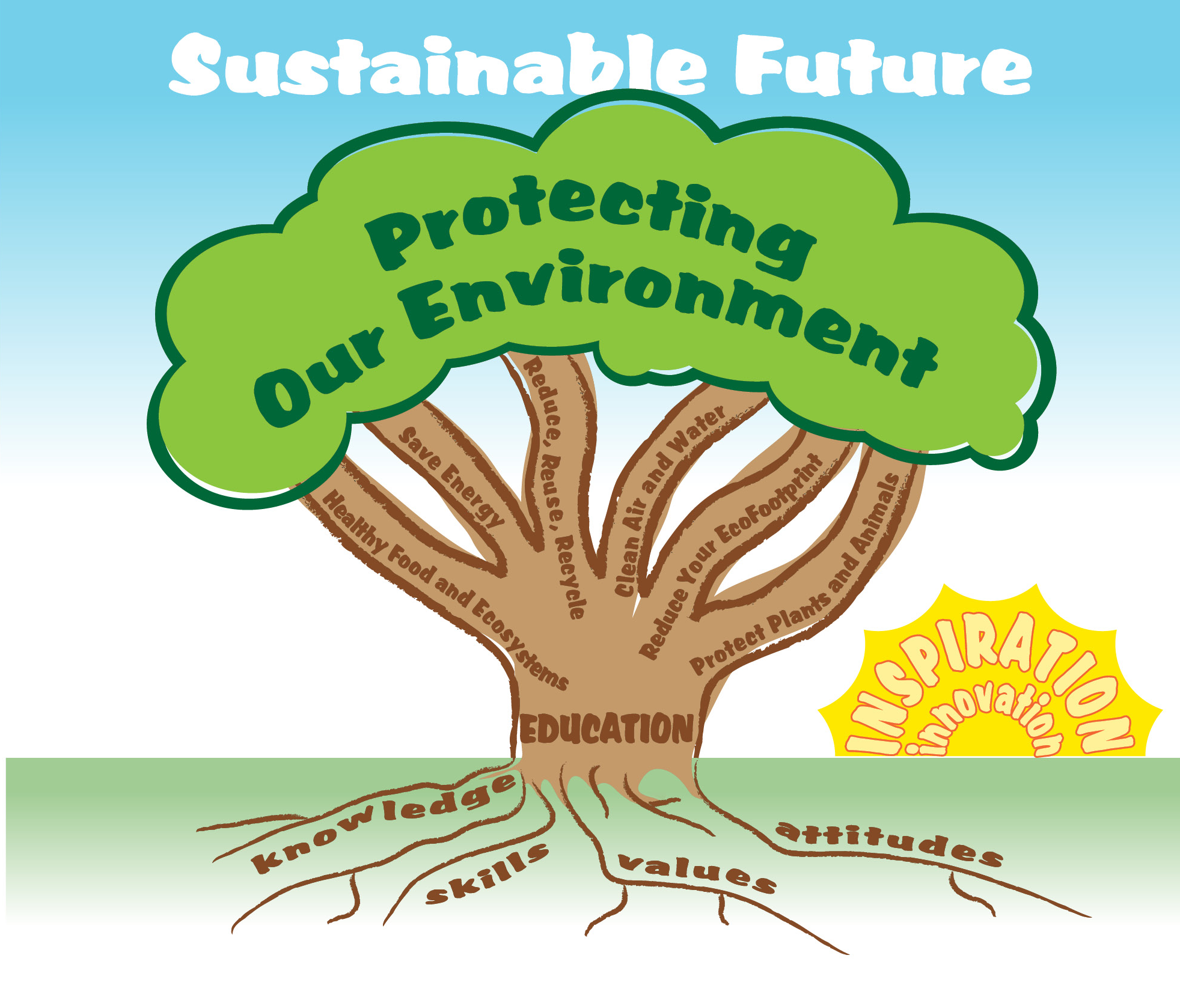
EcoLearn
Developed by the Environmental Protection Agency
With support from Department of State
Virtual Students of Foreign Service Interns
https://www.epa.gov/education
US EPA
Region 10
EcoLearn
For more information: hanft.sally@epa.gov or salazar.viccy@epa.gov

