Slide 1
Extinct, Endangered, or Threatened?

Slide 2
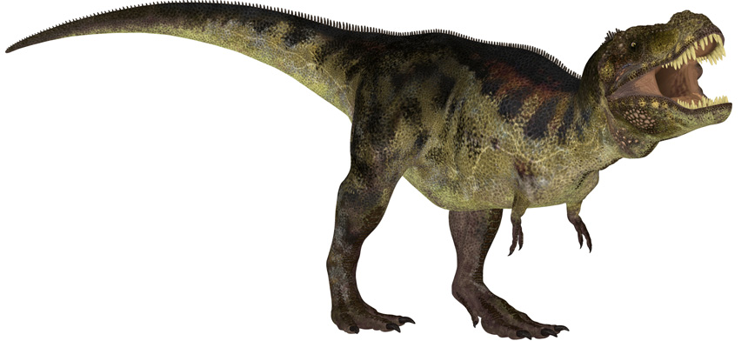
Dinosaurs
Source: https://www.sciencenews.org/article/brain-reconstruction-hints-dinosaur-communication
Extinct

Slide 3
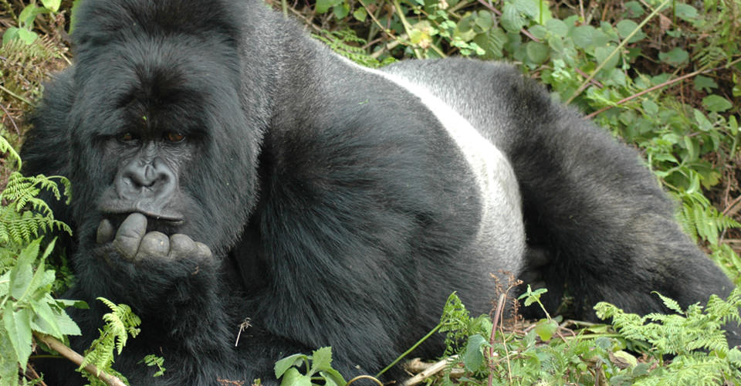
Gorillas
Source: http://www.nathab.com/photo-tours/africa/ultimate-gorilla-photo-safari/
Endangered

Slide 4
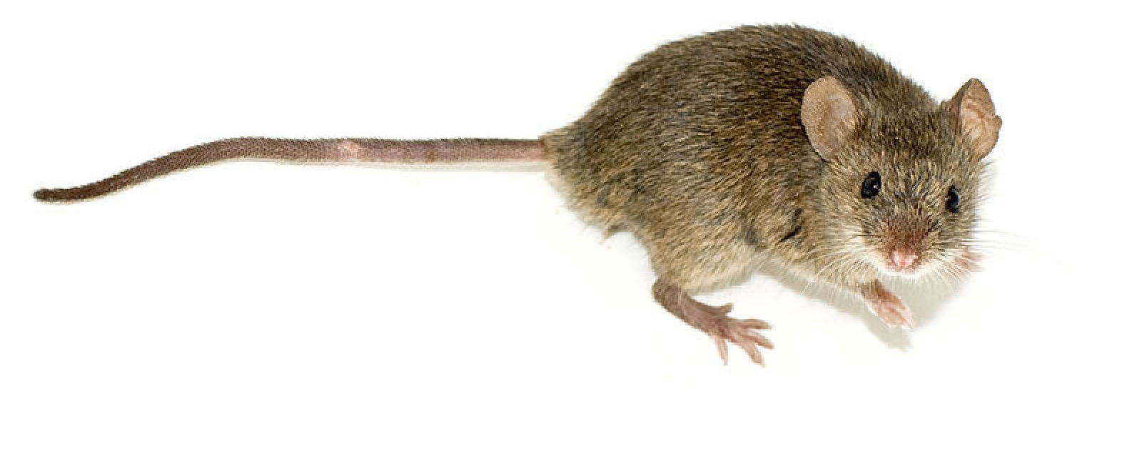
Mice
Source: http://ddar.manchester.ac.uk/blog/?attachment_id=377
Not Threatened

Slide 5
What other animals are endangered?

Slide 6
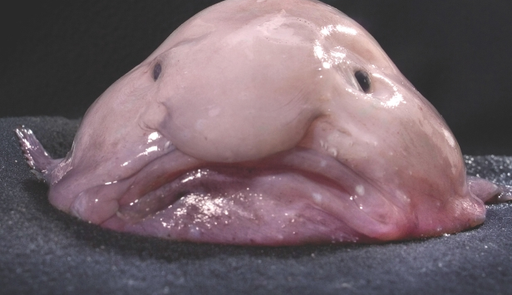
Blobfish
Source: http://www.howitworksdaily.com/what-is-the-blobfish/

Slide 7
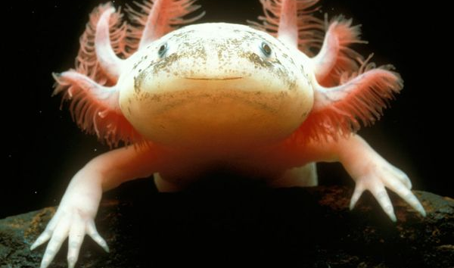
Axolotl
Source: http://animals.nationalgeographic.com/animals/amphibians/axolotl/

Slide 8
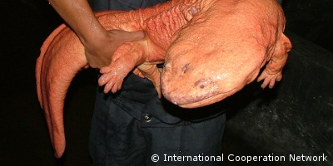
Chinese Giant Salamander
Source: http://www.edgeofexistence.org/conservation/conservation_project.php?id=111

Slide 9
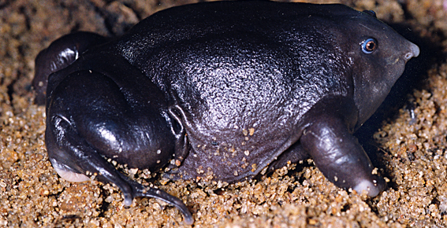
Purple Frog
Source: http://scribol.com/environment/bizarre-animals-on-the-edge-of-extinction?utm_campaign=Feed%3A%20environmentalgraffiti%20%28Environmental%20Graffiti%29&utm_medium=feed&utm_source=feedburner

Slide 10
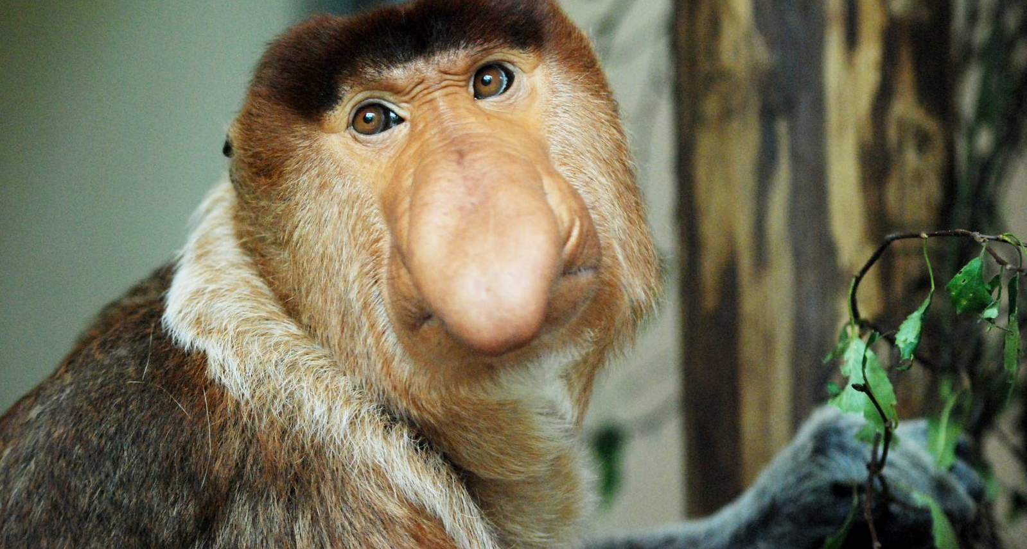
Proboscis Monkey
Source: http://www.zoochat.com/159/proboscis-monkey-apenheul-30-05-12-a-275139/

