Slide 1
Energy Through History

Slide 2
What is Energy?
Energy makes change possible.
It is essential to everything we do.
Which of your daily activities require energy?
  Walking or playing sports
  Riding the bus to school
  Turning on the television or computer
  Growing food
Notes:
For the leading question, receive all answers. Some examples are listed if students are having trouble. After a brief brainstorming session, ask students where energy comes from? The Next few slides will provide some historical context on the subject.

Slide 3
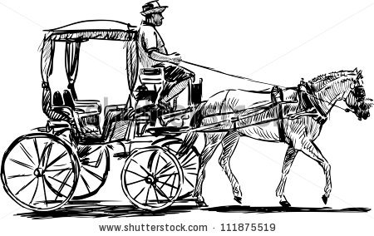
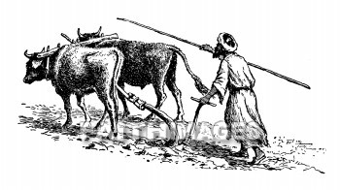
Human or Animal Labor
Source: food cycling through the food chain, ultimately beginning with the sun.
Uses: agriculture, transportation
Notes:
The image to the left depicts two ox pulling a plow to till soil for planting. To the right depicts a horse drawn carriage.

Slide 4

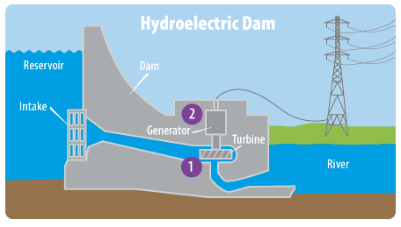
Mechanical Energy
Source: windmills, dams
Uses: machines, irrigation, electricity
Notes:
On the left is a windmill, which can be used to power sawmills or even generate electricity. Dams are powered by gravity: as water falls it creates power by spinning a turbine which used to be used to power sawmills and other machinery, but now is often sued to generate electricity.

Slide 5
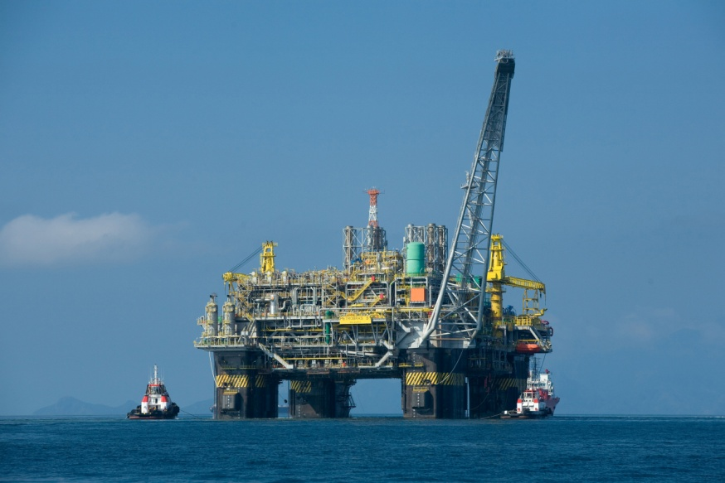

Fossil Fuels
Sources: burning stored carbon in coal, oil, or natural gas
Uses: electricity, transportation
Notes:
More than 100 years ago, people around the world started burning large amounts of coal, oil, and natural gas to power their homes, factories, and vehicles. Today, most of the world relies on these fossil fuels for their energy needs. These forms of energy come from plants and animals that have decayed over millions of years. The instructor should also mention here that burning fossil fuels have some negative environmental impacts, such as the creation of air and water pollution. This includes carbon emissions which is a primary driver of climate change.
The image to the left is an offshore oil rig, which obtains oil from deep below the ocean floor. The image to the right depicts a surface coal mine.

Slide 6
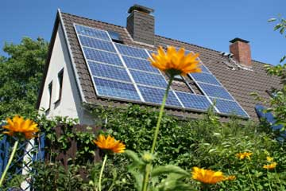
Two Types of Energy
Non-renewable: finite
  Examples: fossil fuels
Renewable: infinite, nonperishable
  Examples: solar, wind, geothermal
Notes:
Fossil fuels are an example of a non-renewable energy source. This means they have a finite, or limited amount.
Renewable energy sources are infinite, meaning their supply is limitless. The Sun is an example of a renewable energy source. Depicted below is a home with solar panels, which transform energy from the sun into electricity to heat and power the home.

Slide 7
Conservation
Today, we are going to discuss ways in which our choices can reduce the amount of energy we use. In turn, this can reduce the negative environmental impacts of fossil fuels.

