Slide 1


2nd Grade
Reducing Waste
Learn what happens to materials and food when we are done using them, and why reducing and reusing are so important
EcoLearn
Notes:
Source: https://www.theodysseyonline.com/learning-bees-american-honey-queen

Slide 2
Do Now
Imagine you just finished a jar of your favorite jelly at home. What would you do with the empty glass container?

Slide 3
Choose to Reduce, Reuse, Recycle
Landfills are filling up as human population increases, causing environmental issues.
Let’s keep our planet clean!
Notes:
Pass out handout

Slide 4
Waste Detective

Slide 5
Practice
Draw a picture that shows why we should reduce the amount of waste we put in our world.

Slide 6
Closure

Slide 7
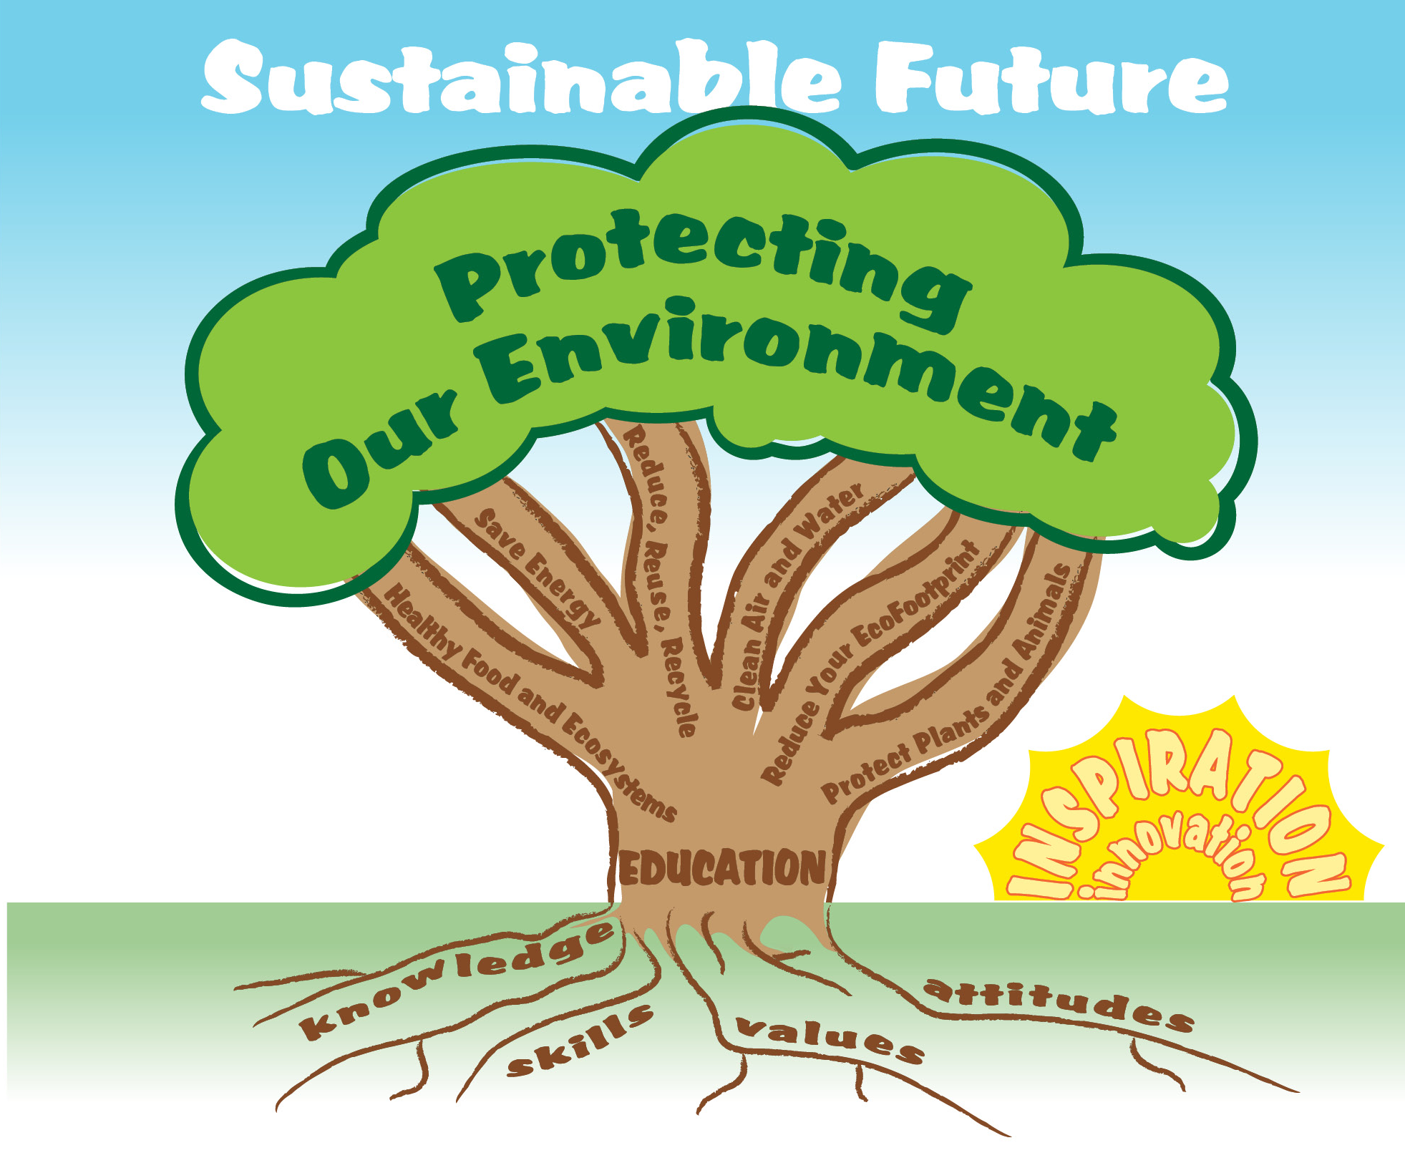
EcoLearn
For more information:
hanft.sally@epa.gov or
salazar.viccy@epa.gov
Developed by the Environmental Protection Agency
With support from Department of State
Virtual Students of Foreign Service Interns
https://www.epa.gov/education
US EPA
Region 10
EcoLearn

