Slide 1

Third Grade
Air Pollution
Learn about what we can do to help keep the air clean and reduce our pollution!
US EPA
Region 10
EcoLearn
Notes:
Source: http://intfs.com/wp-content/uploads/2016/05/cleanair.jpg

Slide 2
Today you will learn about …
Global climate change and air pollution, different kinds of air pollution, and
what you can do to help keep our air clean.
Click for audio.
Notes:
Source: https://i.ytimg.com/vi/ifrHogDujXw/maxresdefault.jpg

Slide 3
Keywords
atmosphere
greenhouse effect
greenhouse gas
global warming
climate change
pollution
climate
weather
photosynthesis
smog
respiration
emission
Click for audio.
Notes:
Source: http://gallery.yopriceville.com/var/resizes/Free-Clipart-Pictures/Sun-and-Moon-PNG/Transparent_Cartoon_Sun_PNG_Clipart_Picture.png?m=1419205415
http://www.fun-lover.com/graphic-shop/Clips/images/FireSmoke/smoke-019.png

Slide 4
Do Now
Try to list all the sources of air pollution! Compare answers with ”In the Air”.
Notes:
Source: http://www.ucsusa.org/sites/default/files/styles/herospace/public/images/2014/08/vehicles-air-cars-traffic-pollution-1_0.jpg?itok=Rb2gdPgb

Slide 5
Does What We Do Matter?
Everything that happens here affects something over there!
Click for audio.
Notes:
Source: http://pngimg.com/uploads/hands/hands_PNG899.png
Record: Everything that happens here affects something over there. Earth has its own control system. The oceans, the land, the air, the plants and animals, and the energy from the Sun all affect each other to make everything work in harmony. Nothing changes in one place without changing something in another place. The overall effect gives us our global climate.

Slide 6
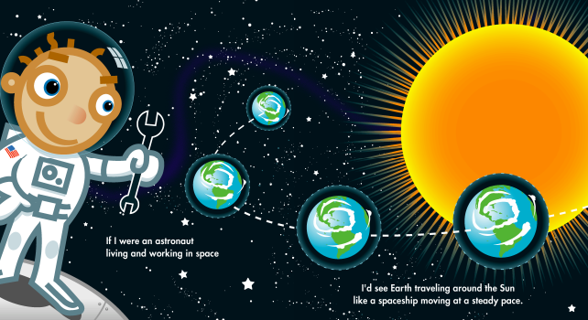
Read “The Air We Breathe”
Click for audio.
Notes:
Source:

Slide 7
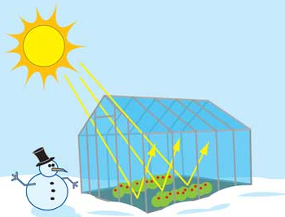
Carbon Dioxide is a Greenhouse Gas
A greenhouse is a house made of glass that traps heat for plants to grow.
Click for audio.
Notes:
Source: NASA
Record: A greenhouse is a house made of glass. People use these to grow plants. During the day, the sun shines and warms the plants. The greenhouse traps the heat.

Slide 8
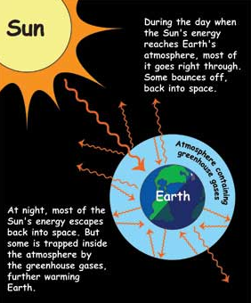
Carbon Dioxide is a Greenhouse Gas
The greenhouse effect keeps some of the Sun’s energy from escaping back into space at night.
Click for audio.
Notes:
Source: NASA
Record: Earth's atmosphere does the same thing as a greenhouse. Gases in the atmosphere act like the roof of a greenhouse. During the day, the Sun shines through the atmosphere. Earth's surface warms up in the sunlight. At night, Earth's surface cools, releasing the heat back into the air. But the energy doesn't all leak back into space; some of the heat is trapped by greenhouse gases in the atmosphere, like carbon dioxide. This is known as the greenhouse effect. This is a good thing, because it means the Earth is warm enough that people, plants, and animals can live here. If it weren't for the greenhouse effect, Earth's oceans wou

Slide 9
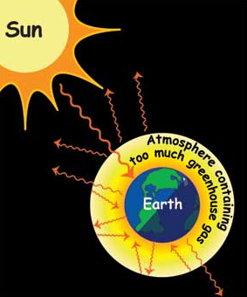
Carbon Dioxide is a Greenhouse Gas
Climate change is when Earth gets too hot or too cold.
Today, Earth is getting too hot from the trapped greenhouse gases in the atmosphere.
Click for audio.
Notes:
Source: NASA

Slide 10
Air Quality Activity
When we burn fossil fuels, we create more than carbon dioxide. We also create air pollution.
Instructions: Hand out the Air Quality Activity and the materials necessary. Discuss the observations as a class.
Click for audio.
Notes:
Source: http://www.commondreams.org/sites/default/files/imce-images/a-coal-fired-power-statio-010.jpg
Record: When we burn fossil fuels, we create more than carbon dioxide. We also create air pollution. Air pollution is caused by chemicals that mix in the air and then make it dirty. It can get so dirty that it makes people sick. For some people, it can become hard to breathe. It can damage plants and animals, rivers and streams, even buildings. Common air pollutants include particulates, nitrogen dioxide, sulfur dioxide, carbon monoxide, and volatile organic compounds. Let's learn about those in the next exercise.

Slide 11
Practice
Many steps that you take to reduce air pollution can also reduce our emissions our emissions of greenhouse gases. Review the recommendations with a parent or guardian!
Click for audio.
Notes:
Source: https://www.lavc.edu/adminservices/library/images/rideshare_med.aspx

Slide 12
Homework
Write a reflection for homework on what you learned about air pollution.
What steps can you and your family make to help keep the air clean?
Click for audio.
Notes:
Source: https://upload.wikimedia.org/wikipedia/commons/d/db/Walk_icon.png

Slide 13
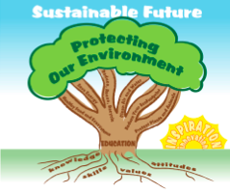
EcoLearn
Developed by the Environmental Protection Agency
With support from Department of State
Virtual Students of Foreign Service Interns
https://www.epa.gov/education
For more information: hanft.sally@epa.gov or salazar.viccy@epa.gov
US EPA
Region 10
EcoLearn

