Slide 1


3rd Grade
Water
Water is a finite and precious resource; we all have a role in keeping it clean.
EcoLearn
Notes:
http://wallpaper-gallery.net/single/wallpaper-of-water-drops/wallpaper-of-water-drops-13.html

Slide 2
Keywords
Water Cycle
Water Treatment
Conservation
Consumption
Water
Solid
Liquid
Gas
Notes:
http://vertassets.blob.core.windows.net/image/b8563775/b8563775-8579-49ee-969f-1c247c9f073f/biological_drinking_water_treatment_running_faucet.jpg

Slide 3
Do Now
How do we use water?
Notes:
Source: http://www.hausjournal.net/wp-content/uploads/Trinkwassergewinnung.jpg

Slide 4
The Water Cycle
Notes:
https://pmm.nasa.gov/education/sites/default/files/article_images/Water-Cycle-Art2A.png

Slide 5
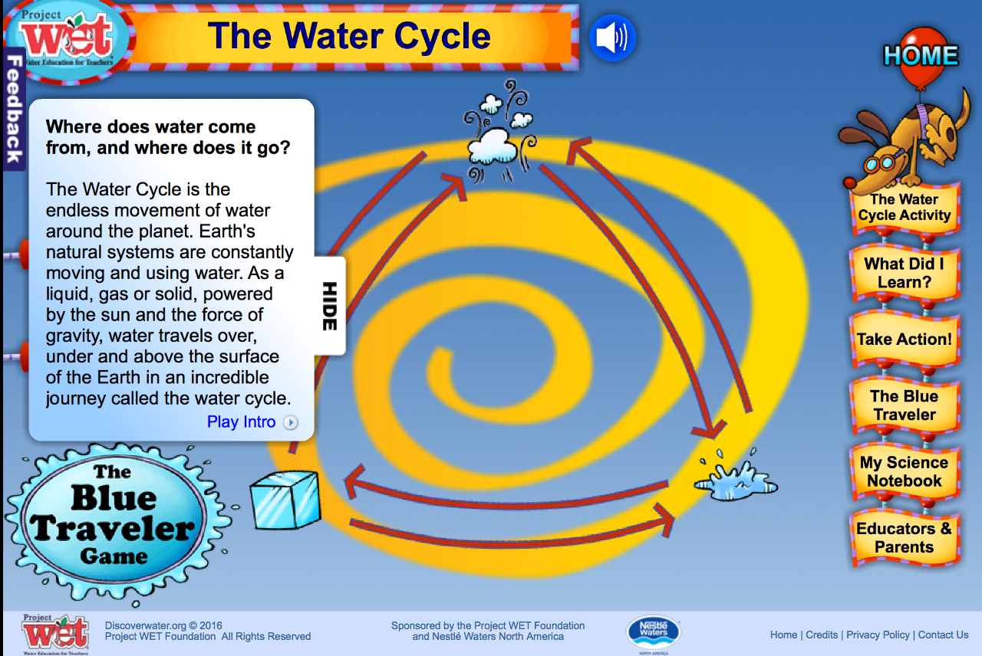
The Water Cycle
Read definitions as a class
Complete the matching activity together
http://www.discoverwater.org/water-cycle/
Notes:
http://www.discoverwater.org/water-cycle/

Slide 6
Water Treatment
https://www.pbslearningmedia.org/resource/ess05.sci.ess.watcyc.h2otreatment/water-treatment-plant/#.WRM6CVL_nV
Notes:
http://mwhconstructors.com/wp-content/uploads/2014/12/Austin-Water-Treatment-Plant-6-High-res_REV.jpg

Slide 7
It’s important to conserve water, but why do you think it matters?
Less than 1% of all the water on Earth is available for people to use!
Notes:
Source: http://www.hdwallpaperup.com/wp-content/uploads/2015/02/Earth-globe-on-water.jpg

Slide 8
How can you help?
Notes:
https://www.affinitywater.co.uk/images/WSP-water-saving-tips-3.png

Slide 9
Closure
What will you do to conserve water?
Notes:
http://zululandobserver.co.za/wp-content/uploads/sites/56/2015/05/water_bucket_solid_state-2.jpeg

Slide 10
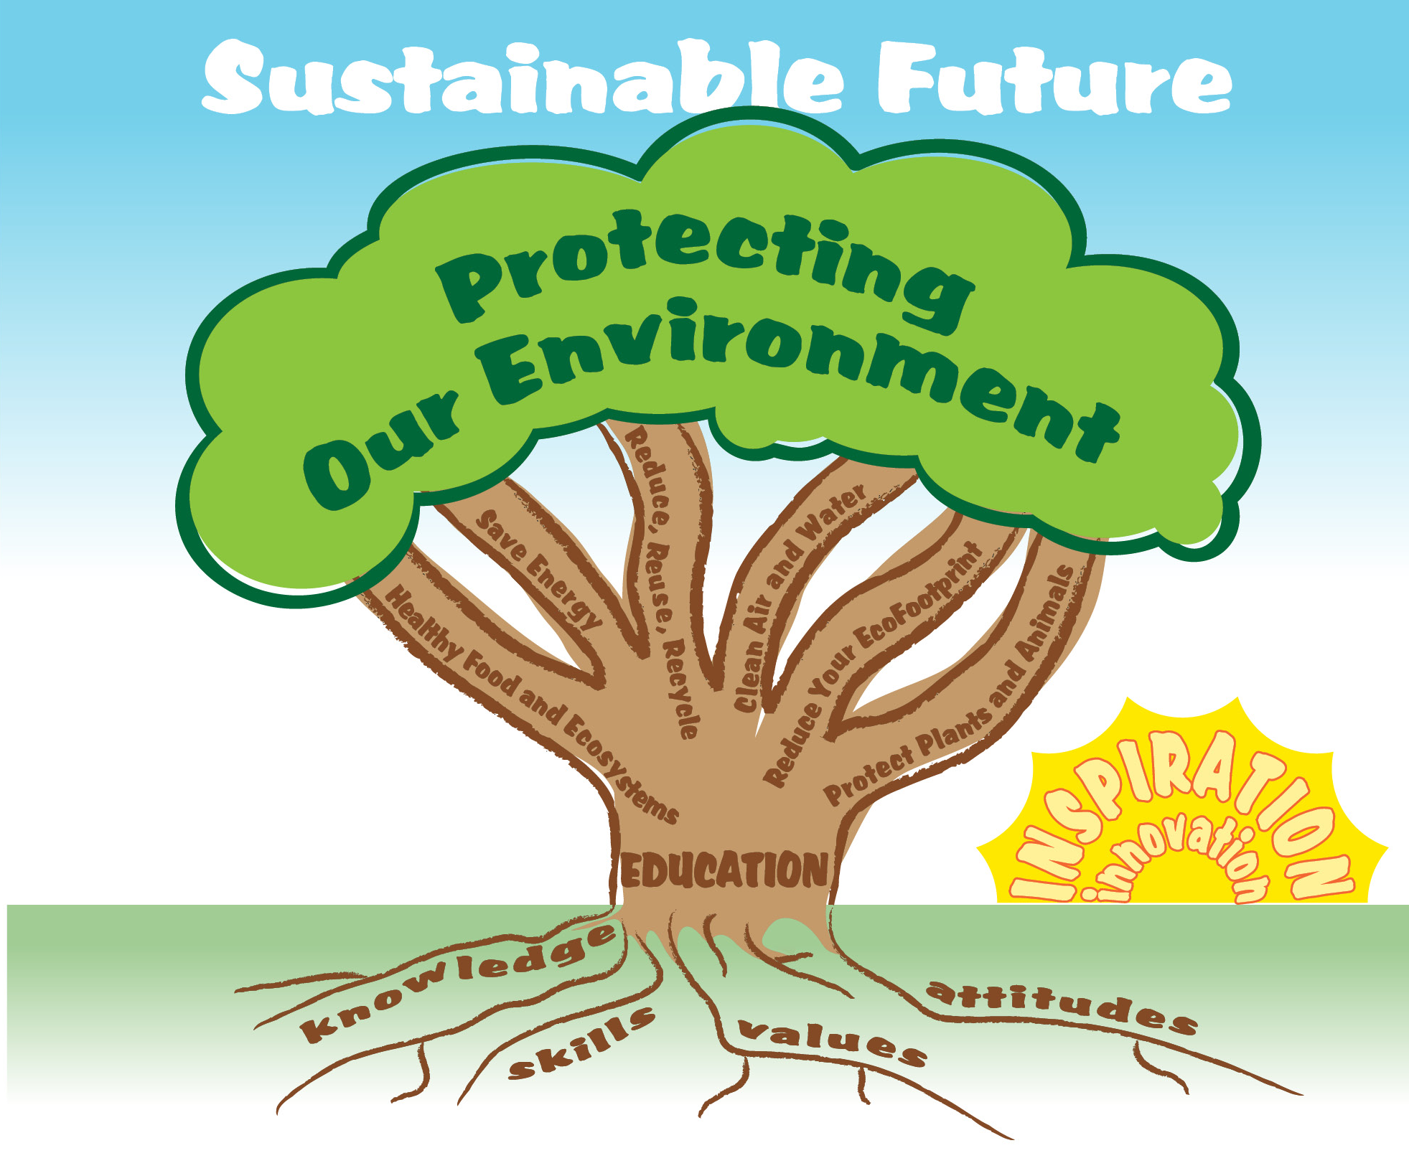
EcoLearn
For more information:
hanft.sally@epa.gov or
salazar.viccy@epa.gov
Developed by the Environmental Protection Agency
With support from Department of State
Virtual Students of Foreign Service Interns
https://www.epa.gov/education
US EPA
Region 10
EcoLearn

