Slide 1
Air pollution
40 Years in Images

Slide 2
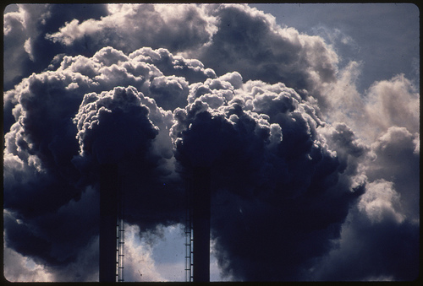
Point Source Pollution
Pollution from the burning of discarded automobile batteries in Houston, Texas:
Power plants release sulfur and Nitrogen compounds, which can create acid rain and smog.

Slide 3
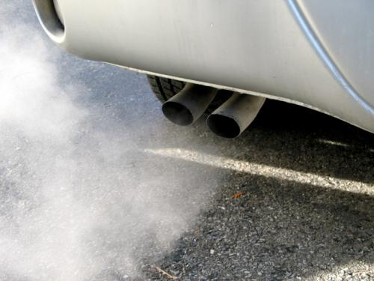
Nonpoint Source Pollution
Tailpipe Emissions from automobiles are nonpoint source pollution
Notes:
Source: http://www.arb.ca.gov/research/mobile-emissions/mobile-emissions.htm

Slide 4
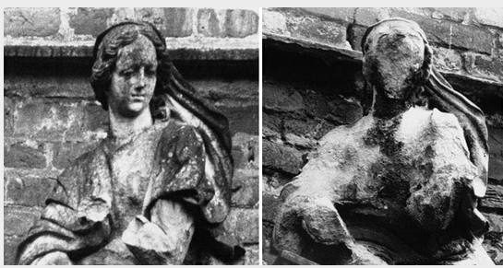
Effects of Acid Rain
1908 1969
Corrosion of stone and metal

Slide 5
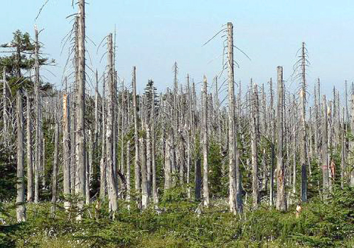
When this pollution falls on forests, it has an acidifying effect which can strip tress of their leaves and destroy forest ecosystems.
Notes:
Source: http://ecowatch.com/2012/06/04/conservation-groups-take-action-against-epas-inability-to-combat-acid-rain/

Slide 6
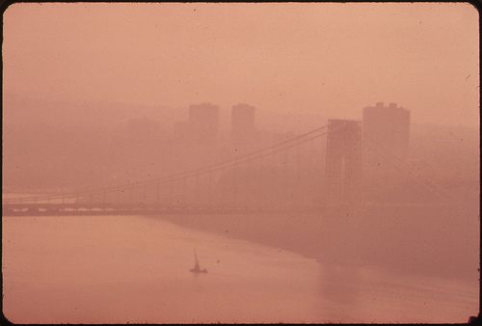
View of the George Washington Bridge through heavy smog in New Jersey and New York.
Modern smog is a type of air pollution derived from vehicular emissions and industrial fumes that react in the atmosphere with sunlight to form secondary pollutants that also combine with the primary emissions to form smog

Slide 7
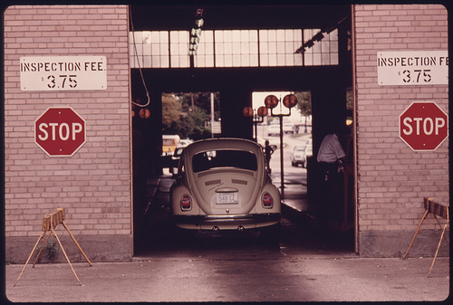
Clean Air Act 1970
The Clean Air Act set air quality standards which limited the amount of emissions of certain pollutants. To meet these standards, many state require auto emissions tests.

Slide 8
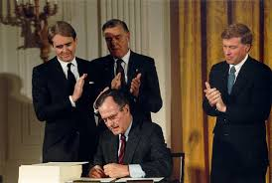
Clean Air Act 1990
addressed acid rain, ozone depletion, and toxic air pollution.
established a permit program for stationary polluters (factories, power plants)
number of permits was slowly reduced to create an over reduction in SO2 and Nox emissions
President George H.W. Bush signing the bill into a law

Slide 9
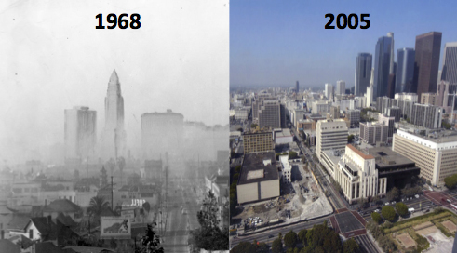
Effects of Clean Air Act: Success
Downtown Los Angeles
Notes:
Source: http://cires.colorado.edu/news/press/2013/LApollution.html

