Slide 1
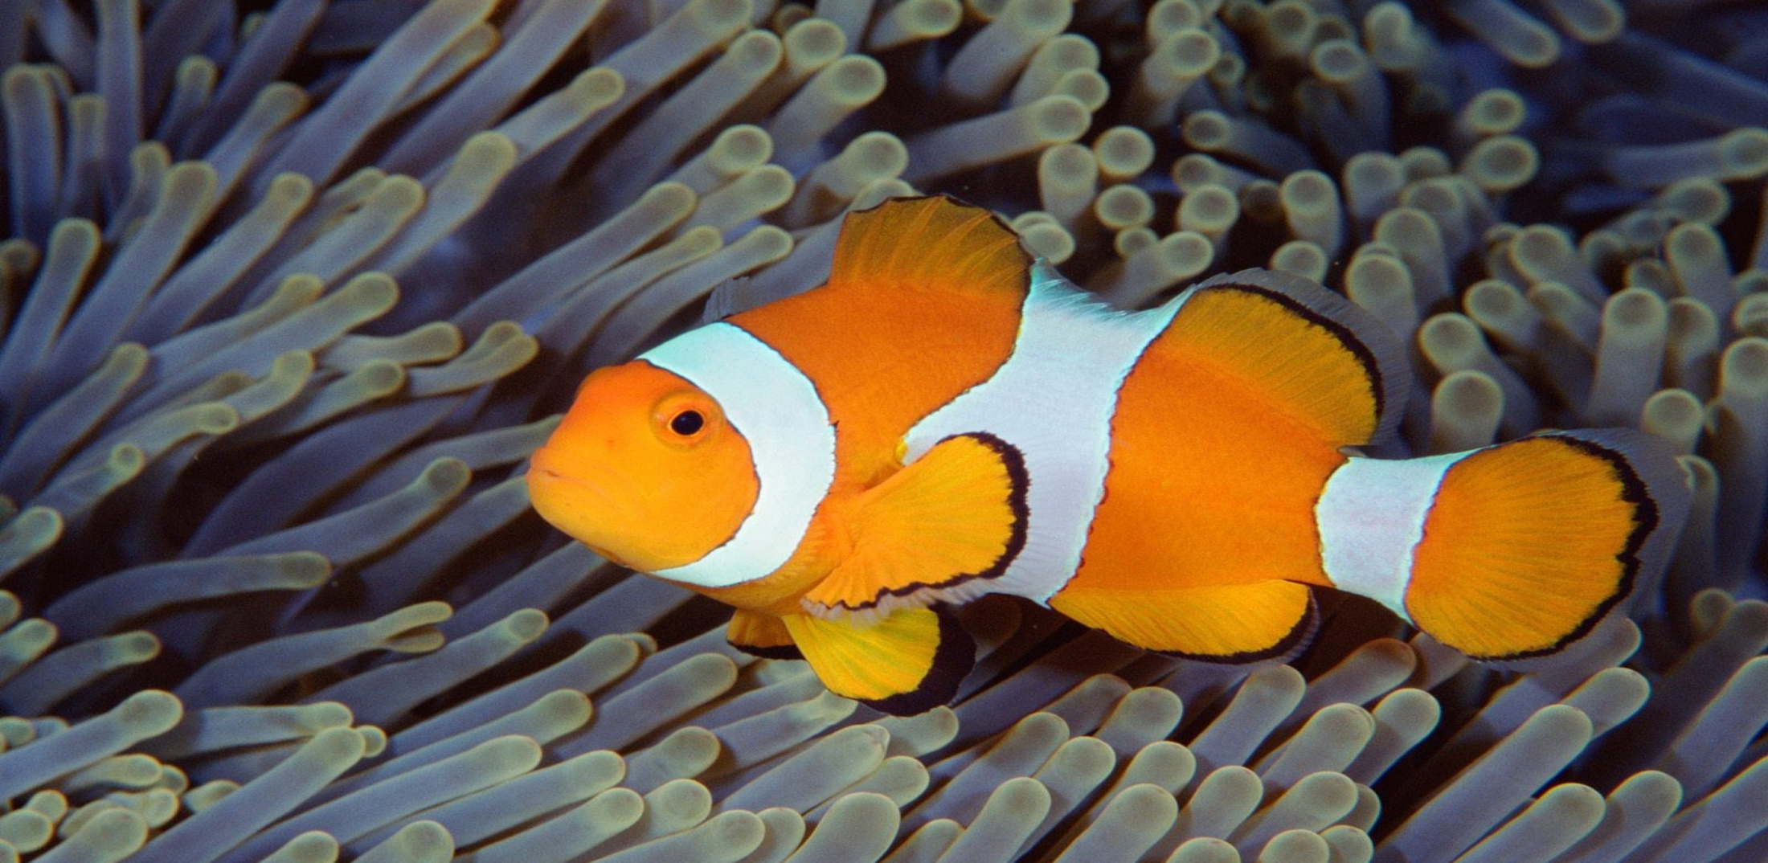

4th Grade:
Animals
It is important to understand how we can protect our oceans in order to preserve the species that live in them
EcoLearn
Notes:
Do Now: (5 minutes)
Watch the following video
National Geographic, “Endangered Sea Creatures,” http://youtu.be/dV9pM3b61e8 (2:56)
<Or>
* Journey to Planet Earth, “State of the Planet's Oceans: Decimation of the Atlantic Cod Fishery,”
http://youtu.be/3fCX6XKzbUY (4:12)

Slide 2
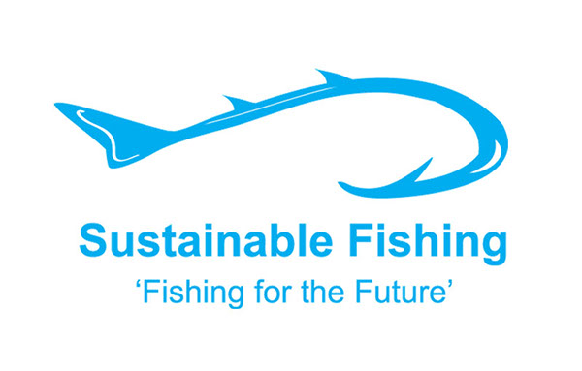


Objective for the day
Today you will…
  Learn about threatened and endangered species
  Learn about fishing practices and sustainable fishing
Click For Audio
Notes:
Objective for the Day - (Written on board/projector)
What skill are you going to teach and what should the students be able to do by the end of the class to demonstrate what they have learned?
Key words –
* Sustainable fishery
* Endangered species

Slide 3
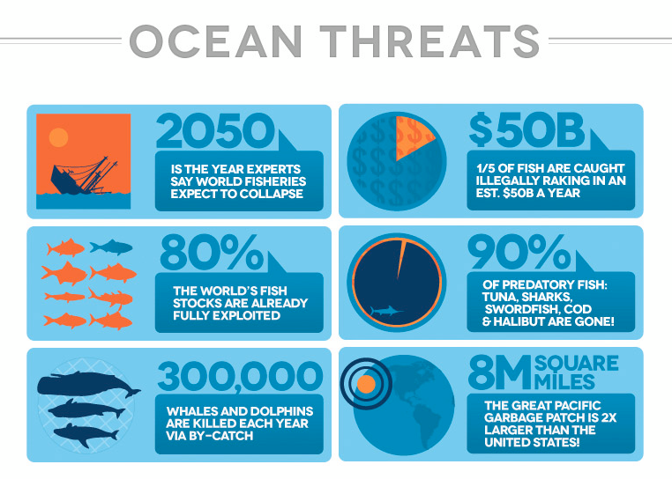
Key Words
Sustainable fishery
Endangered species
Notes:
Purpose –
Why is it important for students to learn this skill? Explain why today’s lesson matters.
Teaching the Skill –
How will you teach this skill to students? What will the examples and the modeling look like? How will you ensure that all students are actively participating in the lesson?

Slide 4
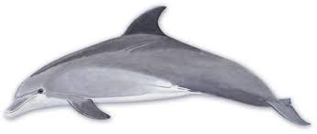
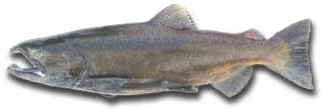
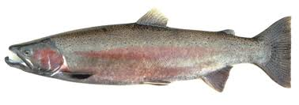
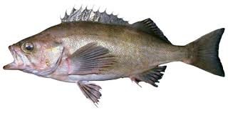
Game of Life
(4)Red Chinook Salmon
(8)Blue
Dolphin
(10)Yellow
Rockfish
(6)Green
Steelhead Trout
Click For Audio
Notes:
Game of Life – (40 min)
Hand out 4 red, 6 green, 8 blue, and 10 yellow stickers to each student. (Add more stickers as needed to arrive at the total number of students in the class, keeping the ratios roughly the same.) Students with red, green, and yellow stickers are fish. Students with blue stickers are dolphins. Ask the students to stand up at their desks or at another place in the classroom.
Tell the class that we are going to see what life is like for animals in the ocean. Explain that over time, humans have overfished the oceans, to the point that some species of fish no longer exist and others are threatened.

Slide 5
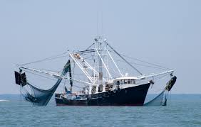
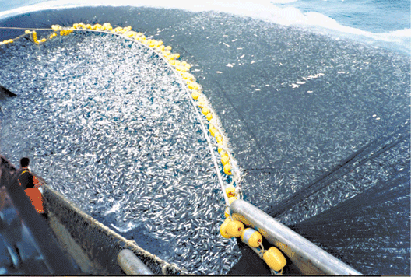
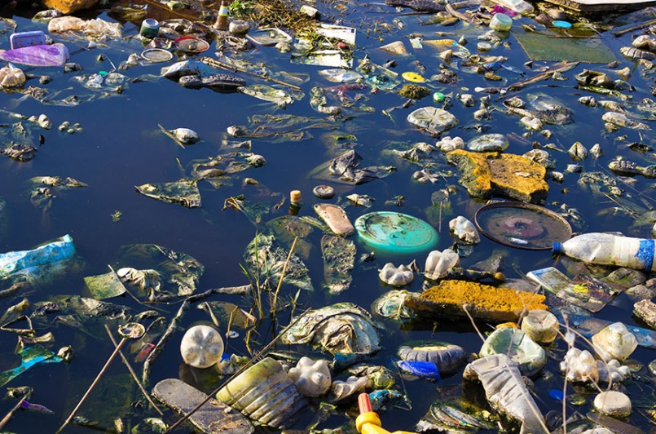
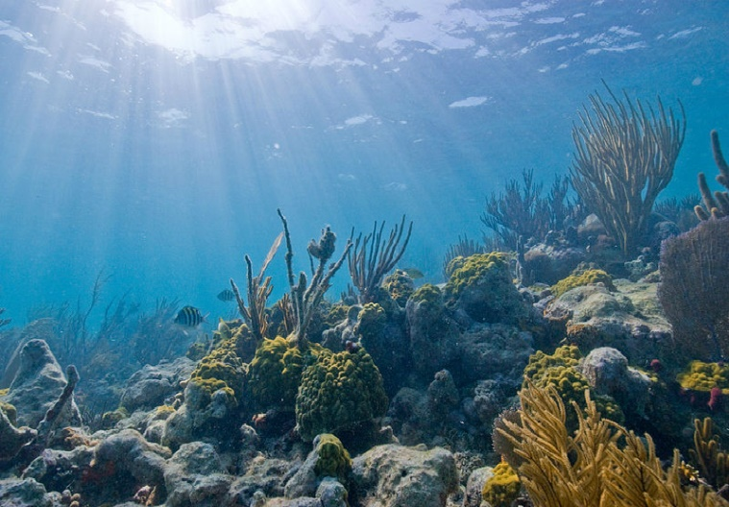
2. Commercial Vessel using illegal nets
1.Fishing Vessel
3. Pollution
Remaining Fish

Slide 6
Class Discussion
What problems could occur for the remaining marine animals (red stickers) that are spread apart?
What happens if a ship strikes one?
What if an animal gets sick?
What if one gets caught in a plastic ring used to group soda?
What is one animal can’t get to another animal of the same species for a mate?
Click For Audio
Notes:
Do Now- Discuss the following prompts with students

Slide 7
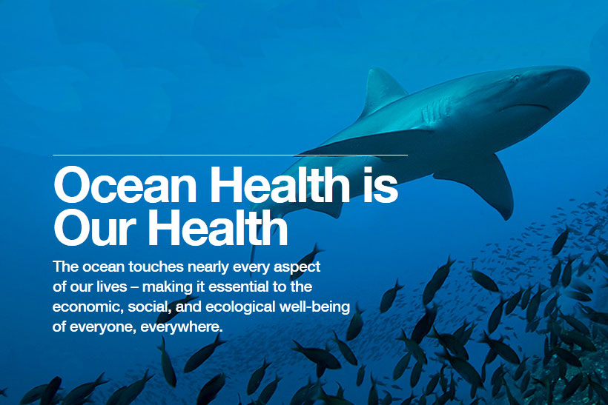
How can YOU help the Ocean?
Click For Audio
Notes:
Practice –
Discuss as a class what can we do to protect our oceans.
Brainstorm as a class ways to protect our oceans. Possible answers include:
When you buy fish to eat, choose fish that isn’t threatened or endangered. Download your state’s sustainable food handout http://www.seafoodwatch.org/seafood-recommendations/consumer-guides to review with the class.
Recycle plastic, aluminum, and glass to keep as much of these materials out of our oceans as possible.
Reuse what you can. The most prevalent form of marine debris are plastics. Reduce your plastic waste by:
Using reusable grocery bags rather than plastic bags.
Using reusable water bottles rather than disposable plastic water bottles.
Avoid purchasing products with excessive amounts of packing.
Bring reusable containers to restaurants for leftovers.

Slide 8
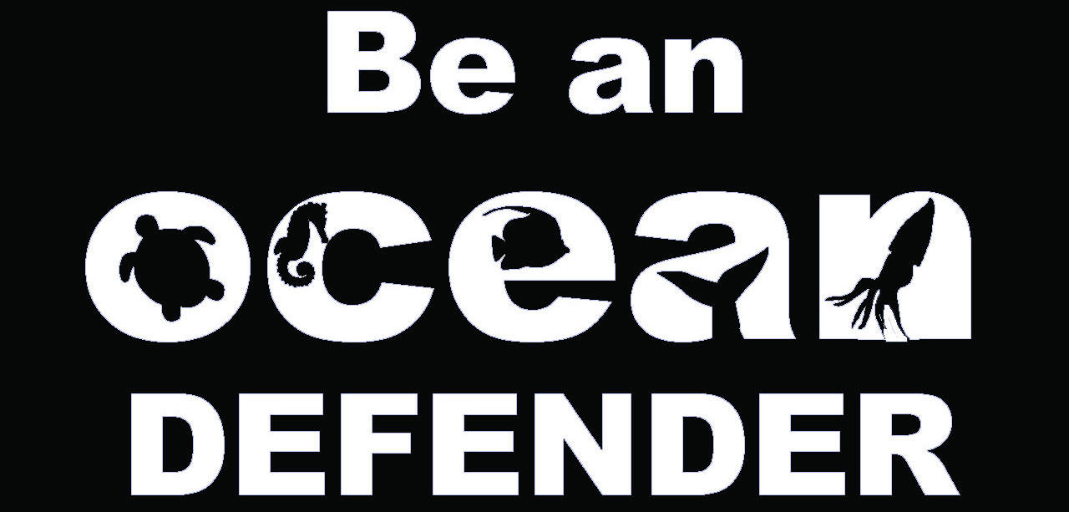
Closure
Watch the video on sustainable fishing from the U.S. Department of State
Why do we need to protect our oceans?
Click For Audio

Slide 9
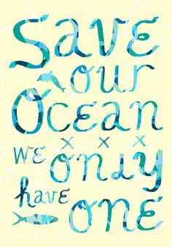
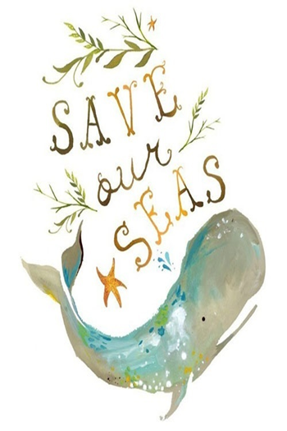
Homework
Go to Seafood Watch and explore a seafood species of your choice. Write a report on whether it is sustainable to eat this species.
Notes:
Homework – An activity for the students to take home and perform.
Optional: Have the students return the next day with proof of completion of the activity.

Slide 10
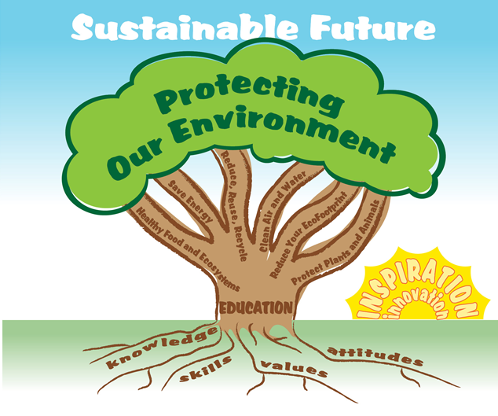

EcoLearn
Developed by the Environmental Protection Agency
With support from Department of State
Virtual Students of Foreign Service Interns
https://www.epa.gov/education
US EPA
Region 10
EcoLearn
For more information: hanft.sally@epa.gov or salazar.viccy@epa.gov
Notes:
Image Sources:
https://wallpaperscraft.com/download/under_water_coral_fish_sea_ocean_78616/3840x2400
http://hurdsguideservice.com/guide-service/chinook-salmon-guide-service/
http://cetus.ucsd.edu/voicesinthesea_org/species/dolphins/bottlenose.html
http://www.afsc.noaa.gov/Rockfish-Game/description/widow.htm
https://www.google.com/url?sa=i&rct=j&q=&esrc=s&source=images&cd=&ved=0ahUKEwiRm97HgarQAhVX52MKHTqbA-sQjxwIAw&url=http%3A%2F%2Fwww.afsc.noaa.gov%2FRockfish-Game%2Fdescription%2Fwidow.htm&psig=AFQjCNEaDrlfN5GBOdeaDjnZxyH_pyFy5w&ust=1479273426128578
http://understanddolphins.tripod.com/dolphinconservation.html
http://sedonawaterworks.com/water-and-water-pollution.html
https://www.google.com/search?biw=1408&bih=672&noj=1&tbm=isch&q=ocean&chips=q:ocean,g_1:underwater&sa=X&ved=0ahUKEwjjs57-karQAhVI12MKHcc-Ck4Q4lYIHygA&dpr=1.36#imgrc=RmPc0_Ro-i6V9M%3A
https://www.google.com/url?sa=i&rct=j&q=&esrc=s&source=images&cd=&ved=0ahUKEwj0jPGDmKrQAhUXzmMKHY3UAEgQjxwIAw&url=http%3A%2F%2Fkreweofthenautilus.com%2Focean-conservation%2F&psig=AFQjCNGQGXOFivP9NxjveZM9byqS7oTY5Q&ust=1479279568560229
http://madasamarinebiologist.com/post/47520984670/underthevastblueseas-via-ocean-conservation
http://beachchairscientist.com/2012/08/02/a-little-dose-of-ocean-conservation-inspiration/
http://www.greenpeace.org/seasia/ph/What-we-do/oceans/save-oceans-pledge/
https://www.pinterest.com/pin/161637074097019477/
https://www.google.com/search?q=protect+the+ocean+quotes&hl=en&biw=1408&bih=672&site=webhp&source=lnms&tbm=isch&sa=X&sqi=2&ved=0ahUKEwjF-c-1narQAhVFLmMKHd2NACMQ_AUIBigB#hl=en&tbm=isch&q=sustainable+fishing&imgrc=GExLdiPPl3nmjM%3A
https://www.google.com/search?q=protect+the+ocean+quotes&hl=en&biw=1408&bih=672&site=webhp&source=lnms&tbm=isch&sa=X&sqi=2&ved=0ahUKEwjF-c-1narQAhVFLmMKHd2NACMQ_AUIBigB#hl=en&tbm=isch&q=endangered+vs+threatened&imgrc=ohkt5D9iqD4ZoM%3A

