Slide 1
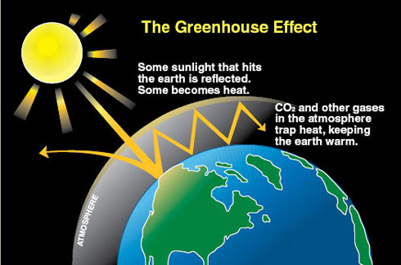
Green House Gas Effect
Notes:
Source: https://www.teachengineering.org/view_lesson.php?url=collection/cub_/lessons/cub_whatkindoffootprint/cub_footprint_lesson1.xml

Slide 2
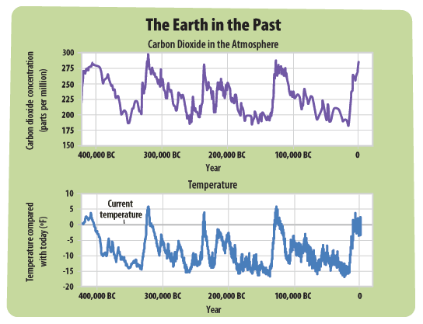
CO2 and Temperature
Notes:
Source: http://www.epa.gov/climatestudents/basics/past.html

Slide 3
Do it Now
What is the Green House Effect?
How does it affect global climate?

Slide 4
Objective for the Day
Develop a better understanding of the carbon cycle
Compare pre-industrial and post-industrial carbon cycles

Slide 5
Key Terms
Lithosphere: outmost, rocky shell of Earth
Hydrosphere: all the liquid on Earth (oceans, rivers, lakes)
Atmosphere: layer of gas surrounding Earth
Biosphere: all the ecosystems on Earth

