Slide 1
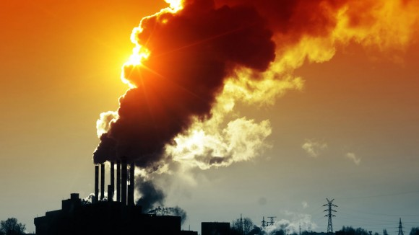


5th Grade: Air Pollution Students will learn about the carbon cycle and the greenhouse effect in order to understand the basics of climate science.
Click for Audio
US EPA, Region 10 EcoLearn
Notes:
Image Source: https://www.universetoday.com/81977/causes-of-air-pollution/

Slide 2
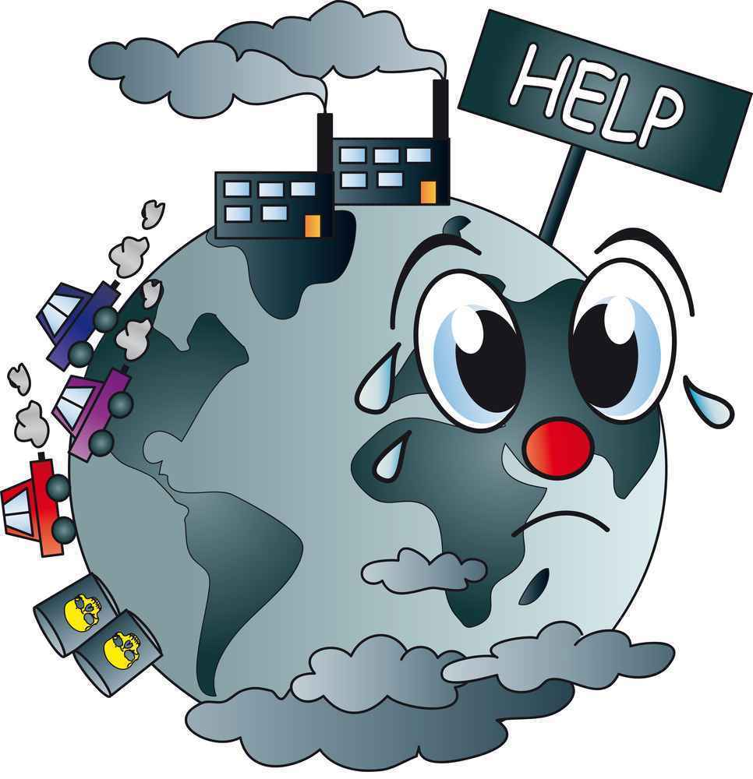
Objective
Today you will learn…
A better understanding of the carbon cycle
To compare pre-industrial and post-industrial carbon cycles
An understanding of the greenhouse effect
Click for Audio
Notes:
Image Source: http://www.publishyourarticles.net/eng/question-and-answers/what-are-the-major-causes-of-water-and-air-pollution/2584/

Slide 3
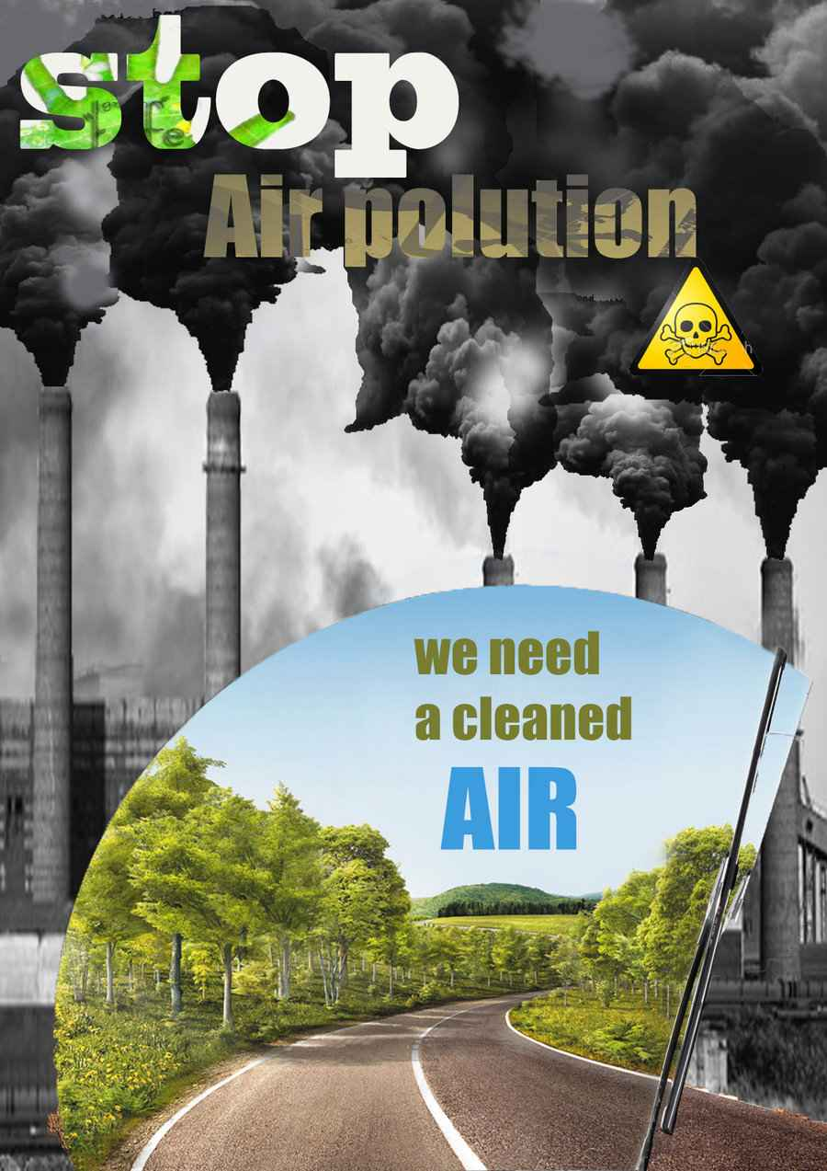
Key Words
Atmosphere
Biosphere
Carbon cycle
Greenhouse effect
Hydrosphere
Lithosphere
Click for Audio
Notes:
Image Source: http://www.publishyourarticles.net/knowledge-hub/environmental-studies/how-have-urbanization-and-industrialization-increased-the-air-pollution/3734/

Slide 4
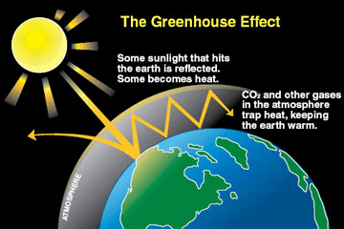

Review
Greenhouse Effect
Notes:
Image Source: http://tool.globalcalculator.org/

Slide 5
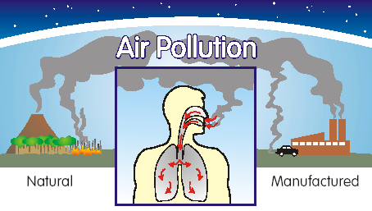
The Incredible Carbon Journey
Instructions and materials
Click for Audio
Notes:
Image Sources: https://www.atsdr.cdc.gov/general/theair.html

Slide 6
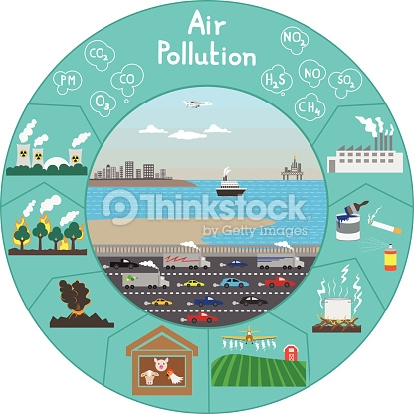

Homework
Notes:
Image Source: http://www.thinkstockphotos.co.uk/image/stock-illustration-sources-of-air-pollution/473628452

Slide 7
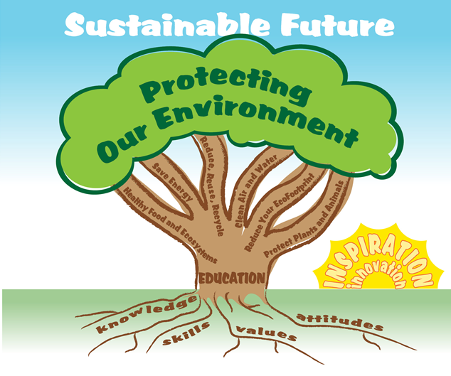

EcoLearn
Developed by the Environmental Protection Agency
With support from Department of State
Virtual Students of Foreign Service Interns
https://www.epa.gov/education
For more information: hanft.sally@epa.gov or salazar.viccy@epa.gov
US EPA
Region 10
EcoLearn

