Slide 1
Endangered Species

Slide 2
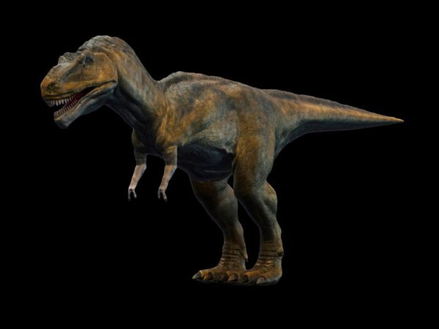
Extinct
A Species that is extinct in no longer in existence
T-Rex became extinct about 65 million years ago
Notes:
Source of dinosaur image: http://animals.nationalgeographic.com/animals/prehistoric/tyrannosaurus-rex/

Slide 3
Threatened Species Categories
Vulnerable
Endangered
Critically Endangered

Slide 4
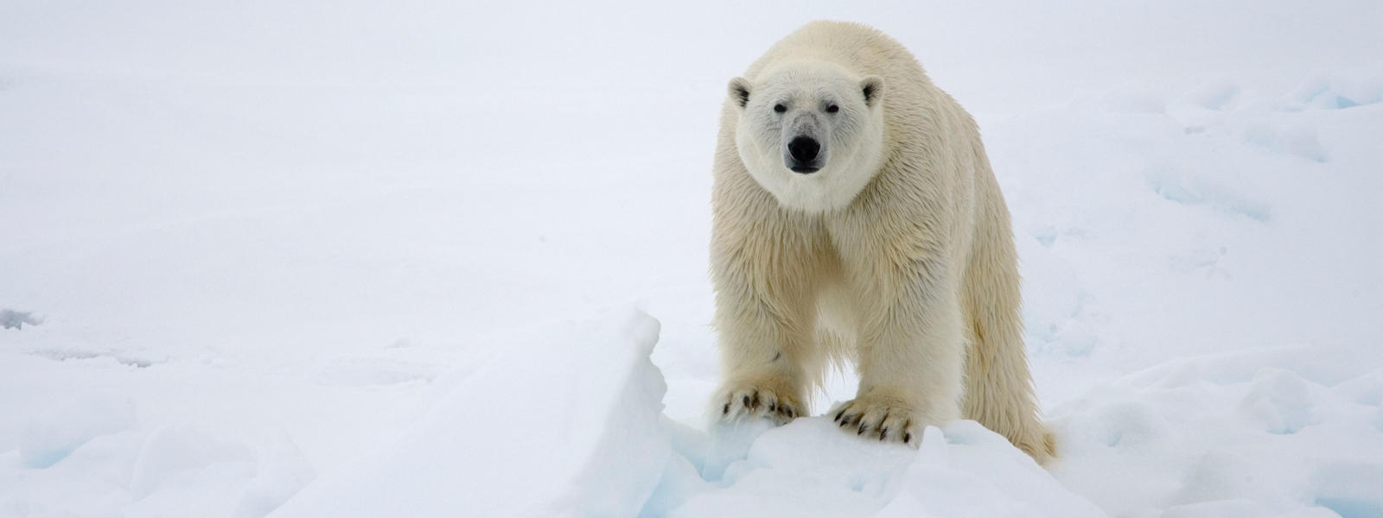
Vulnerable
Vulnerable species are likely to be endangered in the near future.
Because of melting ice in the Arctic, the polar bear is a vulnerable species.
Notes:
Source: http://www.fws.gov/endangered/esa-library/pdf/t-vs-e.pdf

Slide 5
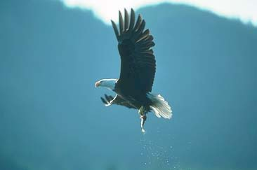
Endangered
Endangered species are those that are at risk for extinction.
The Bald Eagle was once endangered, but has since recovered
Notes:
http://www.fws.gov/midwest/eagle/

Slide 6
Bald Eagle
In the mid-1960s, the number of nesting Bald Eagles in the lower-48 states dropped to 480.
The ban of DDT pesticide and protection afforded from the ESA helped recover the population of bald eagles
On August 9, 2007, the bald eagle was removed from the federal list of threatened and endangered species.
Notes:
http://www.fws.gov/midwest/eagle/

