Slide 1
The Climate as History

Slide 2
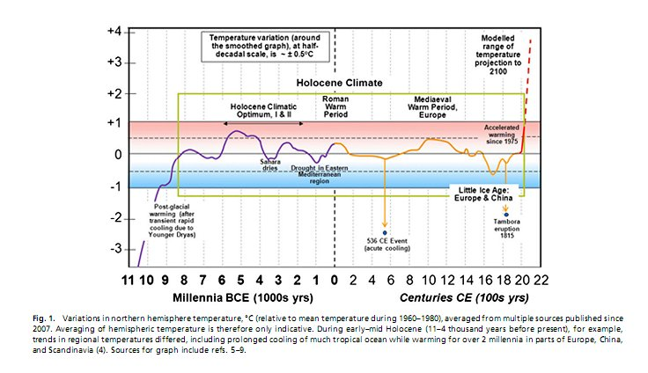
Changes in the climate are not new
Notes:
The Holocene Climate, a warm period beginning around 9,000 B.C. after an ice age, coincided with the beginning of agriculture, a human innovation to produce food on a more stable basis. As you can see, the climate has fluctuated in the past, but never outside the Halocene climate. Events like the eruption a the Volcano Tambora in 1815 led to a brief cooling period because eruptions spew large amounts of dust and ash into the atmosphere, blocking solar radiation from reaching earth. However, note the rapid and dramatic increase in global average temperatures since the 20th century. What caused this?

Slide 3

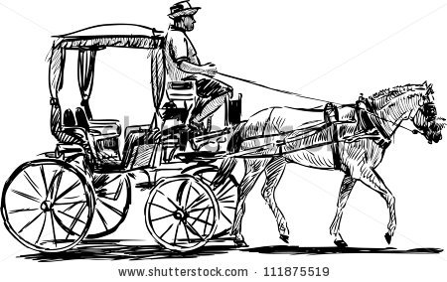
Pre-19th Century
Wood burning for heating
Whale Oil for light
Animal Labor for transport
Notes:
Before fossil fuels, humans relied on other sources of energy. Wood was predominantly used for heating homes, while whale oil provided fuel for lamps. Animals, such as the horse drawn carriage were used for travel.

Slide 4
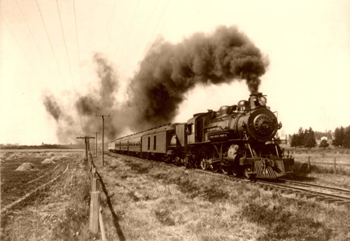
Fossil Fuels= more, more, more, but…
The use of fossil fuels helped us travel further and faster
They provided light and electricity for homes, businesses, and factories
Notes:
But after the discovery of fossil fuels and their widespread use into human activities, we could travel further and faster. As forests shrunk, coal increasingly became the primary resource from which we heated our homes. Coal also fueled railroads which allowed us to move people and goods faster and further. Fossil Fuels also powered the factories of the Industrial Revolution, which lead to the widespread dissemination of many consumer goods, including the automobile in the early twentieth century.
Despite all the benefits of fossil fuels, over the past few decades, the unintended consequences and drawbacks of fossil fuels have become apparent.

Slide 5
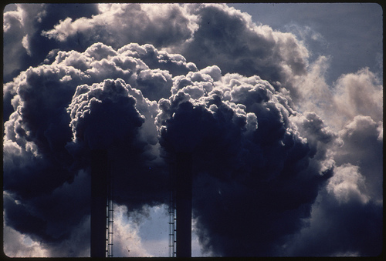
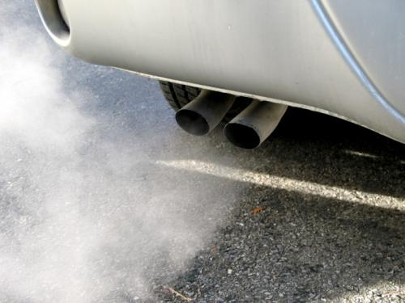
Drawbacks: GHG and other Pollutants
Notes:
Fossil Fuels release carbon dioxide, which is a primary human factor driving climate change today.

Slide 6
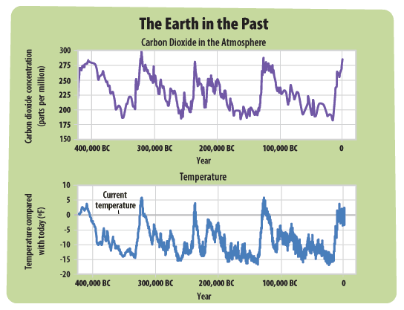
CO2 and Temperature
Notes:
Moreover, scientific models used by the IPCC, the international body of climate experts that study climate change, have shown that natural factors alone cannot account for the changes in temperature during the twentieth century.

Slide 7
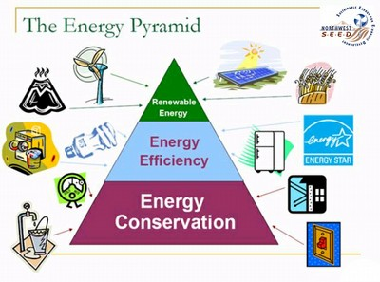
Behavioral Change
Energy Conservation!
Turn of the tap when brushing your teeth and turn off lights when you leave a room
Use energy efficient appliances—look for the Energy Star Sticker
Switch to more energy efficient light bulbs light CFL or LED
Walk, Bike, or take public transit instead of driving if possible
Notes:
But if human action causes climate change, we have the ability to alter our actions!
Go through the conservation tips.

Slide 8
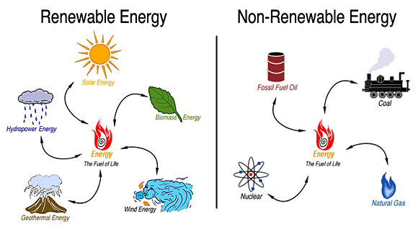
Human Ingenuity and Technology
Renewable Energy Sources are an innovative adaptation to the drawbacks of our current energy system
Notes:
Moreover, we are already in the process of an energy transition, as new renewable energy sources are becoming cheaper and more viable. Sources of energy like wind and solar do not produce carbon dioxide.

