Slide 1
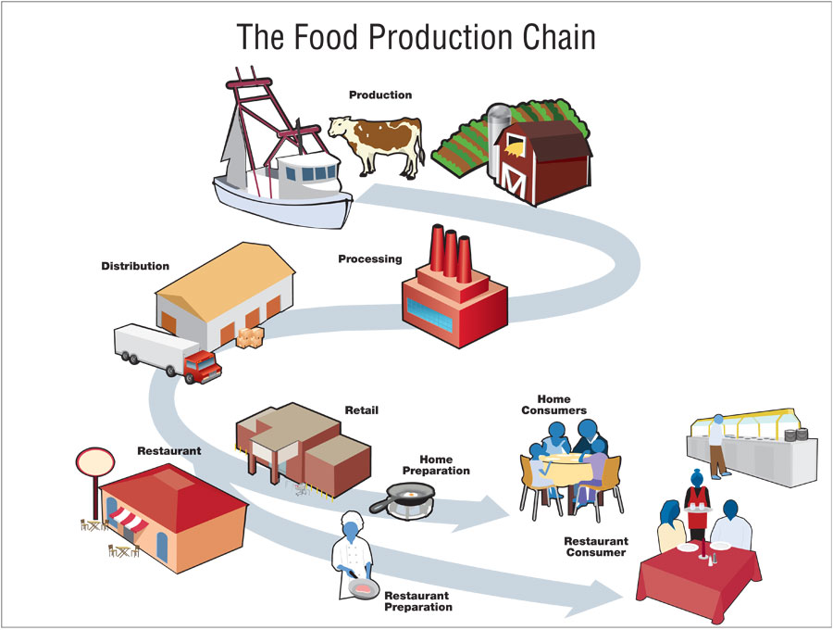
Food Production: how much water is needed to produce food

Slide 2
Food Production
Food Production requires the use of many resources including water, animal feed, energy, and fertilizers.
Agriculture accounts for about 10% of U.S’s Green House Gas emissions—production is the top producer in the agriculture food chain

Slide 3
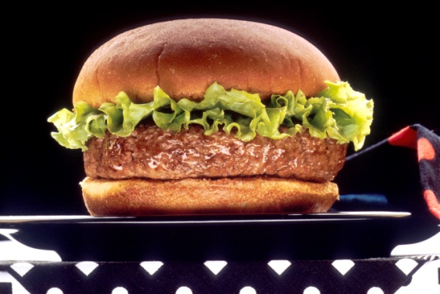

Meats (Based on one pound)
Beef= 1,799 gallons of water and 6.6 pounds of grain/feed

Slide 4


Meats (Based on one pound)
Pork= 576 gallons of water and 4.2 pound of grain/feed

Slide 5

Meats (Based on one pound)
Chicken= 468 gallons of water and 3 pounds of grain/feed

Slide 6

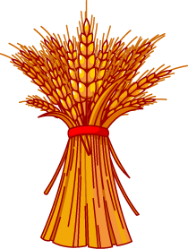
Grains (One Pound)
Rice= 449 gallons of water
Wheat= 132 gallons of water

Slide 7



Vegetables and Fruit
Corn (one pound)= 108 gallons of water
One Apple= 18 gallons of water
One Orange= 13 gallons of water

Slide 8
Why might it take more resources to grow meat rather than grains, vegetables, and fruits?

