Slide 1
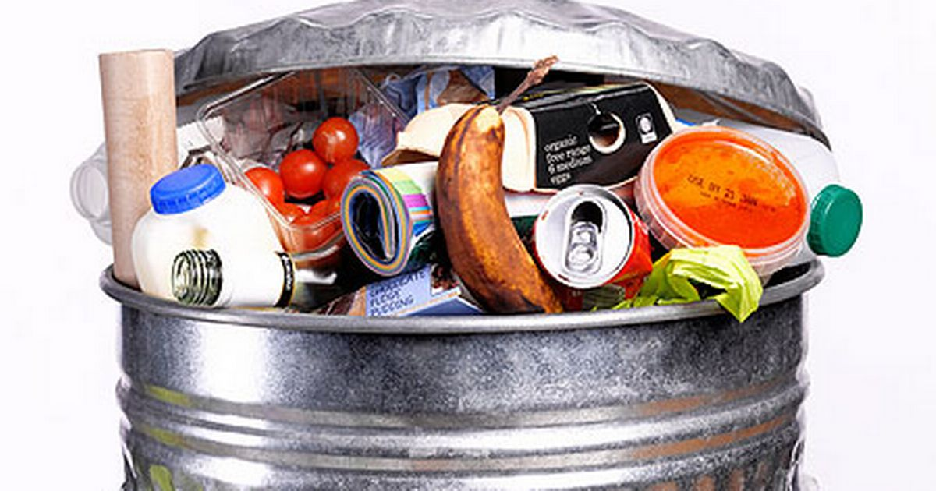



5th Grade:
Waste
Students will be reflecting on their own lives and the sorts of waste they produce. They will also reflect on ways they can reduce waste and how this can help the environment.
US EPA, Region 10 EcoLearn
Notes:
Image Source:
https://pingree.house.gov/media-center/press-releases/congresswoman-pingree-introduce-bill-reduce-food-waste

Slide 2
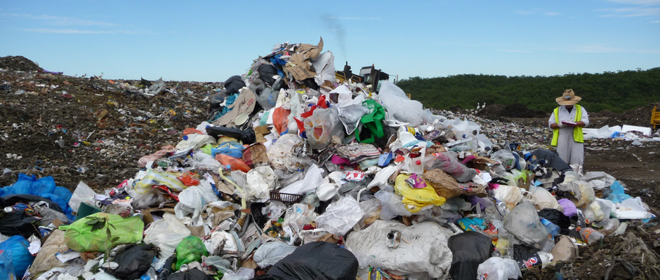
Objective
Today you will learn…
  How lifestyles change over time
  How changes in lifestyle alter waste production and management
  That reducing product packaging can reduce waste
Notes:
Image Source:
https://www.google.com/url?sa=i&rct=j&q=&esrc=s&source=images&cd=&ved=0ahUKEwjHj9S77LnSAhUU9mMKHX6qA6cQjxwIAw&url=http%3A%2F%2Fwww.coresponsibility.com%2Fpackaging-5-opportunities-for-sustainable-development%2F&bvm=bv.148747831,d.cGc&psig=AFQjCNEv8S-hgFnReUuwihnj9eFmXDUh-Q&ust=1488613132278720&cad=rjt

Slide 3
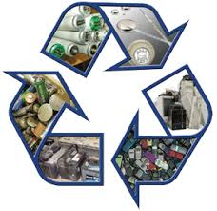
Key Words
Waste
Solid waste
Waste production
Source reduction
Recycling
Composting
Reuse
Click for Audio
Notes:
Image Source:
https://www.google.com/url?sa=i&rct=j&q=&esrc=s&source=images&cd=&ved=&url=http%3A%2F%2Fpresqueislemaine.gov%2Funiversal-waste%2F&bvm=bv.148747831,d.cGc&psig=AFQjCNEv8S-hgFnReUuwihnj9eFmXDUh-Q&ust=1488613132278720&cad=rjt

Slide 4
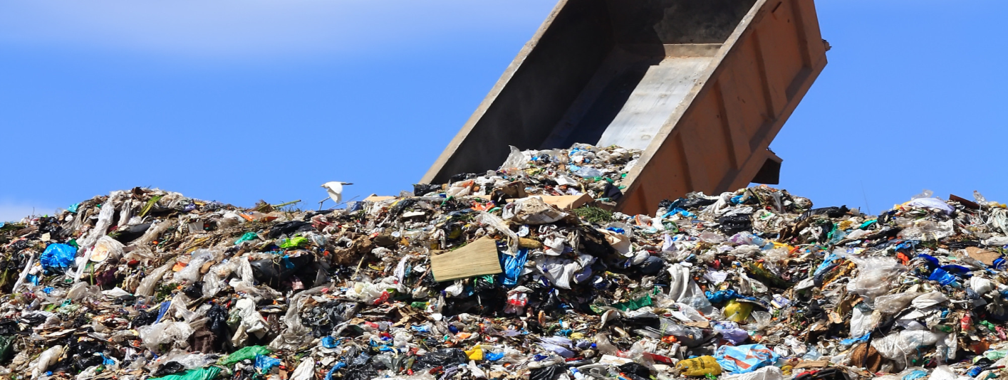
Do Now
  You were asked to interview your parents/relatives to find out what they considered trash years ago and how it was handled.
  Share the responses and compare them to what we consider trash today. What did we learn?
Notes:
Image Source: http://niketalk.com/t/651921/the-official-2016-nfc-south-trash-talk-thread-congrats-to-the-nfc-south-champion-atlanta-falcons

Slide 5

Food Packaging Exercise
Source reduction is one of the most important activities we can engage in to help the environment because all products ultimately come from some natural resource.
Packaging is frequently necessary (it can preserve food and keep it clean, for example), but can also create a lot of waste.
Notes:
Image Source: http://www.ozarkalabama.org/ozark/CityDepartments/PublicWorks/GarbageTrash/tabid/96/Default.aspx

Slide 6
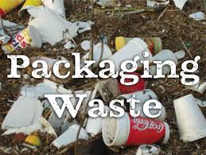
Food Packaging Exercise
Distribute a copy of the Packaging Worksheet to each student.
  List each item in the lunch bag, as well as the bag, in Column A, then weigh each item on a scale and record the weights in Column B on the Packaging Worksheet.
  Let the students eat their lunch and then ask them to place the packaging into a resealable bag.
  Explain for what purposes they should save “nature’s” packaging, such as banana peels, orange rinds, and peanut shells.
Notes:
Image Source:
https://www.google.com/url?sa=i&rct=j&q=&esrc=s&source=images&cd=&ved=0ahUKEwjy2Ofj8bnSAhUBzWMKHfBuB4oQjxwIAw&url=http%3A%2F%2Fwww.londonbiopackaging.com%2Fsustainable-festival-traders-guide%2Ffood-packaging-waste%2F&bvm=bv.148747831,d.cGc&psig=AFQjCNEB0FMz8eX8Q1MwHMMz2yVyfB2O1w&ust=1488614769049183&cad=rjt

Slide 7
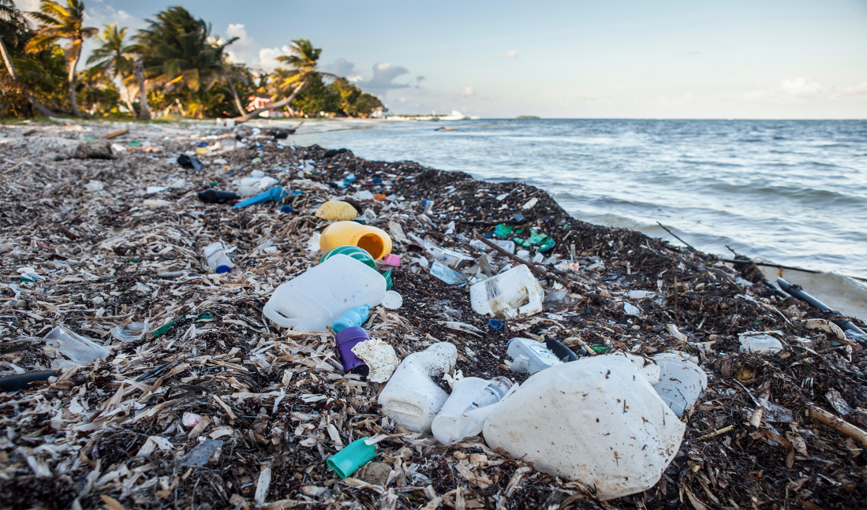
Food Packaging Exercise
Weigh each piece of packaging from their resealable bags and record these numbers in Column C.
Compare the weight of each lunch item before and after eating. Based on these numbers, calculate the percentage of the total weight of packaging for each lunch item.
Notes:
Image Source:http://news.nationalgeographic.com/news/2015/01/150109-oceans-plastic-sea-trash-science-marine-debris/

Slide 8

Food Packaging Exercise
Add Columns B and C and put these figures in the “Total” row of those columns
Look at how much packaging is included in just one bag of lunch.
Now multiply that by every student in this class.
Now multiply that by every student in this school.
There are approximately XX X fifth graders in the country. Let's multiply that.
The numbers get pretty big, don't they?
Notes:
Image Source: http://www.coatesville.org/public-works-department/trash

Slide 9
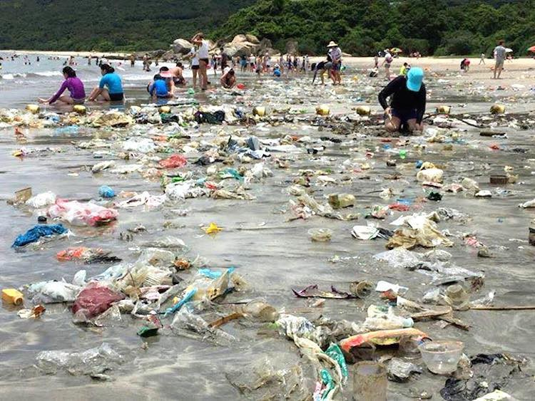
Food Packaging Exercise
Discuss recycling, composting, and reuse.
Put a check in the appropriate box for those packaging items that are reusable, compostable, or recyclable.
These checks show students what methods could be used as alternatives to throwing out these items.
Notes:
Image Source: http://www.ecowatch.com/climate-change/

Slide 10
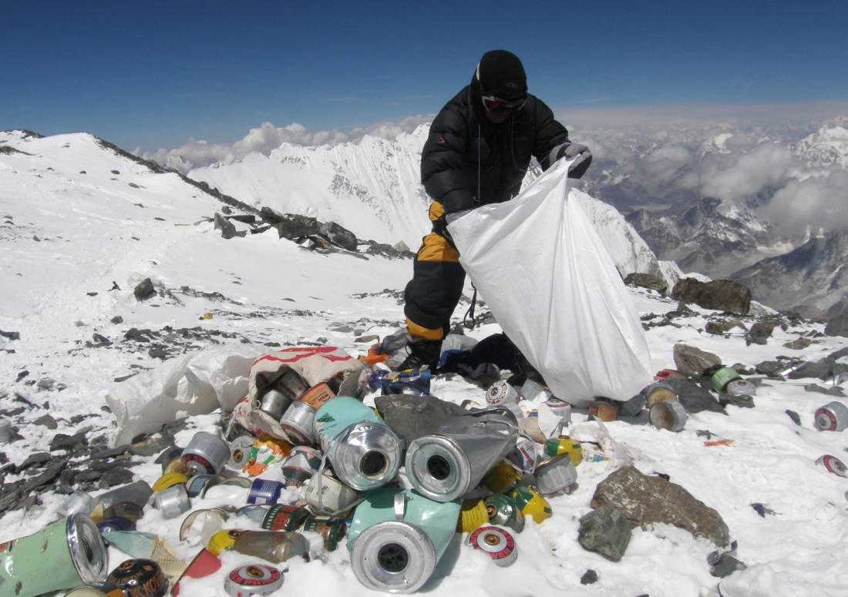
Food Packaging Exercise
If you couldn’t check any of these alternatives, then the total in their final column (H) would be zero.
If however, they can check off any of these (reusable, compostable, recyclable) columns, then that item’s remaining packaging weight gets added to column H.
Notes:
Image Source:http://time.com/3766862/mountaineers-everest-trash/

Slide 11
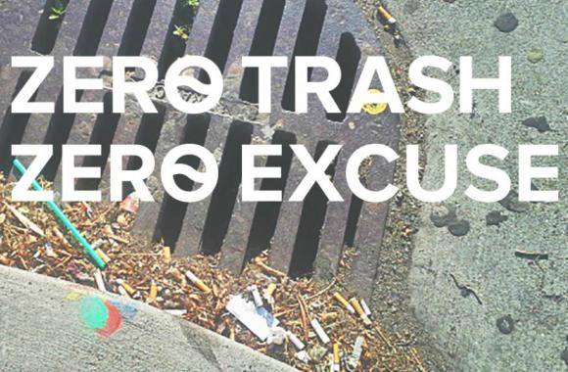
Food Packaging Exercise
Compare your totals from columns B, C, and H and share them with the class.
Discuss what types of packaging waste you could not reuse, compost, or recycle.
Discuss how this waste could be reduced through other actions, such as buying less of that item or changing the design of the packaging.
Notes:
Image Source:https://www.savesfbay.org/prevent-pollution-0

Slide 12
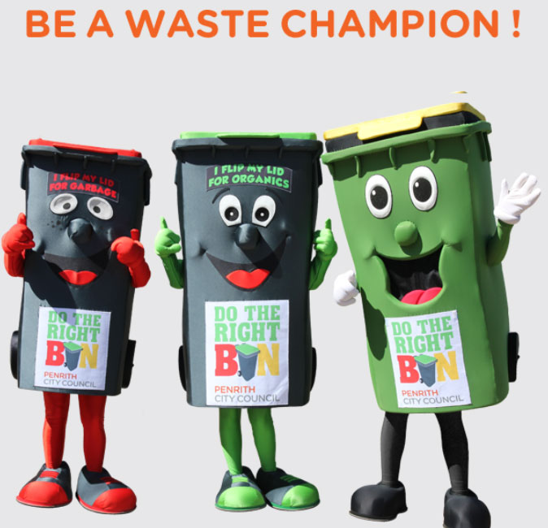
Closure
Notes:
https://www.penrithcity.nsw.gov.au/Waste-and-Environment/Waste/Waste-Smartphone-App/

Slide 13
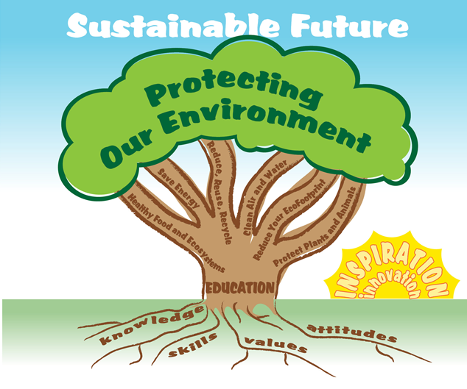

EcoLearn
Developed by the Environmental Protection Agency
With support from Department of State
Virtual Students of Foreign Service Interns
https://www.epa.gov/education
For more information: hanft.sally@epa.gov or salazar.viccy@epa.gov
US EPA
Region 10
EcoLearn

