Slide 1
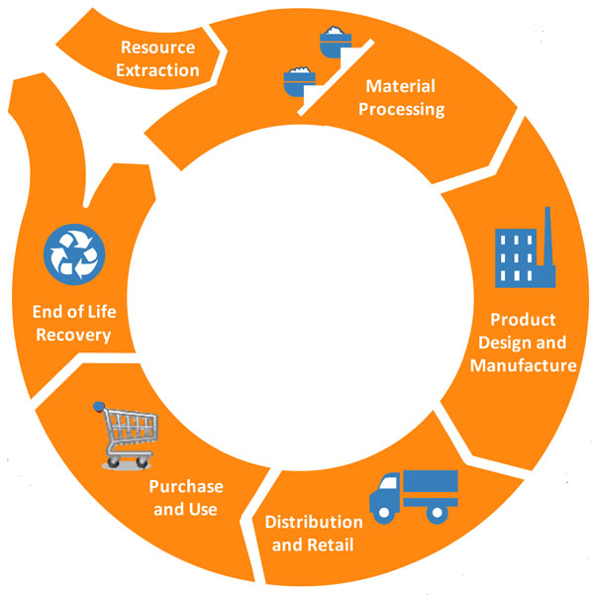
Potential for Waste
Disposal
Recovery
Product Lifecycle
Notes:
The materials for this PowerPoint are copyright of the Product Policy Institute, 2009. Waste= lost natural resources!

Slide 2
“Pollution is nothing but the resources we are not harvesting. We allow them to disperse because we are ignorant of their value.”
- R. Buckminster Fuller
Waste is a Design Flaw or the inability to recover materials for reuse.
Waste subject to changes over time.

Slide 3
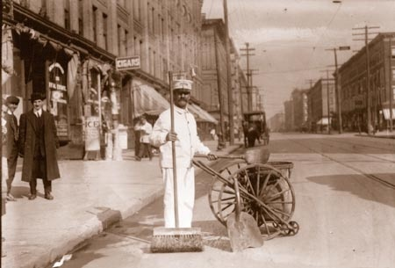
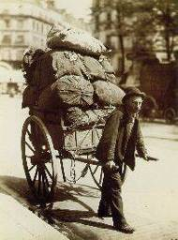
A Simpler Time
Notes:
To fully understand the waste issue, we have to start in the past and look at how our waste has changed.
Managing garbage only became a municipal responsibility 100 years ago when our increasing population – particularly in cities -- was creating a public health problem. It wasn’t just about getting rid of trash, but protecting public health, as well.
But even so, garbage was much simpler then.

Slide 4
CARD OF INSTRUCTION FOR HOUSEHOLDERS
Put into Ash
Receptacles
Put into Garbage
Receptacles
Put into Rubbish
Bundles
Ashes, Sawdust,
Floor and
Street Sweepings,
Broken Glass,
Broken Crockery,
*Oyster and Clam
Shells,
Tin Cans.
Kitchen or
Table Waste,
Vegetables,
Meats,
Fish,
Bones,
Fat.
Bottles, Paper,
Pasteboard, etc.
Rags, Mattresses,
Old Clothes, Old Shoes,
Leather and Leather Scrap,
Carpets, Tobacco Stems,
Straw and Excelsior,
(from households only)
The Sanitary Code requires householders and occupants to provide separate receptacles
for ashes and garbage and forbids mixing these in the same receptacle.
This law will be strictly enforced.

Slide 5
1400
1200
1,213
1000
955
800
Inorganics
Food/Yard
600
607
Products
Pounds / Capita / Year
400
358
387
187
200
92
14
25
0
1900
1960
2000
NYC
USA
USA
Notes:
Much of the product waste comes from packaging.

Slide 7
Rubbish Report:
What did you learn from your interviews?
Notes:
Ask students to share what they learned in their interviews.
What did people say they considered waste and how did people get rid of their waste?
How does this compare with today?

