Slide 1
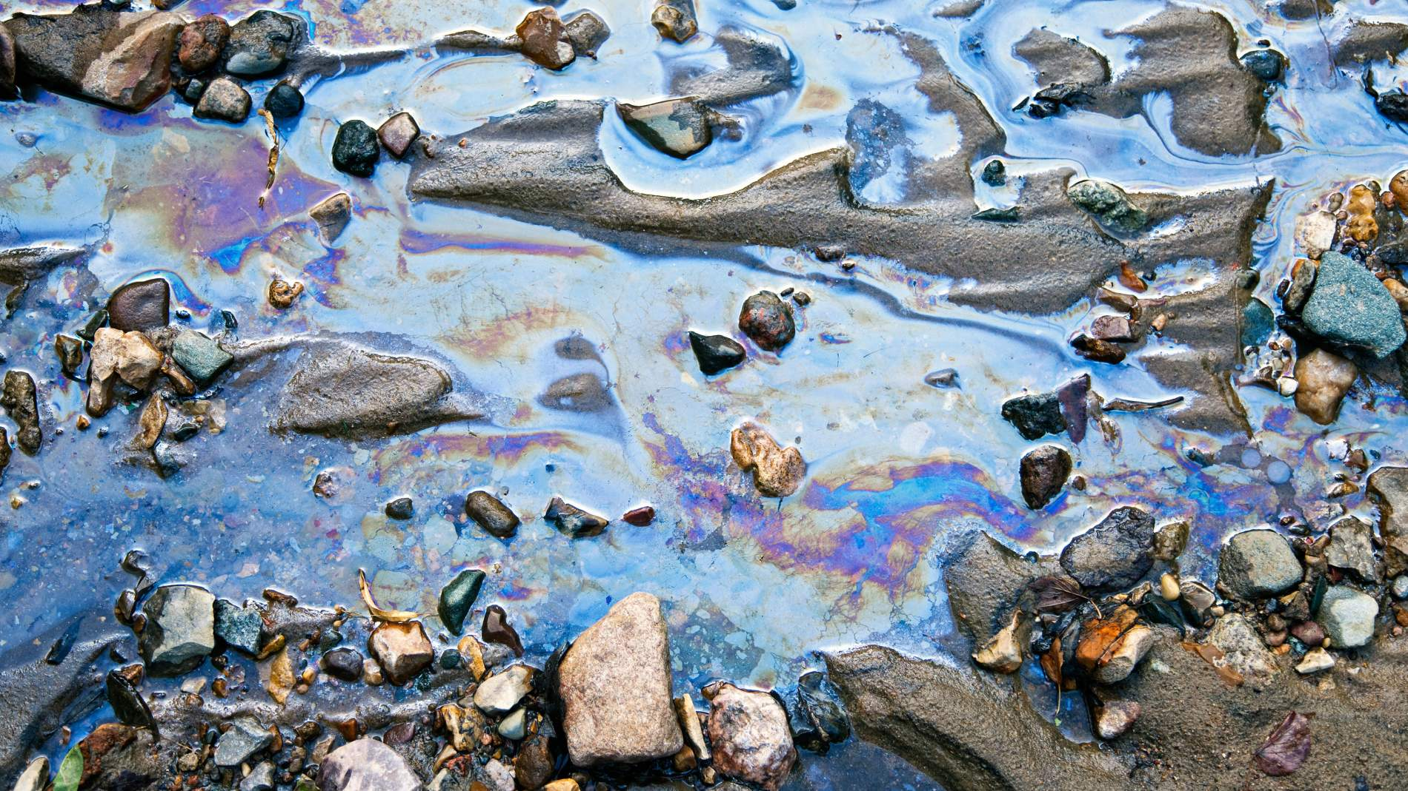


5th Grade:
Water Pollution
To understand how human activities contribute to water pollution and what we can do to prevent it.
Click for Audio
US EPA, Region 10 EcoLearn
Notes:
Image Source:https://prezi.com/tfzzp-jxg-ky/water-pollution/

Slide 2
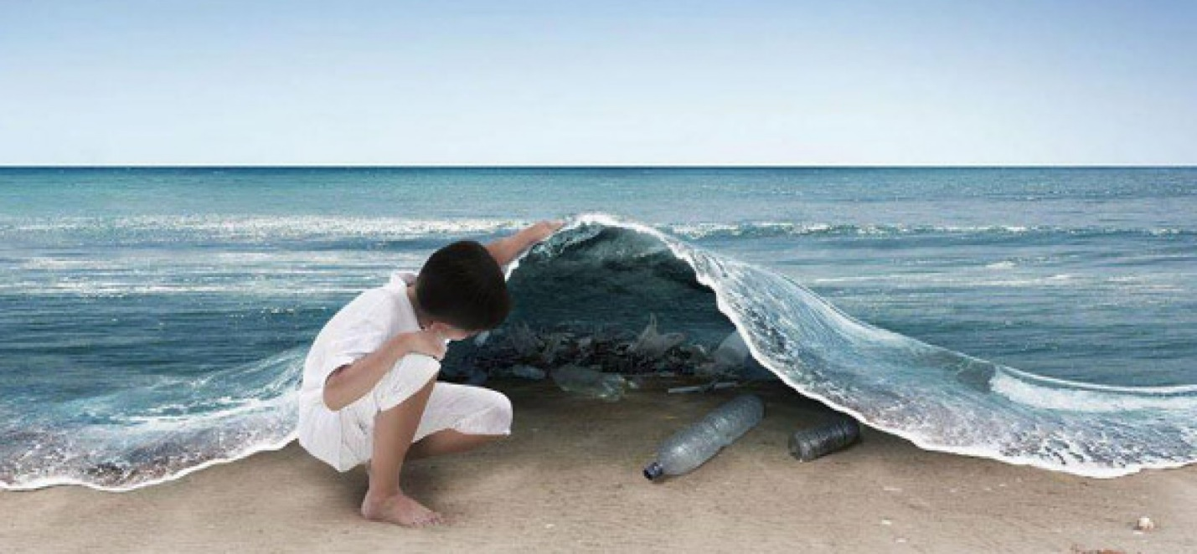

Objective
Today you will learn…
  The history of water pollution
  How runoff can pollute a watershed and affect ecosystems
  How we can prevent water pollution
Notes:
Image Source:http://www.henry4school.fr/Environment/Pollution/water-pollution.htm

Slide 3
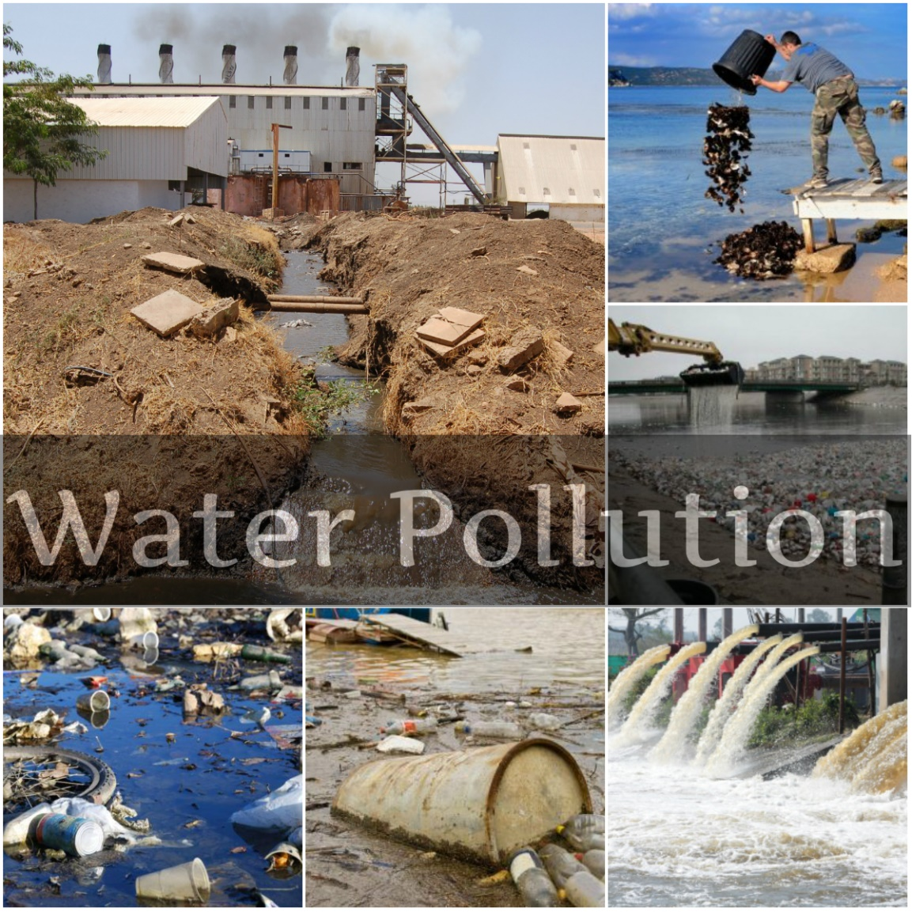

Key Words
Runoff
Watershed
Water pollution
Non-point source pollution
Notes:
ImageSource: https://www.google.com/url?sa=i&rct=j&q=&esrc=s&source=images&cd=&ved=0ahUKEwic7JrTtsvSAhUURGMKHT8sDTsQjxwIAw&url=https%3A%2F%2Fnasaka.in%2Fhow-water-purifier-neutralizes-water-pollution%2F&bvm=bv.149093890,d.cGw&psig=AFQjCNGAHIJvMBMGHTKKKl6GxvZreiaNzg&ust=1489217283454108&cad=rjt

Slide 4

Run Off Activity
  Water pollution can affect the health of humans and ecosystems.
    For example, overflow from sewage pipes carries bacteria that can contaminate drinking water.
    Industrial waste can contaminate rivers and bays with dangerous chemicals that can kill fish.
Notes:
Image Sources:http://www.ctic.purdue.edu/Know%20Your%20Watershed/

Slide 5
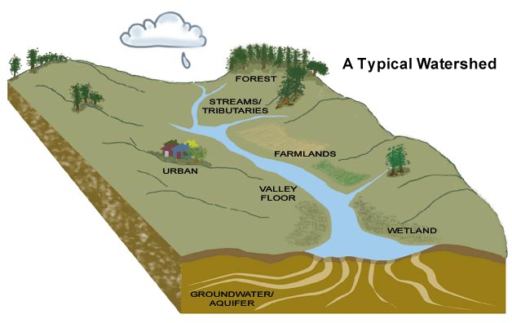
Watershed Demonstration
Notes:
Image Source: https://www.pinterest.com/explore/watershed-management/

Slide 6
Analysis/Evaluation
1. Where did rainfall collect and why?
Identify the tributaries or small streams on your landform.
How many does yours have?
Notes:
Image Source:

Slide 7
Analysis/Evaluation
2. With your finger, trace your stream all the way back up to where it starts at the top of the ridge. (This should be a path of blue ink.)
When you reach the top, this is the edge of the watershed for your stream and lake.
Trace the entire edge of the watershed with your finger by following the ridgeline. This will be something like tracing the edge of a bowl.

Slide 8
Analysis/Evaluation
3. Reflect on how all the communities in a watershed are connected and how pollution can travel between communities, affecting humans and ecosystems along the way.

Slide 9
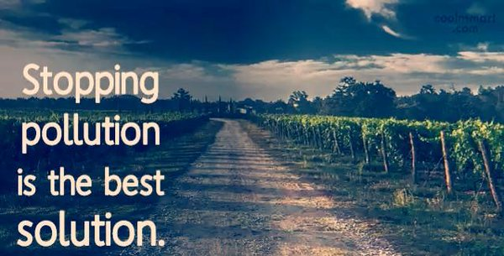
Solution to Pollution: Prevention
Brainstorm- What can you do?
Notes:
Image Source:https://twitter.com/imkashifkhan/status/606759013460512768

Slide 10

What we can do…
Reduce or eliminate the use of pesticides and herbicides on gardens and lawns.
Dispose of trash in the proper waste bins and recycle whenever you can. Pick up litter when you see it and dispose of it properly.
Build a rain barrel to catch rain from a roof. Use that water to water your garden or lawn.
Notes:
Image Source:https://www.tes.com/lessons/v_70k868uVojHw

Slide 11
What we can do…
Scoop the poop! Pick up after your dog to keep pet waste out of rivers and streams.
Do not throw chemicals, oils, paints and medicines down the sink or toilet. Take used paint and other hazardous chemicals to the landfill for proper disposal.
Rather than washing your car with soap in the driveway, take it the car wash.

Slide 12
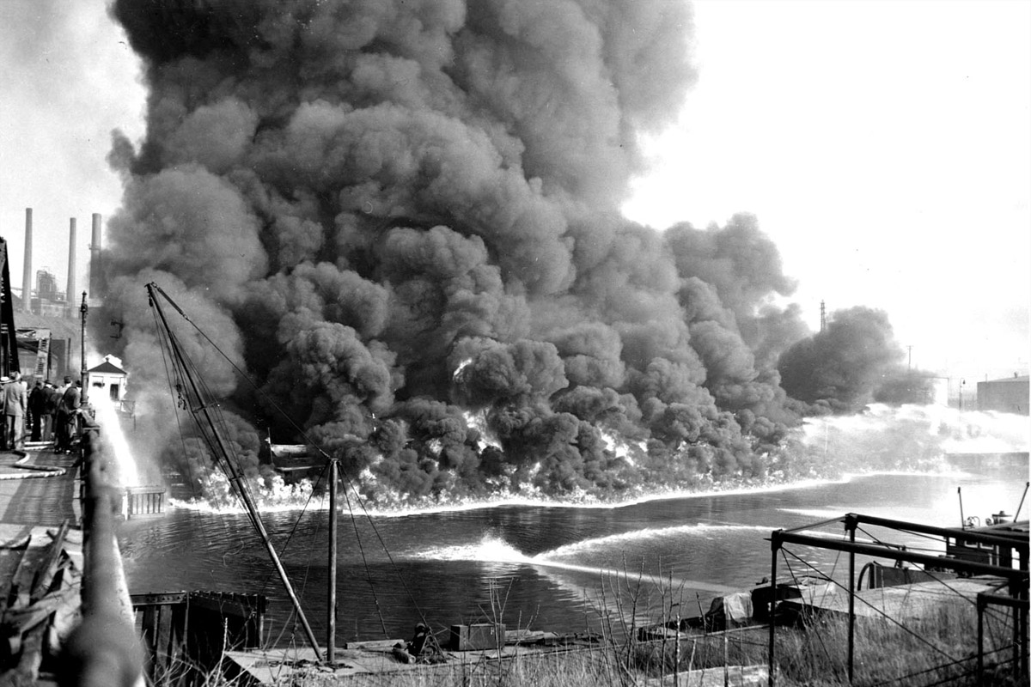
Cayuhoga River Restoration
View “Cahoyuga River Restoration”
Notes:
Image Source: http://www.alleghenyfront.org/about/

Slide 13

Homework
  Two sources for information
    Eschool Today
    EPA
Notes:
Image Source: http://mylifecity.com/indicator/prevent-or-remove-water-pollution/

Slide 14


EcoLearn
Developed by the Environmental Protection Agency
With support from Department of State
Virtual Students of Foreign Service Interns
https://www.epa.gov/education
For more information: hanft.sally@epa.gov or salazar.viccy@epa.gov
US EPA
Region 10
EcoLearn

