Slide 1
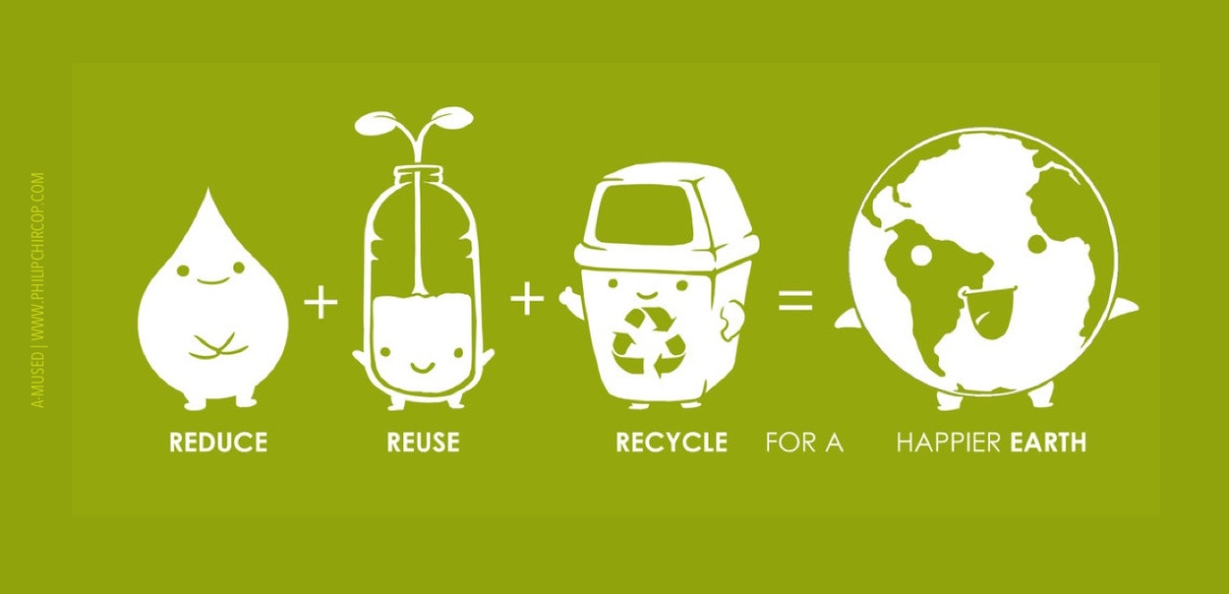
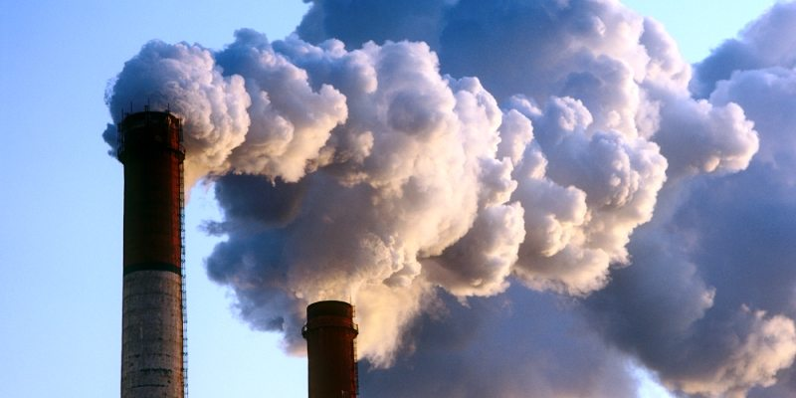


Air
USA EPA,
Region 10
EcoLearn
1st Grade: Air Pollution
Notes:
http://www.philipchircop.com/post/117077877097/reduce-reuse-recycle-today-the-22nd-of-april

Slide 2
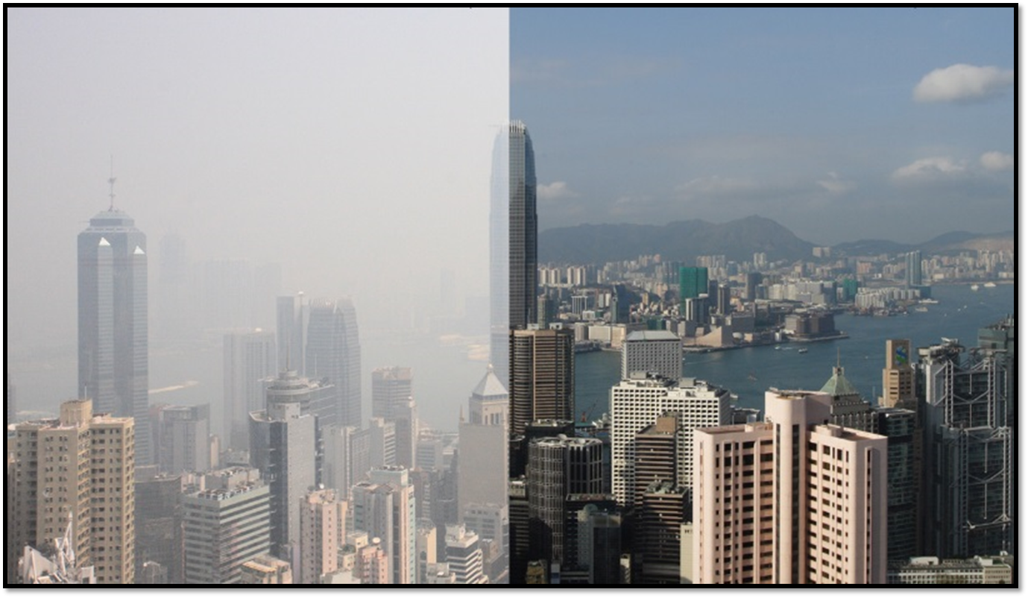
Writing Activity:
What do you think about this picture?

Slide 3
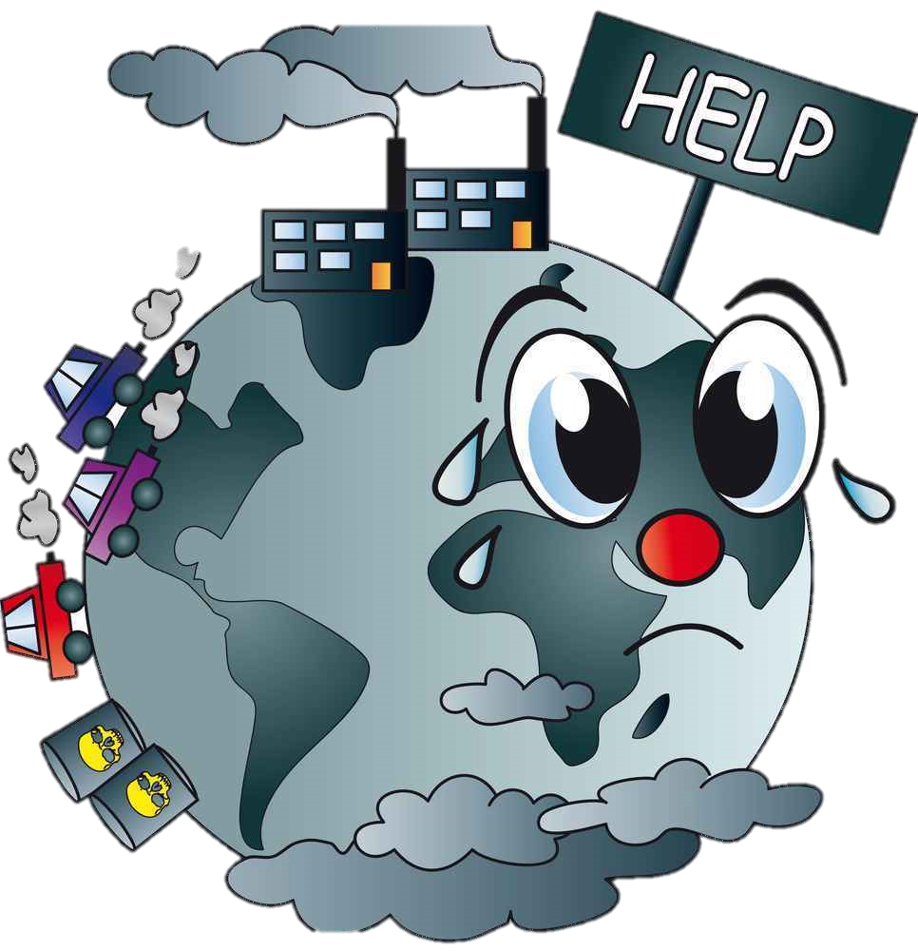
Today:
Today you will…
  Learn what air pollution is and how you can help reduce it.
  Key Words:
  Pollution
  Smog
  Emissions
  Smoke
  Ash
Notes:
http://www.publishyourarticles.net/eng/question-and-answers/what-are-the-major-causes-of-water-and-air-pollution/2584/

Slide 4
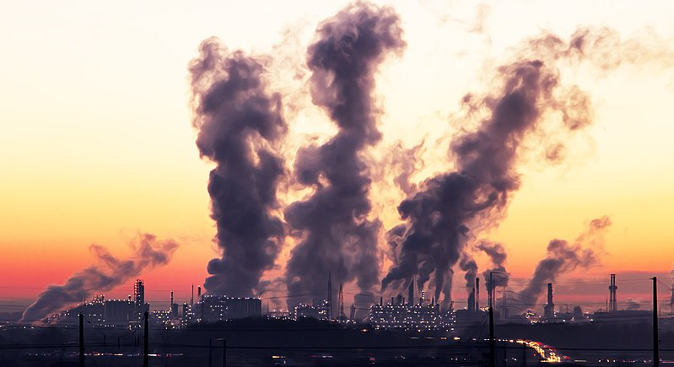
You will be able to determine how you can reduce air pollution and why it matters to do so.
Notes:
http://www.thephuketnews.com/air-pollution-no-time-to-breath-easy-60651.php#gyrJIyu1ylV6Yxvt.97

Slide 5
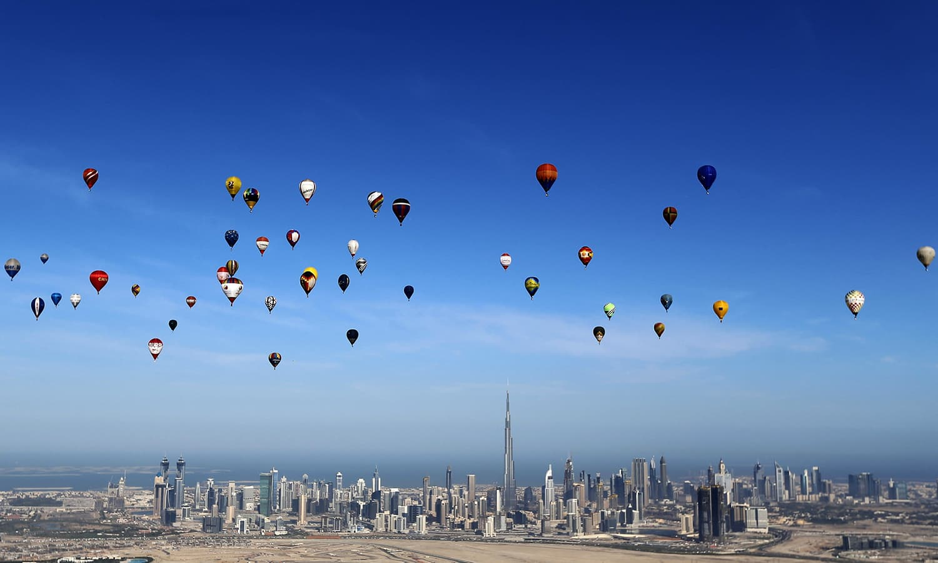
What do we know about air?
Can we see air?
Can we feel it?
Taste it?
Hear it?
Smell it?
Notes:
https://www.dawn.com/news/1225431

Slide 6
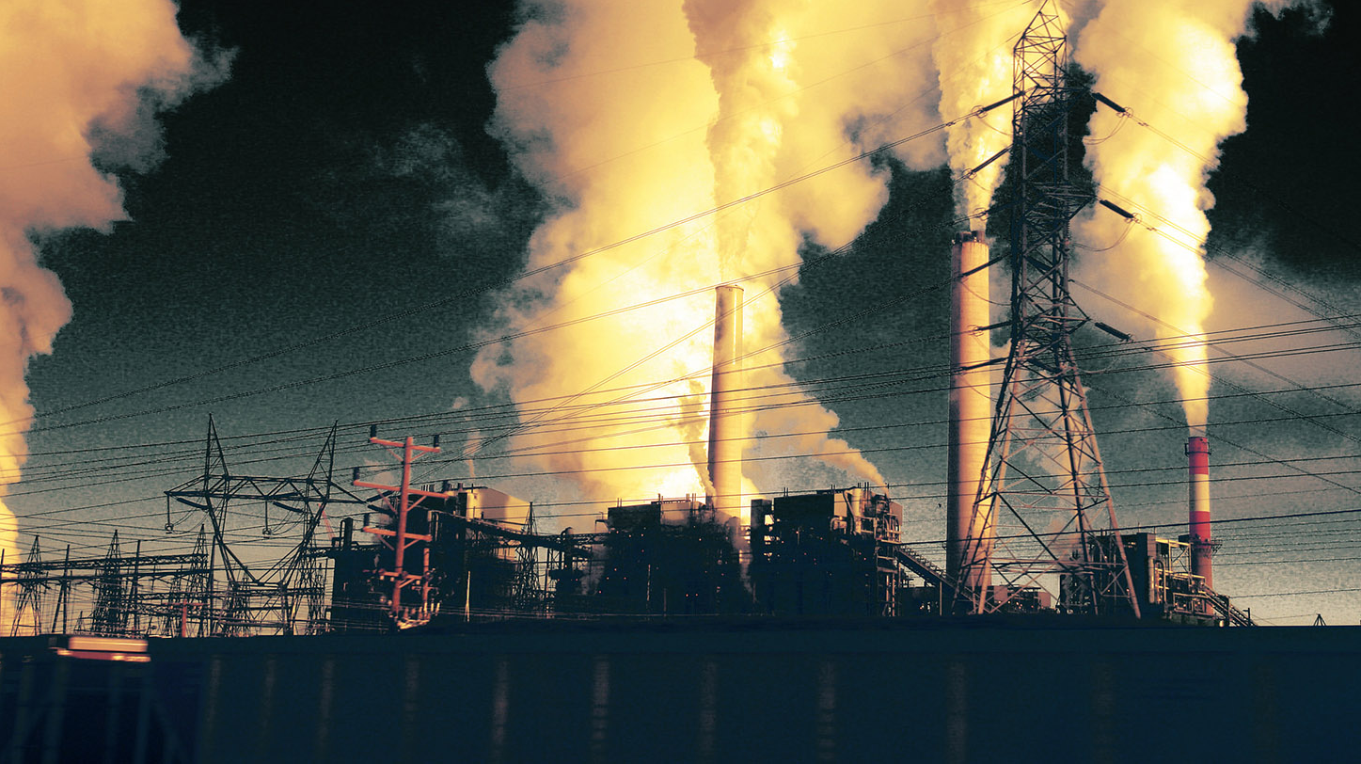
What is “pollution”?
Pollution is something that is bad or harmful for our environment.
Air pollution makes the air dirty and harder for living things to breathe.

Slide 7
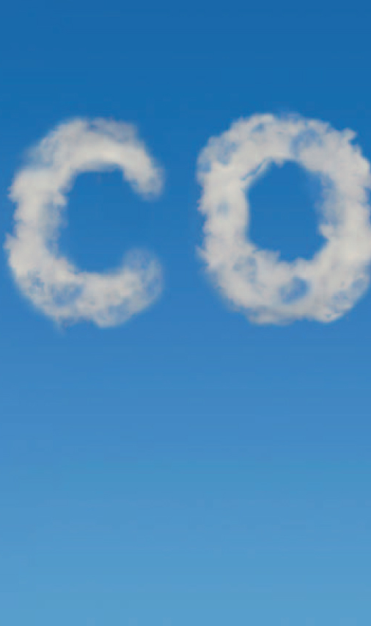
What causes air pollution?
Natural sources of air pollution:
  Fires and volcanic eruptions, which create lots of ash.
  Biggest form of air pollution is air pollution caused by cars called emissions.
  - Come from the burning of fossil fuels, which creates energy.
  - Pollution in big cities is known as smog.

Slide 8
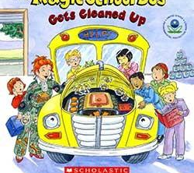
The Magic School Bus Gets Cleaned Up

Slide 9
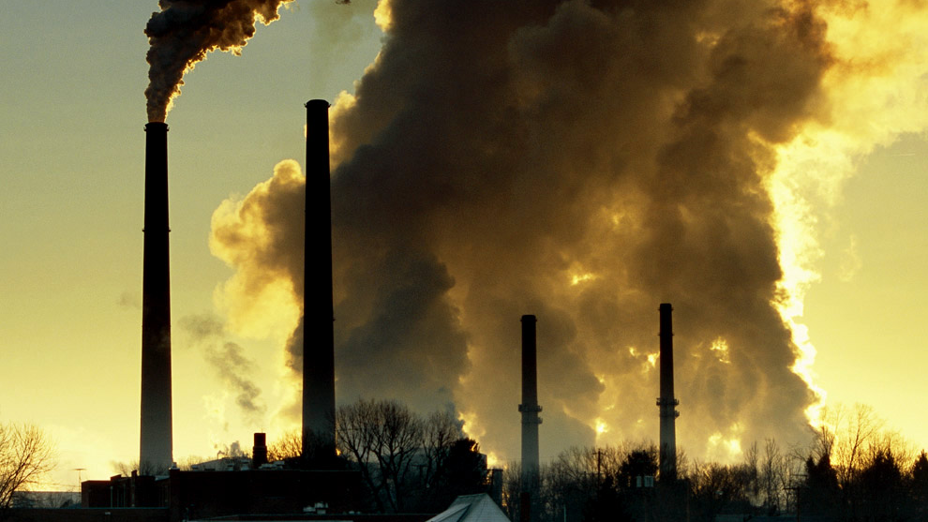
Air Pollution Pledge
“I will reduce air pollution by ______ because ______.”
Example: “I will reduce air pollution by riding my bike because it’s good for me and the environment.”

Slide 10
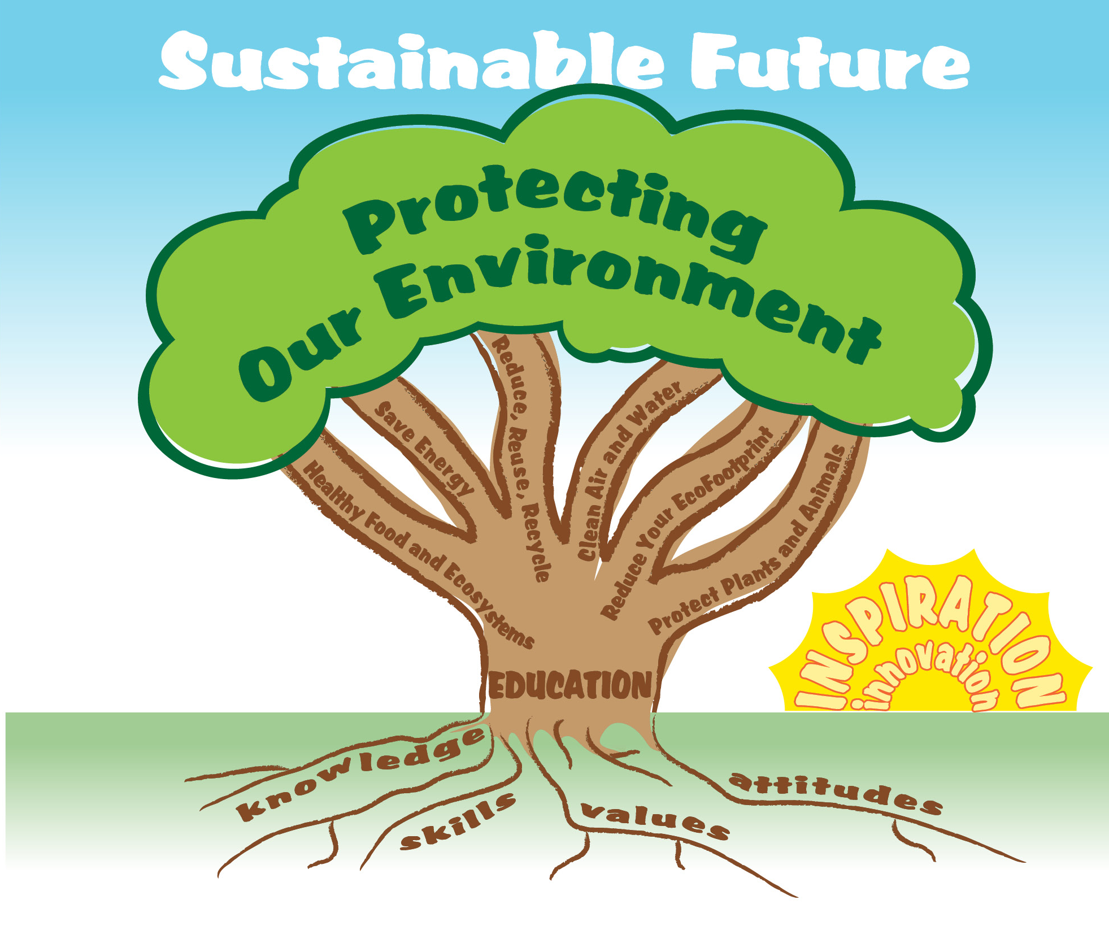

EcoLearn
Developed by the Environmental Protection Agency
With support from Department of State
Virtual Students of Foreign Service Interns
https://www.epa.gov/education
US EPA
Region 10
EcoLearn
For more information: hanft.sally@epa.gov or salazar.viccy@epa.gov

