Slide 1
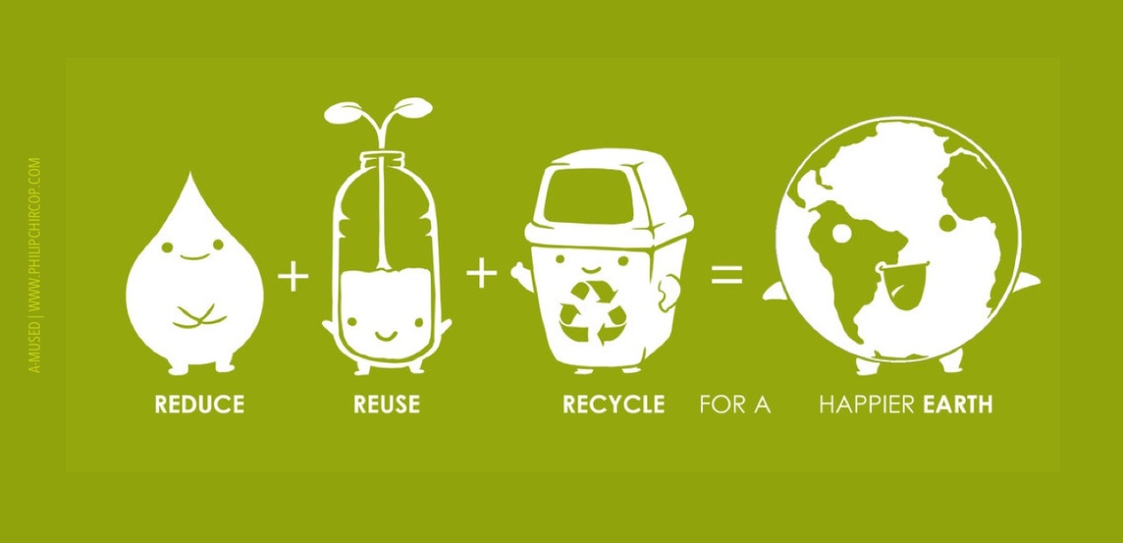
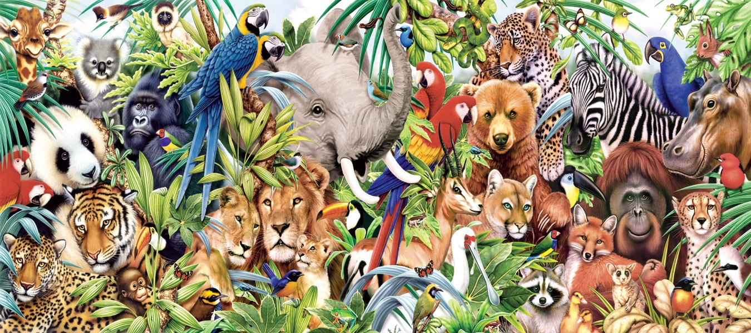


Animals
USA EPA,
Region 10
EcoLearn
1st Grade: Animals and the Food Chain
Notes:
http://www.philipchircop.com/post/117077877097/reduce-reuse-recycle-today-the-22nd-of-april

Slide 2
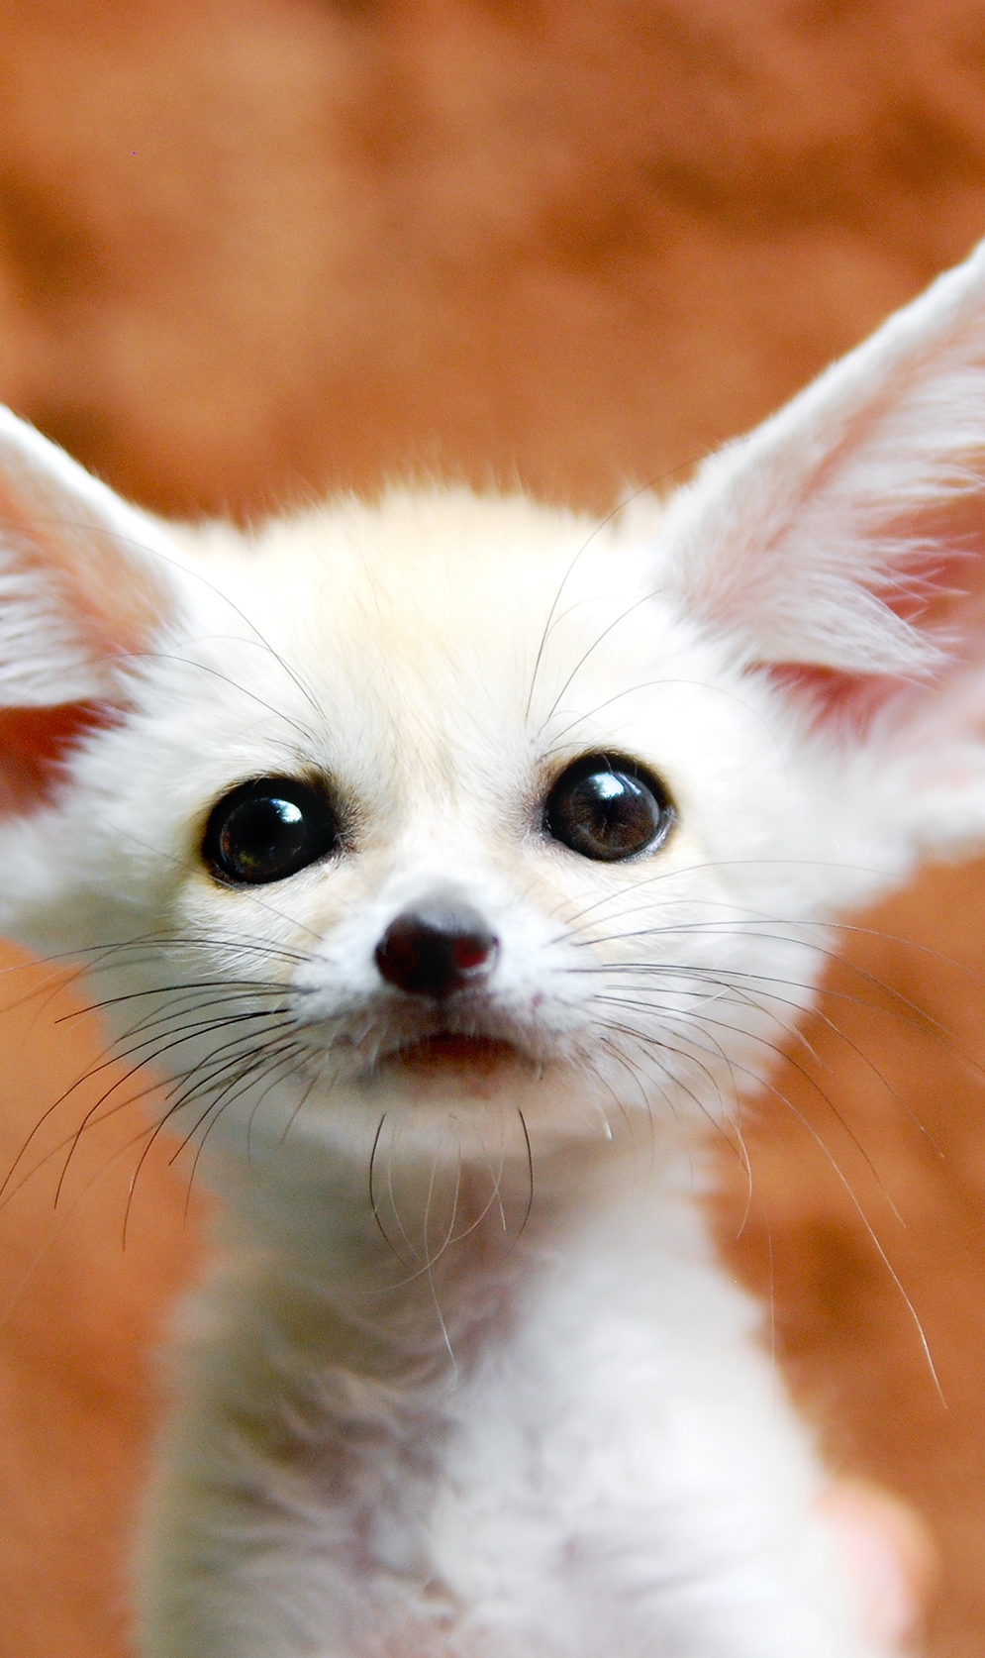
Today:
Today You Will Learn….
  About the food chain and how living things are dependent on their prey for survival.
  Key Terms:
  Animal
  Herbivore
  Predator
  Extinct
  Food chain
Carnivore
Omnivore
Prey
Endangered
Habitat
Notes:
http://weknownyourdreamz.com/animals.html

Slide 3
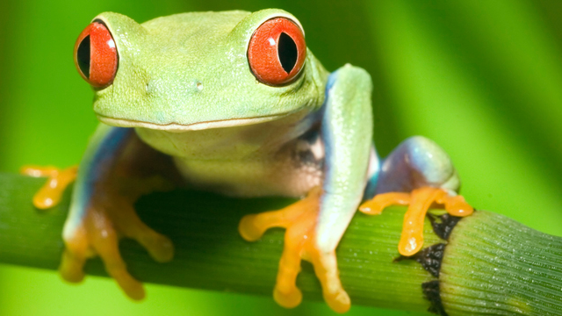
It is important to respect animals and be aware that if an animal becomes endangered or extinct, it has an impact on the entire food chain.
Notes:
http://gzhaixier.com/animal.html

Slide 4
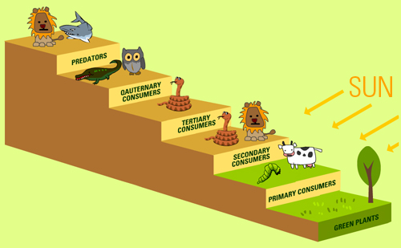
The Food Chain Detailed:
Animals are characterized into different categories based on what and how they eat.
Notes:
http://eschooltoday.com/ecosystems/ecosystem-trophic-levels.html

Slide 5
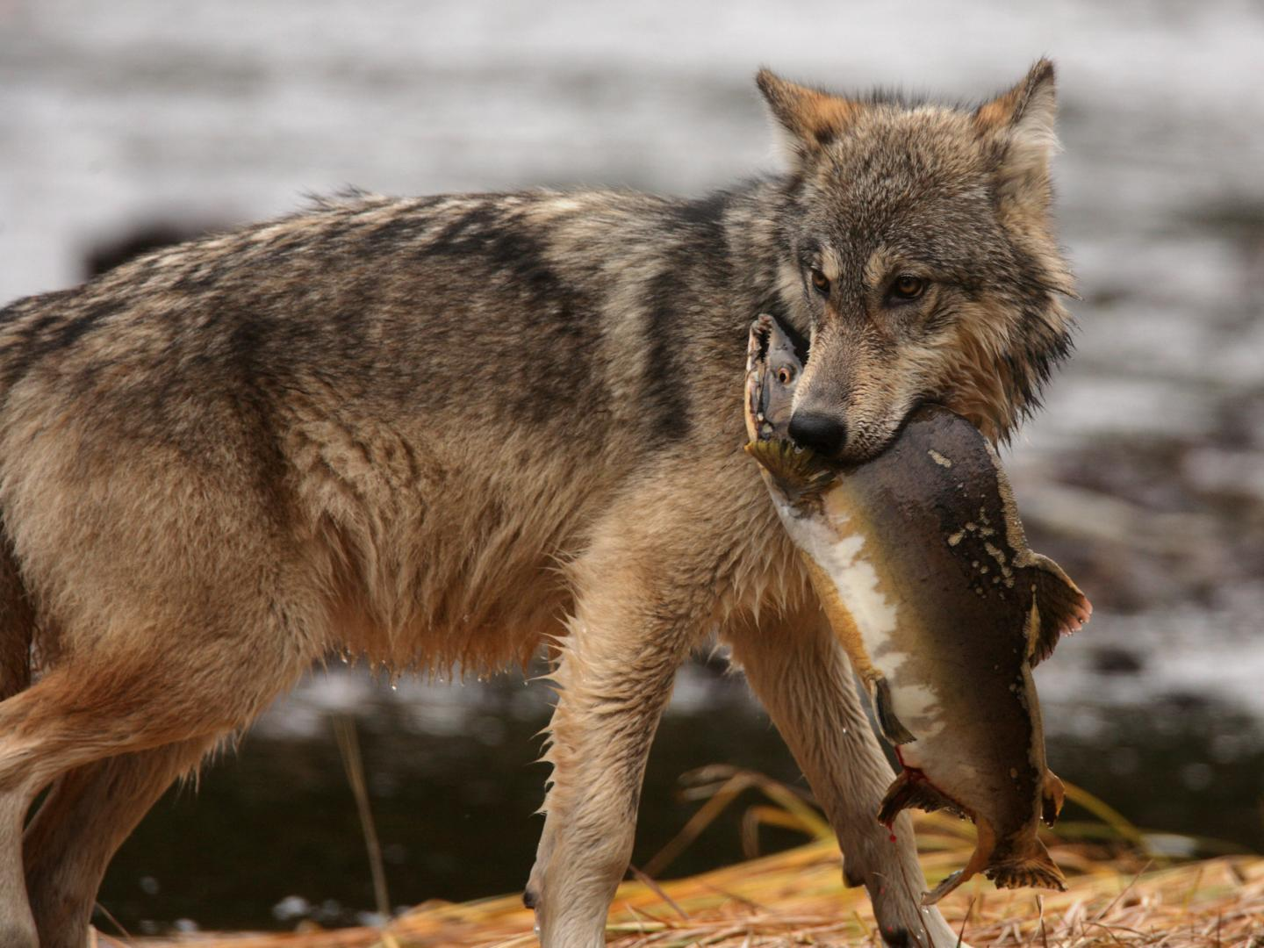
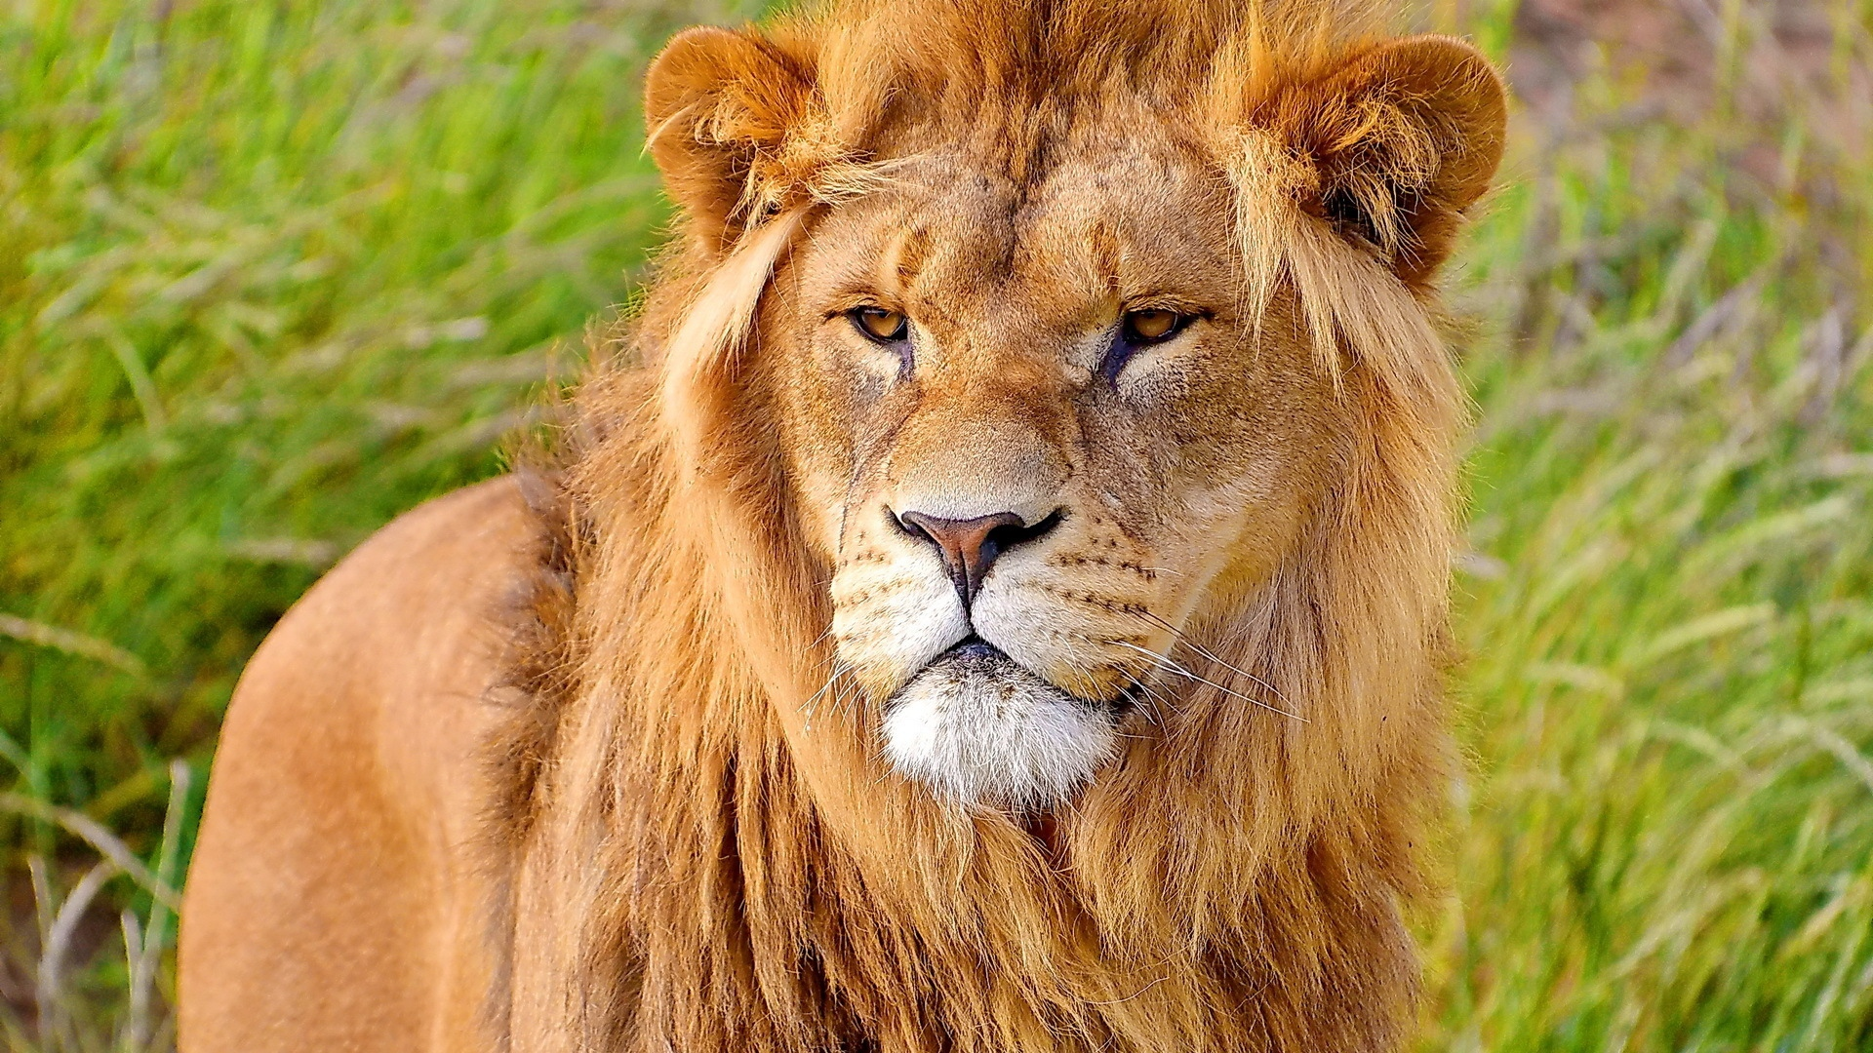
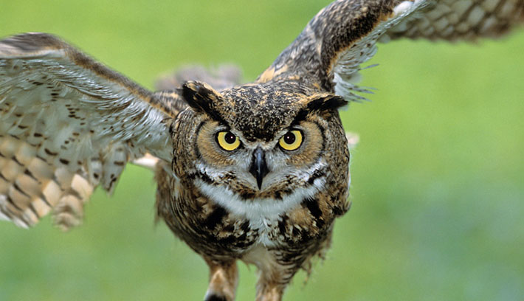
Carnivore
Def. An animal that eats other animals
Notes:
http://kingofwallpapers.com/carnivore.html

Slide 6
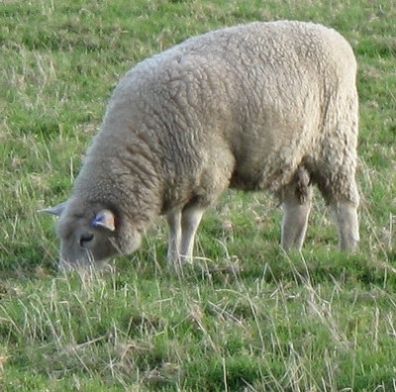
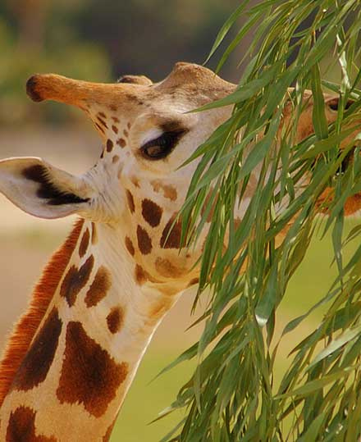
Herbivore
Def. An animal that eats plants
Notes:
http://educationinaction.org/water-rocks-vocabulary/herbivore

Slide 7
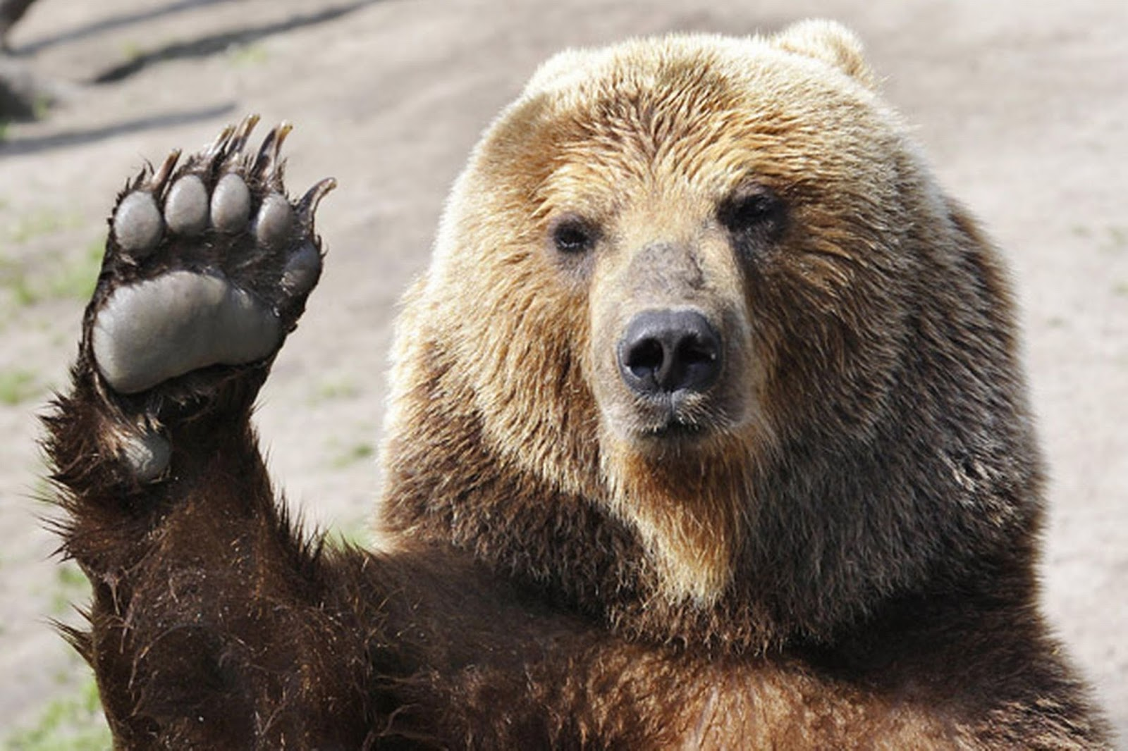
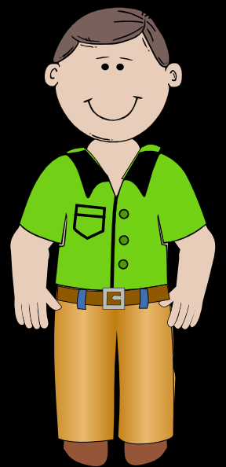
Omnivore
Def. An animal that eats both plants and other animals
Notes:
http://derekbair.blogspot.com/2014/12/herbivore-omnivore-carnivore.html

Slide 8
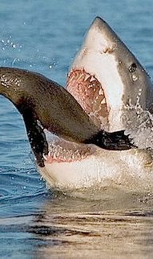
Predator vs. Prey
Animals that eat other animals are called predators.
Animals that are eaten by other animals are called prey.
Notes:
https://www.google.com/url?sa=i&rct=j&q=&esrc=s&source=images&cd=&ved=0ahUKEwiz6db5psDTAhVO32MKHY9zA80QjhwIBQ&url=https%3A%2F%2Fwww.pinterest.com%2Fabu3li%2Fprey-predator%2F&psig=AFQjCNFspAxub-hrvF6sRW2DDrkCJpF6Qg&ust=1493233138750622

Slide 9
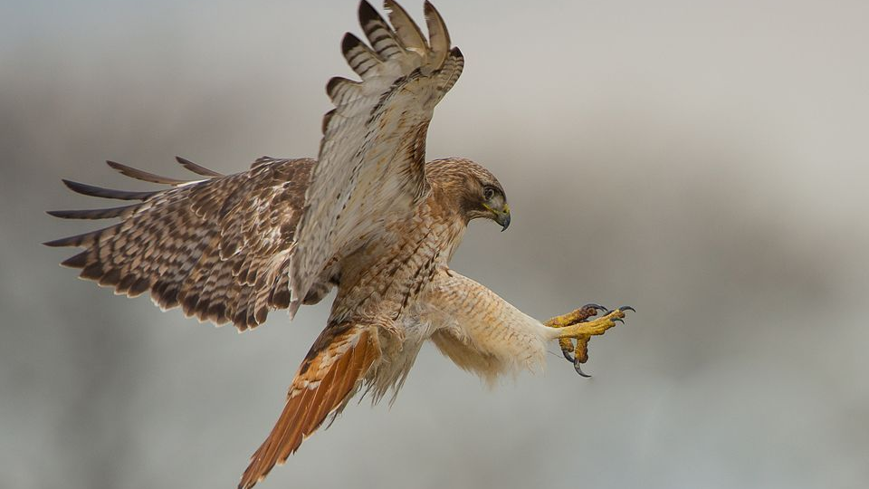
Food Chain Thought Exercise:
Now that we know what a food chain is, can we make an educated guess on what would happen if there were no more hawks?
Notes:
http://animals.nationalgeographic.com/animals/birds/red-tailed-hawk/

Slide 10
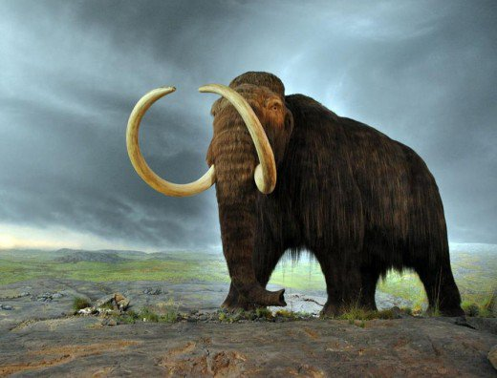
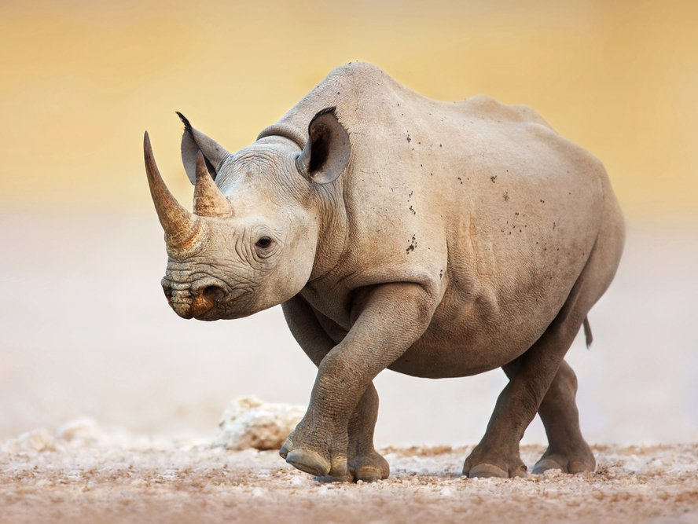
If there were no more hawks, that would mean that all the hawks have died, or gone extinct.
A wooly mammoth is an example of an animal that has gone extinct.
An endangered animal, on the other hand, is facing the threat of going extinct.
Notes:
http://sevennaturalwonders.org/index_/natural-wonders-special-categories/wildlife/endangered-species/
https://owlcation.com/stem/Top-10-Most-Beautiful-Extinct-Animals

Slide 11
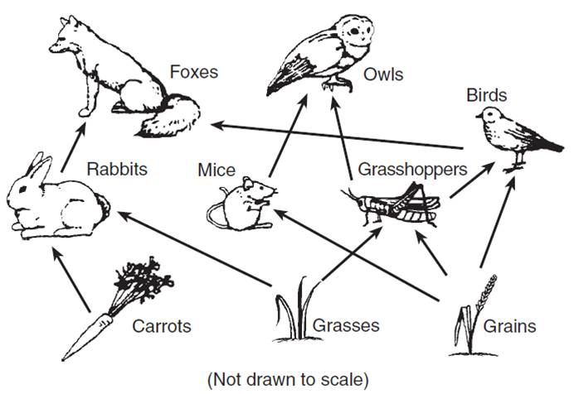
Interactive Food Web Activity:

Slide 12

Questions:
What did we learn about animals today?
What is a food chain and why is it important to understand?

Slide 13
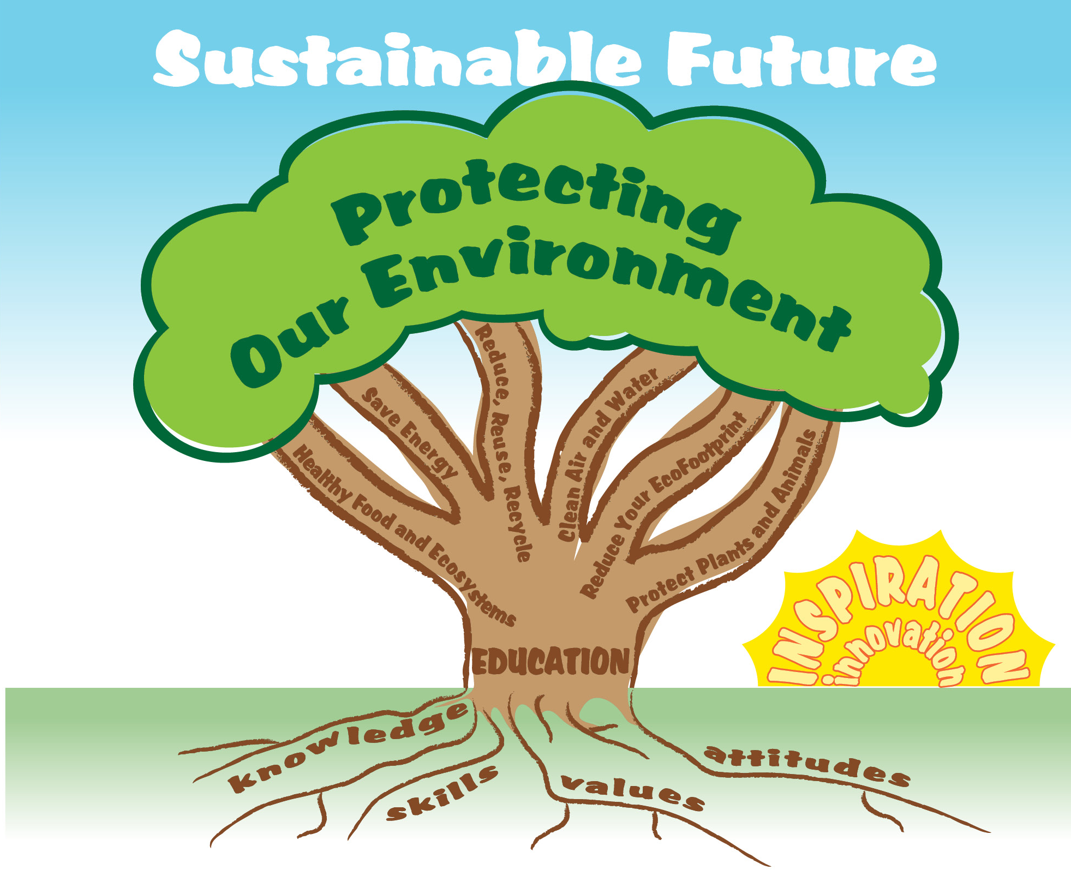

EcoLearn
Developed by the Environmental Protection Agency
With support from Department of State
Virtual Students of Foreign Service Interns
https://www.epa.gov/education
US EPA
Region 10
EcoLearn
For more information: hanft.sally@epa.gov or salazar.viccy@epa.gov

