Slide 1
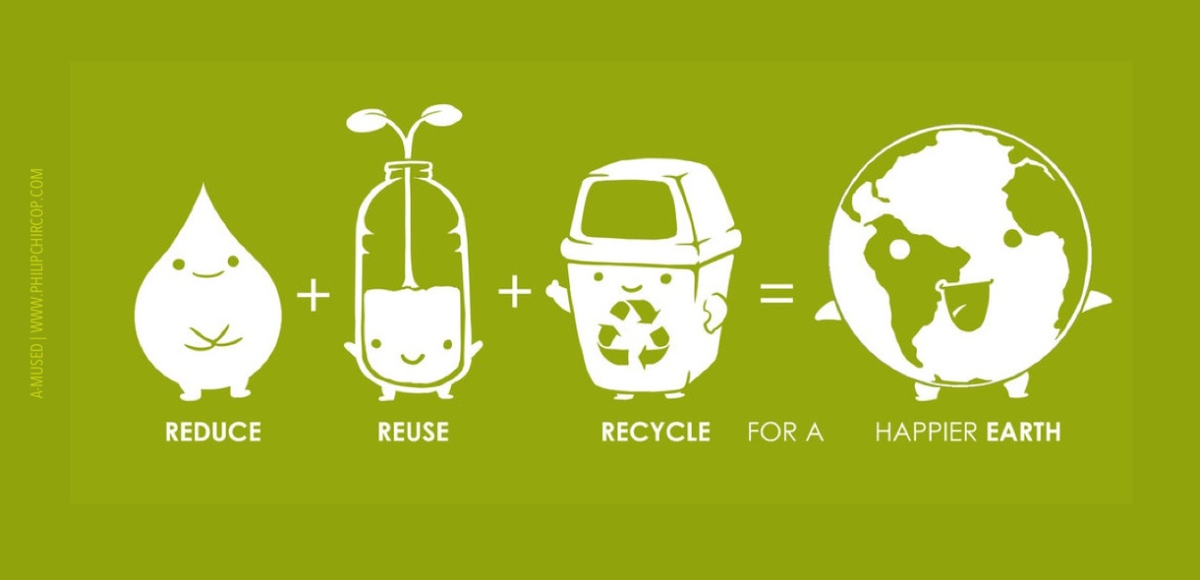
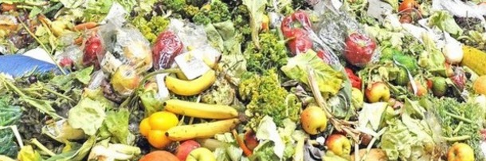

1st Grade
Food
USA EPA,
Region 10
EcoLearn
What Happens to the Food We Do Not Eat?
Notes:
http://www.philipchircop.com/post/117077877097/reduce-reuse-recycle-today-the-22nd-of-april

Slide 2


Today:
Today you will…
Learn about food waste, what kinds of food we see wasted every day, and what we can do to prevent food waste.
Key Words:
Trash
Food waste
Wasted Food
Landfill
Compost
Notes:
https://sites.google.com/a/isswiki.de/food-waste-louisamaier/

Slide 3
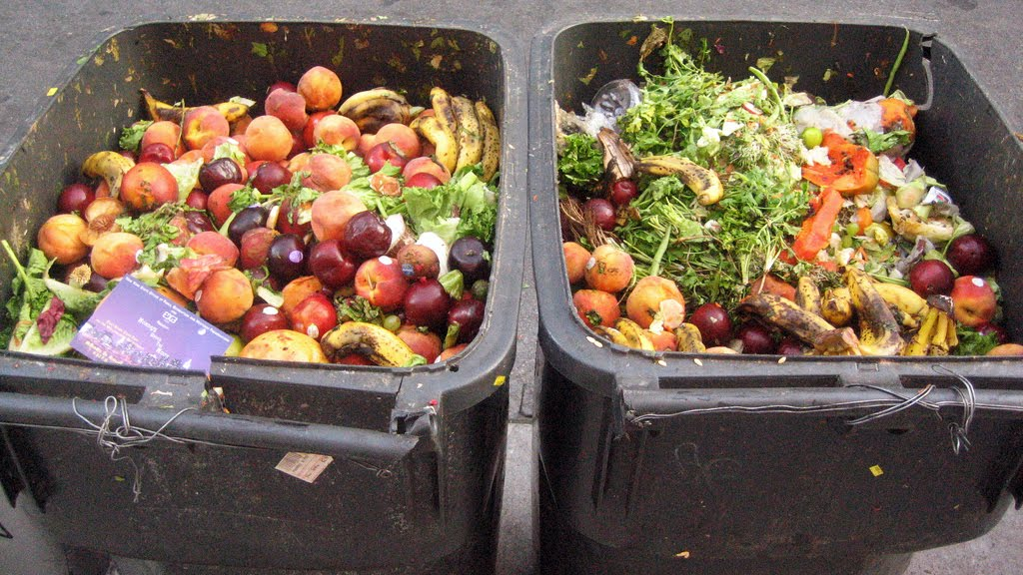
According to the Food and Agriculture Organization, 1/3 of the world’s food produced is thrown away. Let’s learn what we can do to prevent food waste!
Notes:
http://www.konbini.com/us/lifestyle/altruistic-food-waste-revolution-now/

Slide 4
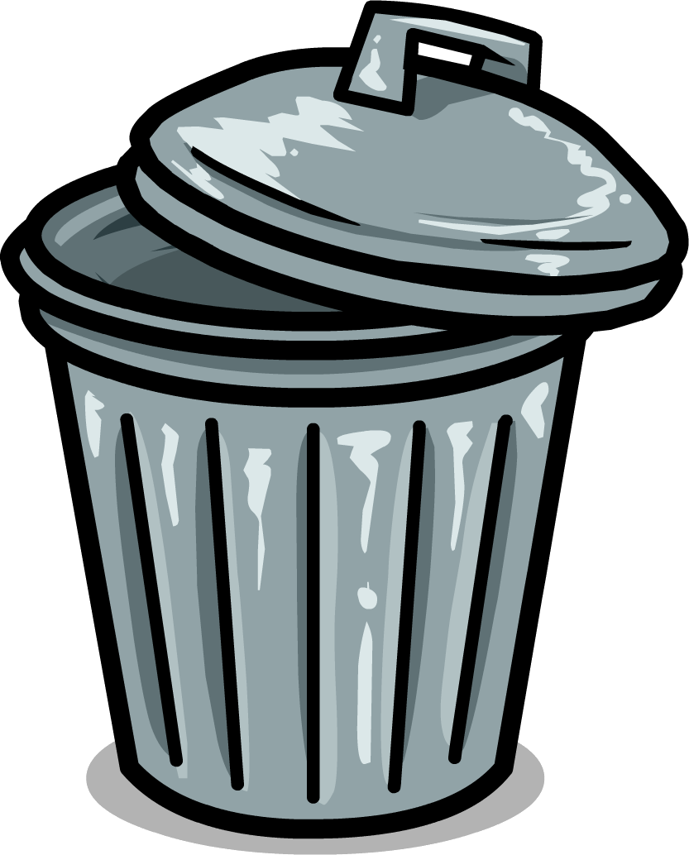
Opening Questions:
What is trash?
Is the trash you throw away able to be used again? Could it be used by someone else?
What are the types of things you throw away?

Slide 5


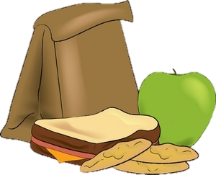
Imagine This…
You’re so hungry that you end up putting one of everything on your plate! You sit down and start eating…but halfway through your plate, you feel full and you have to throw the rest away.

Slide 6
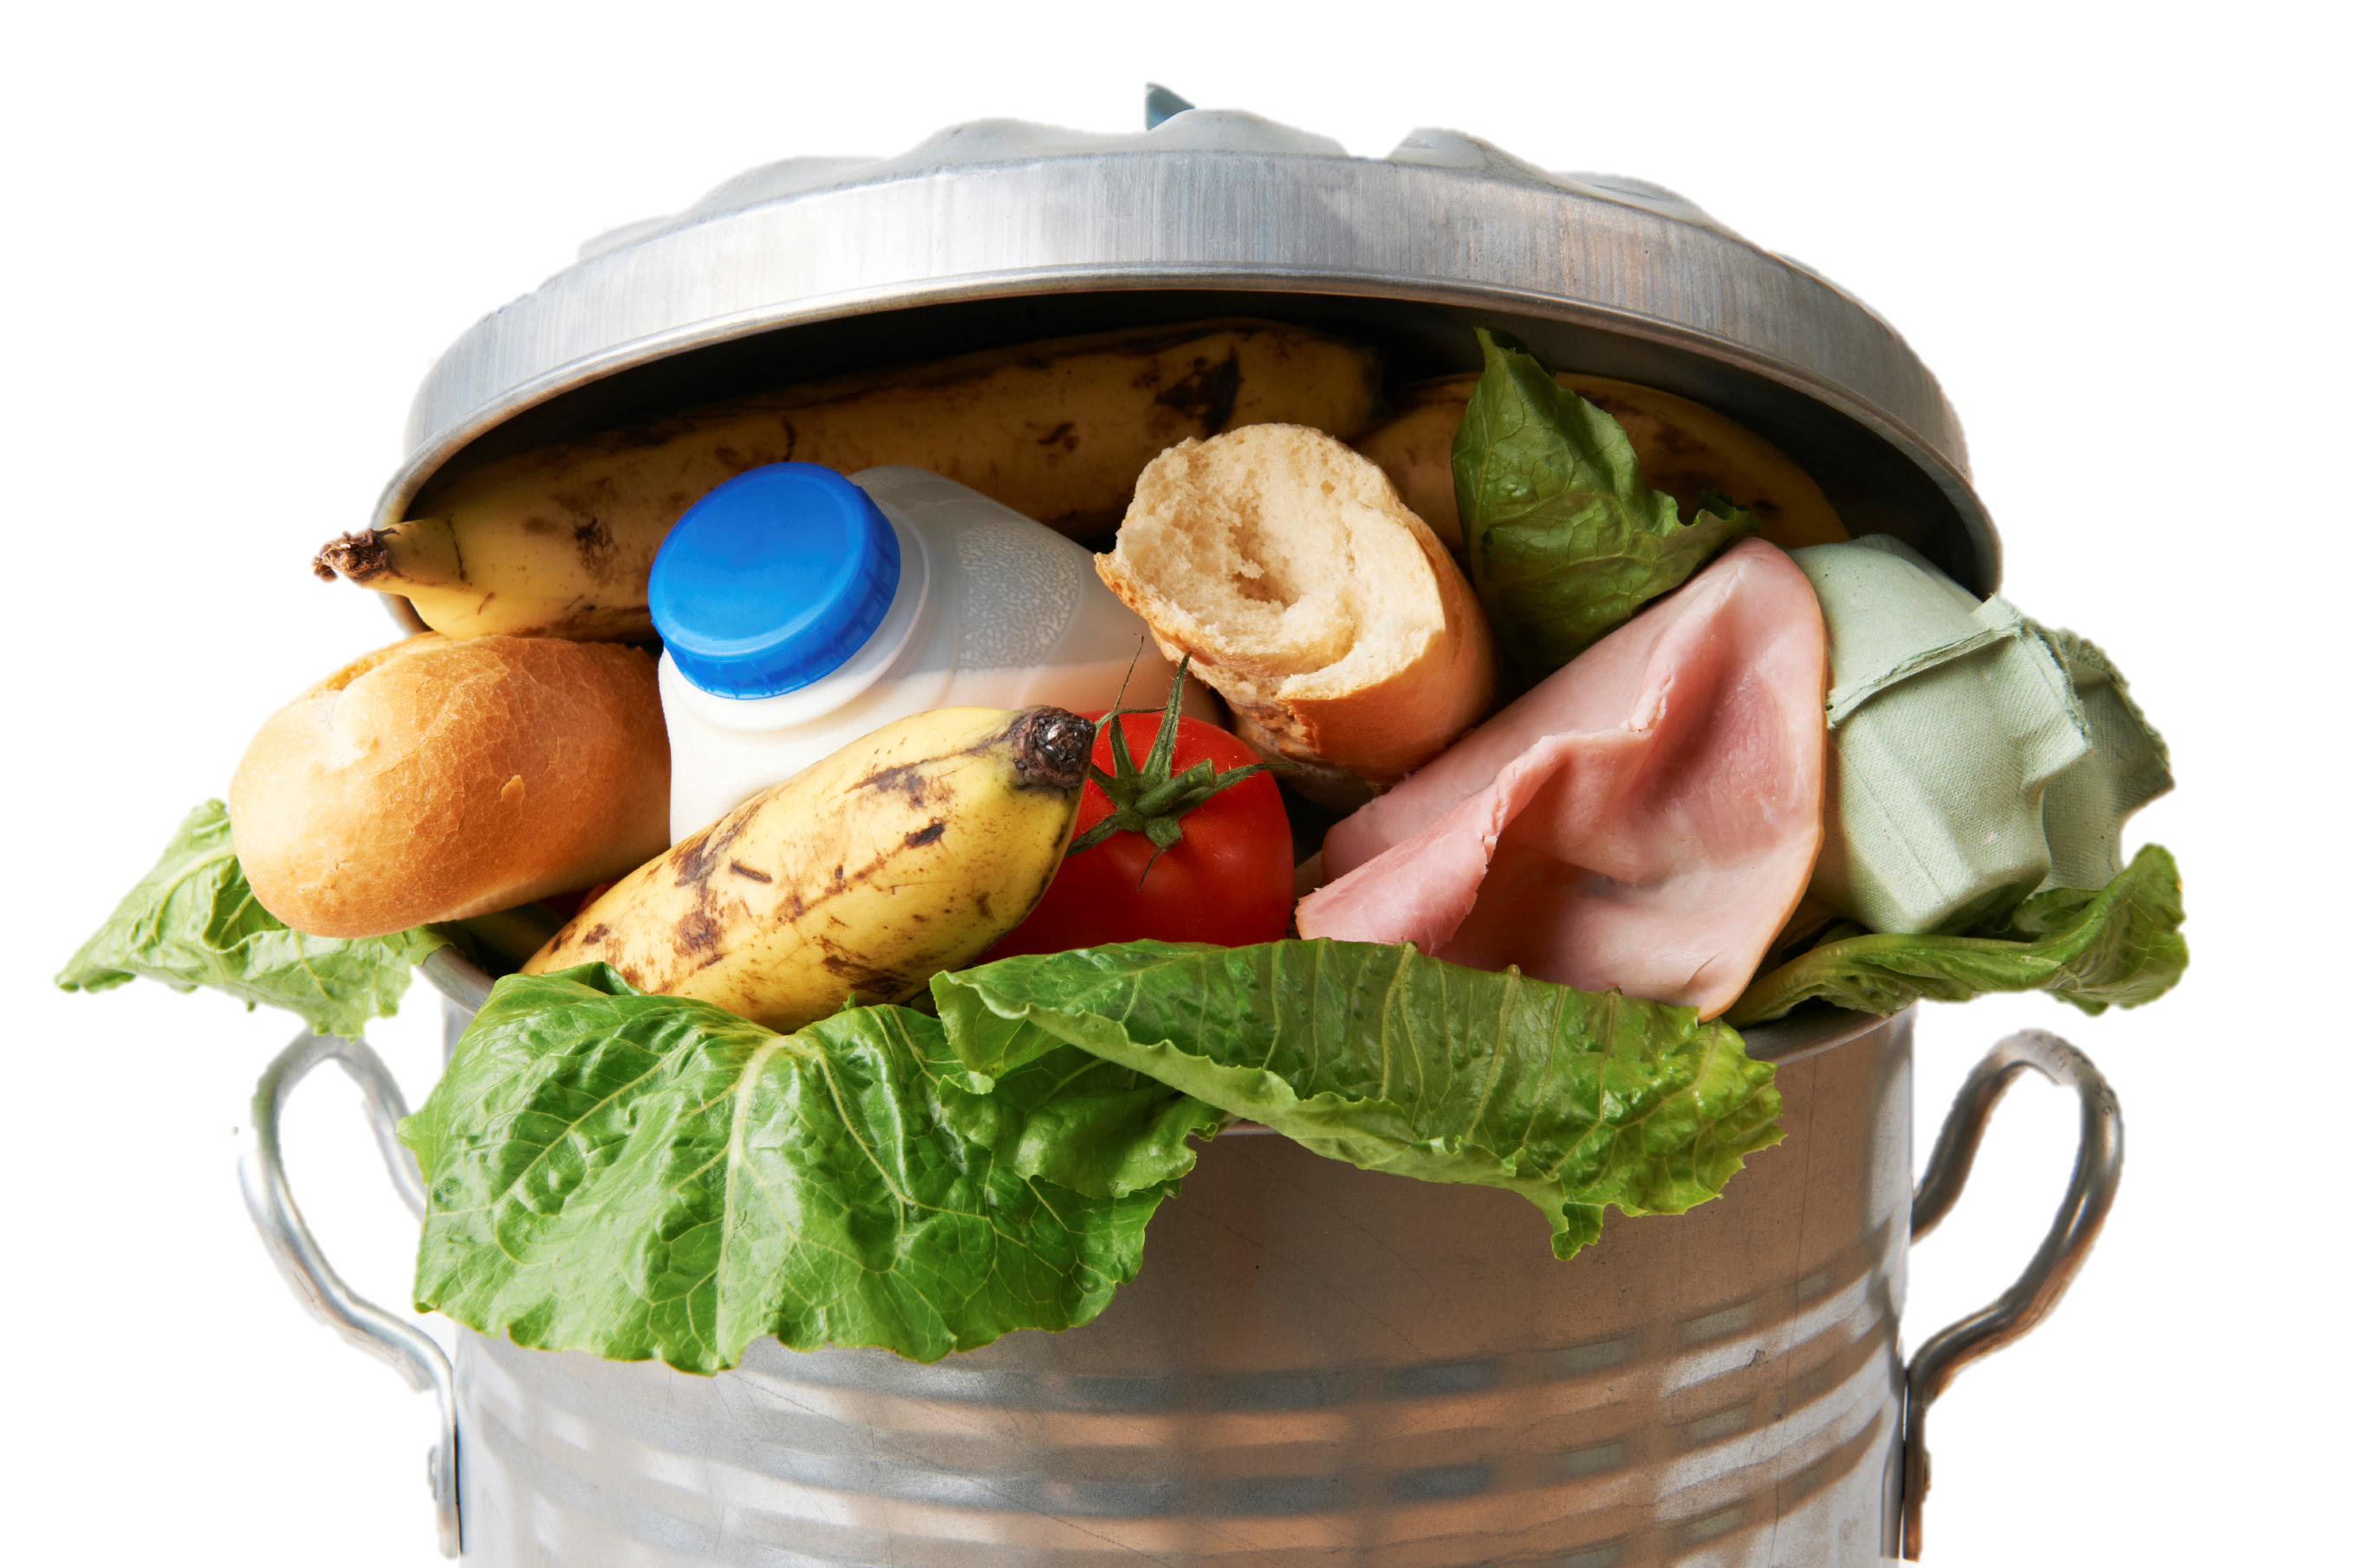
This is called food waste.
Notes:
What kind of foods have you thrown away recently in the cafeteria? What have you seen in the trash? If the food is still good, why does it need to be thrown away? Can you save it for later? Give it to someone else?

Slide 7
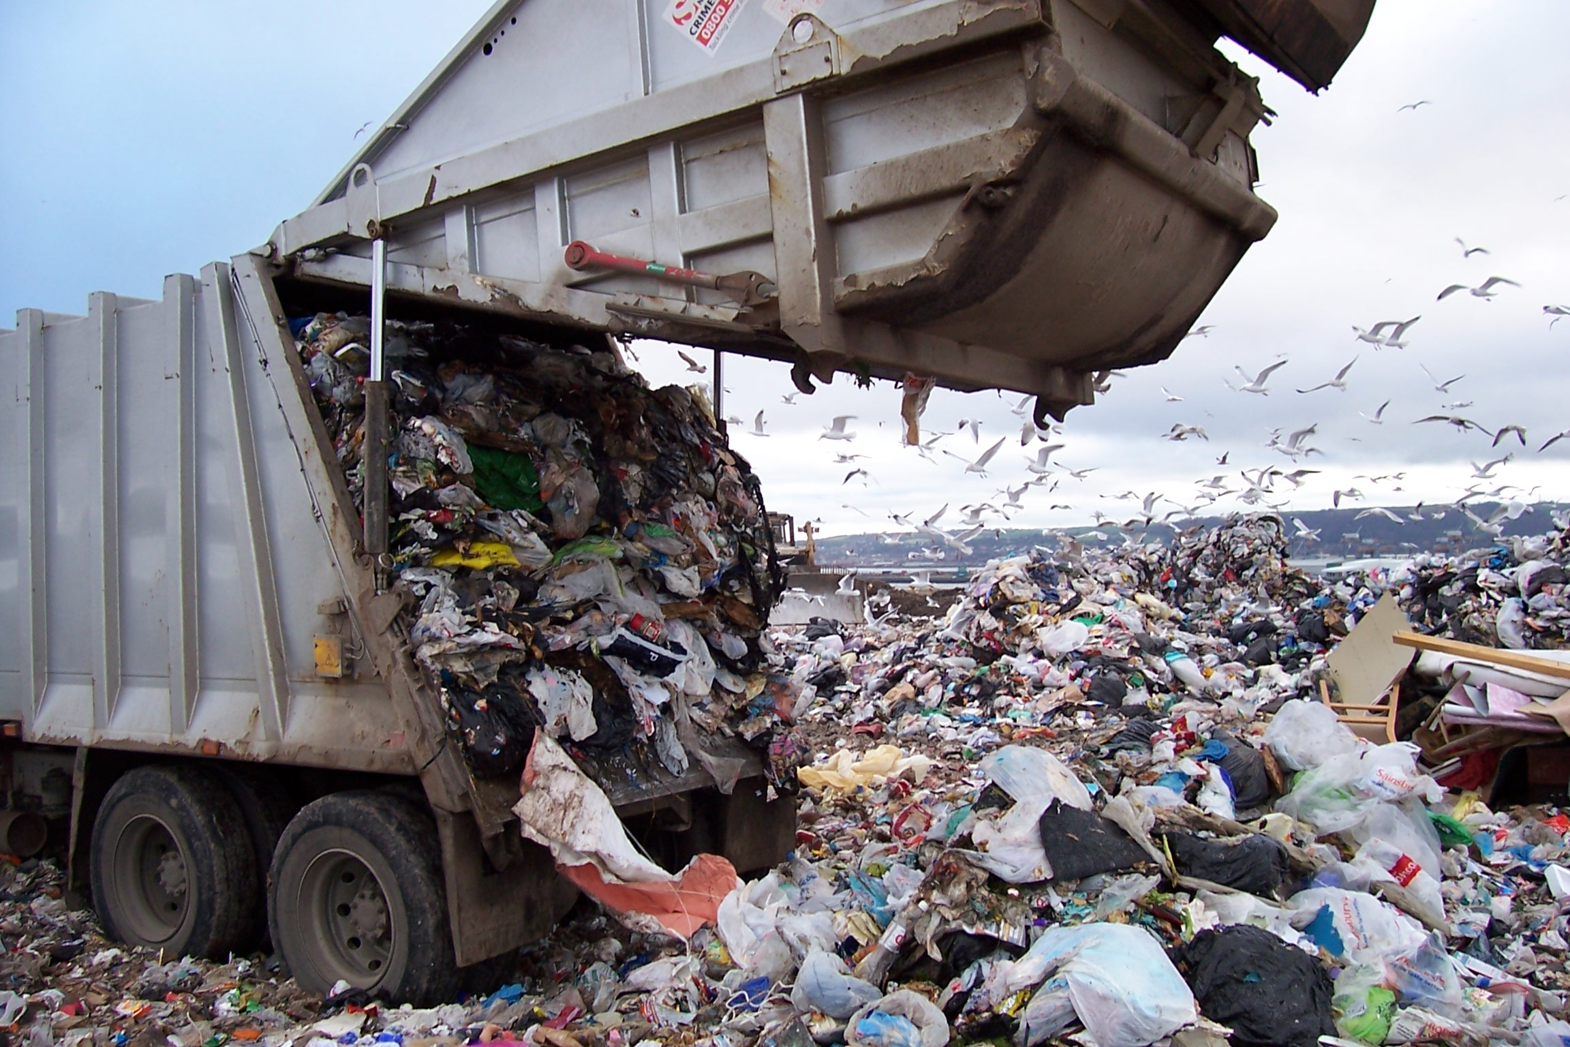
Source: http://www.corvallisadvocate.com/wp-content/uploads/2013/01/Landfill-For-Interior.jpg

Slide 8
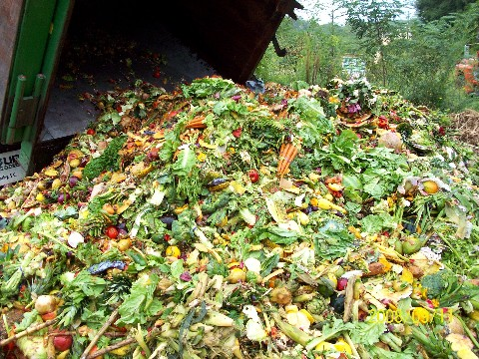
Source: http:///www.triplepundit.com/2010/11/uk-businesses-hoping-to-help-the-planet-and-themselves-join-the-clean-plate-club

Slide 9
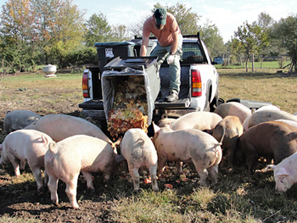
Source: http://reason.kzoo.edu/reason/images/330710.jpg

Slide 10
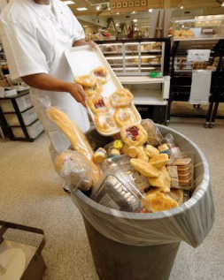
This is called wasted food.
Source: Triple Pundit http://www.triplepundit.com/2011/05/food-waste-information-technology/

Slide 11
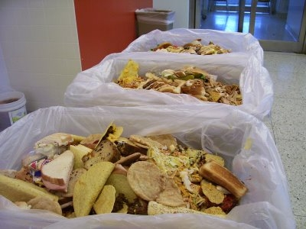
Source: Quiet Environmentalist http://quiet-environmentalist.com/wp-content/uploads/2010/08/Food-Waste-Images.jpg

Slide 12
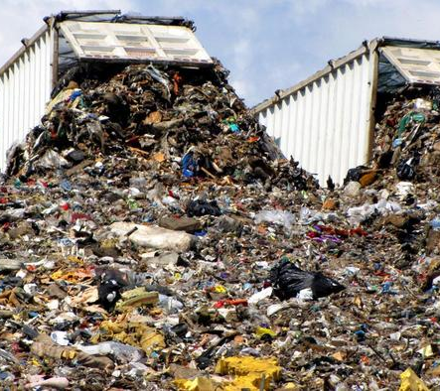
Landfills
Def. a place where unusable trash is dumped.
What is unusable?
Why do they matter?
Notes:
What is unusable? Anything that can’t be composted, recycled, or used by someone else.
Why do they matter? It really matters how much trash ends up in a landfill because landfills can leak pollution into the soil and water. They can also release a gas called methane, which is causing our Earth to become warmer.

Slide 13
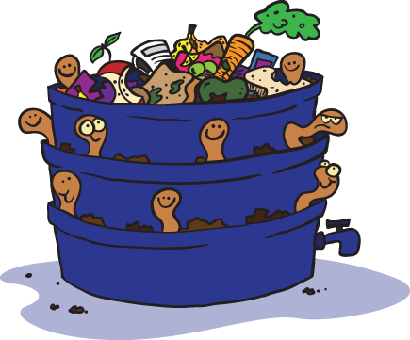
Composting:
When you leave food in a compost bin, it gets broken down by insects, bacteria, and worms to make new soil!

Slide 14
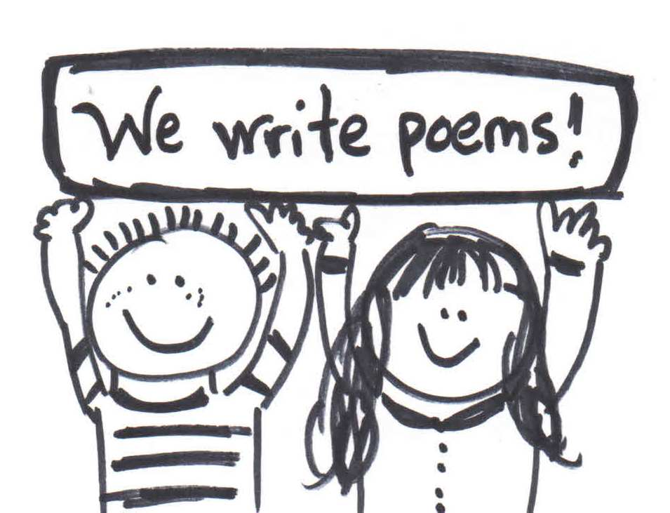
Independent Writing/Drawing Activity:
For the next 10 minutes, write down and/or draw any thoughts you have about what we just learned.
It can be:
a story,
a poem,
a picture,
a reflection, or
a list of questions.

Slide 15
Questions:
What is a landfill?
What does it mean to compost?
What do you think is better for the environment: landfill or compost?
What can you do to help reduce food waste?

Slide 16
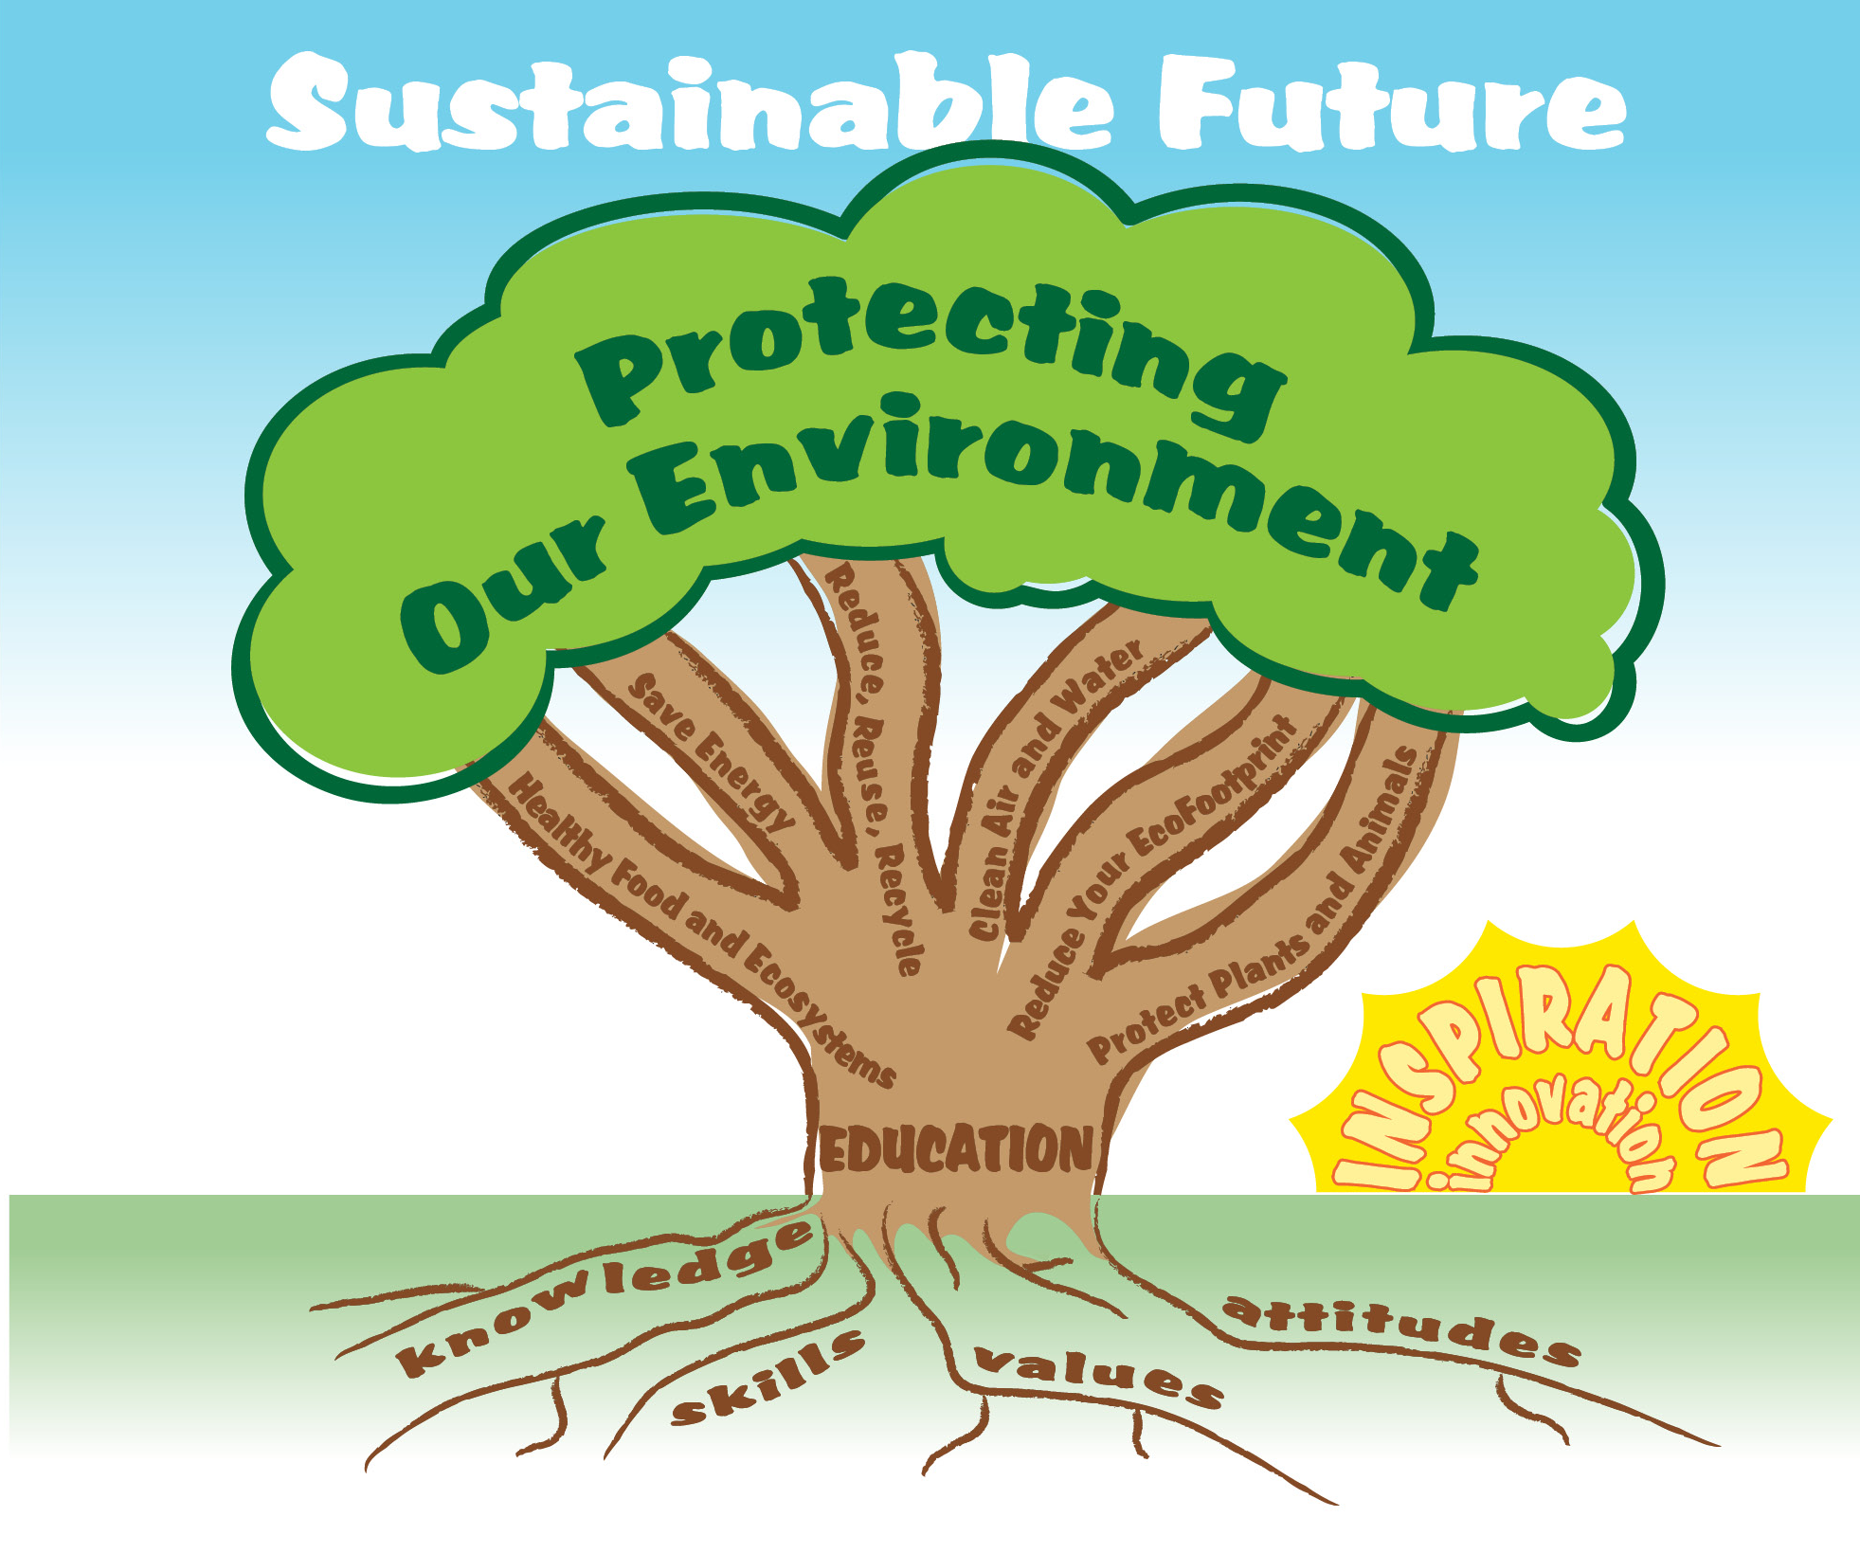

EcoLearn
Developed by the Environmental Protection Agency
With support from Department of State
Virtual Students of Foreign Service Interns
https://www.epa.gov/education
US EPA
Region 10
EcoLearn
For more information: hanft.sally@epa.gov or salazar.viccy@epa.gov

