Slide 1


2nd Grade
Energy and the Environment
Learn about the origins of energy and how the production of energy affects the environment.
EcoLearn
Notes:
Source: https://www.kaggle.com/sogun3/uspollution

Slide 2
Keywords
Energy
Fossil fuels
Nonrenewable energy
Renewable energy
Pollution
Notes:
Throughout history, humans have developed ways to harvest energy. Energy seems to be abundant, but providing energy for power is actually quite costly and damaging to the environment. What kind of energy sources you can think of?

Slide 3
Do Now

Slide 4
Types of Energy
Human and Animal Labor
Agriculture
Transportation
Mechanical energy
Machines
Irrigation
Electricity

Slide 5
What is Energy?
What do you think provides power to cars?
What makes them go?
Energy can take the forms of light, heat, and sound.
Notes:
What is energy?
The sound you hear from clapping is energy
The warmth you feel from rubbing your palms together is heat energy
The light is the room is a form of energy. This includes electricity made by humans as well as light from the sun.
Now that you understand that there are different kinds of energy, can you point out another source of energy in this room?

Slide 6
Where Does Energy Come From?
Fossil fuels
Solar energy
Wind energy
Hydropower
Tidal energy
Geothermal energy
Notes:
All of these forms of energy can be used to power a light bulb, but different forms of energy have different impacts on the environment. Renewable energy generally does less harm to the environment than fossil fuels. People all over the world are trying to reduce the use of fossil fuels and increase the use of renewable energy. Most cars need gas and oil to run. Those are fossil fuels, which are bad for the environment. However, a growing number of cars are electric, also known as hybrids. While they still use gas, they use a lot less. Finding ways to use less gas is better for our environment. Are there ways you and your family could use less gas?

Slide 7
Fossil Fuels
Coal, Gasoline, and Oil
Nonrenewable
Main cause of global climate change
Notes:
Fossil fuels include things like coal, gasoline, and oil, which come from the earth. When we burn these materials, they help us produce energy. However, they release
harmful chemicals into our atmosphere. Fossil fuels are a major cause of water and air pollution, as well as the main cause of global climate change. Another problem with fossil fuels is that they are not renewable, meaning that we have a limited supply and one day, they will run out.

Slide 8
Renewable Energy
These forms of energy can be used forever!
Notes:
Solar, wind, and hydropower are renewable energies. Solar energy is harnessed from the power of the sun. Wind energy is harnessed from the power of the wind. Hydropower is harnessed from the power of falling water. Tidal energy is harnessed from the power of the waves. Geothermal energy is harnessed from the heat in the earth’s core. These forms of energy are unlimited and they can be used forever, also called renewable resources.

Slide 9
Where does it get its energy?
Notes:
Instructions for the activity

Slide 10
Closure
What did we learn about energy today?
What forms can energy take?
What is the relationship between energy and the environment?

Slide 11
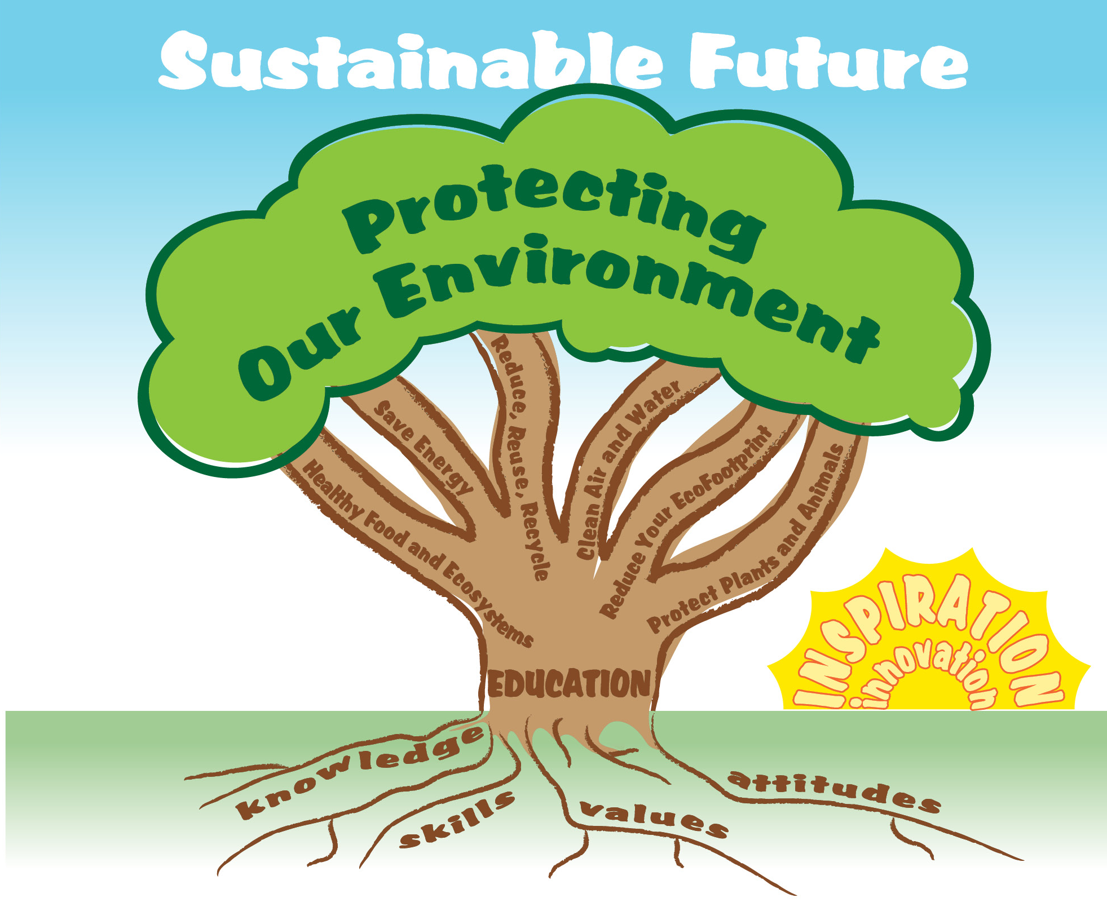
EcoLearn
For more information:
hanft.sally@epa.gov or
salazar.viccy@epa.gov
Developed by the Environmental Protection Agency
With support from Department of State
Virtual Students of Foreign Service Interns
https://www.epa.gov/education
US EPA
Region 10
EcoLearn

