Slide 1


2nd Grade
Food and Food Waste
Learn about the impacts of wasting food and what you can do to reduce food waste.
US EPA
Region 10
EcoLearn
Notes:
Source: http://www.foodnavigator.com/var/plain_site/storage/images/publications/food-beverage-nutrition/foodnavigator.com/policy/uk-the-worst-offender-in-europe-s-22-million-tonne-food-waste-problem/10135015-1-eng-GB/UK-the-worst-offender-in-Europe-s-22-million-tonne-food-waste-problem_strict_xxl.jpg

Slide 2
Do Now
https://goo.gl/images/AO6TEp
What did you have for breakfast this morning?
Where did it come from?
Notes:
Source: https://www.bobevans.com/-/media/bobevans_com/images/our-restaurants/menu/breakfast/waffle-breakfast-with-bacon.jpg?h=333&w=500&la=en&hash=DAB668251C6F07DE002A4DB9199B609E349EF3C9

Slide 3



Buying Food From Around the World
https://goo.gl/images/kpRGdP
https://goo.gl/images/TCI9M8
https://goo.gl/images/bZY3ki

Slide 4
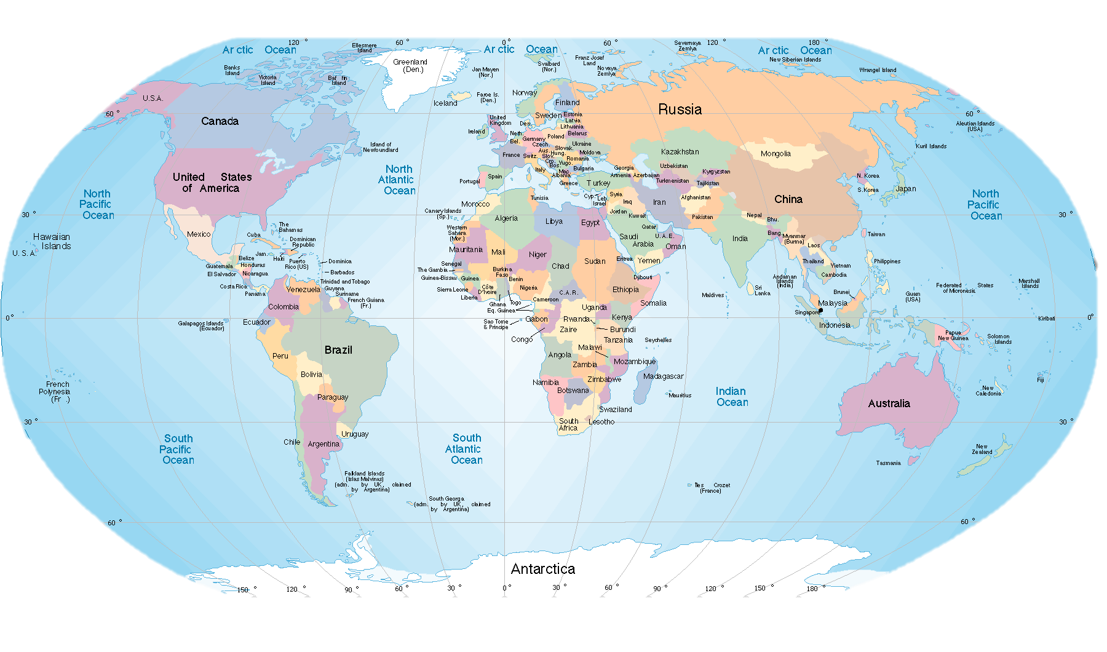
Buying Food From Around the World
Notes:
Audio from left to right
Audio 1: play first for answers
Audio 2 : people eat from all over the world
Audio 3: question
Audio 4: possible answers
Source: http://media.diercke.net/omeda/501/100790_188_1.png

Slide 5
Food Waste
What does it mean to waste food?
Why is food waste a problem?
https://www.youtube.com/watch?v=IoCVrkcaH6Q
http://www.localsharenj.org/hunger-and-food-waste/
Notes:
Play audio, discuss, then play video
Source: http://www.serendipityfood.com/wp-content/uploads/2014/11/pictures-1024x731.jpg

Slide 6
Wasted Food Vs. Food Waste
Notes:
Source: https://grist.files.wordpress.com/2016/07/food-waste-scraps1.jpg?w=1200&h=675&crop=1
http://aestheticsofprotest.org/wp-content/uploads/2014/03/food_waste.jpg

Slide 7
Practice
What ideas do you have about how to reduce food waste?
https://goo.gl/images/mnAsp9
https://goo.gl/images/etHSL6
Notes:
Play audio, discuss prompt, then play audio 2 and 3
Source: http://news.islandcrisis.net/wp-content/uploads/2015/09/portion-size.jpg?w=640

Slide 8
Homework
Notes:
Play audio 1, discuss, then close with audio 2
Source: http://www.diningandstools.com/wp-content/uploads/2016/03/family-around-the-dinner-table.jpg

Slide 9

EcoLearn
For more information:
hanft.sally@epa.gov or
salazar.viccy@epa.gov
Developed by the Environmental Protection Agency
With support from Department of State
Virtual Students of Foreign Service Interns
https://www.epa.gov/education
US EPA
Region 10
EcoLearn

