Slide 1


3rd Grade
Healthy and Sustainable Food
Learn how you can help your community by adopting healthier consumption patterns.
US EPA
Region 10
EcoLearn
Notes:
Source: http://info.esg.adec-innovations.com/blog/climate-change-and-its-effect-on-the-global-food-system

Slide 2
Today you will learn…
How food works as fuel to keep our bodies moving
How to keep ourselves and our environment healthy by eating sustainably and reducing waste
The relationship between energy and transportation resources involved in food production
Notes:
Source: http://cfaes.osu.edu/sites/cfaes_main/files/site-library/site-images/news/Bee%20on%20rapeseed%20flower_0.jpg

Slide 3
Do Now
What do you eat for breakfast?
Does this meal represent a balanced diet?
Notes:
Source: http://fillyourhope.com/wp-content/uploads/2015/02/Balanced-Breakfast.png

Slide 4
Food Sourcing and Production
Where does a nutritious diet come from?
Notes:
Source: https://goo.gl/images/l6JiqT

Slide 5
Transporting Food and Environmental Impacts
Transporting foods around the world uses vast amounts of resources and produces air pollution.
Notes:
Source: http://urban-gallery.net/txl/wp-content/uploads/2012/12/transport_truck_melons_q_17752.jpg

Slide 6
Sustainable Food
How can we eat more sustainably?
Notes:
Source: https://goo.gl/images/xYJNx0

Slide 7
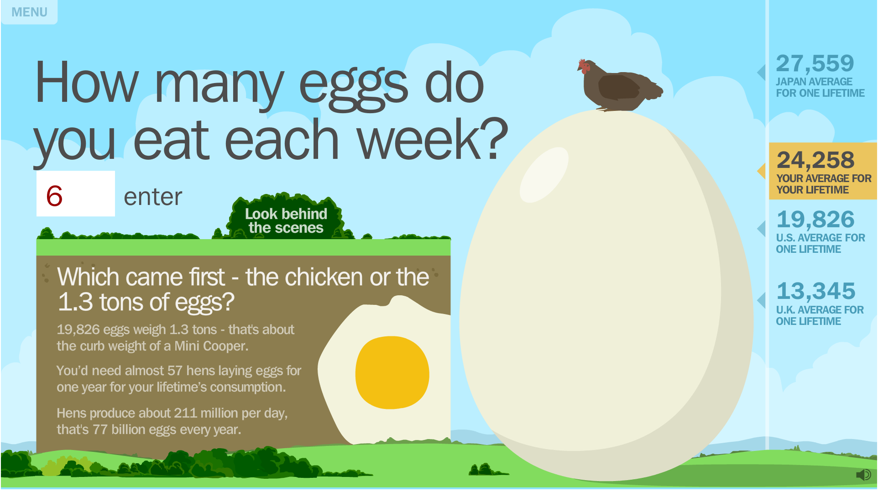
Human Footprint: Discover the Impact of Your Choices
http://education.nationalgeographic.org/interactive/human-footprint-interactive/
Notes:
Click on picture to hyperlink.
If hyperlink does not work:
Teaching Resources > Educational Games > Geographic Decision Making > Human Footprinnt

Slide 8
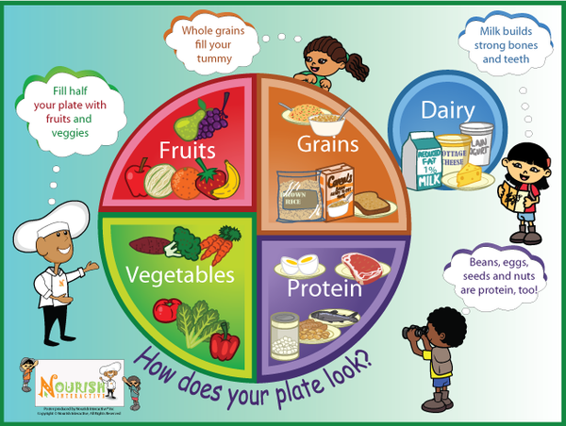
Five Food Groups
Notes:
Source: https://cdn.shopify.com/s/files/1/0214/2594/products/meet-the-food-groups_3f684f3f-fb66-446a-bd06-68083a4b11ed_1024x1024.png?v=1423170562

Slide 9
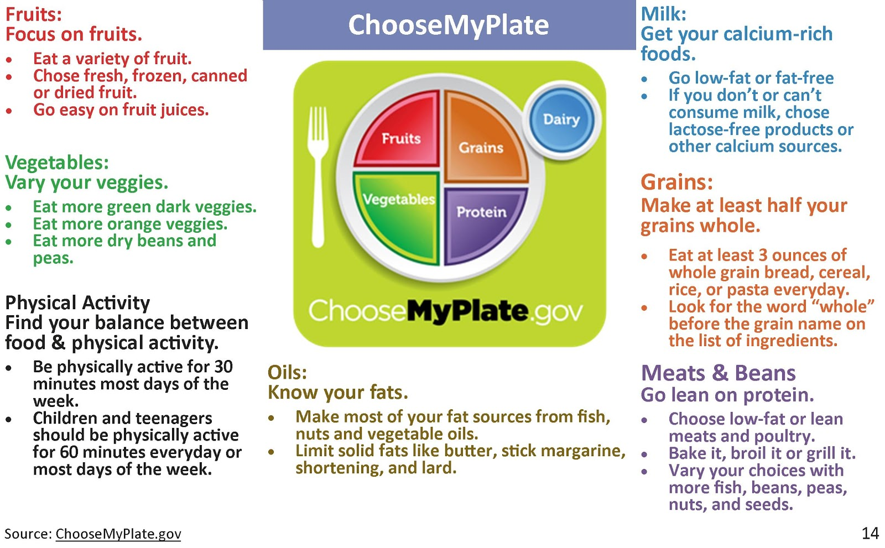
Building a Healthy Eating Lifestyle
Notes:
Source: https://cdn.shopify.com/s/files/1/0214/2594/products/meet-the-food-groups_3f684f3f-fb66-446a-bd06-68083a4b11ed_1024x1024.png?v=1423170562

Slide 10
Activity Guidelines
Use the tips from the previous slide to design a healthy and sustainable meal.
Then exchange your meal with a partner, who will fact-check the meal by answering the following:
Does this meal represent a balanced diet?
Does this meal use local food products to do so?

Slide 11
What can you do?
Think of three things you can do to conserve food resources and support sustainable food.
Notes:
Source: https://files.atkins.com/Low-Carb-Vegetable-Recipes.png

Slide 12
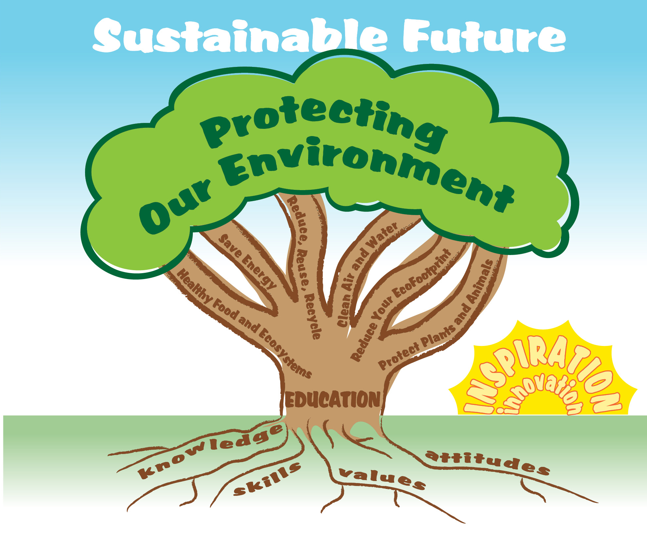
EcoLearn
For more information:
hanft.sally@epa.gov or
salazar.viccy@epa.gov
Developed by the Environmental Protection Agency
With support from Department of State
Virtual Students of Foreign Service Interns
https://www.epa.gov/education
US EPA
Region 10
EcoLearn

